Slide 1
Lecture 25
Chemical Reaction Engineering (CRE) is the field that studies the rates and mechanisms of chemical reactions and the design of the reactors in which they take place.

Slide 2
Web Lecture 25
Class Lecture 21– 4/2/2013
CSI
Ammonium Nitrate Explosion
Monsanto Explosion
T2 Laboratories Explosion

Slide 3

Case 1 – Ammonium Nitrate Explosion
Massive blast at Terra plant kills four.

Slide 4
Example 1: Safety in Chemical Reactors

Slide 5
Example 1: Safety in Chemical Reactors
Only liquid A in the vat as the product gases N₂O and H₂O escape immediately after being formed.

Slide 6
Unsteady State Energy Balance
Adiabatic
T
If the flow rate is shut off, the temperature will rise (possibly to point of explosion!)
t (min)

Slide 7
Case 2 – Monsanto Chemical Company
Keeping MBAs away from Chemical Reactors
The process worked for 19 years before “they” showed up!
Why did they come?
What did they want?

Slide 8
Nitroanline Synthesis Reaction
NO₂
NO₂
Cl
NH₂
+ 2NH₃
+ NH₄Cl
ONCB + Ammonia Nitroanaline + Ammonium Chloride

Slide 9
Nitroanline Synthesis Reaction
NH₃ in H₂O
ONCB
Autoclave
175 ºC
~550 psi
NH₃
Separation
Filter
Press
O-Nitroaniline Product Stream
To Crystallizing Tanks
“fast” Orange

Slide 10
Nitroanline Synthesis Reactor
Old
3 kmol ONCB
43 kmol Ammonia
100 kmol Water
V = 3.25 m³

Slide 11
Same Nitroanline Synthesis Reaction
NO₂
NO₂
Cl
NH₂
+ 2NH₃
+ NH₄Cl
ONCB + Ammonia Nitroanaline + Ammonium Chloride
Batch Reactor, 24 hour reaction time
Management said: TRIPLE PRODUCTION

Slide 12
MBA-Style:
Nitroanline Synthesis Reactor
New
9 kmol ONCB
33 kmol Ammonia
100 kmol Water
V = 5 m³

Slide 13
Batch Reactor Energy Balance

Slide 14
Batch Reactor Energy Balance
The rate of “heat removed” is
For high coolant flow rates, , the maximum rate of heat removal is
The rate of “heat generated” is

Slide 15
Batch Reactor Energy Balance
Recall
For isothermal operation at Qr = Qg, T = 448 K
Vary to keep “heat removed” equal to “heat generation”

Slide 16
Isothermal Operation for 45 minutes
Everything is OK

Slide 17
Adiabatic Operation for 10 minutes

Slide 18
Temperature-Time trajectory
400
Temperature ºC
Q_{r} = 0
Cooling Restored
200
Isothermal
Operation
175
fuse
9:55
t = 0
10:40 10:50
midnight 12:18

Slide 19
Disk Rupture
The pressure relief disk should have ruptured when the temperature reached 265°C (ca. 700 psi) but it did not.
If the disk had ruptured, the maximum mass flow rate out of the reactor would have been 830 kg/min (2-in orifice to 1 atm).
No explosion

Slide 20


All the following three things must have occurred for the explosion to happen
1. Tripled Production
2. Heat Exchange Failure
3.Relief Valve Failure
x3!!!

Slide 21
Case 3 – Manufacture of Fuel Additive
methylcyclopentadiene manganese tricarbonyl (MCMT)

Slide 22



Production of methylcyclopentadienyl manganese tricarbonyl (MCMT).
Step 1a. Reaction between methylcyclopentadiene (MCP) and sodium in a solvent of diethylene glycol dimethyl ether (diglyme, C₆H₁₄O₃) to
produce sodium methylcyclopentadiene and hydrogen gas:
Step 1b. At the end of Step 1a, MnCl₂ is added to the reactor. It reacts with sodium methylcyclopentadiene to produce manganese dimethylcyclopentadiene and sodium chloride:
Step 1c. At the end of Step 1b, CO is added. The reaction between manganese dimethylcyclopentadiene and carbon monoxide produces the final product, methylcyclopentadienyl manganese tricarbonyl (MCMT), a fuel additive.

Slide 23

Only consider Step 1
Desired Reaction
Undesired Reaction of Dygline
Simplified Model
Let A = methycylcopentadiene, B = sodium, S = Solvent (diglyme), and D = H₂.
These reactions are:
(1) A + B → C + 1/2 D (gas)
(2) S → 3 D (gas) + miscellaneous liquid and solid products

Slide 24
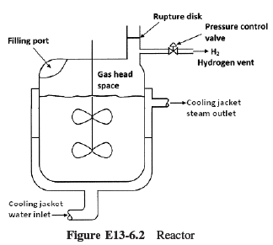
Case 3 – Manufacture of Fuel Additive

Slide 25
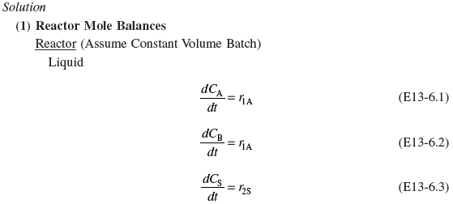

Case 3 – Manufacture of Fuel Additive

Slide 26
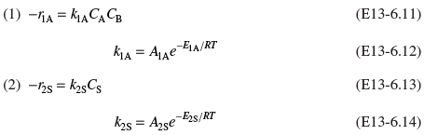
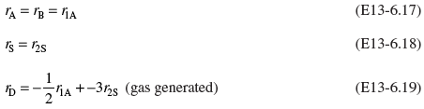
Case 3 – Manufacture of Fuel Additive
(2) Rates
Laws:
Net Rates:
(3) Stoichiometry – Liquid Phase

Slide 27
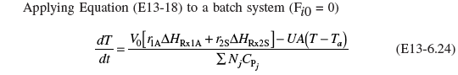

Case 3 – Manufacture of Fuel Additive
(4) Energy Balance:

Slide 28
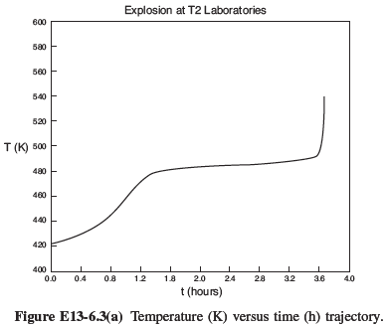
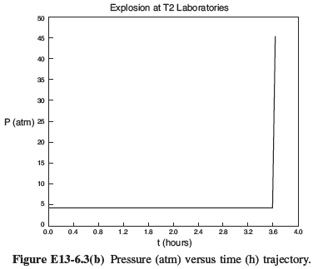

Slide 29
End of Web Lecture 25
Class Lecture 2

