Slide 1
Lecture 2
Chemical Reaction Engineering (CRE) is the field that studies the rates and mechanisms of chemical reactions and the design of the reactors in which they take place.

Slide 2
Lecture 2
Chapter 2
Review of Lecture 1
Definition of Conversion, X
Develop the Design Equations in terms of X
Size CSTRs and PFRs given –r_{A}= f(X)
Conversion for Reactors in Series
Review the Fall of the Tower of CRE

Slide 3
Reactor Mole Balances Summary
Review Lecture 1
The GMBE applied to the four major reactor types
(and the general reaction A→B)
Reactor | Differential | Algebraic | Integral
N_{A}
Batch
t
CSTR
F_{A}
PFR
V
F_{A}
PBR
W

Slide 4
CSTR – Example Problem
Review Lecture 1
Given the following information, Find V
Liquid phase

Slide 5
CSTR – Example Problem
Review Lecture 1
(1) Mole Balance:
(2) Rate Law:
(3) Stoichiometry:

Slide 6
CSTR – Example Problem
Review Lecture 1
(4) Combine:
(5) Evaluate:

Slide 7
Define conversion, X
Chapter 2
Consider the generic reaction:
Chose limiting reactant A as basis of calculation:
Define conversion, X

Slide 8
Batch
Chapter 2

Slide 9
Batch
Chapter 2
Integrating,
The necessary t to achieve conversion X.

Slide 10
CSTR
Chapter 2
Consider the generic reaction:
Chose limiting reactant A as basis of calculation:
Define conversion, X

Slide 11
CSTR
Chapter 2
Steady State
Well Mixed

Slide 12
CSTR
Chapter 2
CSTR volume necessary to achieve conversion X.

Slide 13
PFR
Chapter 2
Steady State

Slide 14
PFR
Chapter 2
Integrating,
PFR volume necessary to achieve conversion X.

Slide 15
Reactor Mole Balances Summary
Chapter 2
_{in terms of conversion, X}
Reactor | Differential | Algebraic | Integral
X
Batch
t
CSTR
PFR
X
PBR
W

Slide 16
Levenspiel Plots
Chapter 2
Reactor Sizing
Given –r_{A} as a function of conversion, -r_{A}= f(X), one can size any type of reactor. We do this by constructing a Levenspiel plot. Here we plot either (F_{A0}/-r_{A}) or (1/-r_{A}) as a function of X. For (F_{A0}/-r_{A}) vs. X, the volume of a CSTR and the volume of a PFR can be represented as the shaded areas in the Levenspiel Plots shown as:

Slide 17
Levenspiel Plots
Chapter 2

Slide 18
CSTR
Chapter 2
Area = Volume of CSTR
F
0
A
−
r
A
X
1

Slide 19
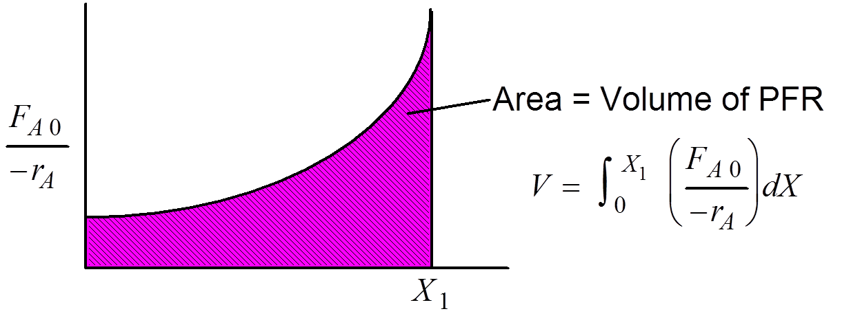
PFR
Chapter 2

Slide 20
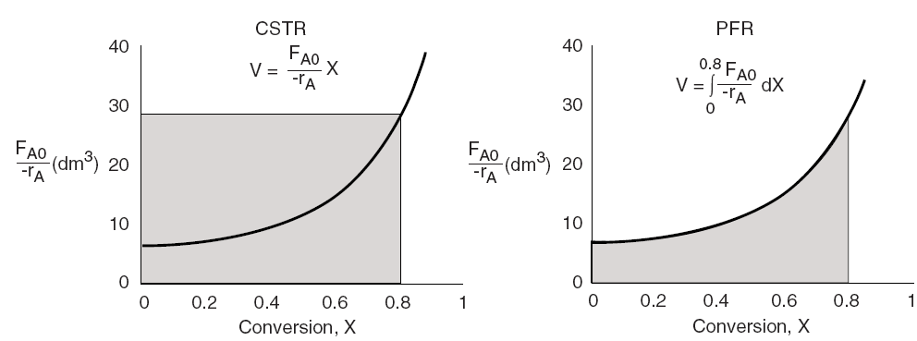
Levenspiel Plots
Chapter 2

Slide 21
Numerical Evaluations of Integrals
Chapter 2
The integral to calculate the PFR volume can be evaluated using method as Simpson’s One-Third Rule: (See Appendix A.4)
  Other numerical methods are:
  Trapezoidal Rule (uses two data points)
  Simpson’s Three-Eight’s Rule (uses four data points)
  Five-Point Quadrature Formula

Slide 22
Reactors in Series
Chapter 2
Given: r_{A} as a function of conversion, one can also design any sequence of reactors in series by defining X:
Only valid if there are no side streams.
Molar Flow rate of species A at point i:

Slide 23
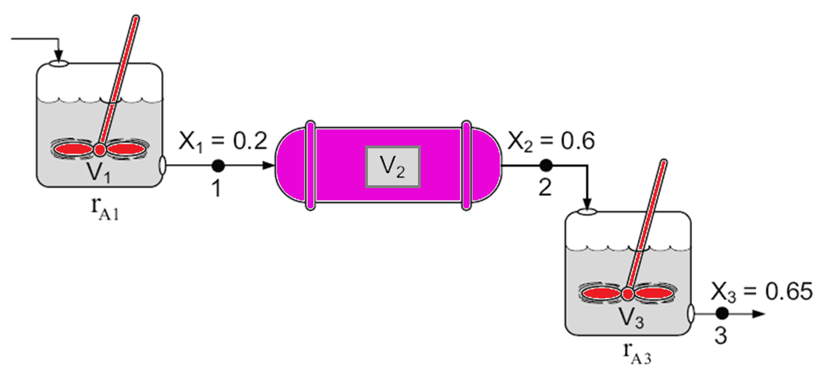
Reactors in Series
Chapter 2

Slide 24
Reactors in Series
Chapter 2
Reactor 1:
V₁

Slide 25
Reactors in Series
Chapter 2
Reactor 2:
V₂

Slide 26
Reactors in Series
Reactor 3:
V₃

Slide 27
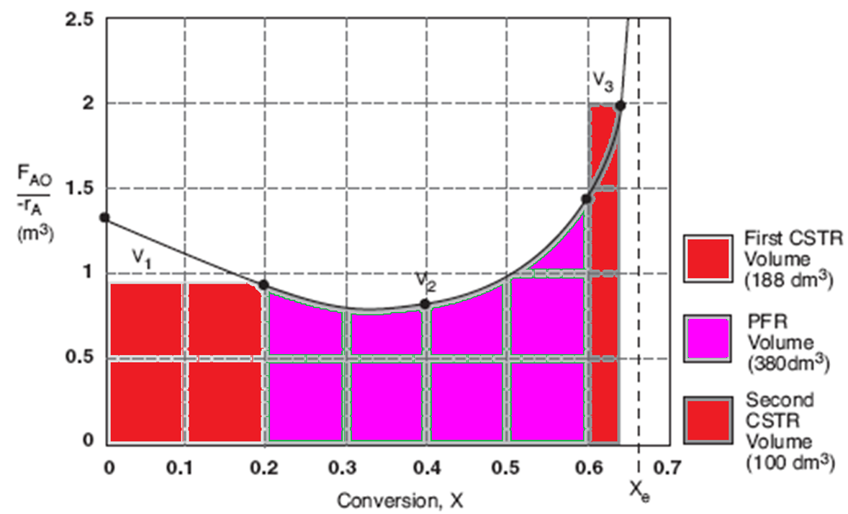
Reactors in Series

Slide 28
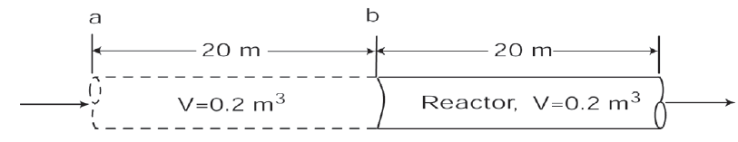
Reactors in Series
Chapter 2
Space time τ is the time necessary to process 1 reactor volume of fluid at entrance conditions.

Slide 29
KEEPING UP
Chapter 2
The tower of CRE, is it stable?

Slide 30
Reaction Engineering
Algorithm
Mole Balance
Rate Laws
Stoichiometry
These topics build upon one another.

Slide 31
Algorithm
Heat Effects
Isothermal Design
Stoichiometry
Rate Laws
Mole Balance
CRE Algorithm

Slide 32
Algorithm
Rate Laws
Mole Balance
Be careful not to cut corners on any of the
CRE building blocks while learning this material!

Slide 33
Algorithm
Isothermal Design
Heat Effects
Rate Laws
Stoichiometry
Mole Balance
Otherwise, your Algorithm becomes unstable.

Slide 34
End of Lecture 2

