Slide 1
Lecture 32
Chemical Reaction Engineering (CRE) is the field that studies the rates and mechanisms of chemical reactions and the design of the reactors in which they take place.

Slide 2
Lecture 32 – Thursday 04/10/2016
Overview - Guidelines for Developing Models
Content
  One and Two Parameter Models
  Tanks In Series (TIS)
  Dispersion One Parameter Model
  Flow Reaction and Dispersion
  Two Parameters Models – Modeling Real Reactors with Combinations of Ideal Reactors
Notes:
Fig 18-1a

Slide 3
Some Guidelines for Developing Models
The overall goal is to use the following equation
  RTD Data + Model + Kinetics = Predictions
The model must be mathematically tractable
The model must realistically describe the characteristics of the non-ideal reactor
The model should not have more than two adjustable parameters

Slide 4
A PROCEDURE FOR CHOOSING A MODEL TO PREDICT THE OUTLET CONCENTRATION AND CONVERSION
Look at the reactor
  Where are the inlet and outlet streams to and from the reactors? (Is by-passing a possibility?)
  Look at the mixing system. How many impellers are there? (Could there be multiple mixing zones in the reactor?)
  Look at the conﬁguration. (Is internal recirculation possible? Is the packing of the catalyst particles loose so channeling could occur?)
Look at the tracer data
  Plot the E(t) and F(t) curves.
  Plot and analyze the shapes of the E(Θ) and F(Θ) curves. Is the shape of the curve such that the curve or parts of the curve can be ﬁt by an ideal reactor model? Does the curve have a long tail suggesting a stagnant zone? Does the curve have an early spike indicating bypassing?
  Calculate the mean residence time, tm, and variance, σ². How does the tm determined from the RTD data compare with τ as measured with a yardstick and flow meter? How large is the variance; is it larger or smaller than τ²?
Choose a model or perhaps two or three models
Use the tracer data to determine the model parameters (e.g., n, D_{a}, v_{b})
Use the CRE algorithm in Chapter 5. Calculate the exit concentrations and conversion for the model system you have selected

Slide 5
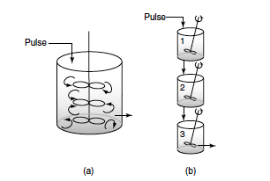


The RTD will be analyzed from a tracer pulse injected into the first reactor of three equally sized CSTRs in series
Generalizing this method to a series of n CSTRs gives the RTD for n CSTRs in series, E(t):
(18-4)
(18-5)

Slide 6


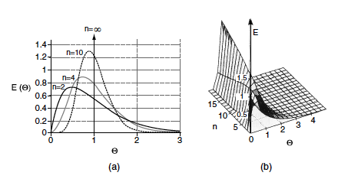

Tanks-in-series response to a pulse tracer input for different numbers of tanks
(18-8)
(18-9)
The number of tanks in series is
(18-11)

Slide 7
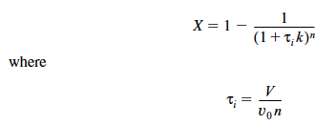
Calculating Conversion for the T-I-S Model
If the reaction is first order, we can use the equation below to calculate the conversion
(5-15)

Slide 8


Tanks-in-Series versus Segregation for a First-Order Reaction
(18-12)
The molar flow rate of tracer (FT ) by both convection and dispersion is:
(14-14)

Slide 9
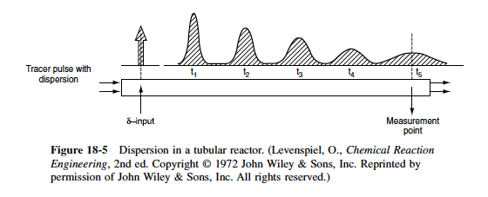
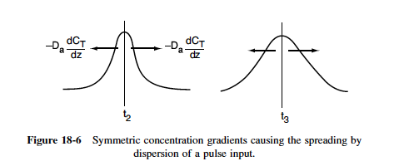

(18-14)

Slide 10
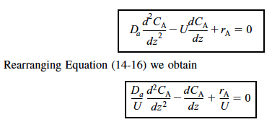


Flow, Reaction, and Dispersion
(14-16)
(18-15)
(18-16)
(18-17)

Slide 11
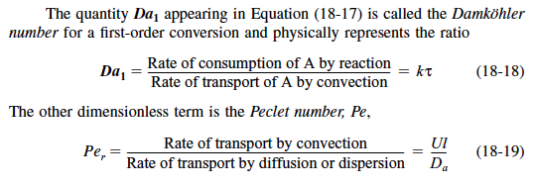
(18-18)
(18-19)

Slide 12
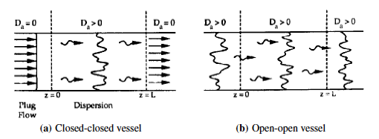


Boundary Conditions
At z = 0
Substituting for F_{A} yields

Slide 13

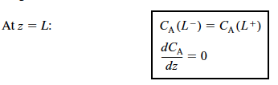
Solving for the entering concentration C_{A}(0–) = C_{A0}
(18-20)
At the exit to the reaction section, the concentration is continuous, and there is no gradient in tracer concentration.
(18-21)

Slide 14


Open-Open System
For an open-open system, there is continuity of flux at the boundaries at
At z = 0
(18-22)

Slide 15
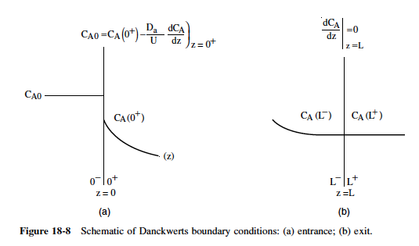

At z = L, we have continuity of concentration and
(18-23)

Slide 16

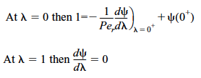
Back to the Solution for a Closed-Closed System
We now shall solve the dispersion reaction balance for a ﬁrst-order reaction
(18-17)
For the closed-closed system, the Danckwerts boundary conditions in dimensionless form are
(18-24)
(18-25)

Slide 17
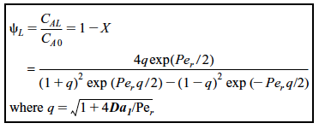

At the end of the reactor, where λ = 1, the solution to the top equation is
(18-26)
(18-27)

Slide 18
Finding D_{a} and the Peclet Number
There are three ways we can use to find D_{a} and hence P_{er}
1. Laminar flow with radial and axial molecular diffusion theory
2. Correlations from the literature for pipes and packed beds
3. Experimental tracer data

Slide 19
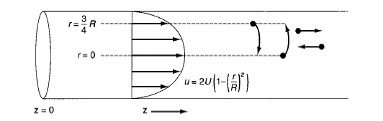

Dispersion in a Tubular Reactor with Laminar Flow
(18-28)

Slide 20



(18-31)
(18-32)
Where D* is the Aris-Taylor dispersion coefficient
(18-33)
That is, for laminar ﬂow in a pipe

Slide 21
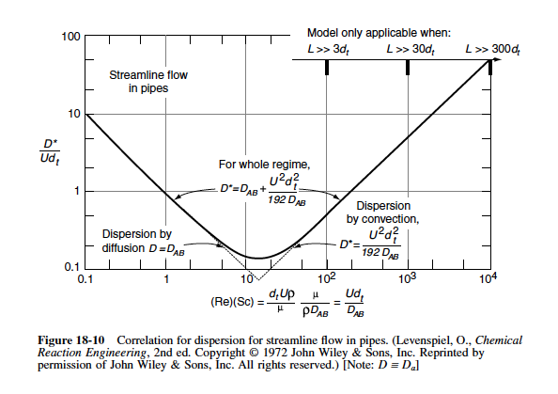
Correlations for D_{a}

Slide 22
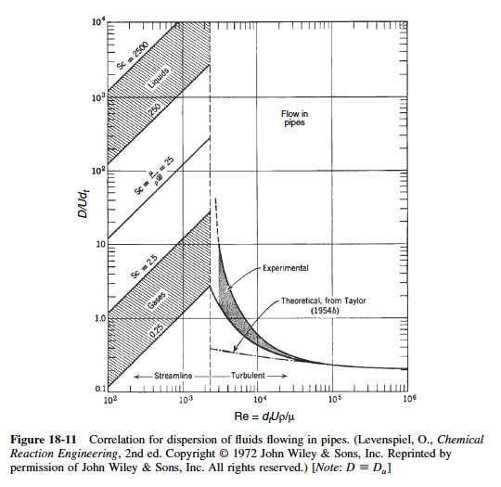

Slide 23
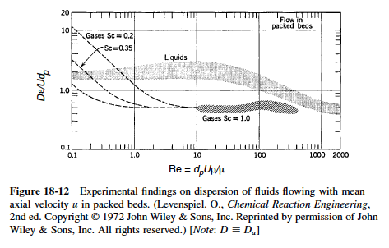
Dispersion in Packed Beds

Slide 24


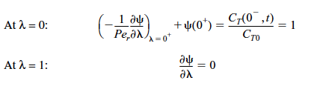
Experimental Determination of D_{a}
(18-13)
The Unsteady-State Tracer Balance
(18-34)
Solution for a Closed-Closed System
In dimensionless form, the Danckwerts boundary conditions are
(18-36)
(18-37)

Slide 25
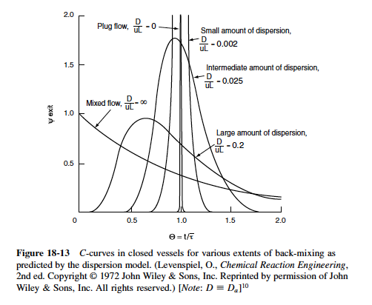

(18-39)

Slide 26



For long tubes (Per > 100) in which the concentration gradient at ± ∞ will be zero, the solution to the Unsteady-State Tracer balance at the exit is¹¹
(18-44)
The mean residence time for an open-open system is
(18-45)
(18-46)
¹¹W. Jost, Diffusion in Solids, Liquids and Gases (New York: Academic Press, 1960), pp. 17, 47.

Slide 27
We now consider two cases for which we can use previous equations to determine the system parameters:
Case 1. The space time τ is known. That is, V and v₀ are measured independently. Here, we can determine the Peclet number by determining t_{m} and σ² from the concentration–time data and then use Equation (18-46) to calculate P_{er}. We can also calculate t_{m} and then use Equation (18-45) as a check, but this is usually less accurate.

Slide 28

Case 2. The space time τ is unknown. This situation arises when there are dead or stagnant pockets that exist in the reactor along with the dispersion effects. To analyze this situation, we first calculate mean residence time, t_{m}, and the variance, σ², from the data as in case 1. Then, we use Equation (18-45) to eliminate τ² from Equation (18-46) to arrive at
(18-47)
We now can solve for the Peclet number in terms of our experimentally determined variables σ² and t_{m} . Knowing P_{er}, we can solve Equation (18-45) for τ, and hence V. The dead volume is the difference between the measured volume (i.e., with a yardstick) and the effective volume calculated from the RTD.

Slide 29
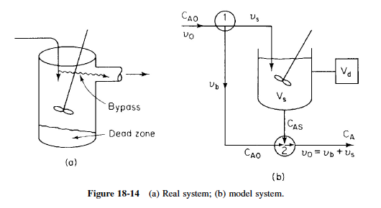
Two-Parameter Models—Modeling Real Reactors with Combinations of Ideal Reactors
Real CSTR Modeled Using Bypassing and Dead Space

Slide 30
Solving the Model System for C_{A} and X
We shall calculate the conversion for this model for the first-order reaction
A ⎯⎯→ B
The bypass stream and effluent stream from the reaction volume are mixed at the junction point 2. From a balance on species A around this point
[In]=[Out]
[C_{A0}v_{b} + C_{as}v_{s}]=[C_{A} (v_{b}+v_{s})]
(18-57)

Slide 31




Let α= V_{s} /V and β=v_{b}/v₀, then
(18-58)
For a ﬁrst-order reaction, a mole balance on V_{s} gives
(18-59)
or, in terms of α and β
(18-60)
Substituting Equation (18-60) into (18-58) gives the effluent concentration of species A:
(18-61)

Slide 32
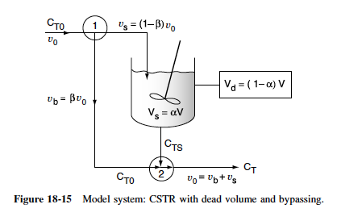
Using a Tracer to Determine the Model Parameters in a CSTR-with-Dead-Space-and-Bypass Model

Slide 33


(18-62)
The conditions for the positive-step input are
At t < 0 , C_{T} = 0
At t ≥ 0 , C_{T} = C_{T0}
A balance around junction point 2 gives
(18-63)

Slide 34




As before
Integrating Equation (18-62) and substituting in terms of α and β
(18-64)
Combining Equations (18-63) and (18-64), the effluent tracer concentration is
(18-65)
(18-66)

Slide 35
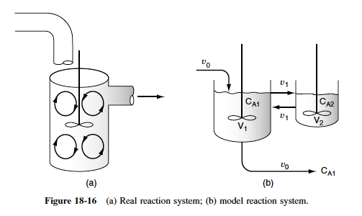
Other Models

Slide 36

Solving the Model System for C_{A} and X
Let β represent that fraction of the total ﬂow that is exchanged between reactors 1 and 2; that is,
and let α represent that fraction of the total volume, V, occupied by the highly agitated region:
Then
The space time is

Slide 37


(18-67)
and
(18-68)

Slide 38


Using a Tracer to Determine the Model Parameters in a CSTR with an Exchange Volume
The problem now is to evaluate the parameters α and β using the RTD data. A mole balance on a tracer pulse injected at t = 0 for each of the tanks is
Accumulation = Rate in - Rate out
Reactor 1:
(18-67)
Reactor 2:
(18-68)

Slide 39
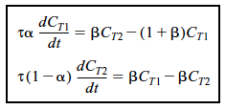


(18-71)
(18-72)
(18-73)
where

Slide 40
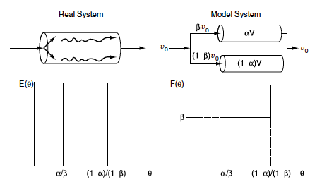
Other Models of Nonideal Reactors Using CSTRs and PFRs
Combinations of ideal reactors used to model real tubular reactors: two ideal PFRs in parallel

Slide 41
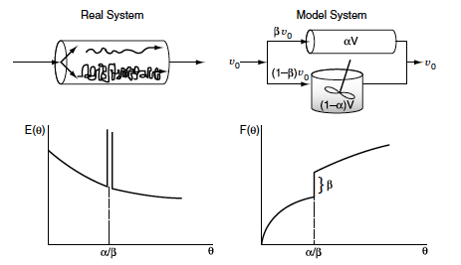
Combinations of ideal reactors used to model real tubular reactors: ideal PFR and ideal CSTR in parallel

Slide 42


Summary
The models for predicting conversion from RTD data are:
  Zero adjustable parameters
    Segregation model
    Maximum mixedness model
  One adjustable parameter
    Tanks-in-series model
    Dispersion model
  Two adjustable parameters: real reactor modeled as combinations of ideal reactors
2. Tanks-in-series model: Use RTD data to estimate the number of tanks in series,
(S18-1)
For a first-order reaction

Slide 43



3. Dispersion model: For a first-order reaction, use the Danckwerts boundary conditions
(S18-2)
where
(S18-3)
(S18-4)
For a first-order reaction
(S18-5)

Slide 44



4. Determine Da
A For laminar ﬂow, the dispersion coefﬁcient is
(S18-6)
B Correlations. Use Figures 18-10 through 18-12.
C Experiment in RTD analysis to find t_{m} and σ².
For a closed-closed system, use Equation (S18-6) to calculate Per from the RTD data
(S18-7)
For an open-open system, use
(18-47)

Slide 45
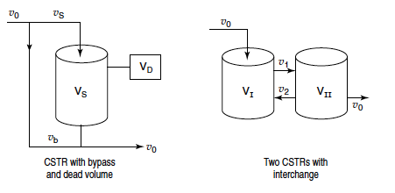
5. If a real reactor is modeled as a combination of ideal reactors, the model should have at most two parameters

Slide 46

6. The RTD is used to extract model parameters.
7. Comparison of conversions for a PFR and CSTR with the zero-parameter and two- parameter models. X_{seg} symbolizes the conversion obtained from the segregation model and X_{mm} is that from the maxi-mum mixedness model for reaction orders greater than one.
Cautions: For rate laws with unusual concentration functionalities or for nonisothermal operation, these bounds may not be accurate for certain types of rate laws.

