Slide 1
Lecture 3
Chemical Reaction Engineering (CRE) is the field that studies the rates and mechanisms of chemical reactions and the design of the reactors in which they take place.

Slide 2
Lecture 3
Chapter 3
Review of Lectures 1 and 2
Building Block 1
  Mole Balances (Review)
  Size CSTRs and PFRs given –r_{A}= f(X)
  Conversion for Reactors in Series
Building Block 2
  Rate Laws
  Reaction Orders
  Arrhenius Equation
  Activation Energy
  Effect of Temperature

Slide 3
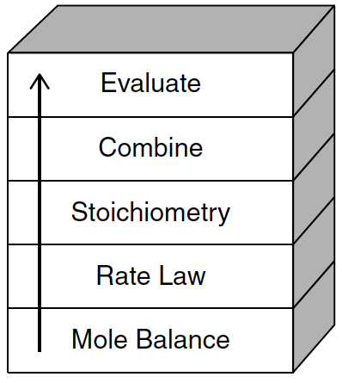
Building Block 1: Mole Balance
Review Chapter 1
The GMBE applied to the four major reactor
types (and the general reaction A→B)
Reactor | Differential | Algebraic | Integral
N_{A}
Batch
t
CSTR
F_{A}
PFR
V
F_{A}
PBR
W

Slide 4
Review Chapter 2

Slide 5
Building Block 1: Mole Balance
Review Chapter 2
In terms of Conversion
Reactor | Differential | Algebraic | Integral
X
Batch
t
CSTR
PFR
X
PBR
W

Slide 6
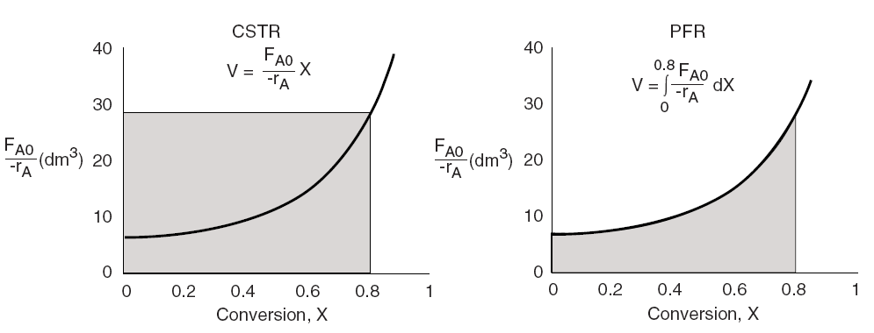
Levenspiel Plots
Review Chapter 2

Slide 7
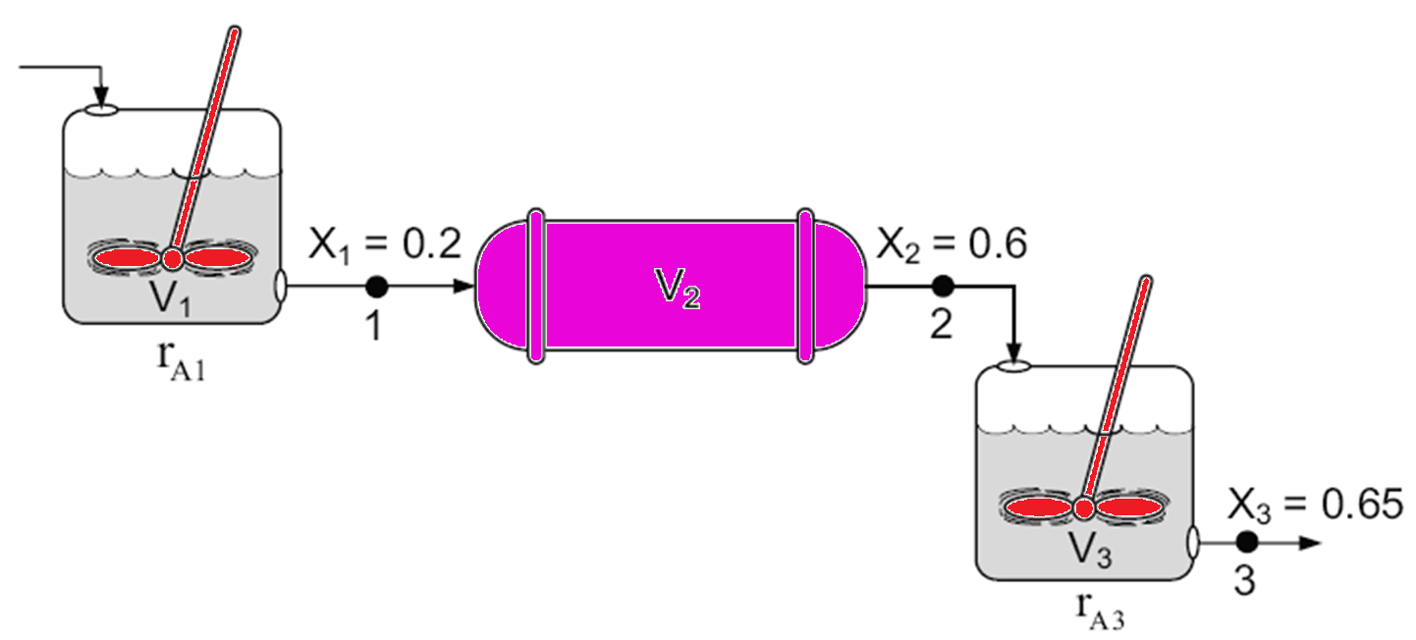
Reactors in Series
Review Chapter 2
Only valid if there are no side streams

Slide 8
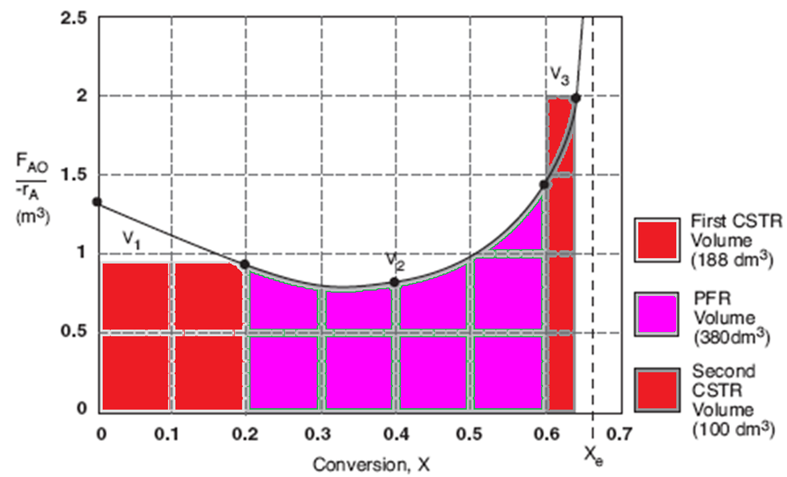
Reactors in Series
Review Chapter 2

Slide 9
Building Block 2: Rate Laws
Chapter 3
Power Law Model:

Slide 10
Building Block 2: Rate Laws
Chapter 3
A reactor follows an elementary rate law if the reaction orders just happens to agree with the stoichiometric coefficients for the reaction as written.
e.g. If the above reaction follows an elementary rate law
2nd order in A, 1st order in B, overall third order

Slide 11
Building Block 2: Rate Laws
Chapter 3
Rate Laws are found from Experiments
Rate Laws could be non-elementary. For example, reaction could be:
Second Order in A
Zero Order in B
Overall Second Order
2A+B→3C

Slide 12
Relative Rates of Reaction
Chapter 3

Slide 13
Relative Rates of Reaction
Chapter 3
Given
Then

Slide 14
Reversible Elementary Reaction
Chapter 3
k_{A}
A+2B 3C
k_{-A}

Slide 15
Reversible Elementary Reaction
Chapter 3
k_{A}
A+2B 3C
Reaction is: First Order in A
Second Order in B
Overall third Order
k_{-A}

Slide 16
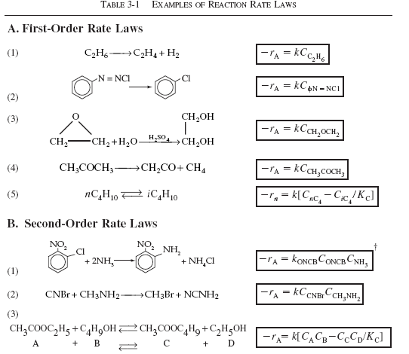
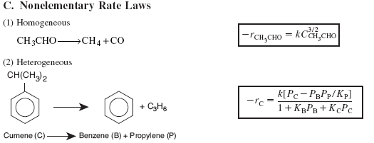
Chapter 3

Slide 17

Algorithm
Chapter 3
How to find
Step 1: Rate Law
Step 2: Stoichiometry
Step 3: Combine to get

Slide 18
Arrhenius Equation
Chapter 3
k is the specific reaction rate (constant) and is given by the Arrhenius Equation.
where:
k
T

Slide 19
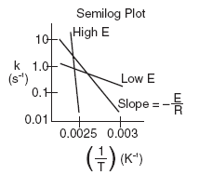

Arrhenius Equation
Chapter 3
where:
E = Activation energy (cal/mol)
R = Gas constant (cal/mol*K)
T = Temperature (K)
A = Frequency factor (same units as rate constant k)
(units of A, and k, depend on overall reaction order)

Slide 20
Activation Energy
Chapter 3
Concept 1. Law of Mass Action
The rate of reaction increases with increasing concentration of reactants owing to the corresponding increase in the number of molecular collisions.
The rate of disappearance of A, –r_{A}, depends on temperature and concentration. For many irreversible reactions, it can be written as the product of a reaction rate constant, k_{A}, and a function of the concentrations (activities) of the various species involved in the reaction:
(3-2)
For example for the elementary reaction
E = Activation Energy, (kJ/mol)

Slide 21
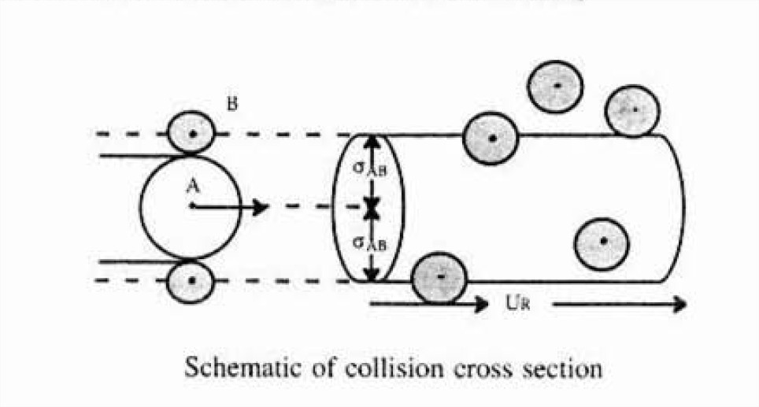
Collision Theory
Chapter 3

Slide 22
Why is there an Activation Energy?
Chapter 3
We see that for the reaction to occur, the reactants must overcome an energy barrier or activation energy E_{A}. The energy to overcome their barrier comes from the transfer of the kinetic energy from molecular collisions to internal energy (e.g. Vibrational Energy).
The molecules need energy to disort or stretch their bonds in order to break them and thus form new bonds
As the reacting molecules come close together they must overcome both stearic and electron repulsion forces in order to react.

Slide 23
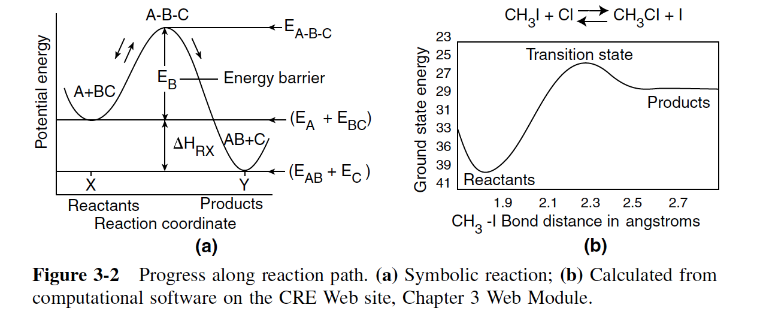
Activation Energy
Chapter 3
Concept 2. Potential Energy Surfaces and Energy Barriers
As two molecules, say AB and C, approach each other, the potential energy of the system (AB, C) increases owing repulsion of the molecules. The reaction coordinate is a measure of progress of the reaction as we go form AB and C to A and BC as shown in Figure 3-2 below.

Slide 24
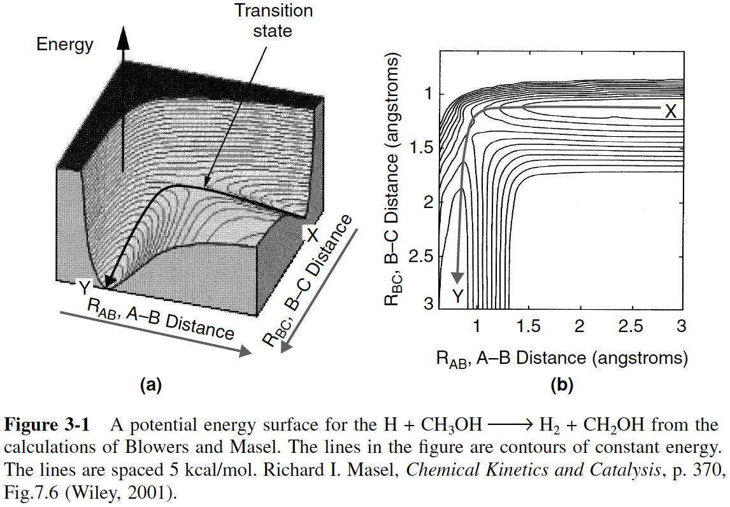
Activation Energy
Chapter 3
Concept 2. Potential Energy Surfaces and Energy Barriers
The figure below shows a 3-dimensional energy surface and barrier over which the reaction must pass

Slide 25
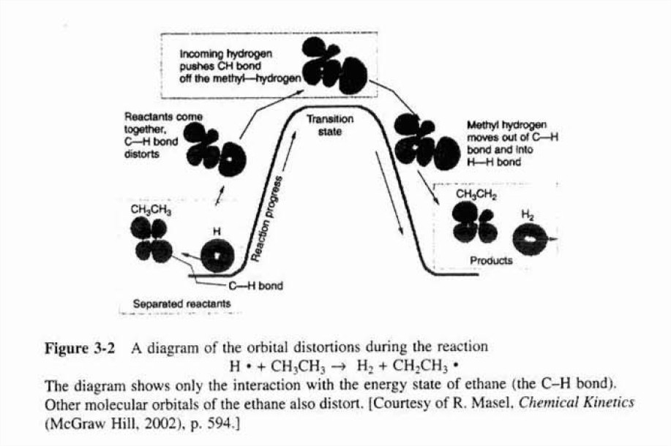
Activation Energy
Chapter 3
Concept 2. Potential Energy Surfaces and Energy Barriers

Slide 26
Activation Energy
Chapter 3
Concept 3. Fraction of Molecular Collisions That Have Sufficient Energy to React
The kinetic energy of the molecule must be transferred to potential energy to distort bonds and overcome steric forces in order for the reacting molecules to pass over the energy barrier.
The distribution of velocities of the reacting molecules relative to one another is given by the Boltzmann distribution
Where
k_{B} = Boltzmann’s constant = 3.29 x 10^{–24} cal/molecule/K
m = Reduced mass, g
U = Relative velocity, m/s
T = Absolute Temperature, K
e = Energy = mU^{2,} kcal/molecule
E = Kinetic energy, kcal/mol
f(U,T) = Fraction of relative velocities between U and U + dU

Slide 27
Activation Energy
Chapter 3
Concept 3. Fraction of Molecular Collisions That Have Sufficient Energy to React
Distribution of Velocities
We will use the Maxwell-Boltzmann Distribution of Molecular Velocities. For a species of mass m, the Maxwell distribution of velocities (relative velocities) is:
f(U,T)dU represents the fraction of velocities between U and (U+dU).

Slide 28

Activation Energy
Chapter 3
Concept 3. Fraction of Molecular Collisions That Have Sufficient Energy to React
Distribution of Velocities
A plot of the distribution function, f(U,T), is shown as a function of U:
T₁
T₂
T₂>T₁
$$f\left(U,T\right)$$
U
Maxwell-Boltzmann Distribution of velocities.

Slide 29
Activation Energy
Chapter 3
Concept 3. Fraction of Molecular Collisions That Have Sufficient Energy to React
Distribution of Velocities
Given
Let
f(E,T)dE represents the fraction of collisions that have energy between E and (E+dE)

Slide 30
Activation Energy
Chapter 3
Concept 3. Fraction of Molecular Collisions That Have Sufficient Energy to React
In terms of energy per mole, E, instead of energy per molecule, e, we have
(3-20)
where E is in (cal/mol) or (J/mole), R is in (cal/mol/K), and f(E,T) is in mol/cal.
The distribution function f(E,T) is most easily interpreted by recognizing that [f(E,T) dE] is the fraction of collisions with energies between E and E + dE.
(3-21)
This distribution is shown as a function of E for two temperatures in the next slide.

Slide 31
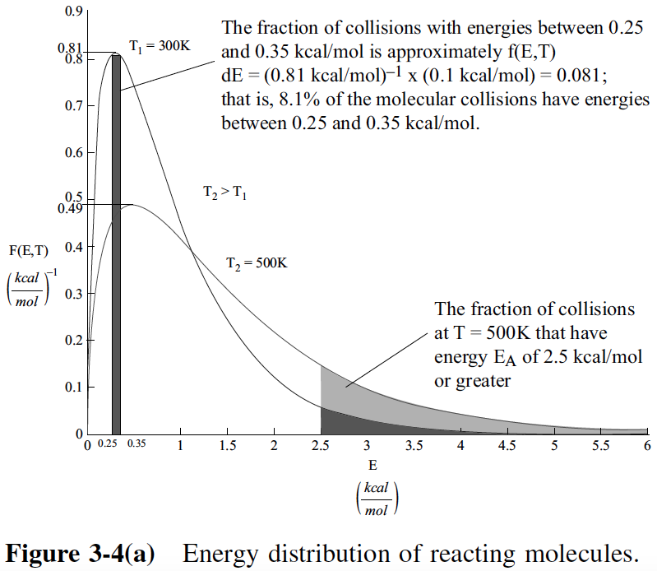
Activation Energy
Chapter 3
Concept 3. Fraction of Molecular Collisions That Have Sufficient Energy to React
This fraction is shown by the shaded area in Figure 3-4(a) and is approximated by the average value of f(E,T) at E = 0.3 kcal/mole is 0.81 mol/kcal.
We see 8.1% of the collisions have energies between 0.25 and 0.35 kcal/mol

Slide 32
Activation Energy
Chapter 3
Concept 3. Fraction of Molecular Collisions That Have Sufficient Energy to React
Fraction of Molecules with Energy Greater than E_{A}
We can also determine the fraction of collision that have energies greater than a certain value, E_{A}
(3-22)
For E_{A} > 3RT, we can obtain an analytical approximation for the fraction of molecules of collision with energies greater than E_{A} by combining Equations (3-21) and (3-22) and integrating to get
(3-23)
Equation (3-23) is plotted in Figure 4-4(b) as a function of activation energy, E_{A}, as shown in the next slide.

Slide 33
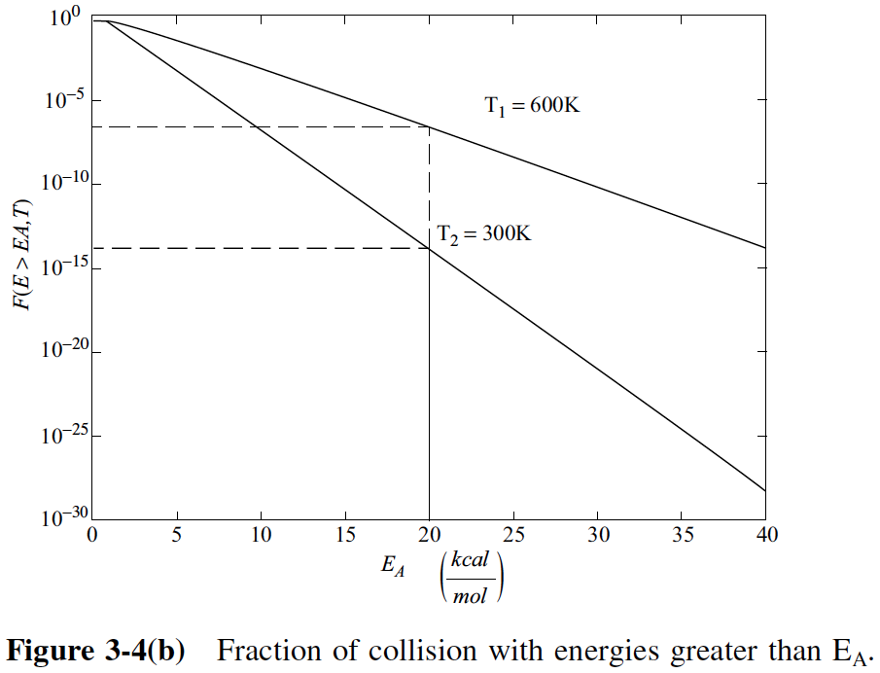
Activation Energy
Chapter 3
Concept 3. Fraction of Molecular Collisions That Have Sufficient Energy to React
Fraction of Molecules with Energy Greater than E_{A}
One observes for an activation energy E_{A} of 20 kcal/mol and a temperature of 300 K the fraction of collisions with energies greater than 20 kcal/mol is 1.76 x 10^{–14} while at 600 K, the fraction increases to 2.39 x 10^{–7}, which is a 7 orders of magnitude difference.

Slide 34
End of Lecture 3

Slide 35
Supplementary Material
Chapter 3 Professional Reference Shelf
BC
AB
V_{BC}
V_{AB}
kJ/
Molecule
kJ/
Molecule
r₀
r_{BC}
r₀
r_{AB}
Potentials (Morse or Lennard-Jones)

Slide 36
Supplementary Material
Chapter 3 Professional Reference Shelf
One can also view the reaction coordinate as variation of the BC distance for a fixed AC distance:
For a fixed AC distance as B moves away from C the distance of separation of B from C, r_{BC} increases as N moves closer to A. As r_{BC} increases r_{AB} decreases and the AB energy first decreases then increases as the AB molecules become close. Likewise as B moves away from A and towards C similar energy relationships are found. E.g., as B moves towards C from A, the energy first decreases due to attraction then increases due to repulsion of the AB molecules as they come closer together. We now superimpose the potentials for AB and BC to form the following figure:

Slide 37
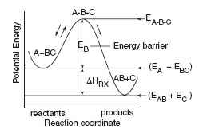
Reaction Coordinate
Chapter 3 Professional Reference Shelf
The activation energy can be thought of as a barrier to the reaction. One way to view the barrier to a reaction is through the reaction coordinates. These coordinates denote the energy of the system as a function of progress along the reaction path. For the reaction:
The reaction coordinate is:

Slide 38
Supplementary Material
Chapter 3 Professional Reference Shelf
Reference
AB
S₂
S₁
BC
Energy
E*
E_{a}
E_{1P}
E_{2P}
r
∆H_{Rx}=E_{2P}-E_{1P}

