Slide 1
Lecture 5
Chemical Reaction Engineering (CRE) is the field that studies the rates and mechanisms of chemical reactions and the design of the reactors in which they take place.

Slide 2
Lecture 5
Chapter 4
Block 1: Mole Balances
Block 2: Rate Laws
Block 3: Stoichiometry
  Stoichiometric Table: Flow
  Definitions of Concentration: Flow
  Gas Phase Volumetric Flow Rate
  Calculate the Equilibrium Conversion X_{e}

Slide 3
Reactor Mole Balances Summary
Review Lecture 2
_{in terms of conversion, X}
Reactor | Differential | Algebraic | Integral
X
Batch
t
CSTR
PFR
X
PBR
W

Slide 4

Algorithm
Review Lecture 3
How to find
Step 1: Rate Law
Step 2: Stoichiometry
Step 3: Combine to get

Slide 5
Reaction Engineering
Review Lecture 3
Mole Balance
Rate Laws
Stoichiometry
These topics build upon one another

Slide 6
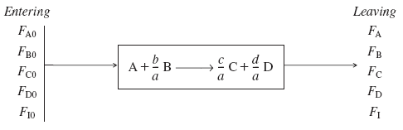
Flow System Stoichiometric Table
Chapter 4
Species | Symbol | Reactor Feed | Change | Reactor Effluent
A | A | F_{A0} | -F_{A0}X | F_{A}=F_{A0}(1-X)
B | B | F_{B0}=F_{A0}Θ_{B} | -b/aF_{A0}X | F_{B}=F_{A0}(Θ_{B}-b/aX)
C | C | F_{C0}=F_{A0}Θ_{C} | +c/aF_{A0}X | F_{C}=F_{A0}(Θ_{C}+c/aX)
D | D | F_{D0}=F_{A0}Θ_{D} | +d/aF_{A0}X | F_{D}=F_{A0}(Θ_{D}+d/aX)
Inert | I | F_{I0}=F_{A0}Θ_{I} | ---------- | F_{I}=F_{A0}Θ_{I}
 |  | F_{T0} |  | F_{T}=F_{T0}+δF_{A0}X
Where:
and
Concentration – Flow System

Slide 7
Chapter 4
Stoichiometry
Concentration Flow System:
Liquid Phase Flow System:
Liquid Systems
Flow Liquid Phase
etc.

Slide 8

Liquid Systems
Chapter 4
If the rate of reaction were
then we would have
This gives us

Slide 9
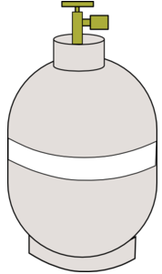
Stoichiometry for Gas Phase Flow Systems
Chapter 4
Combining the compressibility factor equation of state with Z = Z₀
Stoichiometry:
We obtain:

Slide 10
Stoichiometry for Gas Phase Flow Systems
Chapter 4
Since ,
Using the same method,

Slide 11
Stoichiometry for Gas Phase Flow Systems
Chapter 4
The total molar flow rate is:
Substituting F_{T} gives:
Where

Slide 12
Chapter 4
For Gas Phase Flow Systems
Concentration Flow System:
Gas Phase Flow System:

Slide 13
Chapter 4
For Gas Phase Flow Systems
If –r_{A}=kC_{A}C_{B}
This gives us
F_{A0}/-r_{A}
X

Slide 14
Chapter 4
For Gas Phase Flow Systems

Slide 15
Chapter 4
Example: Calculating the equilibrium conversion (X_{ef}) for gas phase reaction in a flow reactor
Consider the following elementary reaction where
K_{C}=20 dm³/mol and C_{A0}=0.2 mol/dm³.
Calculate Equilibrium Conversion or both a batch reactor (X_{eb}) and a flow reactor (X_{ef}).

Slide 16
Chapter 4
Gas Flow Example (X_{ef})
Solution:
Rate Law:

Slide 17
Chapter 4
Gas Flow Example (X_{ef})
Species | Fed | Change | Remaining
A | F_{A0} | -F_{A0}X | F_{A}=F_{A0}(1-X)
B | 0 | +F_{A0}X/2 | F_{B}=F_{A0}X/2
 | F_{T0}=F_{A0} |  | F_{T}=F_{A0}-F_{A0}X/2

Slide 18
Chapter 4
Gas Flow Example (X_{ef})
A | F_{A0} | -F_{A0}X | F_{A}=F_{A0}(1-X)
B | 0 | F_{A0}X/2 | F_{B}=F_{A0}X/2
Stoichiometry: Gas isothermal T=T₀
Gas isobaric P=P₀

Slide 19
Chapter 4
Gas Flow Example (X_{ef})
Pure A → y_{A0}=1, C_{A0}=y_{A0}P₀/RT₀, C_{A0}=P₀/RT₀
At equilibrium: -r_{A}=0

Slide 20
Chapter 4
Gas Flow Example (X_{ef})
Flow:
Recall
Batch:

Slide 21
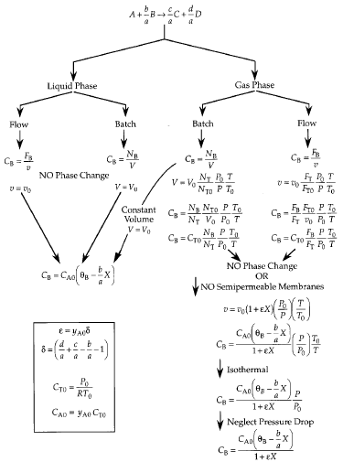
Chapter 4

Slide 22
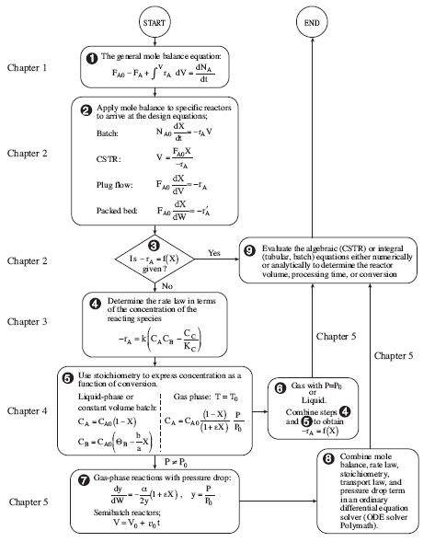
Chapter 4

Slide 23
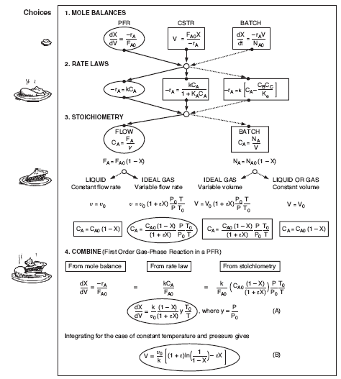
Chapter 4

Slide 24
End of Lecture 5

