Slide 1
Lecture 7
Chemical Reaction Engineering (CRE) is the field that studies the rates and mechanisms of chemical reactions and the design of the reactors in which they take place.

Slide 2
Lecture 7 – Tuesday 1/29/2013
Block 1: Mole Balances
Block 2: Rate Laws
Block 3: Stoichiometry
Block 4: Combine
California Professional Engineers Exam
In the past, the exam has not been curved,
75% or better to pass
Problem 4-12

Slide 3
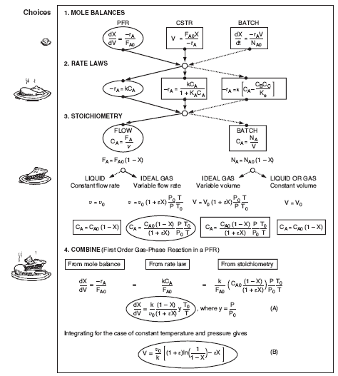

Slide 4

General Guidelines for the California Professional Engineering Exam
Some hints:
1. Group unknown parameters/values on the same side of the equation
example: [unknowns] = [knowns]
2. Look for a Case 1 and a Case 2 (usually two data points) to make intermediate calculations
3. Take ratios of Case 1 and Case 2 to cancel as many unknowns as possible
4. Carry all symbols to the end of the manipulation before evaluating, UNLESS THEY ARE ZERO

Slide 5
P5-17_{B} California Professional Exam Problem
P. E. Example
A B
Knowns: Intermediate Conversion, X₁, K_{C}, and W₁ = W₂
Unknowns: F_{A0}, W₁, C_{A0}

Slide 6
P. E. Example
1) Mole Balances
2) Rate Laws
  3) Stoichiometry
Liquid, υ = υ₀

Slide 7
P. E. Example
4) Combine
5) Evaluate

Slide 8
P. E. Example
Cancel unknowns F_{A0}, k and C_{A0}
Substitute X₁ = 0.55 and K_{C} = 5.8

Slide 9
P. E. Example
Part 2

Slide 10
P. E. Example
Substitute for F_{A1} and cancel F_{A0}, C_{A0}, k

Slide 11
P. E. Example
One equation and one unknown
Solving for

Slide 12
Heat Effects
Isothermal Design
Stoichiometry
Rate Laws
Mole Balance

Slide 13
End of Lecture 7

