Slide 1
Lecture 9
Chemical Reaction Engineering (CRE) is the field that studies the rates and mechanisms of chemical reactions and the design of the reactors in which they take place.

Slide 2
Lecture 9 – Thursday 2/7/2013
Balances in terms of molar flow rates
Block 1: Mole Balances
Balance Equation on Every Species
Block 2: Rate Laws
  Relative Rates
  Transport Laws
Block 3: Stoichiometry
Block 4: Combine
Membrane Reactors:
Used for thermodynamically limited reactions

Slide 3
Reactor Mole Balances Summary
Review Lecture 1
The GMBE applied to the four major reactor types
(and the general reaction A→B)
Reactor | Differential | Algebraic | Integral
N_{A}
Batch
t
CSTR
F_{A}
PFR
V
F_{A}
PBR
W

Slide 4
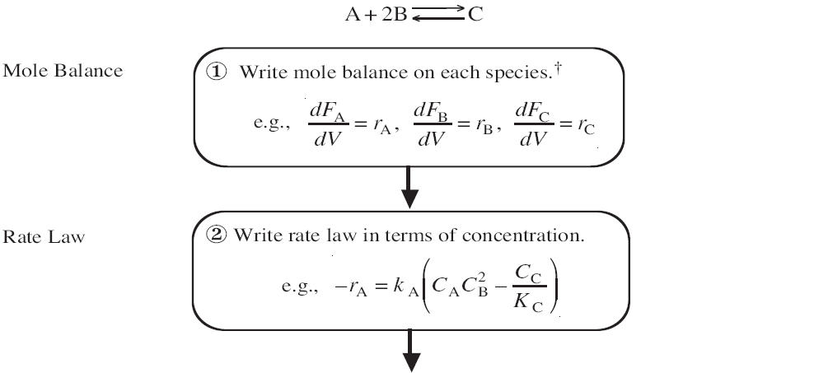
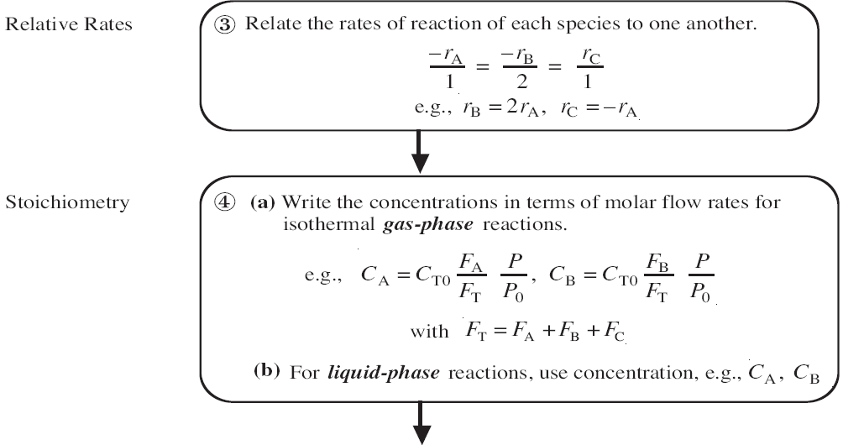
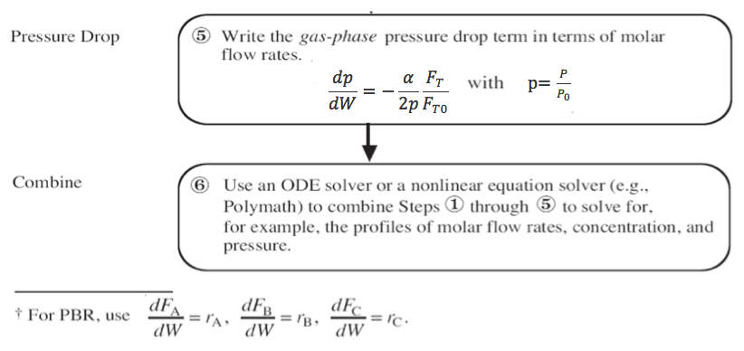

Slide 5
Membrane Reactors
Membrane reactors can be used to achieve conversions greater than the original equilibrium value. These higher conversions are the result of Le Chatelier’s principle; you can remove the reaction products and drive the reaction to the right.
To accomplish this, a membrane that is permeable to that reaction product, but impermeable to all other species, is placed around the reacting mixture.

Slide 6
Membrane Reactors
Dehydrogenation Reaction:
C₃H₈ ↔ H₂ + C₃H₆ A ↔ B + C
Thermodynamically Limited:
exothermic
X_{e}
X_{e}
X_{EB}
T

Slide 7
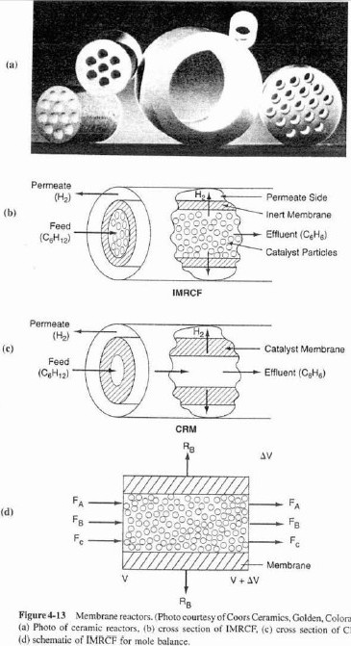
Membrane Reactors
Cross section of IMRCF Membrane Reactors
Cross section of CRM Schematic of IMRCF for mole balance

Slide 8
Membrane Reactors
sweep
B
W = ρ_{b}V = solids weight
ρ_{b} = (1-ϕ)ρ_{C}= bulk solids density
ρ_{C} = density of solids
F_{A0}
A,B,C
B
$$ρ_{b}=\frac{volume solids}{volume total}∗\frac{mass of solids}{volume solids}$$
H₂
H₂
C_{BS}
C_{B}
A,C stay behind since they are too big

Slide 9
Membrane Reactors
Mole Balance on Species A:
Species A: In – out + generation = 0

Slide 10
Membrane Reactors
Mole Balance on Species B:
Species B: In – out – out membrane + generation = 0

Slide 11
Membrane Reactors
Neglected most of the time

Slide 12
Membrane Reactors
Mole Balances:
Rate Law:

Slide 13
Membrane Reactors
Relative Rates:
Net Rates:
Transport Law:
Stoichiometry:
Parameters:
(isothermal, isobaric)
C_{TO} = 0.2, F_{A0}= 5, k = 4, K_{C} = 0.0004, k_{C} = 8

Slide 14
Membrane Reactors
Example: The following reaction is to be carried out isothermally in a membrane reactor with no pressure drop. The membrane is permeable to product C, but impermeable to all other species.
Inert Sweep Gas
H₂ (C)
C₆H₁₂ (A)
C₆H₆ (B)
Inert Sweep Gas
For membrane reactors, we cannot use conversion. We have to work in terms of the molar flow rates F_{A}, F_{B}, F_{C}.

Slide 15
Membrane Reactors
Mole Balances
Inert Sweep Gas
H₂ (C)
C₆H₁₂ (A)
C₆H₆ (B)
Inert Sweep Gas

Slide 16
Membrane Reactors
Rate Law:
Relative Rates:
Net Rates:

Slide 17
Membrane Reactors
Stoichiometry:
  Isothermal, no Pressure Drop

Slide 18
Membrane Reactors
Combine: - Use Polymath
Parameters:

Slide 19
Membrane Reactors
C₆H₁₂ (A)
C₆H₆ (B)
C_{i}
H₂ (C)
W

Slide 20
End of Lecture 9

