Slide 1
Lecture 9
Chemical Reaction Engineering (CRE) is the field that studies the rates and mechanisms of chemical reactions and the design of the reactors in which they take place.

Slide 2
Lecture 9 – Thursday 2/7/2013
Balances in terms of molar flow rates
Block 1: Mole Balances
Balance Equation on Every Species
Block 2: Rate Laws
  Relative Rates
  Transport Laws
Block 3: Stoichiometry
Block 4: Combine
Membrane Reactors:
Used for thermodynamically limited reactions

Slide 3







Reactor Mole Balances Summary
Review Lecture 1
The GMBE applied to the four major reactor types
(and the general reaction A→B)
Reactor | Differential | Algebraic | Integral
N_{A}
$$t=\int_{N_{A0}}^{N_{A}}{\frac{dN_{A}}{r_{A}V}}$$
Batch
$$\frac{dN_{A}}{dt}=r_{A}V$$
t
CSTR
V$=\frac{F_{A0}−F_{A}}{−r_{A}}$
F_{A}
$$\frac{dF_{A}}{dV}=r_{A}$$
$$V=\int_{F_{A0}}^{F_{A}}{\frac{dF_{A}}{dr_{A}}}$$
PFR
V
$$W=\int_{F_{A0}}^{F_{A}}{\frac{dF_{A}}{r_{A}^{′}}}$$
F_{A}
PBR
$$\frac{dF_{A}}{dW}={r′}_{A}$$
W

Slide 4
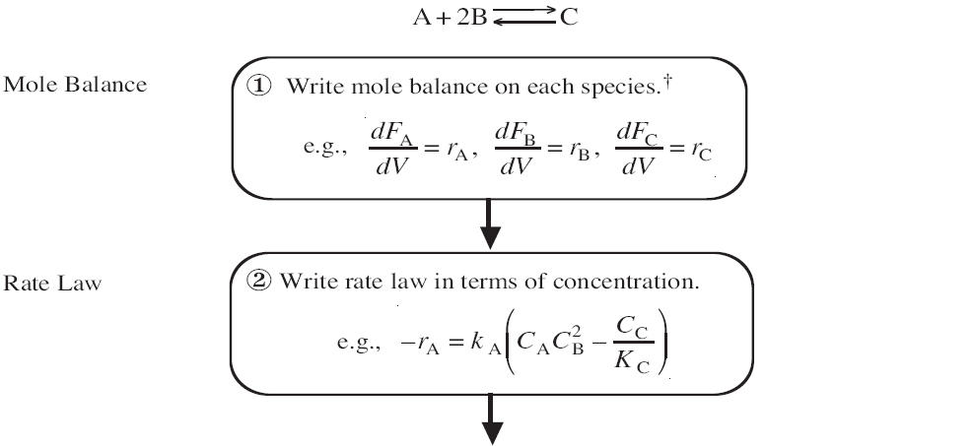
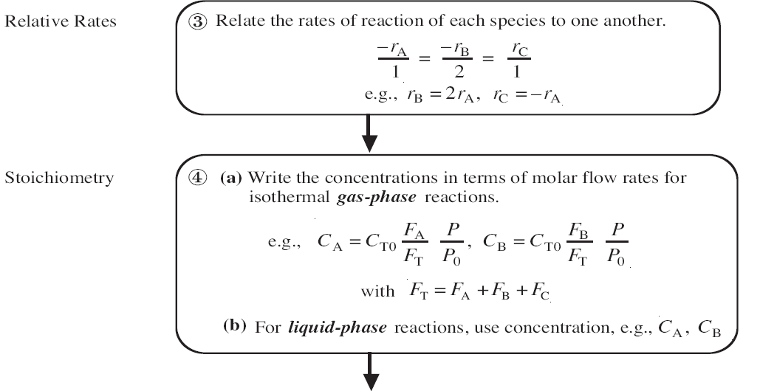
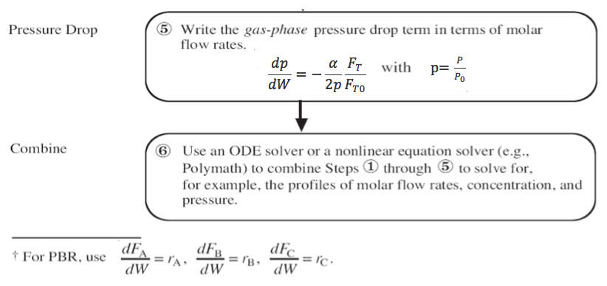

Slide 5
Membrane Reactors
Membrane reactors can be used to achieve conversions greater than the original equilibrium value. These higher conversions are the result of Le Chatelier’s principle; you can remove the reaction products and drive the reaction to the right.
To accomplish this, a membrane that is permeable to that reaction product, but impermeable to all other species, is placed around the reacting mixture.

Slide 6
Membrane Reactors
Dehydrogenation Reaction:
C₃H₈ ↔ H₂ + C₃H₆ A ↔ B + C
Thermodynamically Limited:
exothermic
X_{e}
X_{e}
X_{EB}
T

Slide 7
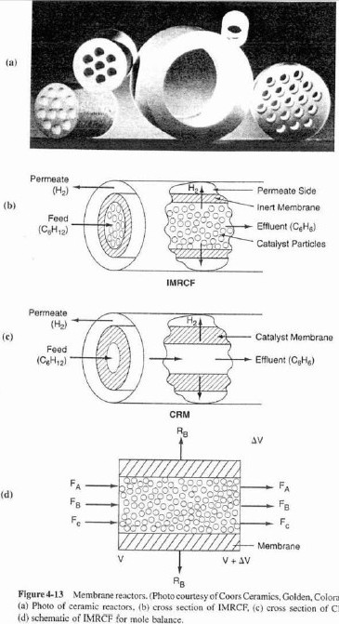
Membrane Reactors
Cross section of IMRCF Membrane Reactors
Cross section of CRM Schematic of IMRCF for mole balance

Slide 8
Membrane Reactors
sweep
B
W = ρ_{b}V = solids weight
ρ_{b} = (1-ϕ)ρ_{C}= bulk solids density
ρ_{C} = density of solids
F_{A0}
A,B,C
B
$$ρ_{b}=\frac{volume solids}{volume total}∗\frac{mass of solids}{volume solids}$$
H₂
H₂
C_{BS}
C_{B}
A,C stay behind since they are too big

Slide 9


Membrane Reactors
Mole Balance on Species A:
Species A: In – out + generation = 0
$${\left.F_{A}\right|}_{V}−{\left.F_{A}\right|}_{V+ΔV}+r_{A}ΔV=0$$
$$\frac{dF_{A}}{dV}=r_{A}$$

Slide 10
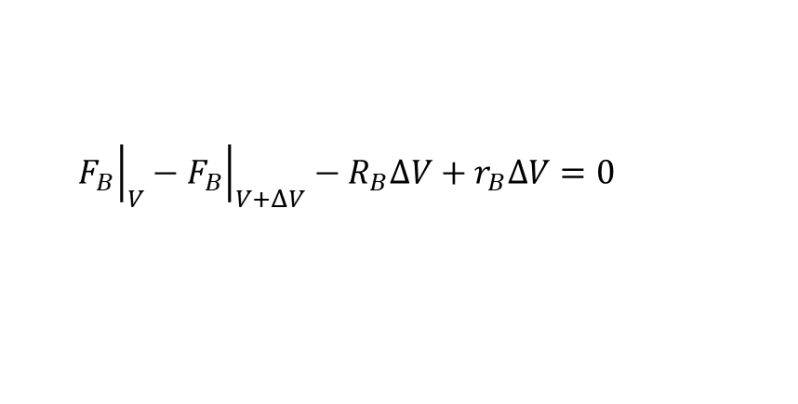
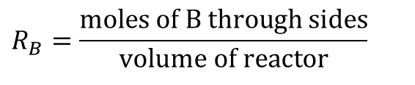

Membrane Reactors
Mole Balance on Species B:
Species B: In – out – out membrane + generation = 0
$${\left.F_{B}\right|}_{V}−{\left.F_{B}\right|}_{V+ΔV}−R_{B}ΔV+r_{B}ΔV=0$$
$$\frac{dF_{B}}{dV}=(r_{B}−R_{B})$$
$$R_{B}=\frac{\text{moles} \text{of} \text{B} \text{through} \text{sides}}{\text{volume} \text{of} \text{reactor}}$$

Slide 11
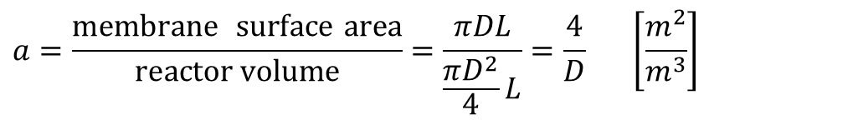
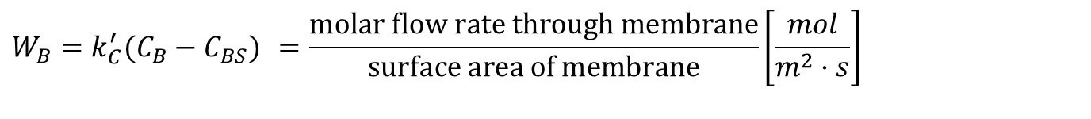

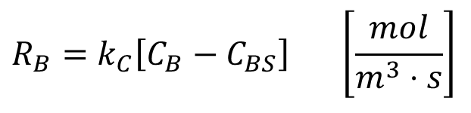

Membrane Reactors
$$W_{B}=k_{C}^{′}(C_{B}−C_{BS}) =\frac{\text{molar} \text{flow} \text{rate} \text{through} \text{membrane}}{\text{surface} \text{area} \text{of} \text{membrane}}\left[\frac{mol}{m^{2}⋅s}\right]$$
$$a=\frac{\text{membrane} \text{surface} \text{area}}{\text{reactor} \text{volume}}=\frac{πDL}{\frac{πD^{2}}{4}L}=\frac{4}{D} \left[\frac{m^{2}}{m^{3}}\right]$$
$$R_{B}=W_{B}a=k_{C}^{′}a\left[C_{B}−C_{BS}\right]$$
$$k_{C}=k_{C}^{′}a$$
$$R_{B}=k_{C}\left[C_{B}−C_{BS}\right] \left[\frac{mol}{m^{3}⋅s}\right]$$
Neglected most of the time

Slide 12
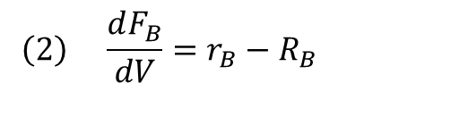

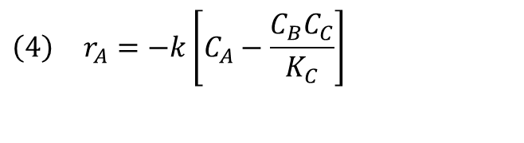

Membrane Reactors
Mole Balances:
Rate Law:
$$\left(1\right) \frac{dF_{A}}{dV}=r_{A}$$
$$\left(2\right) \frac{dF_{B}}{dV}=r_{B}−R_{B}$$
$$\left(3\right) \frac{dF_{C}}{dV}=r_{C}$$
$$\left(4\right) r_{A}=−k\left[C_{A}−\frac{C_{B}C_{C}}{K_{C}}\right]$$

Slide 13








Membrane Reactors
$$\frac{−r_{A}}{1}=\frac{r_{B}}{1}=\frac{r_{C}}{1}$$
Relative Rates:
Net Rates:
Transport Law:
Stoichiometry:
Parameters:
$$\left(5\right) r_{A}=−r_{B}\text{, }r_{A}=−r_{C}$$
$$\left(6\right) R_{B}=k_{C}C_{B}$$
$$\left(7\right) C_{A}=C_{T0}\frac{F_{A}}{F_{T}}$$
(isothermal, isobaric)
$$\left(8\right) C_{B}=C_{T0}\frac{F_{B}}{F_{T}}$$
$$\left(9\right) C_{C}=C_{T0}\frac{F_{C}}{F_{T}}$$
$$\left(10\right) F_{T}=F_{A}+F_{B}+F_{C}$$
C_{TO} = 0.2, F_{A0}= 5, k = 4, K_{C} = 0.0004, k_{C} = 8

Slide 14
Membrane Reactors
Example: The following reaction is to be carried out isothermally in a membrane reactor with no pressure drop. The membrane is permeable to product C, but impermeable to all other species.
Inert Sweep Gas
H₂ (C)
C₆H₁₂ (A)
C₆H₆ (B)
Inert Sweep Gas
For membrane reactors, we cannot use conversion. We have to work in terms of the molar flow rates F_{A}, F_{B}, F_{C}.

Slide 15

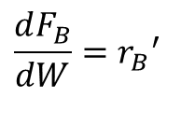
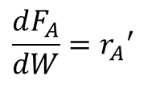
Membrane Reactors
Mole Balances
$$\frac{dF_{A}}{dW}={r_{A}}^{′}$$
Inert Sweep Gas
$$\frac{dF_{B}}{dW}={r_{B}}^{′}$$
H₂ (C)
C₆H₁₂ (A)
$$\frac{dF_{C}}{dW}={r_{C}}^{′}−k_{C}C_{C}$$
C₆H₆ (B)
Inert Sweep Gas

Slide 16

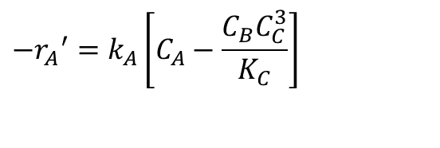

Membrane Reactors
$$−{r_{A}}^{′}=k_{A}\left[C_{A}−\frac{C_{B}C_{C}^{3}}{K_{C}}\right]$$
Rate Law:
Relative Rates:
$$\frac{{r_{A}}^{′}}{−1}=\frac{{r_{B}}^{′}}{1}=\frac{{r_{C}}^{′}}{3}$$
Net Rates:
$${r_{B}}^{′}=−{r_{A}}^{′} \\ {r_{C}}^{′}=−3{r_{A}}^{′}$$

Slide 17
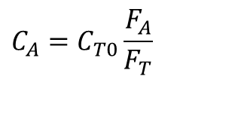
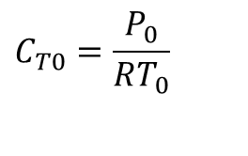
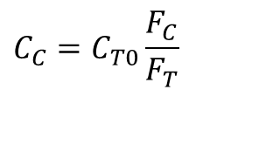

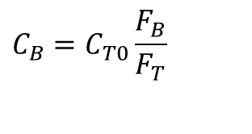
Membrane Reactors
Stoichiometry:
  Isothermal, no Pressure Drop
$$C_{T0}=\frac{P_{0}}{RT_{0}}$$
$$C_{A}=C_{T0}\frac{F_{A}}{F_{T}}$$
$$C_{B}=C_{T0}\frac{F_{B}}{F_{T}}$$
$$C_{C}=C_{T0}\frac{F_{C}}{F_{T}}$$
$$F_{T}=F_{A}+F_{B}+F_{C}$$

Slide 18
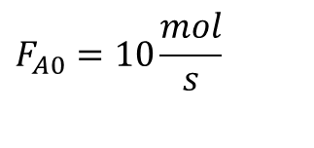
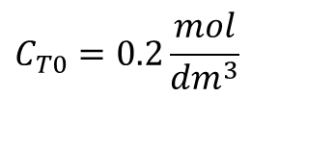
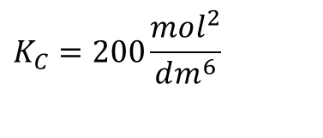
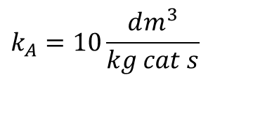

Membrane Reactors
Combine: - Use Polymath
$$C_{T0}=0.2\frac{mol}{dm^{3}}$$
$$F_{A0}=10\frac{mol}{s}$$
Parameters:
$$k_{A}=10\frac{dm^{3}}{kg cat s}$$
$$k_{C}=0.5\frac{dm^{3}}{kg cat s}$$
$$K_{C}=200\frac{mol^{2}}{dm^{6}}$$

Slide 19
Membrane Reactors
C₆H₁₂ (A)
C₆H₆ (B)
C_{i}
H₂ (C)
W

Slide 20
End of Lecture 9

