Slide 1
Lecture 16
Chemical Reaction Engineering (CRE) is the field that studies the rates and mechanisms of chemical reactions and the design of the reactors in which they take place.

Slide 2
Web Lecture 16 Class Lecture 25 – Thursday 4/18/2013
Bioreactors
Monod Equation
Yield Coefficients
Washout

Slide 3
Enzymes - Urease
Review Last Lecture
A given enzyme can only catalyze only one reaction. Urea is decomposed by the enzyme urease, as shown below.
The corresponding mechanism is:
Michaelis Menten Equation

Slide 4
Bioreactors
cells
more cells
+ Products
Nutrient (S) +

Slide 5
Bioreactors

Slide 6
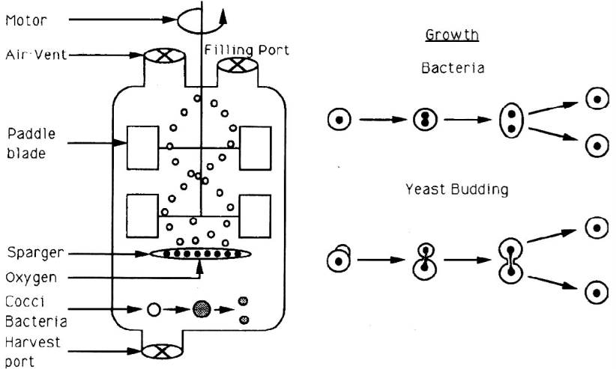
Batch Bioreactor

Slide 7
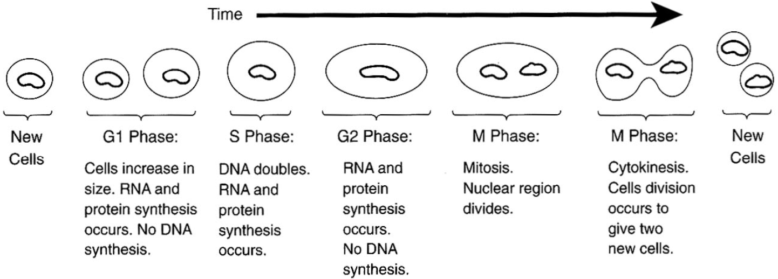
Phases of Cell Growth and Division

Slide 8
Bioreactors
inoculum
t=0 time →
Cells + Substrate → More Cells + Product

Slide 9
Bioreactors
Phases of bacteria growth:
I. Lag II. Exponential III. Stationary IV. Death
b) Monod growth rate law:
Lag Phase
lnC_{c}
Stationary Phase
Death Phase
Exponential Growth Phase
0
time

Slide 10
Bioreactors
1) Mass Balances
Accumulation = [In] - [Out] + [Growth] - [Death]

Slide 11
Bioreactors
Rate Laws:
C_{p}*= Product concentration at which all metabolism ceases

Slide 12
Bioreactors
3) Stoichiometry
A) Yield Coefficients
B) Maintenance

Slide 13
Bioreactors
3) Stoichiometry
Rate of Substrate Consumption
Can’t separate substrate consumption used for cell growth from that used for product formations during exponenial growth.

Slide 14
Bioreactors
v₀
C_{S0}
Volume=V
v
C_{C}
C_{S}
V=V₀
1) Mass Balance:

Slide 15
Bioreactors

Slide 16
Bioreactors
2) Rate Laws:
3) Parameters

Slide 17
Polymath Setup
1.) d(C_{C})/d(t)=-D*C_{C}+(r_{g}-r_{d})
2.) d(C_{S})/d(t)=-D*(C_{S0}-C_{S})-Y_{sg}*r_{g}-m*C_{C}
3.) d(C_{P})/d(t)=-D*C_{P}+Y_{PC}*r_{g}
4.) rg=(((1-(C_{P}/C_{pstar}))**0.52)*mumax*(C_{S}/(K_{S}+C_{S}))*C_{C}
5.) D=0.2
6.) k_{d}=0.01
11.) mumax=0.33
7.) r_{d}=k_{d}*C_{C}
12.) Y_{SC}=12.5
8.) C_{S0}=250
13.) K_{S}=1.7
9.) Y_{PC}=5.6
10.) m=0.3

Slide 18
Bioreactors – Chemostats - CSTRs
1. Steady State - Neglect Death Rate and Cell Maintenance
2. Cell

Slide 19
Bioreactors – Chemostats - CSTRs
3. Substrate

Slide 20
Bioreactors – Chemostats - CSTRs
CSTR Washout
C_{C}
C_{C}
D
D_{W}
Washout dilution rate

Slide 21
Maximum Product Flow Rate
DC_{C}
How does this figure relate to drinking a lot of fluids when you have an infection or cold?
D
D_{maxprod}
D_{W}

Slide 22
End of Web Lecture 16 End of Class Lecture 25

