Slide 1
Lecture 17
Chemical Reaction Engineering (CRE) is the field that studies the rates and mechanisms of chemical reactions and the design of the reactors in which they take place.

Slide 2
Web Lecture 17 Class Lecture 22–Thursday 4/4/2013
Introduction to Catalysts and Catalysis
Interstage cooling
Noble Prize 2007
Catalytic steps

Slide 3
Catalysts and Catalysis
A Catalyst is a substance that affects the rate of chemical reaction but emerges from the process unchanged.
Catalysis is the occurrence, study, and use of catalysts and catalytic processes.
Approximately 1/3 of the GNP of materials produced in the U.S. involves a catalytic process.

Slide 4
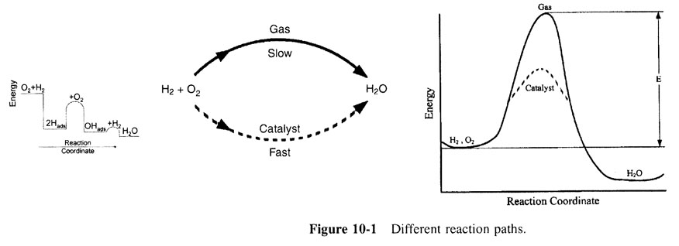
Catalysts and Catalysis
Catalysts affect both selectivity and yield
Different reaction paths

Slide 5
Catalysts and Catalysis
Different shapes and sizes of catalyst.

Slide 6
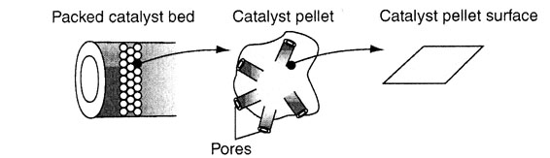
Catalysts and Catalysis
Catalytic packed-bed reactor, schematic.

Slide 7
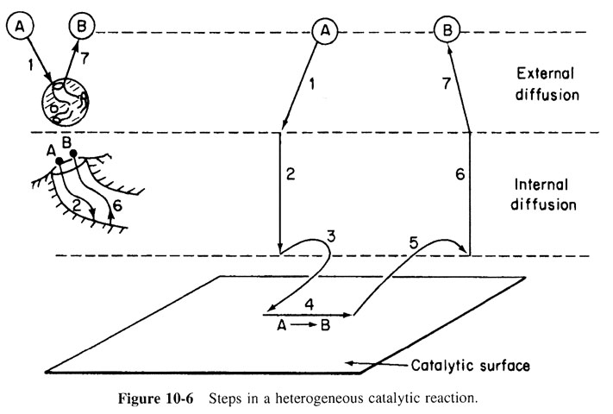
Steps in a Catalytic Reaction

Slide 8
Active Sites
Reactions are not catalyzed over the entire surface but only at certain active sites or centers that result from unsaturated atoms in the surface.
An active site is a point on the surface that can form strong chemical bonds with an adsorbed atom or molecule.

Slide 9
Active Sites – Ethylidyne on Platinum

Slide 10
The Adsorption Step
Vacant and occupied sites
For the system shown, the total concentration of sites is
C_{t} = C_{v} + C_{A.S} + C_{B.S}

Slide 11
The Adsorption Step

Slide 12
Langmuir Adsorption Isotherm

Slide 13
Langmuir Adsorption Isotherm
Increasing T
Slope=k_{A}
Langmuir Adsorption Isotherm

Slide 14
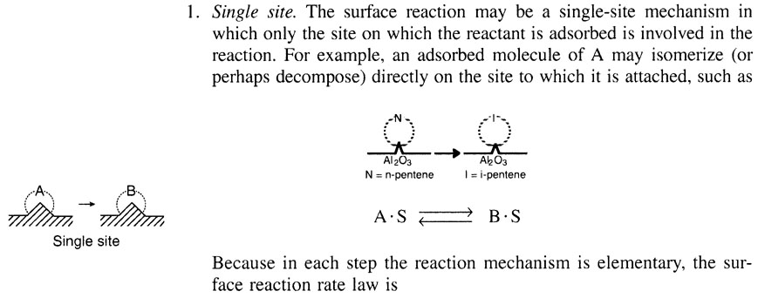
The Surface Reaction Step

Slide 15
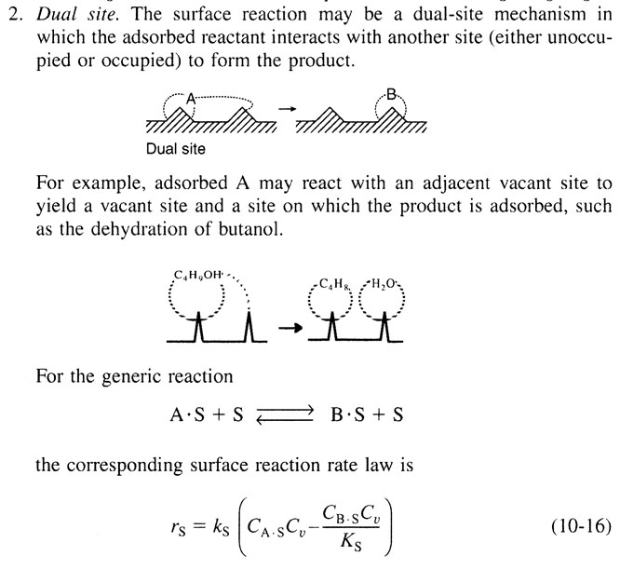
The Surface Reaction Step

Slide 16
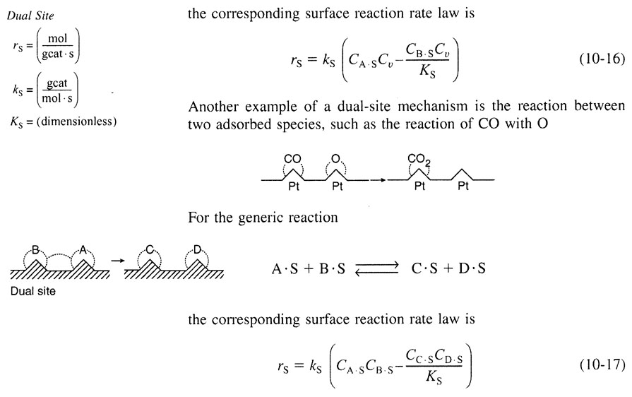
The Surface Reaction Step

Slide 17
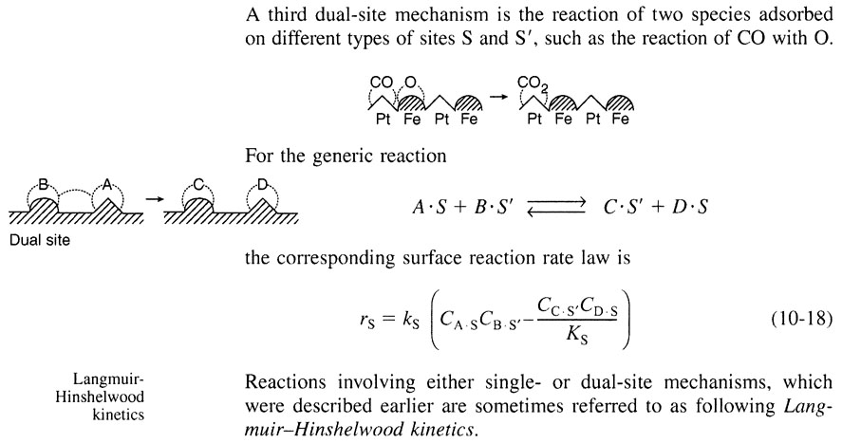
The Surface Reaction Step

Slide 18
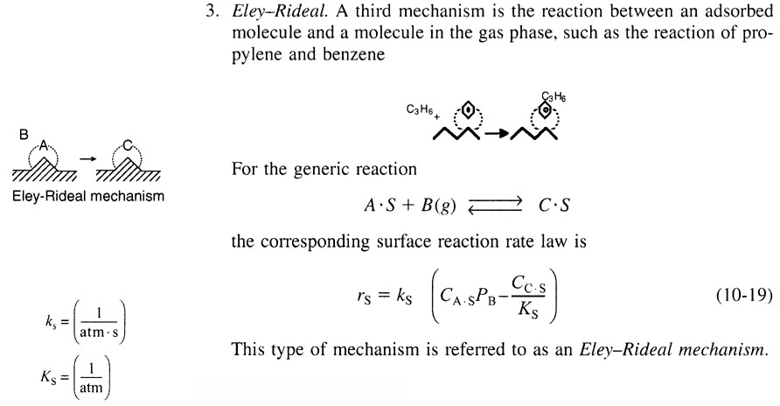
The Surface Reaction Step

Slide 19
Steps in a Catalytic Reaction

Slide 20
Desorption from the Surface for the Reaction
(10-20)
(10-21)

Slide 21
Steps in a Single-Site Catalytic Reactor
Adsorption
Surface Reaction
Desorption
Which step is the Rate Limiting Step (RLS)?

Slide 22
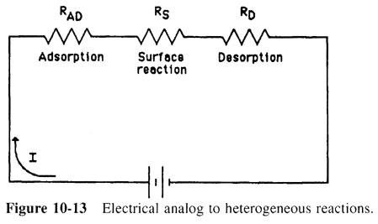
The Rate Limiting Step: Which step has the largest resistance?
Electrical analog to heterogeneous reactions

Slide 23
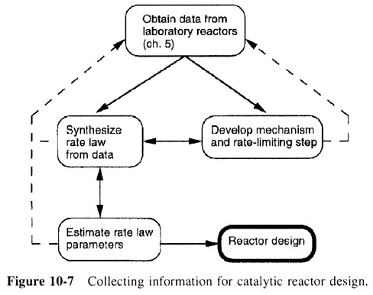
Collecting and Analyzing Data
Collecting information for catalytic reactor design

Slide 24
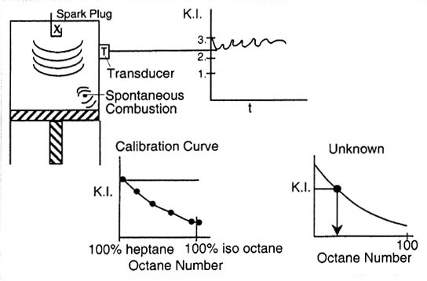
Collecting and Analyzing Data

Slide 25
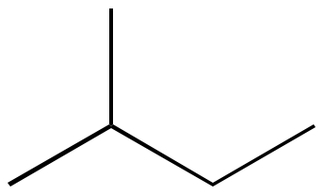
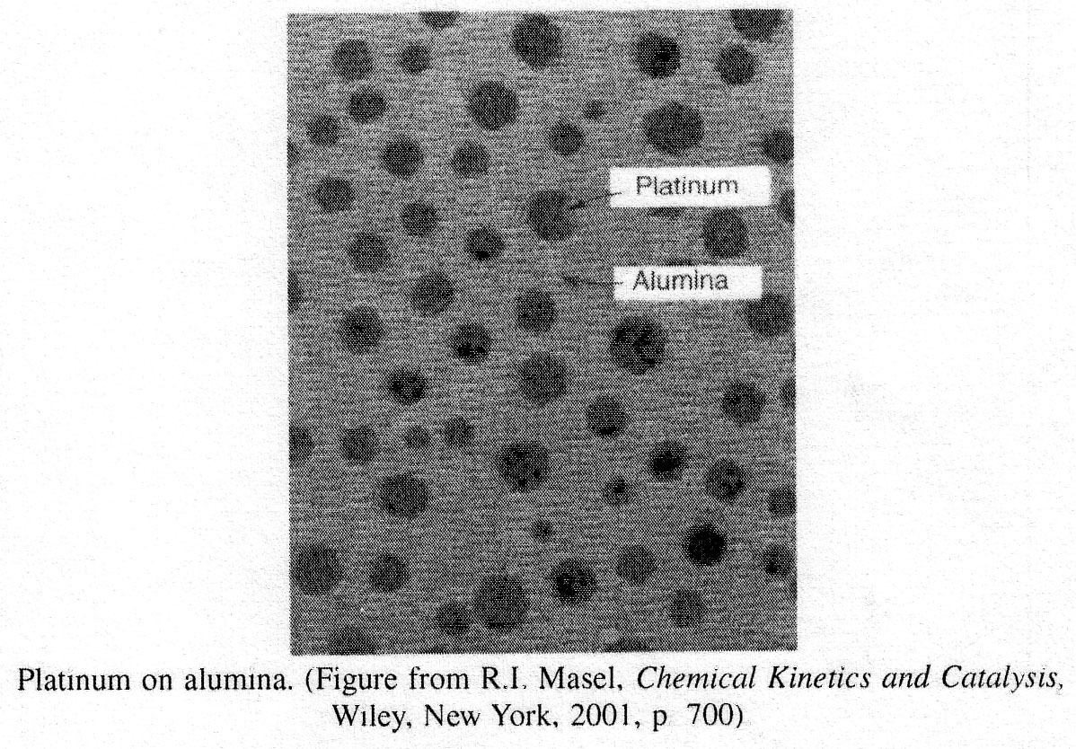
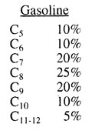
Catalytic Reformers
Normal Pentane Octane Number = 62
Iso-Pentane Octane Number = 95

Slide 26
Catalytic Reformers
0.75 wt% Pt
n-pentane i-pentane
Al₂O₃
-H₂
Al₂O₃
+H₂
n-pentane n-pentene
i-pentene
i-pentane
Pt
Pt
Al₂O₃
n-pentene i-pentene
N I

Slide 27
Catalytic Reformers
Isomerization of n-pentene (N) to i-pentene (I) over alumina
Al₂O₃
N I
1. Select a mechanism (Mechanism Single Site)
Adsorption on Surface:
Surface Reaction:
Desorption:
Treat each reaction step as an elementary reaction when writing rate laws.

Slide 28
Catalytic Reformers
2. Assume a rate-limiting step. Choose the surface reaction first, since more than 75% of all heterogenous reactions that are not diffusion-limited are surface-reaction-limited. The rate law for the surface reaction step is:

Slide 29
Catalytic Reformers
3. Find the expression for the concentrations of the adsorbed species C_{N.S} and C_{I.S}. Use the other steps that are not limiting to solve for C_{N.S} and C_{I.S}. For this reaction:
From
From

Slide 30
Catalytic Reformers
4. Write a Site Balance.
5. Derive the rate law. Combine steps 2, 3 and 4 to arrive at the rate law :

Slide 31
Catalytic Conversion of Exhaust Gas
 | 1994 | 2004 | 2008
HC | 0.41 | 0.125 | 0.10
CO | 3.4 | 3.4 | 3.4
NO | 0.4 | 0.4 | 0.14

Slide 32
Catalytic Conversion of Exhaust Gas

Slide 33
Catalytic Conversion of Exhaust Gas

Slide 34
Catalytic Conversion of Exhaust Gas

Slide 35
Catalytic Conversion of Exhaust Gas
Neglect

Slide 36
Catalytic Conversion of Exhaust Gas
Find optimum partial pressure of CO

Slide 37
End of Web Lecture 17

