Slide 1
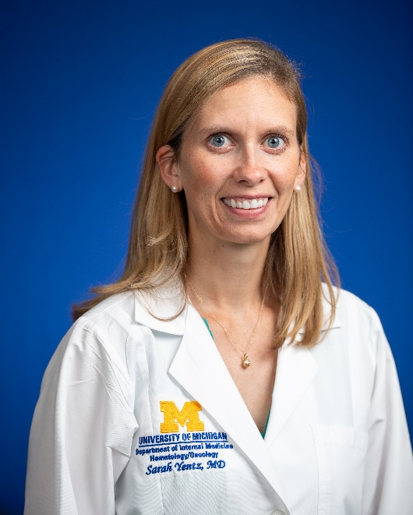
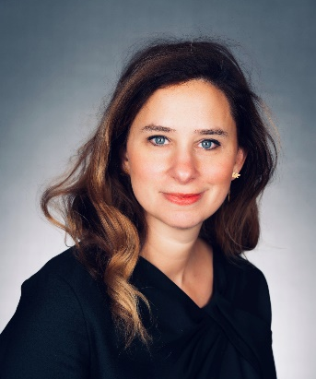


Education and Training in Ambulatory Internal Medicine
Sarah Yentz, MD
Kristin Collier, MD, FACP

Slide 2



Ambulatory Curriculum:
Overall Learning Objective
Provide all our residents with the knowledge and skills necessary to practice as excellent outpatient general internists in academic or community practice settings

Slide 3
Outpatient GIM Clinic
(longitudinal)
Outpatient Subspecialty Electives
Ambulatory Months
Educational Conferences
Daily Ambulatory Morning Report
Weekly Academic Half Days (“TLS”)
Notes:
Educational conferences
Ambulatory Morning Report (daily)
Academic half days (“TLS”) held each Thursday afternoon during your Ambulatory Block Rotations

Slide 4

Continuity Clinic:
Training Model
  Average one half-day of continuity clinic per week
GOAL
  “Hybrid Model”
    During inpatient months, clinics cancelled on call days
    During outpatient rotations residents have full day instead of half day clinics
PROCESS
  Preserves continuity of the clinic experience but allows for balance between inpatient and outpatient responsibilities.
BENEFIT
Notes:
Intern pagers covered by senior resident while in clinic.
During some inpatient rotations, there are no continuity clinics scheduled and that rotation is strictly inpatient-focused. During other inpatient months, clinics are cancelled for on-call or post-call days.
To compensate for those cancelled clinics, additional make-up clinics are scheduled on other rotations (i.e., Ambulatory Block Rotations and consult electives).
Benefit: preserves continuity of the clinic experience but allows for balance between inpatient and outpatient responsibilities.
THE GOAL: average one half-day of continuity clinic per week
THE PROCESS: Clinics scheduled using “hybrid” model
During inpatient months, clinics are cancelled for call days.
Additional make-up clinics are scheduled on elective / ambulatory rotations
THE BENEFIT: preserves continuity of the clinic experience but allows for balance between inpatient and outpatient responsibilities.

Slide 5
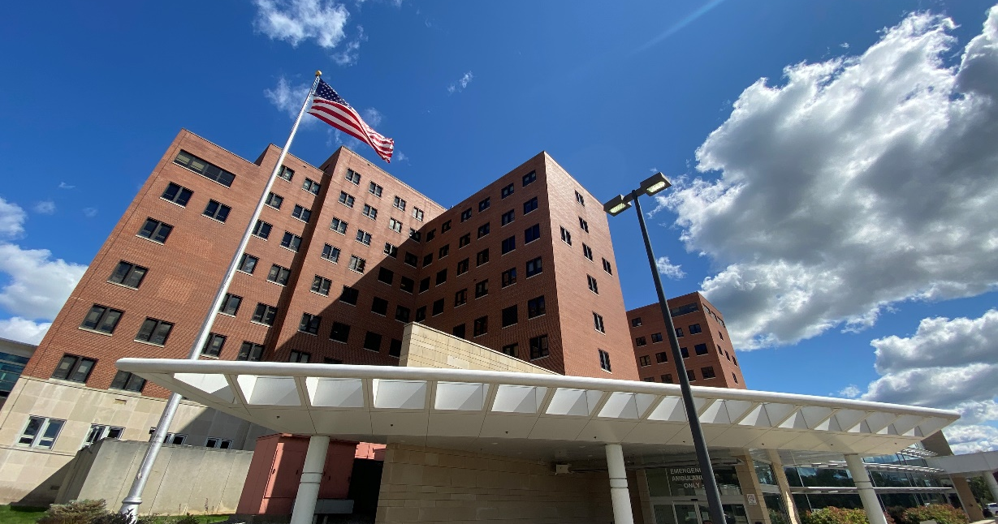
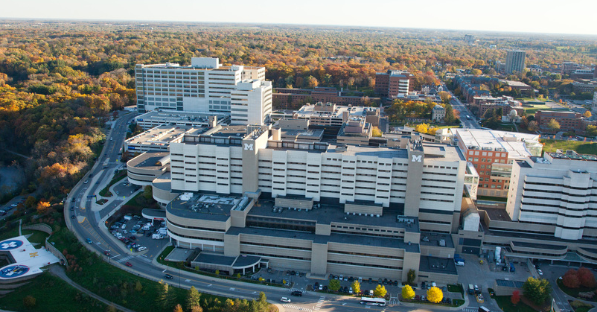
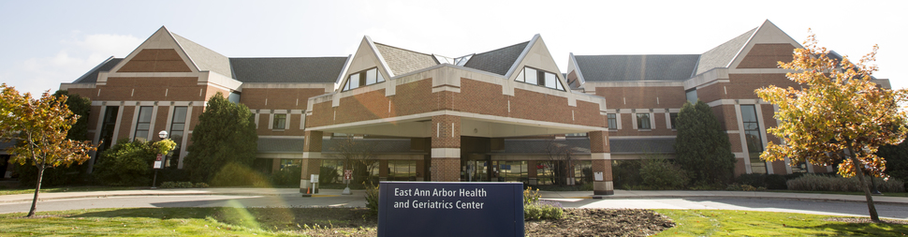
Continuity Clinic Sites
Veterans Affairs Hospital
University Hospital Taubman Center
Community Health Centers
Notes:
Mention EMR/CPRS, travel time incorporated into off site clinics

Slide 6

Continuity Clinic Educational Goals
You serve as the primary care doctor for a diverse group of patients
Notes:
Develop the skills needed to address the common acute complaints seen in the outpatient setting, to manage the chronic medical conditions and address the preventive health needs of your assigned panel of patients (population health and panel management)

Slide 7
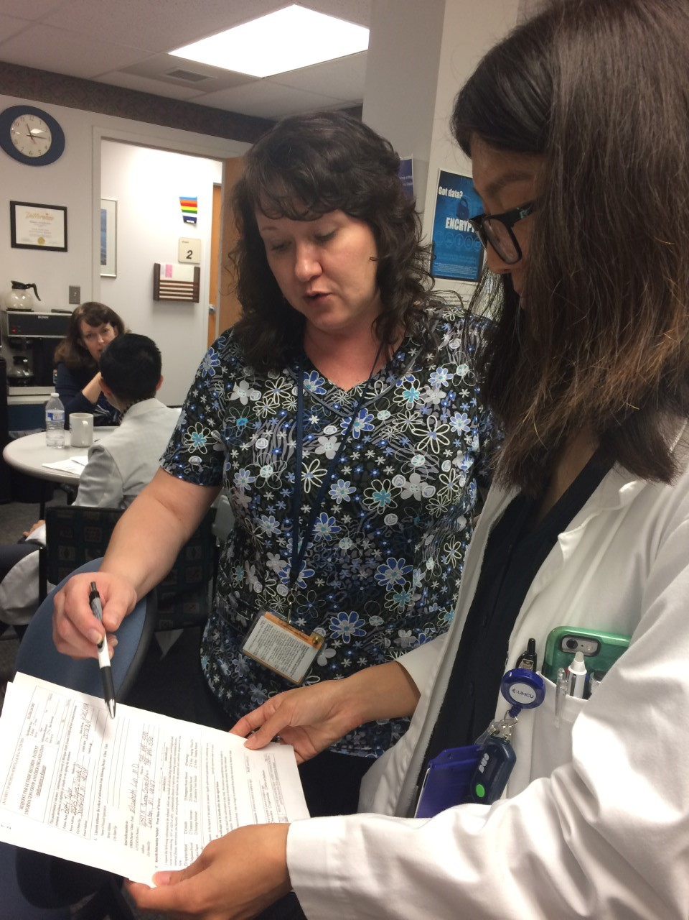
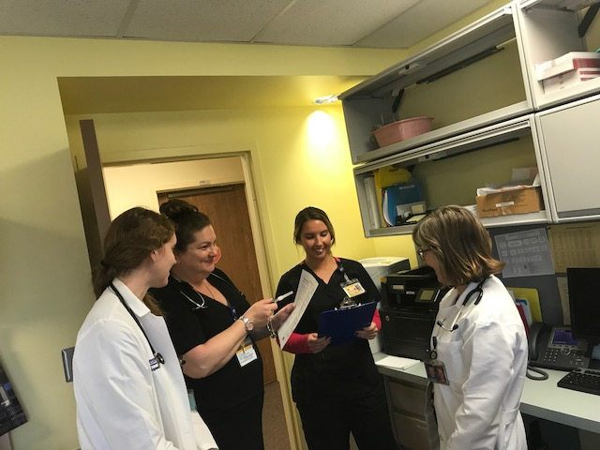
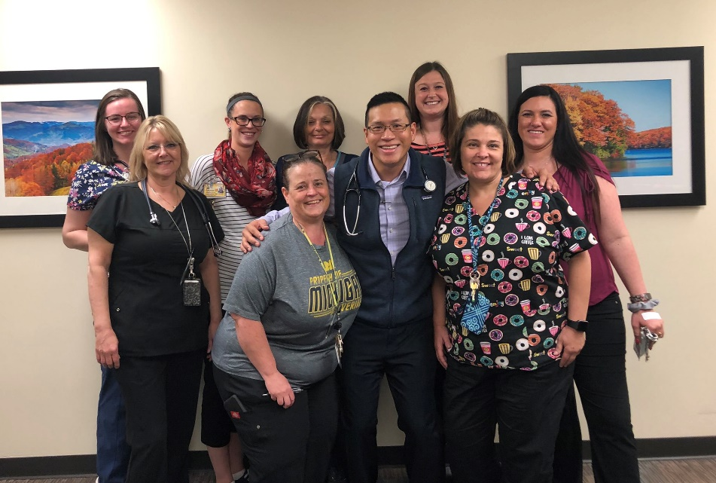
Notes:
Appreciate the collaborative nature of care delivery in a patient centered medical home

Slide 8
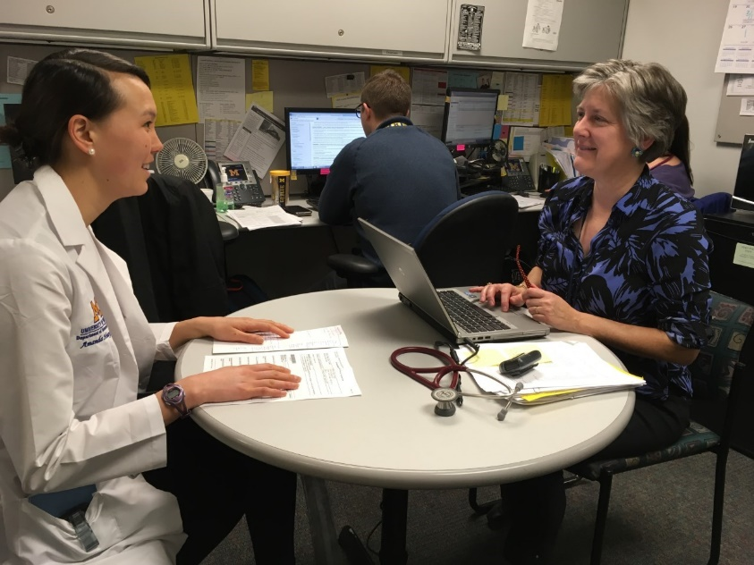
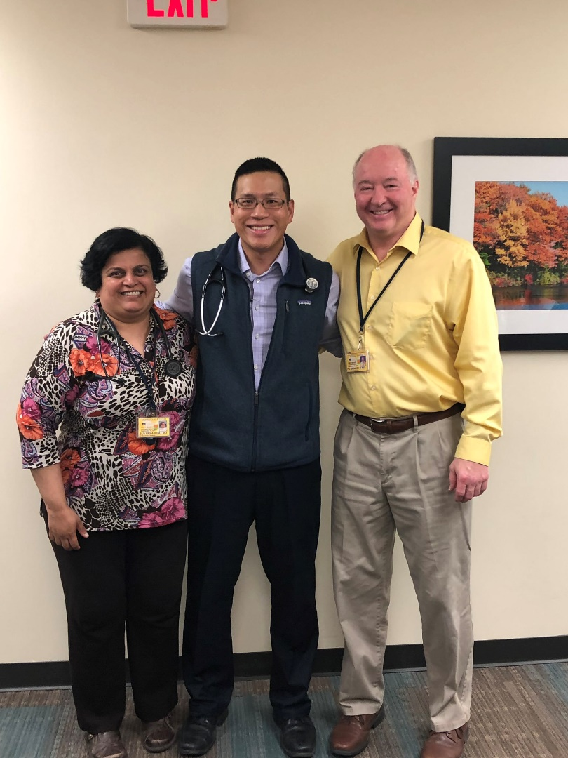
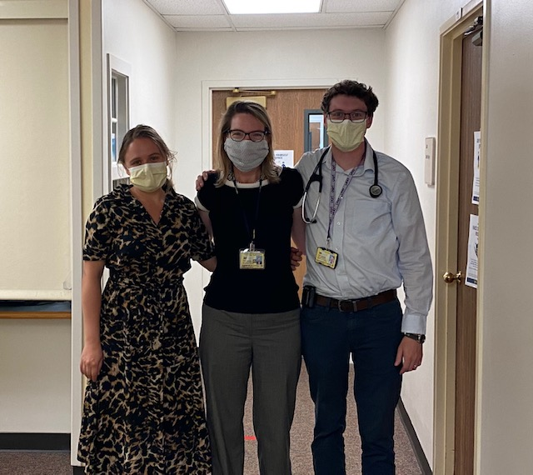
Notes:
Foster longitudinal relationships with your faculty clinic mentors which allow for continued feedback and professional development

Slide 9

Continuity Clinic:
Curriculum
“IMMERSION WEEK”
Early in Intern Year to get acquainted with clinic setting
EXPERIENTIAL LEARNING
Patient encounters and expert clinician educators and research-based GIM faculty
DIRECT OBSERVATION
Of clinical and communication skills
MONTHLY OUTPATIENT TEACHING SESSIONS
  Web-based modules
  Case Presentations
  Evidence-based Literature Reviews
  QI / Panel Management
Notes:
All interns participate in an “immersion week” in clinic early in their training to improve comfort in their clinic setting.
Emphasis on experiential learning from patient encounters with guidance from expert clinician-educator and research-based general internal medicine faculty.
Direct observation of clinical and communication skills
Monthly outpatient teaching sessions with your continuity clinic faculty:
Web-based knowledge content modules
Case vignette presentations
Evidence-based literature reviews
Quality Improvement/Panel Management

Slide 10
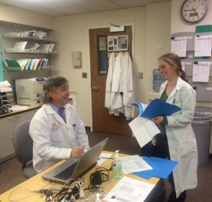
What types of patients will I see in clinic?
Variety in a ½ day: preventive care, acute care, chronic disease management
Age range: 16 to 95+
Patient panel: “inherited” patients and “new recruits” from your inpatient rotations
Many patients have several chronic medical illnesses
To start, most intern visits will be face to face
As you progress in your training, expand to training in telehealth and virtual visits

Slide 11


Ambulatory Block Rotations
Month-long dedicated outpatient rotations
  1-2 months per year
Clinical Opportunities
  General Medicine clinics
  Subspecialty clinics
Dedicated Teaching in Topics Relevant to Outpatient Medicine
  Daily Ambulatory Morning Report
    Common presentations, diagnostic dilemmas, important outpatient conditions
    Review of evidence-based medicine and practice guidelines
  Weekly academic half days (“TLS”)
Notes:
NEW
your outpatient training and education here at Michigan Medicine can be broken down into 3 buckets. The first bucket is the continuity clinic which Dr Yentz covered. The second bucket is the ambulatory block rotations which I'll go through next and then we will talk about the outpatinet electives. The ambulatory block rotations are month long blocks of time in which you spend the entirety of that time in the outpatient setting. You'll have 1-2 of these as an intern and 2-4 of them in total across your senior medical residnet years. If you are in our primary care track you will have the upper limit of these build into your schedule During these month long blocks you will spend time in your regular general medicine continuity clinic. Not only on your regular half day when you normally have your clinic, but you'll also have some make-up continuity clinic build into your schedule at your home clinic as well to make up for times that your continuity clinic had previously been closed because you were on call or post call. The other half days will be spent in outpatinet specialty clinics within internal mediicne and some clinical experiences outside the dept of medicine. You will also have some clinics in which you'll experience what primary care is like outside of your regular continuity clinic site. And then the didactic portion happens in two formats during this time. Every day, monday through Friday when you're on ambulatory, you participate in ambulatory morning report. This is the sister confernce to of inpatient morning report. There is a chief resident and a presenter and a case or topic is presented from the outpatinet setting. There is a faculty discussant who helps the group work through the case and then the group discusses the case focusing on the diagnostic and/or therapuetic dilemmas of the case as it relates to the outpt setting. Tuesdays are reserved for folks to attend the division of general medicine outpt conference. This is the conference for outpt generalists focused on outpt gen med topics. Thursday afternoons on ambulatory, you have what is called TLS which stands for teaching and learning seminars. This is academic half day time that is protected for learning. You will go over various topics related to during to outpt medicine during this time. There is a separate curriculum for the interns and seniors

Slide 12

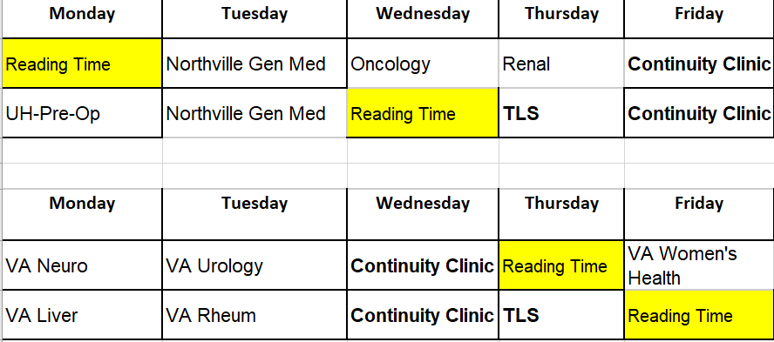
Ambulatory Block Rotations:
Notes:
These are samples of residents schedules during the ambulatory rotation.. As you can see, both residents spend a full day in their own continuity clinics to make up for rotations where clinic may have been canceled since they were on call. They both have their teaching and learning seminar on Thursday afternoon. The rest of the schedule is made up of half day experiences in a variety of clinics. Some of these experiences are in general medicine at a location different than their continuity clinic, like the Northville clinic, others are in internal medicine subspecialites like the VA liver or UM renal clinic and finally others are in subspecialties outside of internal medicine like urology and women’s health to learn skills from other specialties that are pertinent to outpatient medicine.
During the second year, every resident has one of their ambulatory rotations scheduled to be a combined ambulatory and patient safety block.

Slide 13
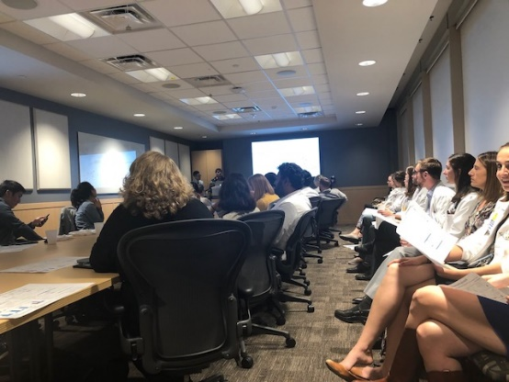
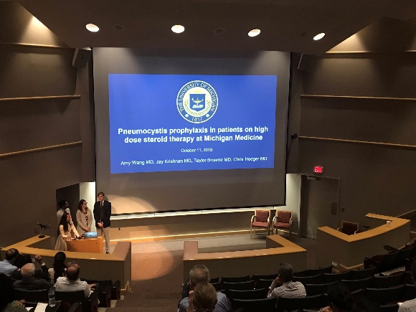

Patient Safety/Quality Improvement Curriculum
Didactic curriculum introduced in HO1 TLS
Longitudinal curriculum in noon conference throughout the year
Ambulatory Block Rotation in HO2 year
  Dedicated time complete team based patient safety project
  Mentored by expert faculty
  Present your results at the end of the month-long rotation (some presented at Grand Rounds)
  Projects have led to University health system changes and scholarly work
Notes:
Identify, develop and execute a patient safety project

Slide 14
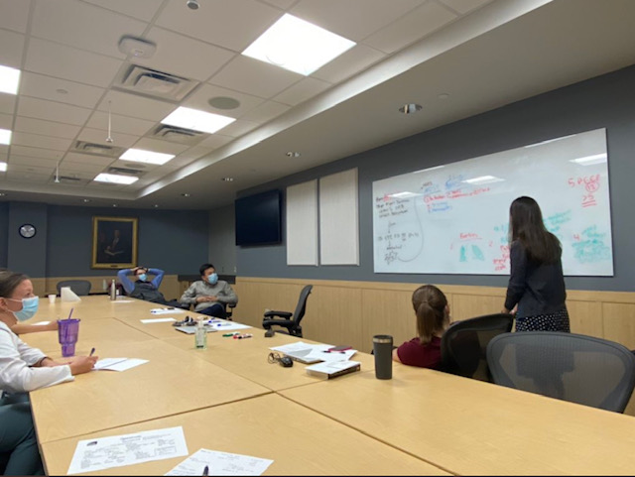
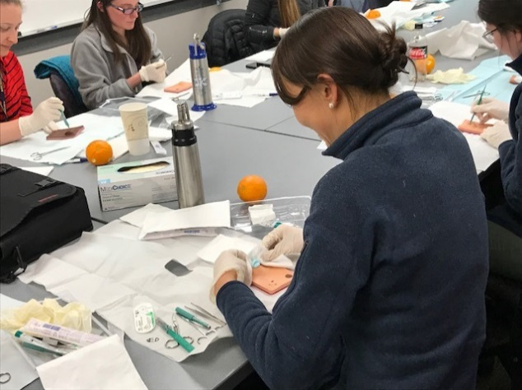
Ambulatory Academic Half Days aka, “TLS”-Teaching and Learning Seminars
Evidence-based Medicine
Patient Safety Curriculum
Teaching to Teach Curriculum
Musculoskeletal Exams/Sports Medicine
Topic-focused small group learning in womens’ health, substance use disorder, and endocrinology
Communication Curriculum (Vital Talk)
Wound care management and dermatology procedures
Implicit bias/microaggressions curriculum.

Slide 15









Outpatient Clinical Electives
Sports Medicine
Women’s Health
Care of Underserved
Geriatrics
Pain
Hematology Bone Marrow Transplant
Cardiology
Electrophysiology
Rheumatology
Endocrinology
Allergy
Nephrology
Gastroenterology
Hepatology
Pulmonary
Infectious Diseasese
Oncology
VA Primary Care
LGBTQIA+ health
Notes:
and finally this is a list of some of the outpatient clinic electives you can choose during your time here. These electives are delivered over a two week period to time and they span across a variety of disciplines. We also have the opportunity to creat a custom elective so if there is an area of medicine or experience that you want to participate in that isn't listed or offered routinely, you can create a custom elective and have that approved as well. the electives provide a way to have a well-balanced view of a potential career you are interested in. For example, if you're interested in doing cardiology you want to see what that specialty looks like in the inpt setting and will see that for example on your ward month, your time in the CCU and on the consult service. You'll also want to get a full view of the carerr as a whole and to do that, because a lot of cardiology in addition to a lot of other specialites, is practiced in the outpt setting, you would want to consider electing an outpt cariology elective as well. I also want to highlight the care of the underserved elective rotation...

Slide 16

Underserved Elective

Slide 17
Women’s Health Elective
Monday | Tuesday | Wednesday | Thursday | Friday
Minimally Invasive Clinic | General OB/Gyn | VA General Women’s Health | Vulvar Clinic | Urogynecology
Urogynecology | Reading/Admin | General OB/Gyn | Colposcopy Clinic
Notes:
We also wanted to highlight the women’s health elective. While many residents rotate through women’s health during their ambulatory rotation, those with a strong interest in women’s health can choose to do a dedicated 2 week outpatient elective in this topic. During the rotation, residents rotate with our colleagues in OB/GYN to get more exposure to a variety of clinical conditions pertinent to women’s health.

Slide 18

Demographics

Slide 19
Primary Care Track
Care of the Population
Care of the Patient
Care of the Panel
Open to all categorical internal medicine residents.
1st year similar for all interns in the program except for a 2-week Primary Care Block early in the year + 2 ambulatory blocks.
2nd and 3rd years have Primary Care blocks + 4 ambulatory blocks and increased time in outpatient electives.
Core rotations in outpatient clinical domains relevant to primary care (ie, Chronic Pain, Women’s Health, Sports Medicine etc.)
Protected time for review of articles relevant to Primary Care, panel management, research.

Slide 20

Primary Care Track
Care of the Population
Care of the Patient
Care of the Panel
All HO3s participate in the General Medicine Faculty Journal Club.
Quarterly activities within the track with faculty and residents.
Ability to customize blocks based on preferences (Underserved, Contraceptive Management, Joint Injection Training, etc.).
Each resident in the track gets matched with a research advisor from the Institute for Healthcare Policy and Innovation (IHPI)
Second year residents in the track have funding available to attend the national SGIM meeting to present their work.
See Dr. Collier if you are interested in further details.

Slide 21
