Slide 1
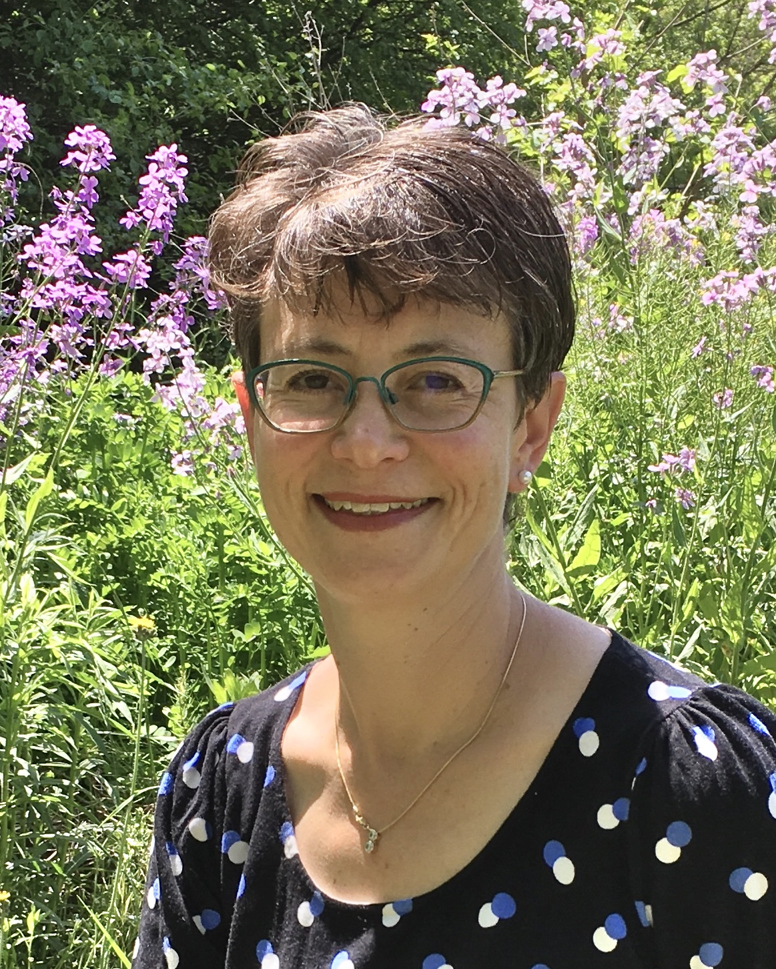



Career Development
Dr. Rachel Perlman
Associate Director, IM Residency Program
Nephrologist

Slide 2

Career Development: Objectives
Selecting career goals
Achieving those goals
Professional development

Slide 3

Career Development
Selecting a career path
Preparing to make informed choices regarding your career directions by the end of residency
  Exposure to subspecialty and general services
  Elective rotations
  Interactions with Faculty

Slide 4

Mentoring at Michigan
  Regular meetings with Program Directors
  Mentoring relationships with faculty member
    Research mentor
    Senior house staff and fellows
    A faculty member with similar clinical interests

Slide 5

Career Development
Achieving your goals
  Preparing for fellowship
  Clinical opportunities
  Research projects
  Expert faculty in many domains
  Sessions with Fellowship Program Directors and Fellows

Slide 6


Career Development
What else does this mean?
Professional & personal development including life long learning & the capacity for work-life balance

Slide 7

Wellness (not just for patients!)
Promote the holistic well-being of our residents
        Physical
        Mental
        Family/Social
        Professional

Slide 8

Wellness
Resident Wellness Committee
Dedicated time off for appointments
U of M Internists in a practice setting
Curriculum (mindfulness, stress management, nutrition, burnout)
House officer mental health
Resources for parents

Slide 9
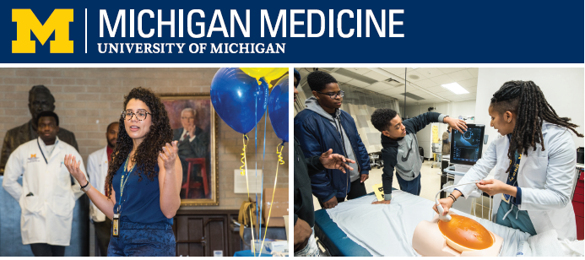

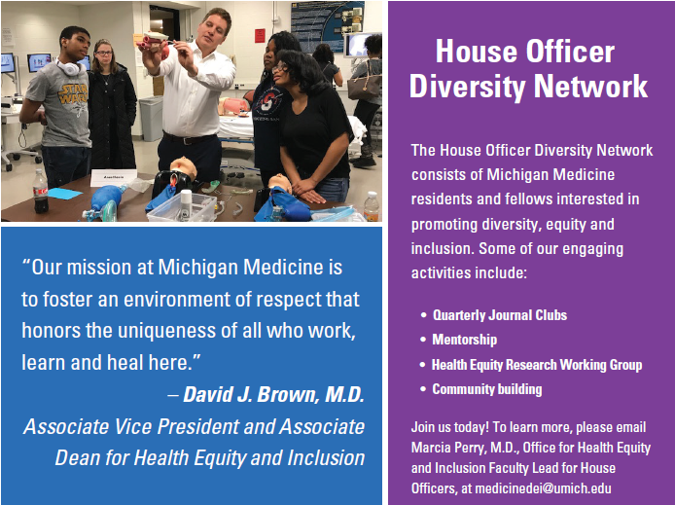

House Officer Diversity Network GROUP E-MAIL
houseofficerdiversity@umich.edu

Slide 10

Professional Development
Professional Development
  Understanding certification & licensure
  Debt management & financial planning
  Billing/coding

Slide 11

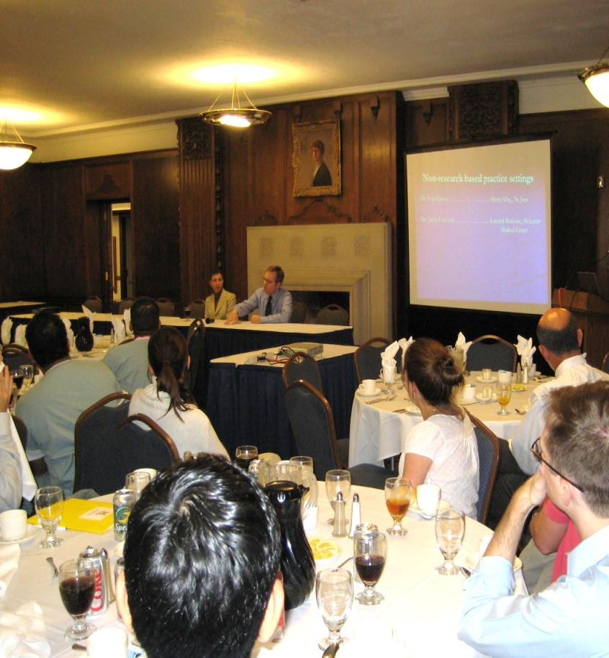
Class Retreats
Curriculum
HO I: Leadership
HO II: Careers in Academic Medicine, Applying for fellowship
HO III-IV: Non-traditional careers, Contracts, Malpractice, Lifelong professional development

Slide 12

Unique Rotations
Infection Control
International Health
Urogynecology
Hospital Administration
Bone Marrow Transplant
Sleep Medicine
Sports Medicine
Alternative Medicine
Medical Spanish
Health Policy
Radiology
Palliative Care
County Health Department

Slide 13


GME Level Tracks
Healthcare Administration Track
Community of Medical Educators in Training
CoMET
20m experience for house officers interested in pursuing healthcare administration to prepare graduates for leadership positions.
Multi-disciplinary med ed fellowship covering topics and research principles, to train future educators, leaders, and scholars.

Slide 14


Fellowship Positions 2005-2022
(Cardiology)
Barnes-Jewish Hospital (3)
Baylor College (3)
Beaumont Hospital (7)
Beth Israel Deaconess (4)
Case Western Reserve (2)
Cleveland Clinic (1)
Columbia University (1)
Cornell University (2)
Duke University (1)
Emory University (3)
Georgetown University (2)
Henry Ford Hospital (7)
Indiana University (5)
Kaiser Permanente – LA (1)
Loyola University (2)
Mayo Clinic (2)
Mt. Sinai (1)
Northwestern University (3)
NY Presbyterian (Cornell) (2)
Ohio State University (8)
Oregon Health Sciences Univ (3)
Penn State University (1)
Rush University (2)
Scripps Clinic (La Jolla) (1)
Spectrum Hlth/Mich State Univ (2)
Stanford University (1)
Texas Heart Institute (1)
Thomas Jefferson University (1)
University of California – LA (1)
University of California – SD (1)
University of Chicago (5)
University of Colorado (5)
University of Iowa (1)
University of Kentucky (2)
University of Michigan (35)
University of Minnesota (1)
University of North Carolina (2)
University of Pennsylvania (2)
University of Pittsburg (8)
University of Rochester (1)
University of Tennessee (1)
UT Houston (4)
UT Southwestern (4)
University of Utah (2)
University of Washington (6)
Vanderbilt University (1)
Washington Hospital Center (2)

Slide 15






Fellowship Positions 2005-2022
(Gastroenterology)
Brigham and Women's (1)
Case Western Univ (1)
Columbia University (1)
Henry Ford Health System (9)
Johns Hopkins Hospital (1)
Lehigh Valley Hospital (1)
Mass General (2)
Mayo Clinic (2)
Medical College of WI (1)
Memorial Sloan-Kettering (1)
Methodist Hospital (1)
NMDNJ (1)
Northwestern Univ (2)
Rush University (1)
Scripps Clinic, La Jolla (1)
Temple University (1)
Tufts Medical Center (2)
UC – Los Angeles (1)
UC – San Diego (2)
University of Chicago (1)
University of Colorado (2)
University of Illinois - Chicago (2)
University of Massachusetts (1)
University of Michigan (32)
University of North Carolina (2)
University of Pittsburgh (3)
University of Southern California (2)
University of Texas Southwestern (3)
University of Virginia (2)
University of Washington (2)
Vanderbilt (1)
Wayne State University (1)
Yale (1)

Slide 16
Fellowship Positions 2005-2022
Pulmonary and Critical Care
Barnes-Jewish Hospital (2)
Columbia University (1)
Northeastern Ohio University (3)
Northwestern University (1)
Ohio State University (1)
Univ of California Los Angeles (1)
Univ of California SF (1)
University of Chicago (1)
University of Colorado (2)
University of Illinois (1)
University of Miami (1)
University of Michigan (16)
University of Missouri (1)
University of Pennsylvania (2)
University of Pittsburgh (5)
University of Texas (1)
University of Washington (2)
Yale (1)
Nephrology
Case Western (1)
Duke University (1)
University of Cincinnati (1)
University of Michigan (7)
University of Wisconsin (1)
Vanderbilt University (1)
Infectious Disease
Beth Israel Deaconess (1)
Duke University (1)
Massachusetts Gen Hospital (1)
Northwestern University (1)
Ohio State University (1)
Rush Presbyterian Chicago (1)
Stanford University (1)
University of Colorado (1)
University of Michigan (9)
University of North Carolina (1)
University of Pittsburgh (1)
University of Washington (2)
Hematology/Oncology
Beaumont Hospital (1)
Beth Israel Deaconess (1)
Cornell/Presbyterian (1)
Duke University (2)
Medical College of Wisconsin (1)
Memorial-Sloan Kettering (3)
Mt. Sinai (1)
Northeastern Ohio Univ (1)
Northwestern University (1)
Ohio State University (3)
Unive of California San Diego (1)
University of Chicago (2)
University of Michigan (27)
University of Minnesota (1)
University of North Carolina (1)
University of Pennsylvania (2)
University of Pittsburgh (3)
University of South Florida (1)
University of Texas (3)
University of Washington (2)
Wayne State University (1)
Wright State University (1)
Yale (1)

Slide 17
Additional Fellowships
Allergy and Immunology
Henry Ford Hospital (1)
Loyola University (1)
Northwestern (1)
Scripps Memorial Hospital (1)
University of Michigan (4)
University of North Carolina (2)
UT Southwest (1)
Endocrine
Cleveland Clinic (1)
Cornell University (1)
Mass General Hospital (1)
University of Miami (1)
University of Michigan (12)
University of Myanmar (1)
University of Washington (1)
Pediatric Genetics
University of Michigan (1)
Behavioral Pediatrics
University of Chicago (1)
Palliative Care
Medical College of Wisconsin (1)
University of North Carolina (1)
University of Michigan (1)
Sports Medicine
Cleveland Clinic (1)
Providence Hospital (1)
University of Michigan (1)
Rheumatology
Cleveland Clinic (1)
Case Western – Peds (1)
Johns Hopkins (1)
NYU (1)
University of Michigan (8)
Wayne State University (1)
Geriatrics
Beth Israel Deaconess (1)
University of Michigan (6)
UT Southwestern (1)
General Medicine Fellowships (5)
Robert Wood Johnson (UCLA, MI)
Cleveland VA (QI Scholar)
Johns Hopkins Greenwall Ethics
Public Policy
Bioethics and Public Policy
Johns Hopkins University
Heath Services Research
University of Michigan (1)
Global Health-Hospital Medicine
University of California - UCSF (1)

Slide 18
Fellowship Positions 2022
Allergy
University of North Carolina
Cardiology
Duke University
Emory University
Henry Ford Hospital
Rush University (2)
Spectrum Health (2)
University of Colorado
University of Iowa
University of Michigan (3)
University of Texas – Dallas
University of Texas – Houston
Endocrine
University of Michigan
Gastroenterology
Henry Ford Hospital
Mayo Clinic
Memorial Sloan-Kettering
University of Michigan (4)
Hematology/Oncology
University of Michigan (4)
University of Southern Florida
Infectious Diseases
University of Pittsburgh
Pulmonary/Critical Care
Northwestern University
University of Michigan (2)

Slide 19

Gen Med/Hospitalist
(2005-2022)
Hospitalist (Some one year positions)
University of Michigan Academic
University of Minnesota
Brigham and Women's (BWH) Academic
University of Washington Academic
McLaren Medical Center Academic (MSU)
Henry Ford Health Systems
St. Joseph Health Systems
Northwestern University
Massachusetts General (MGH)
Emory University
Martha Jefferson (Charlottesville, VA)
(private practice group)
Charlevoix Area (private practice group)
QE2 Jubilee (Australia government practice)
Munson Medical Center (Traverse City, MI)
California Pacific Medical Center
UCLA
UCSD
Duke University
University of Arizona
University of Rochester
Outpatient General Medicine
University of Michigan Academic
Duke University Academic
Lahey Clinic Academic
University of Michigan Student Health Services
Medical College of Wisconsin
Haab Clinic, Ypsilanti, MI
UK General Practicioner
Vanderbilt Academic Group
Inpt./Outpt. Mixed General Medicine
Ann Arbor VA Academic
Northern Navajo Medical Center - IHS
Oakwood Hospital Academic
Michigan Medical Primary Care, Holland MI
(private practice group)
Warwick Internists, RI (private practice group)
Internal Medicine Associates, Lexington KY
Advantage Health, Grand Rapids MI

