Slide 1
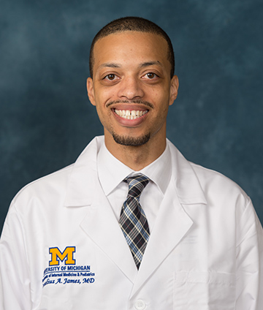

Diversity, Equity and Inclusion
Cornelius A. James, MD
Associate Program Director, Internal Medicine Residency

Slide 2

Mission
The U-M Internal Medicine Residency Program is committed to providing world-class training in an environment that values the experiences, characteristics, backgrounds, and opinions of every individual. Our residents, faculty and staff will be representative of the populations we serve, while exemplifying cultural humility, as we lead efforts to ensure that health care is equitable for all.

Slide 3
Relationships
IM Residency Program
U-M
Department of IM
Michigan Medicine
University of Michigan
National (ACGME, ABIM, etc.)

Slide 4

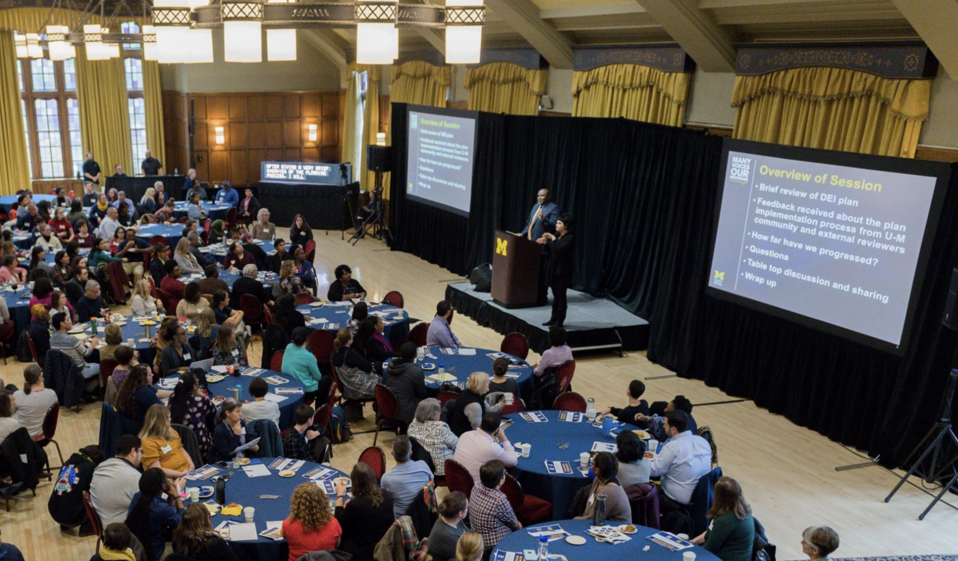
Office of Diversity, Equity, and Inclusion
  Institutional Initiatives
  From DEI 1.0 to DEI 2.0
  Chief Diversity Officer

Slide 5

Office of Health Equity and Inclusion (OHEI)
  Associate Vice President and Associate Dean for Health Equity and Inclusion
  Pre-college, undergraduate, medical students, house officer, faculty programs
  Health Equity and Quality Scholars Program (HEQSP)

Slide 6
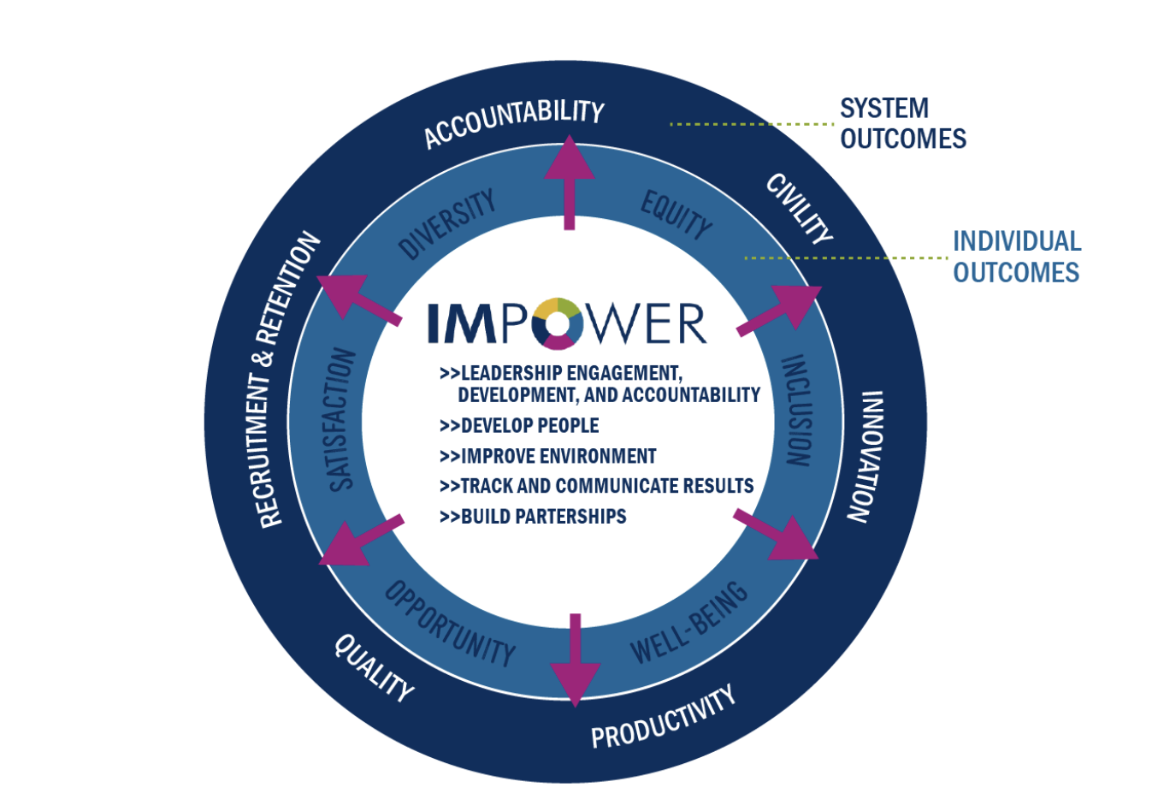
Department of Internal Medicine
Diversity, Equity, Inclusion, and Well-Being
  Vice Chair, DEI & Well-Being
  Inspiring Medicine to Promote Opportunities for Well-Being, Equity, and Diversity (IMPOWER)
  DEI Medicine Grand Rounds

Slide 7
U-M Internal Medicine Residency Program
Current Activities
  DEI Committee
  Equal Medicine
  Residents and Fellows for Global Health Health Equity
  Caring for the underserved
  Maternity/Paternity Policies
  Lactation Policies
IM Residency Program
U-M
Department of IM
Michigan Medicine
University of Michigan
National (ACGME, ABIM, etc.)

Slide 8
Resident DEI Committee
Specific Initiatives
  Anti-Racist Book Club
  Addressing Bias in Medical Student Evaluations
  Bias in PSQI Projects
  Compassion Rounds
  Implicit and Structural Bias Curriculum
  LGBTQ+ Allies
  Purchase of pronoun pins

Slide 9
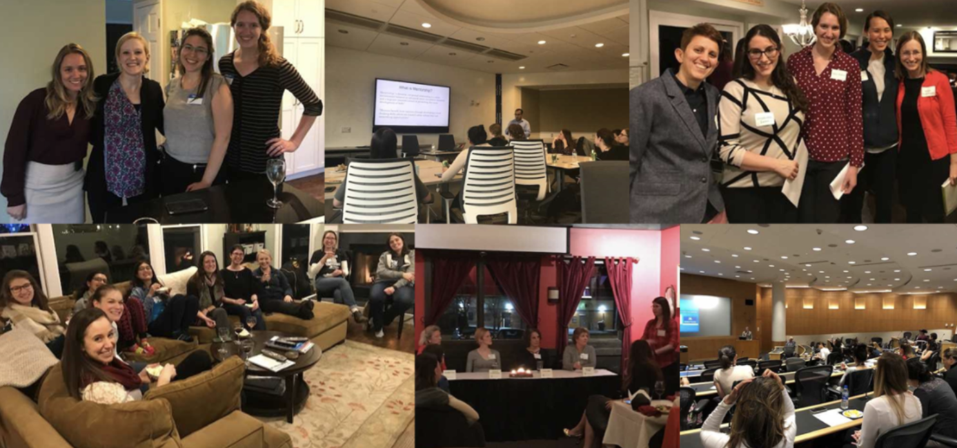
Equal Medicine
Addressing Gender Disparities in Medicine
  Founded in 2017
  Formal curricular programming
  Mentorship, career development

Slide 10
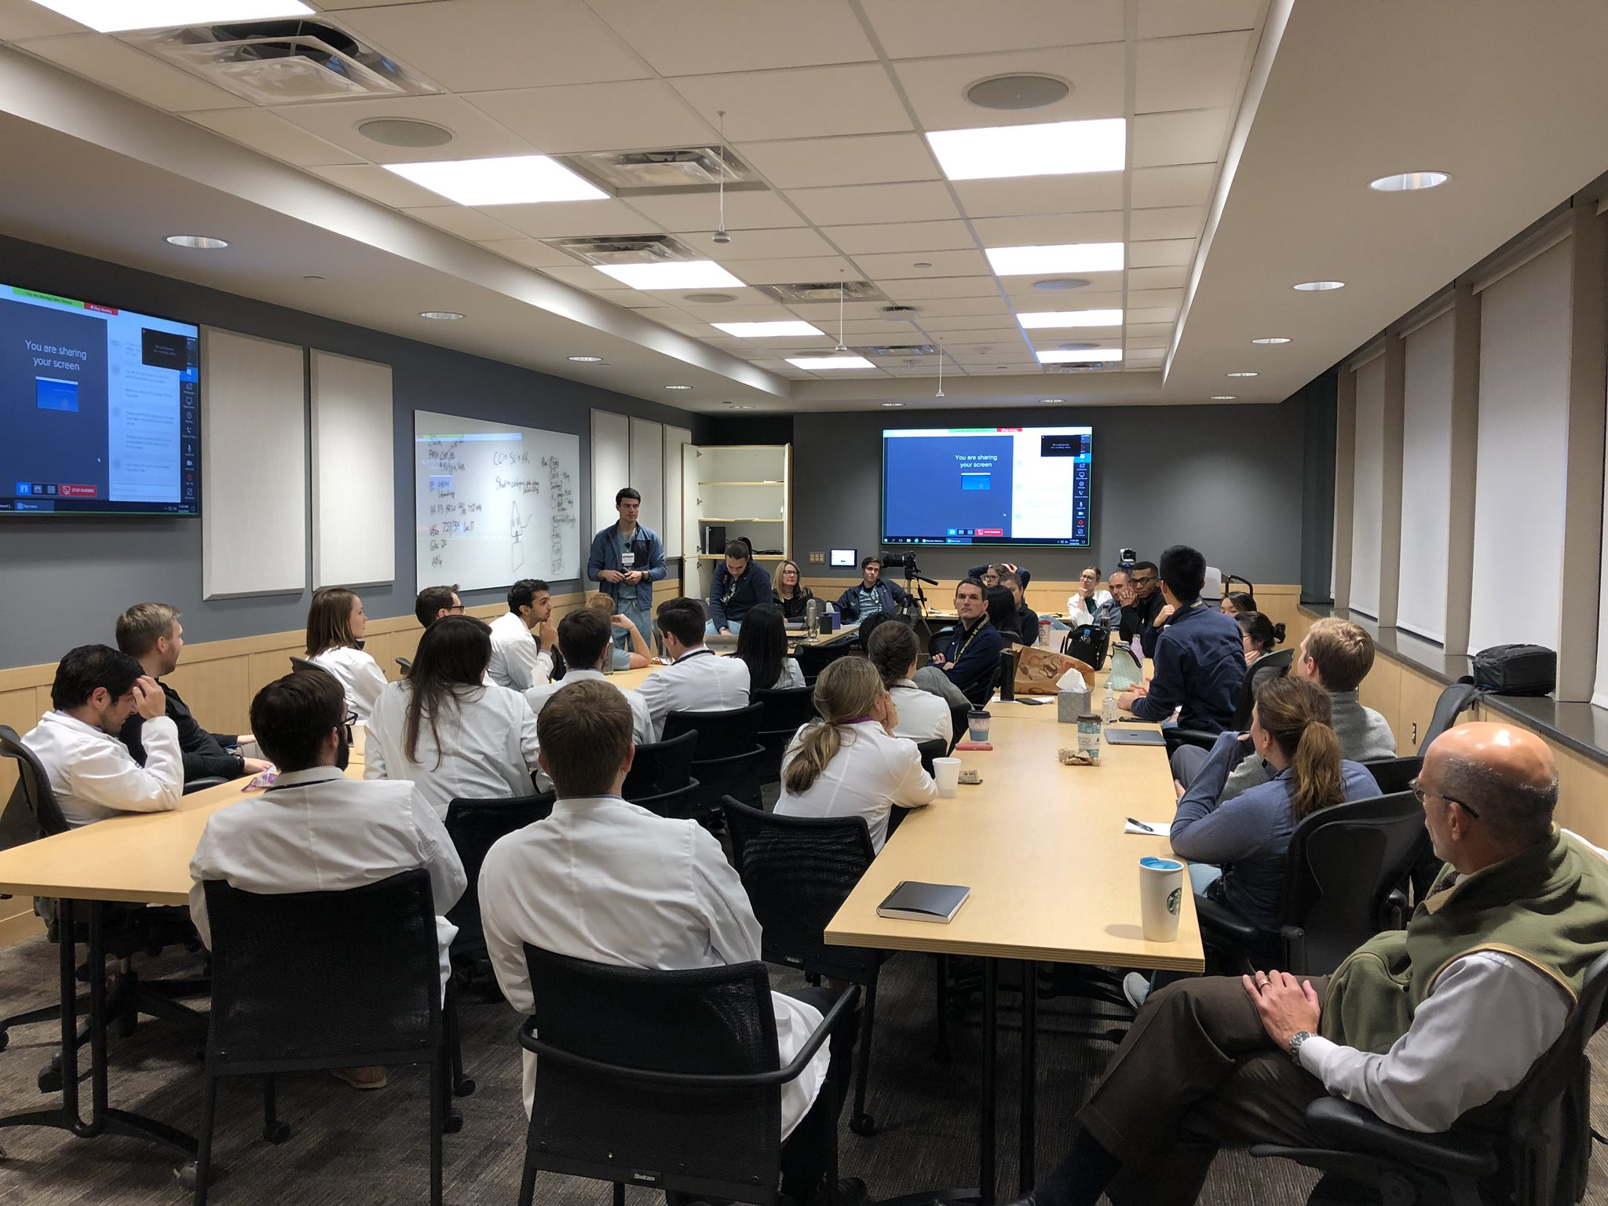
Curriculum
Didactics and Clinical Experiences
  Diverse population of patients
  Morning reports and noon conferences
  Implicit and structural bias curriculum
  Underserved Electives

Slide 11
Committed to Caring for the Underserved
  Hamilton Clinic (Flint, MI)
  Hope Clinic (Westland, MI)
  Rural Health Elective (Cadillac, MI)
  Women’s Correctional Facility (Ypsilanti, MI)
  Chass Clinic (Detroit, MI)
  ACT Rotation (Ann Arbor, MI)
  Delonis Clinic (Ann Arbor, MI)
  Packard Health (Ann Arbor, MI)
  U-M Student Run Free Clinic (Pinckney, MI)
  Wolverine Street Medicine (Detroit, MI)
  Migrant Farm Clinic (Adrian, MI)
  Food Gatherers (Ann Arbor, MI)

Slide 12
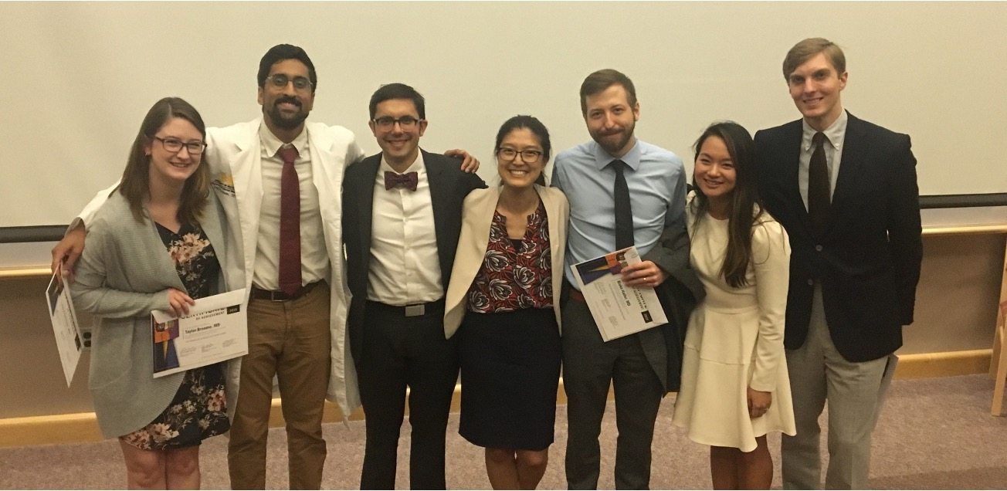
Scholarly Activity
Funding Opportunities
  GME Innovations Grant
  Center for Research on Learning and Teaching
  Phyllis M. Blackman Innovation Grants to Promote DEI

Slide 13
