Slide 1


Introduction to Inpatient Training
Sarah Hartley MD
Associate Program Director
Hospitalist

Slide 2


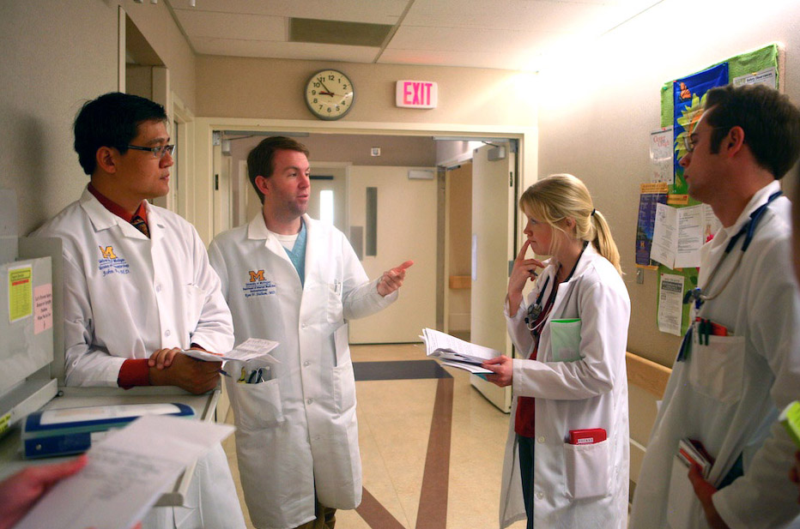
Inpatient Training Program
Inpatient Training Environment
Unique Aspects of our Inpatient Structure and Schedules
Focus on Education

Slide 3
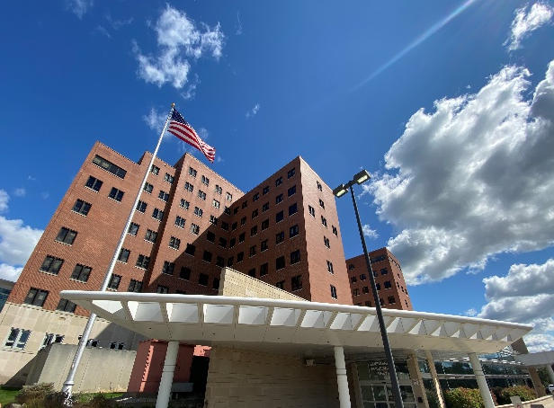
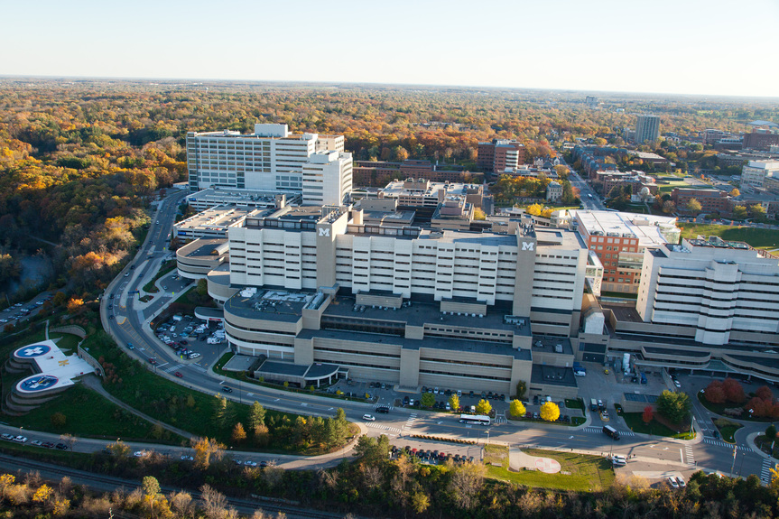
Department of Internal Medicine Inpatient Training Environment
VA Ann Arbor Healthcare System
University of Michigan Hospital
VA referral center for entire region, also serves the local veteran community
Broad general medicine exposure (including ICU) and care for underserved patients
Tertiary referral center (Michigan, Northern Ohio, Indiana) but also a community hospital for Ann Arbor and surrounding areas
Focused sub-specialty services combined with broad general medicine exposure

Slide 4
Inpatient Training Program
Inpatient Training Environment
Unique Aspects of our Inpatient Structure and Schedules
Focus on Education

Slide 5

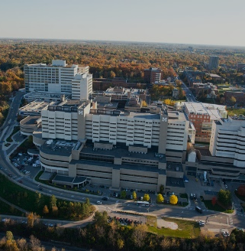
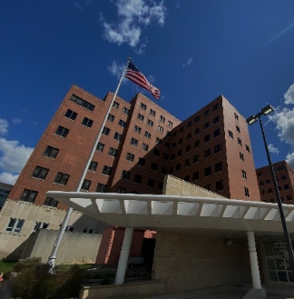
Inpatient Service Model
Guiding Principal: The optimal inpatient experience includes specialty experiences balanced with general medicine and critical care exposure
UH
GM Wards
Specialty Services (GI / Liver, Heme / Onc, Cardiology)
ICU Services (Medical ICU, Cardiac ICU)
Hospitalist Service (Senior Residents)
VA
GM Wards
ICU (Senior Residents)

Slide 6

Maintaining a Focus on Education:
Key Elements
Maximize Time for Education
Optimal Patient Exposure and Workload
Innovative Patient Care Technology

Slide 7
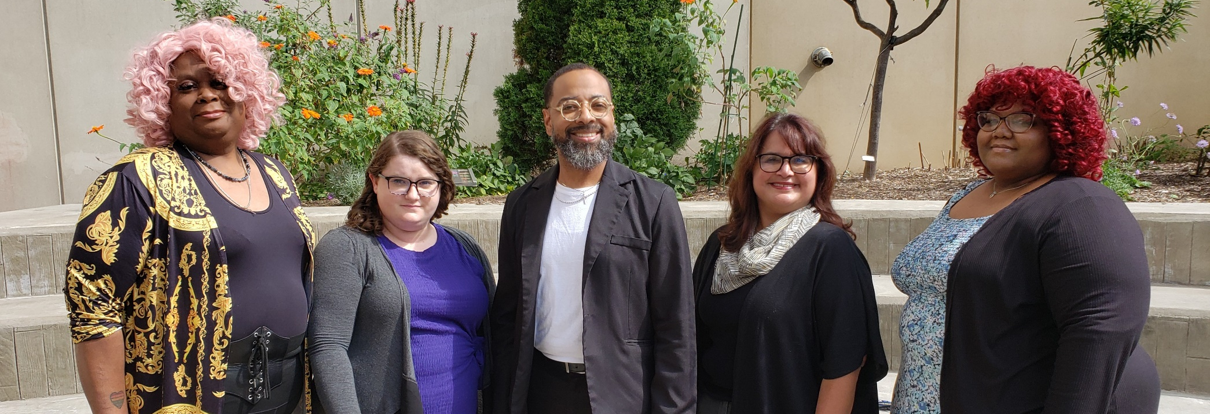
Maximizing Time for Education
Resident Assistant Program – designed to help teams with non-medical patient care tasks
At U of M each service has a resident assistant that performs clerical and other support tasks for the team
At the VA a care coordinator rounds with each team to assist with similar support tasks and a focus on transition to the outpatient setting

Slide 8

Maximizing Time for Education
Inpatient Service Caps designed around education
Admission and Census Caps: determined based on educational goals in terms of patient exposure
Intern census cap = 8 patients
Intern admissions = 5 per day or night shift
Average daily census for interns typically ~5-6 patients
Senior admission and team census caps in place as well

Slide 9


Creating Optimal Patient Exposure and Workload:
Non-resident Services
MFH - Medicine Faculty Hospitalist Service
  Currently 120+ faculty member with 24/7 coverage
  Take admission pagers after the resident teams have their designated number of admissions
Hospital Medicine/ACE unit at St. Joes
Chelsea Community Hospital
Two Medicine Short Stay Units
VA Hospital – Non-resident Hospitalist Service (“Blue Medicine”)
Bone Marrow Transplantation NP-PA Service
Cardiac Procedures/Chest Pain NP-PA Service
Hematology/Chemotherapy PA Service
Heart Transplantation NP-PA Service
Pulmonary/Transplant NP-PA Service

Slide 10

Patient Care Technology
University Hospital
  MiChart: EPIC based w/ mobile access
VA Hospital
  CPRS – nationwide integrated system
Inpatient teams carry phones to help coordinate care
Online resources / mobile apps

Slide 11

Inpatient Services: Basic Structure
Day team + Night Team Model
  Call days are and night rotations are 12 hour shifts
Night teams
  Intern + Senior: CCMU, Cardiology, Heme/Onc, GI/Liver
  Senior only: General Medicine
  Senior + Fellow: CCU, VA MICU
Direct attending contact for night float in all ICUs, cardiology and GI/liver service
Notes:
.

Slide 12


Three Year Overview
Rotation | HO 1 | HO 2 | HO 3
Inpatient Wards and ICU | 26-28 weeks* | 16-18 weeks* | 16-18 weeks*
Electives | 8-10 weeks | 12-14 weeks | 12-14 weeks
Ambulatory Blocks | 4-8 weeks* | 4-8 weeks* | 4-8 weeks*
Night Team | 4 weeks | 4-6 weeks | 4-6 weeks
Research | -- | 4 weeks | 4 weeks
Other |  | Emergency Medicine (2 wk) | Geriatrics (2 wk)
Vacation | 4 weeks + 5 days during winter holidays | 4 weeks + 5 days during winter holidays | 4 weeks + 5 days during winter holidays
*Primary Care Track may vary

Slide 13

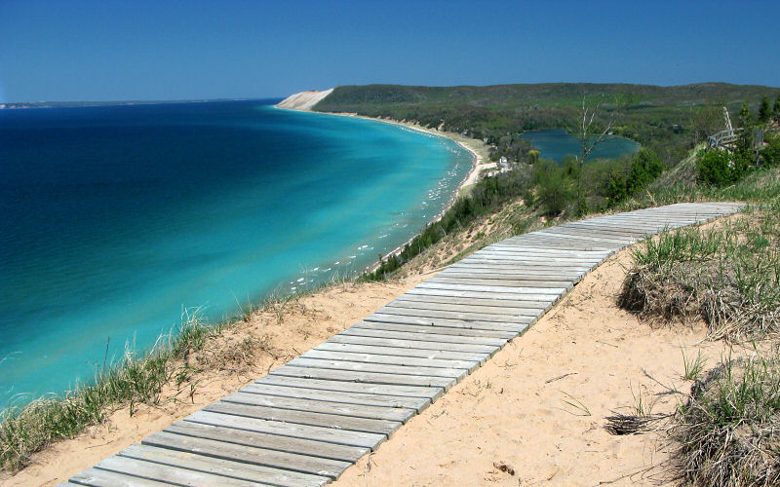


Pictured Rocks, Lake Superior
Empire Bluffs, Lake Michigan
Jordan River Valley, Northern Michigan
The Mackinac Bridge

