Slide 1


Becoming a Clinician Educator

Slide 2
Developing Skills:
Clinical Teaching and Medical Education
Why is it important ?
  30-60% of medical student knowledge results from interaction with resident physicians
  25% of resident time is devoted to teaching
  Residents are enthusiastic in their role as clinical teachers but often feel that they lack the skills and support to flourish
  Many U of M residents intend to pursue careers in academic medicine and identify involvement in medical education as a long term career goal

Slide 3
Medical Education Opportunities
Teaching to Teach Lectures during TLS
Topics covered:
  Developing teaching scripts
  How to give (and receive) high quality feedback
  Incorporating evidence-based medicine into your teaching
Notes:
We incorporate med ed into our curriculum in two ways. The first is through lectures on med ed topics during the Thursday learning sessions during the ambulatory rotation. Topics that have been presented in the past include developing strong teaching scripts, giving effective feedback and incorporating EBM into teaching.

Slide 4
Medical Education Opportunities
Medical Education Elective
  Two week elective focused on developing clinical teaching skills
    Work with different levels of learners (M1-M4, interns) in various teaching environment (small group didactics, leading case conferences and physical exam rounds)
    Work with M2s during Transition to Clerkships
    Work with M4s during their Residency Prep Course

Slide 5
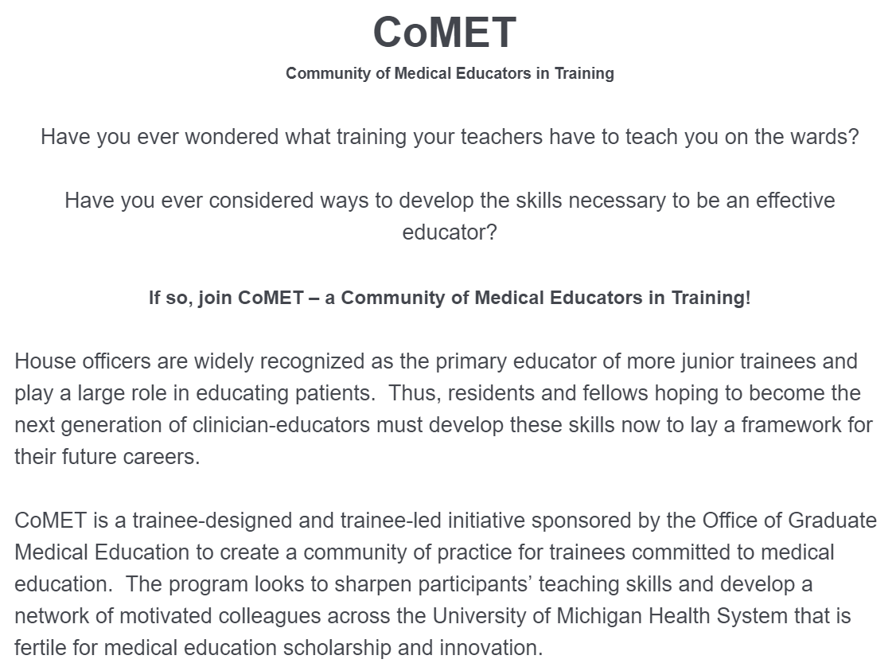
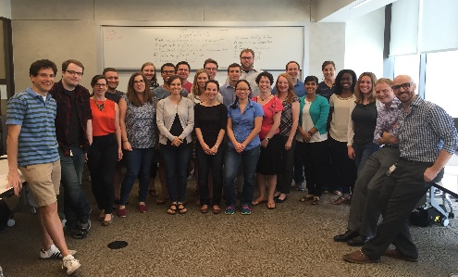
CoMET
Community of Medical Educators in Training

Slide 6
The Team,
The Team,
The TeaM.

