Slide 1


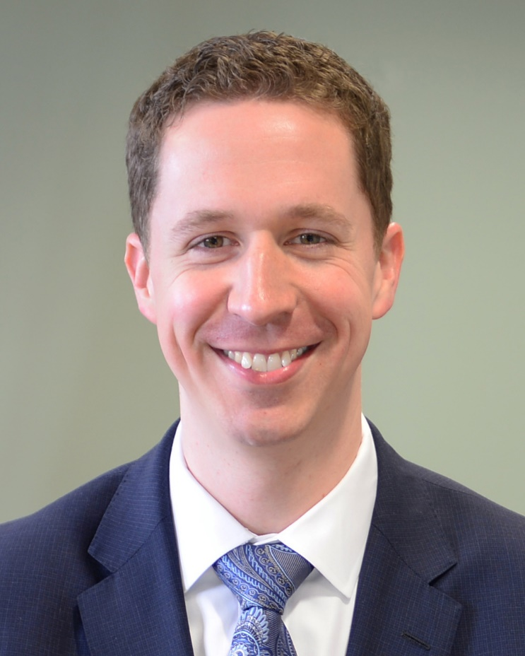



University of Michigan Internal Medicine Residency
Patient Safety and Quality Improvement
Learning Program
Nathan Houchens, MD
Associate Chief of Medicine | VA Ann Arbor Healthcare System
Associate Professor of Medicine | University of Michigan
Assistant Program Director | Internal Medicine Residency
Director | Patient Safety and Quality Improvement Learning Program
Katie Grzyb
Continuous Improvement Specialist
Lead | GME Patient Safety and Quality Improvement
Continuous Improvement Specialist | Quality & Innovation Program
Department of Internal Medicine | University of Michigan
@UM_IntMedPSQI
Notes:
Hi there and welcome to the University of Michigan Internal Medicine Residency Patient Safety and Quality Improvement Learning Program. My name is Nathan Houchens, I’m an assistant program director for the residency, and I’m the director of the safety and quality curriculum. I wanted to spend a few minutes talking about what makes learning PSQI at the University of Michigan innovative and special.

Slide 2
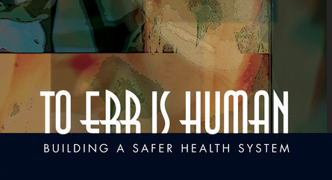
Notes:
In 1999, the Institute of Medicine released a seminal work titled “To Err is Human.” This report revealed details about the US healthcare system and brought the issues of medical errors and patient safety to the forefront.
44-98K preventable deaths from medical errors per year
2% of hospitalized patients experience major permanent injury or death due to medical care
8th leading cause of death in the US
$17-29 billion dollars
90% were due to failures in faulty systems or processes of care rather than negligence

Slide 3
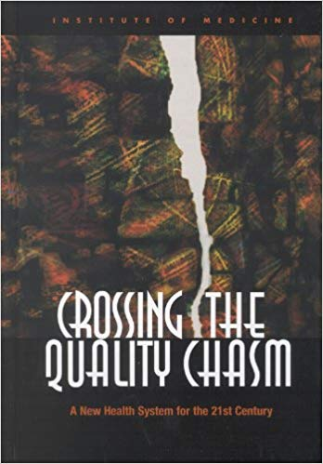
Notes:
In follow up, two years later, “Crossing the Quality Chasm” was published. This quote stands out: “The American health care delivery system is in need of fundamental change. The current care systems cannot do the job. Trying harder will not work: Changing systems of care will.”
The report outlined the necessary components of high-quality healthcare:
Safe: Avoiding injuries to patients
Effective: Providing care based on scientific knowledge
Patient-centered: Providing respectful and responsive care that ensures that patient values guide clinical decisions
Timely: Reducing waits for both recipients and providers of care
Efficient: Avoiding waste
Equitable: Ensuring that quality of care does not vary because of characteristics such as gender, ethnicity, socioeconomic status, or geographic location

Slide 4
“The American healthcare delivery system is in need of fundamental change. The current care systems cannot do the job. Trying harder will not work: Changing systems of care will.”
Notes:
In follow up, two years later, “Crossing the Quality Chasm” was published. This quote stands out: “The American health care delivery system is in need of fundamental change. The current care systems cannot do the job. Trying harder will not work: Changing systems of care will.”
The report outlined the necessary components of high-quality healthcare:
Safe: Avoiding injuries to patients
Effective: Providing care based on scientific knowledge
Patient-centered: Providing respectful and responsive care that ensures that patient values guide clinical decisions
Timely: Reducing waits for both recipients and providers of care
Efficient: Avoiding waste
Equitable: Ensuring that quality of care does not vary because of characteristics such as gender, ethnicity, socioeconomic status, or geographic location

Slide 5
Since Then…
An explosion of interest and focus:
  Organizations, educational offerings, journals, and roles
A deficit in medical education in safety and quality
Residents are at the frontline of patient encounters
Funding from a grant to develop the PSQI learning program initiative
Notes:
Since these two IOM reports, there has been an explosion of interest and focus on PSQI as a field.
Organizations: Institute for Healthcare Improvement, VA National Center for Patient Safety
Education: Masters programs in Healthcare Quality & Safety
Journals: BMJ Quality & Safety, the Joint Commission Journal on Quality and Patient Safety
Roles: Chief Quality Officer, Chief Patient Safety Officer
During the early 2000s, it became clear that there was a deficit in medical education surrounding the topics of PS and QI. And yet, for Michigan Medicine, this learning is absolutely paramount, given that residents are taking direct care of patients and their families. Indeed, our residents are poised to first identify opportunities to improve safety and quality… therefore, in 2006, our residency obtained a funded grant to develop the PSQI initiative with two clear goals in mind…

Slide 6
Goals of the PSQI Initiative
Equip frontline residents with foundational tools to understand patient safety and quality improvement
View daily patient care through a new lens
    Improving work ~ doing work
    Focus on systems and processes
Foster a culture of safety and continuous quality improvement
Notes:
Goals of the PSQI curriculum:
equip frontline residents with foundational tools to understand PS and QI
view daily individual patient care through a new lens
Some may describe this as… improving the way work is done is just as important as doing the work
We focus on improving systems and processes that will support all healthcare providers
At Michigan Medicine, we foster a culture of safety and continuous quality improvement

Slide 7

PSQI Curricular Innovation
Partnered with the Department of Internal Medicine Quality & Innovation Program
Developed a novel curricular method aligning PSQI resident group project work with institutional goals
Experts in engineering and continuous quality improvement embedded into groups
Notes:
In 2016, the internal medicine residency PSQI learning program partnered with the Department of Internal Medicine’s Quality & Innovation Program to improve the safety and quality curriculum. We sought to combine efforts by aligning resident group projects with institutional goals and initiatives.
To cultivate this partnership, engineering experts were embedded as co-facilitators into PGY2 resident groups. Some of the benefits they bring include:
Weekly educational modules
Focus on lean methods and A3 thinking
Access to institutional data, resources, and connections with other similar projects
Longitudinal emphasis on scholarly activity
End-of-rotation presentation assistance (using A3s to communicate)

Slide 8

Support Provided by Continuous Improvement Team
Program Development
  Course Objectives • Evaluation Surveys • Curriculum Development and Maintenance
  Annual Facilitators meeting and PDCA • Alignment with Quality Department
PGY1 Sessions
Education on QI tools
Post-project support
Updating content to align with Quality Department and High Reliability training
PGY2 Project Support
Fellowships
Data requests
Attend meetings
Supporting development of formal QI curriculums across departments
Medical Students
Sub-I QI project rotation support with Hospital Medicine, as needed
Ambulatory Resident Module
Supporting updates to QI and Panel Management didactic video and A3
Assistance with A3 documents
Connections
Additional Support Services
  Poster or Abstract Development • Data Requests • General Consultation
  Travel Award • Grand Rounds
Notes:
The ongoing support provided by the Continuous Improvement team’s partnership is demonstrated on this slide.
Our team continues to assist in developing the program, as we go through our own cycles of PDCA (or plan, do, check, act) and make sure that our efforts are in alignment with the larger Quality Department at Michigan Medicine.
We also continue to partner with residents in supporting their ongoing quality improvement and patient safety work, as shown at the bottom of this slide. This may include preparations for scholarly work or conferences, additional data needs, and general consultation or connections to resources required.

Slide 9
Overview of the Longitudinal PSQI Curriculum
PGY1
Foundational interactive sessions
PGY2
Team-based safety & quality projects
(ambulatory rotation)
PGY3
Resident-driven opportunities for participation in safety & quality activities
Notes:
Here is an overview of the longitudinal PSQI curriculum you can expect.
In the PGY1 year, foundational interactive sessions are facilitated by content experts and leaders in the field. In these sessions, small groups of residents discuss real-world case examples to take a deep dive into key techniques and tools used in PSQI projects (e.g., root cause analysis, using process flow mapping to identify waste in systems).
In the PGY2 year, small groups of residents have protected, dedicated time to work together with faculty facilitators to choose a real-world challenge and use PSQI tools to investigate and alleviate it. The key steps for each group include:
Describe the background and current state
Obtain and interpret baseline data
Formulate a problem statement and specific, measurable, time-bound goals
Conduct a thorough analysis of the root causes of the identified problem
Propose and implement interventions with clearly defined follow-up plans
Engage in CQI through Plan-Do-Check-Act cycles
At the conclusion of the PGY2 rotation, each group gives a presentation to the residents and residency leadership to discuss their findings, using the A3 document as a communication tool.
In the PGY3 year, interested residents have the opportunity to build upon these concepts by participating in additional PSQI activities that align with their career interests and professional goals.

Slide 10


HO2 Project Month Titles: Academic Year 2021-2022
Block 1
Block 2
Block 3
Block 4
Block 5
Block 6
Examining the Outside Hospital Transfer Process
Penicillin Allergies: Demystifying the Delabeling Process
No More Urgent Secure Chats
Too Little, Too Late: Diuresis Delays at the AAVA
Dude, Where’s My Code? Reforming the VA Code Announcement System
Make It or Break It: Improving Osteoporosis Screening Rates at Michigan Medicine
Block 7
Block 8
Block 9
Block 10
Block 11
Block 12
Don’t Let It Be, Screen for HCC!
Do not GoLytely into that good endoscopy suite, get your CRC screening
Entrusting our PCPs with Entresto
Cardiology Discharge Follow-Up For Patients Admitted to Gen Med: Bridging the Gap
Inequity and Moral Distress due to COVID-19 Visitor Policies
Gun Safety Screening (actual title TBD)
11 out of 12 project had “impact” through an implemented intervention, a completed PDCA cycle, presentation or publication of work, continuation of the project past the end of the rotation, and/or connection to a division / department / system priority.
Notes:
Here is a listing of the various projects completed by our talented and dedicated residents for the 2021-2022 academic year.
An incredible 11 out of 12 projects had some form of meaningful impact at the system level!

Slide 11
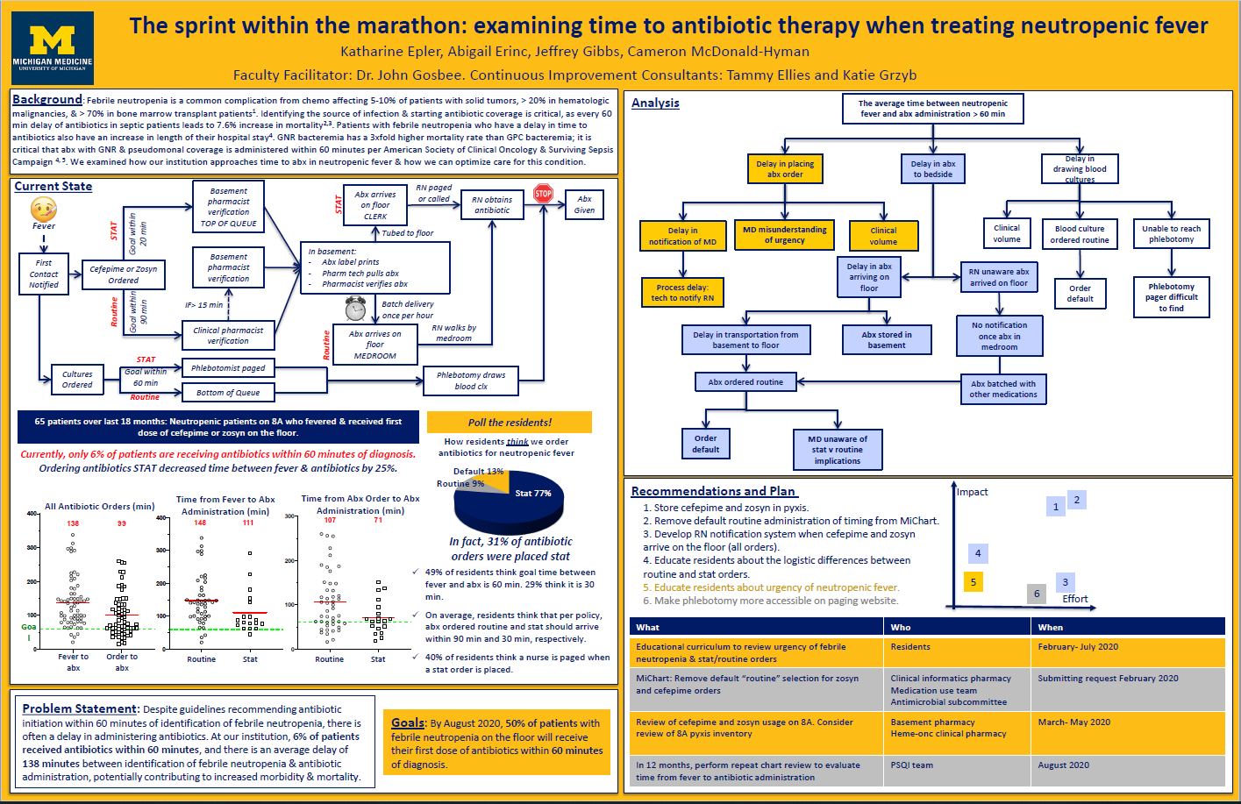
A Sample A3 Document
Notes:
Here is a sample A3 document from a PGY2 resident group at the end of their ambulatory PSQI rotation. No need to pause this video and zoom in until your eyes cross. Rather, note the level of detail, the effort to understand root causes, and the thoughtful approach to recommending high-yield interventions with clear follow-up plans.

Slide 12

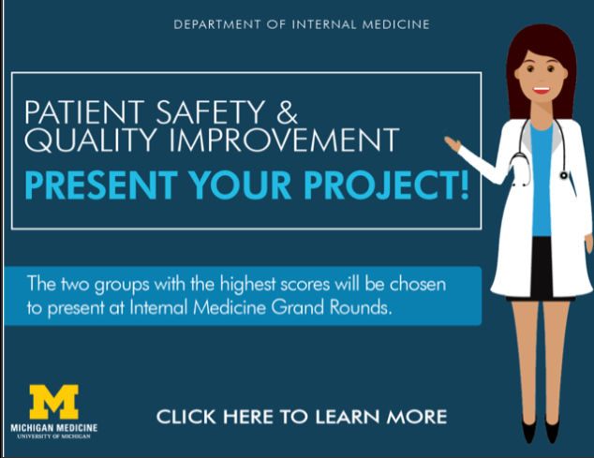

Other Outcomes from the PSQI Learning Program
Notes:
There are a number of other important outcomes for residents:
Nearly all residents indicate that the PSQI learning program concepts are a valuable part of training and relevant and helpful to their future careers.
Residents have produced terrific scholarly work
Society of Hospital Medicine
SGIM
High Value Practice Academic Alliance
Local presentations
Publications
We celebrate the efforts and achievements of our residents. So, at the conclusion of the PGY2 academic year, a panel of experts reviews all groups’ A3 documents and selects the top 2 groups using pre-specified criteria. These groups are invited to present their work in front of the entire Department of Internal Medicine during a special Grand Rounds.

Slide 13
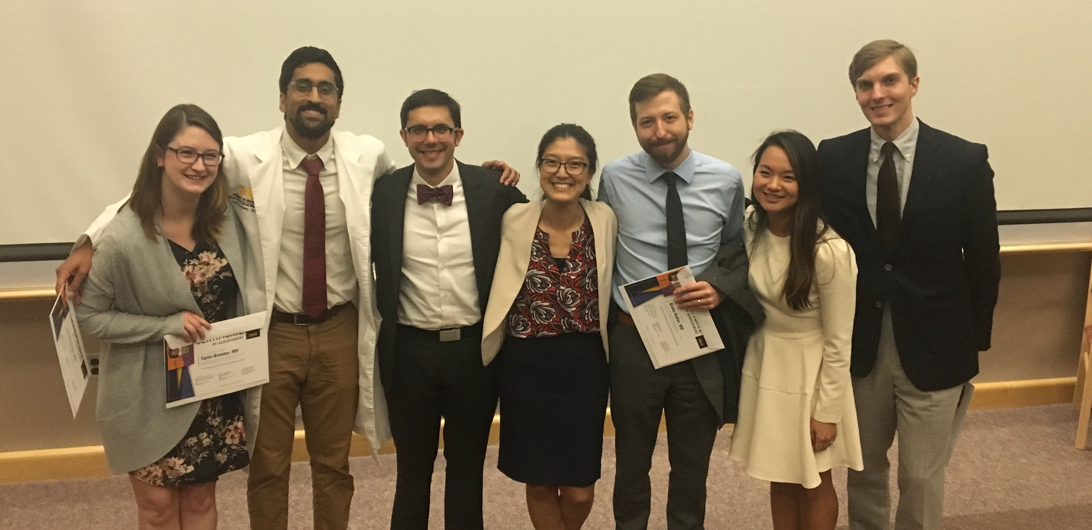
The Bottom Line
Our residents obtain the skills and techniques with which to implement meaningful system changes
Notes:
Our residents obtain the skills and techniques with which to implement meaningful system changes. And they have fun doing it.
Thank you for visiting and for considering Michigan Medicine.

