Slide 1
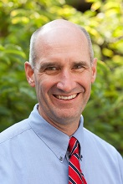

Internal Medicine Residency
Research Program
Kevin R. Flaherty MD, MS
Professor of Internal Medicine
Vice Chair IRB MED
Associate Program Director IM Residency - Research

Slide 2


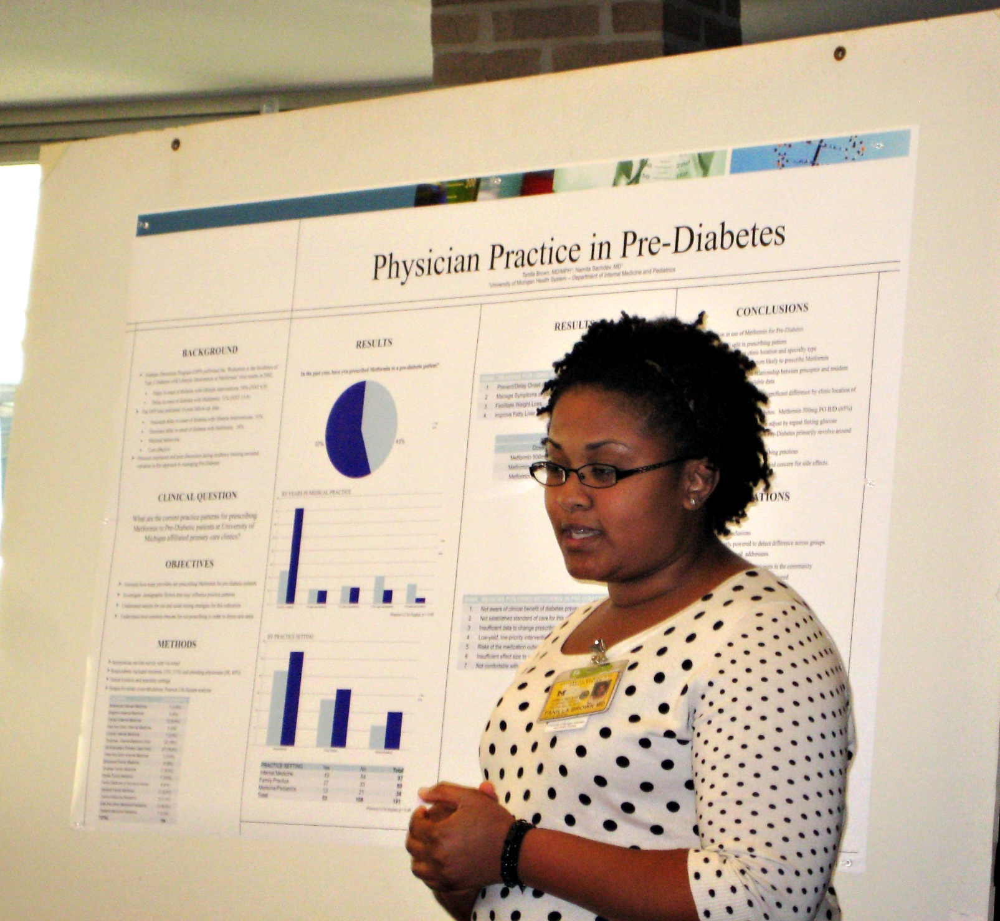
Research During Residency
Appreciate HOW research is conducted
UNDERSTAND scientific methodology
Apply EVIDENCE-BASED thinking
Preparation for next CAREER step
Notes:
A Research project is required during residency – why?

Slide 3


Michigan Research
University of Michigan
~1.71 billion in expenditures FY 2022
973 million in Federally Sponsored Projects FY 2022
Department of Internal Medicine
269 million in federal and non-federal grants in FY 2022
3946+ publications in 2022

Slide 4


Robust Research Environment
Clinical care & teaching provided by faculty actively engaged in research
Broad range of patients referred for specific illnesses
Excellence in basic sciences, clinic research, health outcomes
Discovering the basis for new interventions
Translating new discoveries to the clinical realm
Studying the outcomes of known interventions

Slide 5
Overview
Intern
Research
Retreat
Choose Mentor
Research
Day
HO1
HO2
HO3
Protected
Research
Time
HO II
Retreat
Research
Progress
Protected
Research
Time

Slide 6
Intern Research Retreat
  Finding a mentor
    Resources
    How to choose a good mentor
  Formulating a research question
  Library/Database resources
  Human subjects research (navigating the IRB)
  Resident/fellow panel discussion
  Face time with faculty
Notes:
Intern Report, HO2 retreat, noon conferences

Slide 7
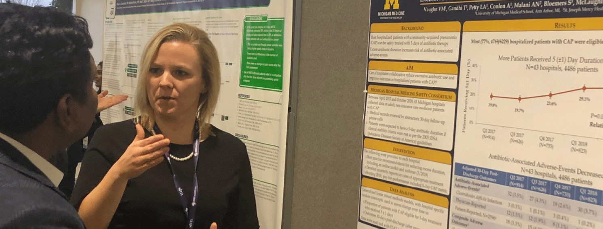
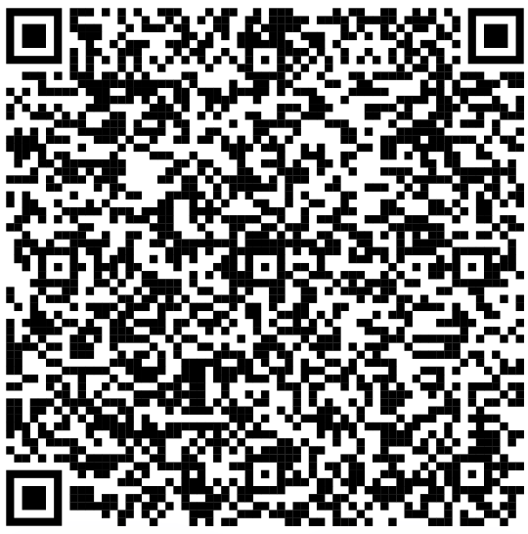
Department Research Days
Link to 2023
Presentations
Poster and slide presentations
Interaction with faculty & other resident researchers

Slide 8
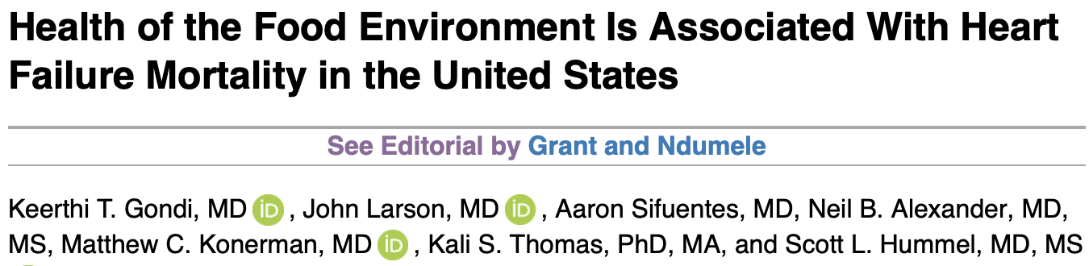
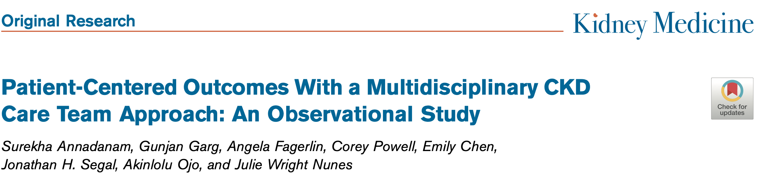
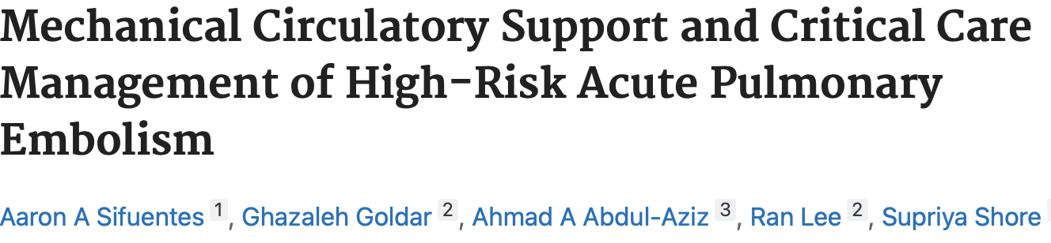

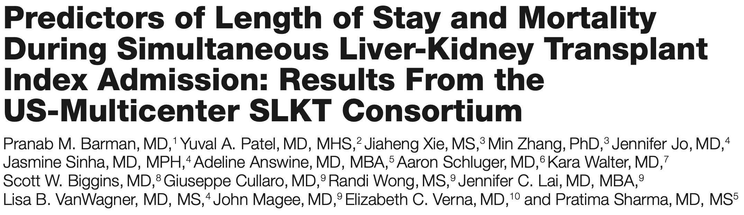
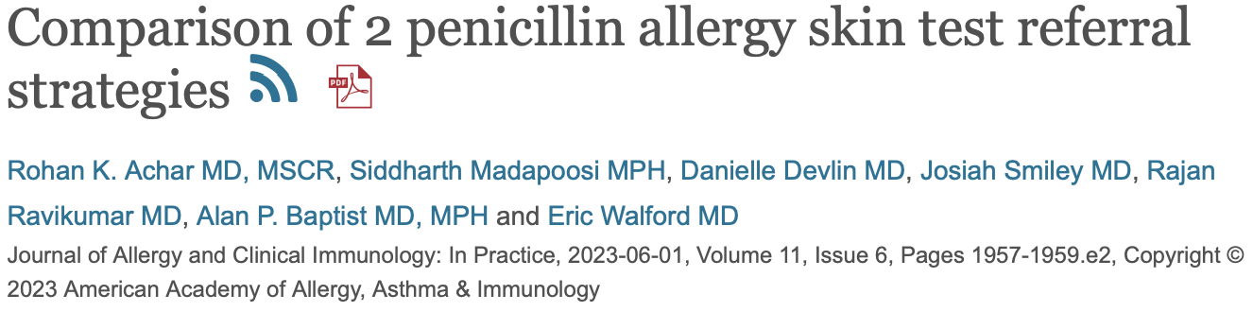
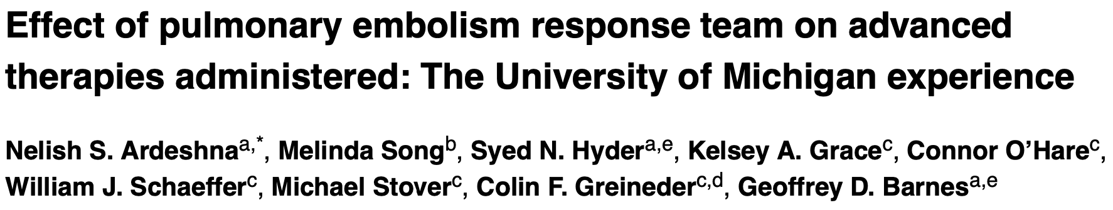
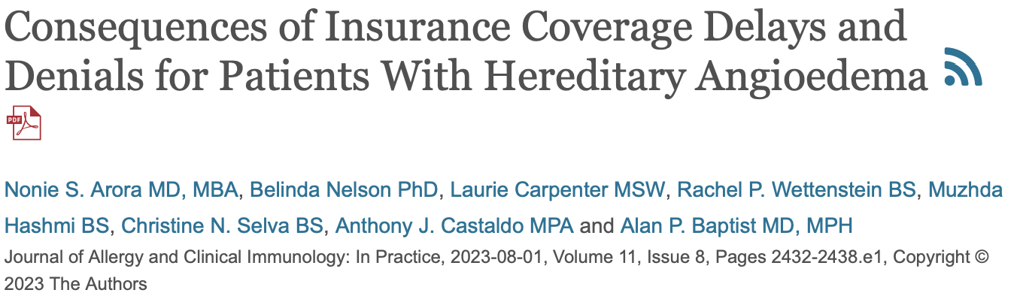
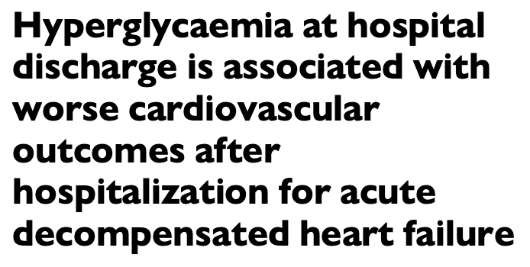
Publication Success

Slide 9
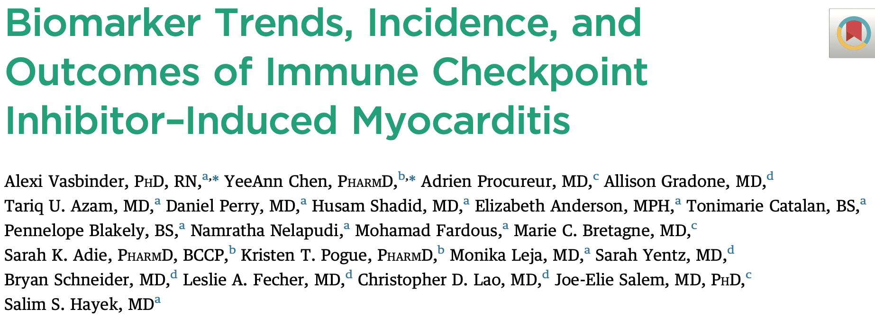
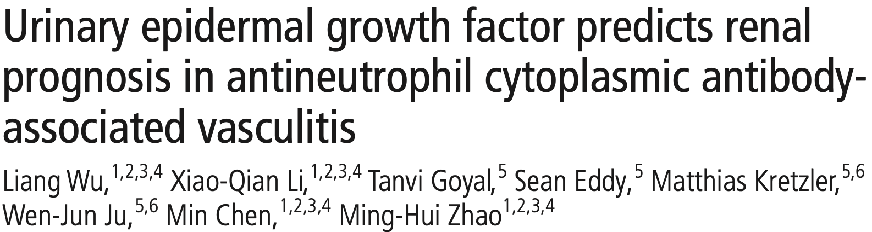
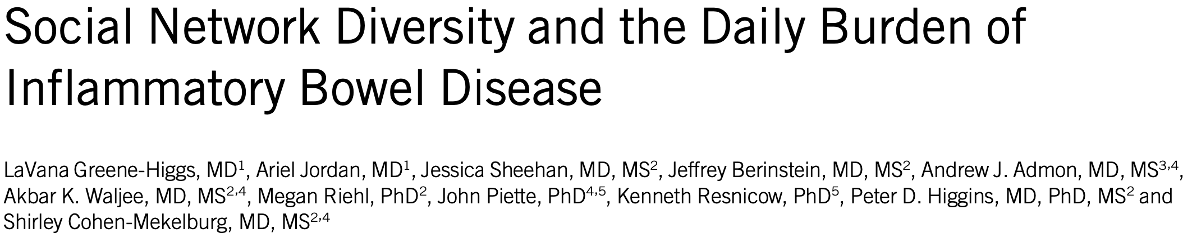
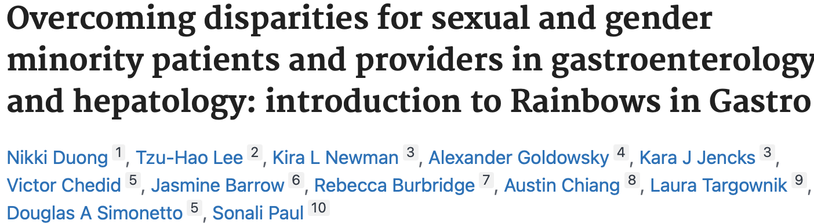
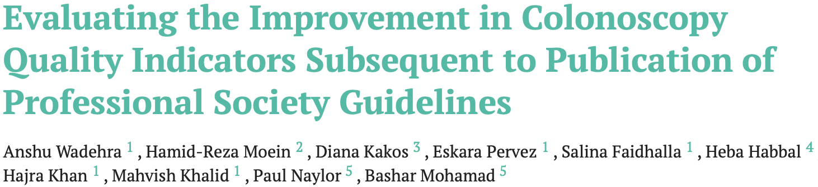
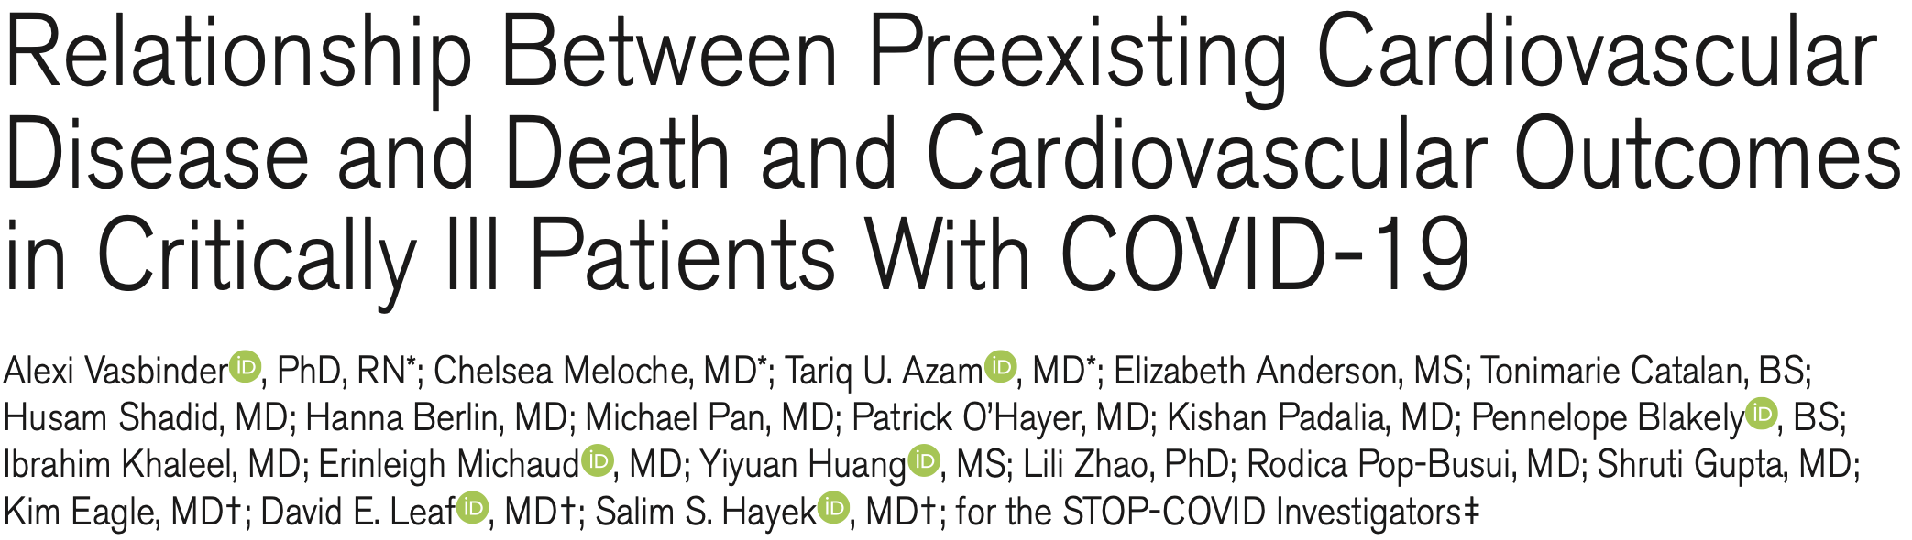
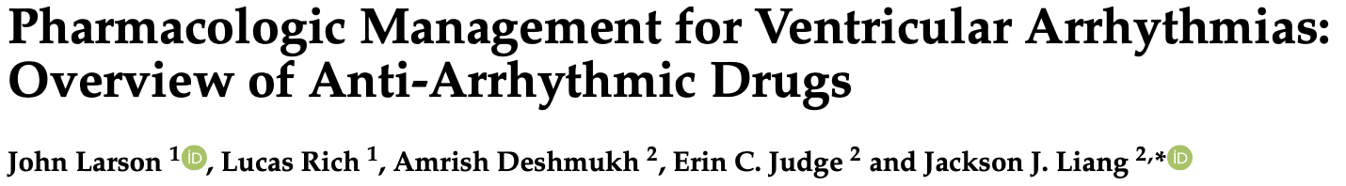
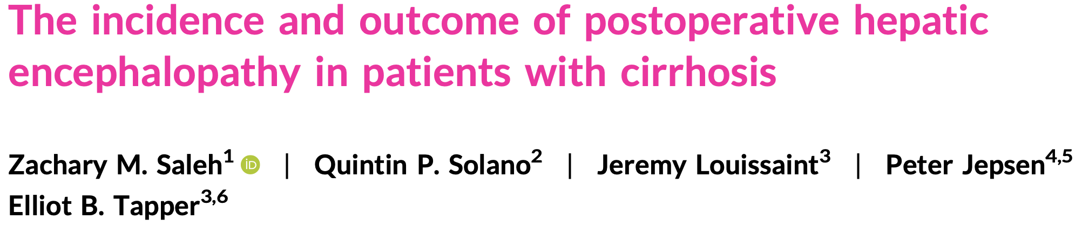
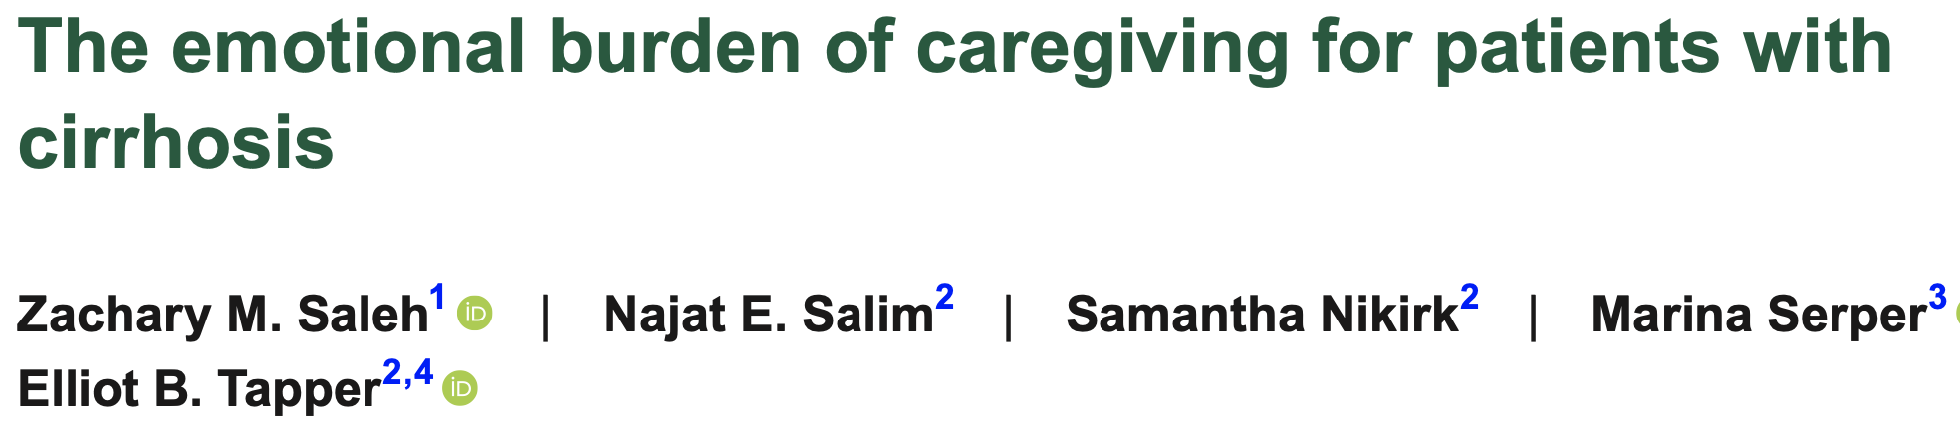
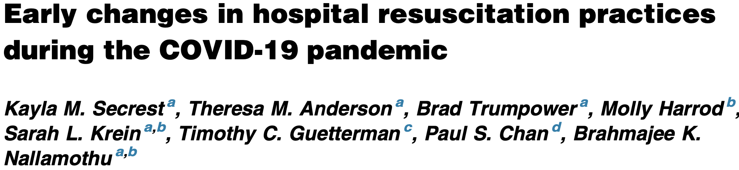

Publication Success

Slide 10
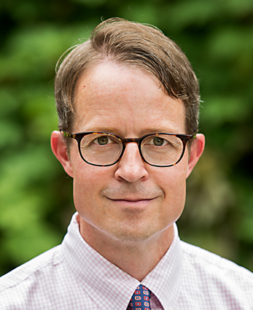
Physician-Scientist Program
Individuals with M.D./Ph.D. or other advanced degrees
“Short-track” into fellowship program in year 3
36 months of protected research training
~20 trainees in program (~4 per class/year) from internship to junior faculty
Individuals add scientific diversity and specialized expertise to the Residency Program

Slide 11
Thank You!!!

