Slide 1





DOWNLOAD
KATA
POWERPOINT SLIDES
Includes IK Card
Includes
5 Videos
For creating your own KATA presentations and training

Slide 2


Slide 3
About These Kata Slides & Graphics
v4.1, March 2016
This collection of Improvement Kata / Coaching Kata slides
is for use by anyone. You can incorporate any of these PowerPoint format slides into your own training and presentations, and adjust them however you like.
Also included are links to five short videos that help make
key points in IK/CK presentations and training. You'll find
many more videos on the IK/CK YouTube channel at www.youtube.com/user/734mike.
Please post your Kata presentations on SlideShare (www.slideshare.net) and on YouTube, so we can learn
from you. Include some keywords like those listed below so other Kata practitioners can find and learn from your efforts!
Suggested keywords: IK, CK, Kata, Improvement Kata, Coaching Kata, Toyota Kata, Scientific Thinking

Slide 4
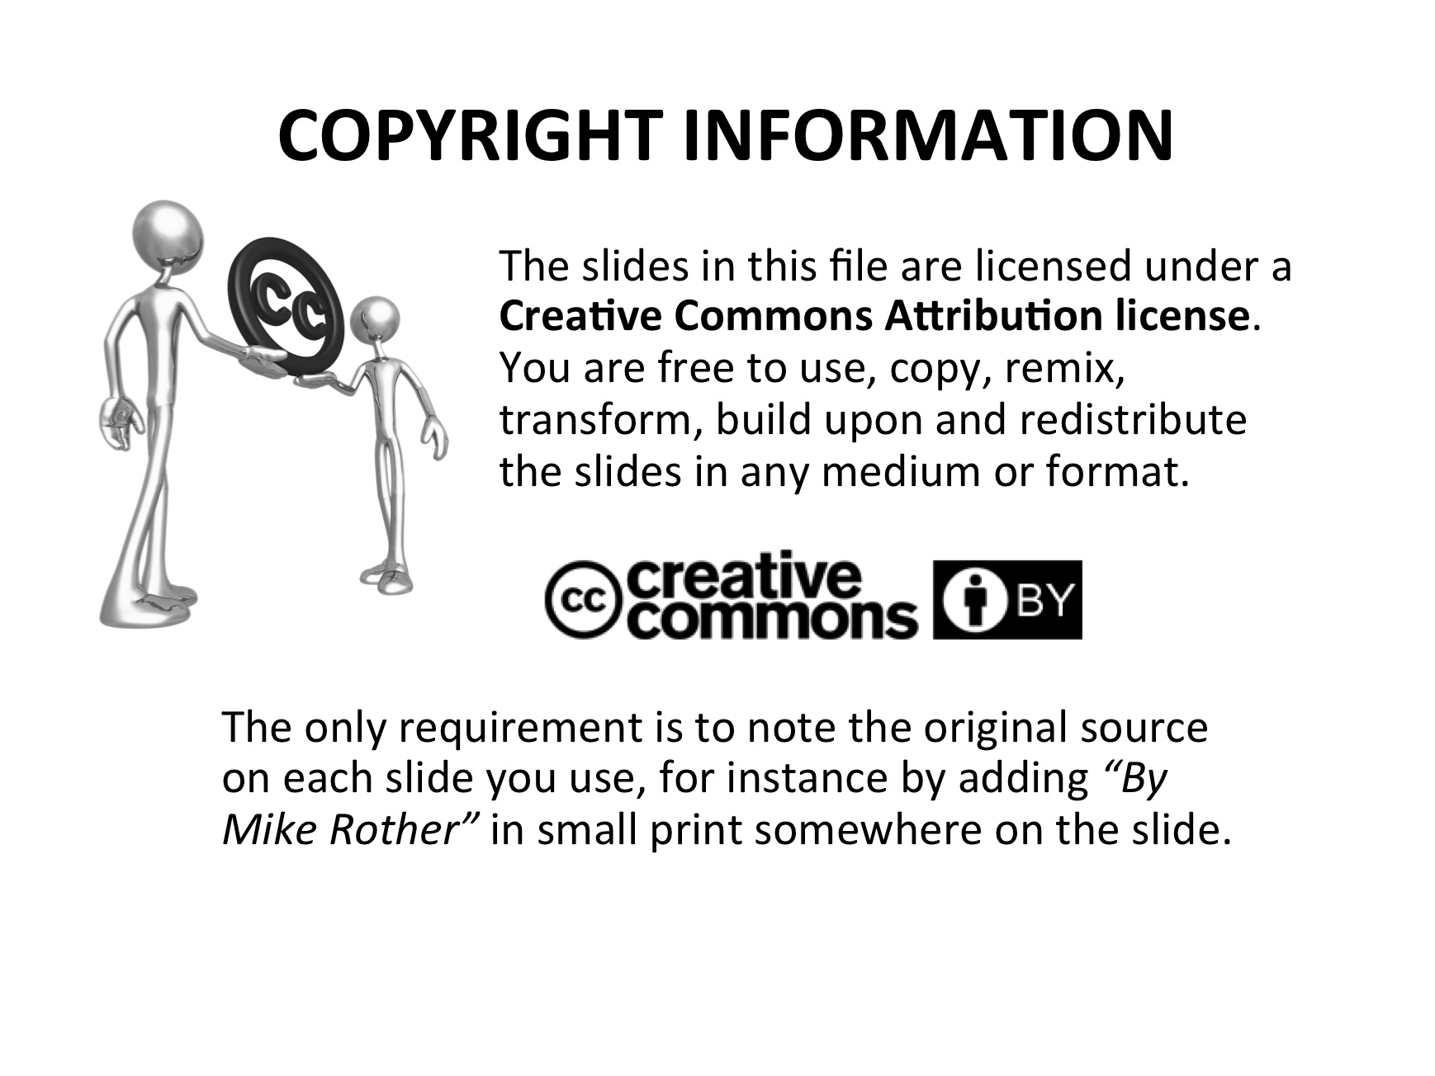

Slide 5
A NOTE ABOUT "KATA"
Kata are structured routines that you practice deliberately, especially at the beginning, so their pattern becomes a habit and leaves you with new abilities. Kata are a way of learning fundamental skills that you can build on. The word comes from the martial arts, where Kata are used to train combatants in fundamental moves. But the idea of a Kata can be applied in a much broader sense. The Improvement Kata and Coaching Kata are for training managers and leaders in a new way of doing their jobs.
At first you should try to practice each Kata exactly as described, until its pattern becomes somewhat automatic and habitual for you. That can take several months of practice. When you reach that point and have learned through practice to understand the "why" behind that Kata's routine, then you can start to deviate from it by evolving your own version or style of the pattern... as long as its core principles remain intact.
Practice Kata to Find Your Way. No one can show you precisely how your management
system should look and function. That would be impossible since each organization has unique characteristics and exists in unique conditions. Developing an organization's managerial system is not about copying the tools and techniques that another organization has come up with, which would be jumping to solutions. You can and should start with some already-existing basics, like in sports and music, but then it's an iterative process of trial and adjustment.
The routines of the Improvement Kata and Coaching Kata help you develop and build your own 21st Century management approach via a well-proven set of "Starter Kata" to practice daily. They come from the Toyota Kata research and have been used for practice at thousands of organizations around the world. Begin with the Starter Kata and then, as you gain skill and understanding, add to or adjust them to fit your situation as needed. Then you’ll be developing your own way.
Best wishes for your practicing!
Mike Rother

Slide 6

Here are the slides →
Remember... it’s about you and your story! Use these slides as some building blocks.

Slide 7

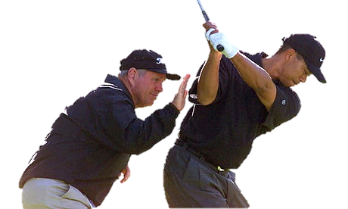
PRACTICING FOUNDATIONAL SKILLS
FOR SCIENTIFIC THINKING
Visible
Lean tools and techniques to improve quality, cost and delivery
A systematic, scientific way of thinking and acting
Managers as the teachers of that way
Less
Visible
What we're focusing on

Slide 8


THE IK & CK GIVE YOU AN EASY WAY
TO PRACTICE SCIENTIFIC THINKING
Scientific thinking is a basis for:
Successfully pursuing seemingly unattainable goals in complex systems
Enabling teams to make decisions close to the action and maneuver effectively
Science + Kata = Problem Solving Skill
The Improvement Kata & Coaching Kata make scientific thinking a skill anyone can learn, by combining a 4-Step scientific pattern + simple, structured routines for practicing the pattern.

Slide 9

WHAT IS
SCIENTIFIC
THINKING?
Scientific thinking is the intentional coordination of theory and
evidence, whereby we encounter new information, interpret it and, if warranted, revise our understanding accordingly. This pattern is in contrast to relying on already-held beliefs to explain causality. Scientific thinking gives us the ability to look beyond our preconceptions and see the world and ourselves in a truer light.
Whatʼs important about scientific thinking is not just whether we decide to revise beliefs based on new information, but that practicing it helps us reshape how we think... moving away from relying on subconscious biases and an artificial sense of certainty. Happily, humans are equipped to think about thinking, which is called “metacognition,” and are able to change how they think through personal experience (practice)!

Slide 10
SCIENTIFIC
THINKING
"Let's try it and see"
Scientific thinking is a routine of intentional coordination between what we think will happen (theory), what actually happens (evidence), and adjusting based on what we learn from the difference.
What we
expect
to happen
What
actually
happened
Learning

Slide 11
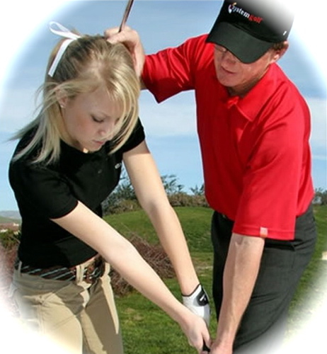

4 INGREDIENTS FOR ACQUIRING NEW SKILLS
Brain research is clear: To develop new habits you should practice new routines and experience a progressive sense of mastering them (which helps generate and maintain enthusiasm). The following ingredients help us rewire our brain (new neural circuits) to acquire new skills & mindset.
k
STARTER
KATA
l
COACHING
Structured routines
for beginners
to practice
fundamentals
Corrective feedback
to ensure the Learner practices the right
patterns
j
m
This is how you do it
FREQUENT
PRACTICE
MASTERY
Growing self efficacy
"I'm getting better at this"
A little every day

Slide 12
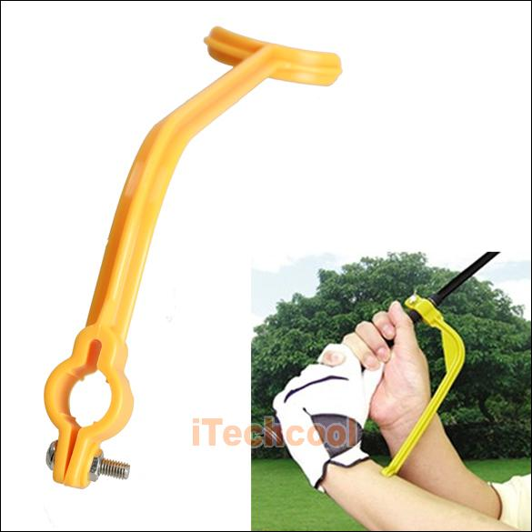
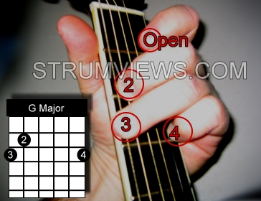
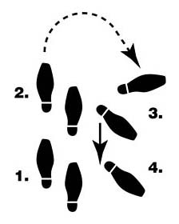
WHAT ARE KATA?
They're practice routines. Kata are structured routines to practice deliberately, especially at the beginning, so their pattern becomes a habit and leaves you with new abilities. Kata are for learning fundamentals that you can build on. Kata are a way of transferring skills and developing shared abilities and mindset in a team or organization.
“Let’s begin by practicing it this way for a while”
Science + Kata = Problem Solving Skill
Combining a scientific pattern with structured practice
routines (Kata) develops effective problem solvers

Slide 13
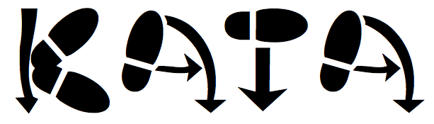
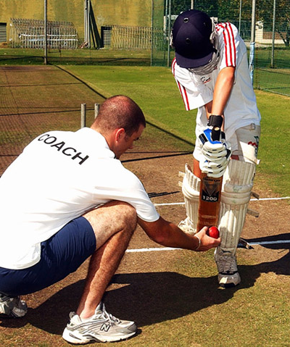
Example of a Kata
“Let’s begin by practicing it this way for a while.”

Slide 14
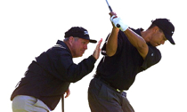

WHAT KATA ARE FOR
The Routines of the Improvement Kata and Coaching Kata
are Practiced to Develop Scientific Mindset
Kata
Practice
To develop foundational
skill and mindset
Beginners should follow Kata exactly; not deviating from them, so the Learner can internalize the patterns. But with increasing proficiency each Learner can start to (within limits) develop their own style.
Likewise, over time each organization can evolve the Kata it began with to better suit and mesh with its culture. The original Kata evolve into organization-specific practice routines.

Slide 15
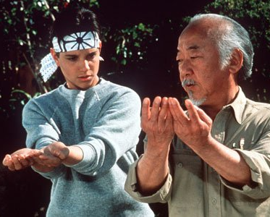
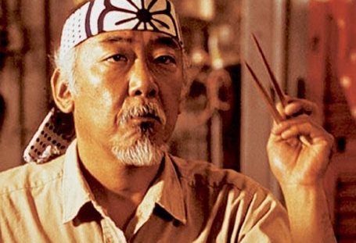
HOW LONG DO YOU PRACTICE RELIGIOUSLY?
Real practice doesn't pass through these discrete stages,
but they are a useful way to depict your progression
(1) FOLLOW: Start by repeating each practice routine without modification, so you can absorb its fundamental pattern.
(2) DETACH: Once the basic patterns get habitual and you understand the 'why' behind them, you'll start to adapt them.
(3) FLUENCY: At this stage your actions become natural. You can create your own approaches to fit different circumstances, while sticking to basic underlying principles.

Slide 16
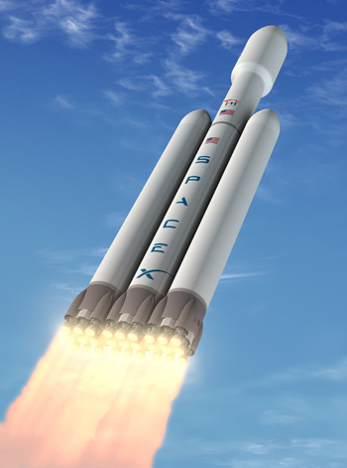
KATA ARE LIKE ROCKET ENGINES
They help you get started
Beginners should follow Kata exactly; not deviating from them, so the Learner can internalize the patterns. But with increasing proficiency each Learner can start to (within limits) develop their own style.
Likewise, over time each organization can evolve the Kata it began with to better suit and mesh with its culture. The original Kata evolve into organization-specific practice routines.
KATA

Slide 17

THE IMPROVEMENT KATA MODEL
Kata¹ (方) – Suffix Meaning "Way of Doing"
We found a common, scientific pattern of thinking and behavior in Toyota managers' approach -- their 'Way of Improving' -- and depicted it with a four-step model we named the “Improvement Kata.”
1
3
Get the Direction or
Challenge
Establish your Next
Target
Condition
2
4
Conduct Experiments
to get there
Grasp the Current
Condition
The Improvement Kata model comes from research into how Toyota manages people, which is summarized in the book “Toyota Kata”

Slide 18
THE IMPROVEMENT KATA MODEL
Kata¹ (方) – Suffix Meaning "Way of Doing"
We found a common, scientific pattern of thinking and behavior in Toyota managers' approach -- their 'Way of Improving' -- and depicted it with a four-step model we named the “Improvement Kata.”
1
3
Get the Direction or
Challenge
Establish your Next
Target
Condition
2
4
Conduct Experiments
to get there
Grasp the Current
Condition
The Improvement Kata model comes from research into how Toyota manages people, which is summarized in the book “Toyota Kata”

Slide 19
A WAY OF IMPROVING
The IK pattern is similar to other models of the human creative, scientific process: Systems thinking,
learning organization, design thinking,
creative thinking, solution focused
practice, preferred futuring, skills
of inquiry, evidence-based
learning.
Get the Direction or
Challenge
Establish your Next
Target
Condition
1
3
2
4
Conduct Experiments
to get there
Grasp the Current
Condition
Important point: Toyota's success has come from striving scientifically for all sorts of challenging goals, not just from "eliminating waste" for greater efficiency.

Slide 20
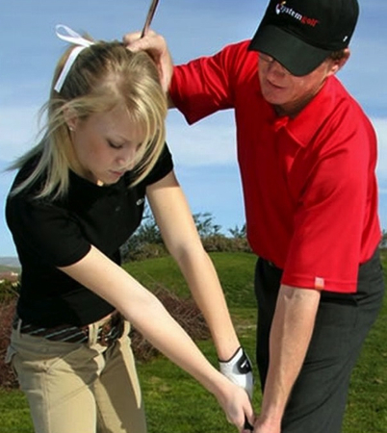
THERE'S ALSO A COACHING KATA
A way of coaching. Toyota's Master-Apprentice style
teaching approach is like training in sports and music.
Coach
(Manager)
Learner
Together the Improvement Kata and Coaching Kata
make up a management approach

Slide 21


BUT THERE IS A PROBLEM
No matter how good it is, just explaining a model
doesn't generate new ways of thinking and acting.
Hoping to create different behavior by explaining
or trying to convince generally doesn't work.

Slide 22
THIS DOESN'T WORK
Toyota's
Way
Our
Organization
We don't behave a certain way because we lack information. We behave one way or another because it's a habit.
Changing means deliberately practicing a different routine, which over time changes how you think.
But you wouldn't try to run 20 miles at the start. You begin with some starter practice routines, to help you learn fundamentals and build some initial confidence in the new skill you're trying to learn.

Slide 23

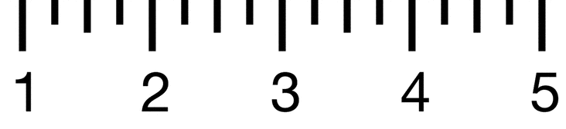
DEVELOPING YOUR OWN WAY
Begin with some practice routines, then evolve to
suit your organization as some proficiency is developed
Our
Organization's
Way
Toyota's
Way
Expert
Proficient
Competent
Advanced Beginner
Novice
Each person may start at a different point and advance at different rates.

Slide 24
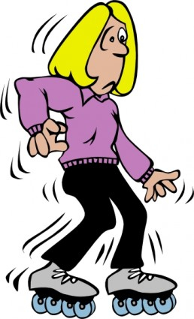
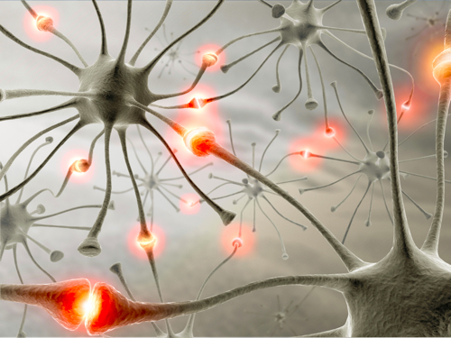
THE ROLE OF PRACTICE ROUTINES
Kata² (型 or 形) – Meaning "Form"
Kata are also practice routines that help you adopt new ways of acting and thinking.
This is where brain
science comes in

Slide 25
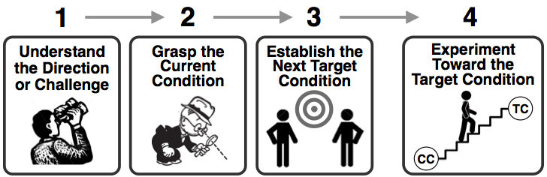
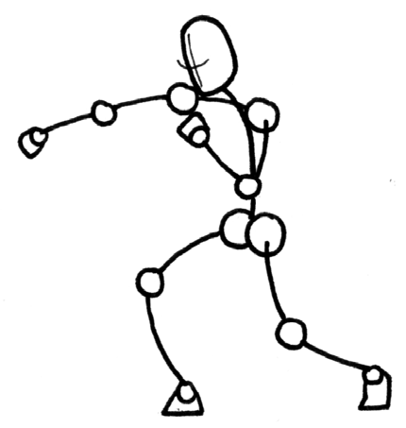
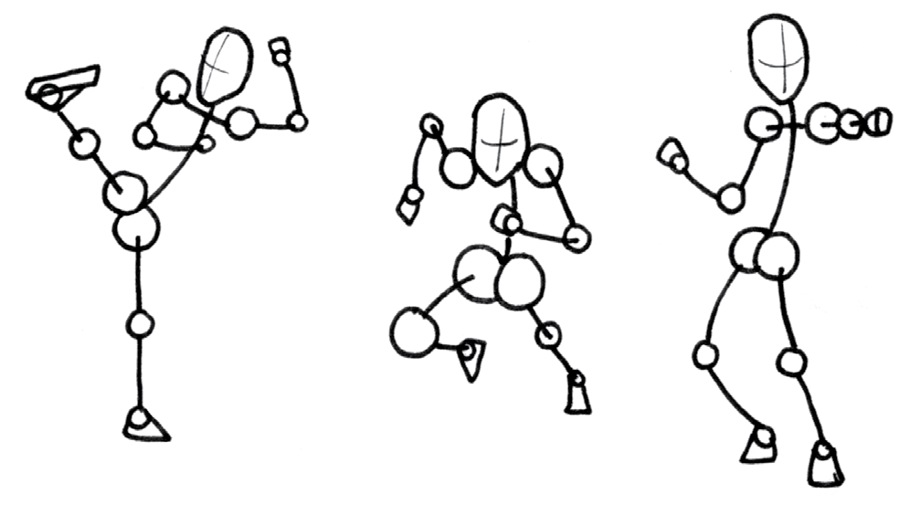
STARTER KATA
There are structured practice routines, or Starter Kata, for each step of the IK model, and for coaching, to help Learners develop fundamental skills and operationalize the model. They're a starting point for any individual, team or organization who would like to develop a more scientific mindset and approach.
The Improvement Kata model
The practice routines are a way to begin to operationalize the IK pattern

Slide 26
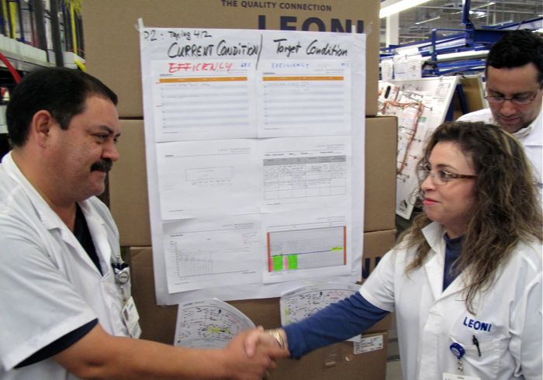
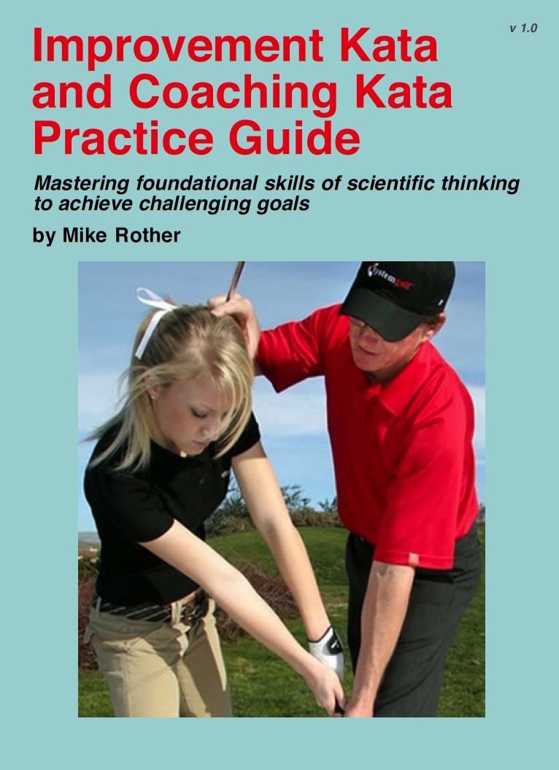
THE IK & CK PRACTICE GUIDE
Instructions for each Starter Kata
(Free on the Toyota Kata Website)

Slide 27
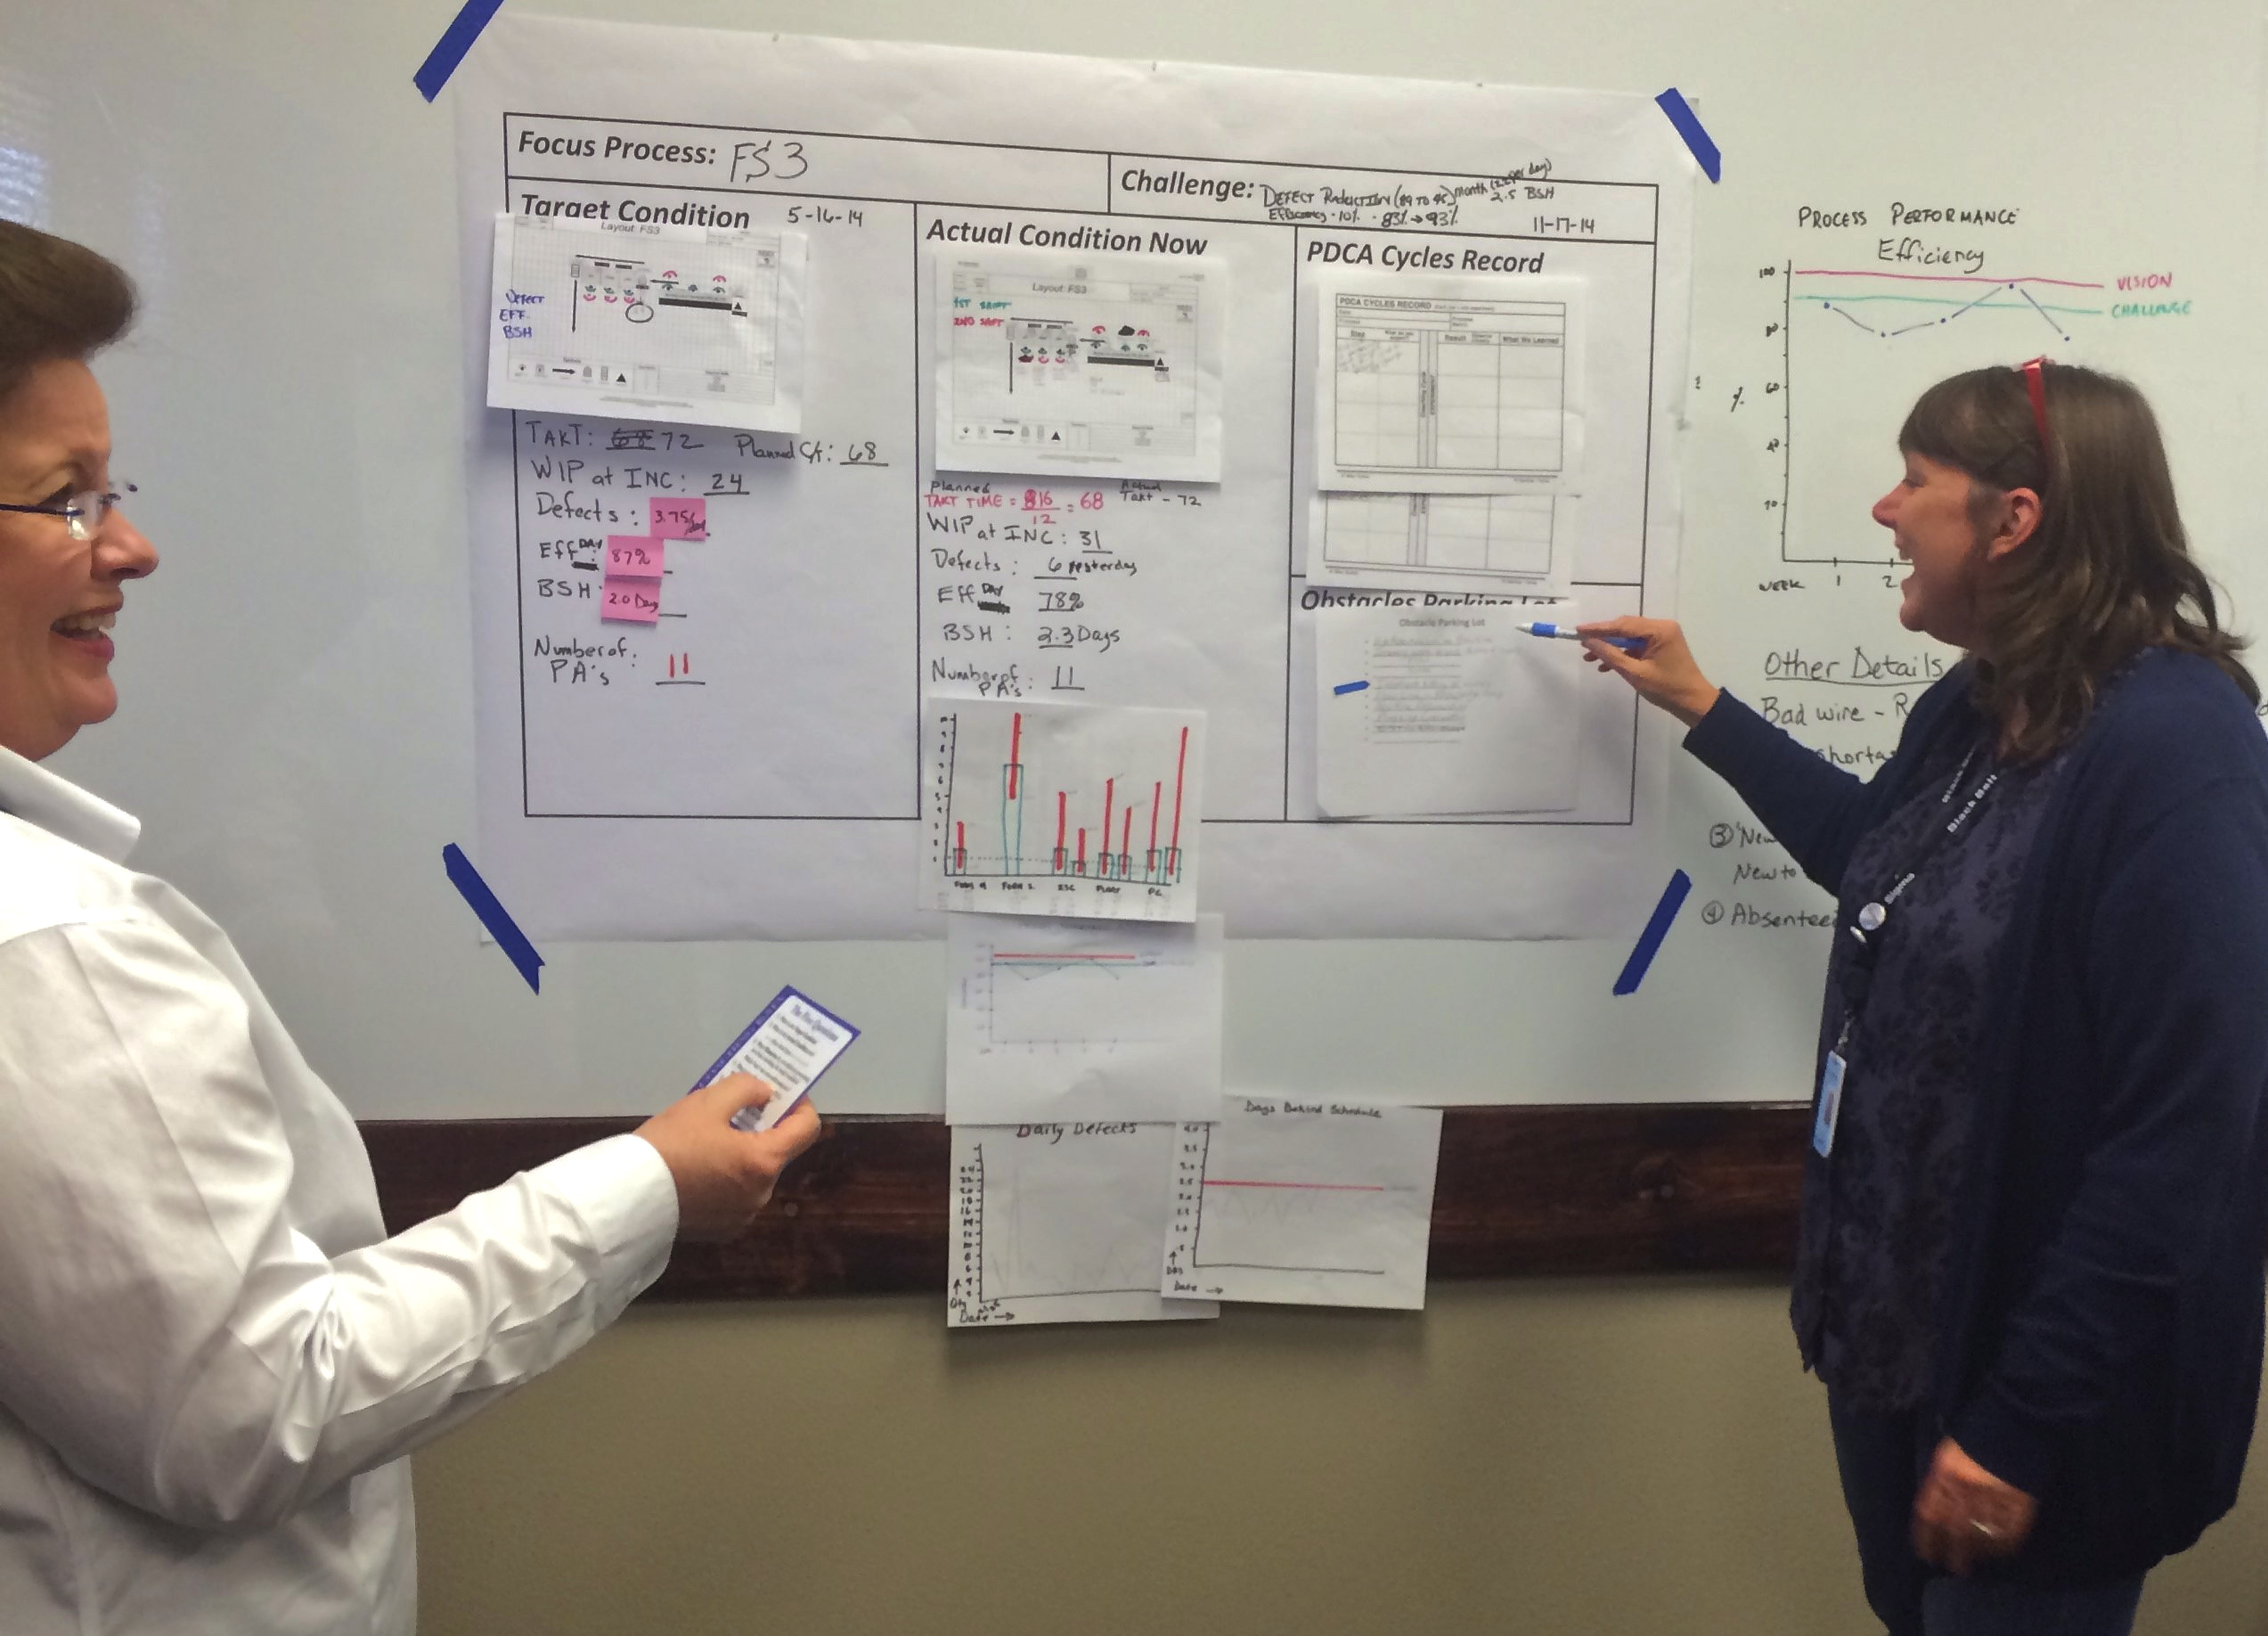
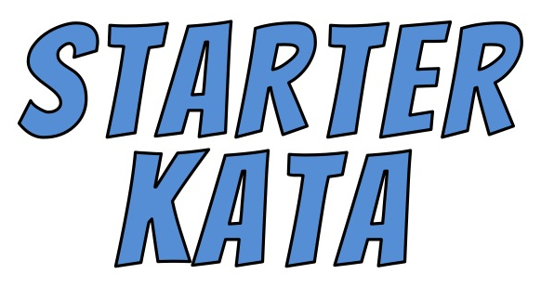
Learner's Storyboard
Challenge
PDCA Cycles Record
Current
Condition Analysis
Target
Condition
Definition
Obstacles Parking Lot
LEARNER
Five Coaching Kata Questions
COACH
Block
Diagram
Run Charts
Coaching Cycle

Slide 28



VIDEO 1:
What We Know About How People Learn
(2 minutes)
https://www.youtube.com/watch?v=ELpfYCZa87g
Also available on the IK/CK YouTube Channel

Slide 29
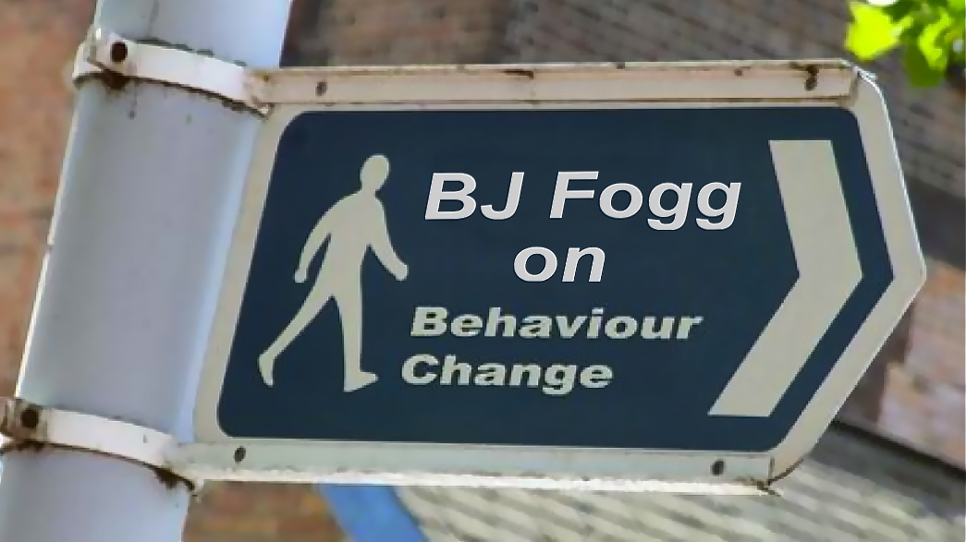
VIDEO 2:
Practicing in Small Steps
(4 minutes)
https://www.youtube.com/watch?v=cfAQ8oJIGoA
Also available on the IK/CK YouTube Channel

Slide 30
QUICK DEFINITIONS
The Improvement Kata: A practical four-step model of scientific of thinking and acting, for achieving challenging goals.
The Improvement Kata includes practice routines for
each step, for learning through practice how to work scientifically when you pursue goals in complex systems.
The Coaching Kata: Is a pattern for teaching the Improvement Kata pattern of thinking and acting.
The Coaching Kata includes practice routines for anyone who wants to teach the Improvement Kata pattern.

Slide 31
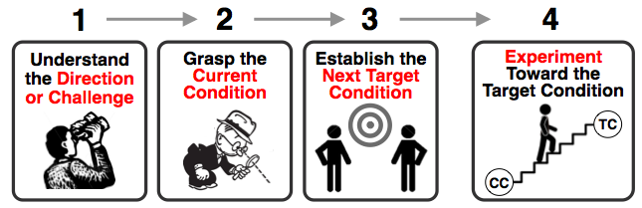
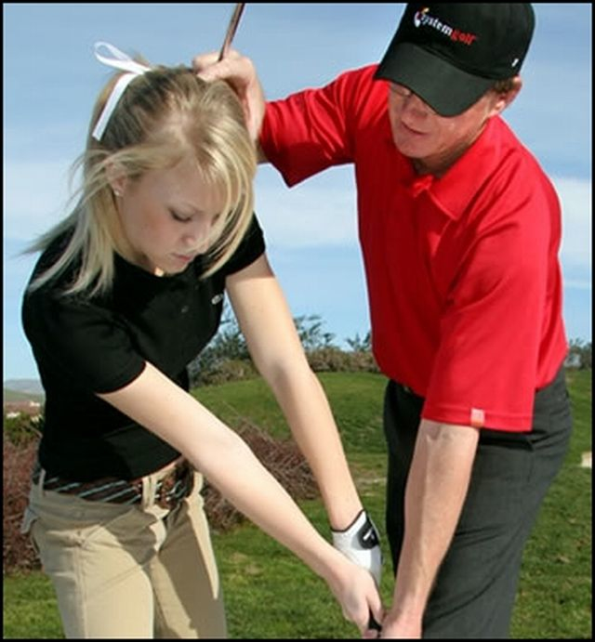
THE
IMPROVEMENT KATA
The Improvement Kata is a model of the human creative process. It’s a 4-step pattern of establishing target conditions and then working iteratively (scientifically) through obstacles, by learning from them and adapting based on what's being learned.
THE COACHING KATA
The Coaching Kata is a pattern for managers to follow in teaching the Improvement Kata pattern in daily work, so that it becomes part of an organization's culture.

Slide 32





THE FOUR STEPS OF THE IMPROVEMENT KATA MODEL
A systematic, scientific pattern of working
1
2
3
4
Understand
the Direction
or Challenge
Grasp the
Current
Condition
Establish the
Next Target
Condition
Experiment
Toward the Target Condition
TC
CC
Planning
Phase
Executing
Phase
Remember: The Improvement Kata combines
scientific steps + techniques of deliberate practice for each step, to develop effective problem solving skill

Slide 33
THE FOUR STEPS OF THE IMPROVEMENT KATA PATTERN
A systematic, scientific way of working
2
4
3
1
Current
Condition
Next
Target
Condition
Obstacles
Challenge
Vision

Slide 34

THE IMPROVEMENT KATA PATTERN
A systematic, scientific way of working
Current
Condition
Next
Target
Condition
Obstacles
Challenge
Vision

Slide 35





THE IMPROVEMENT KATA PATTERN
Awesome!
Next
Target
Now
Experiments
Diagram by Tobias Leonhardt

Slide 36

THE IMPROVEMENT KATA PATTERN
Challenge
Test!
Current
Condition
Target
Condition

Slide 37

THE IMPROVEMENT KATA
+ THE COACHING KATA
It’s a methodology for developing people
to meet challenges
Understand the Direction or Challenge
Grasp the Current Condition
Establish the Next Target Condition
Experiment
Toward the Target Condition
Improvement
Kata
Learner
‘Executing’
Coaching Cycles
Coaching
Kata
‘Planning’ Coaching Cycles
Coach
(Manager)

Slide 38

THE STEPS BUILD ON ONE ANOTHER
Each step of the Improvement Kata pattern operates
within the context of the previous step. This framing
effect is an integral part of effective problem solving.
Frames
Frames
Frames
Understand
the Direction
or Challenge
Grasp the
Current
Condition
Establish the
Next Target
Condition
Experiment
Toward the Target Condition
TC
CC

Slide 39
CONNECTING STRATEGY & EXECUTION
The role of Challenge in an organization
Managers develop people by coaching application practice of the Improvement Kata in the direction of the challenge
Leaders establish the organizationʼs strategic concept (the “rallying point” or overall direction)
Current
Condition
Next
Target
Condition
Obstacles
Challenge
Vision
Execution
Strategy

Slide 40


TERMINOLOGY
The
Direction
or Challenge
Next
Target
Condition
(dated)
Obstacles
Threshold of Knowledge
Experiments
Current
Condition

Slide 41
WHAT IT REALLY LOOKS LIKE
Challenge
Next
Target
Condition
(date)
Threshold of Knowledge
Experiments
At the Current
Knowledge Threshold
Current
Condition

Slide 42
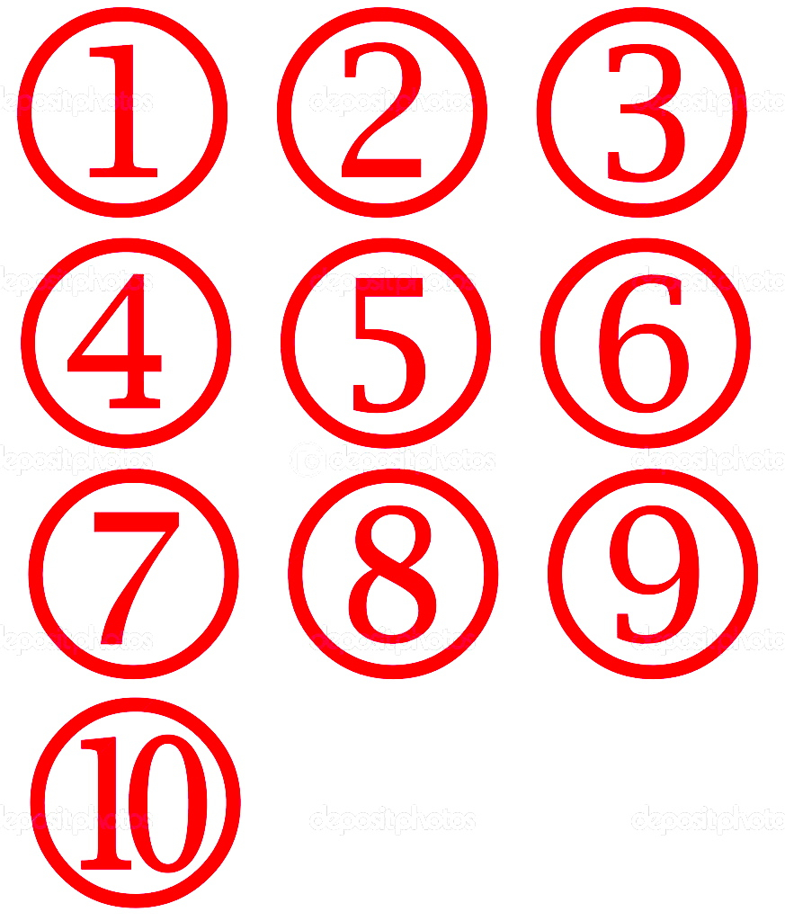
WHAT IT REALLY LOOKS LIKE
Challenge
Next
Target
Condition
(date)
Threshold of Knowledge
Experiments
At the Current
Knowledge Threshold
Current
Condition

Slide 43
PRACTICING WORKING SCIENTIFICALLY
STEP 1
The
Direction
or Challenge
Next
Target
Condition
(dated)
Obstacles
Threshold of Knowledge
Experiments
Current
Condition

Slide 44
PRACTICING WORKING SCIENTIFICALLY
STEP 2
The
Direction
or Challenge
Next
Target
Condition
(dated)
Obstacles
Threshold of Knowledge
Experiments
Current
Condition

Slide 45
PRACTICING WORKING SCIENTIFICALLY
STEP 3
The
Direction
or Challenge
Next
Target
Condition
(dated)
Obstacles
Threshold of Knowledge
Experiments
Current
Condition

Slide 46
PRACTICING WORKING SCIENTIFICALLY
STEP 4
The
Direction
or Challenge
Next
Target
Condition
(dated)
Obstacles
Threshold of Knowledge
Experiments
Current
Condition

Slide 47
The Improvement Kata
1.
The Improvement Kata
1.
Four steps for achieving goals
Four steps for achieving goals
Understand
the
Challenge
Understand
the
Challenge
3.
TC
3.
TC
Establish
Your Next
Target
Condition
TC
Establish
Your Next
Target
Condition
TC
2.
2.
4.
Experiments
Toward the Target Condition
4.
Experiments
Toward the Target Condition
Grasp the Current
Condition
Grasp the Current
Condition
Mike Rother
Mike Rother
The Improvement Kata
1.
The Improvement Kata
1.
Four steps for achieving goals
Four steps for achieving goals
Understand
the
Challenge
Understand
the
Challenge
3.
TC
3.
TC
Establish
Your Next
Target
Condition
TC
Establish
Your Next
Target
Condition
TC
2.
2.
4.
Experiments
Toward the Target Condition
4.
Experiments
Toward the Target Condition
Grasp the Current
Condition
Grasp the Current
Condition
Mike Rother
Mike Rother

Slide 48

THE IK PATTERN IS PRACTICED
AT ALL LEVELS
The content differs, but the pattern of thinking is the same
Understand
the Direction
or Challenge
(from level above)
ExperimentToward the Target Condition
Grasp the
Current
Condition
Establish the Next Target Condition
Organization
Level
(Organization’s vision and strategic objectives)
Value Stream
Level
Process
Level
PLANNING
EXECUTING

Slide 49
THE IK PATTERN CONNECTS THE LEVELS
A Target Condition at one level is the Direction for the next level
Understand
the Direction
or Challenge
(from level above)
ExperimentToward the Target Condition
Coach/Learner
relationships
Grasp the
Current
Condition
Establish the Next Target Condition
Organization
Level
Longer-Cycle Experiments
Value Stream
Level
Current State Value Stream Mapping
Future State Value Stream Mapping
Process
Level
Short-Cycle Experiments
PLANNING
EXECUTING

Slide 50
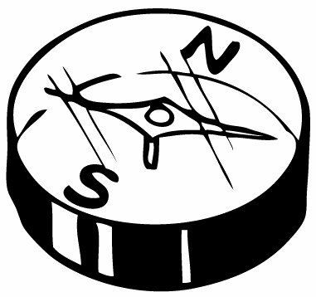
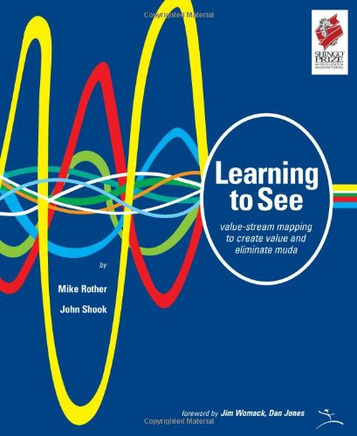
THE ROLE OF
VALUE STREAM MAPPING
The Future-State Map helps provide
an overarching Challenge to strive for
Frames
Frames
Frames
Understand
the Direction
or Challenge
Grasp the
Current
Condition
Establish the
Next Target
Condition
Experiment
Toward the Target Condition
TC
CC
In what direction should process teams improve, using the Improvement Kata pattern?
VSM Here

Slide 51

THE ROLE OF
VALUE STREAM MAPPING
This is a main intended role for VSM
Target
Condition
Next
Target
Condition
Typically a
6-month
to 3-year
time frame
Process Team A
Target
Condition
Next
Target
Condition
Process Team B
Challenge
Vision
Target
Condition
Next
Target
Condition
Process Team C

Slide 52
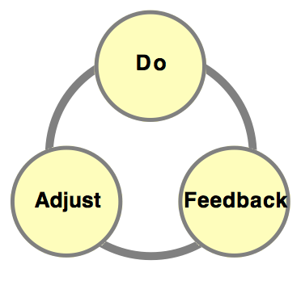
WHAT IS “DELIBERATE PRACTICE”?
Itʼs practice designed specifically to improve performance over time.
Itʼs practice that involves continual evaluation of your weaknesses and targeting specific weaknesses, rather than repeatedly doing what you already know how to do.
Itʼs practice that requires a coach. Observation and specific feedback on your current performance is critical to understanding what to work on and acquiring new skill.
Itʼs practice where you donʼt move on to the next part of the routine youʼre trying to learn until you master the part youʼre currently working on.

Slide 53
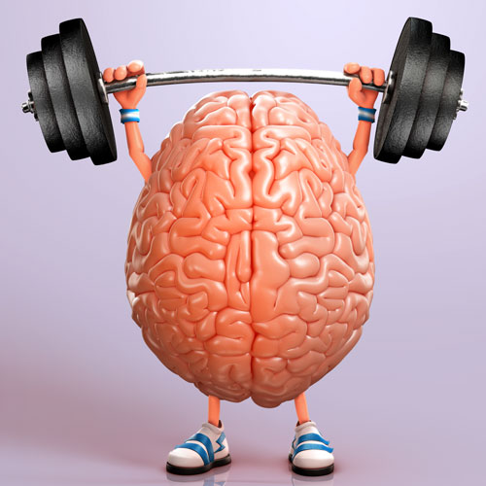
A FEW SKILL-DEVELOPMENT BASICS
Any complex performance requires skill.
We develop new skill through practice.
Long time-gaps between practice sessions diminishes the effectiveness of practice. Daily often seems to be a good frequency.
We are not good at self-feedback to understand where we are deviating from good practice and need corrective action.

Slide 54
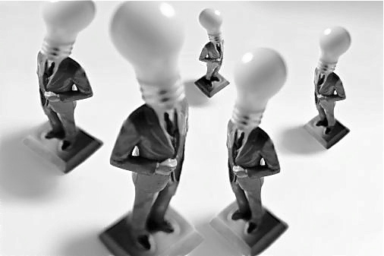
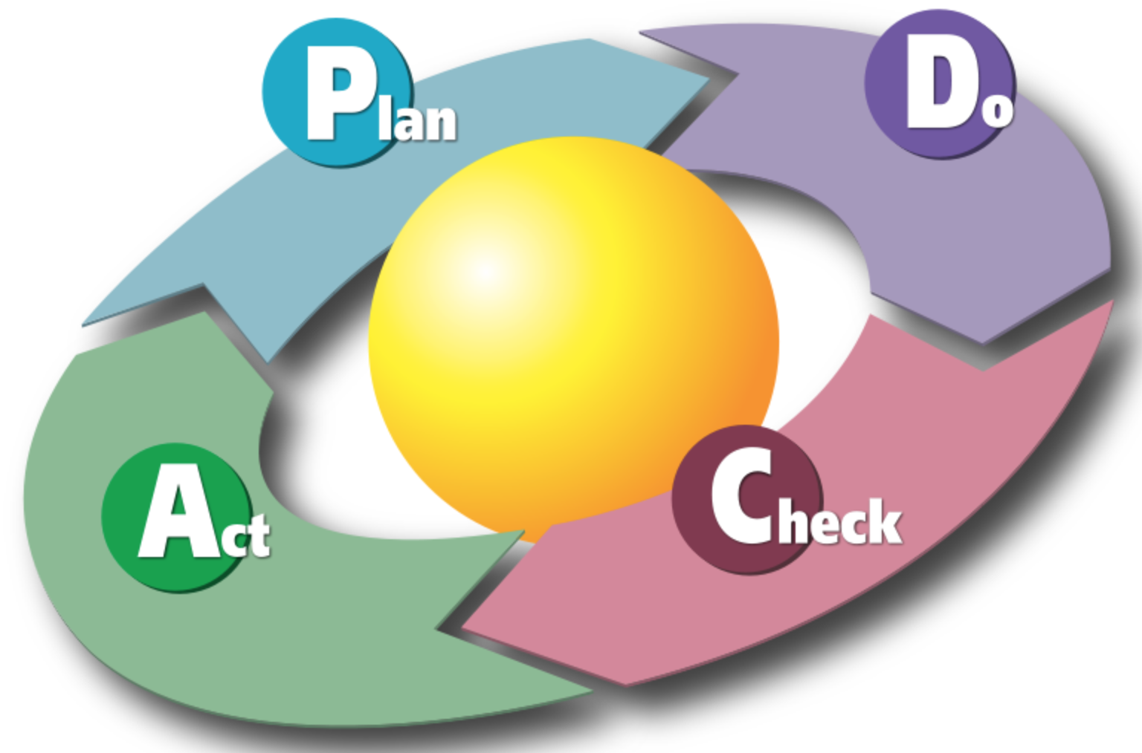
WHY KATA FOR
CONTINUOUS IMPROVEMENT?
‘Continuous’ means many minds engaged in improving their processes, and daily cycles of experimentation.
Yet our existing work routines rarely include improvement.
Systematically and scientifically
improving processes is a complex
skill set we are not naturally good at!
We can learn systematic, scientific improvement through deliberate practice of the
Improvement Kata routines

Slide 55

THE IK & CK INCLUDE
PRACTICE ROUTINES
The Improvement Kata & Coaching Kata don't just model a way of working, they also include structured practice routines for each step, to make their pattern teachable and transferrable. Coached practice of these routines, especially at the start, is a way to build improvement capability into an organization and make effective empowerment possible.
Practical
Application
A team or organization that’s pursuing continuous improvement will do well to use some structured practice routines -- Kata -- for developing new behavior, habits and culture, especially at the beginning.

Slide 56
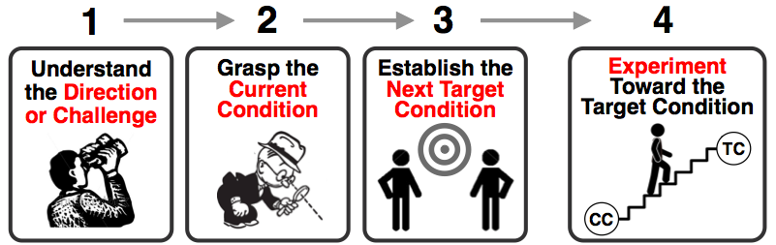

START BY PRACTICING FUNDAMENTAL SKILLS
The IK
Model
A scientific way
of working
BASIC PRINCIPLES
The IK
Practice Routines
For the Learner
START PRACTICING
THESE
Then build on them to suit your organization
The Coaching Kata Practice Routines
For the Coach
START PRACTICING
THESE
Then build on them to suit your organization

Slide 57

The Improvement Kata and Coaching Kata have starter practice routines that help anyone develop scientific-thinking skills and mindset. Deliberate, coached IK/CK practice is a way of creating a scientific-thinking 'culture'
in an individual, a team or an organization.
Ultimately, though, the Kata are not the important thing, but rather the skills and mindset that practicing them
leaves behind.
As in music, sports and with other complex skills, you begin by practicing some fundamental Kata until their pattern becomes somewhat routine. Then you can move beyond rigidly practicing the Kata to develop your own style and focus on the sound of the 'music' you are making... as long as the basic principles & patterns of the Kata remain.

Slide 58
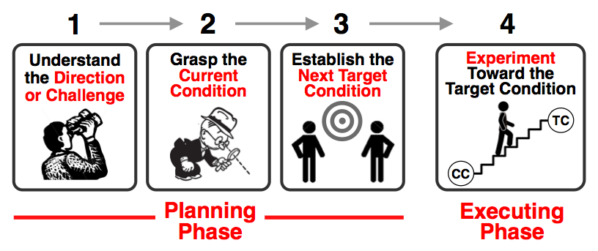



THE TOYOTA KATA RESEARCH & APPROACH
(1) A Model
A representation of something
that occurs in reality. Models help researchers describe, predict, test and understand systems.
”Essentially, all models are wrong, but some are useful.” - George E. P. Box
(2) Structured Starter
Practice Routines
Starting routines ("Starter Kata"). Specific training drills to develop fundamental skills and mindset, especially at the beginning. These help turn concepts into reality.
(Supported by coaching routines.)
(3) Organization-Specific
Routines
As proficiency increases, each organization can evolve the starting practice routines into its own practice routines, to better fit its circumstances and culture.

Slide 59

THE IMPROVEMENT KATA PATTERN
IS A SCIENTIFIC APPROACH
Since the path to a challenging goal cannot be predicted with exactness, we have to find that path by experimenting like a scientist. With each insight a scientist adjusts his/her course to take advantage of what has just been learned.
The scientific process helps you find the path not by telling you what's ahead.
It only confirms or refutes
the results of experiments.
One trick to making effective progress toward a goal is not to try to decide the way forward, but to have your team iterate its way forward by experimenting as cheaply and rapidly as possible. This is the action of innovation and it can be taught.

Slide 60
THE SCIENTIFIC LEARNING CYCLE
The scientific process of acquiring knowledge
EVALUATE
Adjust based on
what you learn
MAKE A PREDICTION
Must be testable
EVALUATE
Interpret the
evidence
PREDICTION
Testable
4
1
3
2
EVIDENCE
Collect facts and data
ACTION
Conduct the
experiment
EVIDENCE
Collect facts & data
ACTION
Let's test it
and see
This cycle gives you a practical way to reach your Target Condition, by providing a systematic way of working through the grey zone between here and there.

Slide 61
THE SCIENTIFIC LEARNING CYCLE
Is sometimes called
"Plan-Do-Check-Act" or "Plan-Do-Study-Act"
EVALUATE
Adjust based on what you learn
PREDICTION
Testable
ACT
PLAN
4
1
3
2
CHECK
(Study)
DO
EVIDENCE
Collect facts and data
ACTION
Conduct the
experiment

Slide 62
THE CORE DYNAMIC
OF SCIENTIFIC THINKING
This is the dynamic that allows us to reach challenging new goals through unclear territory
What we
expect
to happen
What
actually
happened
Learning
When experimenting is done right, small failures often provide new insight that advance your design!
“If the result confirms the hypothesis, then you've made a measurement. If the result is contrary to the hypothesis, then you've made a discovery."
~ Enrico Fermi

Slide 63
DO YOUR TESTS IN THE
"EXPERIMENTING ZONE"
The Target Condition is measureable and has a firm achieve-by date. There are budget constraints and quality & safety parameters.
There’s an effective way (Kata) of carrying out experiments
A measureable
Target Condition
with achieve-by date
Current
Condition
Quality & safety parameters
Experiments cannot hurt customer or empl
Experimenting
Zone
Using an effective means or pattern (Kata) for experimenting
Use your brain, not your wallet
A budget limit
Itʼs within these boundary conditions that we design and conduct frequent, rapid, cheap, non-harmful, successive experiments toward the Target Condition. Experiments are done as cheaply, quickly and safely as possible.

Slide 64

THERE'S A THRESHOLD OF KNOWLEDGE
BETWEEN YOU AND YOUR GOAL
It's the point at which you have no facts or data
and start guessing
Where
you
are
Limit of what you currently know
The
Goal
Path isn't knowable in advance
Complexity
Obstacles
?
?
Next
Target
Condition
(date)
?
Unclear
Territory
Your Current
Knowledge
Threshold
Where you
want to be
next

Slide 65


THERE'S A THRESHOLD OF KNOWLEDGE
BETWEEN YOU AND YOUR GOAL
It's the point at which you have no facts or data
and start guessing, and it's closer than you think
Predictable Zone
Unpredictable / Learning Zone
Obstacles
Complexity
?
Next Target Condition
?
Unclear Territory
Current Knowledge Threshold
We want
to be here next
Any human endeavor involves a scientific process of testing
and possibly adjusting. Why? Because you never know
for sure how you are going to get there until you get there.

Slide 66
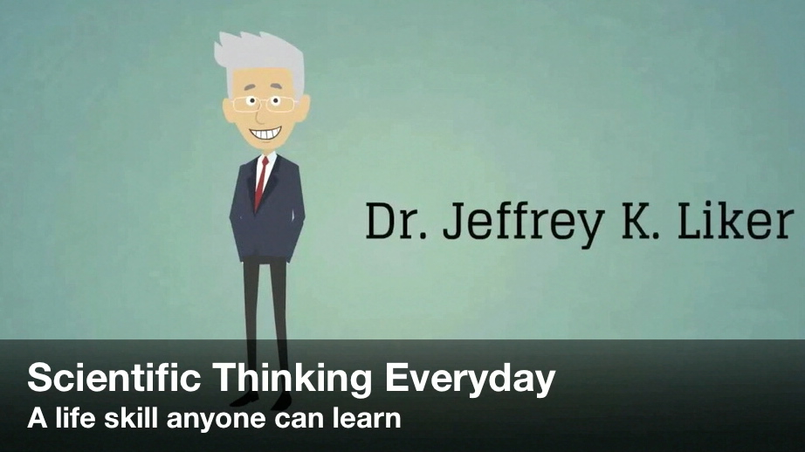
VIDEO 3:
You're in the unpredictable Learning Zone!
(2 minutes)
https://www.youtube.com/watch?v=SaTOASsrHFs
Also available on the IK/CK YouTube Channel

Slide 67
Danger Zone
Threshold of
Knowledge
Learning Zone
Apparent
Certainty

Slide 68
A CHALLENGE FOR THE COACH
Learning new skills and habits requires
an emotion of enthusiasm in the Learner
Danger Zone
Learning Zone
The Learner should practice in a Learning Zone, beyond their current knowledge and skill thresholds, yet also periodically get a feeling of progress.
In other words, the Coach is responsible for the Learner's success.
Apparent
Certainty

Slide 69

WHAT SHOULD YOU DO AT THE
THRESHOLD OF KNOWLEDGE?
1) Acknowledge it. (Difficult to do, until you get into the habit.)
Key realization: There's always a threshold of knowledge.
2) Stop and see further by conducting an experiment. Don't deliberate over answers. Deliberate over the next experiment.
Uncertainty / Learning Zone
Condition
?
?
Next
Target
Condition
(date)
?
Now
Your Current
Knowledge
Threshold
Where you
want to be
next
Hey Coach
There's a knowledge threshold
in every coaching cycle.
When you hit a knowledge threshold, have the Learner plan the next experiment there. Ask... "How can we find that out?"

Slide 70
The Scientific Approach
SMALL, RAPID EXPERIMENTS
ADVANCE OUR KNOWLEDGE QUICKLY
The Grey Zone
Current Condition
Next
Target Condition
(date)

Slide 71
The Scientific Approach
SMALL, RAPID EXPERIMENTS
ADVANCE OUR KNOWLEDGE QUICKLY
Next
Target
Condition
(date)
Where you are now
Your Current
Knowledge
Threshold
Where you
want to be
next

Slide 72

VIDEO 4: Working Iteratively
(3 minutes)
https://www.youtube.com/watch?v=COKqiFaHm1s
Also available on the IK/CK YouTube Channel

Slide 73
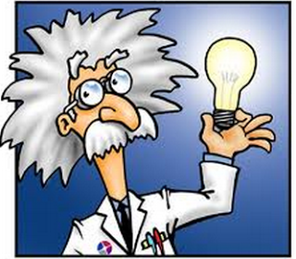
PRACTICING THE IMPROVEMENT KATA
TEACHES SCIENTIFIC THINKING
Use deliberate practice of the Improvement Kata routines in order to make basic skills of scientific thinking more automatic.
That’s the Kata part.
Those automatic fundamentals are then a foundation upon which all sorts of creativity and initiative can proliferate in your team and organization, to achieve what seems impossible.
That’s improvisation & creativity!

Slide 74

LEVELS OF IK/CK SKILL DEVELOPMENT
To coach the Improvement Kata, managers first
need experience with applying the Improvement Kata
Here you understand the thinking behind the Kata. Now you can coach others and evolve your own Kata.
Able to TEACH it
Able to DO it
Skill development
begins here
Learning begins when
you start applying the Improvement Kata yourself
AWARE of it
Concepts and information alone generally don’t change anything

Slide 75


There is a
LEARNING PROGRESSION
Developing
Others
Able to TEACH it
Self
Development
Able to DO it
AWARE of it
Sorry, no
way around it

Slide 76
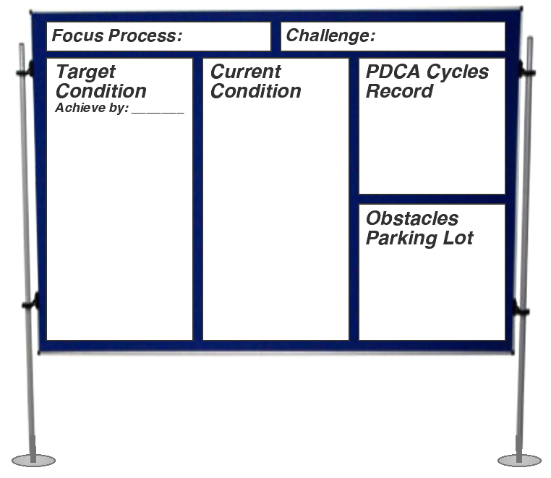





Roles / Org Structure for Practicing
Team
Learner's
Storyboard
2nd Coach
Coach
(Manager)
Learner
Coaches
the Coach
Practices the
Coaching Kata
Practices the
Improvement Kata

Slide 77
WHAT DEPLOYMENT OFTEN LOOKS LIKE
Don’t try to expand Improvment Kata practice faster
than you can develop internal Coaching Kata proficiency!
Phase I Phase II Phase III
Increasing number of managers in the organization who are proficient as IK coaches
Slice 4
Form an "Advance Group," i.e., which practices first
AG works toward a series of 3 target conditions
(does ~ 25 PDCA cycles)
on real processes
Slice 3
Advance Group makes 6 or 12-month plan
Advance Group reflection and next plan
Slice 2
Slice 1 (a process, area, department, VS Loop, etc.)
Scouts study the subject
Form AG
AG and first coaches practice the IK
Advance Group conducts bi-weekly reflections
External Coach's Role
(consultant)
Initial instructor & coach
On site every ~ 2 weeks
2nd coach
On site every 2 - 4 weeks
As needed

Slide 78
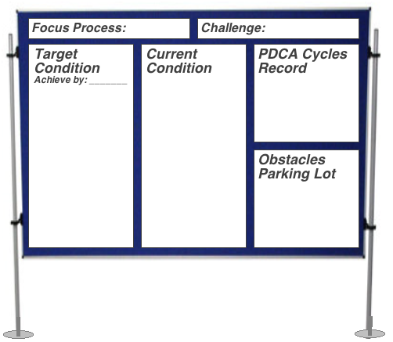
The Learner's Storyboard
Start with this format

Slide 79
Focus Process:
Challenge:
Target Condition
Achieve by:
Current Condition
PDCA Cycles Record
Obstacles Parking Lot

Slide 80
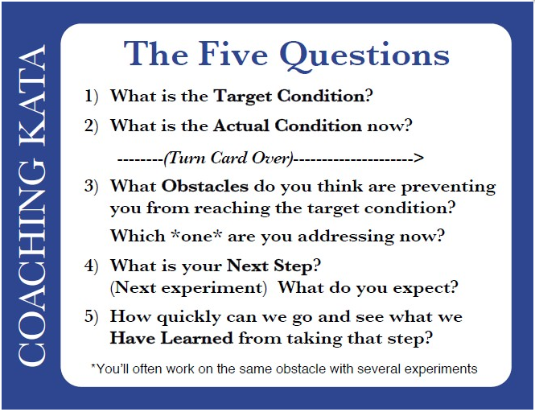
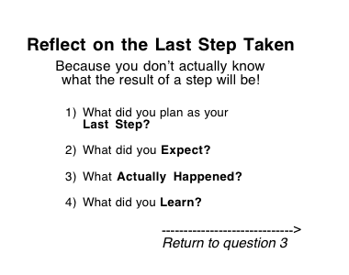
Card is downloadable at:
http://www-personal.umich.edu/~mrother/KATA_Files/5Q_Card.pdf

Slide 81
PDCA CYCLES RECORD
(Each row = one experiment)
Obstacle:
Process:
Learner:
Coach:
Date, step & metric
What do we expect?
What happened
What we learned
Do a Coaching Cycle
Conduct the Experiment

Slide 82
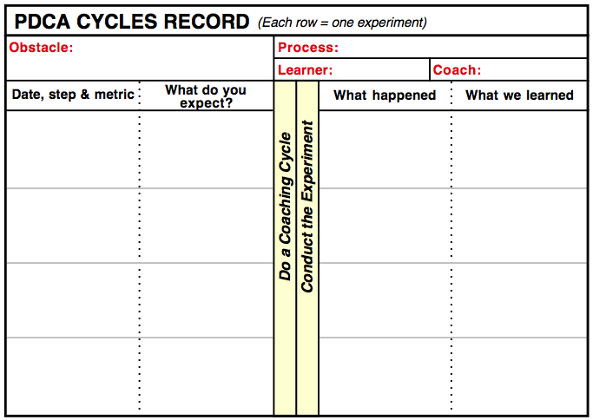
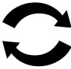
The Five Coaching Kata Questions and
the PDCA Cycles Record are used together
5-Question Coaching Dialog
Rapid PDCA Cycles
Used by the Coach
Used by the Learner

Slide 83
ASK THE FIVE QUESTIONS AT EACH STEP

Slide 84
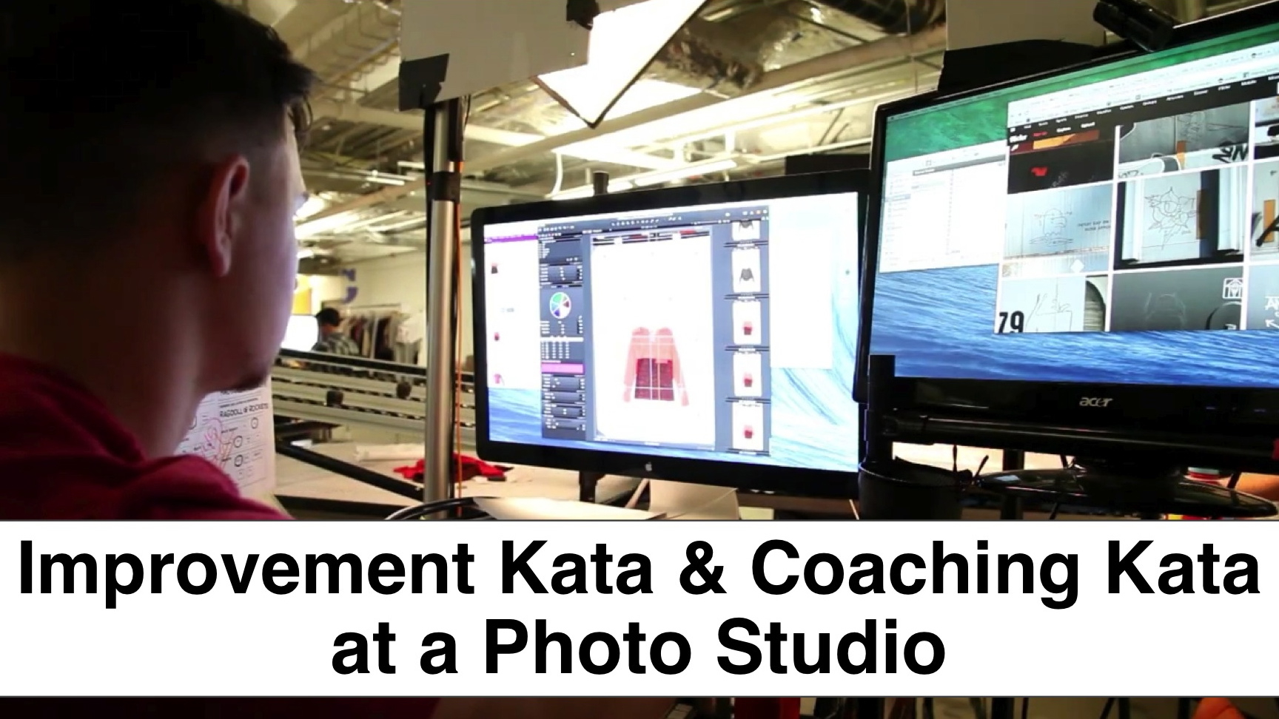
VIDEO 5: Improvement Kata Case Example
A good example of what happens when we practice a scientific way of working – a meta skill – rather then just benchmarking someone else's solutions
https://www.youtube.com/watch?v=6EHo4KrRKbQ
Also available on the IK/CK YouTube Channel

Slide 85
