Slide 1


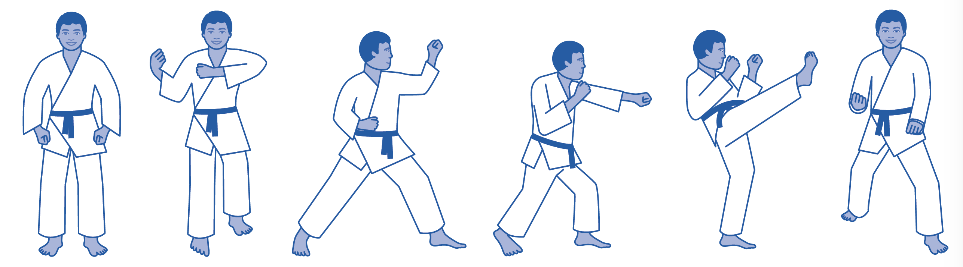

The Toyota Kata
STARTER KATA
To get better at scientific thinking you can begin with these seven Starter Kata, and build on them once you master their patterns.
Instructions for each Starter Kata are in the Toyota Kata Practice Guide
By Mike Rother

Slide 2
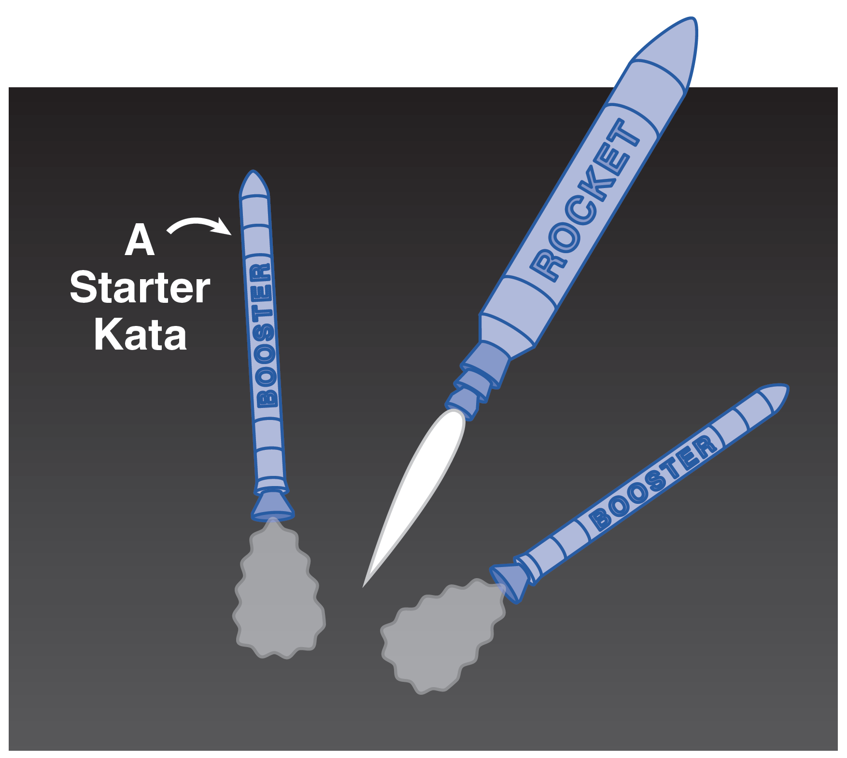
What Are Starter Kata?
Starter Kata are small, predefined practice routines,
or drills, of fundamentals. They help you get started
in adopting a new way of acting and thinking.
A good way to begin acquiring
a new skill is with Starter Kata.
Then, as you gain some skill and understanding, you build upon them to suit your situation and develop your own way.
Starter Kata are not the
end game — they put you
on the road to new skills.
Toyota Kata Practice Guide

Slide 3
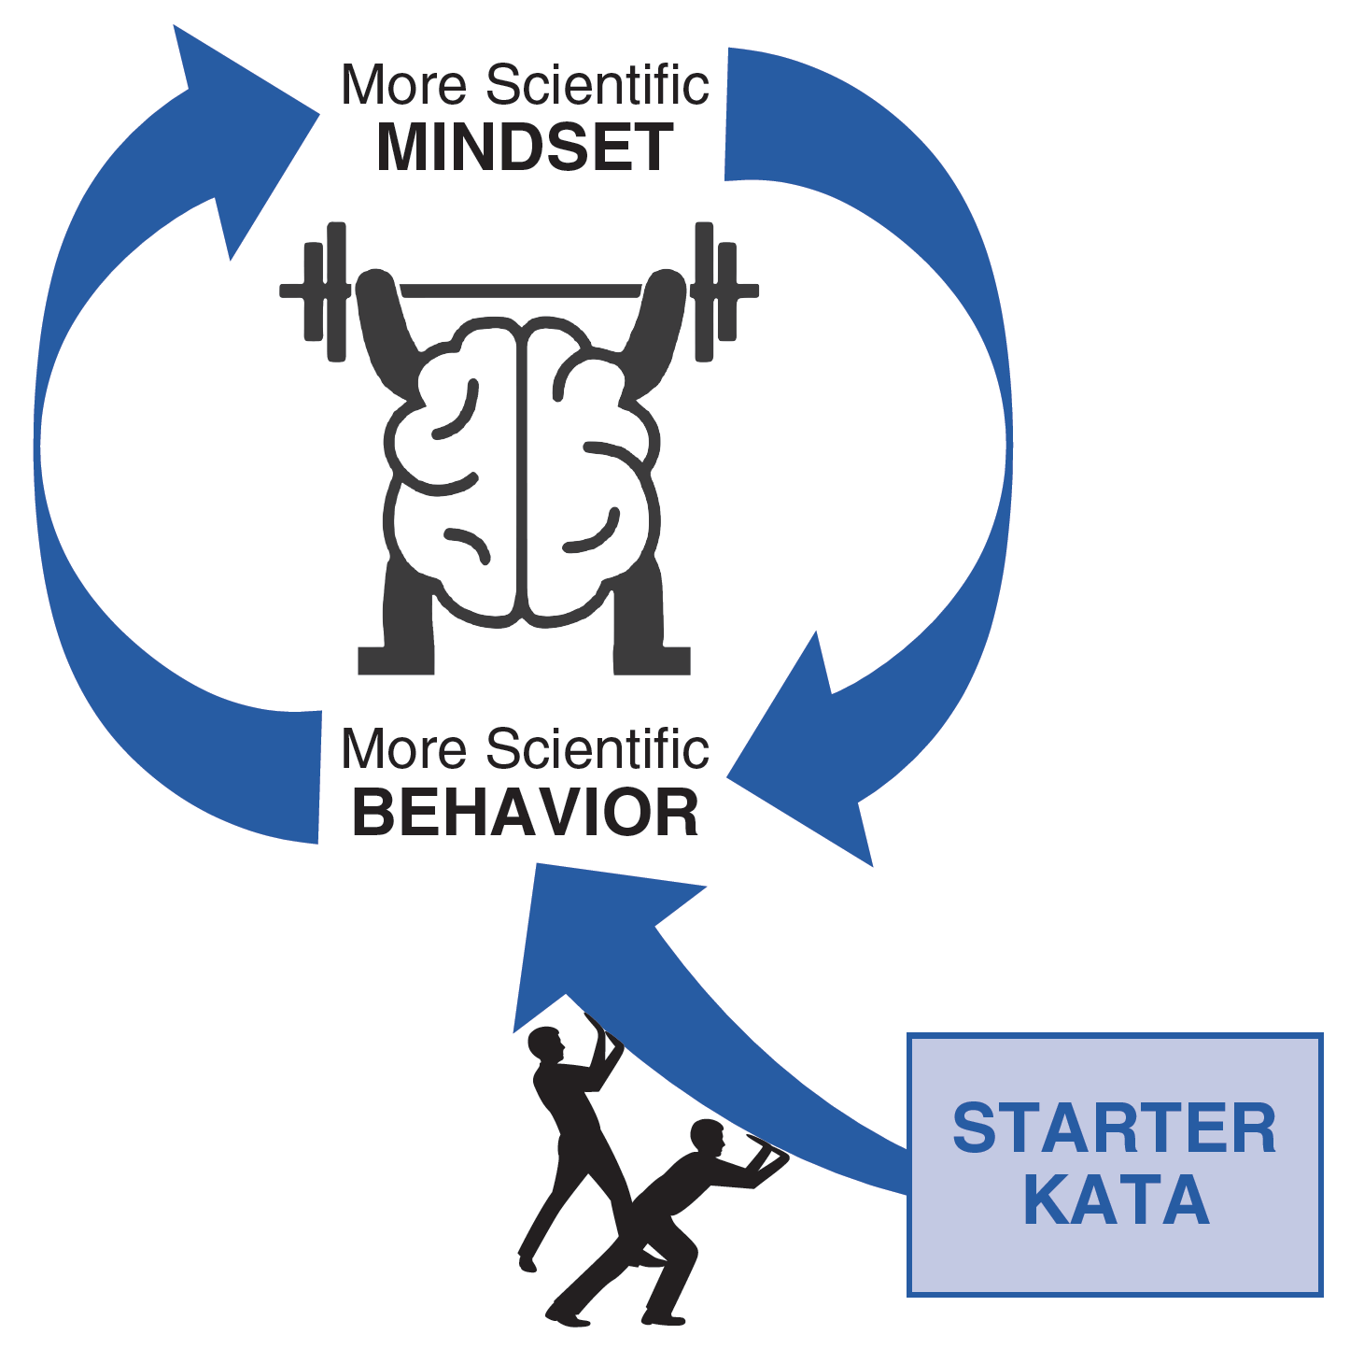
The Toyota Kata Starter Kata Are For Practicing Scientific Thinking Skills
To help develop practical, everyday scientific-thinking skills you can begin by practicing the Starter Kata presented here. Instructions are in the Toyota Kata Practice Guide.

Slide 4
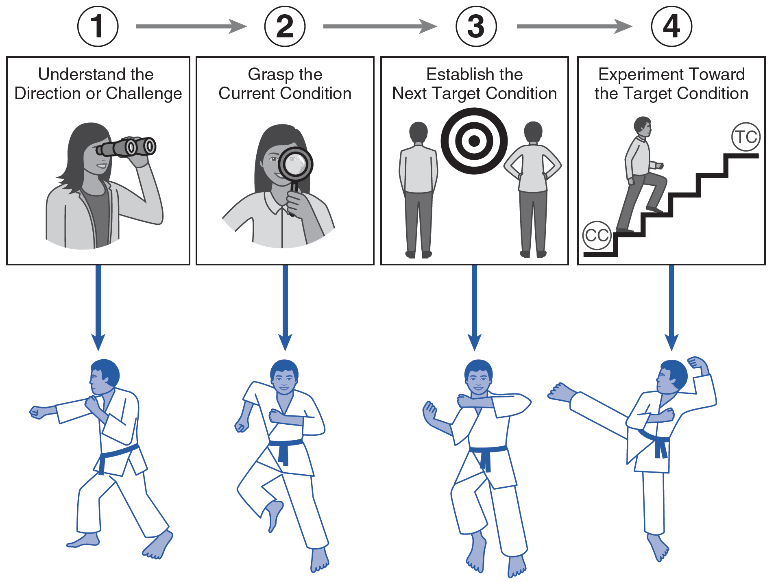
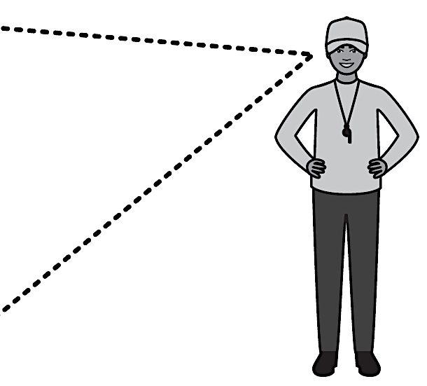
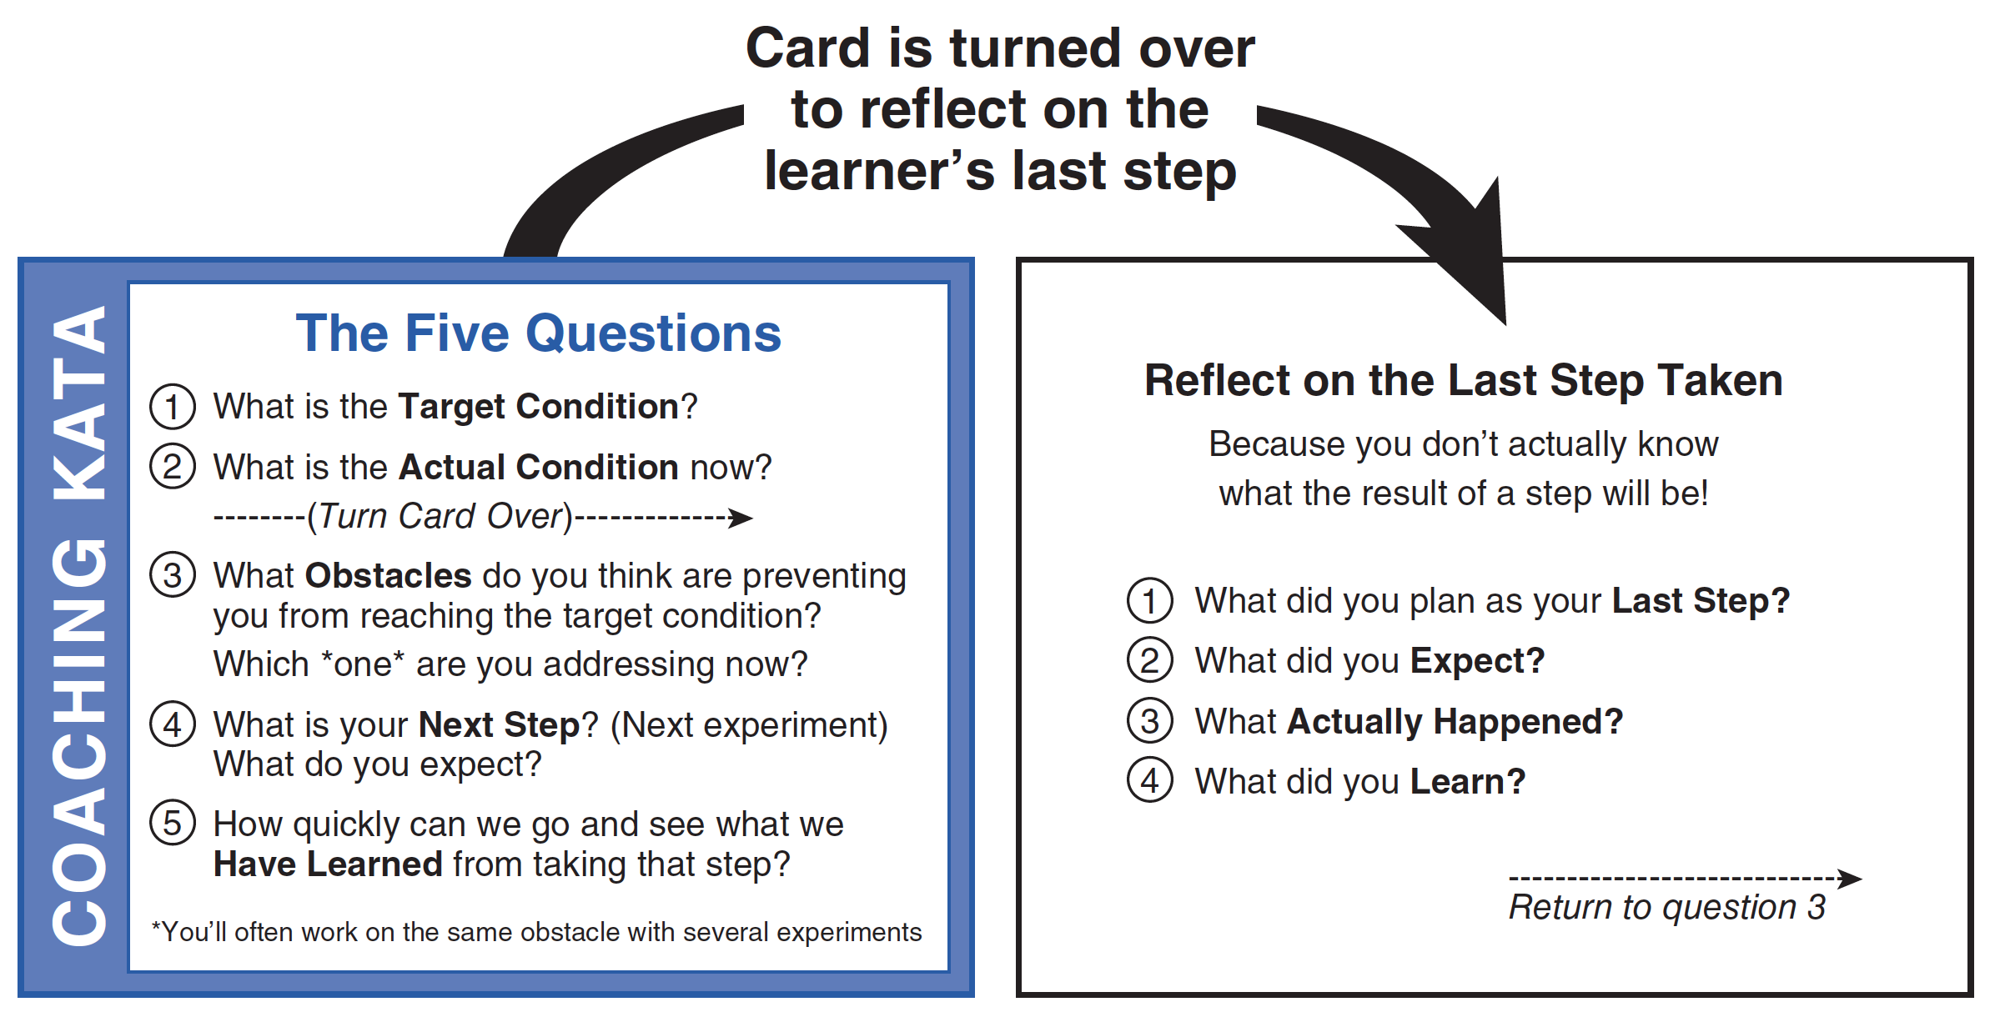
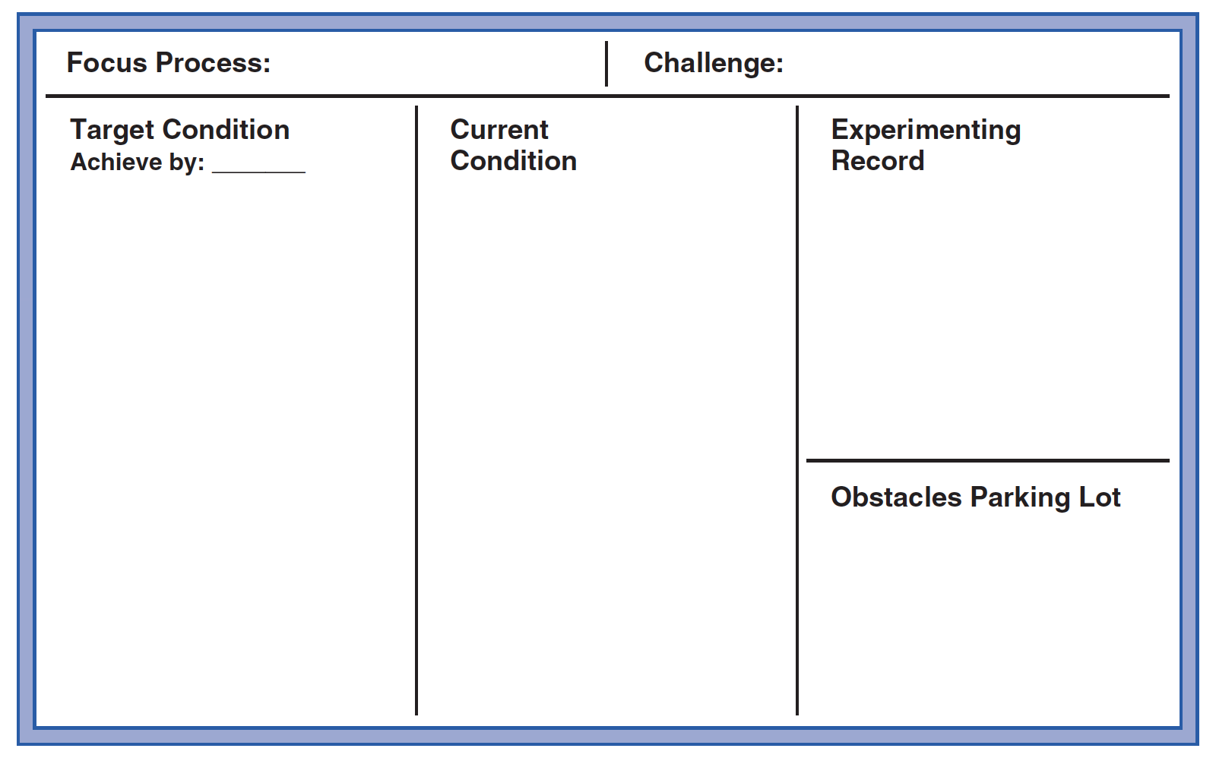
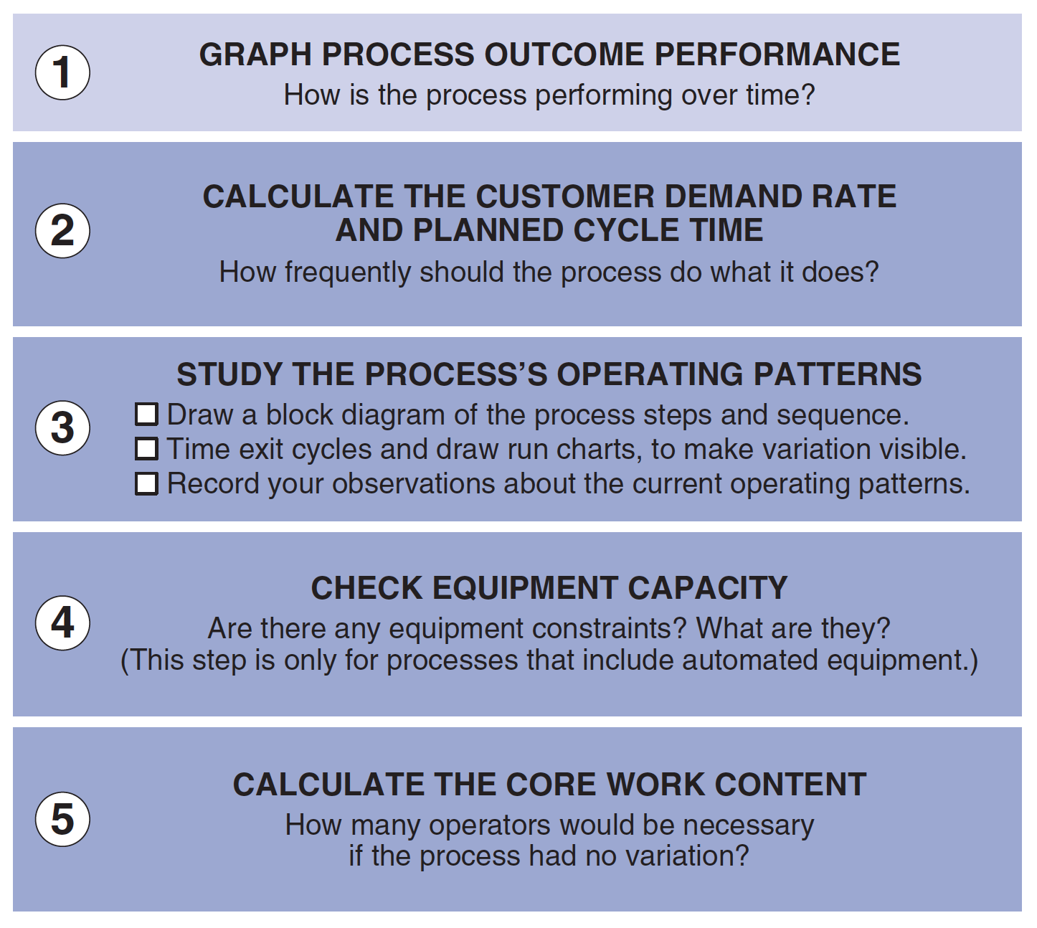
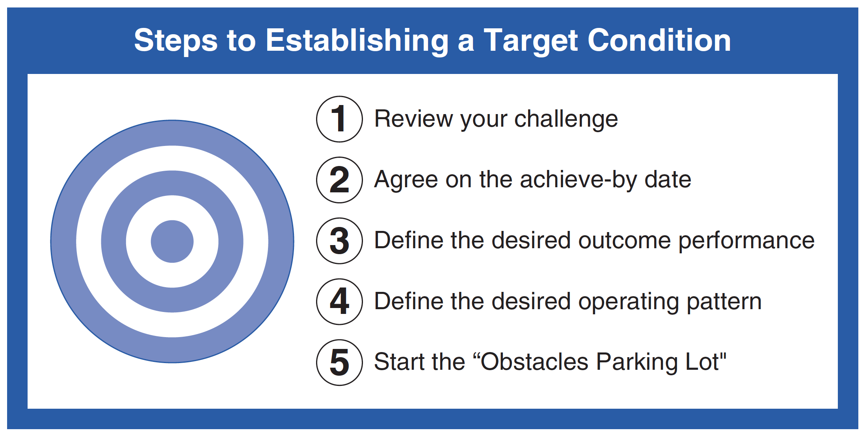
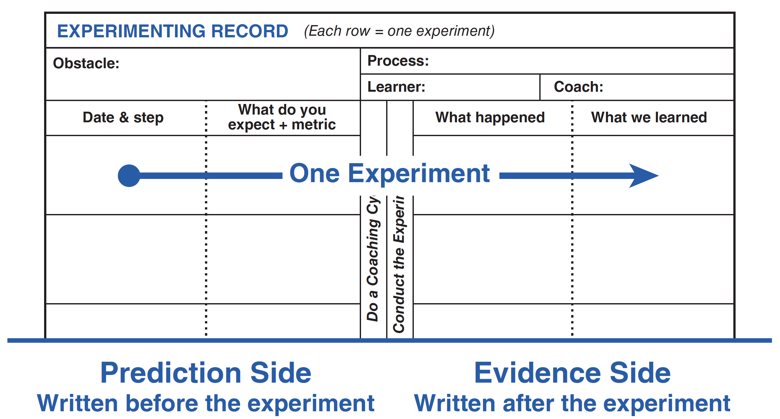
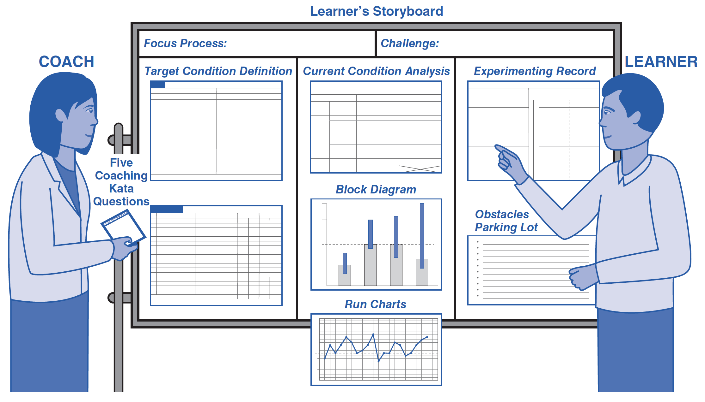
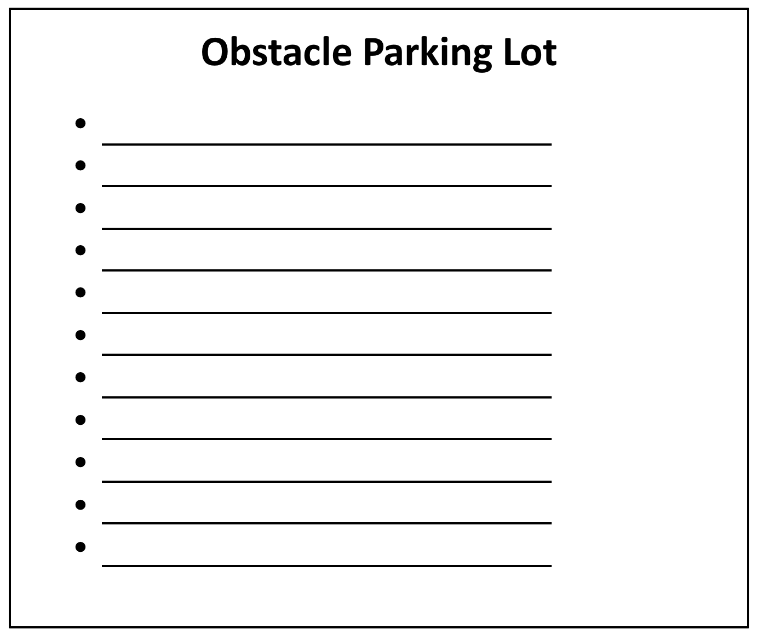
The 7 Toyota Kata Starter Kata
The Improvement Kata Pattern
LEARNER
COACH
Five
Coaching
Kata
questions
Establishing a
target condition
Experimenting
record
Learner’s
Storyboard
Current condition
analysis
Daily coaching cycles
Obstacle
parking lot

Slide 5


It’s About Developing
Some New Neural Patterns
Information entering our mind self-organizes into the patterns of our existing neural library.
Toyota Kata is about practicing some new patterns of thinking. Practice the Starter Kata patterns and you’re on the way to reacting more scientifically.
This makes you more adaptive, innovative, and more comfortable with uncertainty.
You can apply your increased scientific-thinking skill
to whatever goals and challenges you have!

Slide 6
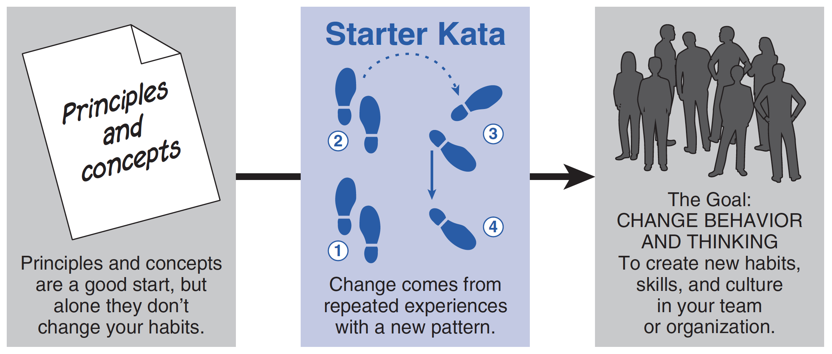
Benefits of Practicing Starter Kata
They help beginners acquire new skill.
They give the coach a point of comparison for gaging a learner’s performance, and for providing corrective feedback and suggestions.
Starter Kata are particularly helpful when you want to create a shared way of thinking and acting in a group of people. Everyone starts with the same basics.
Perhaps most important, Starter Kata help translate theoretical principles and concepts into something real and teachable.

Slide 7

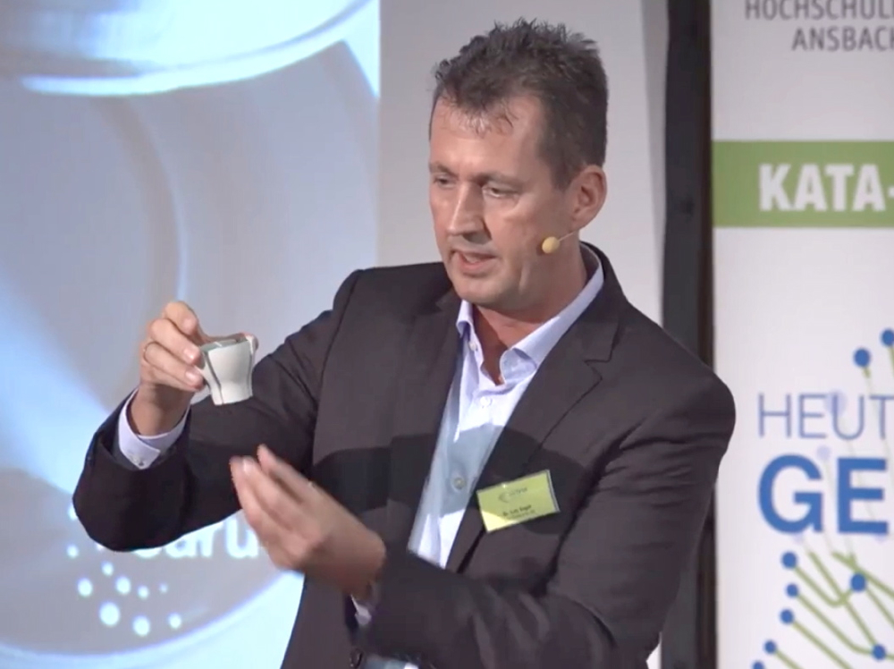

Why Do We Have Kata?
Mastering the Starter Kata is not the goal
The goal is to develop scientific thinking
This manager thinks about how their people think, react, and work together

Slide 8


Two Common Errors With Starter Kata
1. The Permanent Beginner
Doesn’t want to practice Starter Kata, or wants to change them right away.
2. The Implementer
Wants to permanently stick with the structured routine of the Starter Kata, rather than seeing them as an initial step in the process of developing new skills.

Slide 9


If you’re experienced, don’t make this mistake
Don’t overload a beginner with the more advanced stuff you’ve learned. It's too soon. That confuses their initial practice and slows down their learning.
Beginner
Experienced
As we grow more proficient in any skill, we learn and develop our own style and techniques. When a new learner comes along it’s natural to want to share that with them. But it’s too much for the beginner!
Have the next new beginner start with Starter Kata practice routines. Then they can build from there — just like you did.
Starter
Kata
(begin here)
Skills grown
beyond the
Starter Kata
Like
This!
Not
This
NEXT
Beginner

Slide 10
Where Do You Start?
Add some Starter Kata to an existing activity
Adding 1 or 2 of the TK Starter Kata to something you already do is a great way to start. Here are some examples. Resist the temptation to add Starter Kata to several activities at once. Begin with only one activity. See how it goes and what you learn, and adjust. Expand as you gain experience.
In project meetings and daily huddles, use the Five Question Card. Keep an Improvement Kata poster on the wall to serve as a you-are-here map.
If you use the A3 format, add the Experimenting Record to the right side of the A3. This is a missing piece in many A3s.
If you are running some experiments, use the Five Question Card + the Experimenting Record.
If you do improvement events, add the Learner’s Storyboard, the Five Question Card, and the Experimenting Record.
If you do gemba walks, use the Five Question Card at each stop.
To what other existing activities might you add a TK Starter Kata?

Slide 11

Poster
The Four Steps of the Improvement Kata
1
3
Get the Direction or
Challenge
Establish your Next
Target
Condition
2
4
Conduct Experiments
to get there
Grasp the Current
Condition
Notes:
Read through the Four Steps of the Improvement Kata pattern, in numerical order.
Key points to notice:
You don't have to reach the big challenge right away
The path is not predictable or straight
You have to experiment to get to your next goal
Point out the corresponding poster in the room (Poster 1).

Slide 12



THE STARTER KATA
Instructions are in the TKPG and other TK books

Slide 13
The Learner’s Storyboard
FOR THE LEARNER
Start with this board format

Slide 14
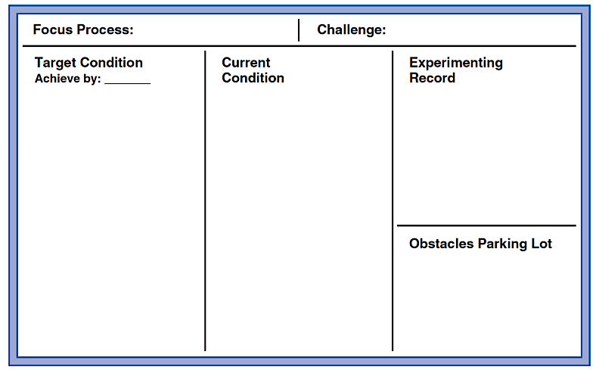
FOR THE LEARNER
Alternative Terminology
Long-term goal
Where we want to be next
Where we are now
Experiments
Obstacles to the target condition

Slide 15
Steps of Process Analysis
FOR THE LEARNER
For grasping the current condition

Slide 16
FOR THE LEARNER
Steps to Establishing a Target Condition
A desired outcome and operating pattern, as your next goalpost

Slide 17
FOR THE LEARNER
Obstacle Parking Lot
The learner updates this by adding & crossing off obstacles

Slide 18
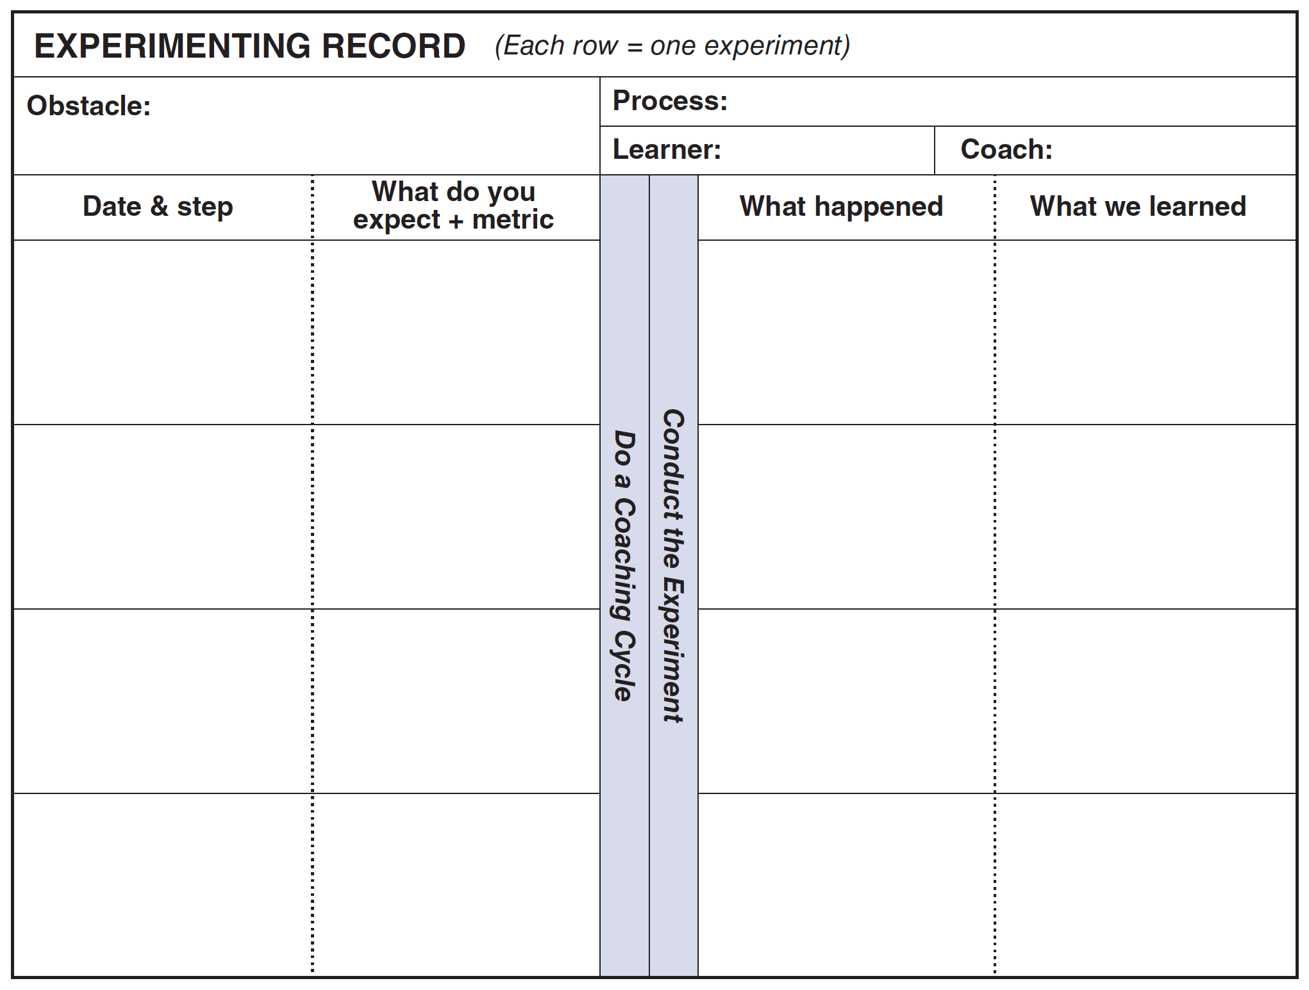
FOR THE LEARNER
Experimenting Record
Conduct experiments against an obstacle

Slide 19
The scientific learning cycle is embedded in the
experimenting record, to make the cycle easy to practice
ACTION
PREDICTION
EVIDENCE
EVALUATE

Slide 20


Layout of the Experimenting Record = one obstacle per form,
one experiment per row. Predict what you expect and compare
that with what actually happens. That’s how you learn.
This is the one obstacle to the target condition that you are currently working on
The prediction side is where you plan the next experiment and predict the outcome
The evidence side is where you record what actually happened, compare that with the prediction, and record what you learned
It often takes a series of experiments
in order to overcome an obstacle

Slide 21

FOR THE COACH
The Five Coaching Kata Questions
A printer / copier 5Q card template is on the next two pages, or you can purchase cards at www.dollarbillcoursepacks.com/products/toyota-kata

Slide 22
Front of card
COACHING KATA
COACHING KATA
COACHING KATA
COACHING KATA

Slide 23
Back of card

Slide 24
FOR THE COACH
Daily Coaching Cycles
With the 5 Questions
- 20 minutes or less -

Slide 25
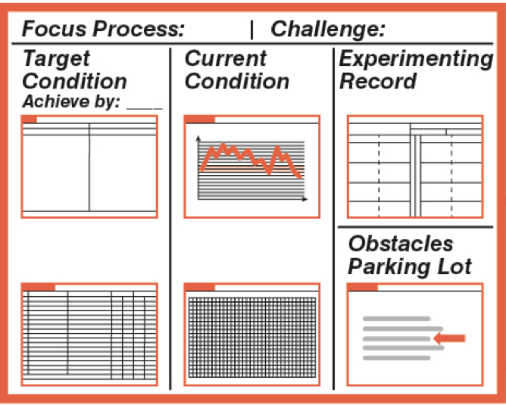

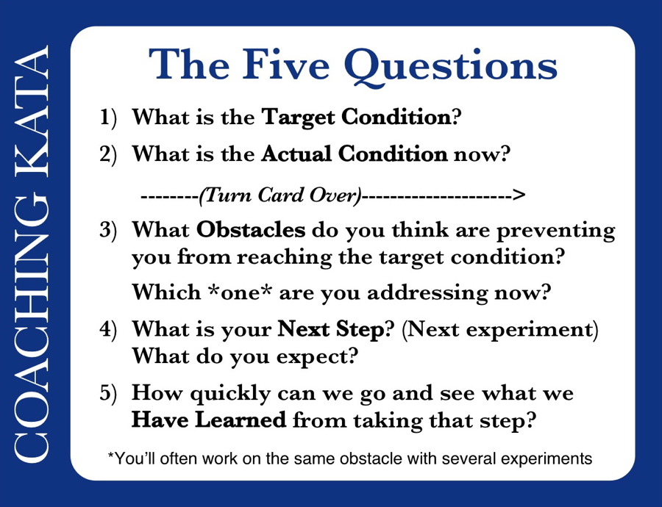
With beginner learners, go through the five
Coaching Kata questions after each step they take
Next
Target
Condition
Learner
Learner's Storyboard
Coaching
Cycle
Dialogue
Current
Condition
Coach
TIP: Identify the learner’s threshold of knowledge
and have them plan their next experiment there.

Slide 26
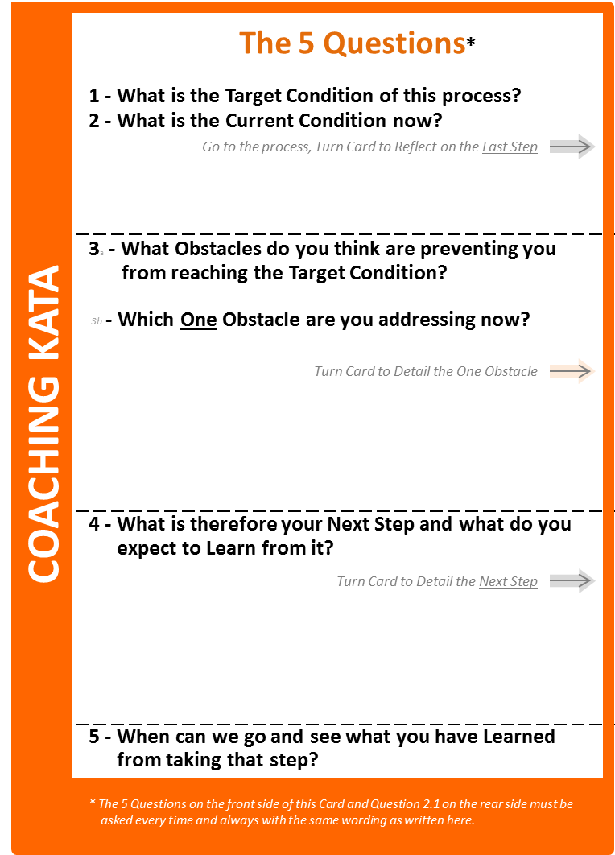


As your coaching abilities grow you should evolve your own coaching style, which includes adding your own deepening questions to the basic five.
Begin with the Starter Kata five-question card. As you get used to the card, start adding notes and your own clarifying questions. One technique is to make a folding card as shown below. The folded card still fits in your pocket, but has space on the right side to jot down notes and test your own questions. The xample notes and clarifying questions here are just thought starters.
The Starter Kata Coaching Questions
Example notes & clarifying questions
1) What is the Target Condition?
• Is the target condition connected to the challenge?
• What do you want to be happening? • No verbs!
• Measureable? • Not 'lack of something' • Achieve-by date?
2) What is the Actual Condition now?
• Numbers, not opinions. • Can you show me? • How do you know? • How did you get the data? • Is there a run chart?
What did you plan as your Last Step?
What did you Expect?
What Actually Happened?
What did you Learn?
• What was being tested?
• Is the PDCA Cycles Record filled in?
REFLECTION
• Was this written down? • Just read it!
• Only facts & numbers. • Are the numbers written down?
• Is there a run chart? • What is different than expected?
• Did the Learner really reflect on this?
3) What Obstacles do you think are preventing you from reaching the target condition?
Which *one* are you addressing now?
• Is the Obstacles Parking Lot up-to-date?
• True obstacles (variation), not action items or lack of a perceived solution.
• Where does this problem occur? • Can you show me?
• When does this problem occur?
4) What is your next step? (Next experiment)
What do you expect?
• What is the current knowledge threshold?
• Did what was learned in the last experiment frame this one?
• Is expectation written down? • Please read it.
• What numerical outcome do you expect?
• How will you measure it?
• How many cycles do you plan to measure?
5) How quickly can we go and see what we Have Learned from taking that step?
• Strive for cheap and fast experiments
• Can we run this experiment today? Right now?
• When is the next coaching cycle?
• Accompany the Learner if necessary.
Card folds here
The underlying pattern of the five Coaching Kata questions should remain!

Slide 27



BEST WISHES
FOR YOUR PRACTICE!
Notes:
- Unable to replicate.
- Knew it was probably in their management system, but that's invisible (even to Toyota).
- Now focus more on 2nd Q

