Slide 1
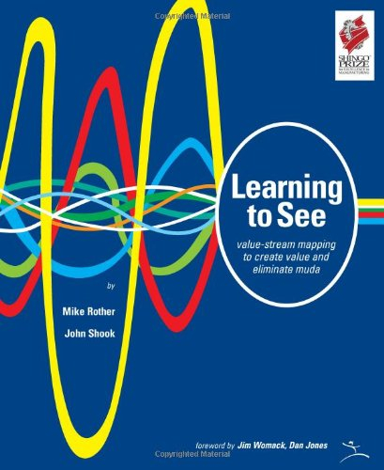
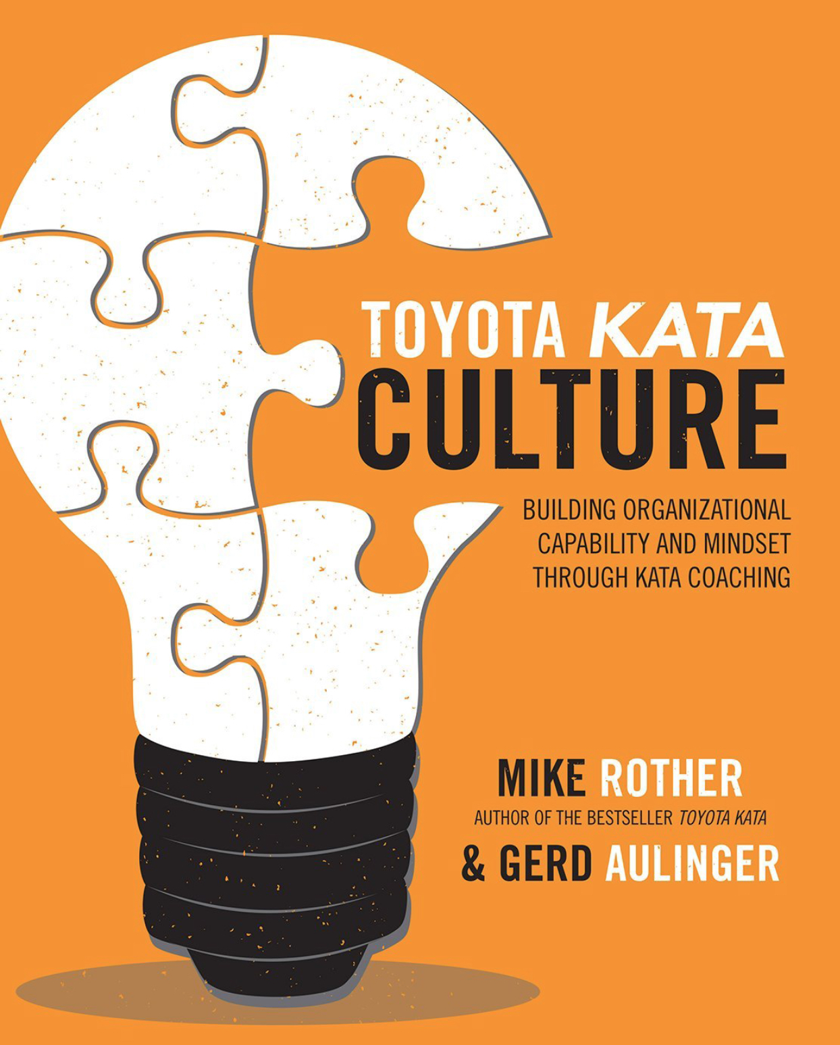
WHAT HAVE WE LEARNED
SINCE LEARNING TO MAP?

Slide 2
A significant area of learning has been how to turn future-state VS maps into reality, rather than wallpaper.

Slide 3
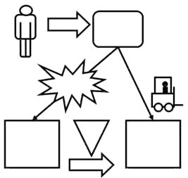
A future-state map provides a
high-level picture of an imagined
material and information flow

Slide 4
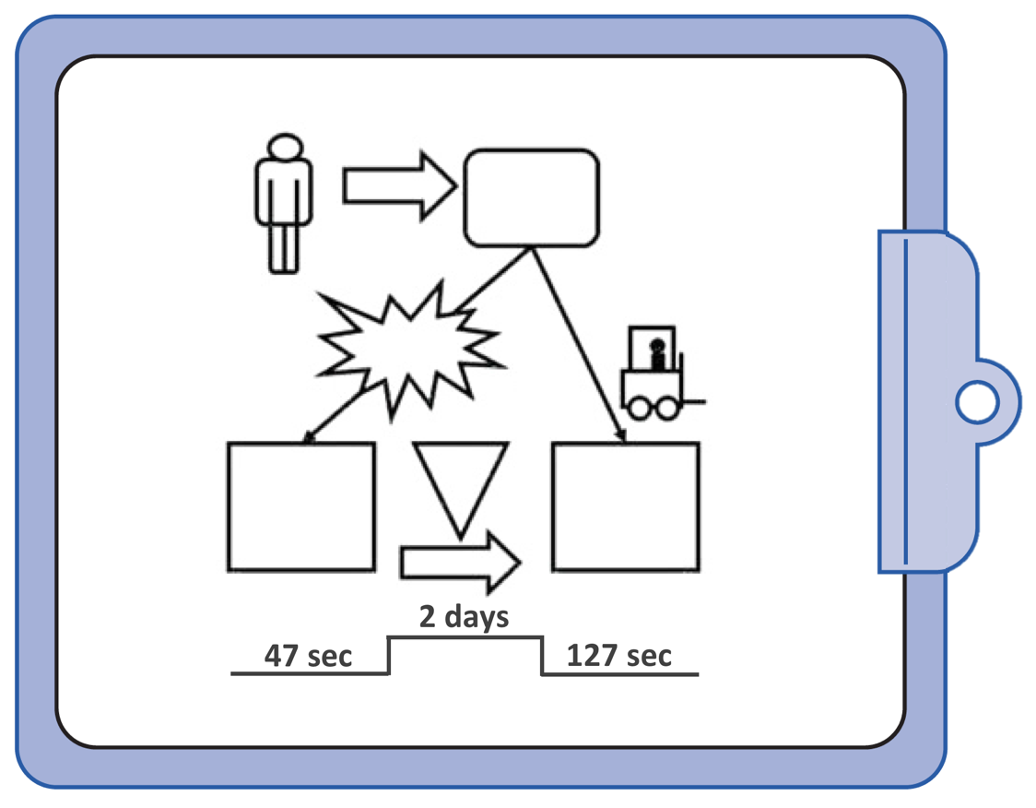
Then What?
Once you’ve drawn a future-state map how do you effectively
handle the effort to move from current to future-state?
New Ways
of Working

Slide 5
Problem #1:
We convert our imagined future into a list of implementation actions. Ironically these action-item lists are made at the point of maximum uncertainty about how the implementation will actually go.
An action list is only a prediction, and a poor
one at that

Slide 6
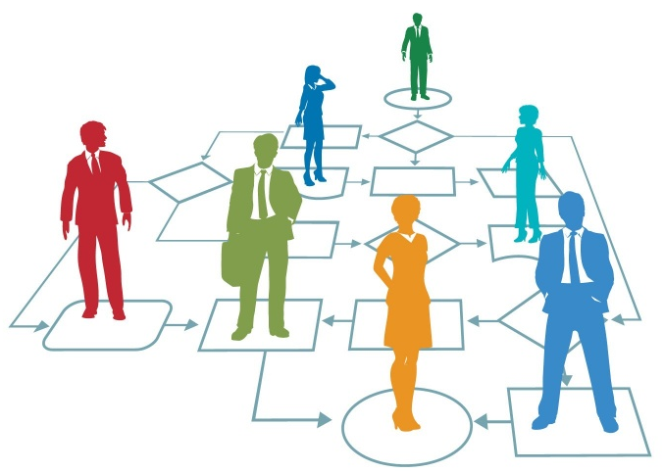
Problem #2:
A value stream design involves multiple
departments, processes and people.
It’s more complicated than modifying a single process.

Slide 7
So Much Can (and will) Go Wrong

Slide 8
What Should You Do?

Slide 9
Apply Scientific Thinking!
What you learn in one step can
influence what you do in the next step
Future
State
Value Stream
Source: Toyota Kata Practice Guide

Slide 10
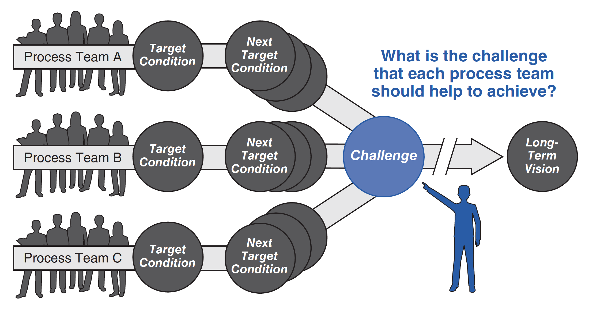
The book Learning to See helps you create a shared picture of delivering customer value
What is the challenge each team should help to achieve?
Challenge

Slide 11
The follow-on book Toyota Kata Culture
shows you how to get there by practicing scientific thinking in your teams
Challenge
Daily dialogs that progressively reveal how to get there.

Slide 12
Lesson Learned
We need both a sense of direction
and to mobilize team scientific-thinking skill

