Slide 1







Fixed-target Drell Yan -- Present & Future
Wolfgang Lorenzon
3D-PDF Workshop, Frascati, Italy
(2-December-2016)
This work is supported by
Notes:
I assume not much has been said about DY this week, so I want to start contrasting DY and SIDIS and highlight some of the advantages that DY has over SIDIS. I then want to focus on the fixed-tgt DY program at SeaQuest and say a few words about the ongoing program at COMPASS and plans at JPARC.

Slide 2
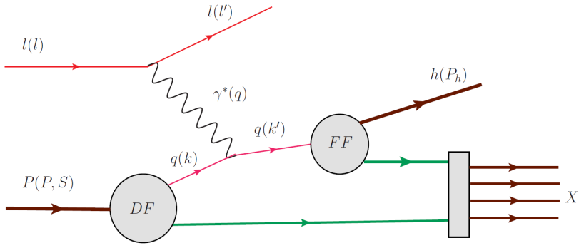
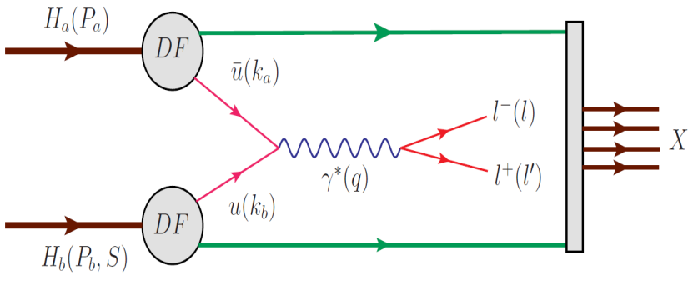
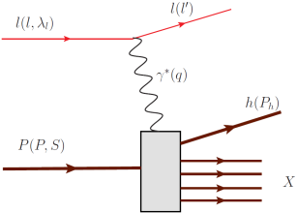
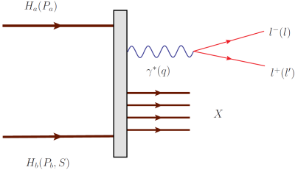
Complementarity between SIDIS and Drell Yan
SIDIS and Drell-Yan have similar physics reach:
  tools to probe quark and antiquark structure of nucleon
  electromagnetic probes
SIDIS (spacelike) Drell-Yan (timelike) virtual photon
credit: A. Kotzinian
Quintessential probe of hadron structure:
  relatively simple to measure and
  calculate
  charge-weighted flavor sensitivity
  QCD final state effects
  fragmentation process
  no quark-antiquark selectivity
Cleanest probe to study hadron structure:
  no QCD final state effects
  no fragmentation process
  production of two TMD parton
  distribution functions
  ability to select sea quark distribution
  hadron beam: σ(DY) / σ(nuclear) ≈ 10⁻⁷
2
Notes:
DY is an interesting process. As you can see in the diagrams for SIDIS and DY, both of these processes are purely leptonic in one half of their hard scattering diagrams. DY has therefore a similar physics reach as SIDIS – which is quite interesting considering that DY is a p-p scattering process. SIDIS has been the principal tool to probe hadron structure, because ……
In fact, DY may be the cleanest probe to study hadron structure: …
The price you have to pay, however, is that the DY cross section is strongly suppressed wrt the hadronic cross section. Special experiments have to be designed, therefore, that can isolate DY events from the vast hadronic background

Slide 3
Factorization and Universality (SIDIS - DY)
SIDIS DY
PDF
FF
credit: A. Kotzinian
PDF
PDF
Probe Universality
are TMD PDFs in SIDIS identical to TMD PDFs in DY?
Test using unpolarized experiments, transverse SSA and DSA
Notes:
Assuming factorization is valid in QCD, Drell-Yan can be written as a hard scattering process, and the direct production of two transverse momentum-dependent (TMD) distribution functions (Sivers, Boer-Mulders, etc); and SIDIS allows to measure convolution of DF with FF.
A central question is whether TMDs in SIDIS are the same as TMDs in DY. While there are good theoretical arguments why this should be true in some cases, but not in others, ultimately, experiment will have to tell.

Slide 4
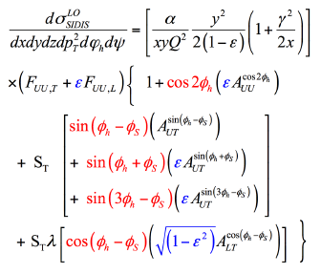
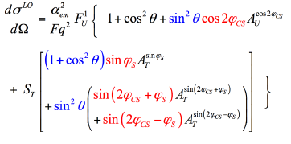
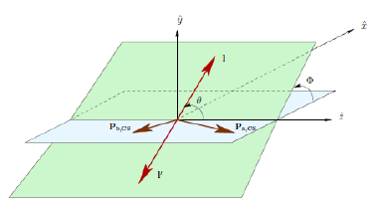
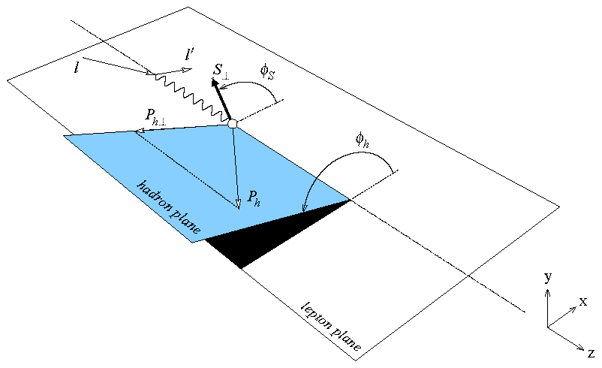
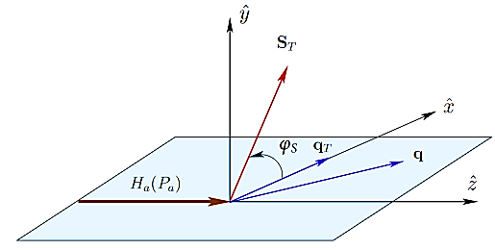
LO SIDIS and single polarized DY cross sections
SIDIS DY
Measure magnitude of
azimuthal modulations in
cross section:
“Single Spin Asymmetries”
credit: M. Chiosso & B. Parsamyan
Collins-Soper frame
(ie. dimuon c.m. frame)
target rest frame
target rest frame
Notes:
It turns out that TMDs are most cleanly accessed via the azimuthal distributions of the final state products of the SIDIS and DY processes with polarized beams and/or targets. Shown here are the LO SIDIS and single pol DY x-sections.
In SIDIS there are two angles of relevance Phi_S and Phi_h, and
for DY there are three: the azimuthal angle Phi_s of the transverse spin orientation of beam (determined in tgt rest frame), and
the polar and azimuthal angles theta and phi_CS of the dimuon pair (determined in C-S frame, ie. dimuon c.m. frame)
So what you do is, you measure the magnitude of azimuthal modulations in the cross section to obtain the asymmetry amplitudes

Slide 5
LO SIDIS and single polarized DY cross sections
SIDIS DY
beam target
BM CF
Sivers FF
Transv CF
Pretz CF
BM BM
f₁ Sivers
BM Transv
BM Pretz
within QCD TMD framework:
Notes:
It is the asymmetry amplitudes which contain the information regarding the TMDs. They are proportional to convolutions of PDFs & FFs in SIDIS and of two PDFs in DY. Shown here are 4 asymmetry amplitudes and their relation to 4 leading twist TMDs. So, again, a central question is whether the PDFs in SIDIS and DY are the same.
Well, w/in the QCD TMD framework, it is predicted that the first two (BM and Sivers) change sign, while the last two (Transv and Pretz) do not.

Slide 6
Drell Yan Advantage
Complementarity is emphasized by (LO): (Arnold,Metz,Schlegel:PRD79,034005(2009))
  in SIDIS: there is 1 F_{U(L),T} per TMD
  in DY: at least 2 F_{(U)T} per TMD
  → same TMDs can be measured in different F_{(U)T}
  → allowing cross checks of TMD extraction
  & even of underlying formalism
beam target
BM CF
Sivers FF
Transv CF
Pretz CF
BM BM
f₁ Sivers
BM Transv
BM Pretz
Notes:
Complementarity is emphasized by the fact in SIDIS there is, at leading twist, one structure function per TMD, while in DY, there are at least two structure functions per TMD. This means that the same TMDS can be measured in different structure functions, allowing to perform cross checks of the TMD extraction and even the underlying formalism.

Slide 7
Complementarity between SIDIS and Drell Yan
Complementarity is emphasized by (LO): (Arnold,Metz,Schlegel:PRD79,034005(2009))
  in SIDIS: there is 1 F_{U(L),T} per TMD
  in DY: at least 2 F_{(U)T} per TMD
  → same TMDs can be measured in different F_{(U)T}
  → allowing cross checks of TMD extraction
  & even of underlying formalism TMD
Systematic study of quark TMDs in Drell Yan
  requires double-polarization
  only then can all 8 leading twist TMD be measured
Double-Spin Drell Yan
  Measure DY with both Beam and Target polarized
    broad spin physics program possible
    truly complementary to spin physics programs at Jlab and RHIC
Notes:
A systematic study of quark TMDs in DY requires double polarization. Only in that case can all 8 leading twist TMDs be measured.
Having both a polarized beam and a polarized target would allow measurement of a variety of double-spin observables, thus opening up opportunities for a very rich spin physics program, which would be complementary to those at RHIC and Jlab.

Slide 8
(Un)Polarized Drell Yan Experiments
Experiment | Particles | Energy (GeV) | x_{b} or x_{t} | Luminosity (cm⁻² s⁻¹) |  | P_{b} or P_{t} (f) | rFOM# | Timeline
COMPASS (CERN) | π⁻ + p↑ | 160 GeV √s = 17 | x_{t} = 0.1 – 0.3 | 2 x 10³³ | 0.14 | P_{t} = 90% f = 0.22 | 1.1 x 10⁻³ | 2015-2016, 2018
PANDA (GSI) | p + p↑ | 15 GeV √s = 5.5 | x_{t} = 0.2 – 0.4 | 2 x 10³² | 0.07 | P_{t} = 90% f = 0.22 | 1.1 x 10⁻⁴ | >2018
PAX (GSI) | p↑ + p | collider √s = 14 | x_{b} = 0.1 – 0.9 | 2 x 10³⁰ | 0.06 | P_{b} = 90% | 2.3 x 10⁻⁵ | >2020?
NICA (JINR) | p↑ + p | collider √s = 26 | x_{b} = 0.1 – 0.8 | 1 x 10³¹ | 0.04 | P_{b} = 70% | 6.8 x 10⁻⁵ | >2020?
J-PARC (high-p beam line) | π⁻ + p | 10-20 GeV √s = 4.4-6.2 | x_{b} = 0.2 – 0.97 x_{t} = 0.06 – 0.6 | 2 x 10³¹ | --- | --- | --- | >2019? under discussion
fsPHENIX (RHIC) | p↑ + p↑ | √s = 200 √s = 510 | x_{b} = 0.1 – 0.5 x_{b} = 0.05 – 0.6 | 8 x 10³¹ 6 x 10³² | 0.08 | P_{b} = 60% P_{b} = 50% | 4.0 x 10⁻⁴ 2.1 x 10⁻³ | >2021
SeaQuest (FNAL: E-906) | p + p | 120 GeV √s = 15 | x_{b} = 0.35 – 0.9 x_{t} = 0.1 – 0.45 | 3.4 x 10³⁵ | --- | --- | --- | 2012 - 2017
Pol tgt DY‡ (FNAL: E-1039) | p + p↑ | 120 GeV √s = 15 | x_{t} = 0.1 – 0.45 | 4.4 x 10³⁵ | 0 – 0.2* | P_{t} = 85% f = 0.176 | 0.15 | >2018
Pol beam DY§ (FNAL: E-1027) | p↑ + p | 120 GeV √s = 15 | x_{b} = 0.35 – 0.9 | 2 x 10³⁵ | 0.04 | P_{b} = 60% | 1 | >2020
‡ 8 cm NH₃ target / § L= 1 x 10³⁶ cm⁻² s⁻¹ (LH₂ tgt limited) / L= 2 x 10³⁵ cm⁻² s⁻¹ (10% of MI beam limited) *not constrained by SIDIS data / # rFOM = relative lumi * P² * f² wrt E-1027 (f=1 for pol p beams, f=0.22 for π⁻ beam on NH₃)
W. Lorenzon (U-Michigan) 7/2016
Notes:
There is interest in DY at a number of laboratories. Here is a list of experiments either being conducted or planned to measure pol or unpol DY with a variety of beams and targets. At present only COMPASS has collected pol DY data, and we are eagerly awaiting the results from COMPASS on the sign change. Although a lot of information is provided on this list, let me focus on two points:
Running DY w/ a primary beam in fixed tgt mode (SeaQuest) has a huge advantage over running with a secondary beam in fixed tgt mode (COMPASS) or with a primary beam in collider mode (RHIC-fsPHENIX), where you get a penalty of a factor of ~1000 in rFOM. 1 day at FNAL corresponds to 3 years at COMPASS or RHIC
SeaQuest is sensitive to the interaction of valence quarks and sea anti-quarks, while COMPASS measures interaction of valence quarks and valence antiquarks, and is not sensitive to sea anti-quarks. Thus we have to go beyond COMPASS to do pol DY to learn about sea (anti)quarks
These points highlight specific strengths of Fermilab, making SeaQuest is the natural place to measure (pol) DY. It is also the only place that is collecting DY data right now. So let’s discuss the program at SeaQuest

Slide 9
Current and Future DY Program at FNAL
Unpolarized Beam and Target w/ SeaQuest detector
E-906: 120 GeV p from Main Injector on LH₂,LD₂, C,Fe,W targets → high-x Drell Yan
Science run: March 2014 - July 2017
  2015 data set: preliminary results
Polarized Beam and/or Target w/ SeaQuest detector
  → development of high-luminosity facility for polarized Drell Yan
E-1039: SeaQuest w/ pol NH₃/ND₃ targets (2018-2019?)
  probe sea quark distributions
E-1027: pol p beam on (un)pol tgt (2020-2021?)
  Sivers sign change (valence quark)

Slide 10
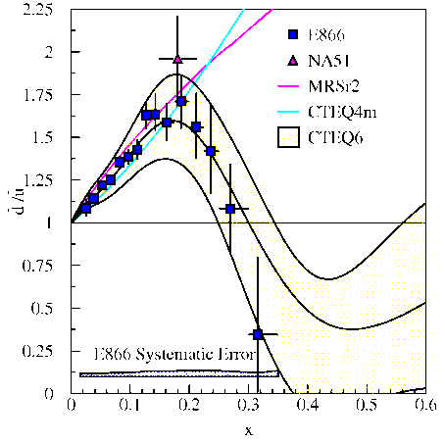
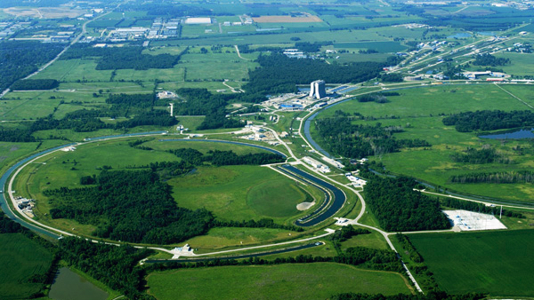
SeaQuest Experiment
Fixed Target Beam lines
Tevatron 800 GeV
Main Injector 120 GeV
10% of available beam to SeaQuest / 90% to neutrino program

Slide 11
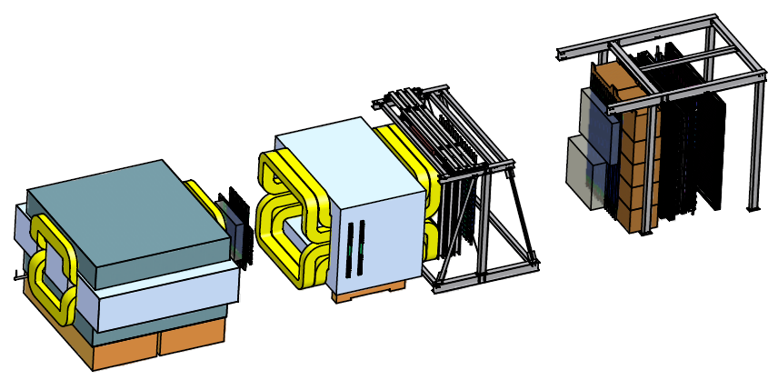
SeaQuest Spectrometer
Station 4:
Hodoscope array
Prop tube tracking
Station 2 and 3:
Hodoscope array
Drift Chamber tracking
Station 1:
Hodoscope array
MWPC tracking
Solid Iron Focusing Magnet, Hadron absorber and beam dump
Mom. Meas.
(KTeV Magnet)
4.9m
Hadron Absorber
(Iron Wall)
Liquid H₂, D₂, and solid targets (Fe, C, W)
25m
Drawing: T. O’Connor and K. Bailey

Slide 12
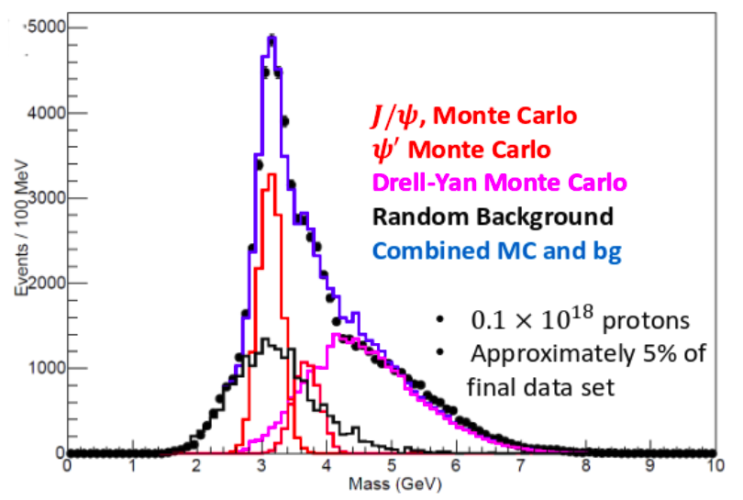
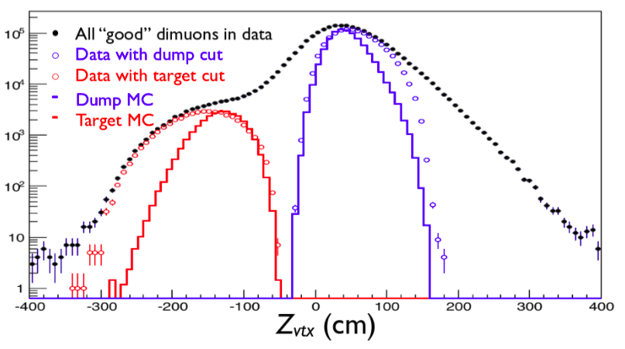
Event Selection & Reconstruction
Monte Carlo describe data well
Resolution better than expected
  σ_{M}(J/ψ ) ~180 MeV
  σ_{M}(D-Y ) ~220 MeV
  J/ψ to ψ’ separation
  lower J/ψ mass cut (more Drell-Yan
  events)
good Target/Dump separation
pointing resolution poor along beam axis
dominated by random coincidences
Notes:
Combinatorial bkg by random event mixing
Remarks of top plot:
• Very tight event multiplicity cuts
• Very tight analysis cuts too

Slide 13
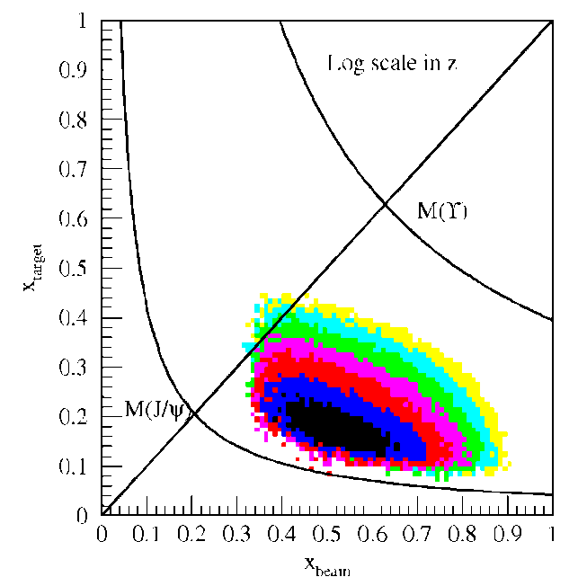

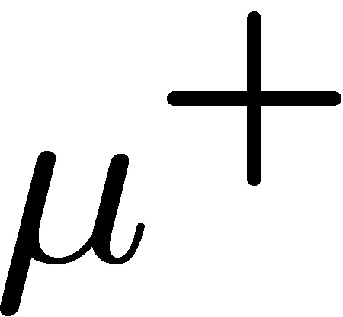

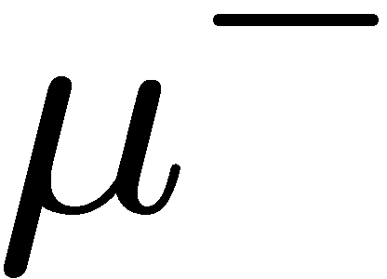
Fixed Target Drell-Yan: Sensitivity to sea quarks
Drell-Yan Spectrometer for E906
x_{target}
E906 spect.
acceptance
Cross section: convolution of beam and target parton distributions
x_{beam}
  beam: valence quarks at high x
  target: sea quarks at low/intermediate x
u-quark dominance
  (2/3)² vs. (1/3)²
acceptance limited
(Fixed Target, Hadron Beam)
Notes:
Sensitivity of D-Y process to anti-quark distribution of target or beam become clear from examining diff. cross section
At large x, parton distributions are dominated by valence quarks, at small x by sea quarks.
So in limit of large x_b and small x_t, cross section is dominated by first term -> providing direct sensitivity to antiquark sea of target nuclei

Slide 14
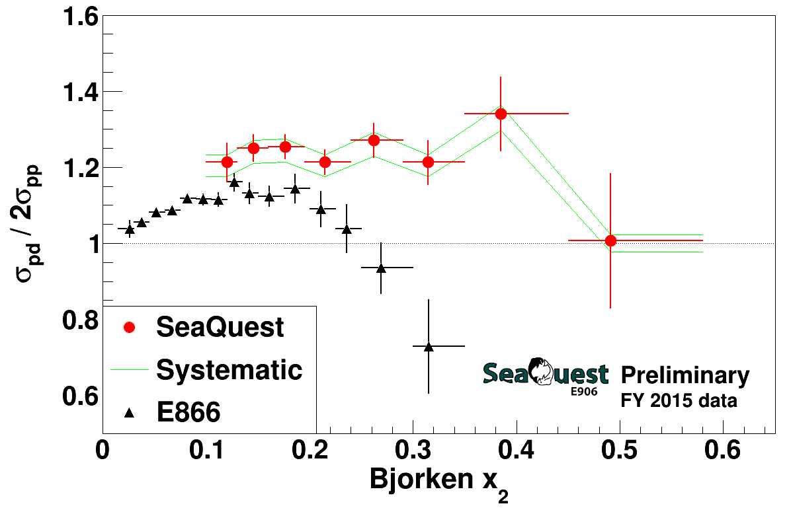
different kinematics and Q² for E866 & SeaQuest data sets
new chambers installed in March 2016: improve acceptance in high x₂ region
30% of anticipated data (~1.2 × 10¹⁸ pot)
approved for 5 × 10¹⁸ pot

Slide 15
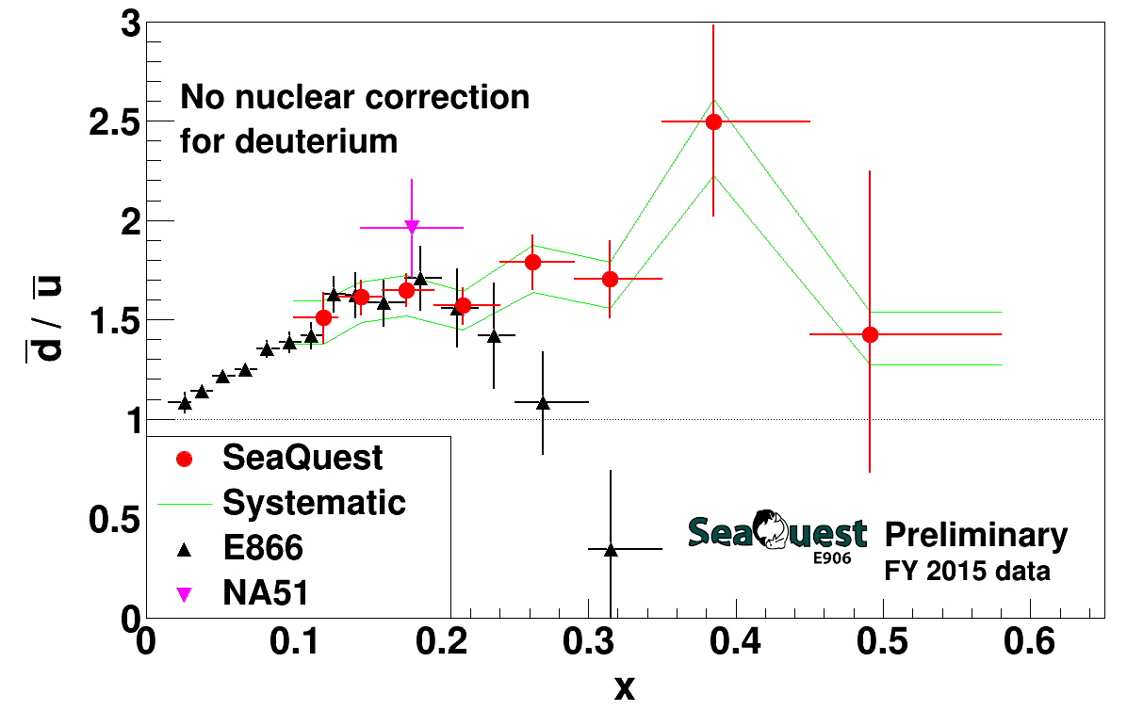
SeaQuest Leading Order extraction (2015 Data Set)
E866 data is for Q² = 54 GeV² while SeaQuest data has Q² ≈ 29 GeV²
  difference should be insignificant
no nuclear correction for deuterium
  expected larger at higher x, but still small compared to error bars
is there disagreement at high x?

Slide 16
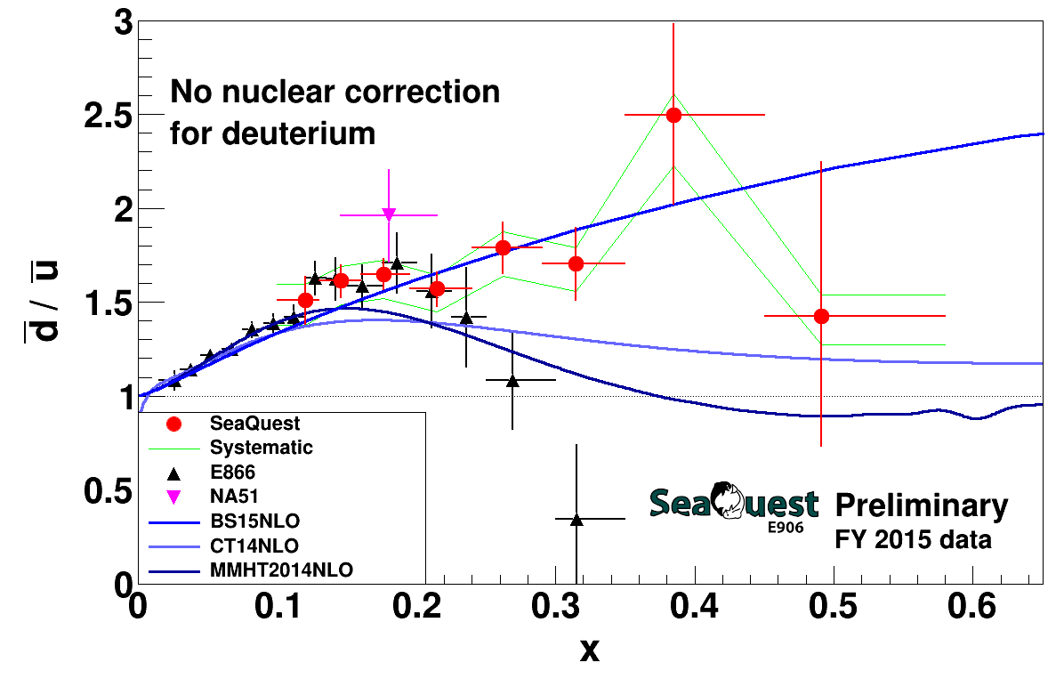
SeaQuest Leading Order extraction (2015 Data Set)
BS15 (statistical model) calculated using parameters from NPA941(2015)307
CT14 and MMHT2014 calculated with the LHAPDF library
PDF scales taken as 29 GeV²
Notes:
Note: BS15 PDF were calculated using the QCD evolution program which evolves PDFs in the moment space, not in x-space. It is required that the initial PDF must be "analytically" Mellin transformed. It is satisfied at least for the BS15 unpolarized sector.
BS15 at Q=1,29,100 GeV^2 are compared in the attachment GS15.png, as done in NPA948(2916)63. The calculated pdfs seem to be consistent with one in NPA948(2016)63.

Slide 17
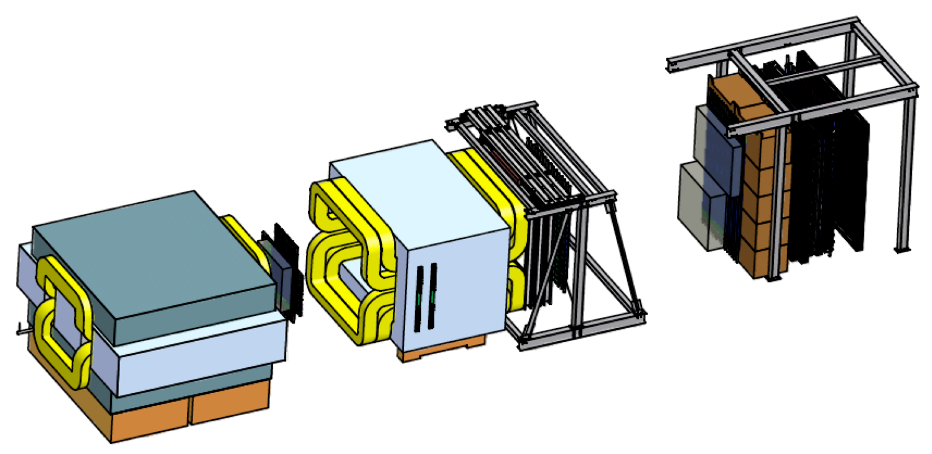
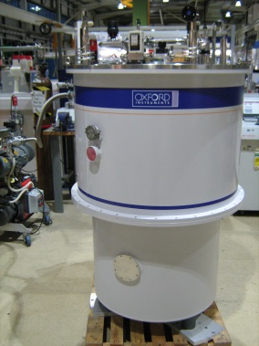
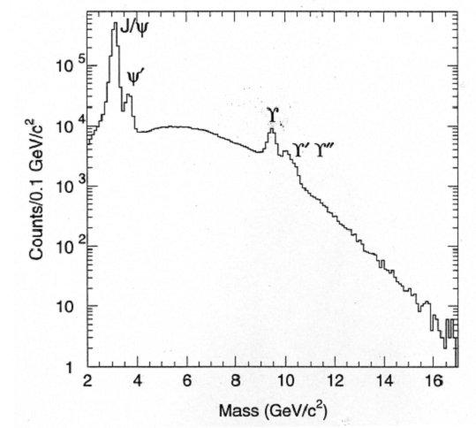
Let’s Add a Polarized Target (E-1039)
ST2
Polarized
Target
ST1
KMAG
B-Field
FMAG
μ⁺
ST3
ST4
x
y
μ⁻
E906 Spectrometer
x
Proton Beam
120 GeV/c
2.7∙10¹² p/spill, one 4s spill/minute
kinematic range 4 < M <9 GeV
luminosity: 3∙10³⁵ /cm²/s (NH₃)
√s = 15 GeV
move polarized target ~2m upstream
→ improves target-dump separation
→ moves acceptance to lower x₂
E866
L_{int} = 1.82 *10⁴²/cm² NH₃ / 2.11 *10⁴²/cm² ND₃ for 2 years
Ref: Andi Klein (LANL)
17

Slide 18
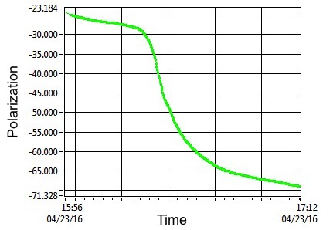
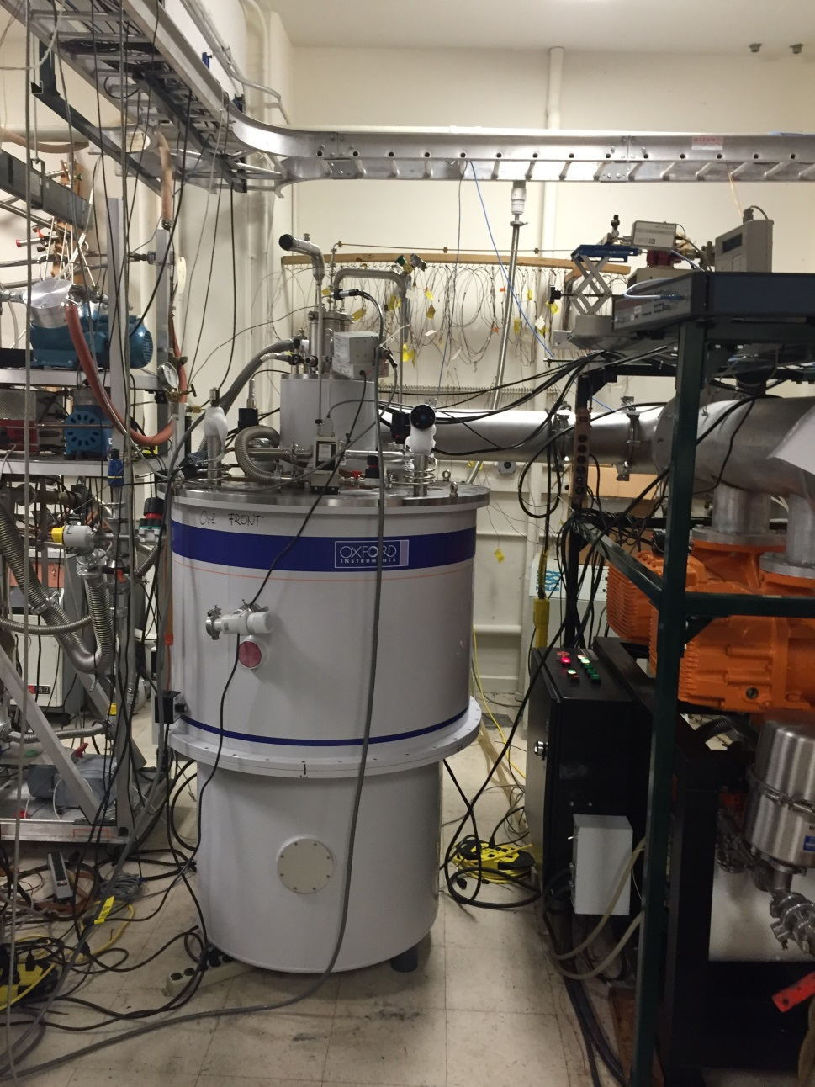
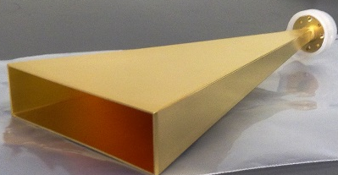
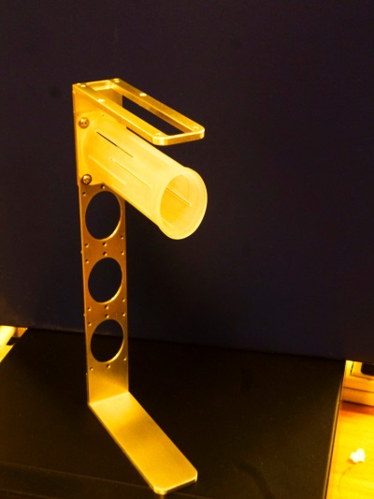
The Polarized Target
field: 5T @ 1K
elliptical: 1.9 cm x 2.1 cm (x,y), l:7.9 cm (z)
ρ: 0.87 g/cm³ NH_{3 ,} 1 g/cm³ ND₃
packing fraction: 0.6
dilution factor : 0.176 , 0.3
Polarization <80%>, <32%>
IL: 8.6%, 9.5%
3 active cells, 1 empty
Helium consumption 100 l/day
NH₃
ND₃
Ref: Andi Klein (LANL)
18
Notes:
green pol curve maxes out at ~71% b/c microwave horn irradiated only portion of tgt, while NMR coil sampled entire tgt.
71% is average polarization of entire tgt, but irradiated region is >90%

Slide 19
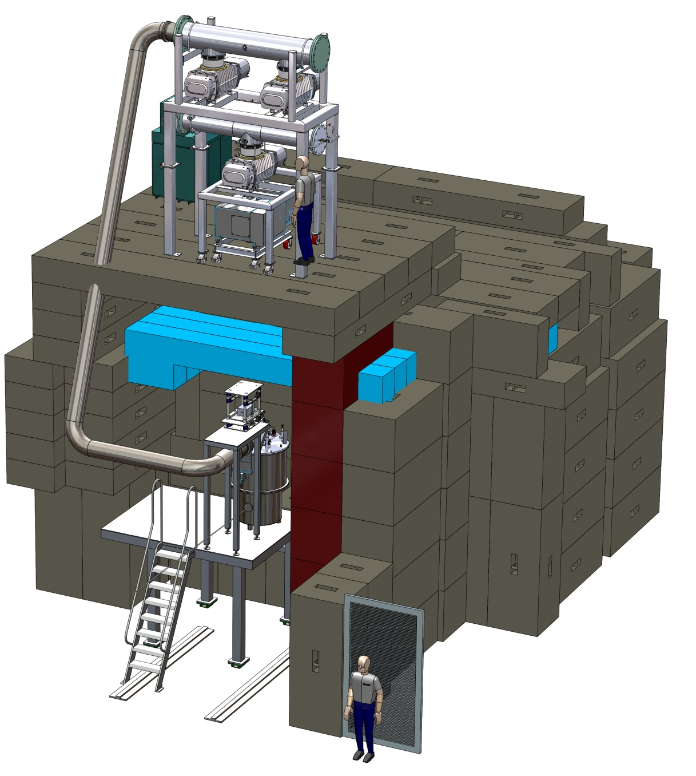
The E1039 Target and FMAG
Changes needed :
Collimators upstream
Closed Loop He system
90 degree monitors L/R, T/B
Beam
σ_{x}=17mm, σ_{y}=19mm
Target upstream by ~200cm
moves acceptance to lower x₂
better target – dump separation
Ref: Andi Klein (LANL)
19

Slide 20
Projected Statistical Precision with a Polarized Target at (E-1039)
Probe Sea Quark Sivers Asymmetry
with a polarized proton/deuteron target at SeaQuest
existing SIDIS data poorly constrain
sea-quark Sivers function (Anselmino)
significant Sivers asymmetry expected
from meson-cloud model (Sun & Yuan)
first Sea Quark Sivers Asymmetry Measurement
determine sign and value of and Sivers distribution
If A_{N}≠0, major discovery: “Smoking Gun” evidence for
Statistics shown for two calendar years of running:
target = NH₃ / ND₃
L = 1.82 *10⁴² /cm² / 2.11*10 ⁴² /cm²
P = 80% / 32%
Ref: Andi Klein (LANL)

Slide 21
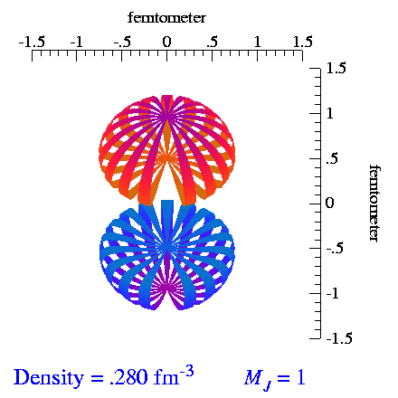
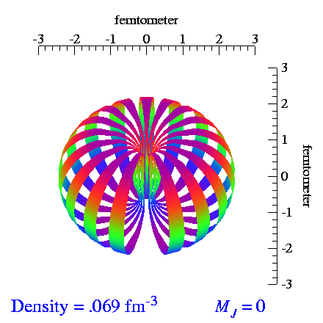
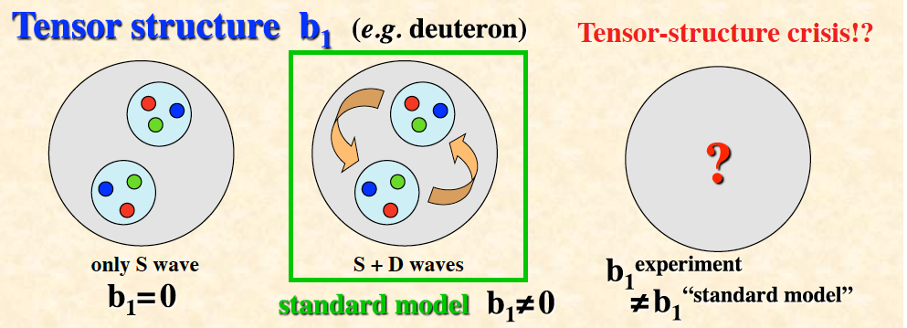
Tensor Polarization of Deuteron
deuteron is spin 1 particle, opens up new physics
spin-1 system in a B-field leads to
3 sublevels via Zeeman interaction
Vector polarization: (n ⁺ - n ⁻); -1 < P_{z} < +1
Tensor polarization: (n ⁺ - n⁰) – (n⁰ – n ⁻); - 2 < P_{zz} < +1
Normalization: (n ⁺ + n ⁻ +n⁰) = 1
From S. Kumano, arxiv.org/1606.03149
21
Notes:
Tensor-polarization asymmetries A_Q.
Very interesting since it means that b1 not only depends on the parton distributions but also on the relative alignment of the two nucleons. Bridge between nuclear and particle physics. Why should there be an asymmetry on the quark level depending on the spin of the nucleons they are embedded in. Why should the quarks be concerned about the coupling of the spin of the two nucleons.
The dashed curves are for the set-1 without antiquark tensor polarization at the initial scale (Q 2 = 2.5 GeV2 ), the solid curves indicate the set-2 results
Set 1: There is no antiquark tensor polarization at the scale Q^2_0 (alpha_ q¯ = 0).
Set 2: There could be finite antiquark tensor polarization at the scale Q^2_0 (alpha_ q¯ is a free parameter).

Slide 22
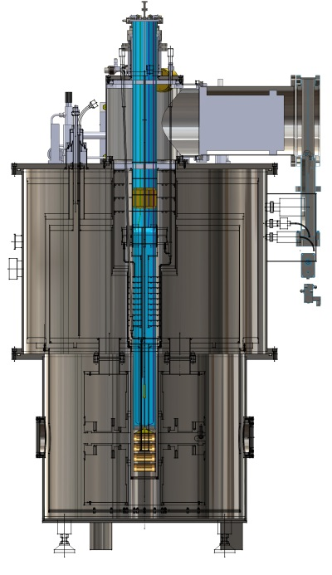
Current Status and Plans for E-1039
Progress
  magnet system is finished and working
  refrigerator is finished and tested (at 1K)
  NMR system is finished and working
  mechanical design completed
  partial systems test performed in April 11-22, 2016
Current status
  full system cooldown/test with full extended 8cm long target
  also for the first time measure three coil NMR
Funding
  DoE has requested formal proposal for E-1039 support (out for review)
  Expect go-ahead in January 2017
Plans
  ready to start installation in summer 2017 (if green light from DoE)
  take beam in early 2018

Slide 23
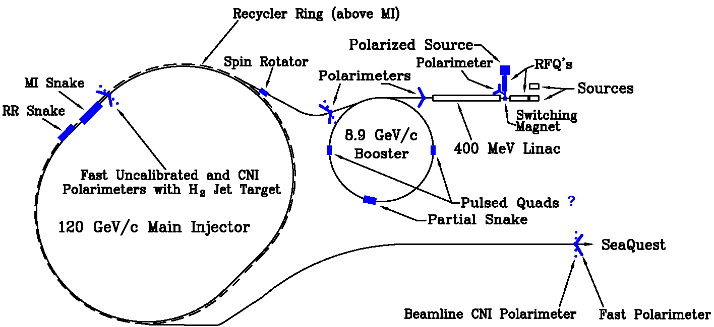

Let’s Polarize the Beam at Fermilab (E-1027)
The Plan:
Use fully understood SeaQuest Spectrometer
Add polarized beam
Measure sign-change in Sivers Function:
  QCD (and factorization) require sign change
  major milestone in hadronic physics (HP13)
Fermilab (best place for polarized DY):
  very high luminosity, large x-coverage (primary beam, fixed target)
Cost Est.: $6M +$4M Contingency & Management = $10M (in 2013)

Slide 24
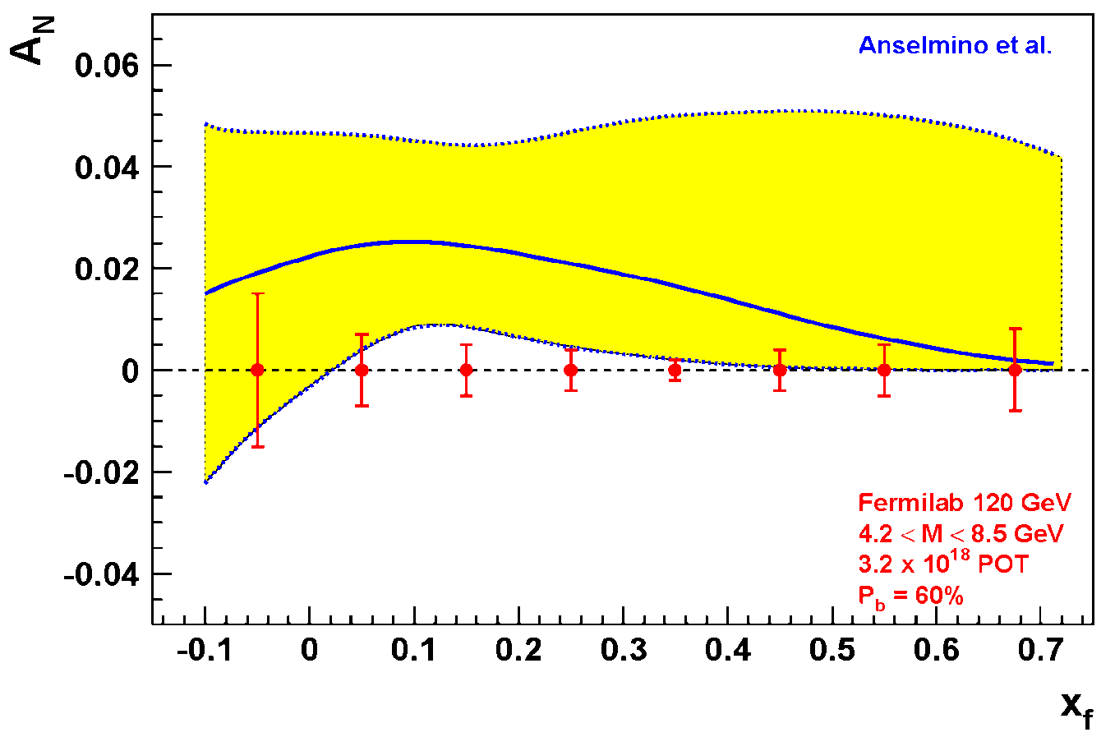
Expected Precision from E-1027 at Fermilab
Probe Valence Quark Sivers Asymmetry with a polarized proton beam at SeaQuest
1.3 Mio
DY events with no dilution
Experimental Conditions
  same as SeaQuest
  luminosity: L_{av} = 2 x 10³⁵ (10% of available beam time: I_{av} = 15 nA)
  3.2 X 10¹⁸ total protons for 5 x 10⁵ min: (= 2 yrs at 50% efficiency) with P_{b} = 60%
Can measure not only sign, but also the size & probably shape of the Sivers function!
as well as TMD evolution!
Notes:
Note that SSA A_N (measured left-right asymmetry) is related to Sivers SSA amplitude (provided in the TMD predictions) by 2/pi. So the red curve is scaled down by factor 2/pi relative to the prediction of Anselmino’s groups
1.3 Mio DY events, error<1% for all points except lowest xf

Slide 25
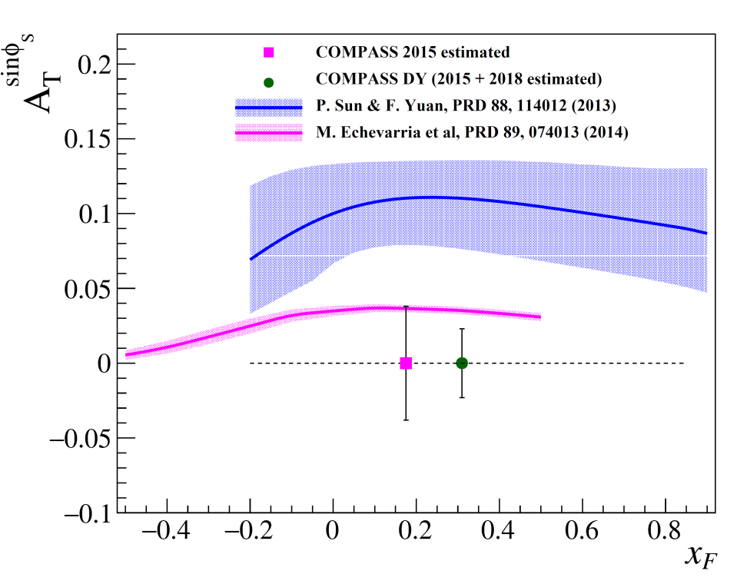
COMPASS Projection & Plans
  COMPASS: 190 GeV π⁻ beam on transverse polarized H target (NH₃)
  first year of polarized running completed
  2015 data ~120 days
  Transverse target polarization ~80%
estimated Statistics
  DY events [M(μ⁺μ⁻) > 4 GeV/c²): ~80,000
  J/ψ events: ~2,000,000
analysis on 2015 DY data underway
First physics results: late 2016
2018: second year of polarized DY planned
(to be approved)
COMPASS statistical significance after one/two years of running for M_{γ} > M_{J/Ψ}
COMPASS Beyond 2020 (under study: https://indico.cern.ch/event/502879/)
  consider running with radio separated kaon/anti-proton beam for DY and spectroscopy
  improve significantly our knowledge of pion and kaon PDFs
  detailed study of the fundamental Lam-Tung relation violation
  Gluon TMDs ?
Ref: M. Chiosso & Oleg Denisov & Bakur Parsamyan (Torino)

Slide 26
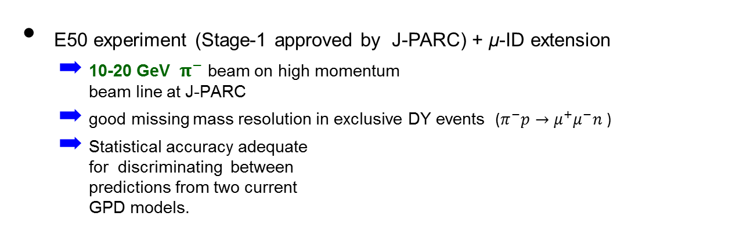
J-PARC Projection & Plans
T. Sawada et al., PRD 93, 114034 (2016)
  Accessing GPD of nucleon via exclusive meson-induced Drell-Yan
  Test of factorization of exclusive Drell-Yan process
  Test of universality of GPD in space-like (DVMP) and time-like processes (DY).
Space-like approach: JLAB, HERMES, COMPASS
Time-like approach: J-PARC
E50 experiment (Stage-1 approved by J-PARC) + μ-ID extension
  10-20 GeV ${ π}^{−}$beam on high momentum
  beam line at J-PARC
  good missing mass resolution in exclusive DY events ($π^{−}p→μ^{+}μ^{−}n$ )
  Statistical accuracy adequate
  for discriminating between
  predictions from two current
  GPD models.
P_{π} = 10 GeV
GK2013 (red)
BMP2001 (black)
M_{X} (GeV)
GK2013: P. Kroll et al. Eur.Phys.J.C73, 2278 (2013)
BMP2001: E.R. Berger et al. Phys.Lett.B523, 265 (2001)
|t - t₀| (GeV²)
Ref: T. Sawada (Acad. Sinica)
Notes:
The parametrization of H^{~} in "GK2013" is determined by the HERMES's experiment result on the cross sections and the target asymmetries for pi^+ electro-production.
The pion distribution amplitudes for the parametrization of E^{~} in "GK2013" has the term to match the sharp rise of the pi gamma transition form factor with Q^2 observed in the Babar experiment. This term doesn't exist in "BMP2001".
References for "BMP2001":
ER Berger, M Diehl, B Pire
E.R.Berger et al. Phys.Lett.B523,265(2001)
E.R.Berger et al. Eur.Phys.J.C23,675(2002)
Reference for "GK2013":
P Kroll, H Moutarde, F Sabatie
P.Kroll et al. Eur.Phys.J.C73,2278(2013)

Slide 27
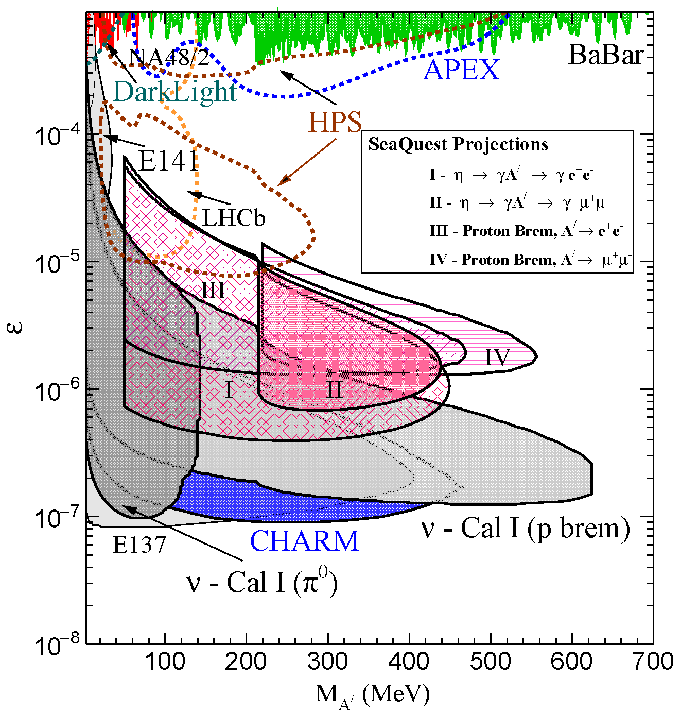
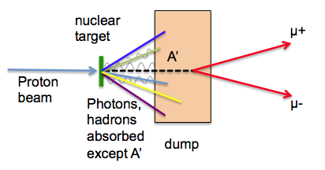
Search for Dark Photons at SeaQuest
Classic Beam Dump Experiment
Minimal impact on Drell-Yan program
  run parasitically during E906
SeaQuest experimental parameters:
  E₀ = 5 - 110 GeV for Proton Bremsstrahlung
  N_{eff} = 2
  l₀ = 0.17m – 5.95m
J. D. Bjorken et al, PRD 80 (2009) 075018
Notes:
95% C.I. assuming 10 events during a 200 day search (@ 30% efficiency), and no decays of the A’ to the invisible sector
Changing either the p beam energy or the length of the iron beam dump can extend the sensitivity of SeaQuest

Slide 28
Conclusions
There is an exciting Drell Yan program with polarized/unpolarized beams and targets underway
  although experimentally more challenging, it has some clear
  advantages over SIDIS
Future opportunities look very promising
  support from hadronic community vital to move forward
We are eagerly awaiting results from COMPASS on the sign-change
  later this year? or early next year?
Hope to answer some of the questions:
  How much do the quarks and gluons contribute to the nucleon
  spin?
  In particular, what is the role of the sea quarks?
  Is there significant orbital angular momentum?
  Does TMD formalism work? Does Sivers function change sign?

Slide 29
Thank You

Slide 30
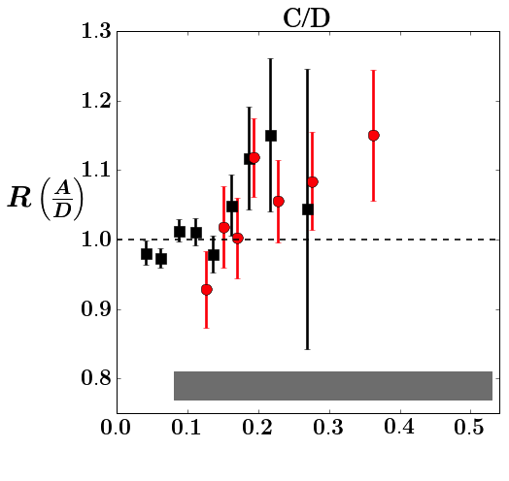
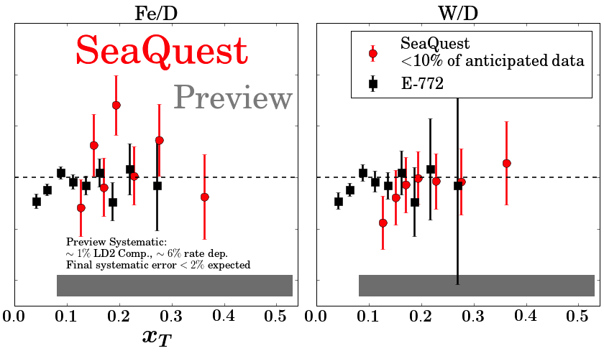
SeaQuest Nuclear Dependence (Preview)
no antiquark enhancement apparent
10% of anticipated statistical precision
increased detector acceptance at large-x_{T} to come (new D1 chamber)

Slide 31
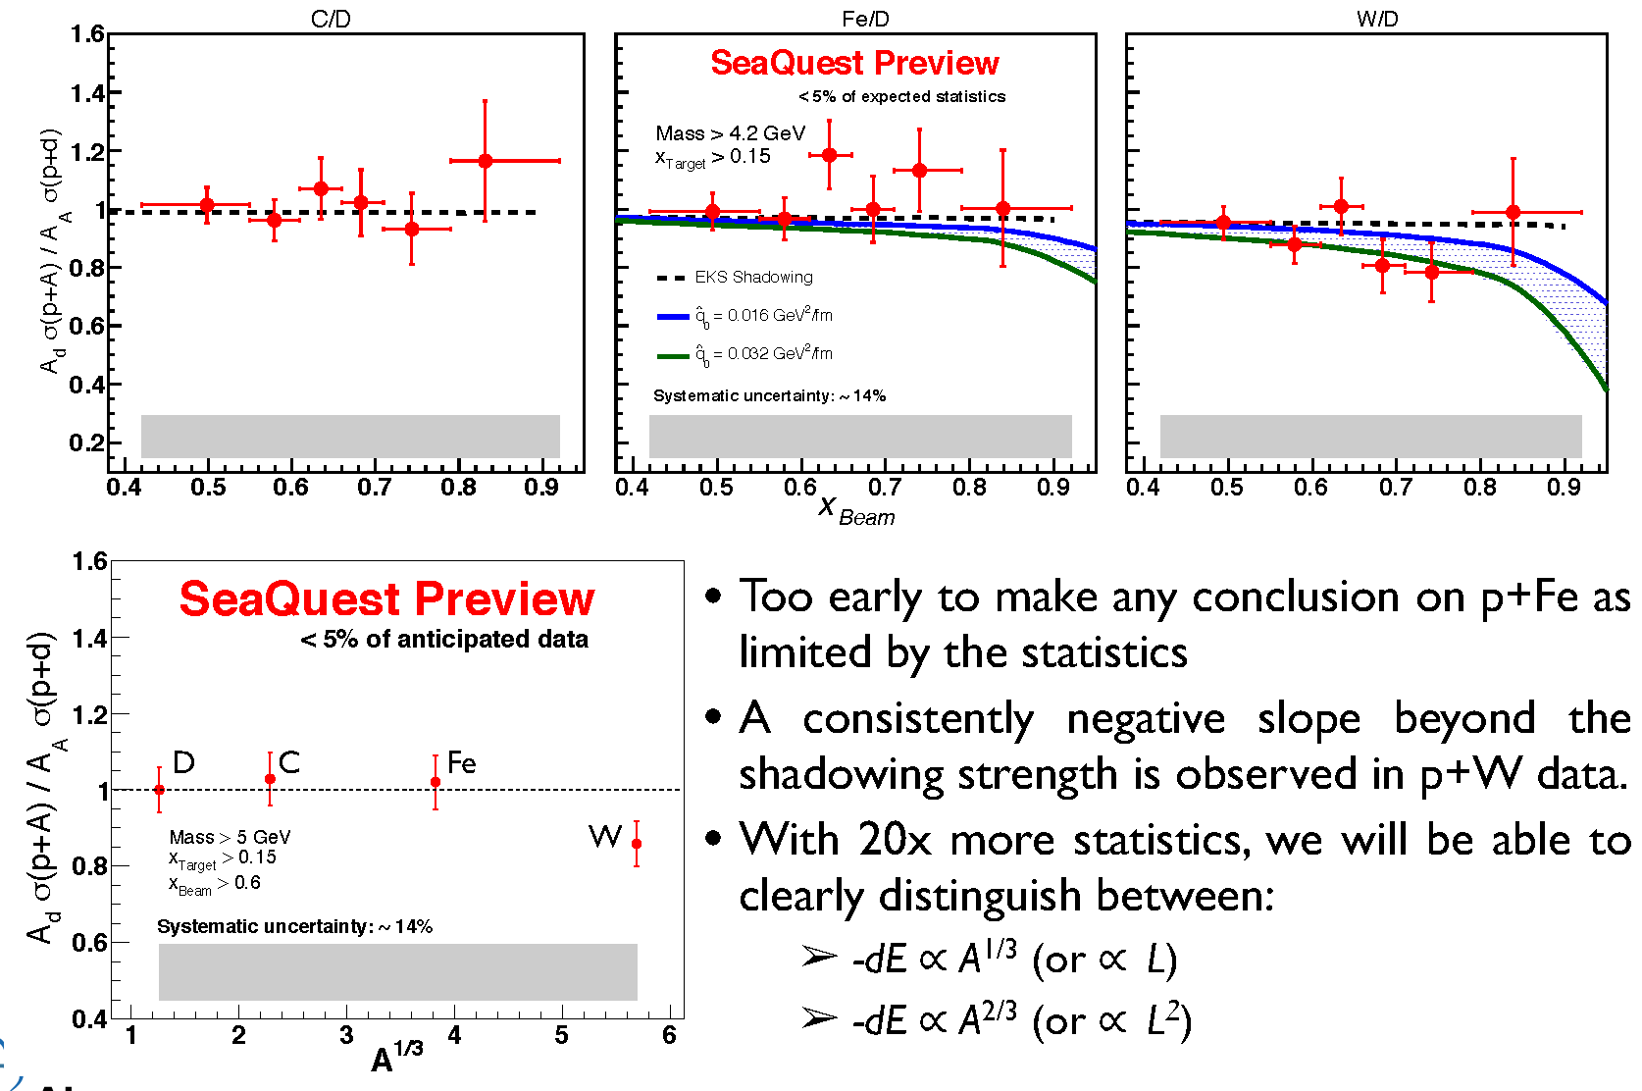

SeaQuest Quark Energy Loss (Preview)
Pre-interaction quark moves through cold nuclear matter and looses energy.
Expect suppression of the per-nucleon cross section ratio to be significant at high x_{Beam} or x_{F}
R.B. Neufeld, I. Vitev and B. W. Zhang,PLB 704, 590 (2011)
collisional
radiative

Slide 32
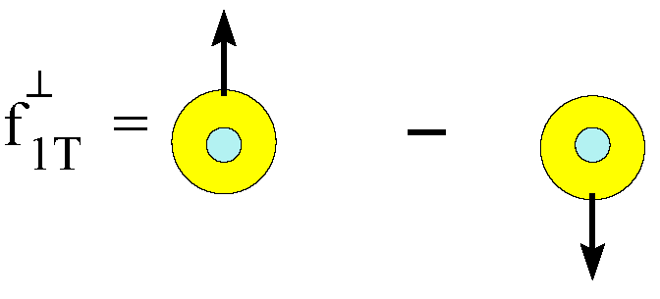
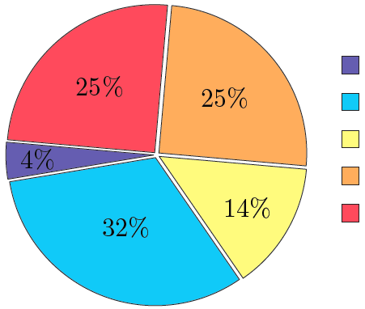
Sivers Function and Spin Crisis
cannot exist w/o quark OAM
describes transverse-momentum distribution of unpolarized quarks inside transversely polarized proton
captures non-perturbative spin-orbit coupling effects inside a polarized proton
How measure quark OAM ?
GPD: Generalized Parton Distribution
TMD: Transverse Momentum Distribution
Lattice QCD:
K.-F. Liu et al arXiv:1203.6388
Notes:
The connection b/w Sivers function and OAM is yet model-dependent, but what is clear is that the existence of the Sivers function requires non-zero quark OAM in the proton

Slide 33
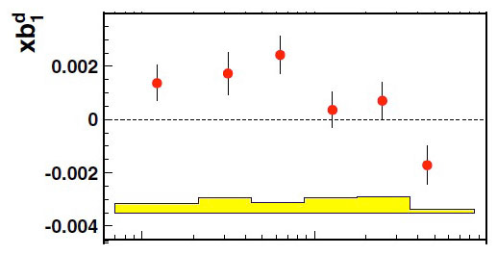
HERMES , Phys. Rev. Lett. 95, 242001
10⁻²
10⁻¹
x
S. Kumano, arxiv.org/1606.03149

Slide 34
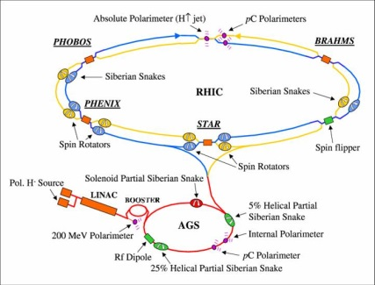
Polarized protons: Fermilab vs RHIC
Simulations of final polarization as function of Energy in Fermilab Main Injector look promising (Meiqin Xiao (FNAL AD), Etienne Forest (KEK)):
  point-like snake in correct location, w/ actual ramp rate for acceleration:
  final polarization: ~ 90%
Most significant difference:
Ramp time of Main Injector < 0.7 s, at RHIC 1-2 min
  warm magnets at MI vs. superconducting at RHIC
  → pass through all depolarizing resonances much more quickly
Beam remains in MI ~2 s, in RHIC ~8 hours
  extracted beam vs. storage ring
  much less time for cumulative depolarization
Disadvantage compared to RHIC — no institutional history of accelerating polarized proton beams
  Fermilab E704 had polarized beams through hyperon decays

Slide 35
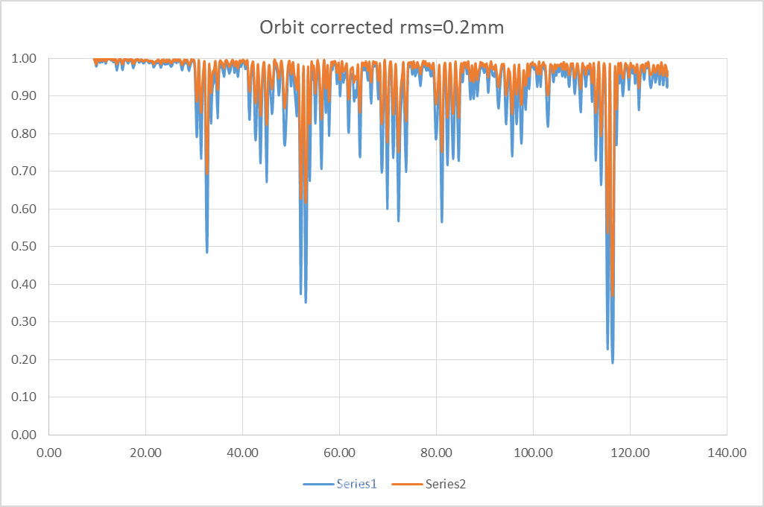
Simulation of final polarization as function of Energy in MI
Point-like snake in correct location, actual ramp rate for acceleration.
Polarizations with magnet field error and misalignment
(from magnet database and survey group), corrected
(for SeaQuest
running conditions)
Final polarization: ~ 90%
P_{y}
beam: Gaussian distribution
beam: flat distribution
gamma
e_{max} = 20 π mm.mrad in y plane and Δp =1.25*10⁻³ in longitudinal plane
Ref: Meiqin Xiao (FNAL)

