Slide 1
Polarized Dell-Yan at Fermilab MI
Project Briefing
(Mar 6, 2015)
Sivers Function in Polarized Drell-Yan
fundamental QCD prediction:
Polarized Drell-Yan at Fermilab
polarized Target (E-1039) and Beam (E-1027)
Main Injector Polarization Scheme
present status & plans
This work is supported by

Slide 2
The Sign Change
fundamental prediction of QCD (in non-perturbative regime)
goes to heart of gauge formulation of field theory
“Smoking gun” prediction of Transverse Momentum PDF formalism
Universality test includes not only the sign-reversal character of the TMDs but also the comparison of the amplitude as well as the shape of the corresponding TMDs
NSAC Milestone HP13 (2015): “Test unique QCD predictions for relations between single-transverse spin phenomena in p-p scattering and those observed in deep-inelastic lepton scattering”

Slide 3
Planned Polarized Drell-Yan Experiments
Experiment | Particles | Energy (GeV) | x_{b} or x_{t} | Luminosity (cm⁻² s⁻¹) |  | P_{b} or P_{t} (f) | rFOM# | Timeline
COMPASS (CERN) | π± + p↑ | 160 GeV √s = 17 | x_{t} = 0.1 – 0.3 | 2 x 10³³ | 0.14 | P_{t} = 90% f = 0.22 | 1.1 x 10⁻³ | 2015, 2018
PANDA (GSI) | p + p↑ | 15 GeV √s = 5.5 | x_{t} = 0.2 – 0.4 | 2 x 10³² | 0.07 | P_{t} = 90% f = 0.22 | 1.1 x 10⁻⁴ | >2018
PAX (GSI) | p↑ + p | collider √s = 14 | x_{b} = 0.1 – 0.9 | 2 x 10³⁰ | 0.06 | P_{b} = 90% | 2.3 x 10⁻⁵ | >2020?
NICA (JINR) | p↑ + p | collider √s = 26 | x_{b} = 0.1 – 0.8 | 1 x 10³¹ | 0.04 | P_{b} = 70% | 6.8 x 10⁻⁵ | >2018
PHENIX/STAR (RHIC) | p↑ + p↑ | collider √s = 510 | x_{b} = 0.05 – 0.1 | 2 x 10³² | 0.08 | P_{b} = 60% | 1.0 x 10⁻³ | >2018
fsPHENIX (RHIC) | p↑ + p↑ | √s = 200 √s = 510 | x_{b} = 0.1 – 0.5 x_{b} = 0.05 – 0.6 | 8 x 10³¹ 6 x 10³² | 0.08 | P_{b} = 60% P_{b} = 50% | 4.0 x 10⁻⁴ 2.1 x 10⁻³ | >2021
SeaQuest (FNAL: E-906) | p + p | 120 GeV √s = 15 | x_{b} = 0.35 – 0.9 x_{t} = 0.1 – 0.45 | 3.4 x 10³⁵ | --- | --- | --- | 2012 - 2016
Pol tgt DY‡ (FNAL: E-1039) | p + p↑ | 120 GeV √s = 15 | x_{t} = 0.1 – 0.45 | 3.1 x 10³⁵ | 0 – 0.2* | P_{t} = 80% f = 0.176 | 0.09 | 2017 -2018
Pol beam DY§ (FNAL: E-1027) | p↑ + p | 120 GeV √s = 15 | x_{b} = 0.35 – 0.9 | 2 x 10³⁵ | 0.04 | P_{b} = 60% | 1 | >2019
‡ 8 cm NH₃ target / § L= 1 x 10³⁶ cm⁻² s⁻¹ (LH₂ tgt limited) / L= 2 x 10³⁵ cm⁻² s⁻¹ (10% of MI beam limited) *not constrained by SIDIS data / # rFOM = relative lumi * P² * f² wrt E-1027 (f=1 for pol p beams, f=0.22 for π⁻ beam on NH₃)
W. Lorenzon (U-Michigan) 2/2015
Notes:
COMPASS scheduled t run from April-Dec 2015, 2018 not confirmed yet

Slide 4
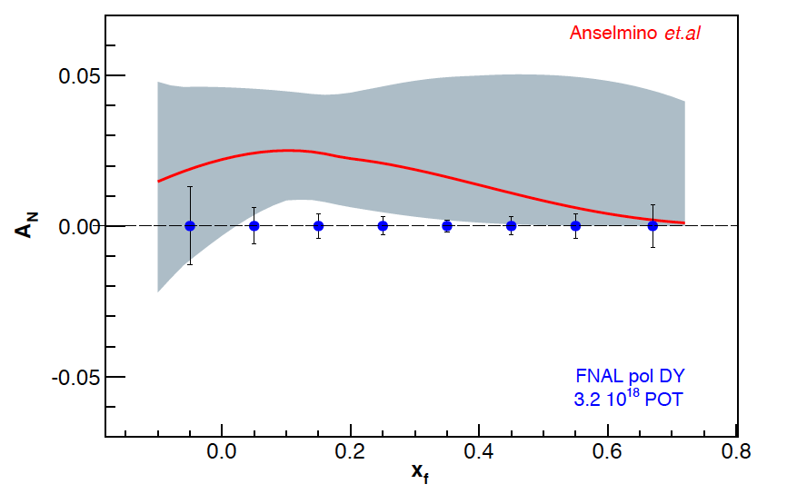
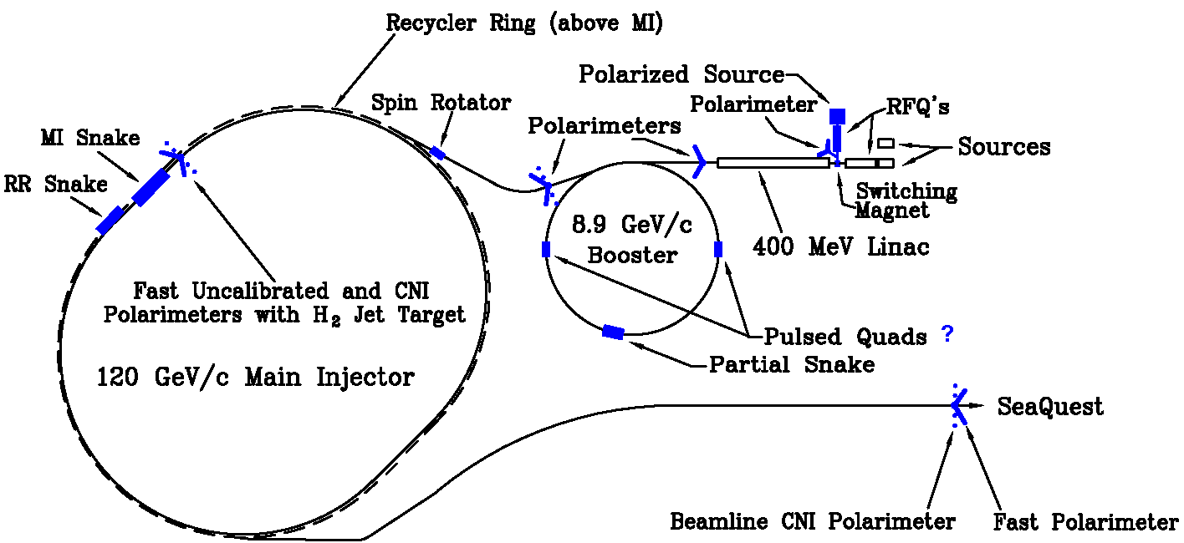
Polarized Beam Drell-Yan at Fermilab (E-1027)
Extraordinary opportunity at Fermilab (best place for polarized DY) :
high luminosity, large x-coverage
(SeaQuest) spectrometer already setup and running
run alongside neutrino program (w/ 10% of beam)
experimental sensitivity:
2 yrs at 50% eff, P_{b} = 60%, I_{av} = 15 nA
luminosity: L_{av} = 2 x 10³⁵ /cm²/s
measure sign, size & shape of Sivers function
Path to polarized proton beam at Main Injector
perform detailed design studies
proof that single-snake concept works
applications for JPARC, NICA, ….
community support
Cost estimate to polarize Main Injector:
$6M (M&S, labor), + $4M (project management & contingency)
Fermilab

Slide 5
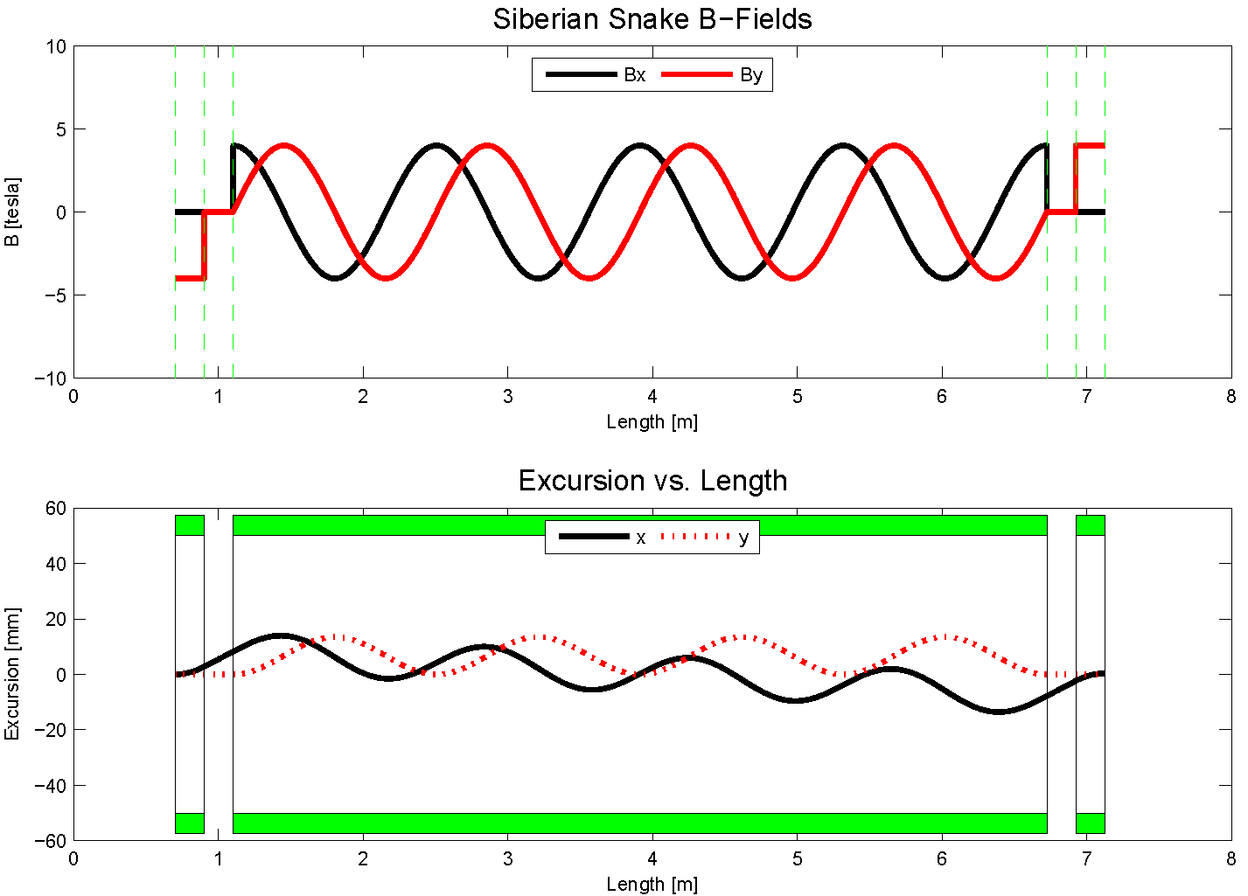
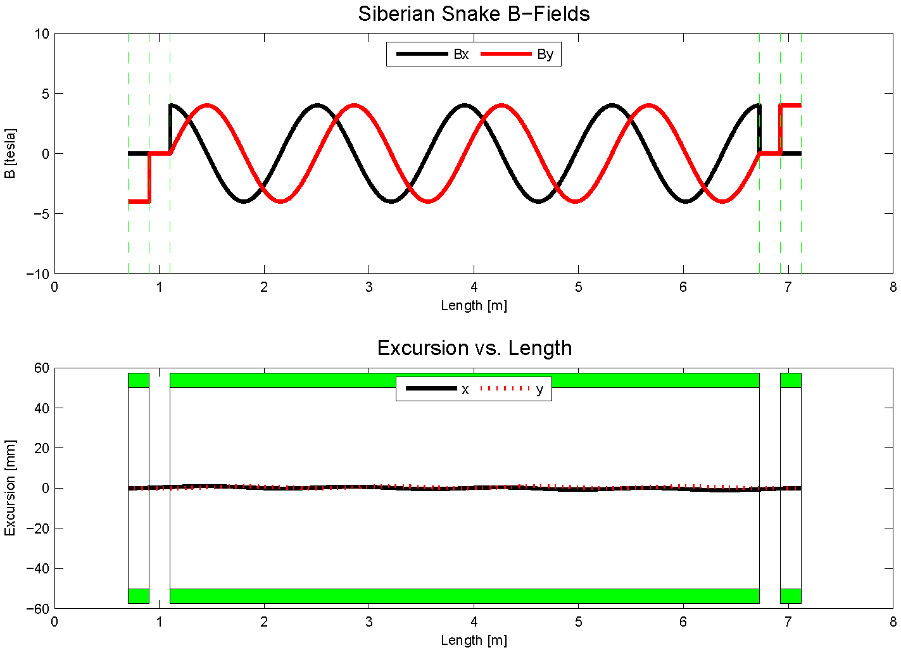
A Novel, Compact Siberian Snake for the Main Injector
Single snake design (5.8m long):
1 helical dipole + 2 conv. dipoles
helix: 4T / 4.2 m / 4” ID
dipoles: 4T / 0.62 m / 4” ID
use 4-twist magnets
8π rotation of B field
never done before in a high energy ring
RHIC uses snake pairs
4 single-twist magnets (2π rotation)
location: MI-30
max beam excursions:
8.9 GeV: 17 mm
120 GeV: 1.3 mm
initial design studies
8.9 GeV
120 GeV
beam excursions shrink w/ beam energy

Slide 6
The Path to a polarized Main Injector
Stage 1 approval from Fermilab: 14-November-2012
Collaboration with A.S. Belov at INR and Dubna to develop polarized source
Detailed machine design and costing using 1 snake in MI
Spin@Fermi collaboration provide design
get latest lattice for NOVA:
translate “mad8” optics file to spin tracking code (“zgoubi”)
determine intrinsic resonance strength from depolarization calculations
do single particle tracking with “zgoubi”
set up mechanism for adding errors into the lattice:
orbit errors, quadrupole mis-alignments/rolls, etc.
perform systematic spin tracking
explore tolerances on beam emittance
explore tolerances on various imperfections: orbit / snake / etc
Fermilab (AD) does verification & costing

Slide 7
Polarized Drell-Yan at Fermilab Main Injector - II
Polarized Beam in Main Injector
use SeaQuest spectrometer
use SeaQuest target
liquid H₂ target can take I_{av} = ~5 x 10¹¹ p/s (=80 nA)
1 mA at polarized source can deliver about I_{av} = ~1 x 10¹² p/s (=150 nA) for 100% of available beam time (A. Krisch: Spin@Fermi report in (Aug 2011): arXiv:1110.3042 [physics.acc-ph])
26 μs linac pulses, 15 Hz rep rate, 12 turn injection into booster, 6 booster pulses into Recycler Ring, followed by 6 more pulses using slip stacking in MI
1 MI pulse = 1.9 x 10¹² p
using three 2-s cycles (1.33-s ramp time, 0.67-s slow extraction) /min (=10% of beam time): → 2.8 x 10¹² p/s (=450 nA) instantaneous beam current , and I_{av} = ~0.95 x 10¹¹ p/s (=15 nA)
Scenarios:
L = 2.0 x 10³⁵ /cm²/s (10% of available beam time: I_{av} = 15 nA)
L = 1 x 10³⁶ /cm²/s (50% of available beam time: I_{av} = 75 nA)
x-range:
x_{b} = 0.35 – 0.85 (valence quarks) x_{t} = 0.1 – 0.35 (sea quarks)

