Slide 1
E1039 @ FNAL:
Measuring the Sea Quark Sivers Asymmetry
Andi Klein
Los Alamos National Laboratory

Slide 2
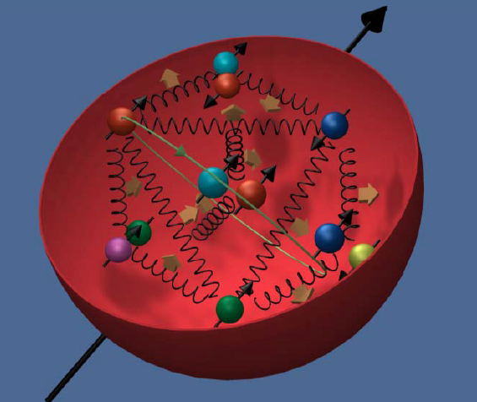
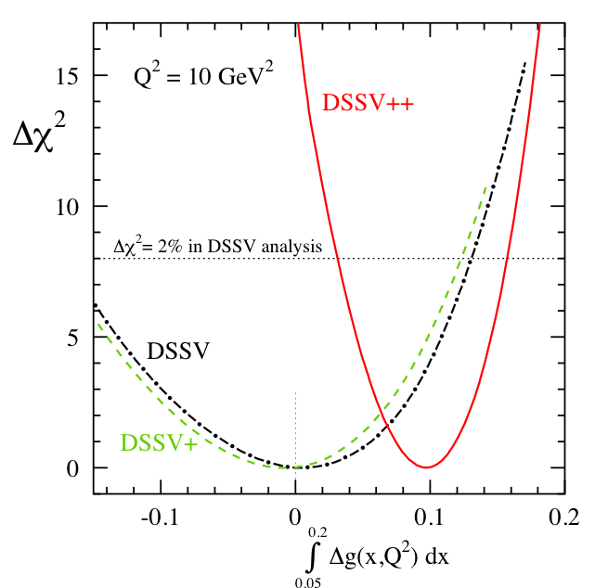
Where are we today
½ = ½ ΔΣ + ΔG +L_{q} + L_{g}
Quark contribution
Gluon contribution
Angular Momentum of q,g
RHIC
Quark Polarization from all flavors
=50% ?
✚
Notes:
Today lots of experiment to determine the quark polarization, getting more info on the gluon
Looks like we are 50% short.
Not very satisfactory picture

Slide 3
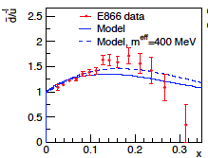
Indication of Angular Momentum:
Results from E866
Gottfried Sum Rule: =1/3
=0
Phys Rev D71 094015 (2005)
x_{Target}
Why not symmetric:
Pion cloud model

Slide 4
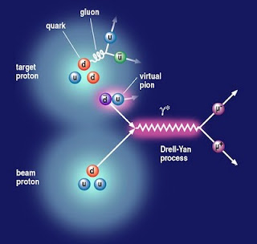
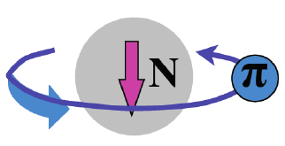
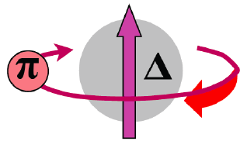
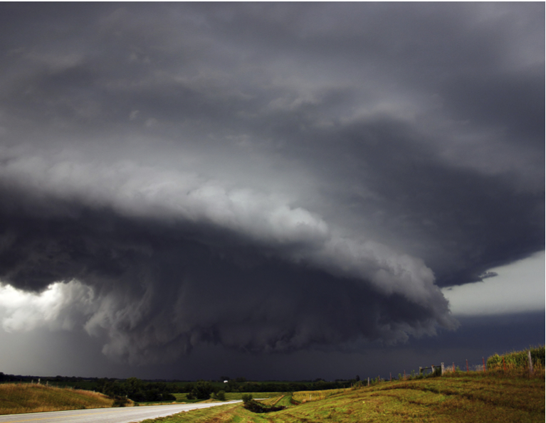
The meson cloud model explains the flavor asymmetry in the sea, and requires quarks to carry angular momentum.
|p>=p + Nπ + Δπ +…
Pions J^{p}=0⁻ Negative Parity
Need L=1 to get proton’s J^{p}=½⁺
π⁺
L_{π} = 1
Sea quarks should carry orbital angular momentum.

Slide 5
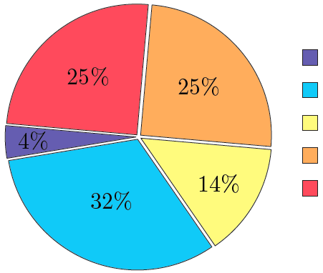
Lattice Calculations
Non perturbative approach to QCD; formulated on a grid of points in space and time
Lattice QCD: K.-F. Liu et al arXiv:1203.6388
When including disconnected diagrams, most orbital angular momentum (OAM) from sea
How measure quark OAM ?
GPD: Generalized Parton Distribution
TMD Transverse Momentum Distribution
L_{u} ≈ - L_{d}

Slide 6


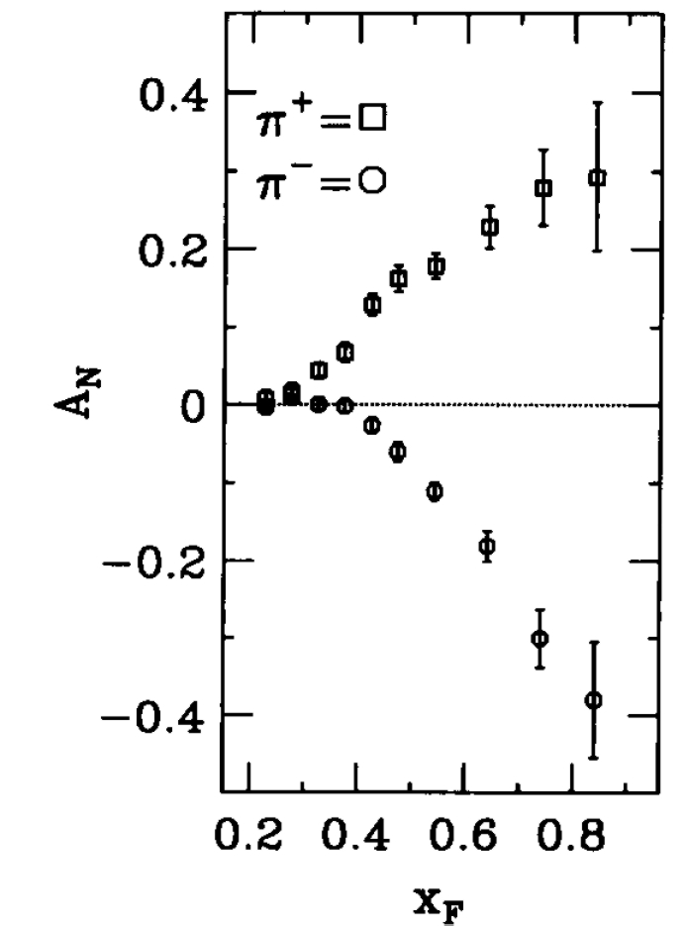
Quark Orbital Momentum and the Sivers Function
The Sivers function is the distribution of unpolarized quarks in a transversely polarized proton, one of 8
Transverse Momentum Distributions (TMDs)
S: nucleon spin
p_{T:} Transverse momentum
Sivers distribution
T-odd =>
First proposed to explain E704
also T-odd
Sivers effect: quark’s transverse motion generates a left-right bias.
up-quarks favor the left, down-quarks favor the right (L_{u} ≈ - L_{d})
E704 √s =20 GeV. PLB 264 (1991) 462.
Sivers function = 0 ⬅➔ L_{q}=0
Notes:
Measure analyzing power was An=Pol_beam*(p_beam x p_pion)whih is Odd under naïve Time reversal. To produce such an observable (T even) need interference of Teven amplitudes which have different helicity structures, one spin flip one non spin-flip, interference of Lz,Lz+1 states
E704 was transverse polarized p and antip beam on unpolarized target

Slide 7
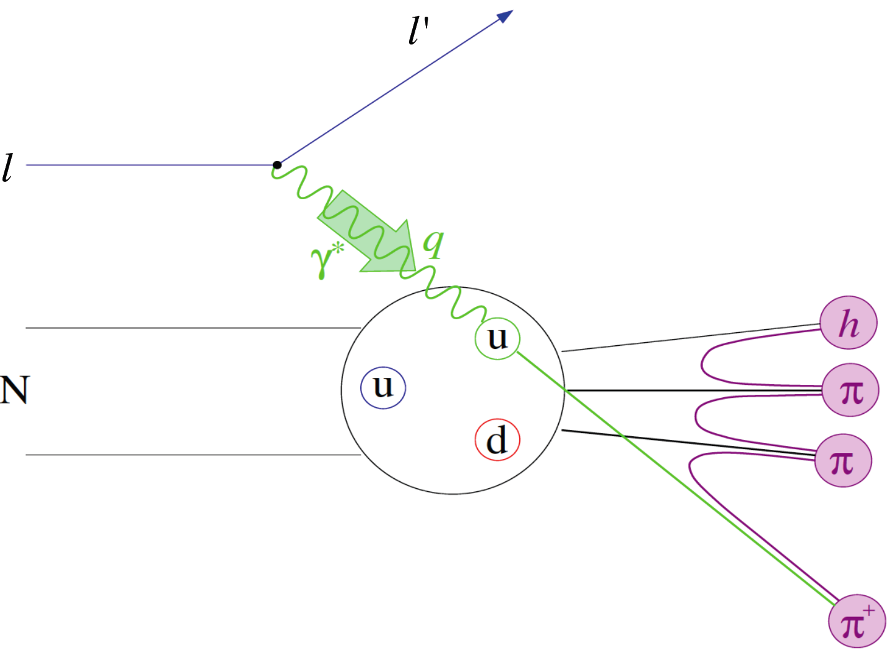
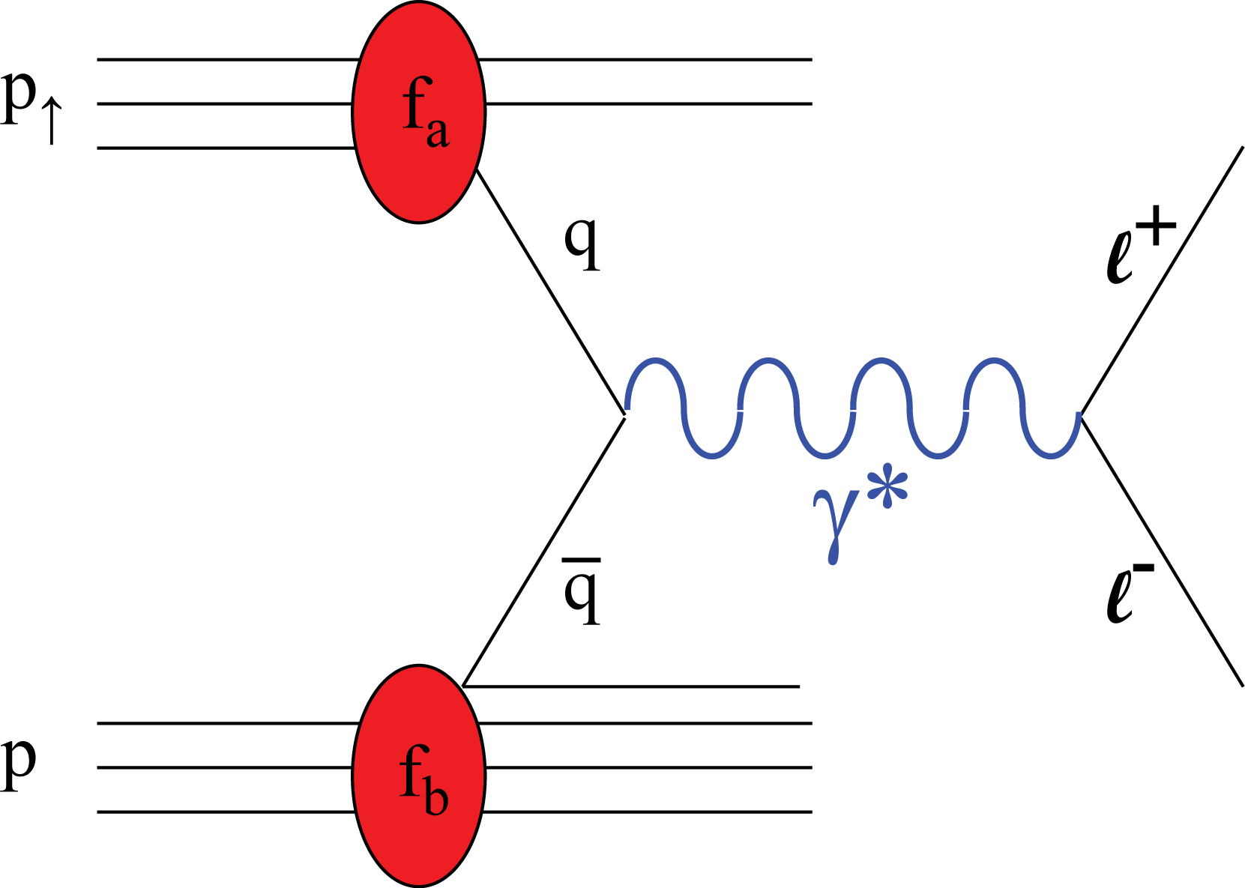
Asymmetry in Semi-Inclusive DIS
Asymmetry in Drell-Yan
Never
done
Involves quark to hadron frag. function.
Valence and sea quarks are mixed.
No quark frag. func. involved.
Valence and sea quarks can be isolated
  Pol. Beam➔valence quark (E-1027)
  Pol. Target➔sea quark (E-1039)
Result of repulsive initial state (DY) vs attractive final state (SIDIS) interaction

Slide 8
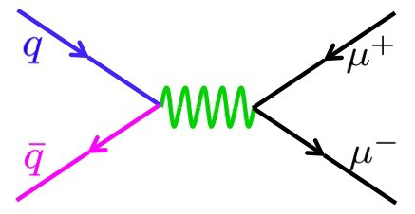
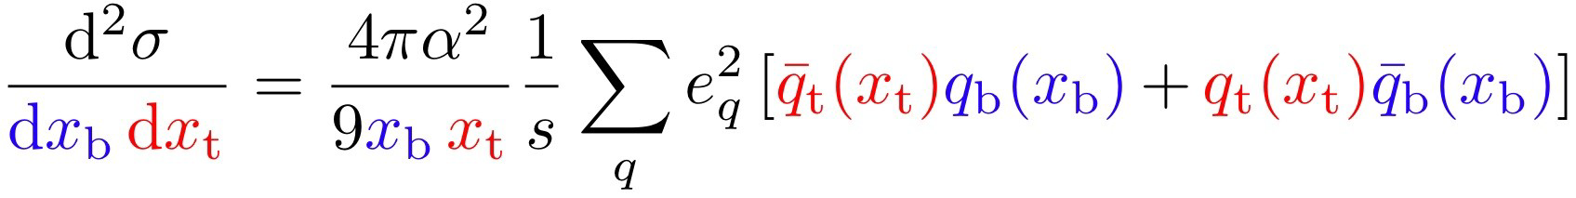
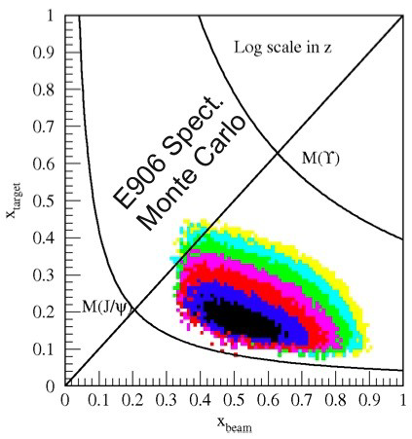
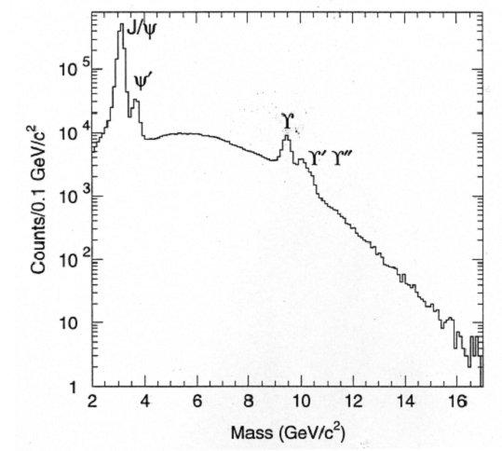
Drell Yan
target sea quark
beam valence quark
small
x_{F} = 0
x_{F}= Feyman x
dominates
Through kinematics choose quark from beam and antiquark from target
x_{F}>> 0
E866
800 GeV beam
√s: 40 GeV
120 GeV:
√s: 15.5 GeV
cross section scales as s
7 times higher
Notes:
Accepted event distribution

Slide 9
Where are we?
π⁺
We know very little about sea quarks angular momentum.
E866 might point to OAM
Quark orbital angular momentum leads to quark Sivers distribution.
Identifying a non-vanishing sea quark Sivers distribution could lead to a major breakthrough in nucleon structure.
Polarized target D-Y at Fermilab’s SeaQuest provides an unique opportunity to pin down sea quark’s angular momentum.
Does Drell-Yan yield depend on target’s spin direction?
if
Notes:
----- Meeting Notes (7/10/2014 12:08) -----
8.25'

Slide 10
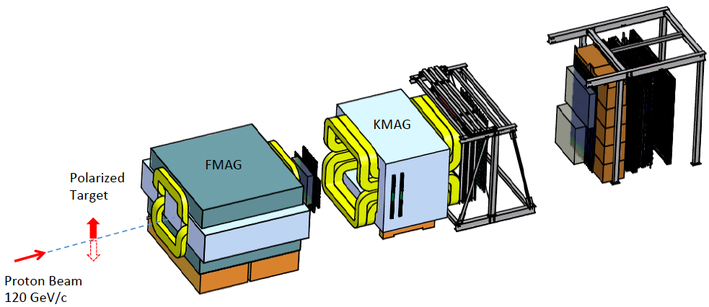
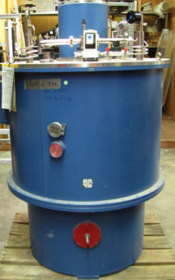
E-1039 Collaboration:
D. Geesaman, P. Reimer
Argonne National Laboratory, Argonne, IL 60439
C. Brown , D. Christian
Fermi National Accelerator Laboratory, Batavia IL 60510
M. Diefenthaler, J.-C. Peng
University of Illinois, Urbana, IL 61081
W.-C. Chang, Y.-C. Chen
Institute of Physics, Academia Sinica, Taiwan
S. Sawada
KEK, Tsukuba, Ibaraki 305-0801, Japan
T.-H. Chang
Ling-Tung University, Taiwan
J. Huang, X. Jiang, M. Leitch, A. Klein, K. Liu, M. Liu, P. McGaughey
Los Alamos National Laboratory, Los Alamos, NM 87545
E. Beise, K. Nakahara
University of Maryland, College Park, MD 20742
C. Aidala, W. Lorenzon, R. Raymond
University of Michigan, Ann Arbor, MI 48109-1040
T. Badman, E. Long, K. Slifer, R. Zielinski
University of New Hampshire, Durham, NH 03824
R.-S. Guo
National Kaohsiung Normal University, Taiwan
Y. Goto
RIKEN, Wako, Saitama 351-01, Japan
L. El Fassi, R. Gilman, K. Myers, R. Ransome, A. Tadepalli, B. Tice
Rutgers University, Rutgers NJ 08544
J.-P. Chen, C. Keith
Thomas Jefferson National Accelerator Facility, Newport News, VA 23606
K. Nakano, T.-A. Shibata
Tokyo Institute of Technology, Tokyo 152-8551, Japan
D. Crabb, D. Day, D. Keller, O. Rondon
University of Virginia, Charlottesville, VA 22904
N. Doshita, Y. Miyachi
Yamagata University, Yamagata 990-8560, Japan
Co-Spokespersons: A. Klein, X. Jiang Los Alamos National Lab Laboratory
✚

Slide 11
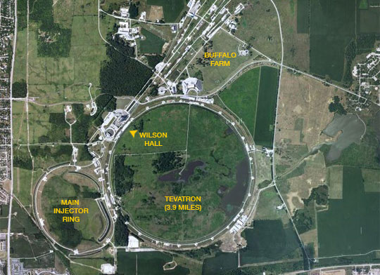
Beam @FNAL
Notes:
Put red line

Slide 12
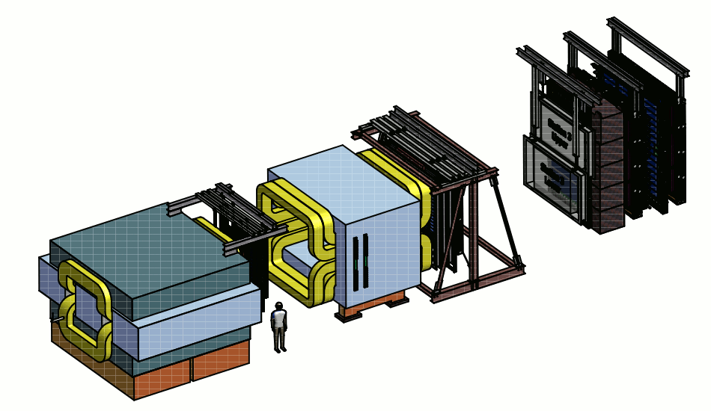
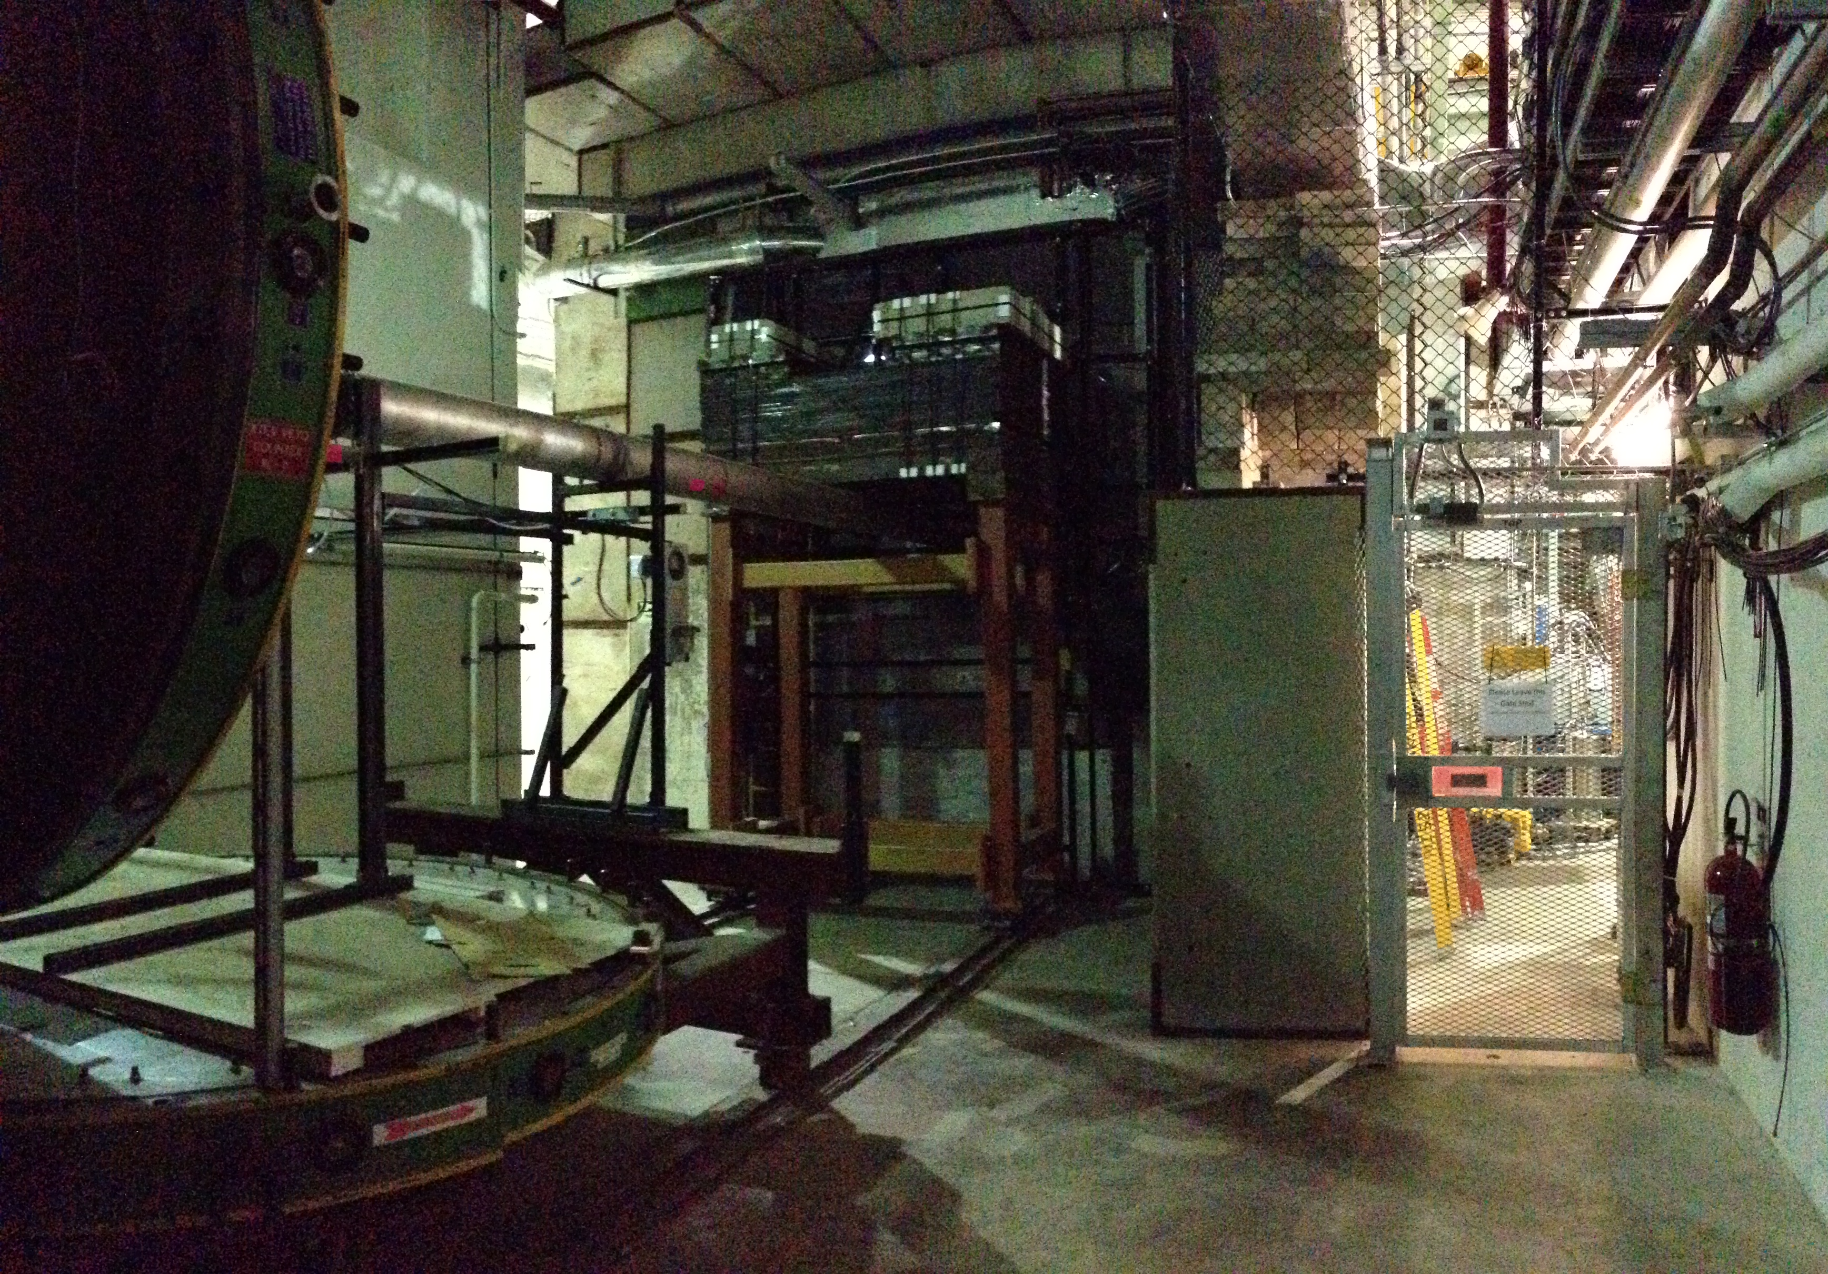
How do we measure the Sivers A
KMAG
B-Field
FMAG
x
z
E906 Spectrometer
p beam 120 GeV
1*10¹³ p/spill, one 5s spill/minute
Kinematic Range 4 < M <8 GeV
E866

Slide 13
Schematic
Dump
KMAG
FMAG
4 scintillator hodoscope stations (x and y)
4 tracking stations (x and stereos) MWPC
Notes:
more details from p906 proposal

Slide 14
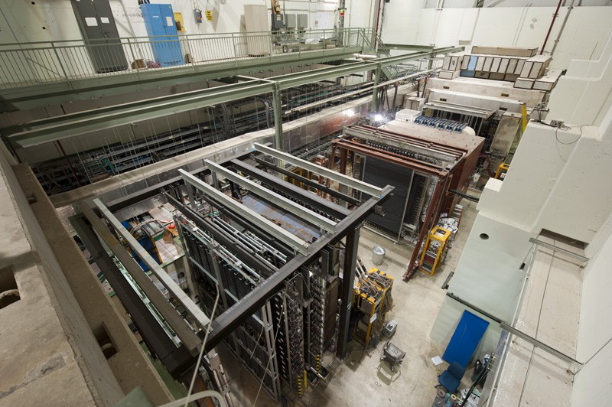
FMAG
ST1
KMAG
ST3
ST2
ST4
Notes:
Change label color, more station label

Slide 15
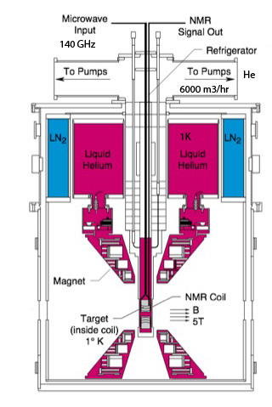
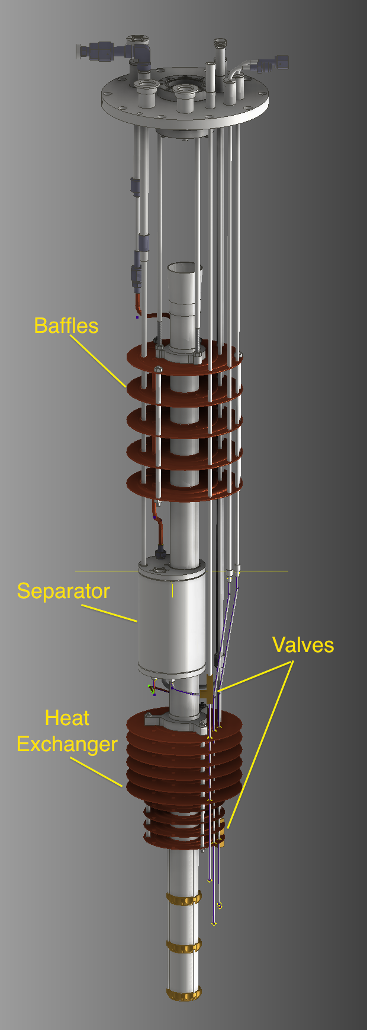
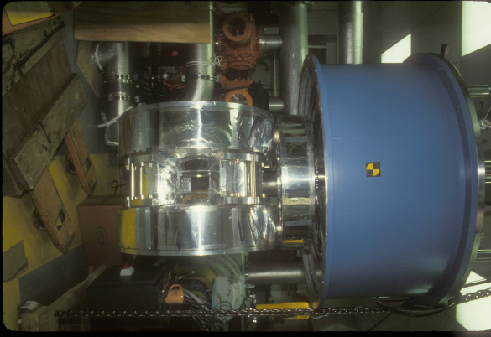
The Polarized Target System
Magnet from LANL
Measure polarization
Microwave: Induces electron spin flips
Tube + Power equip:
Roots pump system used to pump on ⁴He vapor to reach 1K
12,000 m³/hr
Cryostat: UVa
4
Superconducting Coils for Magnet: 5T
Rotation needed
Target material: frozen NH₃
Irradiation @ NIST

Slide 16
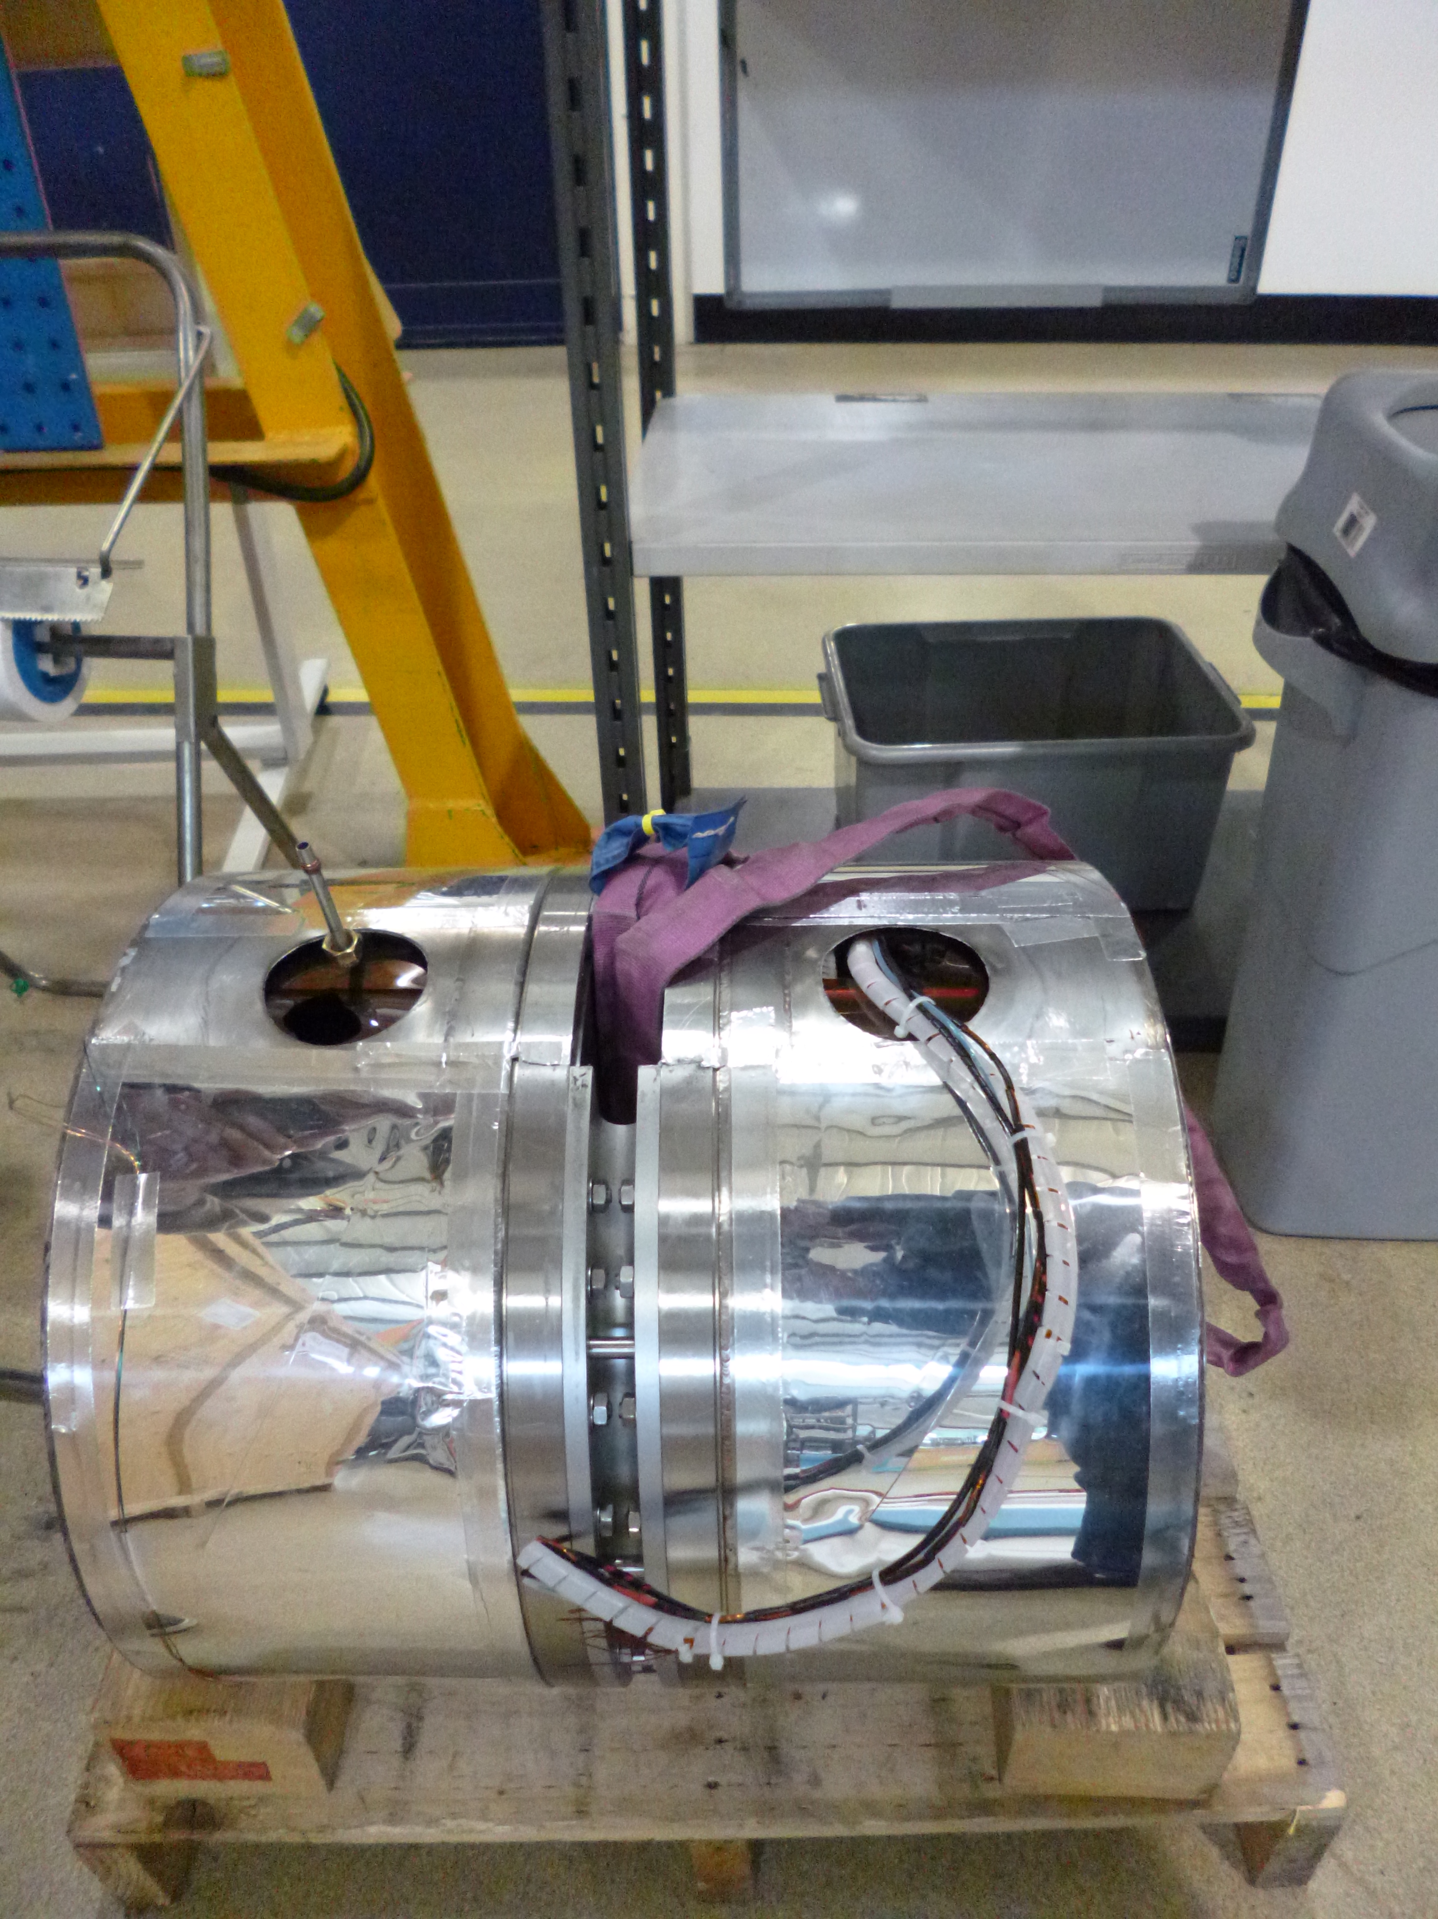
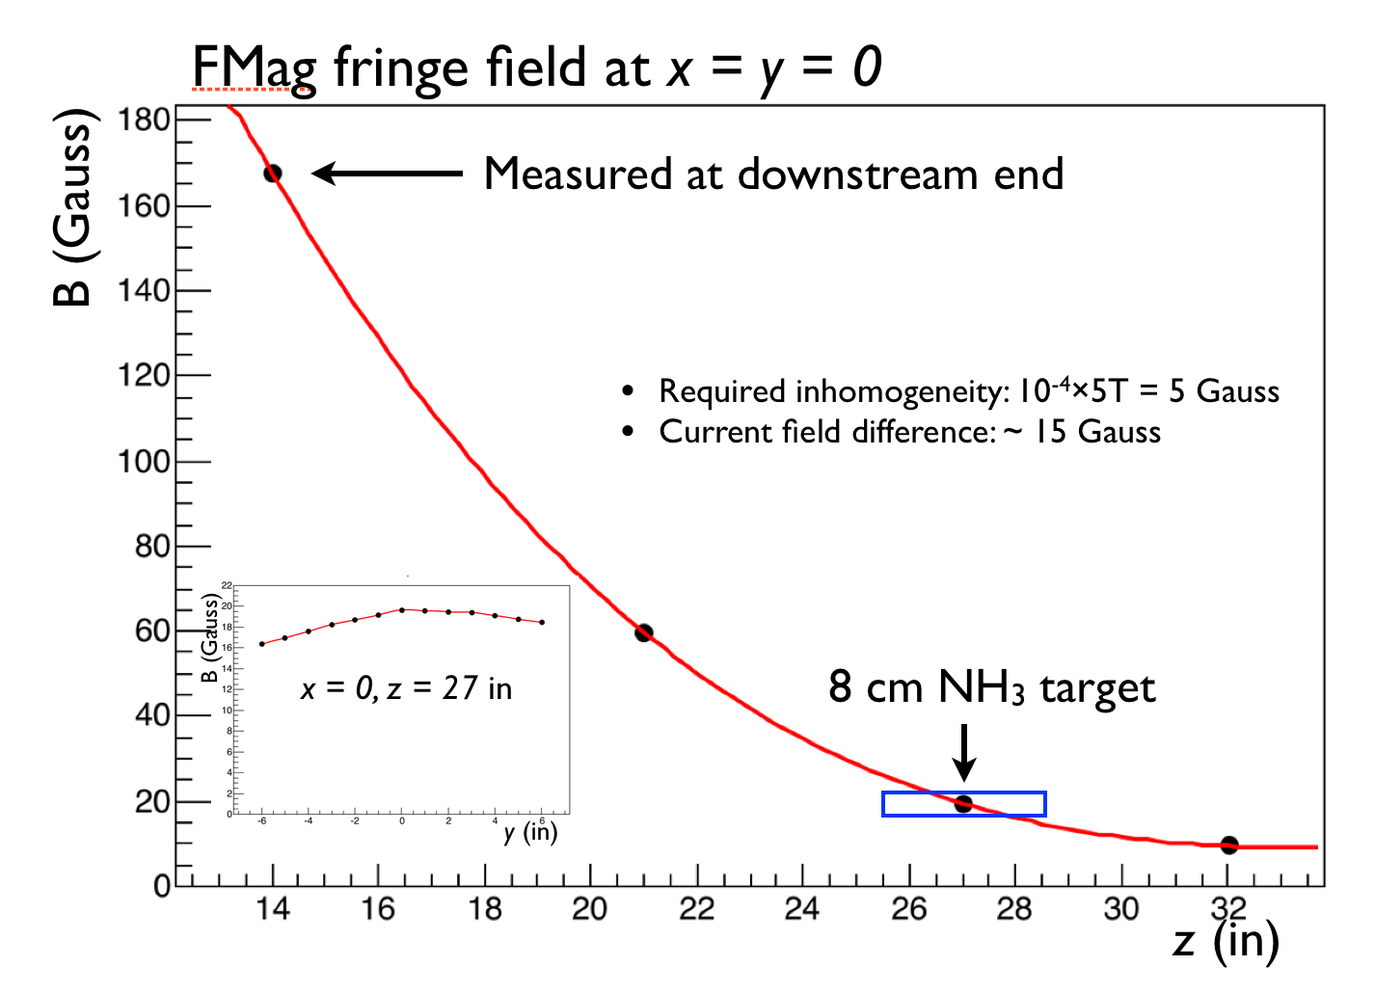
The magnet

Slide 17
Principle of Dynamic Nuclear Polarization:
Polarization P for paramagnetic materials:
Thermal Equilibrium TE: T=1K, H=5T
P_{e} = .998
P_{p} =.005 since μ_{N} / μ_{B} ~ 10⁻³
TE
Polarization Measurement P~92 %
ν_{e =} 140GHz
protons
B
Keith et al. NIM A 501 (2003), 327 JLAB
Well established technology: SLAC, JLAB, PSI …
electrons
ν_{e}+ν_{p}
ν_{e}-ν_{p}
Hydrogen
micro wave
Notes:
Create paramagnetic centers through irradiation since NH₃ is not paramagnetic
Use dipole-dipole interaction=> Hyperfine Splitting
Pump on electrons with 140 GHz
τ_{e} << τ_{p} => Large Polarization (τ Relaxation times)

Slide 18
LANL Q-meter Design
Follow general Liverpool design, but:
Use modern RF microwave electronics from Mini-Circuits, etc.
Use 16 bit ADCs and DACs from Analog Devices, etc.
Replace mechanical controls/adjustments with electronic ones (DACs or digital)
On board temperature and voltage monitors
House in double wide VME modules and VME crate -
VME module has 1 analog and 1 digital circuit board Includes RF and analog processing, ADCs + DACs
USB interface on each module for standalone testing
Ethernet <-> VME interface module for readout and controls using LabVIEW
Power and forced air cooling from crate, <7 W per VME module

Slide 19
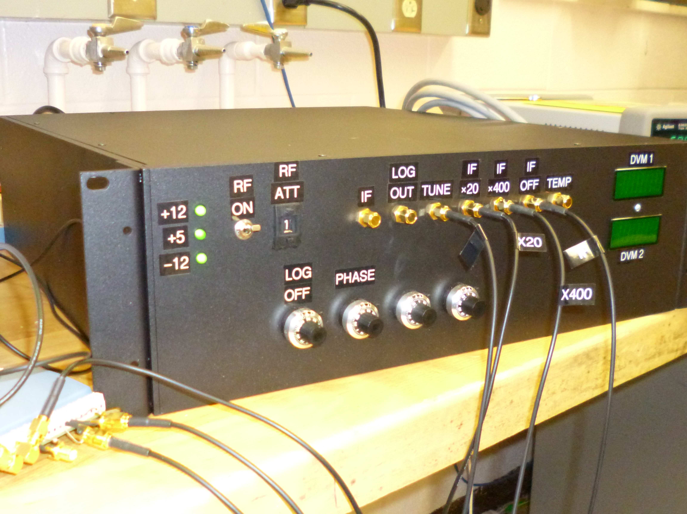
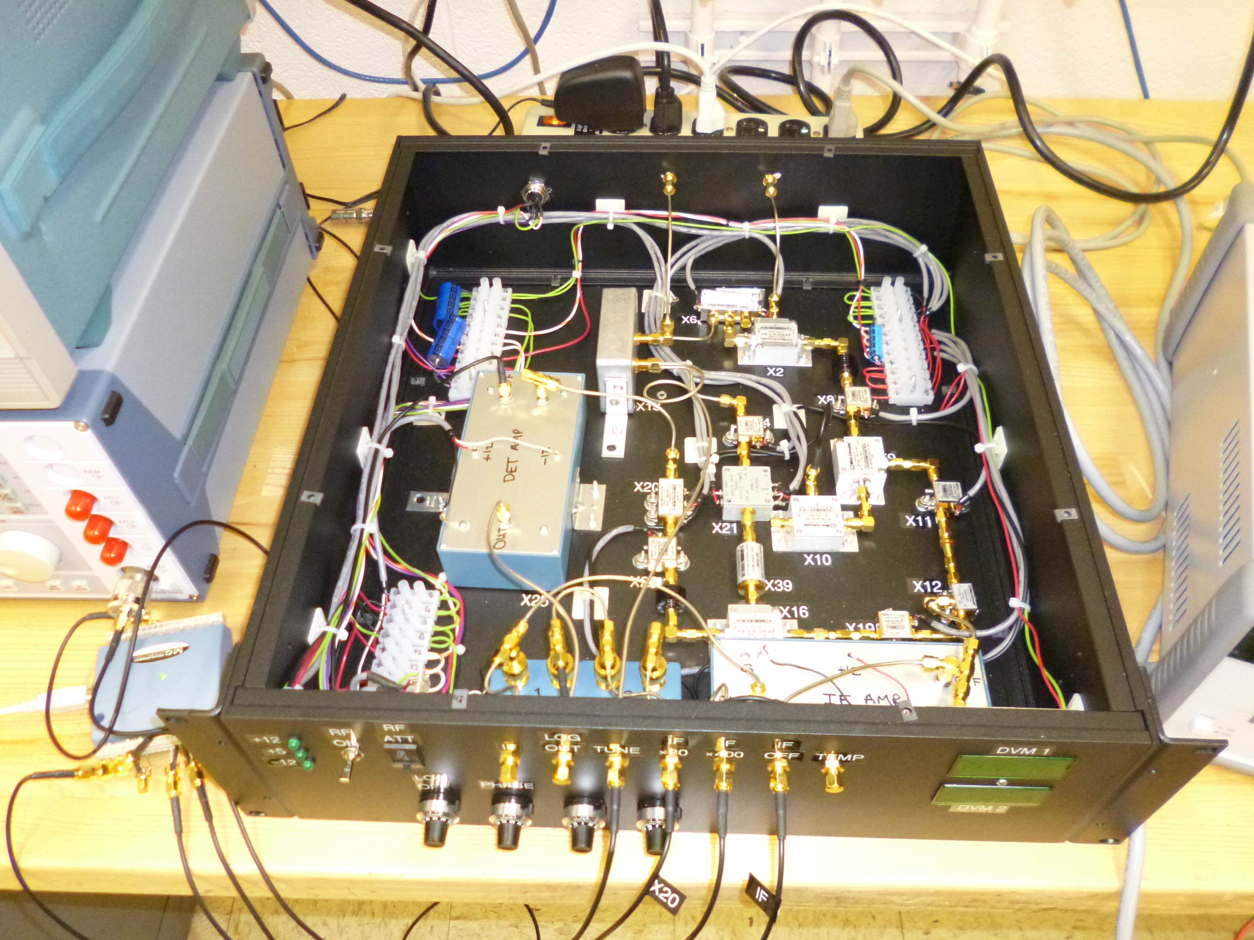
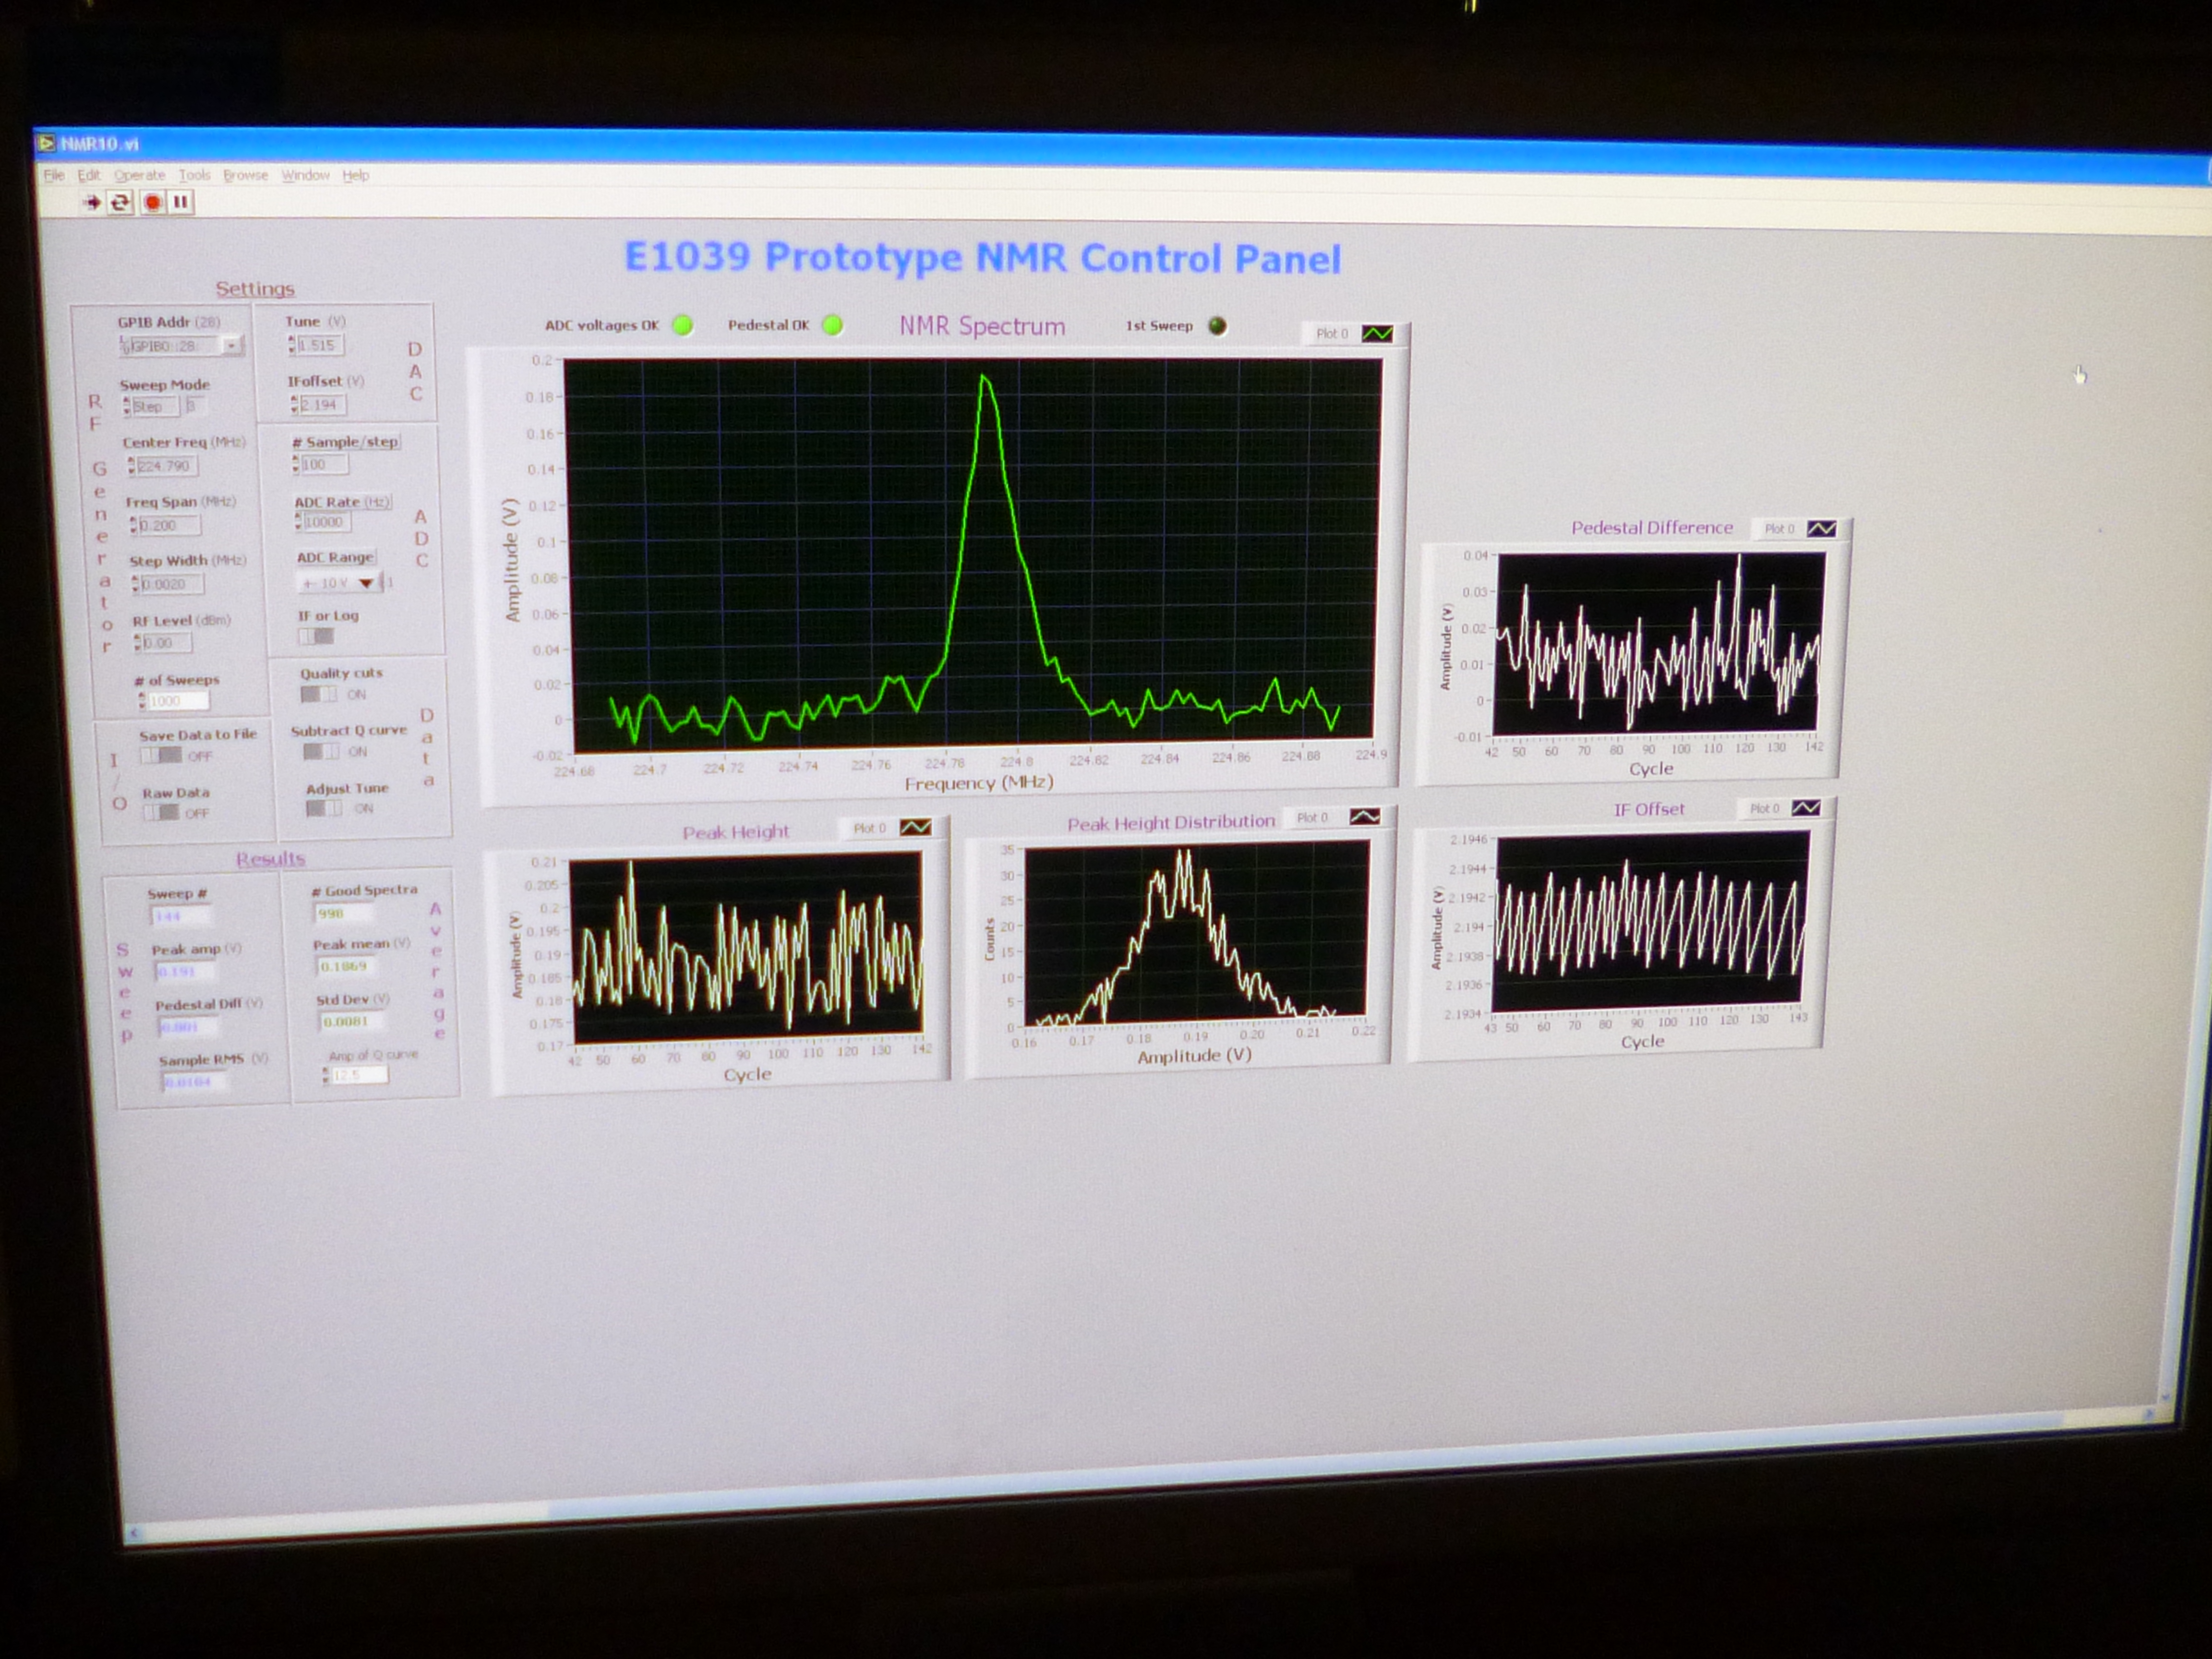
Details of new NMR
Successfully tested at Uva with NH3
Extremely low noise
excellent thermal stability, no need for additional cooling fan
Currently working on VME design

Slide 20
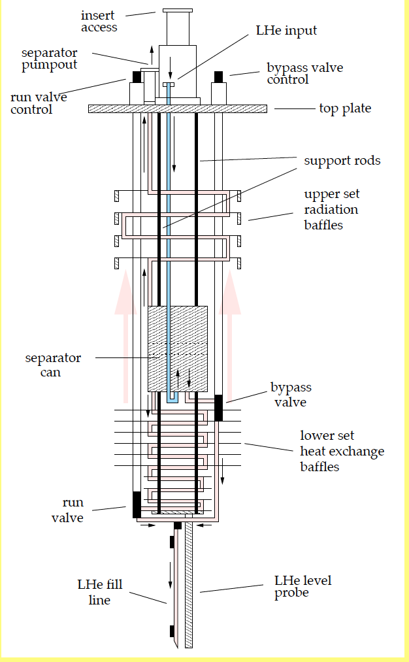
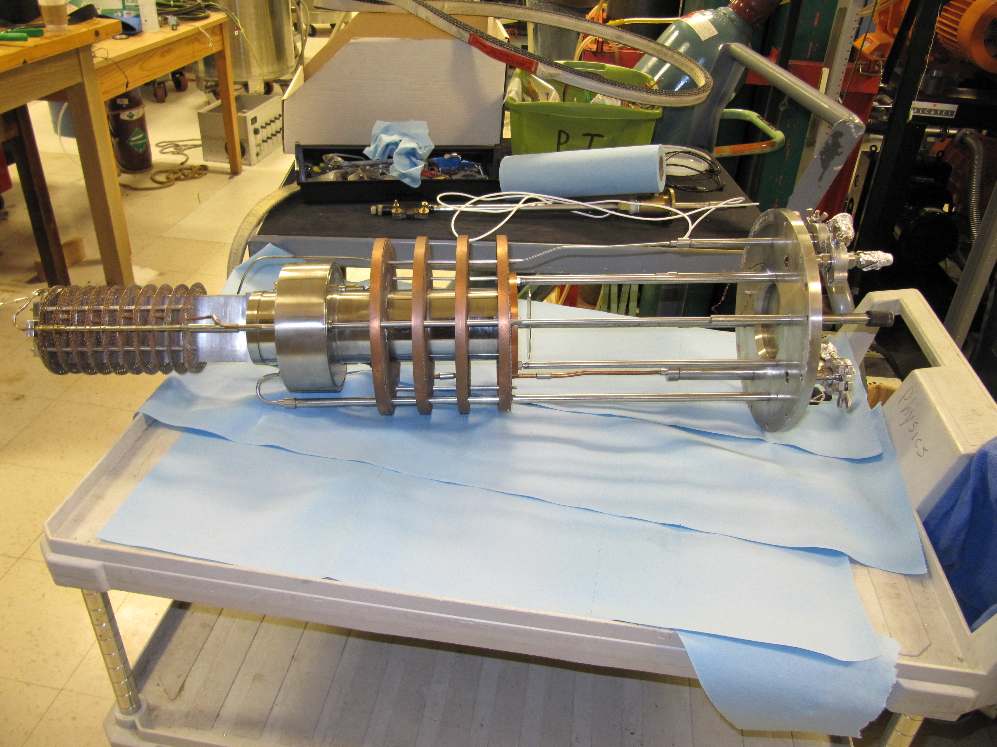
NH₃ Target Parameters:
Cylinder Φ : 2cm (x,y), length 8cm (z)
ρ= .89 g/cm³ frozen NH₃
Packing Fraction = .6
Dilution Factor = 3/17 NH₃
5.1 g/cm² (NH₃) + .44 g/cm² He
4.2 * 10²³ H/cm²
μ-wave horn
JLAB target
Refrigerator
Notes:
μ- wave: 132 J/min, beam 14J/minute
100 liter liquid He/day
Requires 12,000 m³/hr pumping capacity
special requirements because of beam duty cycle

Slide 21
Beam effects on polarized Target
Anneal every 24 hours ~ 1hr at 80K (yellow line)
Replace target material every 10 days (two active targets) , will take one shift
  Replace target stick
  Cool down
  perform TE measurement
  Turn on microwave, measure again
Polarization
Polarization as a function of accumulated beam dose 2.5T target
(D. Crab private communication)
Systematics control:
Reverse Polarization Direction once a day
Reverse magnet field of Fmag and Kmag every two days
Reverse magnetic field of target magnet every target replacement
Background measurements every shift with target out
Systematic errors:
Absolute: 1% (Luminosity precision on different pol directions)
ΔA/A ~ 4% (Dominant effect polarization measurement)
Notes:
Replace vertical scale with polarization
----- Meeting Notes (7/10/2014 12:08) -----
20'

Slide 22
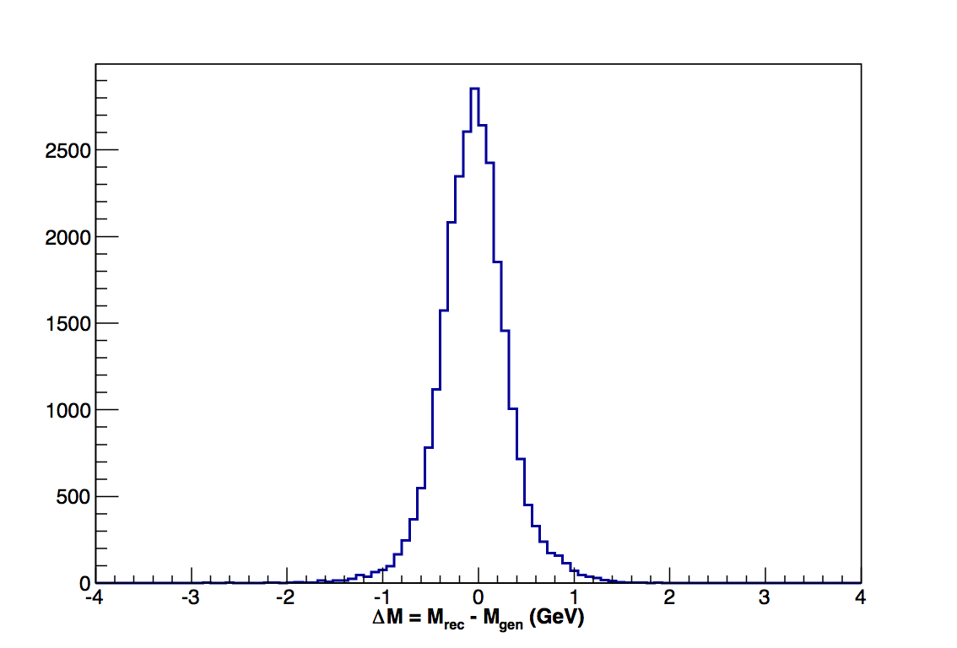
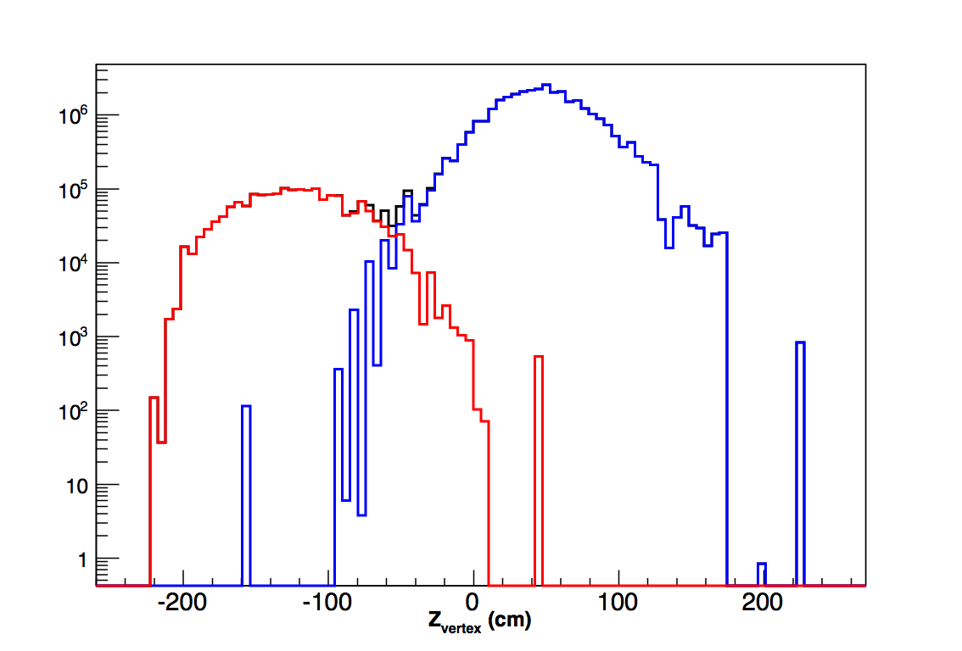
Target and Beam Performance
Target
Polarization: 85%
Packing fraction .6
Dilution factor: .176
Density: .89 g/cm³
Beam
Beam: 1*10¹³ p/spill; spill is 5 s
Luminosity: 4.4*10³⁵ /cm^2/sec
120 GeV protons
KTev beam line
√s = 15 GeV
One year L = 7.2 *10⁴²/cm²
POT = 2.7*10¹⁸ (187 days)
σ = 310 MeV
Mass Resolution
Reconstructed Vertex
Notes:
Labesl of plots

Slide 23

Yield and Asymmetry estimates
Cuts | Efficiency | Yield
All DY in the kinematic range | 100% | 1.34E+08
µ⁺µ⁻ accepted by all detectors | 2% | 2.78E+06
Accepted by trigger | 50% | 1.39E+06
µ⁺µ⁻ pair reconstructed (with target/dump separation cut) | 33% | 4.59E+05
Range x₂ | Mean x₂ | N events | ΔA
0.1-0.14 | 0.123 | 159097.2 | 0.016
0.14-0.17 | 0.154 | 136557.6 | 0.017
0.17-0.21 | 0.188 | 123566.4 | 0.018
0.21-0.5 | 0.258 | 119508 | 0.019
Exp + Beam availability from E906 = .6
efficiency due to pol target =.8
measuring time for given ΔA
f = .6
P = .85
Notes:
Red box

Slide 24
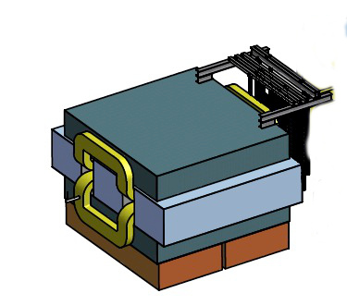
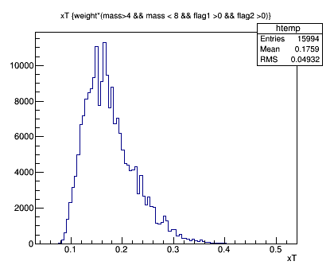
Changes under study
SM0 2Tm
Beam
500 cm
Add third magnet SM0 ~500cm upstream
Improves Dump-Target separation
Moves <x₂ > from .21 to .176
Reduces overall acceptance
Adds shielding problems
x_{Target}
Notes:
Beam in picture
Label bottom plot

Slide 25
Projected Statistical Precision with a Polarized Target at SeaQuest
First Sea Quark Sivers Measurement
Determine sign and value of ubar Sivers distribution
Statistics shown for one calendar year of running :
L = 7.2 *10⁴² /cm² ⬅➔ POT = 2.7*10 ¹⁸
Running will be two calendar years of beam time
Notes:
Reduce text

Slide 26
Possible Extension with polarized beam
Measure Sivers on n (unpol beam)
Many different models explaining flavor asymmetry
Make also predictions for polarized sea symmetry
non-relativistic quark model: transversity = helicity distributions
E1039 can easily measure this through NH₃ and ND₃ targets.
Requires only new NMR coil and material
tube, horn all the same
Polarization of D ~ 35-40%
Chang and Peng,arXiv:1406.1260
Notes:
non relativsitic quark model: boosts and rotations commute: transversity distributions equal to helicty distributions.
Any difference reflects relativsitic nature.

Slide 27
Summary
First Measurement of p-p Drell Yan with a polarized target.
Measure Single Spin Asymmetry for Sea Quarks
Access Quark Angular momentum through Sivers Distribution.
Help solve the nucleon spin puzzle
Establish sign of Sivers Distribution, if nonzero
If A_{N}≠0, major discovery: “Smoking Gun” evidence for L_{ubar}≠0
If A_{N}=0: L_{ubar}=0, spin puzzle more dramatic ?
Approved experiment E1039
2 calendar years of beam time
Start of a spin program at FNAL

Slide 28
Backup

Slide 29
Hints of Non-Vanishing Sea Quark Sivers Distribution ?
Sea quark generates left-right bias ?
Left-right bias generated through fragmentation process ?

Slide 30
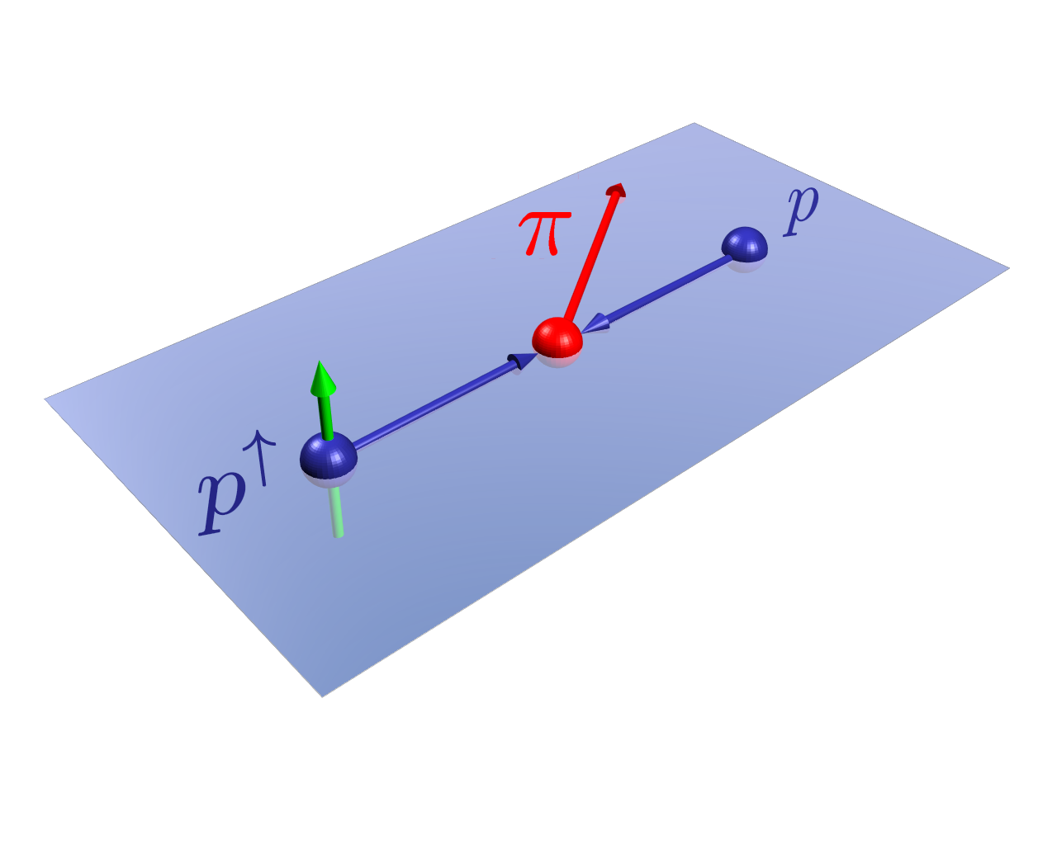

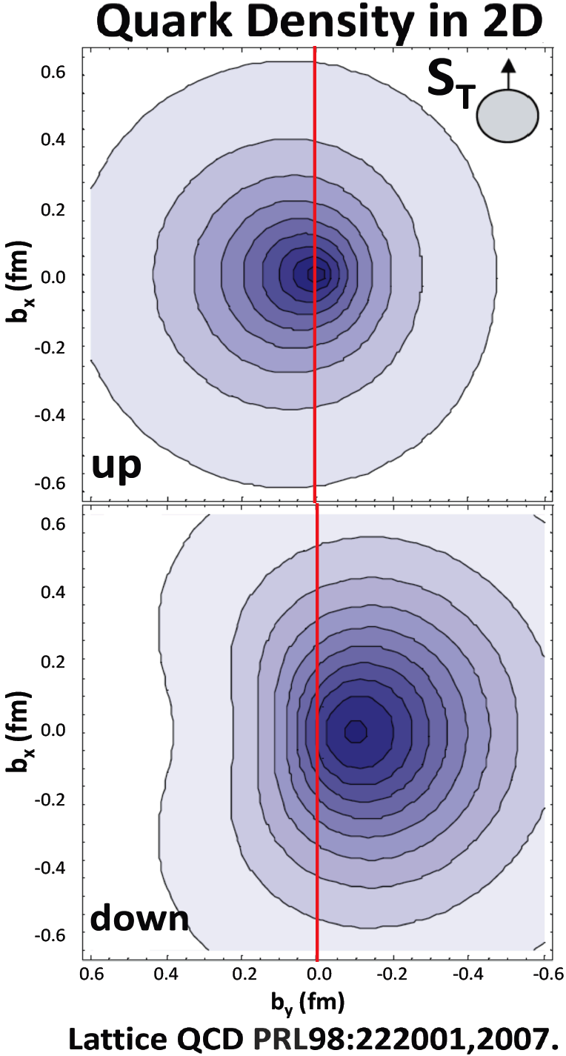
Quark Sivers Distribution Leads to Left-Right Bias
E704 √s =20 GeV. PLB 264 (1991) 462.
Sivers effect: quark’s transverse motion generates a left-right bias.
up-quarks favor the left, down-quarks favor the right (L_{u} ≈ - L_{d})
Valence quarks have a clear left-right bias due to orbital angular momentum.
Sea quark Sivers distribution =0 ?
Notes:
----- Meeting Notes (7/10/2014 12:09) -----
transverse proton

Slide 31
Accessing the quark Sivers distribution
Polarized target experiments
Left-right asymmetry in Semi-Inclusive Deep Inelastic Scattering (SIDIS) on a polarized nucleon
Left-right asymmetry in Drell-Yan di-muon production (DY) on a polarized nucleon
Never
done
Cornerstone prediction of QCD
The same quark Sivers distribution in both processes, but with opposite sign
Result of repulsive initial state (DY) vs attractive final state (SIDIS) interaction
Sivers =0 if no gluons

Slide 32
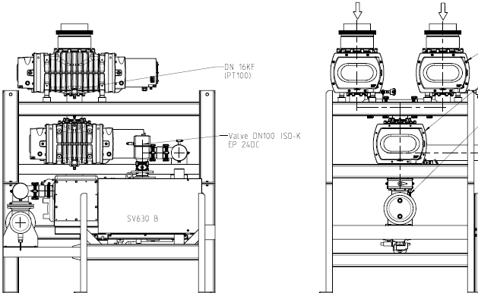
ROOTS Pumping System
μ- wave: 132 J/min, beam 14J/minute
100 liter liquid He/day
Requires 12,000 m³/hr pumping capacity
special requirements because of beam duty cycle
180 cm
150 cm

Slide 33
Planned Polarized Drell-Yan Experiments
Experiment | Particles | Energy (GeV) | x_{b} or x_{t} | Luminosity (cm⁻² s⁻¹) |  | P_{b} or P_{t} (f) | rFOM# | Timeline
COMPASS (CERN) | π± + p↑ | 160 GeV √s = 17 | x_{t} = 0.2 – 0.3 | 2 x 10³³ | 0.14 | P_{t} = 90% f = 0.22 | 1.1 x 10⁻³ | 2014, 2018
PANDA (GSI) | p + p↑ | 15 GeV √s = 5.5 | x_{t} = 0.2 – 0.4 | 2 x 10³² | 0.07 | P_{t} = 90% f = 0.22 | 1.1 x 10⁻⁴ | >2018
PAX (GSI) | p↑ + p | collider √s = 14 | x_{b} = 0.1 – 0.9 | 2 x 10³⁰ | 0.06 | P_{b} = 90% | 2.3 x 10⁻⁵ | >2020?
NICA (JINR) | p↑ + p | collider √s = 26 | x_{b} = 0.1 – 0.8 | 1 x 10³¹ | 0.04 | P_{b} = 70% | 6.8 x 10⁻⁵ | >2018
PHENIX (RHIC) | p↑ + p | collider √s = 500 | x_{b} = 0.05 – 0.1 | 2 x 10³² | 0.06 | P_{b} = 60% | 3.6 x 10⁻⁴ | >2018
SeaQuest (FNAL: E-906) | p + p | 120 GeV √s = 15 | x_{b} = 0.35 – 0.9 x_{t} = 0.1 – 0.45 | 3.4 x 10³⁵ | --- | --- | --- | 2012 - 2015
Pol tgt DY‡ (FNAL: E-1039) | p + p↑ | 120 GeV √s = 15 | x_{t} = 0.1 – 0.45 | 4.4 x 10³⁵ | 0 – 0.2* | P_{t} = 80% f = 0.176 | 0.13 | 2016
Pol beam DY§ (FNAL: E-1027) | p↑ + p | 120 GeV √s = 15 | x_{b} = 0.35 – 0.9 | 2 x 10³⁵ | 0.04 | P_{b} = 60% | 1 | 2018
 | ‡ 8 cm NH₃ target § L= 1 x 10³⁶ cm⁻² s⁻¹ (LH₂ tgt limited) / L= 2 x 10³⁵ cm⁻² s⁻¹ (10% of MI beam limited) *not constrained by SIDIS data / # rFOM = relative lumi * P² *f² wrt E-1027 (f=1 for pol p beams)
W. Lorenzon (U-Michigan)
Notes:
PPT:
Length of the target = 8 cm
Diameter of the target = 2 cm
Density of the solid NH3 target = 0.817 g/cm^3
Density of the NH3 beads = 0.554 g/cm^3
Nitrogen dilution factor = D_N = 0.823
Density of hydrogen = [0.554(1-0.823)] g/cm^3 = 0.098 g/cm^3 (need to calculate L1 for NH3 first)
L1 = N_p * I
where N_p = number of protons = 0.554 * 6.023e23 * 8/cm^2 = 2.7e24/cm^2.
And I = 1.6e11 p/s (E906 approved conditions)
So L1 = 4.4e35/cm^2
LH2 target:
length=50.8 cm, density = 0.0678 g/cm^3
So N_p = 2.1e24/cm^2
And I=0.95e11 p/s (expected from pol beam - see proposal for details)
So L2 = 2.0e35/cm^2
Ratio of pol tgt to pol beam lumi = 2.2 (does include all nucleons); 0.38 for only polarized p

Slide 34
COMPASS, E-1027, E-1039 (and Beyond)
 | Beam Pol. | Target Pol. | Favored Quarks | Physics Goals
 |  |  |  | (Sivers Function) |  |  | L_{sea}
 |  |  |  | sign change | size | shape
COMPASS | ✕ | ✔ | valence | ✔ | ✕ | ✕ | ✕
E-1027 | ✔ | ✕ | valence | ✔ | ✔ | ✔ | ✕
E-1039 | ✕ | ✔ | sea | ✕ | ✔ | ✔ | ✔
E-10XX | ✔ | ✔ | sea & valence | Transversity, Helicity, Other TMDs …

Slide 35
y
S_{T}
x
Φ_{S}
q
q_{T}
Beam
z

Slide 36
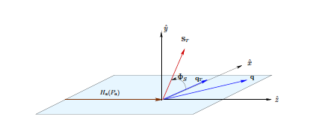
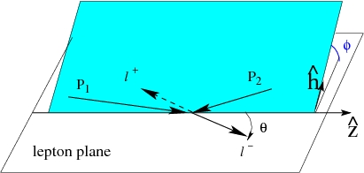
Observables and Kinematics
Drell Yan
Target Frame
SIDIS
Collins Soper frame: rest frame of virtual photon

Slide 37
σ = 310 MeV
Target
Dump

Slide 38
The meson cloud model explains the flavor asymmetry in the sea, and requires quarks to carry angular momentum.
|p>=p + Nπ + Δπ +…
Pions J^{p}=0⁻ Negative Parity
Need L=1 to get proton’s J^{p}=½⁺
π⁺
L_{π} = 1
Sea quarks should carry orbital angular momentum.

Slide 39
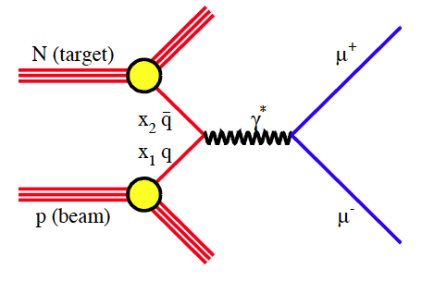
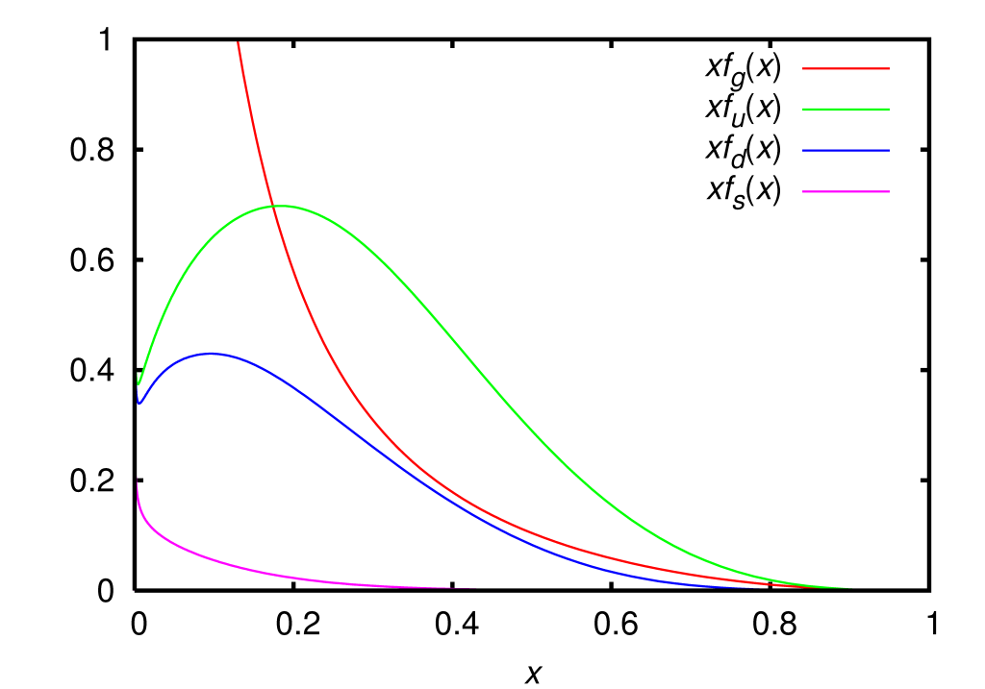
The Drell Yan Process
S. Drell and T.M.Yan Phys. Rev. Lett 25, 316 (1971)
Parton Distribution Functions
x = xP_{L} momentum fraction of the nucleon carried by the quark
* : virtual heavy photon produced
x₁,x₂:refer to beam and target quark
gluon
u
d
There are other DY processes: π⁺p,….
sea

Slide 40
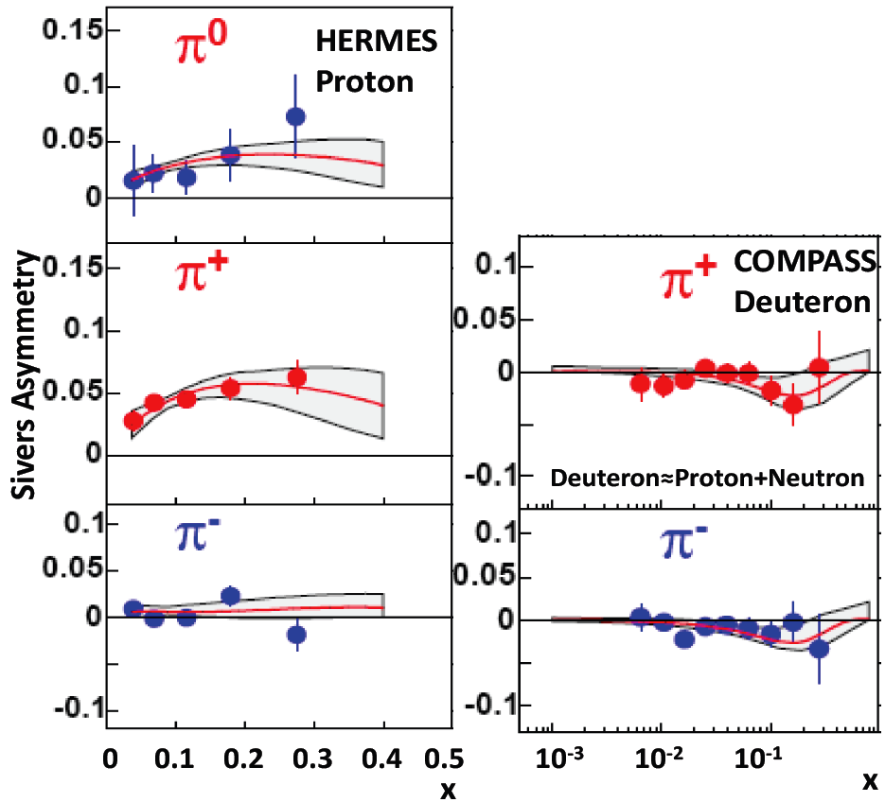
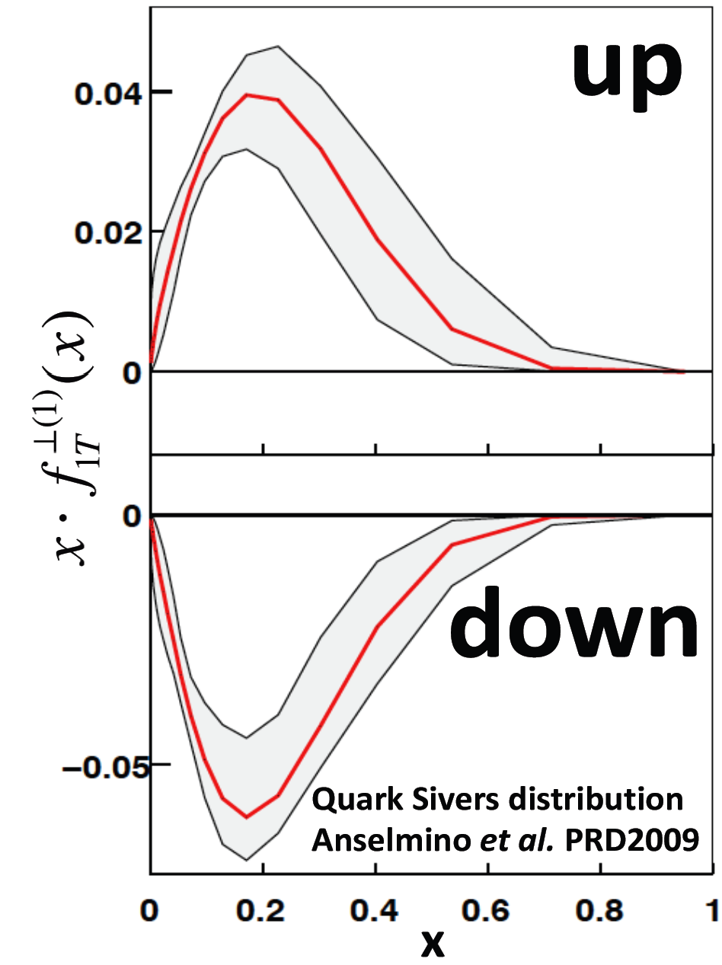
Quark Sivers Distributions: fit to HERMES and COMPASS data (2009)
Semi-Inclusive Deep-Inelastic Scattering on transversely polarized targets
Involves quark fragmentation functions.
Valence quark overwhelmingly dominate.
Limited sensitivity to sea quark leads to zero sea quark Sivers distribution.
➔ large uncertainties in Sivers distribution
up-quark favors left (L_{u}>0),
down-quark favors right (L_{d}<0).
2002-2004
2002-2004
L_{u} ≈ - L_{d}

Slide 41
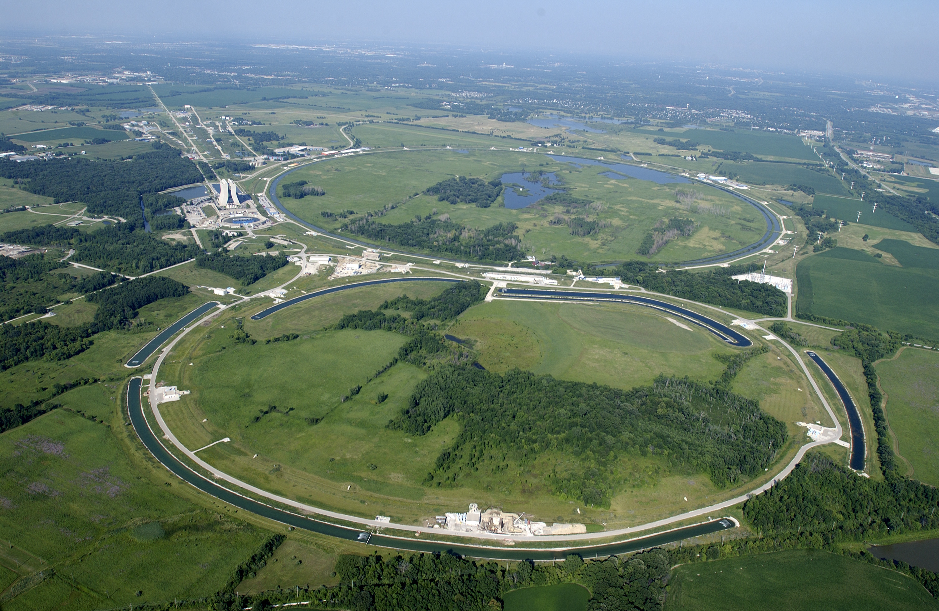
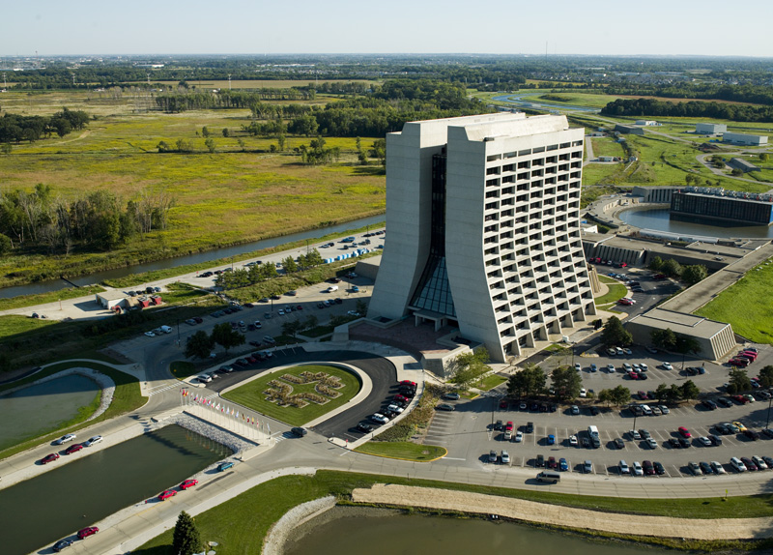
Beam @FNAL
1*10¹³ p / minute
5 s spill
120 GeV protons from main injector
KTev beam line
√s = 15 GeV
10% interaction length target

Slide 42
Overview
Motivation and Current Situation
Discussion of Experiment
Summary and Outlook

