Slide 1



Polarized Protons in the Fermilab
Main Injector
Wolfgang Lorenzon
(12-September-2013)
PSTP 2013
Sivers Function in Polarized Drell-Yan
  fundamental QCD prediction:
Polarized Drell-Yan at Fermilab
  polarized Beam (E-1027) or Target (E-1039)
Main Injector Polarization Scheme
  present status & plans
This work is supported by

Slide 2
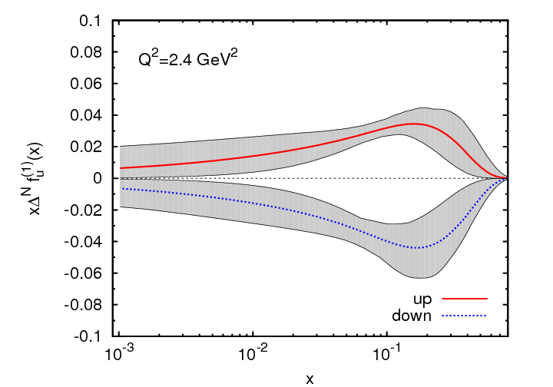
Sivers Function
describes transverse-momentum
distribution of unpolarized quarks inside transversely polarized proton
captures non-perturbative spin-orbit
coupling effects inside a polarized proton
Sivers function is naïve time-reversal odd
leads to
  sin(φ – φ_{S}) asymmetry in SIDIS
  sinφ_{b} asymmetry in Drell-Yan
measured in SIDIS (HERMES, COMPASS)
future measurements at Jlab@12 GeV planned
Anselmino et al. (arXiv:1107.4446 [hep-ph])
x
First moment of Sivers functions:
  u- and d- Sivers have opposite signs, of roughly equal magnitude

Slide 3
Polarized Drell-Yan Experiment
NOT Yet Done!
Access to transverse-momentum dependent distribution (TMD) functions
    Sivers, Boer-Mulders, etc
Transversely Polarized Beam or Target
    Sivers function in single-transverse spin asymmetries (sea quarks or valence quarks)
      − valence quarks constrain SIDIS data much more than sea quarks
      − global fits indicate that sea quark Sivers function is small
    transversity Boer-Mulders function
    baryon production, incl. pseudoscalar and vector meson production,
    elastic scattering, two-particle correlations, J/ψ and charm production
Beam and Target Transversely Polarized
    flavor asymmetry of sea-quark polarization
    transversity (quark anti-quark for pp collisions)
      − anti-quark transversity might be very small

Slide 4
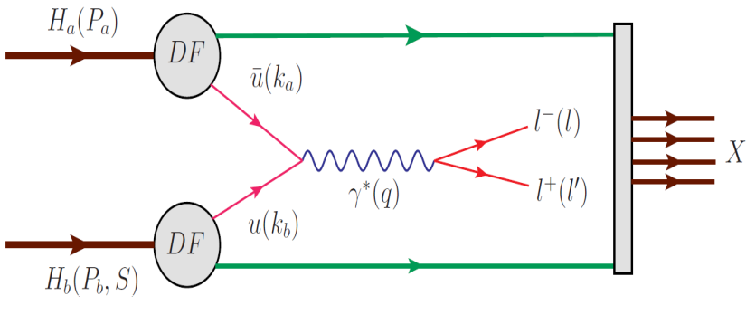
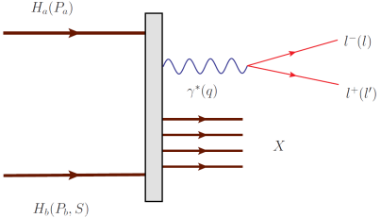
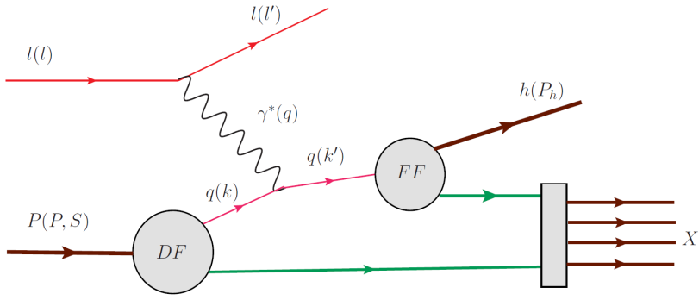
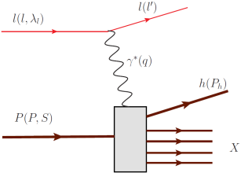
Drell Yan Process
Similar Physics Goals as SIDIS:
  parton level understanding of nucleon
  electromagnetic probe
timelike (Drell-Yan) vs. spacelike (SIDIS) virtual photon
Drell-Yan
SIDIS
A. Kotzinian, DY workshop, CERN, 4/10
Cleanest probe to study hadron structure:
  hadron beam and convolution of parton distributions
  no QCD final state effects
  no fragmentation process
  ability to select sea quark distribution
  allows direct sensitivity of transverse momentum-dependent distribution (TMD)
  functions (Sivers, Boer-Mulders, etc)

Slide 5
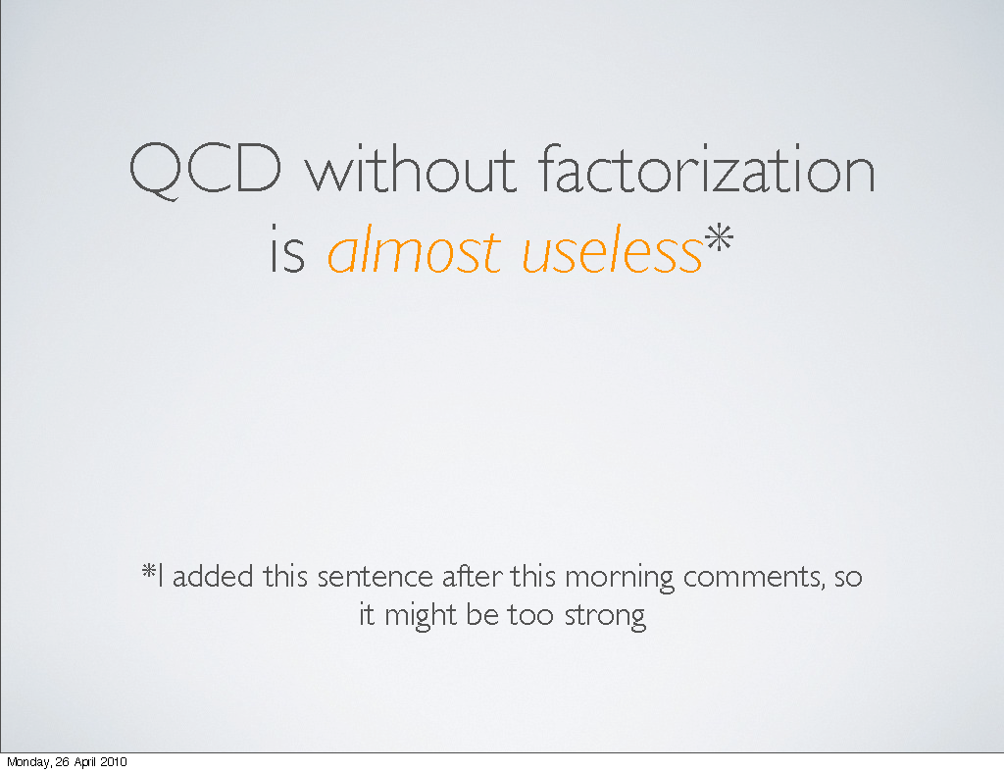
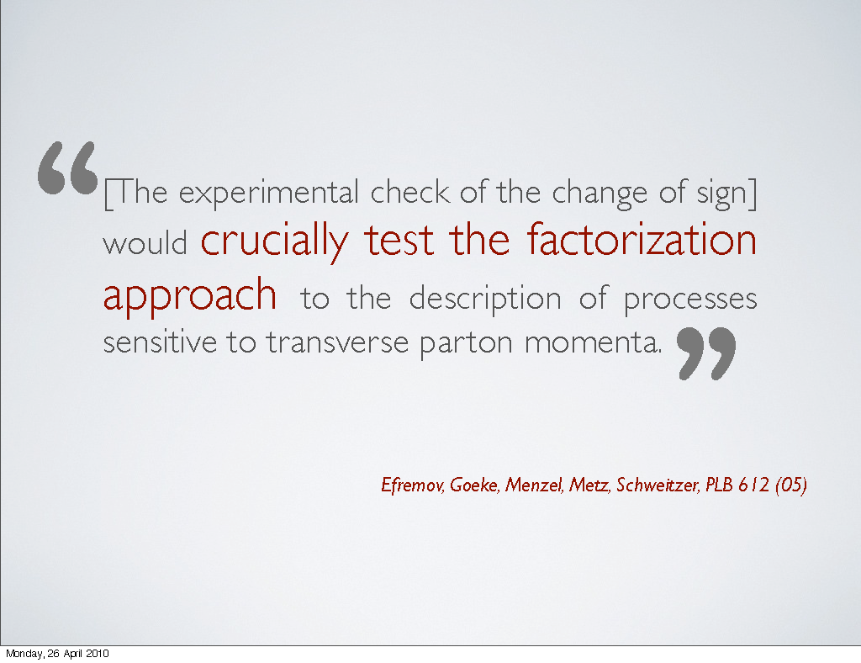
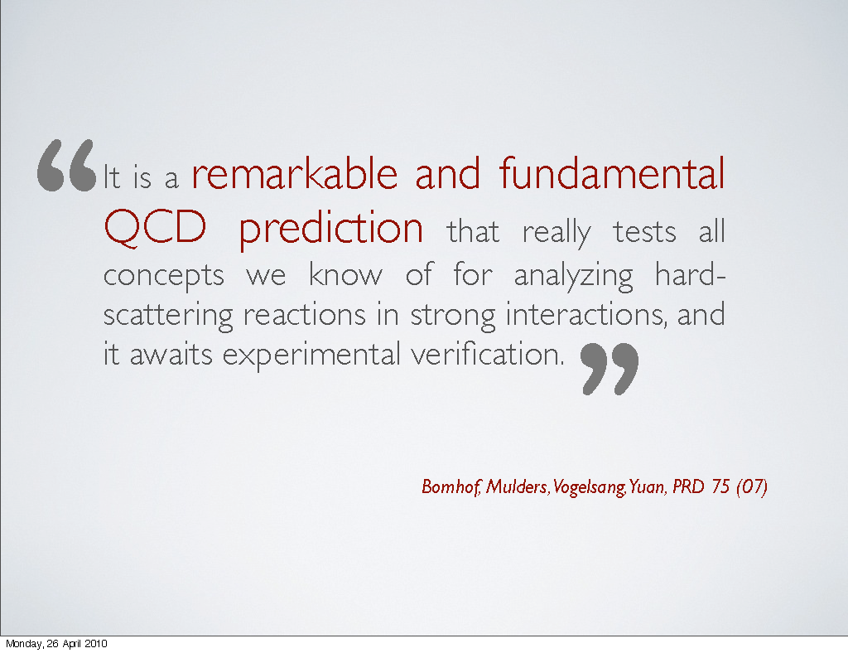
Sivers in Drell-Yan vs SIDIS: The Sign Change
fundamental prediction of QCD (in non-perturbative regime)
  goes to heart of gauge formulation of field theory
Polarized Drell-Yan:
  major milestone in hadronic physics
  (HP13)
Importance of factorization in QCD:
A. Bacchetta , DY workshop, CERN, 4/10

Slide 6
Planned Polarized Drell-Yan Experiments
experiment | particles | energy | x_{b} or x_{t} | Luminosity | timeline
COMPASS (CERN) | π± + p↑ | 160 GeV √s = 17.4 GeV | x_{t} = 0.2 – 0.3 | 2 x 10³³ cm⁻² s⁻¹ | 2014, 2018
PAX (GSI) | p↑ + p_{bar} | collider √s = 14 GeV | x_{b} = 0.1 – 0.9 | 2 x 10³⁰ cm⁻² s⁻¹ | >2017
PANDA (GSI) | p_{bar} + p↑ | 15 GeV √s = 5.5 GeV | x_{t} = 0.2 – 0.4 | 2 x 10³² cm⁻² s⁻¹ | >2016
NICA (JINR) | p↑ + p | collider √s = 20 GeV | x_{b} = 0.1 – 0.8 | 1 x 10³⁰ cm⁻² s⁻¹ | >2014
PHENIX (RHIC) | p↑ + p | collider √s = 500 GeV | x_{b} = 0.05 – 0.1 | 2 x 10³² cm⁻² s⁻¹ | >2018
RHIC internal target phase-1 | p↑ + p | 250 GeV √s = 22 GeV | x_{b} = 0.25 – 0.4 | 2 x 10³³ cm⁻² s⁻¹
RHIC internal target phase-1 | p↑ + p | 250 GeV √s = 22 GeV | x_{b} = 0.25 – 0.4 | 6 x 10³⁴ cm⁻² s⁻¹
SeaQuest (unpol.) (FNAL) | p + p | 120 GeV √s = 15 GeV | x_{b} = 0.35 – 0.85 x_{t} = 0.1 – 0.45 | 3.4 x 10³⁵ cm⁻² s⁻¹ | 2012 - 2015
polDY§ (FNAL) | p↑ + p | 120 GeV √s = 15 GeV | x_{b} = 0.35 – 0.85 | 2 x 10³⁵ cm⁻² s⁻¹ | >2016
 | § L= 1 x 10³⁶ cm⁻² s⁻¹ (LH₂ tgt limited) / L= 2 x 10³⁵ cm⁻² s⁻¹ (10% of MI beam limited)

Slide 7
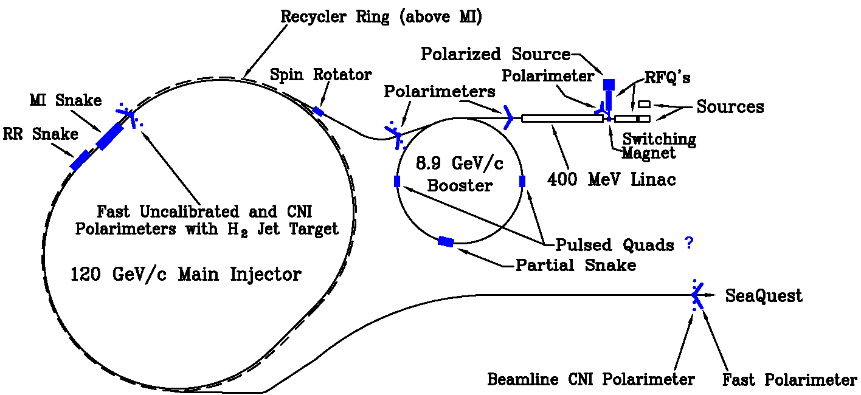
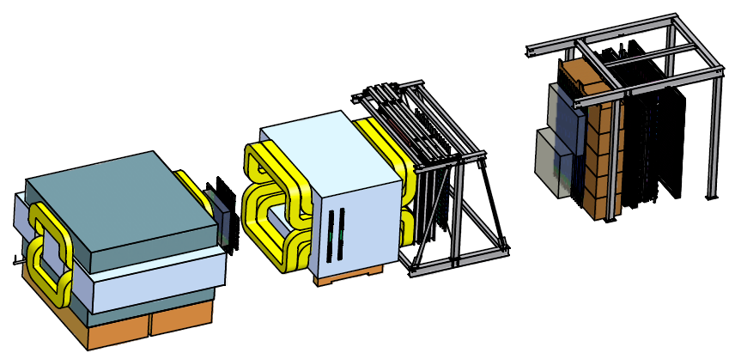
Polarized Drell-Yan at Fermilab Main Injector
Polarize Beam in Main Injector & use SeaQuest di-muon spectrometer
  measure Sivers asymmetry
SeaQuest di-muon Spectrometer
  fixed target experiment, optimized for Drell-Yan
  luminosity: L_{av} = 3.4 x 10³⁵ /cm²/s
    I_{av} = 1.6 x 10¹¹ p/s (=26 nA) / N_{p}= 2.1 x 10²⁴ /cm²
  approved for 2-3 years of running: 3.4 x 10¹⁸ pot
  by 2015: fully understood, ready to take pol. beam

Slide 8
Polarized Drell-Yan at Fermilab Main Injector - II
Polarized Beam in Main Injector
  use SeaQuest target
    liquid H₂ target can take about I_{av} = 5 x 10¹¹ p/s (=80 nA)
  1 mA at polarized source can deliver about I_{av} = 1 x 10¹² p/s (=150 nA)
  for 100% of available beam time (A. Krisch: Spin@Fermi report in (Aug 2011): arXiv:1110.3042 [physics.acc-ph])
    26 μs linac pulses, 15 Hz rep rate, 12 turn injection into booster, 6 booster pulses into Recycler Ring, followed by 6 more pulses using slip stacking in MI
    1 MI pulse = 1.9 x 10¹² p
    using three 2-sec cycles/min (~10% of beam time):
    → 2.8 x 10¹² p/s (=450 nA) instantaneous beam current , and I_{av} = 0.95 x 10¹¹ p/s (=15 nA)
  Luminosity considerations:
    L_{av} = 2.0 x 10³⁵ /cm²/s (beam-time limited)
    L_{av} = 1 x 10³⁶ /cm²/s (target heating limited)

Slide 9
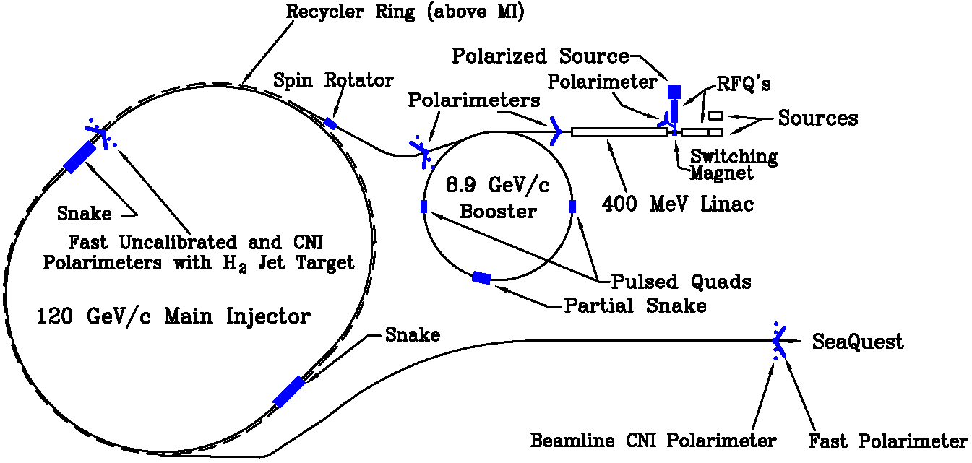
From 2 Siberian Snakes to 1 Snake
2 Siberian Snakes in MI
(not enough space)
1 Siberian Snake in MI
(fits well)
plus 1 solenoid snake in RR

Slide 10
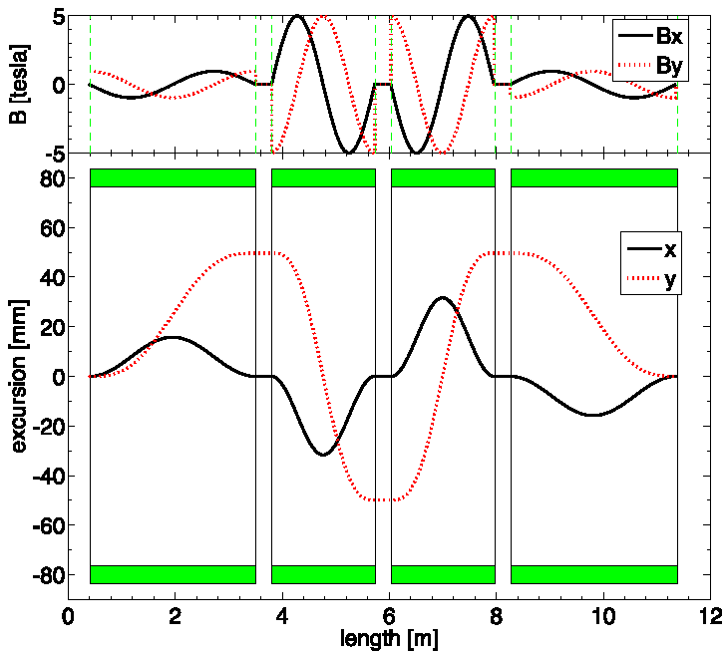
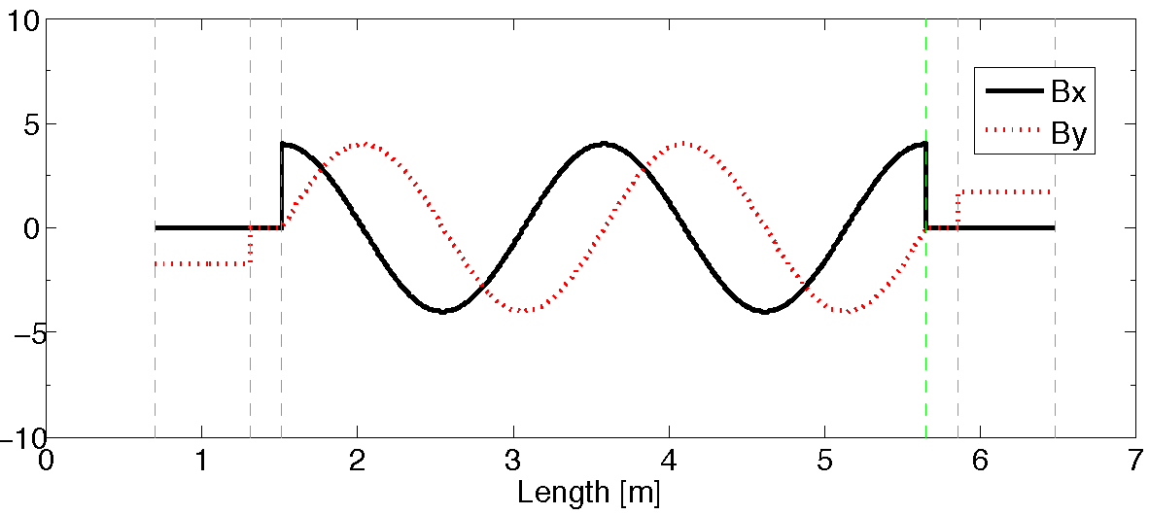
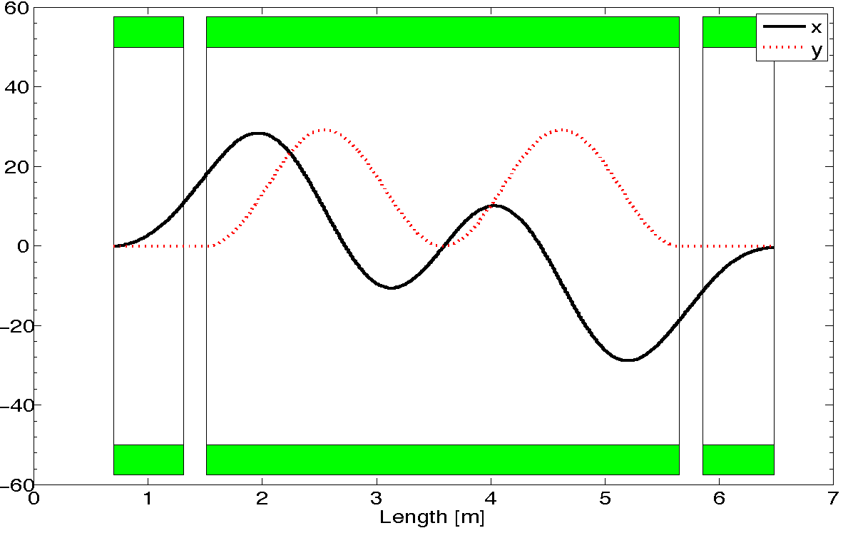
From 2 Siberian Snakes to 1 Snake - II
2-snake design (11m long):
4 helical dipoles / snake
  2 helices: 5T / 3.1m / 6” ID
  2 helices : 5T / 2.1m / 6” ID (cold)
1-snake design (5.8m long):
1 helical dipole + 2 conv. dipoles
  helix: 4T / 4.2 m / 4” ID
  dipoles: 4T / 0.62 m / 4” ID (warm)
does not fit
fits well
T. Roser (BNL): - test snakes/rotators up to 5.4T
- operation not above 4T

Slide 11
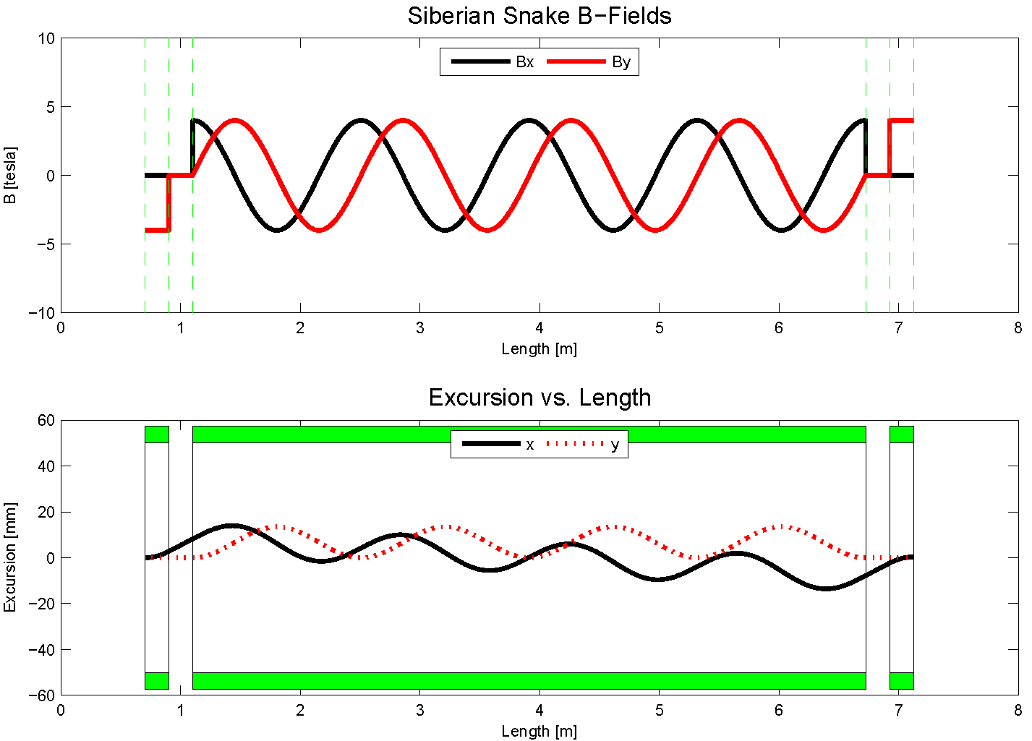
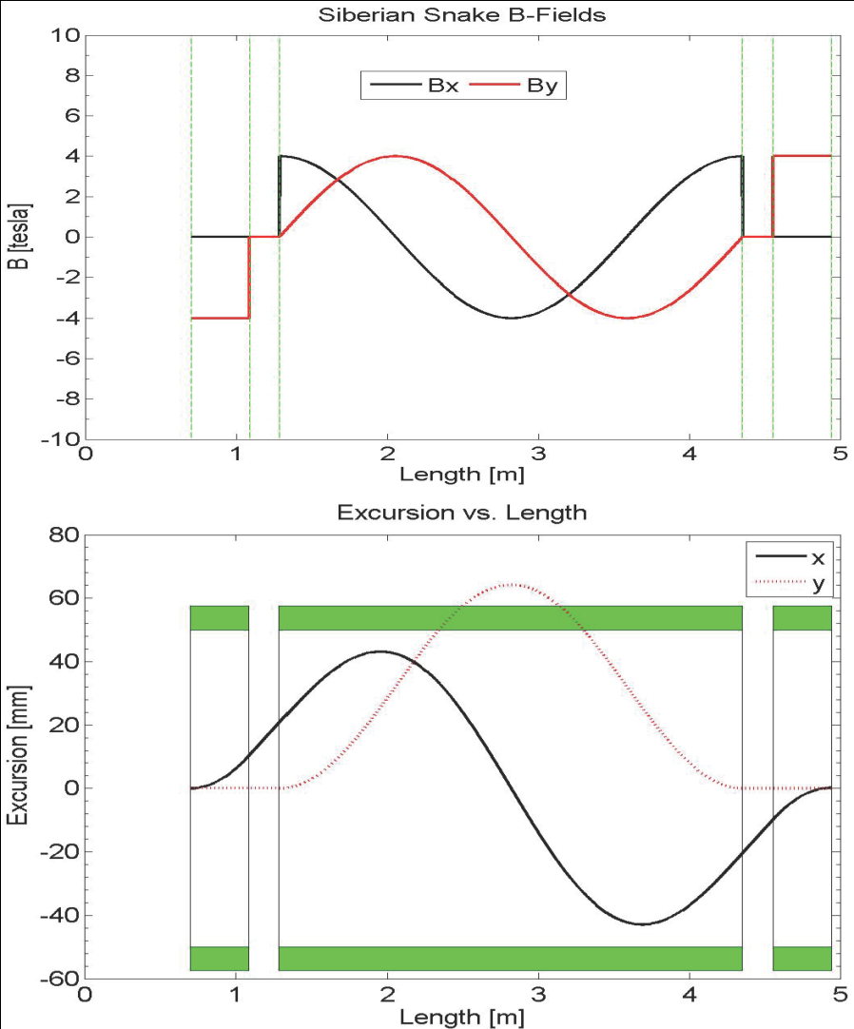
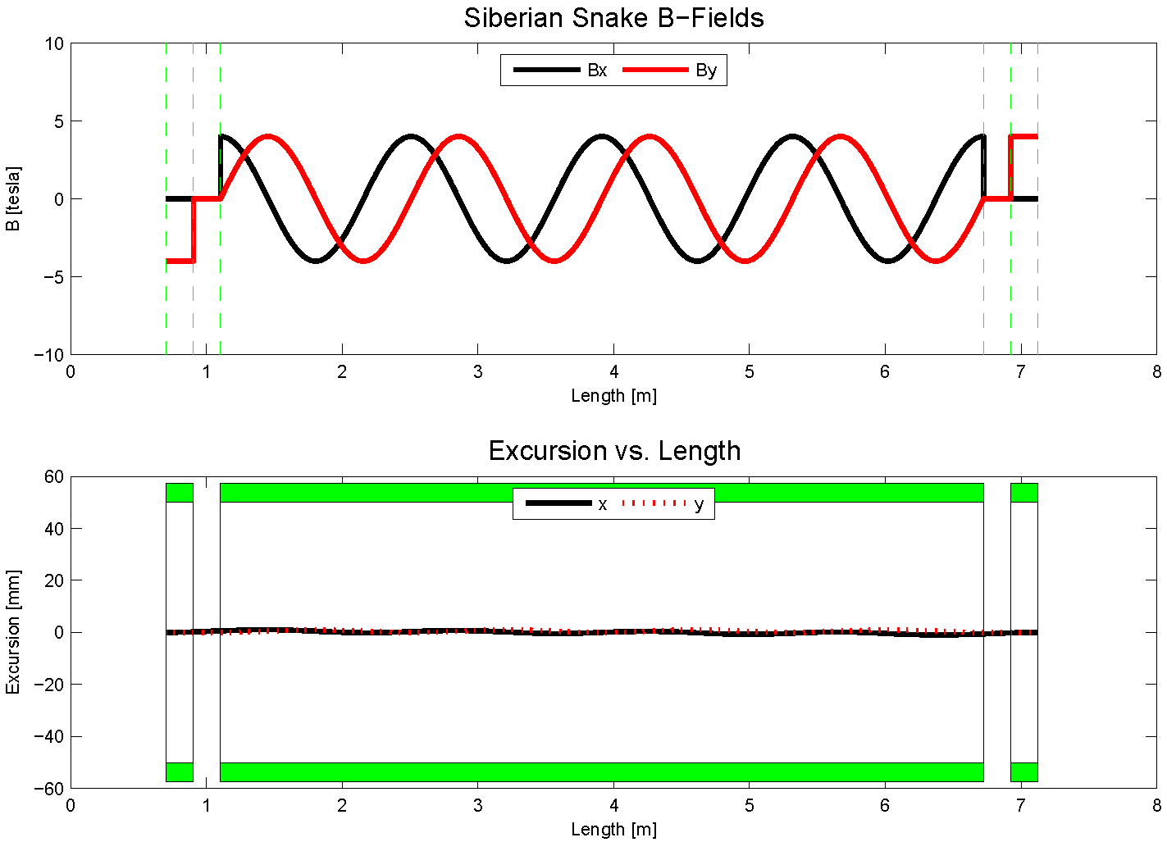
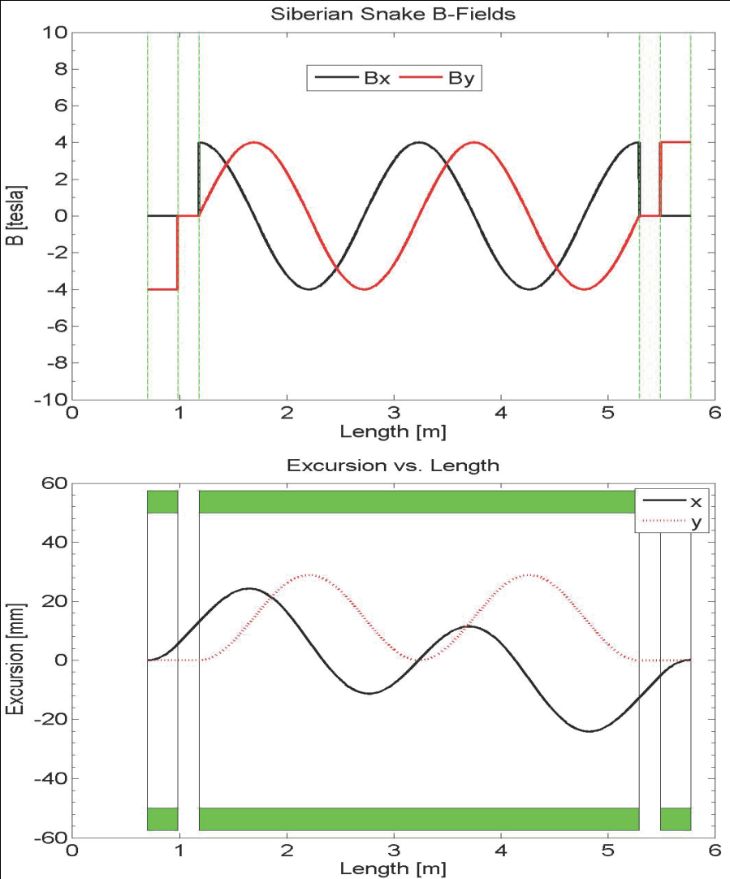
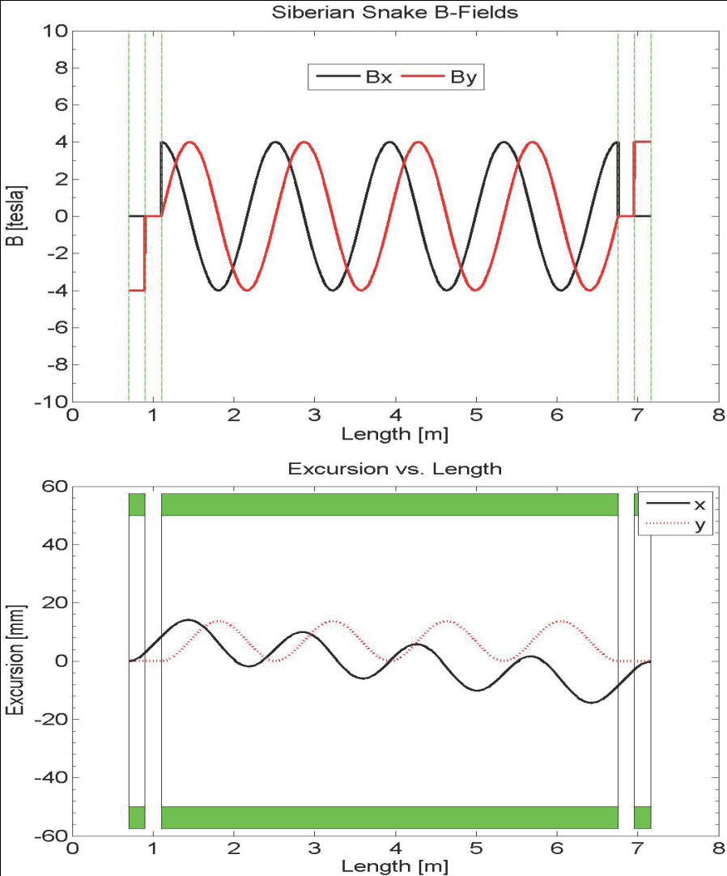
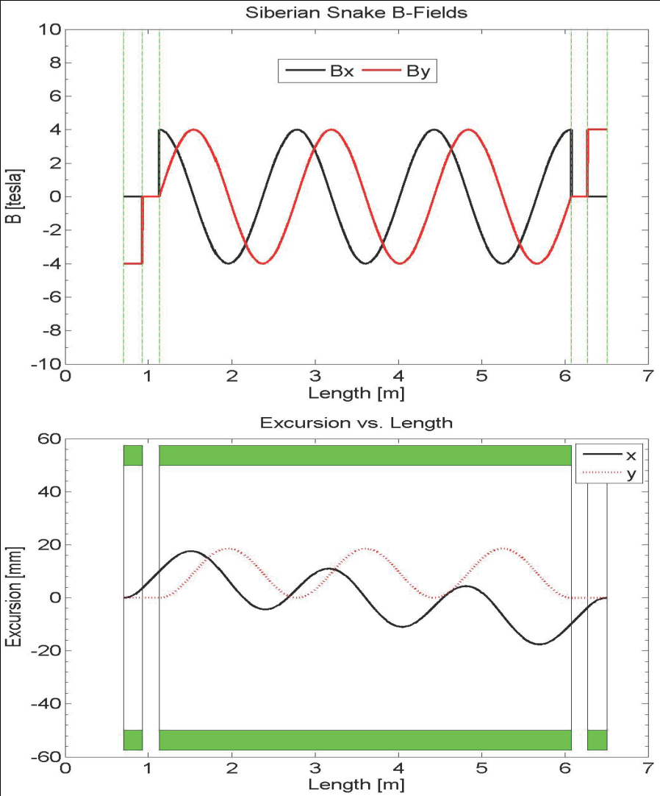
Steady Improvements to 1 Snakes solution - I
8.9 GeV 4T
4-twist 4T
8.9 GeV
120 GeV
beam excursions shrink w/ number of twists
beam excursions shrink w/ beam energy

Slide 12
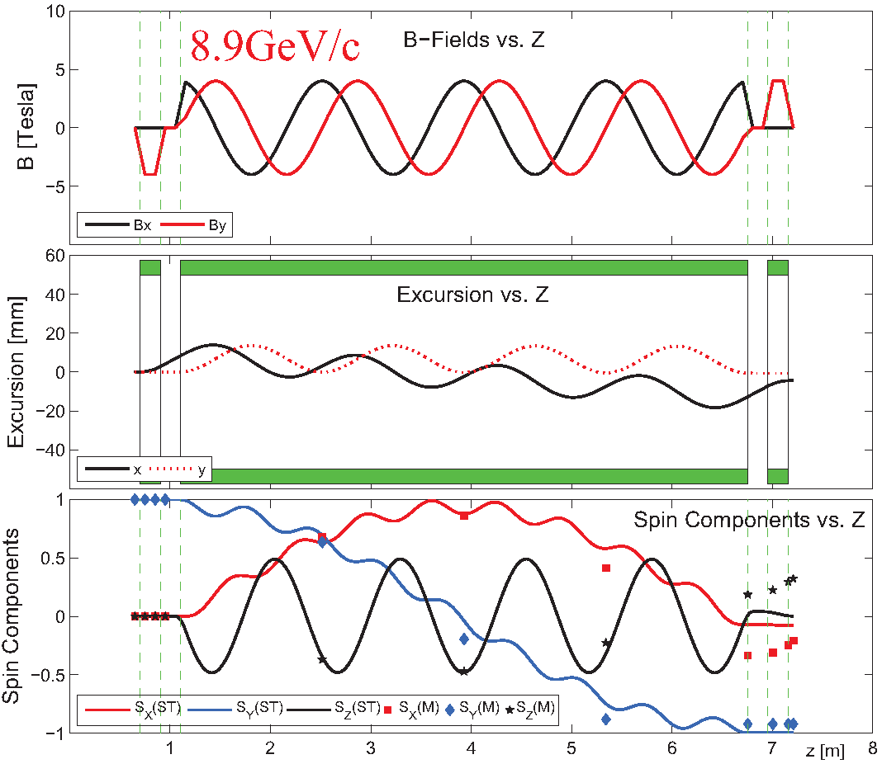
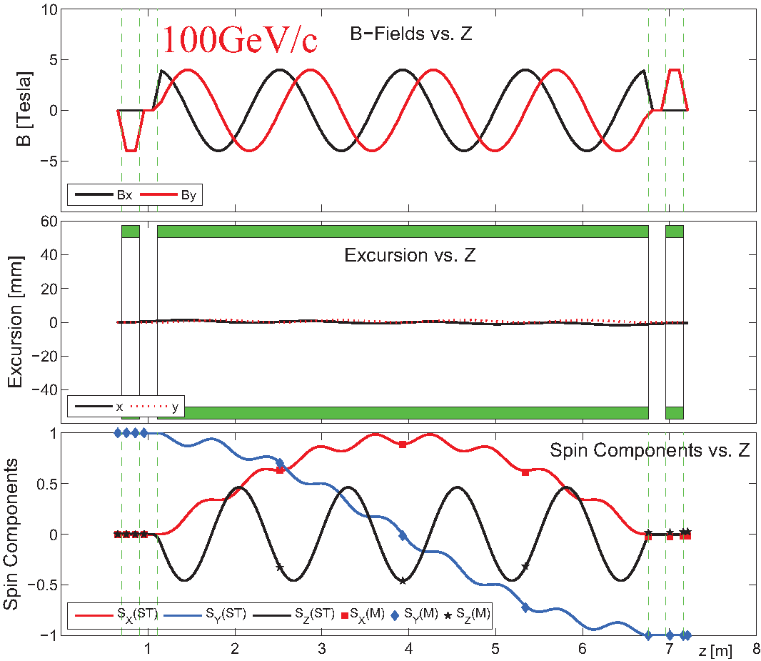
Steady Improvements to 1 Snakes solution - II
Including fringe fields
x, y, z spin components vs distance
transport matrix formalism (E.D. Courant): fringe field not included, β = 1 (fixed)
spin tracking formalism (Thomas-BMT): fringe field included, β varibale
fringe fields have <0.5% effect at 8.9 GeV and <<0.1% effect at 100 GeV [arXiv: 1309.1063]

Slide 13
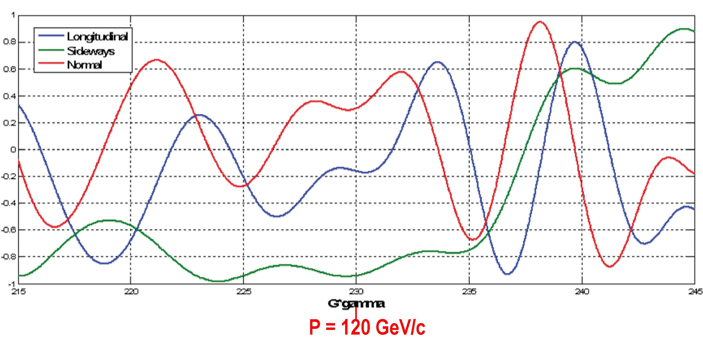
Spin direction control for extracted beam
Spin rotators used to control spin direction at BNL
Spin@Fermi collaboration recent studies (to save $$)
  rotate beam at experiment by changing proton beam energy around nominal 120 GeV
  radial (“sideways”) / vertical (“normal”)
Spin component magnitudes
112 GeV/c
128 GeV/c
124.5 GeV/c
Notes:
Beam direction can be rotated w/in the horizontal plane or into the vertical direction as required by the experiments. This is at the end of a 2.4 km long beam line with 140 bending magnets, some w/ horizontal fields, some w/ vertical and some w/ skew fields.

Slide 14
The Path to a polarized Main Injector
Stage 1 approval from Fermilab: 14-November-2012
Collaboration with A.S. Belov at INR and Dubna to develop polarized source
Detailed machine design and costing using 1 snake in MI
  Spin@Fermi collaboration provide design
    get latest lattice for NOVA:
      translate “mad8” optics file to spin tracking code (“zgoubi”)
    determine intrinsic resonance strength from depolarization calculations
    do single particle tracking with “zgoubi” with novel single-snake
    set up mechanism for adding errors into the lattice:
      orbit errors, quadrupole mis-alignments/rolls, etc.
    perform systematic spin tracking
      explore tolerances on beam emittance
      explore tolerances on various imperfections: orbit / snake / etc
  Fermilab (AD) does verification & costing

Slide 15
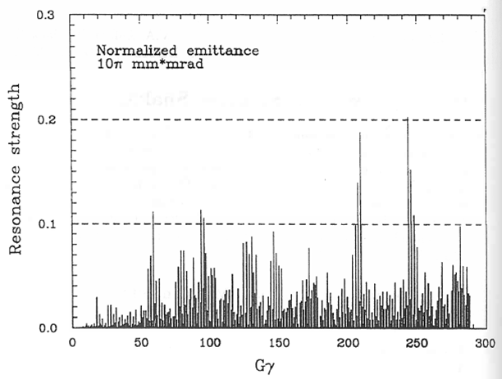
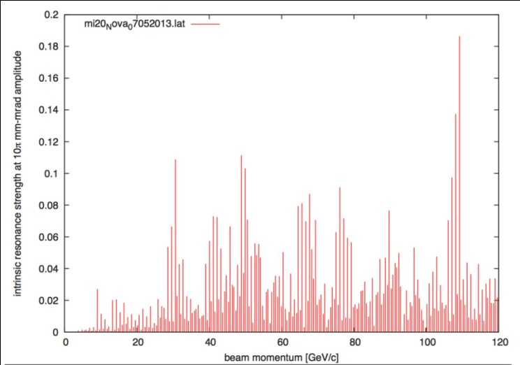
Intrinsic Resonance Strength in Main Injector
Depol calculations: single particle at 10π mm-mrad betatron amplitude
1995 Spin@Fermi report
  before MI was built
using NOVA lattice (July 2013)
very similar: largest resonance strength just below 0.2
  one snake sufficient (E. Courant rule of.thumb)

Slide 16
Polarized Target at Fermilab (E-1039)
Probe Sea-quark Sivers Asymmetry
with a polarized proton target at SeaQuest
sea-quark Sivers function poorly known
significant Sivers asymmetry expected
from meson-cloud model
KMAG
FMAG
Polarized Target
use current SeaQuest setup
a polarized proton target, unpolarized beam
Proton Beam 120 GeV/c
Ref: Andi Klein (ANL)

Slide 17
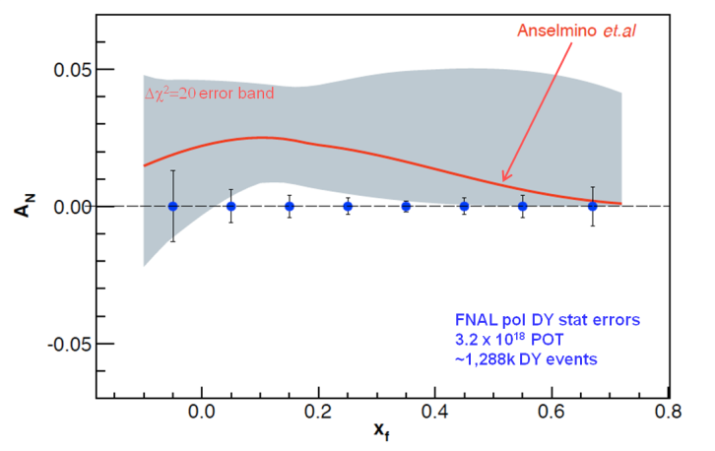
Summary
QCD (and factorization) require sign change
Fermilab is arguably best place to do this measurement
    high luminosity, large x-coverage
    spectrometer already setup and running
Run alongside neutrino program (10% of beam needed)
Measure DY with both Beam or/and Target polarized
    broad spin physics program possible
Path to polarized proton beam at Main Injector
    perform detailed machine design and costing studies
      proof that single-snake concept works
      applications for JPARC, NICA, ….
    Secure funding
Fermilab

Slide 18
The END

Slide 19
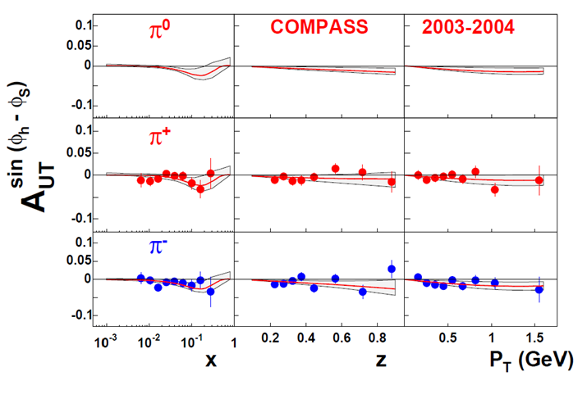
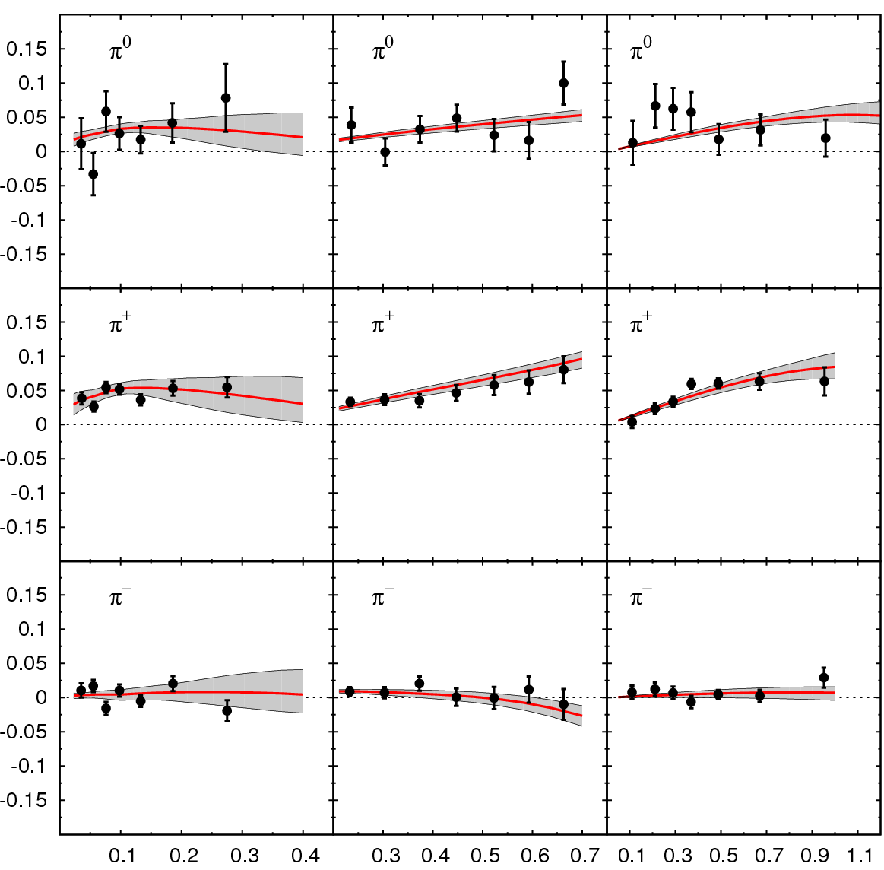
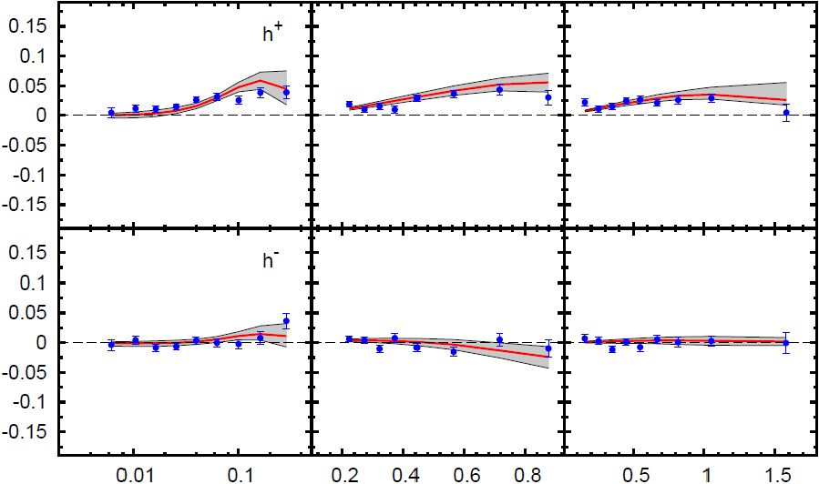
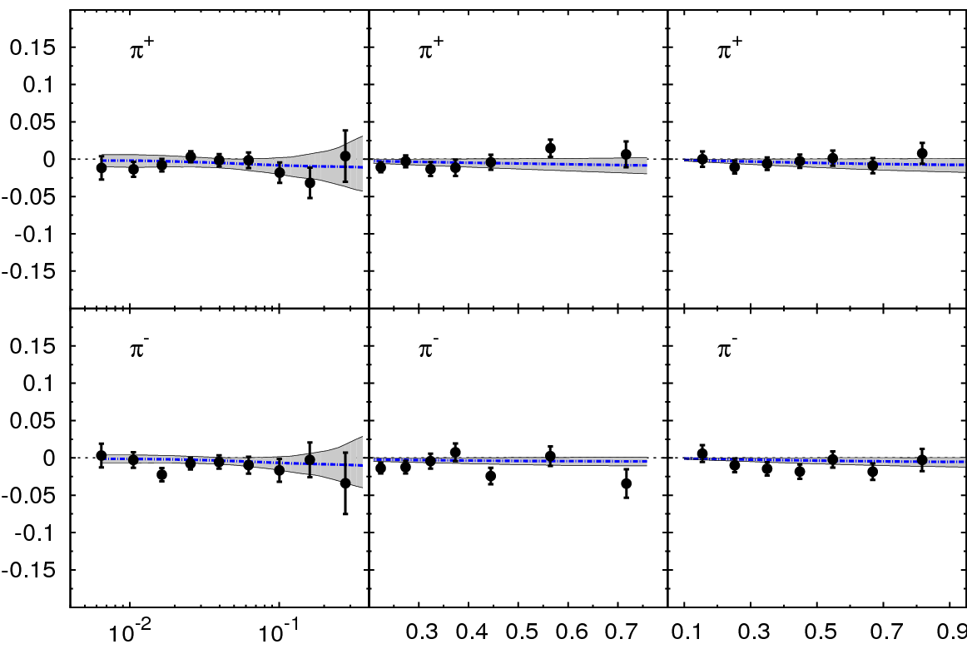
Sivers Asymmetry in SIDIS
HERMES (p)
COMPASS (p)
π⁰
h⁺
π⁺
h⁻
π⁻
x z P_{T} (GeV)
COMPASS (d)
π⁺
Global fit to sin (φ_{h} – φ_{S}) asymmetry in SIDIS (HERMES (p), COMPASS (p), COMPASS (d))
π⁻
x z P_{T} (GeV)
Comparable measurements needed in Drell-Yan process

Slide 20
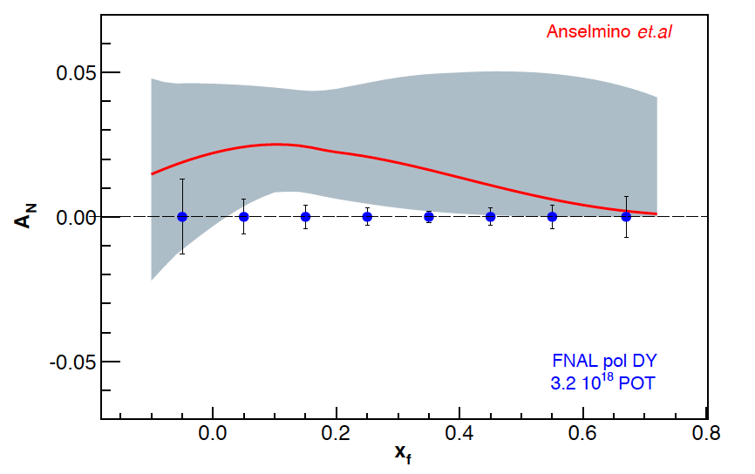
Sivers Asymmetry at Fermilab Main Injector
Experimental Sensitivity
  luminosity: L_{av} = 2 x 10³⁵ (10% of available beam time: I_{av} = 15 nA)
  3.2 x 10¹⁸ total protons for 5 x 10⁵ min: (= 2 yrs at 50% efficiency) with P_{b} = 70%
  Can measure not only sign, but also the size & maybe shape of the Sivers function !
Δχ²=20 error band
Note:
~650k DY events
FNAL pol DY stat errors
3.2 x 10¹⁸ POT
~1,288k DY events
330k DY events
Notes:
Note that SSA A_N^sin(phi-phi_s) is scaled by 2/pi

Slide 21
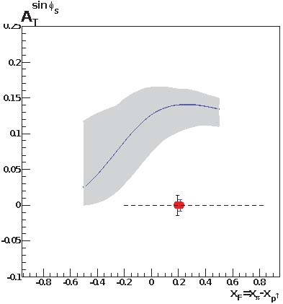
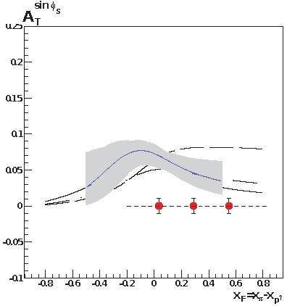
Main Competition: COMPASS
COMPASS statistical significance after two years of running for M_{γ} > M_{J/Ψ}
approved for one year run at LHC restart
  2nd year after 2 years of Primakoff measurements
for comparison of Sivers function need to measure entire function
  must evolve to same Q²
  cannot do QCD evolution on a point
for M_{γ} < M_{J/Ψ} significant contamination from many sources
  charm decays that appear to reconstruct to low mass
  combinatorial background
2.0 GeV < M_{γ} < 2.5 GeV

