Slide 1
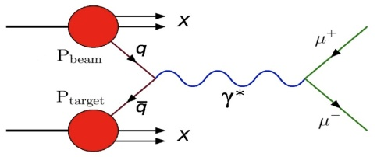

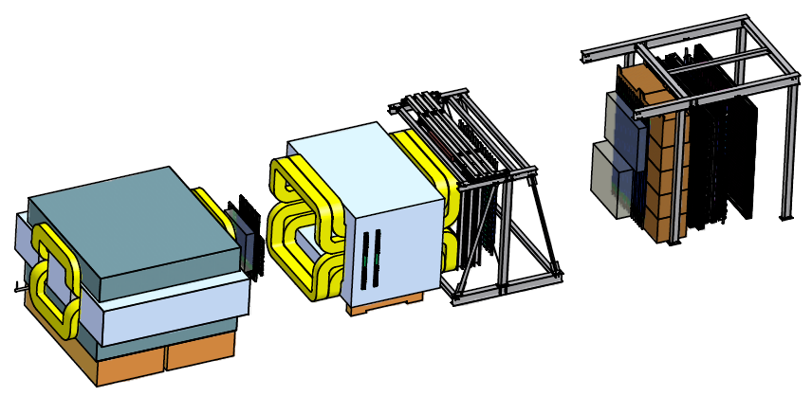


Polarized Drell-Yan at Fermilab
Wolfgang Lorenzon
(20-May-2013)
Workshop on
Opportunities for Polarized Physics at Fermilab
Single Spin Asymmetries and Sivers Function
Sivers Function in Polarized Drell-Yan
  fundamental QCD prediction:
Polarized Drell-Yan at Fermilab
  polarized Beam or Target
Main Injector Polarization Scheme
SeaQuest Spectrometer
This work is supported by

Slide 2
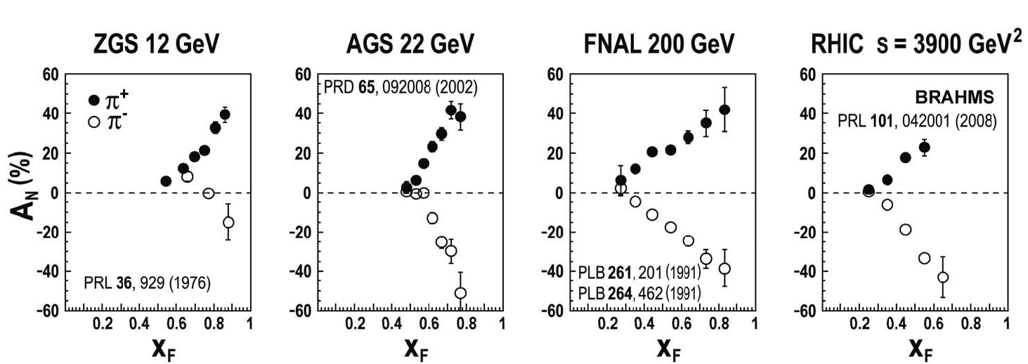
Single Spin Asymmetries in p↑p → πX
(huge) single spin asymmetries for forward meson production in hadron-hadron interactions have been observed over a wide range of c.m. energies
C. Aidala SPIN 2008 Proceeding and CERN Courier June 2009
“E704 effect”:
  polarized beam at Fermilab (tertiary beam from production & decay of hyperons)
  beam intensity too low for DY
possible explanation for large inclusive asymmetries:
  Sivers distribution function, or Collins fragmentation function

Slide 3
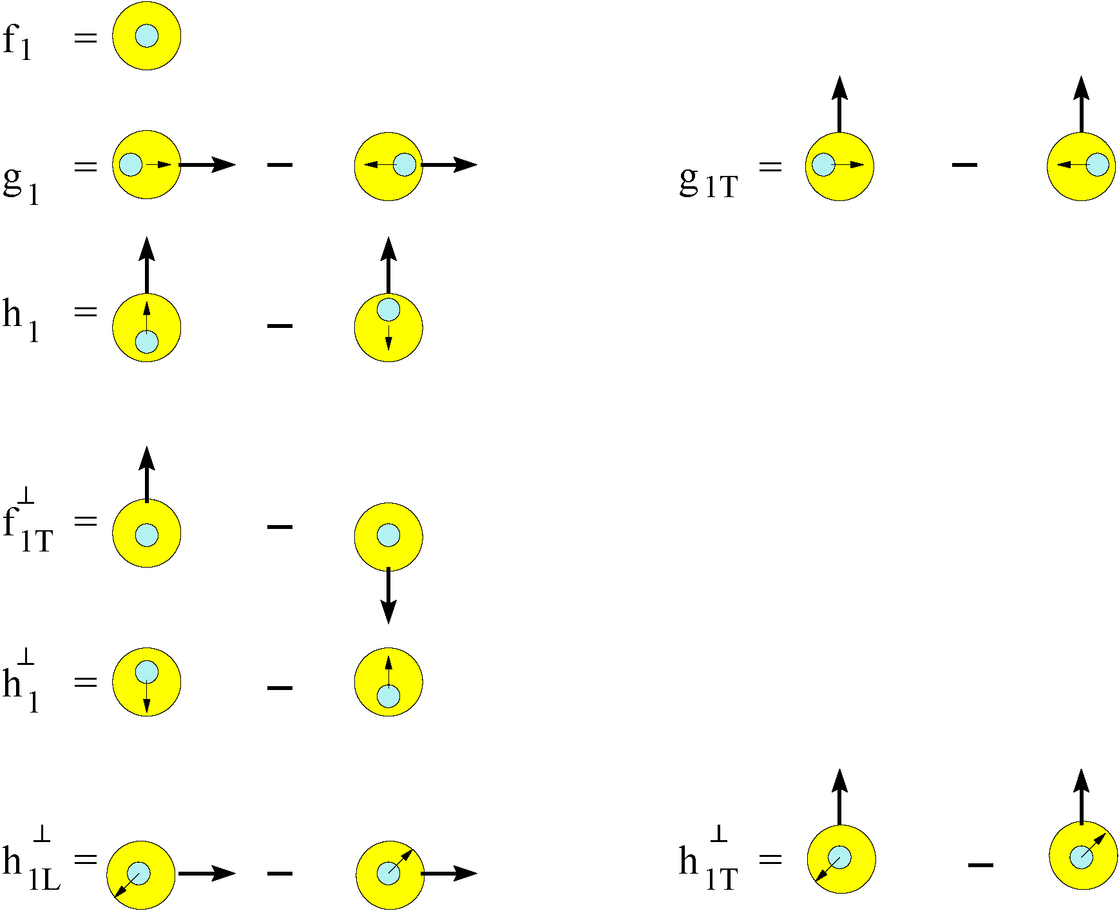
Transverse Momentum Distributions (Introduction)
survive k_{T} integration
Sivers Function
k_{T} - dependent, T-even
k_{T} - dependent,
Naïve T-odd
Boer-Mulders Function

Slide 4
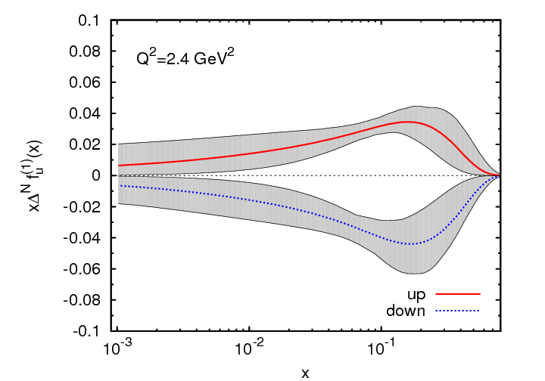
Sivers Function
describes transverse-momentum
distribution of unpolarized quarks inside transversely polarized proton
captures non-perturbative spin-orbit
coupling effects inside a polarized proton
Sivers function is naïve time-reversal odd
leads to
  sin(φ – φ_{S}) asymmetry in SIDIS
  sinφ_{b} asymmetry in Drell-Yan
measured in SIDIS (HERMES, COMPASS)
future measurements at Jlab@12 GeV planned
Anselmino et al. (arXiv:1107.4446 [hep-ph])
x
First moment of Sivers functions:
  u- and d- Sivers have opposite signs, of roughly equal magnitude

Slide 5
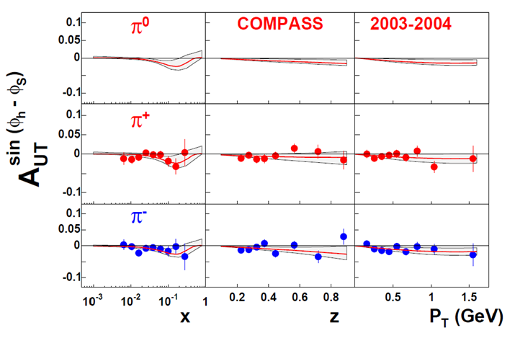
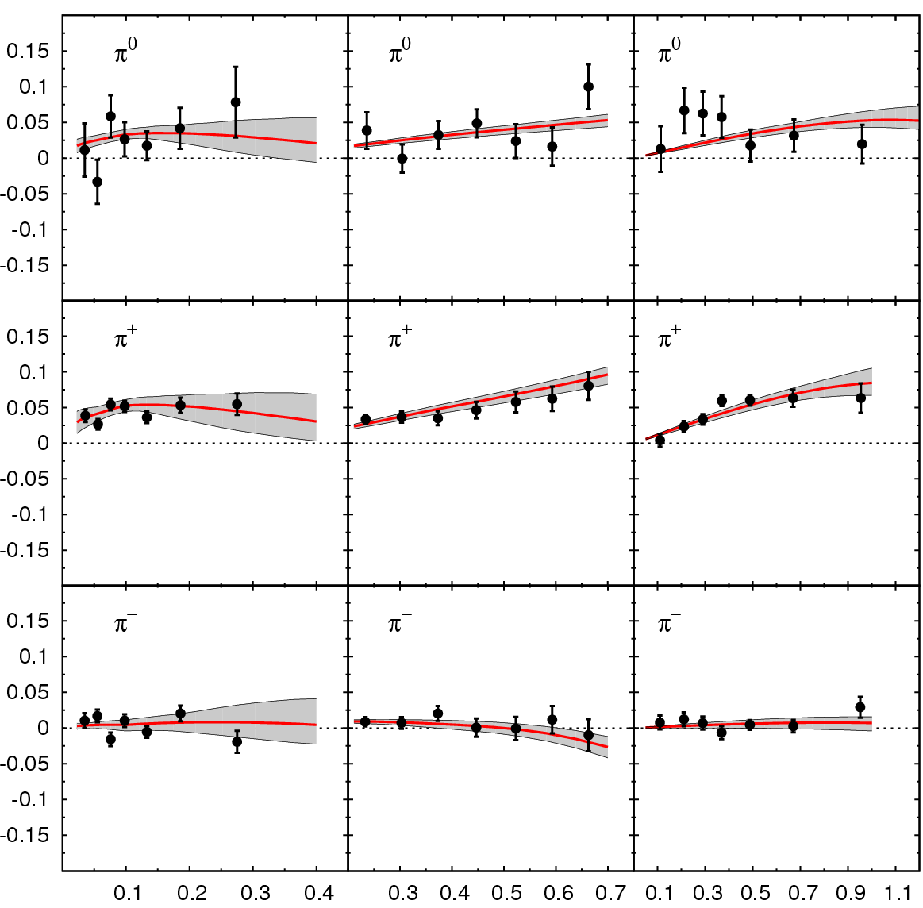
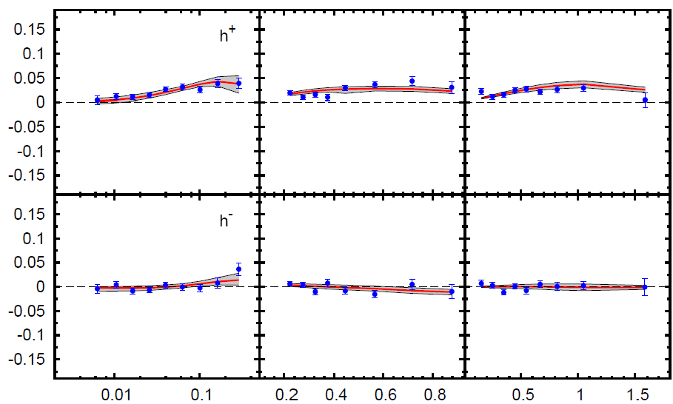
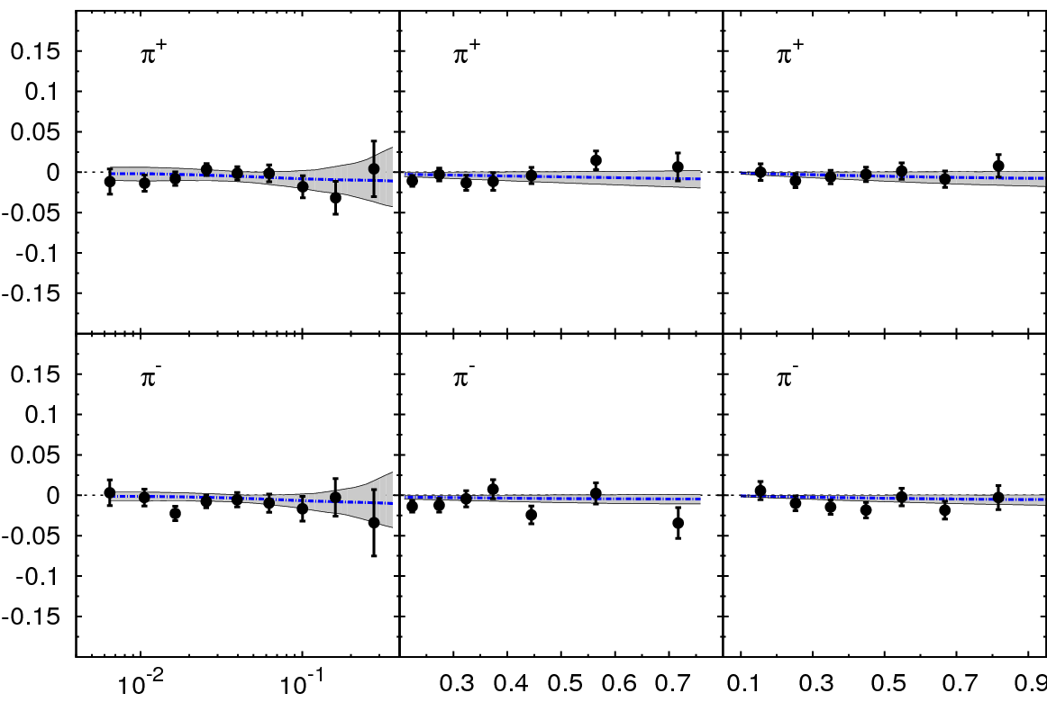
Sivers Asymmetry in SIDIS
HERMES (p)
COMPASS (p)
π⁰
h⁺
π⁺
h⁻
π⁻
x z P_{T} (GeV)
COMPASS (d)
π⁺
Global fit to sin (φ_{h} – φ_{S}) asymmetry in SIDIS (HERMES (p), COMPASS (p), COMPASS (d))
π⁻
x z P_{T} (GeV)
Comparable measurements needed in Drell-Yan process

Slide 6
Polarized Drell-Yan Experiment
NOT Yet Done!
Access to transverse-momentum dependent distribution (TMD) functions
    Sivers, Boer-Mulders, etc
Transversely Polarized Beam or Target
    Sivers function in single-transverse spin asymmetries (sea quarks or valence quarks)
      − valence quarks constrain SIDIS data much more than sea quarks
      − global fits indicate that sea quark Sivers function is small
    transversity Boer-Mulders function
    baryon production, incl. pseudoscalar and vector meson production,
    elastic scattering, two-particle correlations, J/ψ and charm production
Beam and Target Transversely Polarized
    flavor asymmetry of sea-quark polarization
    transversity (quark anti-quark for pp collisions)
      − anti-quark transversity might be very small

Slide 7
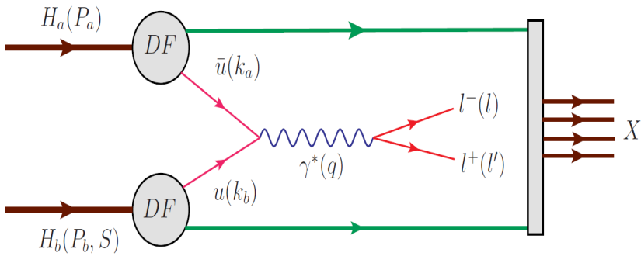
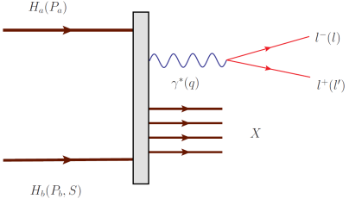
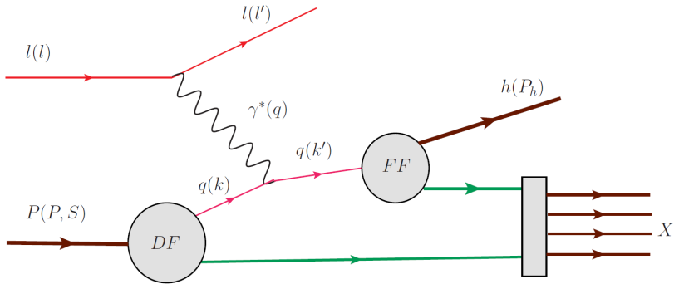
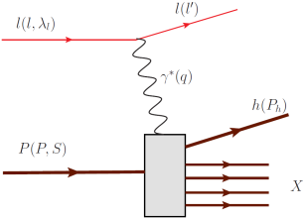
Drell Yan Process
Similar Physics Goals as SIDIS:
  parton level understanding of nucleon
  electromagnetic probe
timelike (Drell-Yan) vs. spacelike (SIDIS) virtual photon
Drell-Yan
SIDIS
A. Kotzinian, DY workshop, CERN, 4/10
Cleanest probe to study hadron structure:
  hadron beam and convolution of parton distributions
  no QCD final state effects
  no fragmentation process
  ability to select sea quark distribution
  allows direct production of transverse momentum-dependent distribution (TMD)
  functions (Sivers, Boer-Mulders, etc)

Slide 8
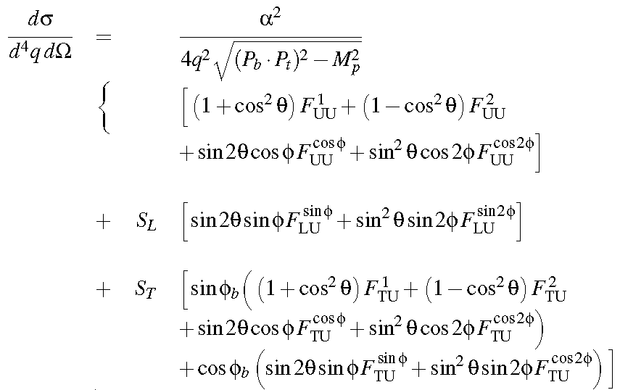
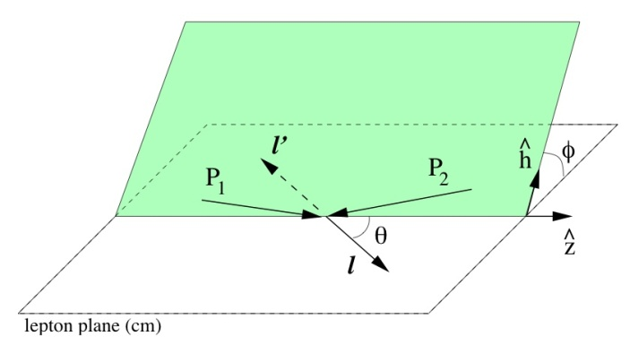
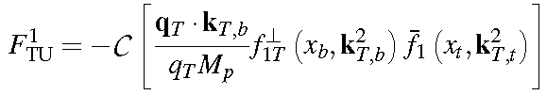

Leading order DY Cross Section
DY cross section at LO:
Sivers Mechanism
Sivers function
  with the asymmetry amplitude:

Slide 9
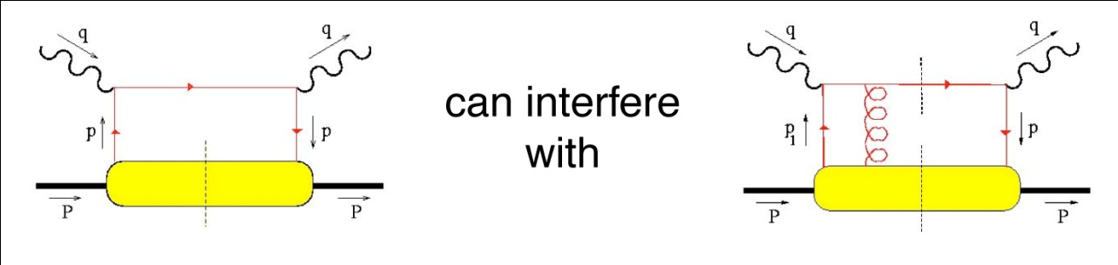
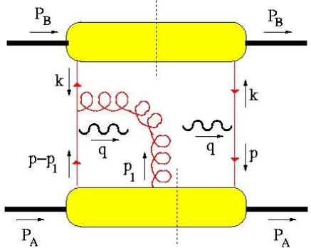
Sivers Function
T-odd observables
  SSA observable ~ odd under naïve Time-Reversal
  since QCD amplitudes are T-even, must arise from interference
  (between spin-flip and non-flip amplitudes with different phases)
Cannot come from perturbative subprocess xsec at high energies:
  q helicity flip suppressed by
  need suppressed loop-diagram to generate necessary phase
  at hard (enough) scales, SSA’s must arise from soft physics
A T-odd function like must arise from interference (How?)
  soft gluons: “gauge links” required for color gauge invariance
  such soft gluon re-interactions with the soft wavefunction are
  final (or initial) state interactions … and maybe process dependent!
  leads to sign change:
Brodsky, Hwang & Smith (2002)
and produce a T-odd effect!
(also need )
e.g. Drell-Yan)

Slide 10
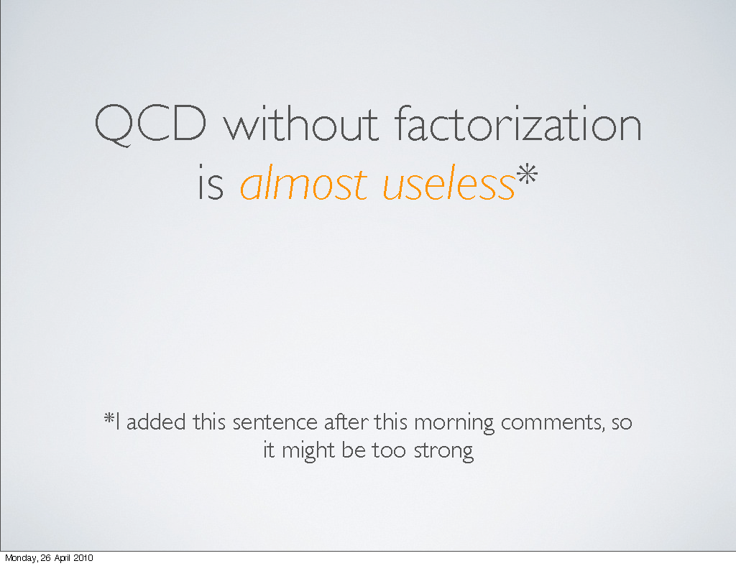
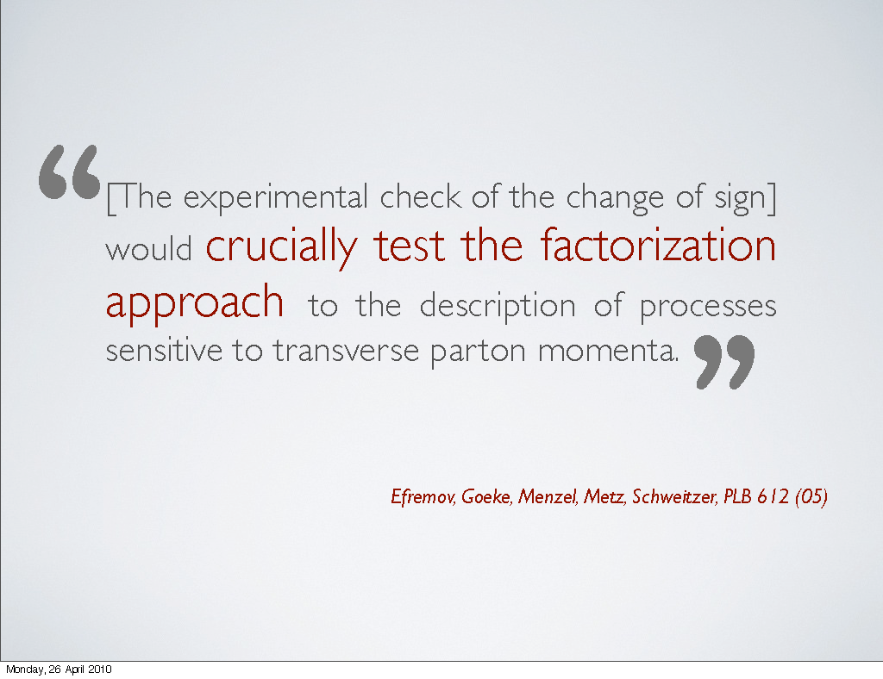
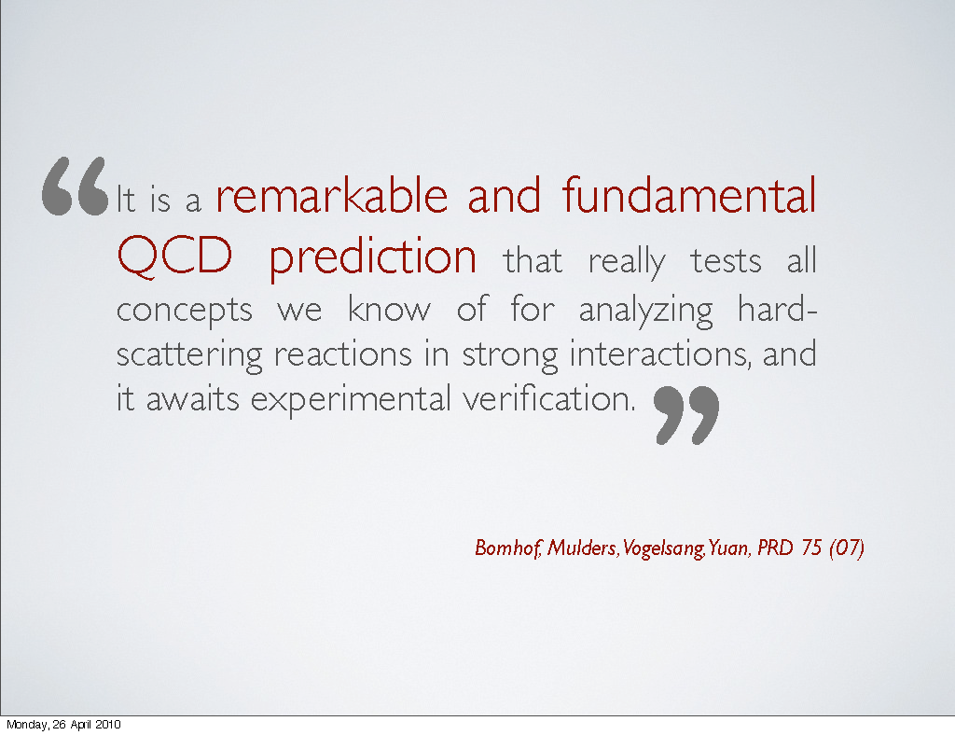
Sivers in Drell-Yan vs SIDIS: The Sign Change
fundamental prediction of QCD (in non-perturbative regime)
  goes to heart of gauge formulation of field theory
Importance of factorization in QCD:
A. Bacchetta , DY workshop, CERN, 4/10

Slide 11
Planned Polarized Drell-Yan Experiments
experiment | particles | energy | x_{b} or x_{t} | Luminosity | timeline
COMPASS (CERN) | π± + p↑ | 160 GeV √s = 17.4 GeV | x_{t} = 0.2 – 0.3 | 2 x 10³³ cm⁻² s⁻¹ | 2014, 2018
PAX (GSI) | p↑ + p_{bar} | collider √s = 14 GeV | x_{b} = 0.1 – 0.9 | 2 x 10³⁰ cm⁻² s⁻¹ | >2017
PANDA (GSI) | p_{bar} + p↑ | 15 GeV √s = 5.5 GeV | x_{t} = 0.2 – 0.4 | 2 x 10³² cm⁻² s⁻¹ | >2016
NICA (JINR) | p↑ + p | collider √s = 20 GeV | x_{b} = 0.1 – 0.8 | 1 x 10³⁰ cm⁻² s⁻¹ | >2014
PHENIX (RHIC) | p↑ + p | collider √s = 500 GeV | x_{b} = 0.05 – 0.1 | 2 x 10³² cm⁻² s⁻¹ | >2018
RHIC internal target phase-1 | p↑ + p | 250 GeV √s = 22 GeV | x_{b} = 0.25 – 0.4 | 2 x 10³³ cm⁻² s⁻¹ | >2018
RHIC internal target phase-1 | p↑ + p | 250 GeV √s = 22 GeV | x_{b} = 0.25 – 0.4 | 6 x 10³⁴ cm⁻² s⁻¹ | >2018
SeaQuest (unpol.) (FNAL) | p + p | 120 GeV √s = 15 GeV | x_{b} = 0.35 – 0.85 x_{t} = 0.1 – 0.45 | 3.4 x 10³⁵ cm⁻² s⁻¹ | 2012 - 2015
polDY§ (FNAL) | p↑ + p | 120 GeV √s = 15 GeV | x_{b} = 0.35 – 0.85 | 2 x 10³⁵ cm⁻² s⁻¹ | >2016
 | § L= 1 x 10³⁶ cm⁻² s⁻¹ (LH₂ tgt limited) / L= 2 x 10³⁵ cm⁻² s⁻¹ (10% of MI beam limited)

Slide 12
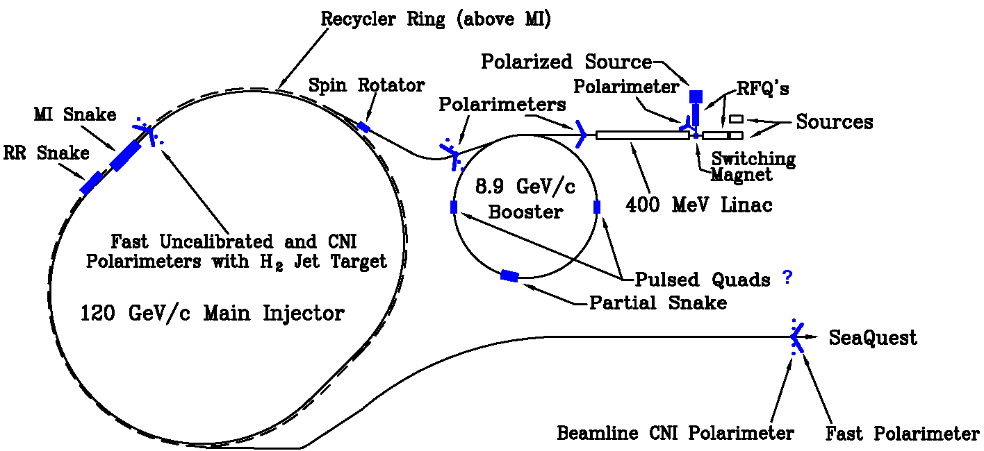
Polarized Drell-Yan at Fermilab Main Injector
Polarize Beam in Main Injector & use SeaQuest di-muon spectrometer
  measure Sivers asymmetry
SeaQuest di-muon Spectrometer
  fixed target experiment, optimized for Drell-Yan
  luminosity: L_{av} = 3.4 x 10³⁵ /cm²/s
    I_{av} = 1.6 x 10¹¹ p/s (=26 nA) / N_{p}= 2.1 x 10²⁴ /cm²
  approved for 2-3 years of running: 3.4 x 10¹⁸ pot
  by 2015: fully understood, ready to take pol. beam

Slide 13
Polarized Drell-Yan at Fermilab Main Injector - II
Polarized Beam in Main Injector
  use SeaQuest target
    liquid H₂ target can take about I_{av} = 5 x 10¹¹ p/s (=80 nA)
  1 mA at polarized source can deliver about I_{av} = 1 x 10¹² p/s (=150 nA)
  for 100% of available beam time (A. Krisch: Spin@Fermi report in (Aug 2011): arXiv:1110.3042 [physics.acc-ph])
    26 μs linac pulses, 15 Hz rep rate, 12 turn injection into booster, 6 booster pulses into Recycler Ring, followed by 6 more pulses using slip stacking in MI
    1 MI pulse = 1.9 x 10¹² p
    using three 2-sec cycles/min (~10% of beam time):
    → 2.8 x 10¹² p/s (=450 nA) instantaneous beam current , and I_{av} = 0.95 x 10¹¹ p/s (=15 nA)
  possible scenarios:
    L_{av} = 2.0 x 10³⁵ /cm²/s (10% of available beam time: I_{av} = 15 nA)
    L_{av} = 1 x 10³⁶ /cm²/s (50% of available beam time: I_{av} = 75 nA)
  Systematic uncertainty in beam polarization measurement (scale uncertainty)
ΔP_{b}/P_{b} <5%

Slide 14
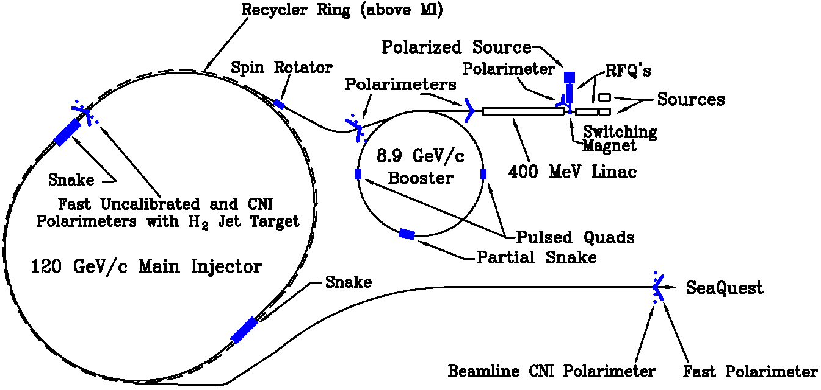
From 2 Siberian Snakes to 1 Snake
2 Siberian Snakes in MI
(not enough space)
1 Siberian Snake in MI
(fits well)
plus 1 solenoid snake in RR

Slide 15
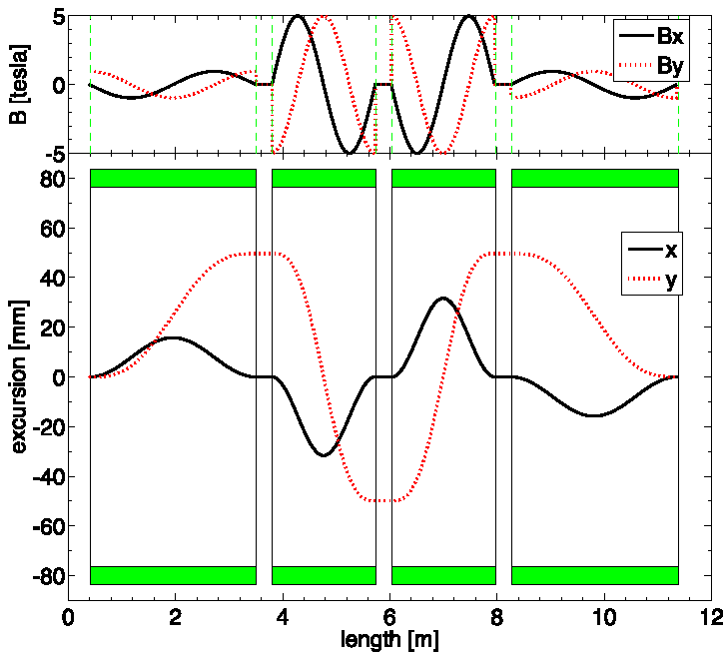
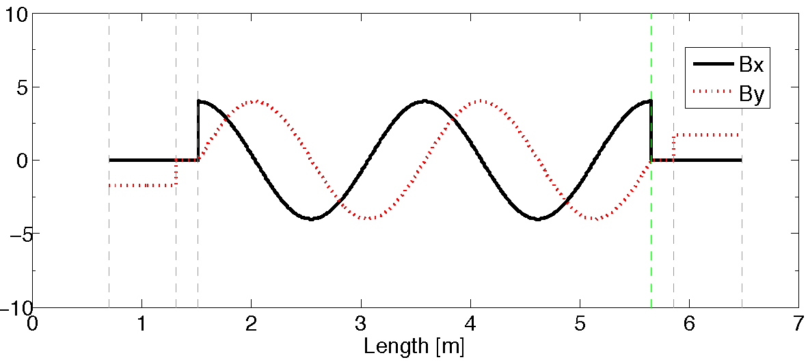
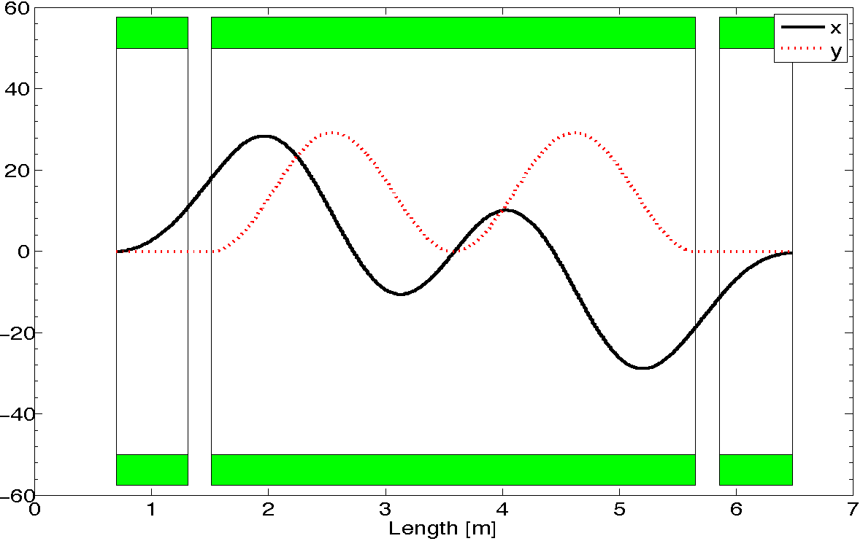
From 2 Siberian Snakes to 1 Snake - II
2-snake design (11m long):
4 helical dipoles / snake
  2 helices: 5T / 3.1m / 6” ID
  2 helices : 5T / 2.1m / 6” ID (cold)
1-snake design (5.8m long):
1 helical dipole + 2 conv. dipoles
  helix: 4T / 4.2 m / 4” ID
  dipoles: 4T / 0.62 m / 4” ID (warm)
does not fit
fits
T. Roser (BNL): - test snakes/rotators up to 5.4T
- operation not above 4T
Notes:
4 single twist helixes / snake vs 1 2-twist helix snake

Slide 16
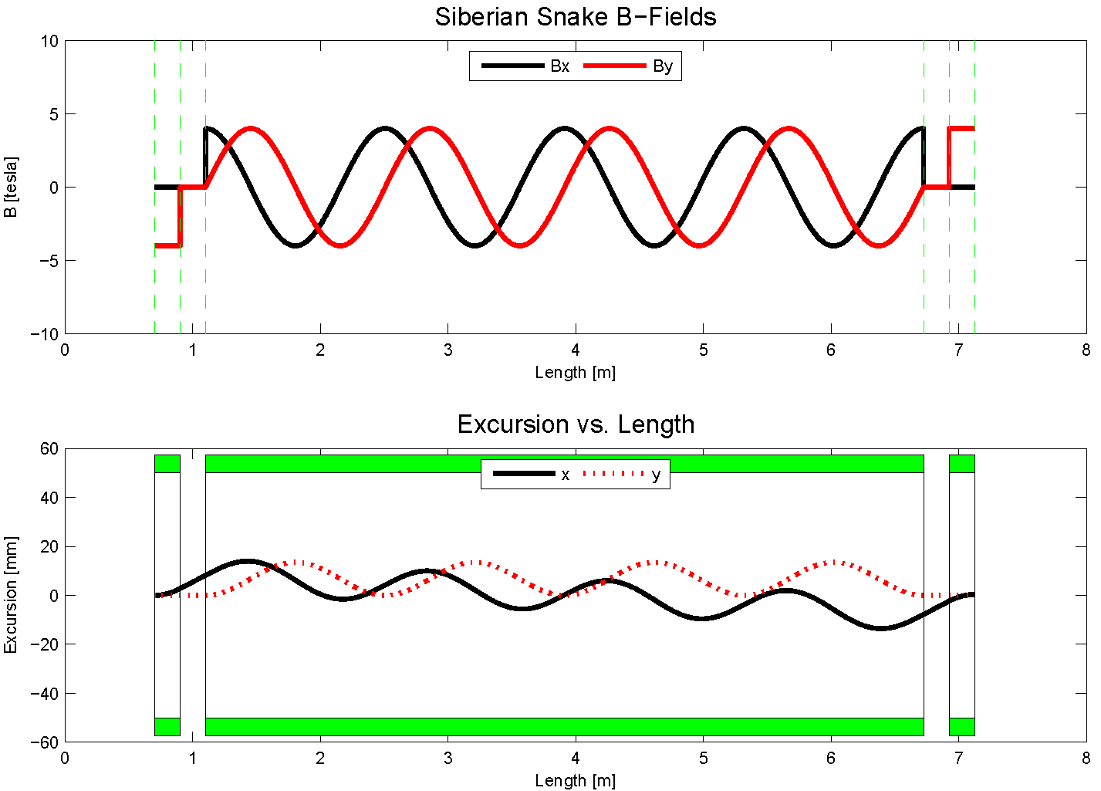
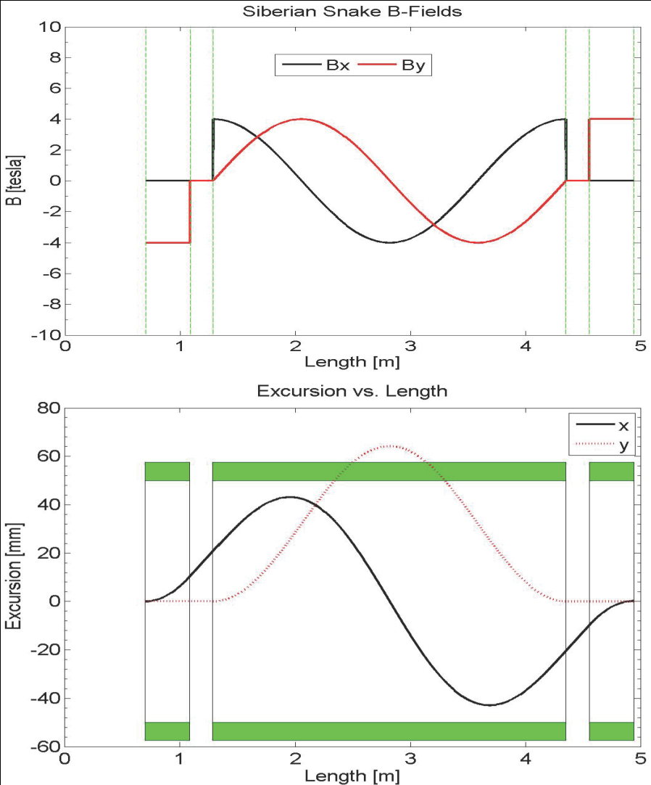
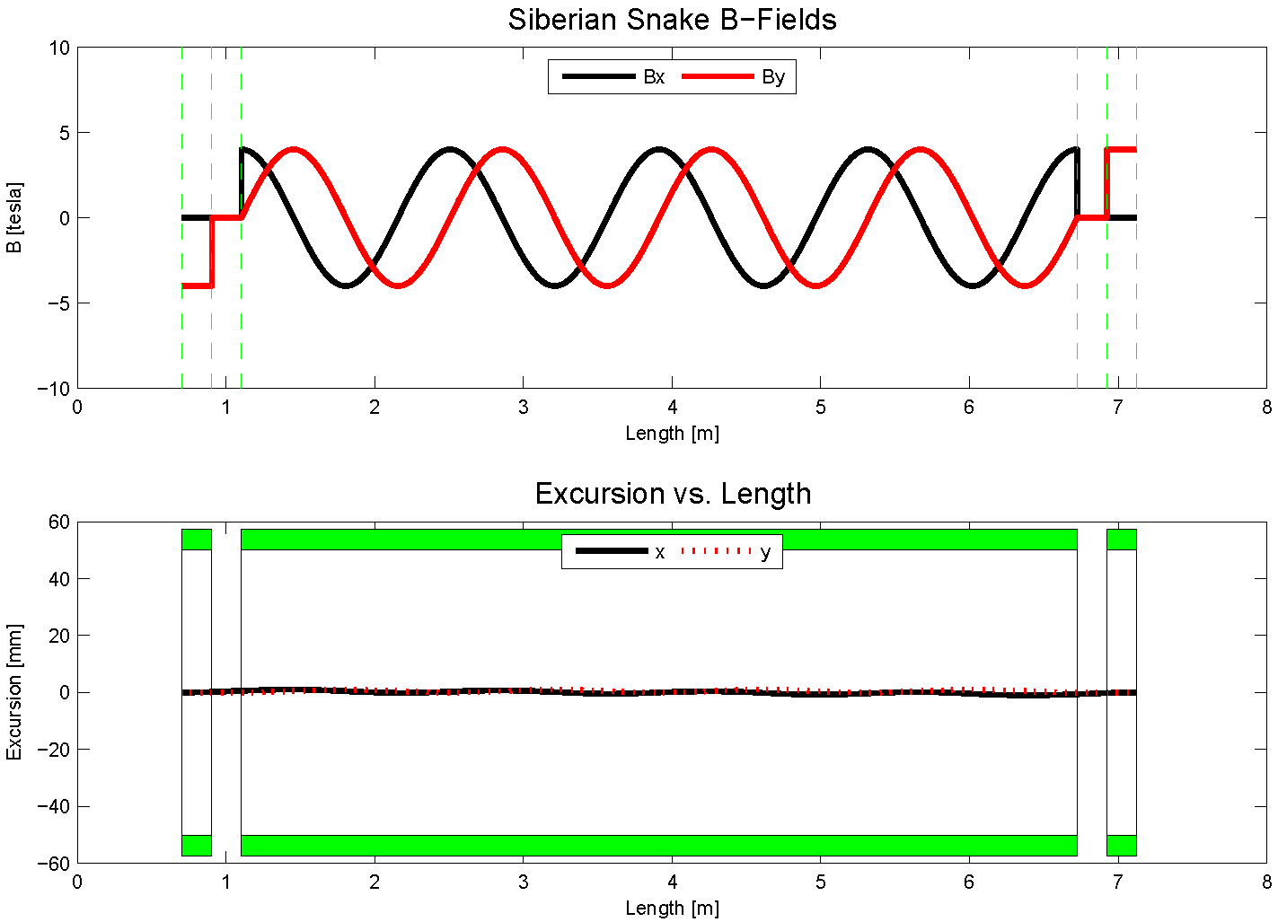
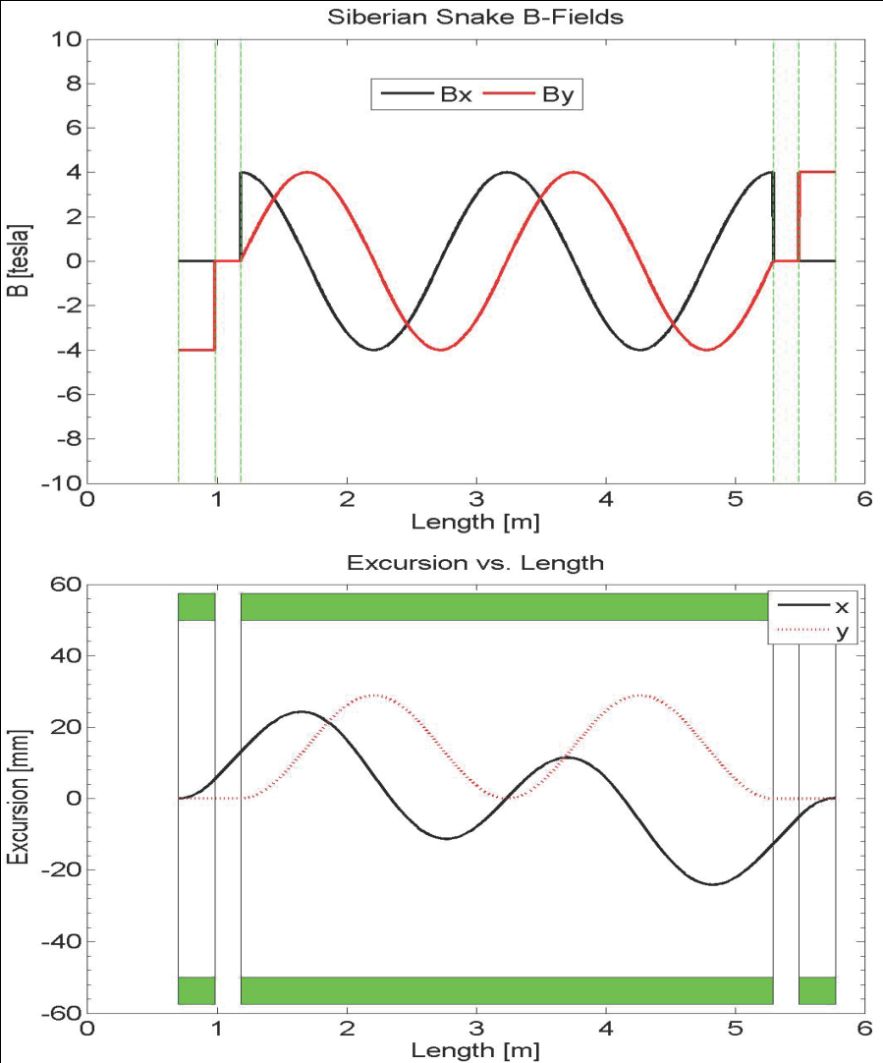
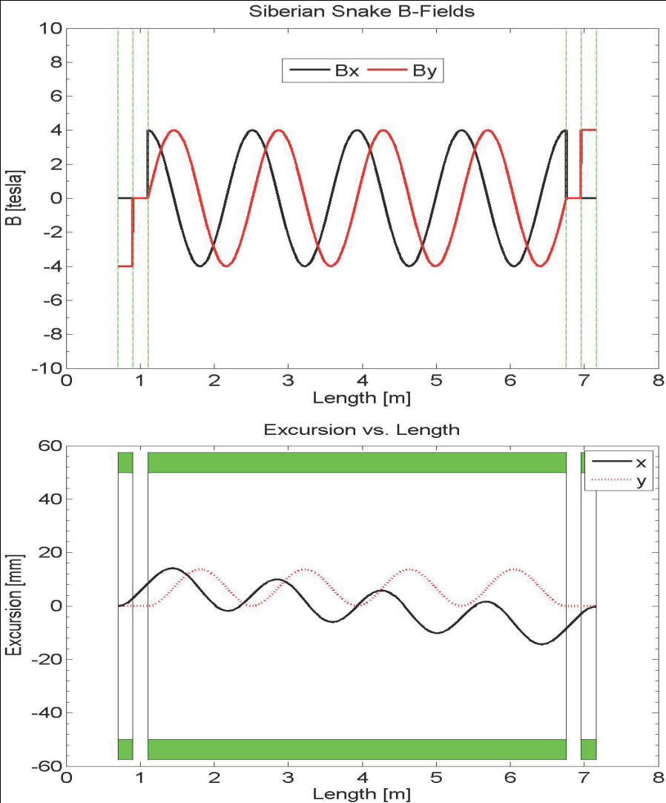
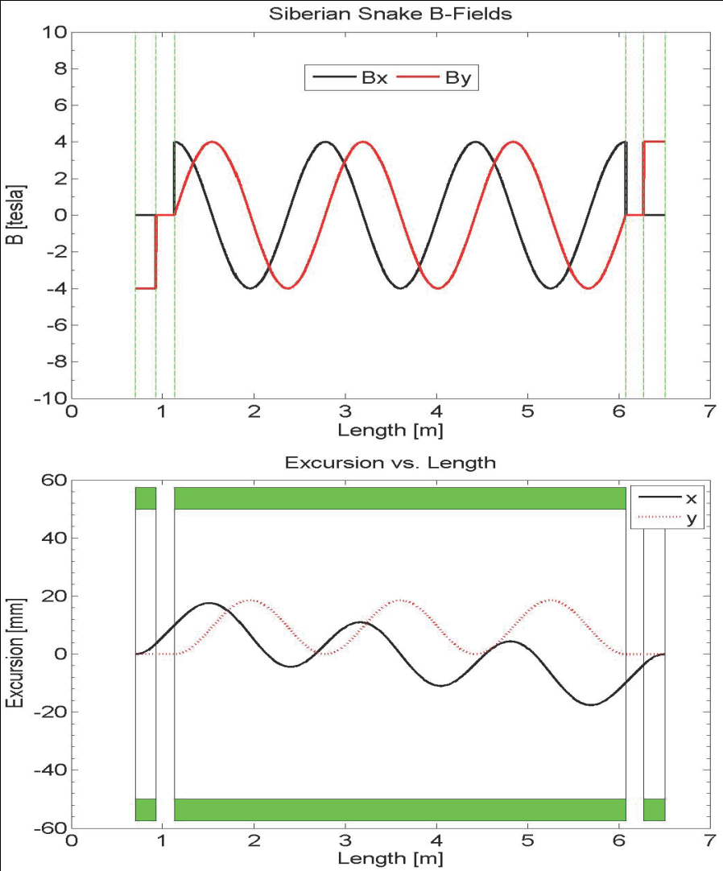
Steady Improvements to 1 Snakes solution
8.9 GeV 4T
4-twist 4T
8.9 GeV
120 GeV
beam excursions shrink w/ number of twists
beam excursions shrink w/ beam energy

Slide 17
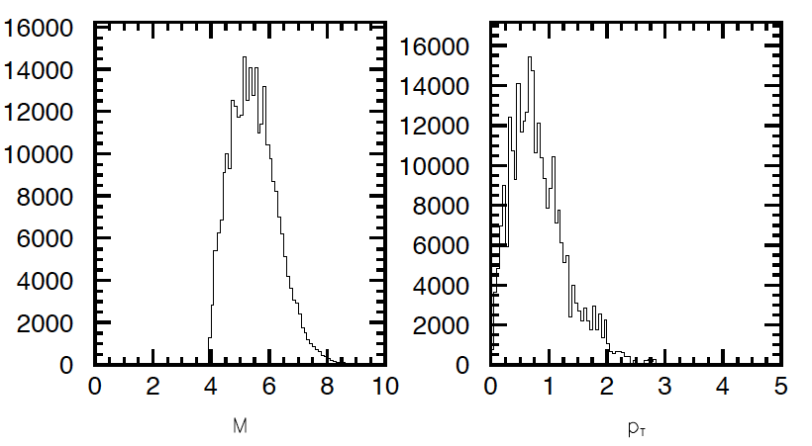
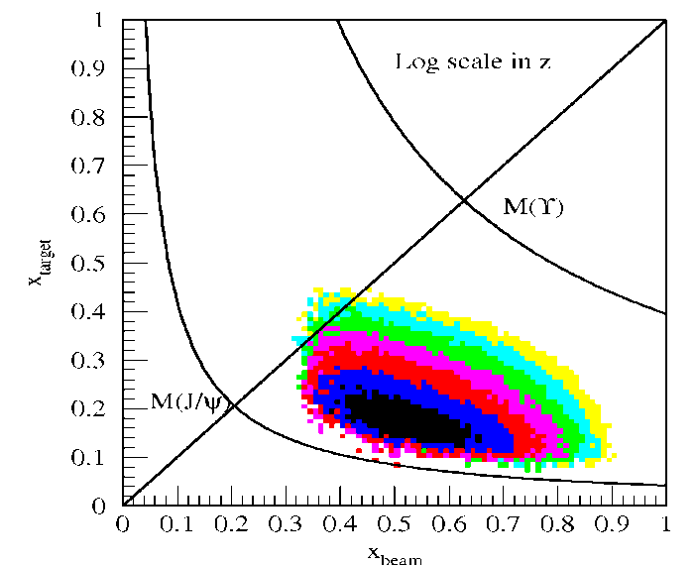
Acceptance for Polarized Drell-Yan - I
x-range: x_{b} = 0.35 – 0.85 (valence quarks in proton beam)
x_{t} = 0.1 – 0.45 (sea quarks in proton target)
Invariant mass range: M = 4 – 8.5 GeV (avoid J/Ψ contamination)
Transverse momentum: p_{T} = 0 – 3 GeV
E906 Spect.
Monte Carlo

Slide 18
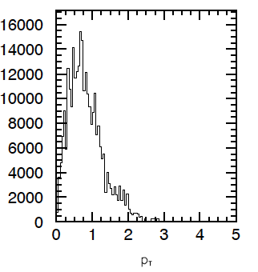
Measurement at Fermilab Main Injector
FMag
Retune 1st spectrometer magnet (FMag):
  focuses high p_{T} muons and
  over focuses low p_{T} muons
    we loose low p_{T} muons when field is high!
    SeaQuest is all about going to the largest x_{t} quarks, requiring high-p_{T} muons
  Lowering FMag field
    we get back the low p_{T} muons
    we loose the high low p_{T} muons
BUT
p_{T} spectrum peaks at low p_{T}

Slide 19
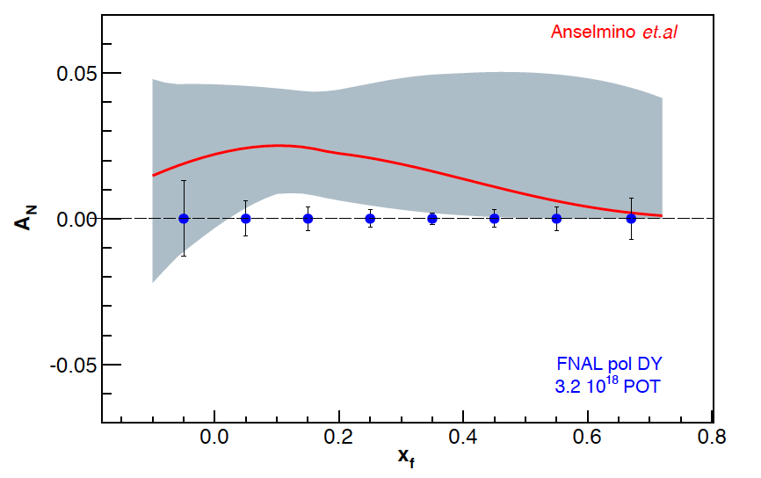
Sivers Asymmetry at Fermilab Main Injector
Experimental Sensitivity
  luminosity: L_{av} = 2 x 10³⁵ (10% of available beam time: I_{av} = 15 nA)
  3.2 x 10¹⁸ total protons for 5 x 10⁵ min: (= 2 yrs at 50% efficiency) with P_{b} = 70%
  Can measure not only sign, but also the size & maybe shape of the Sivers function !
Δχ²=20 error band
Note:
~650k DY events
FNAL pol DY stat errors
3.2 x 10¹⁸ POT
~1,288k DY events
330k DY events
Notes:
Note that SSA A_N^sin(phi-phi_s) is scaled by 2/pi

Slide 20
E-1027 Collaboration (May 2013)
Abilene Christian University
Donald Isenhower, Tyler Hague,
Rusty Towell, Shon Watson
Academia Sinica
Wen-Chen Chang, Yen-Chu Chen,
Shiu Shiuan-Hal, Da-Shung Su
Argonne
John Arrington, Don Geesaman
Kawtar Hafidi, Roy Holt, Harold
Jackson, Paul E. Reimer*
University of Colorado
Ed Kinney
Fermilab
Chuck Brown, David Christian,
Jin-Yuan Wu
University of Illinois
Bryan Dannowitz, Markus Diefenthaler,
Bryan Kerns, Naomi C.R
Makins, R. Evan McClellan
KEK
Shinya Sawada
Los Alamos National Laboratory
Ming Liu, Xiang Jiang, Pat McGaughey, J. Huang
University of Maryland
Betsy Beise, Kaz Nakahara
University of Michigan
Christine Aidala,
Wolfgang Lorenzon*, Joe Osborn, Bryan Ramson, Richard Raymond, Joshua Rubin
National Kaohsiung Normal University
Rurngsheng Guo, Su-Yin Wang
RIKEN
Yuji Goto
Rutgers University
Ron Gilman, Ron Ransome,
A. Tadepalli
Tokyo Institute of Technology
Shou Miyasaka, Ken-ichi Nakano,
Florian Saftl, Toshi-Aki Shibata
Yamagata University
Yoshiyuki Miyachi
University of Basque Country†
Gunar Schnell
*Co-Spokespersons
†new group (Aug’12)
Collaboration contains most of the E-906/SeaQuest groups and one new group (total 16 groups as of May 2013)
E-1027 collaboration working closely with SPIN@FERMI collaboration
20

Slide 21
Polarized Target at Fermilab
Probe Sea-quark Sivers Asymmetry
with a polarized proton target at SeaQuest
sea-quark Sivers function poorly known
significant Sivers asymmetry expected
from meson-cloud model
KMAG
FMAG
Polarized Target
use current SeaQuest setup
a polarized proton target, unpolarized beam
Proton Beam 120 GeV/c
Ref: Ming Liu (ANL)

Slide 22
The Path to a polarized Main Injector
Stage 1 approval from Fermilab: 14-November-2012
Detailed machine design and costing using 1 snake in MI
  Spin@Fermi collaboration provide design
  Fermilab (AD) does verification & costing
Collaboration with A.S. Belov at INR and Dubna to develop polarized source
Develop proposal to DoE NP/HEP to polarize the Main Injector
  Cost to polarize Main Injector $10M
    includes 15% project management & 50% contingency
  secure funding to
    do detailed design: $200k/yr (short-term)
    implement modifications to MI: $10M (longer-term)
    conversations with DoE NP & HEP, NSF NP have started

Slide 23
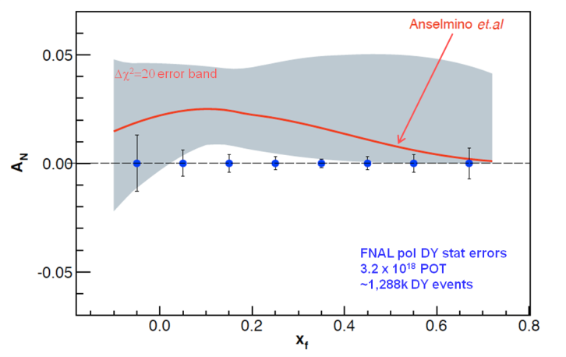
Summary
π⁰
A non-zero Sivers asymmetry has been measured both at HERMES and COMPASS
QCD (and factorization) require sign change
Fermilab is arguably best place to do this measurement
    high luminosity, large x-coverage,
    high-intensity polarized beam
    spectrometer already setup and running
Run alongside neutrino program (10% of beam needed)
Measure DY with both Beam or/and Target polarized
    broad spin physics program possible
π⁺
π⁻
Fermilab

Slide 24
The END

Slide 25
Backup Slides

Slide 26
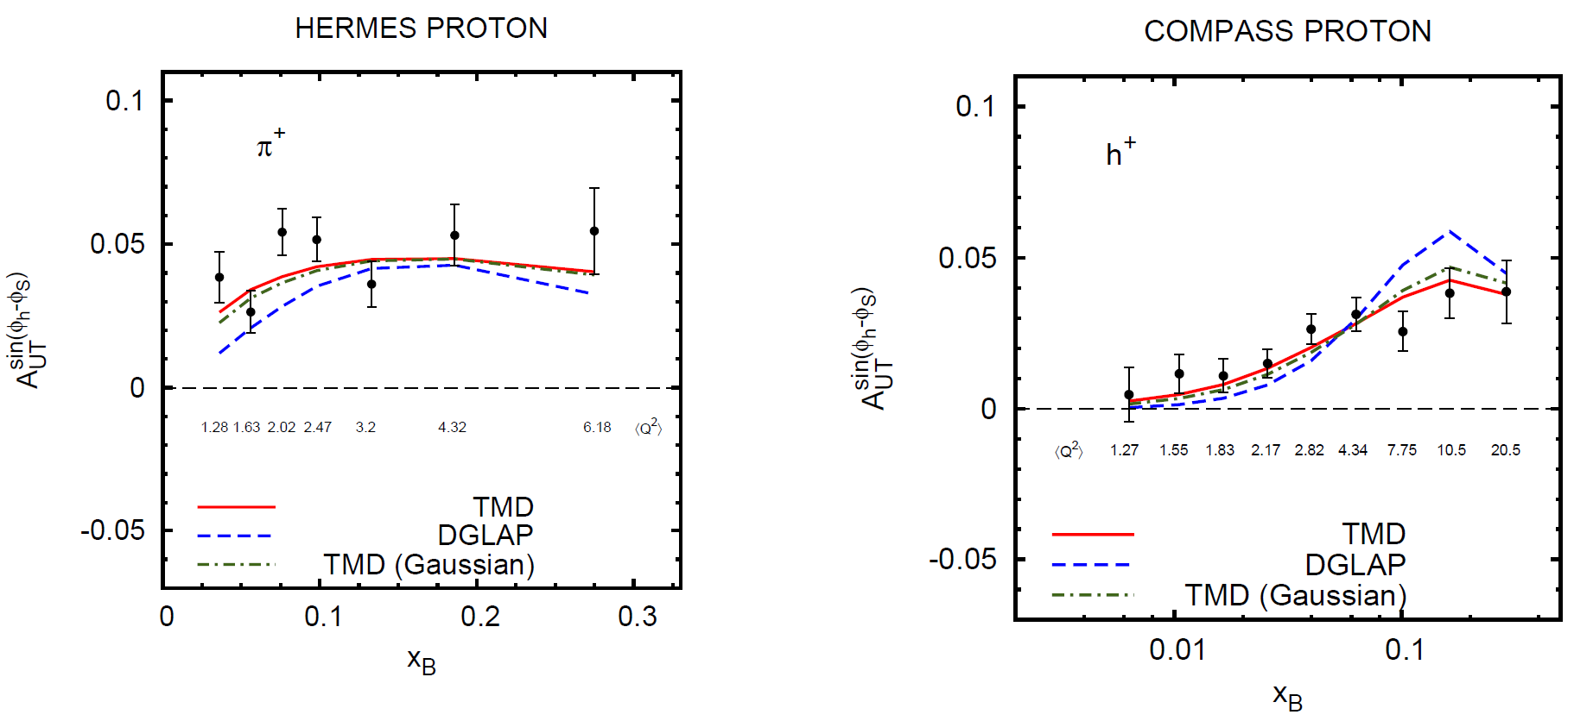
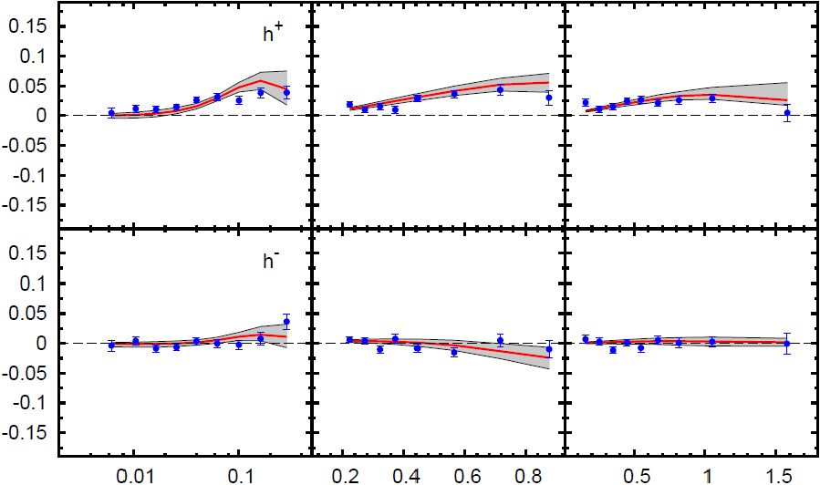
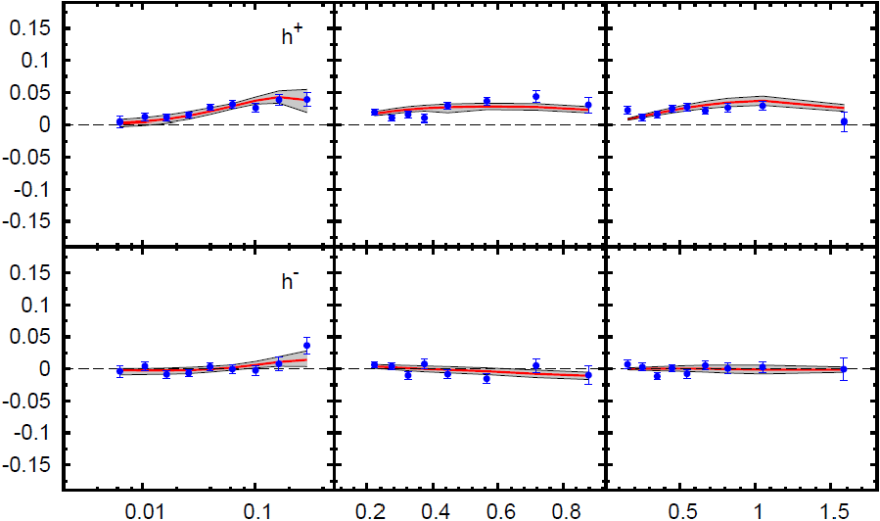
QCD Evolution of Sivers Function
HERMES (p)
COMPASS (p)
π⁻
h⁺
Anselmino et al. (arXiv:1209.1541 [hep-ph])
h⁺
DGLAP
Initial global fits by Anselmino group included DGLAP evolution only in collinear part of TMDs (not entirely correct for TMD-factorization)
Using TMD Q² evolution:
  agreement with data improves
TMD
h⁻
Notes:
Since Q^2 = x y s, s-behavior of asymmetries is intimately connected to their Q^2 evolution
HERMES: <Q^2> 1.28 …… 6.18
COMPASS: <Q^2> 1.27 …… 20.5 -> larger effect if proper TMD evolution equations are used

Slide 27
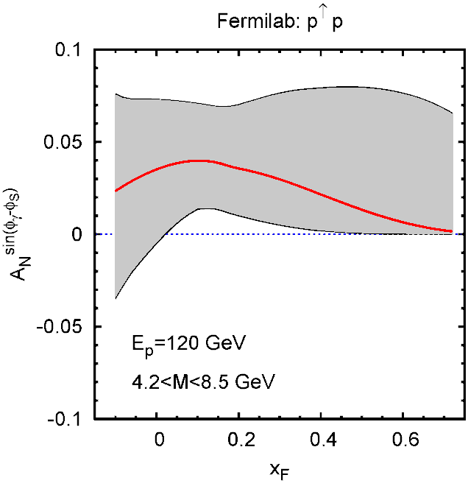
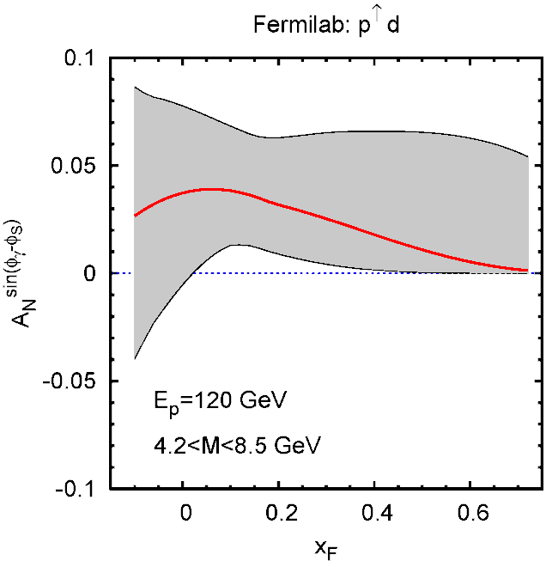
Polarized Drell-Yan at Fermilab
Global fit to sin (φ_{h} – φ_{S}) asymmetry in SIDIS (HERMES (p), COMPASS (p, d) )
→ Predictions for Drell-Yan (gray error bands correspond to Δχ² =20)
polarized beam: E_{p}=120 GeV √s ~ 15 GeV 4.2 < M < 8.5 GeV
hydrogen target deuterium target
Anselmino et al. priv. comm. 2010

