Slide 1

Polarized Dell-Yan at Fermilab
APS LRP:
Joint Town Meetings on QCD
(13-September, 2014)
Wolfgang Lorenzon
Unpolarized Drell-Yan at Fermilab: (~70 collaborators)
  SeaQuest [E-906]: (USA, Japan, Taiwan)
  science run: Feb 2014 — spring/summer 2016
Polarized Drell-Yan at Fermilab: (USA, Japan, Taiwan, Spain) (~80 collaborators)
  polarized Target [E-1039]: 2016 (for 2 yrs) Stage 1 approval: July-2013
  polarized Beam [E-1027]: >2018 (for 2 yrs) Stage 1 approval: Nov-2012
Present status & needs

Slide 2
Planned Polarized Drell-Yan Experiments
Experiment | Particles | Energy (GeV) | x_{b} or x_{t} | Luminosity (cm⁻² s⁻¹) |  | P_{b} or P_{t} (f) | rFOM# | Timeline
COMPASS (CERN) | π± + p↑ | 160 GeV √s = 17 | x_{t} = 0.1 – 0.3 | 2 x 10³³ | 0.14 | P_{t} = 90% f = 0.22 | 1.1 x 10⁻³ | 2014, 2018
PANDA (GSI) | p + p↑ | 15 GeV √s = 5.5 | x_{t} = 0.2 – 0.4 | 2 x 10³² | 0.07 | P_{t} = 90% f = 0.22 | 1.1 x 10⁻⁴ | >2018
PAX (GSI) | p↑ + p | collider √s = 14 | x_{b} = 0.1 – 0.9 | 2 x 10³⁰ | 0.06 | P_{b} = 90% | 2.3 x 10⁻⁵ | >2020?
NICA (JINR) | p↑ + p | collider √s = 26 | x_{b} = 0.1 – 0.8 | 1 x 10³¹ | 0.04 | P_{b} = 70% | 6.8 x 10⁻⁵ | >2018
PHENIX/STAR (RHIC) | p↑ + p↑ | collider √s = 510 | x_{b} = 0.05 – 0.1 | 2 x 10³² | 0.08 | P_{b} = 60% | 1.0 x 10⁻³ | >2018
fsPHENIX (RHIC) | p↑ + p↑ | √s = 200 √s = 510 | x_{b} = 0.1 – 0.5 x_{b} = 0.05 – 0.6 | 8 x 10³¹ 6 x 10³² | 0.08 | P_{b} = 60% P_{b} = 50% | 4.0 x 10⁻⁴ 2.1 x 10⁻³ | >2021
SeaQuest (FNAL: E-906) | p + p | 120 GeV √s = 15 | x_{b} = 0.35 – 0.9 x_{t} = 0.1 – 0.45 | 3.4 x 10³⁵ | --- | --- | --- | 2012 - 2015
Pol tgt DY‡ (FNAL: E-1039) | p + p↑ | 120 GeV √s = 15 | x_{t} = 0.1 – 0.45 | 4.4 x 10³⁵ | 0 – 0.2* | P_{t} = 88% f = 0.176 | 0.15 | 2016
Pol beam DY§ (FNAL: E-1027) | p↑ + p | 120 GeV √s = 15 | x_{b} = 0.35 – 0.9 | 2 x 10³⁵ | 0.04 | P_{b} = 60% | 1 | >2018
‡ 8 cm NH₃ target / § L= 1 x 10³⁶ cm⁻² s⁻¹ (LH₂ tgt limited) / L= 2 x 10³⁵ cm⁻² s⁻¹ (10% of MI beam limited) *not constrained by SIDIS data / # rFOM = relative lumi * P² * f² wrt E-1027 (f=1 for pol p beams, f=0.22 for π⁻ beam on NH₃)
W. Lorenzon (U-Michigan) 9/10/2014

Slide 3
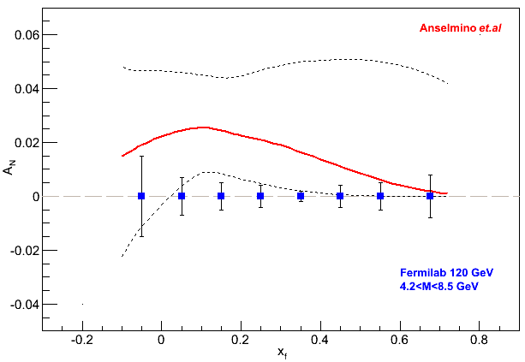
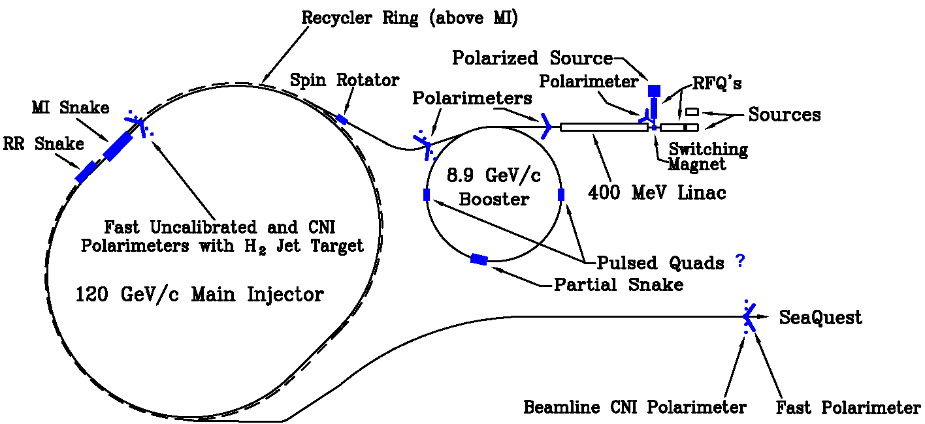
Polarized Beam Drell-Yan at Fermilab (E-1027)
Polarized Drell-Yan:
  QCD (and factorization) require sign change
  major milestone in hadronic physics (HP13)
Extraordinary opportunity at Fermilab (best place for polarized DY) :
  high luminosity, large x-coverage
  (SeaQuest) spectrometer already setup and running
  run alongside neutrino program (w/ 10% of beam)
  experimental sensitivity:
    2 yrs at 50% eff, P_{b} = 60%, I_{av} = 15 nA
    luminosity: L_{av} = 2 x 10³⁵ /cm²/s
Path to polarized proton beam at Main Injector
  perform detailed design studies
Cost estimate to polarize Main Injector $10M (total)
  includes M&S, labor, 15% project management
  & 50% contingency
Workshop at Hawaii 2014 Joint Mtg (7-Oct-2014)
  Polarized Drell‐Yan Physics at Fermilab
Fermilab

Slide 4
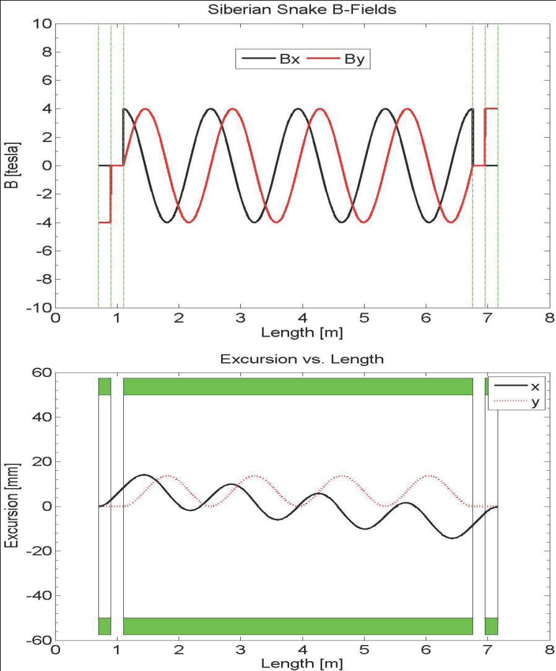
A Novel, Compact Siberian Snake for the Main Injector
Single snake design (6.4m long):
1 helical dipole + 2 conv. dipoles
  helix: 4T / 5.6 m / 4” ID
  dipoles: 4T / 0.2 m / 4” ID
use one 4-twist helical magnet
  8π rotation of B field
never done before in a high energy ring
  RHIC uses snake pairs
  4 single-twist magnets (2π rotation ea)
  Path to polarized proton beam at MI
  detailed design studies: $300k (short-term)
  implement modifications to MI $10M (longer-term)
  Needs
  recommendation in LRP document
  initial design studies

Slide 5
Polarized Beam Drell-Yan at Fermilab (E-1039)
Probe Sea-quark Sivers Asymmetry
with a polarized proton target at SeaQuest
existing SIDIS data poorly constrain
sea-quark Sivers function
significant Sivers asymmetry expected
from meson-cloud model
first Sea Quark Sivers Measurement
determine sign and value of u Sivers distribution
If A_{N}≠0, major discovery: “Smoking Gun” evidence for L_{u} ≠0
- Statistics shown for one calendar year of running:
- L = 7.2 *10⁴² /cm² ↔ POT = 2.8*10 ¹⁸
- Running will be two calendar years of beam time

Slide 6
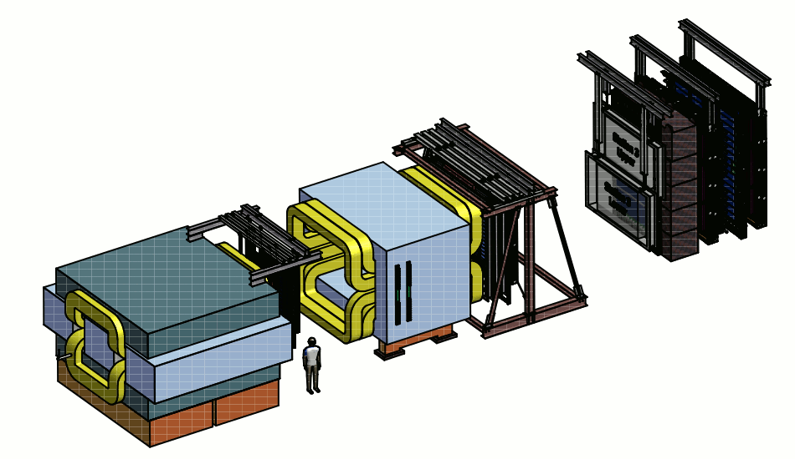
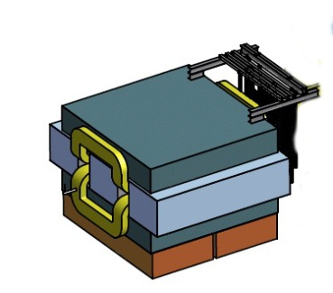
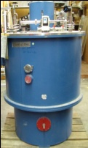
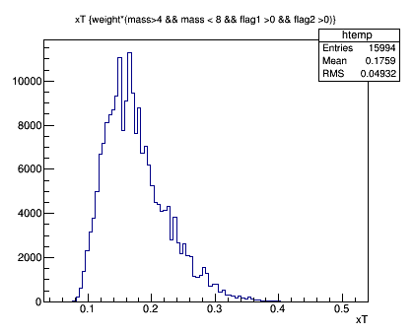
Status and Plans (E-1039)
Target
Polarization: 85%
Packing fraction 0.6
Dilution factor: 0.176
Density: 0.89 g/cm³
KMAG
FMAG
Polarized
Target
SM0 2Tm
Proton Beam
120 GeV/c
500 cm
- use current SeaQuest setup, a polarized
proton target, unpolarized beam
- add third magnet SM0 ~5m upstream
improves dump-target separation
moves <x_{t}> from 0.21 to 0.176
reduces overall acceptance
adds shielding challenges
x_{t}
Ref: Andi Klein (LANL)

Slide 7
COMPASS, E-1027, E-1039 (and Beyond)
 | Beam Pol. | Target Pol. | Favored Quarks | Physics Goals
 |  |  |  | (Sivers Function) |  |  | L_{sea}
 |  |  |  | sign change | size | shape
COMPASS | ✕ | ✔ | valence | ✔ | ✕ | ✕ | ✕
E-1027 | ✔ | ✕ | valence | ✔ | ✔ | ✔ | ✕
E-1039 | ✕ | ✔ | sea | ✕ | ✔ | ✔ | ✔
E-10XX | ✔ | ✔ | sea & valence | Transversity, Helicity, Other TMDs …

Slide 8
Proposed Polarized Drell-Yan Recommendation Text for the QCD Town Meeting
A high-luminosity polarized Drell-Yan program at the Fermilab Main Injector with both polarized beams and targets is endorsed by the U.S. QCD community.

