Slide 1

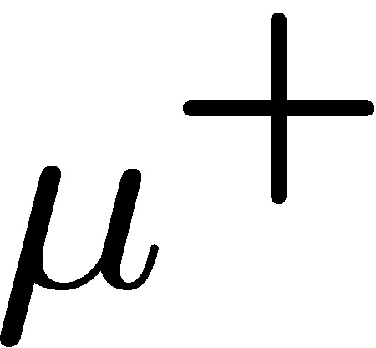



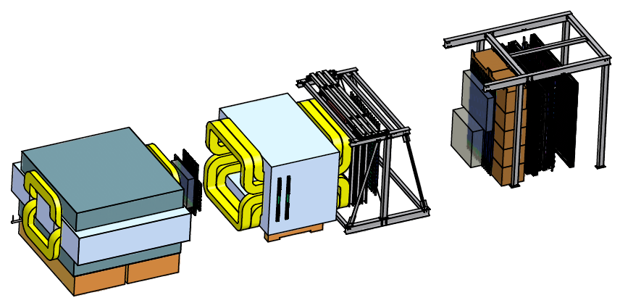


Drell-Yan Experiments at Fermilab: SeaQuest and Beyond
Wolfgang Lorenzon
(30-October-2013)
PacSPIN2013
SeaQuest: Fermilab Experiment E906
  Status and Plans
Beyond SeaQuest
  Polarized Drell-Yan at Fermilab (E1027)
This work is supported by

Slide 2
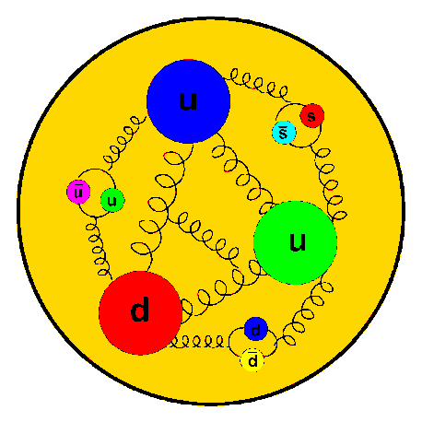
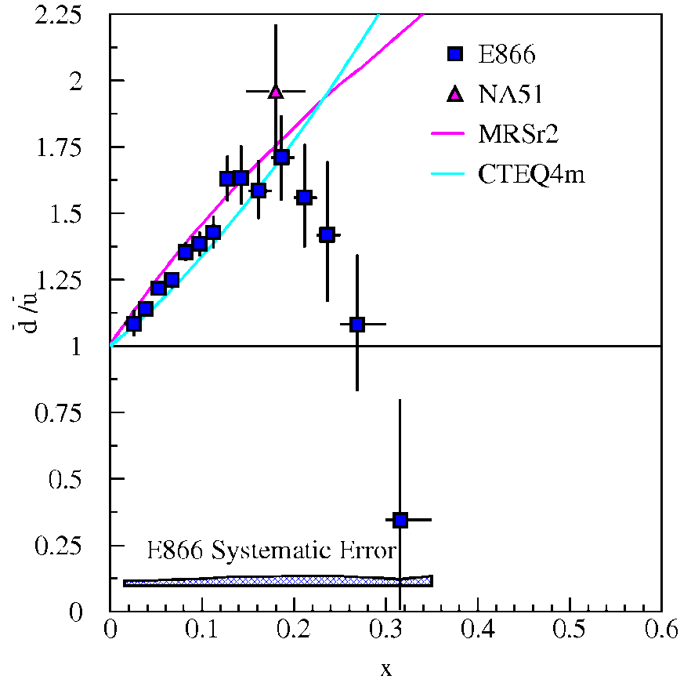
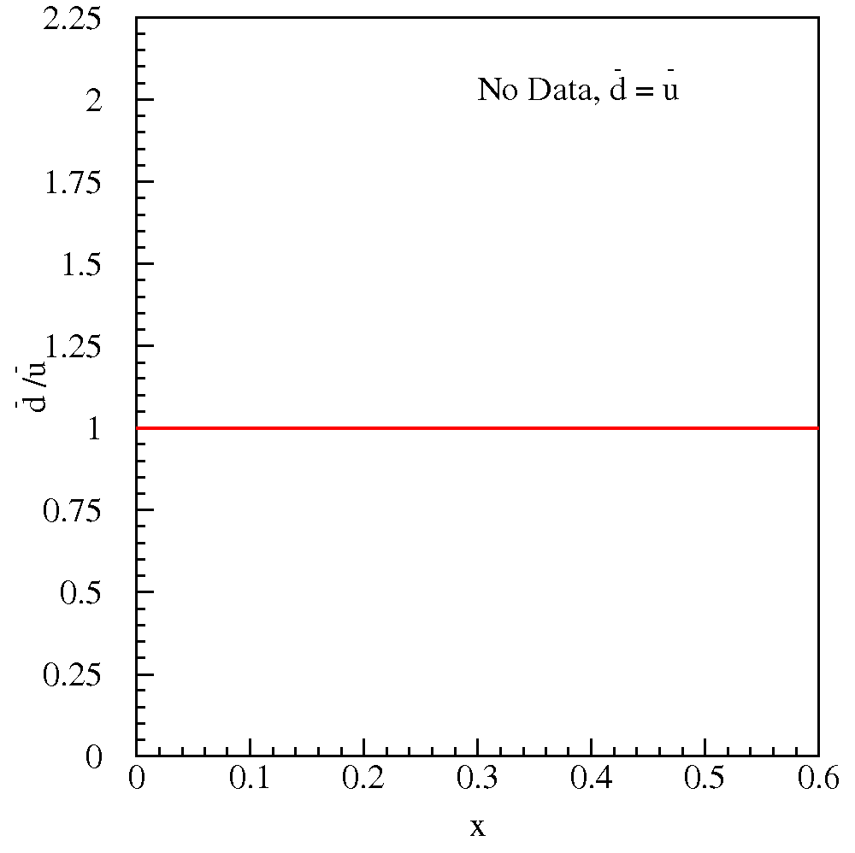
What is the Structure of the Nucleon?
Flavor Structure of the Proton
E866:
No Data,
Constituent Quark Model
Pure valence description: proton = 2u + d
Perturbative Sea
sea quark pairs from g qq
should be flavor symmetric:
What does the data tell us?
  Are there more gluons and thus
  symmetric anti-quarks at higher x?
  Unknown other mechanisms with
  unexpected x-dependence?
2

Slide 3
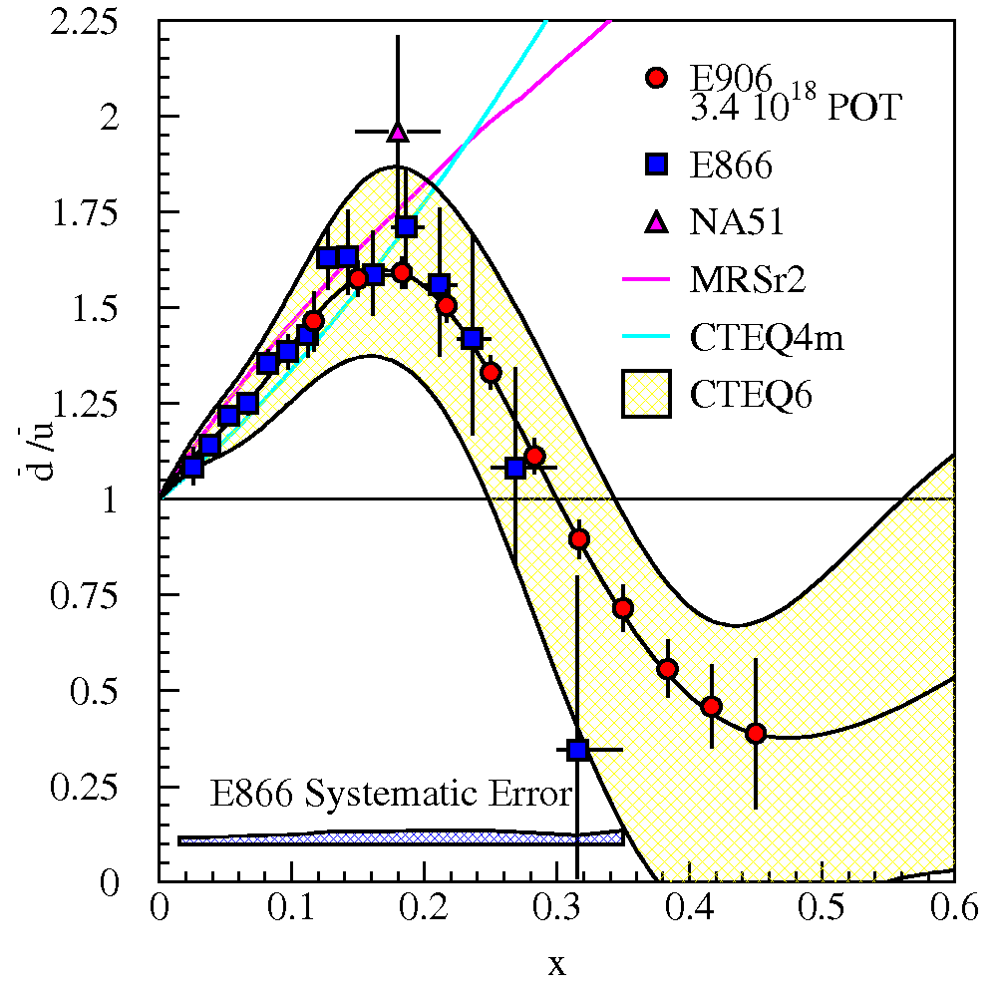
SeaQuest Projections for d-bar/u-bar Ratio
SeaQuest will extend E866 measurements and reduce statistical uncertainty
SeaQuest expects systematic uncertainty to remain at ≈1% in cross section ratio
5 s slow extraction spill each minute
Intensity:
  2 x 10¹² protons/s (I_{inst} =320 nA)
  1 x 10¹³ protons/spill

Slide 4
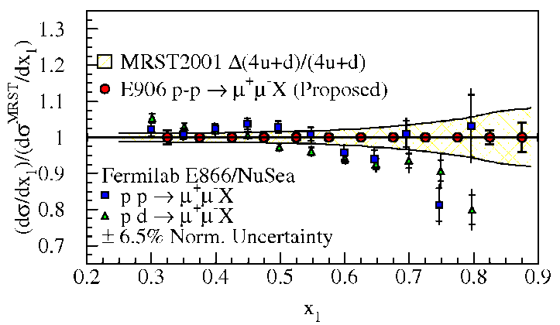
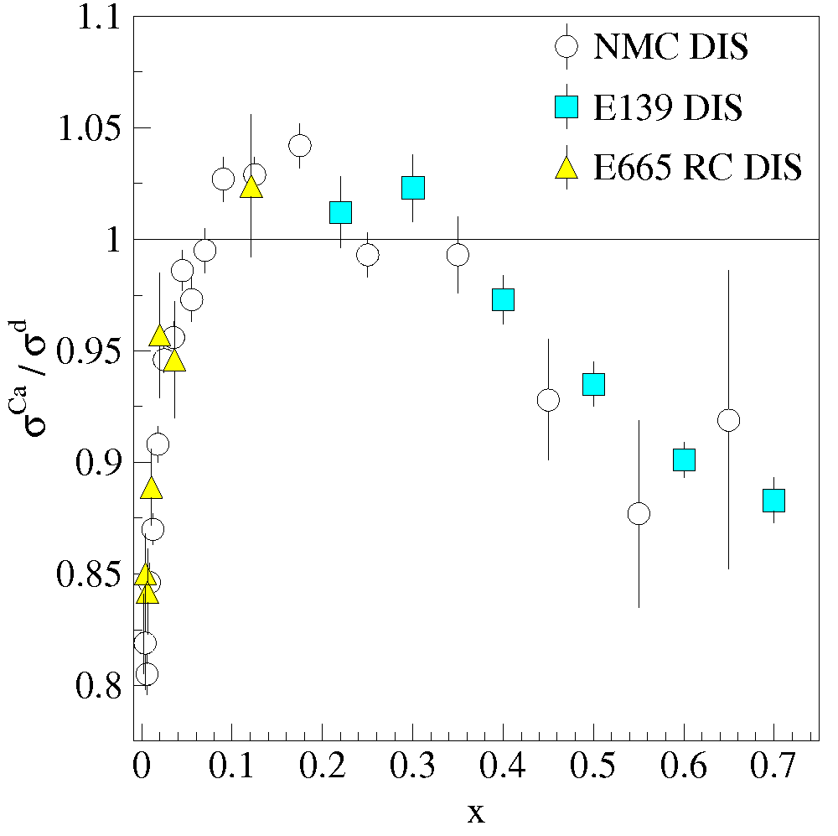
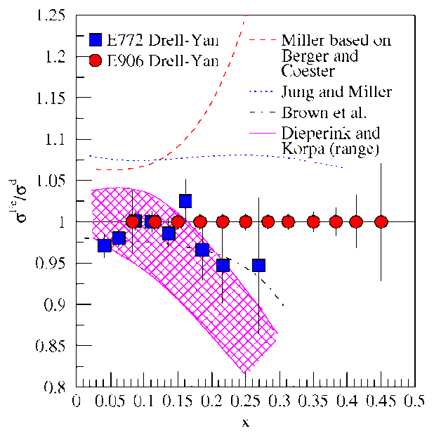
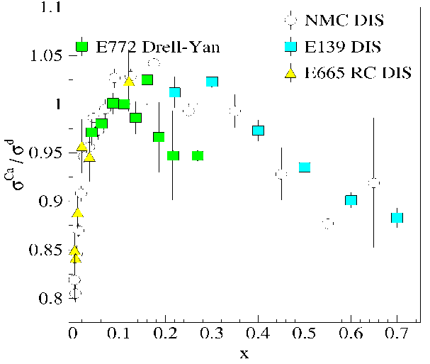
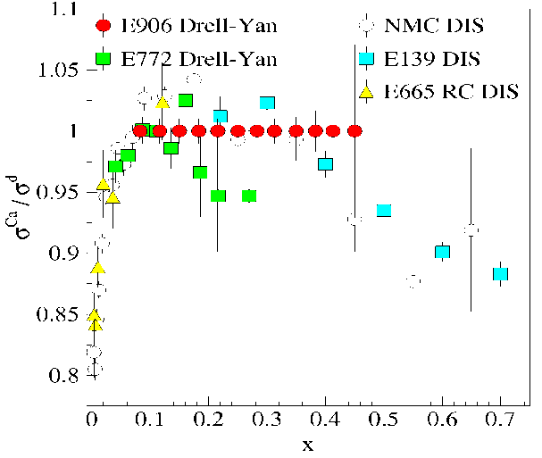
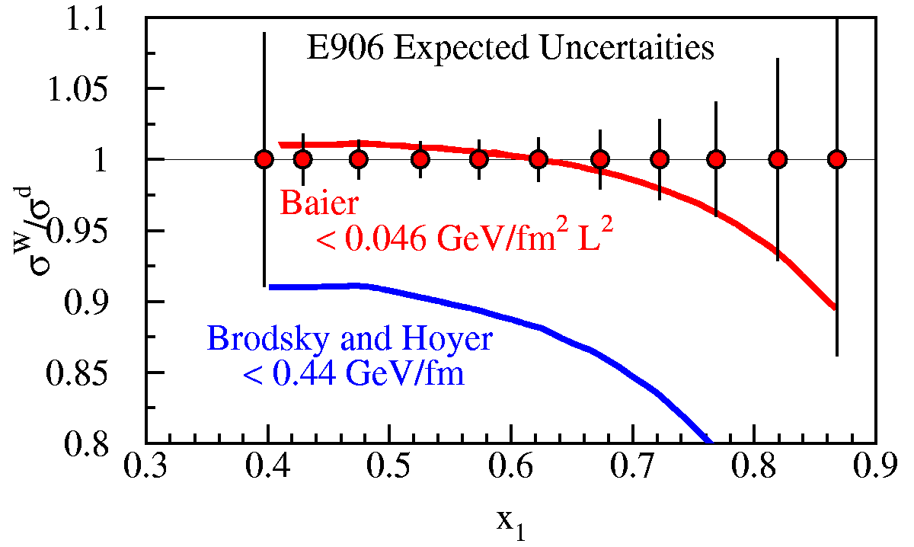
SeaQuest: what else …
What is the structure of the nucleon?
  What is ? What is the origin of the sea quarks?
  What is the high x structure of the proton?
Anti-Shadowing
What is the structure of nucleonic matter?
  Is anti-shadowing a valence
  effect?
  Where are the nuclear pions?
Shadowing
EMC Effect
Do colored partons lose energy in cold nuclear matter ?
  How large is energy loss of fast quarks in cold
  nuclear matter?
Notes:
While providing direct input to the parton distribution fits, the ultimate impact of E906 will be to provide a better understanding on the physical mechanism which generates the sea of the proton. Besides DY ratios, we can also measure abs DY cross sections.
Are nuclear effects different for sea quark distributions than for valence distributions? Indeed, DY apparently sees no anti-shadowing effect (valence effect only?) What can the sea parton distributions tell us about effects of nuclear bindings?
Contemporary nucl models predict large effects to anti-quark distributions as x increases. But no anti-quark enhancement seen in DY E772.

Slide 5
A simple Spectrometer for SeaQuest
Drell-Yan Spectrometer for E906
Station 3
(Hodoscope array, drift chamber track.)
Optimized for Drell-Yan (25m long)
Station 1
(hodoscope array,
MWPC track.)
4.9m
Iron Wall
(Hadron absorber)
Station 4
(hodoscope
array, prop
tube track.)
KTeV Magnet
(Mom. Meas.)
Solid Iron Magnet
(focusing magnet, hadron absorber and beam dump)
Station 2
(hodoscope array, drift chamber track.)
Targets
(liquid H₂, D₂,
and solid targets)

Slide 6
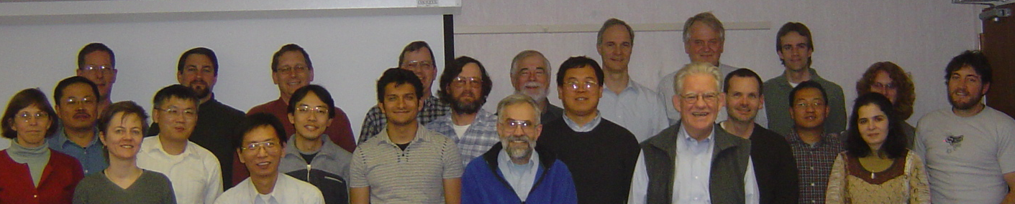
The SeaQuest Collaboration
Abilene Christian University
Andrew Boles, Kyle Bowling, Ryan Castillo, Michael Daughetry, Donald Isenhower, Hoah Kitts, Rusty
Towell, Shon Watson
Academia Sinica
Wen-Chen Chang, Yen-Chu Chen, Jai-Ye Chen, Shiu Shiuan-Hal,
Da-Shung Su,Ting-Hua Chang
Argonne National Laboratory
John Arrington, Don Geesaman*,
Kawtar Hafidi, Roy Holt, Harold Jackson, David Potterveld, Paul E. Reimer*, Brian Tice
University of Colorado
Ed Kinney, Joseph Katich, Po-Ju Lin
Fermi National Accelerator Laboratory
Chuck Brown, David Christian,
Su-Yin Wang, Jin Yuan Wu
University of Illinois
Bryan Dannowitz, Markus Diefenthaler, Bryan Kerns,
Naomi C.R Makins, R. Evan McClellan, Jen-Chieh Peng, Shivangi Prasad,
Mae Hwee Teo
KEK
Shinya Sawada
Los Alamos National Laboratory
Gerry Garvey, Andi Klein,
Mike Leitch, Ming Liu, Pat McGaughey, Joel Moss,
Andrew Puckett
University of Maryland
Betsy Beise, Kaz Nakahara
*Co-Spokespersons
University of Michigan
Christine Aidala, Catherine Culkin, Wolfgang Lorenzon, Bryan Ramson, Richard Raymond, Josh Rubin
National Kaohsiung Normal University
Rurngsheng Guo, Su-Yin Wang
RIKEN
Yoshinori Fukao, Yuji Goto, Atsushi Taketani, Manabu Togawa
Rutgers University
Ron Gilman, Ron Ransome, Arun Tadepalli
Tokyo Institute of Technology
Shou Miyaska, Kei Nagai, Ken-ichi Nakano, Shigeki Obata, Florian
Sanftl, Toshi-Aki Shibata
Yamagata University
Yuya Kudo, Yoshiyuki Miyachi
Oct, 2013
(70 collaborators)
6
6

Slide 7
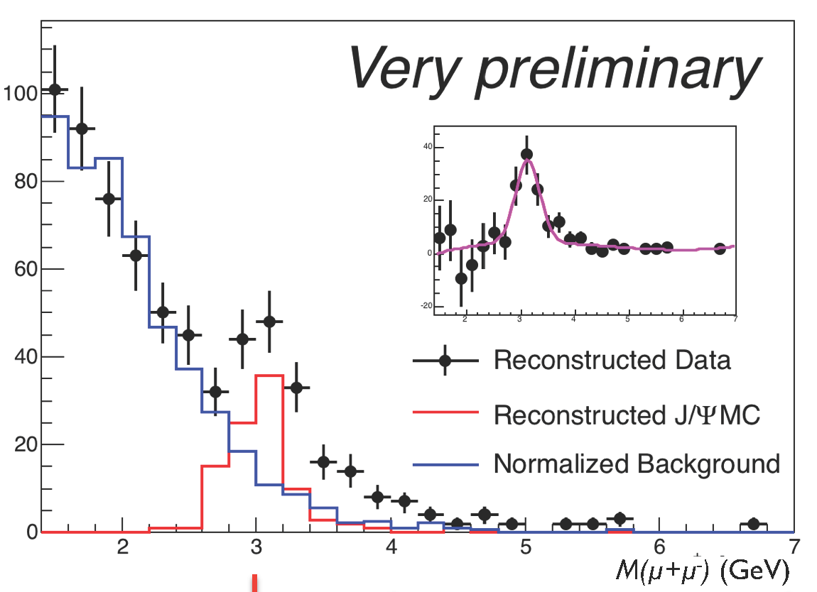
From Commissioning Run to Science Run
Commissioning Run (late Feb. 2012 – April 30th, 2012)
First beam in E906 on March 8th, 2012
Extensive beam tuning by the Fermilab accelerator group
  1 x10¹² protons/s (5 s spill/min)
  120 GeV/c
All the detector subsystems worked
  improvements for the production run completed
Main Injector shut down began on May 1st , 2012
Reconstructable dimuon events seen:
M_{J/Ψ} = 3.12 ± 0.05 GeV
σ = 0.23 ± 0.07 GeV
A successful commissioning run
Science Run start in Nov. 2013 for 2 years
Notes:
In the background-subtracted insert, the deficit of events just below the J/Πσι is understood as originating from the event mixing process that creating an artificially large background here by mixing a high p_{T} muon from a real J/Πσι with another muon.

Slide 8
The long Path towards the Science Run
Stage I approval in 2001
Stage II approval in December 2008
Commissioning Run (March - April 2012)
Expect beam again in November 2013 (for 2 years of data collection)
Expt. Funded
Experiment
Construction
Exp. Experiment
Run Runs
Shutdown
2009
2010
2011
2012
2013
2014
2015
2016
Oct 2013
Apparatus available for future programs at, e.g. Fermilab, (J-PARC or RHIC)
  significant interest from collaboration for continued program:
    Polarized beam in Main Injector
    Polarized Target at NM4

Slide 9
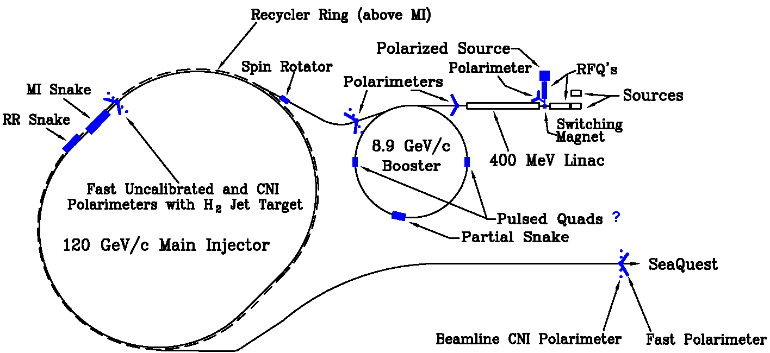
Let’s Add Polarization
Polarize Beam in Main Injector & use SeaQuest dimuon Spectrometer
  measure Sivers asymmetry
Sivers function
  captures non-perturbative spin-orbit coupling effects inside a polarized proton
  is naïve time-reversal odd:
    leads to sign change:
    Sivers function in SIDIS = - Sivers function in Drell-Yan:
    fundamental prediction of QCD (in non-perturbative regime)

Slide 10
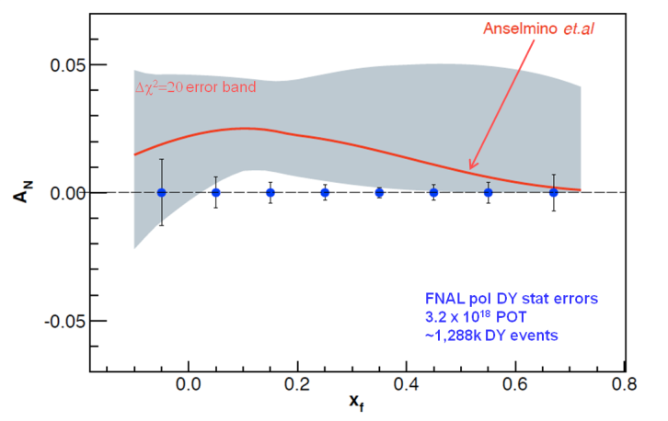
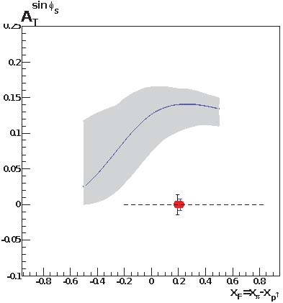
Polarized Drell-Yan at Fermilab Main Injector - II
NOT Yet Done!
Polarized Drell-Yan:
  major milestone in hadronic physics (HP13)
Extraordinary opportunity at Fermilab
  set up best polarized DY experiment to measure sign change in Sivers function
    high luminosity, large x-coverage,
    high-intensity polarized beam
    (SeaQuest) spectrometer already setup and running
  with (potentially) minimal impact on neutrino program
    run alongside neutrino program (10% of beam needed)
  experimental sensitivity:
    2 yrs at 50% eff, P_{b} = 70%
    luminosity: L_{av} = 2 x 10³⁵ /cm²/s
Cost estimate to polarize Main Injector $10M (total)
  includes 15% project management & 50% contingency
COMPASS
Fermilab

Slide 11
Planned Polarized Drell-Yan Experiments
experiment | particles | energy | x_{b} or x_{t} | Luminosity | timeline
COMPASS (CERN) | p± + p↑ | 160 GeV √s = 17.4 GeV | x_{t} = 0.2 – 0.3 | 2 x 10³³ cm⁻² s⁻¹ | 2014, 2018
PAX (GSI) | p↑ + p_{bar} | collider √s = 14 GeV | x_{b} = 0.1 – 0.9 | 2 x 10³⁰ cm⁻² s⁻¹ | >2017
PANDA (GSI) | p_{bar} + p↑ | 15 GeV √s = 5.5 GeV | x_{t} = 0.2 – 0.4 | 2 x 10³² cm⁻² s⁻¹ | >2016
NICA (JINR) | p↑ + p | collider √s = 20 GeV | x_{b} = 0.1 – 0.8 | 1 x 10³⁰ cm⁻² s⁻¹ | >2014
PHENIX (RHIC) | p↑ + p | collider √s = 500 GeV | x_{b} = 0.05 – 0.1 | 2 x 10³² cm⁻² s⁻¹ | >2018
RHIC internal target phase-1 | p↑ + p | 250 GeV √s = 22 GeV | x_{b} = 0.25 – 0.4 | 2 x 10³³ cm⁻² s⁻¹
RHIC internal target phase-1 | p↑ + p | 250 GeV √s = 22 GeV | x_{b} = 0.25 – 0.4 | 6 x 10³⁴ cm⁻² s⁻¹
SeaQuest (unpol.) (FNAL) | p + p | 120 GeV √s = 15 GeV | x_{b} = 0.35 – 0.85 x_{t} = 0.1 – 0.45 | 3.4 x 10³⁵ cm⁻² s⁻¹ | 2012 - 2015
polDY§ (FNAL) | p↑ + p | 120 GeV √s = 15 GeV | x_{b} = 0.35 – 0.85 | 2 x 10³⁵ cm⁻² s⁻¹ | >2016
 | § L= 1 x 10³⁶ cm⁻² s⁻¹ (LH₂ tgt limited) / L= 2 x 10³⁵ cm⁻² s⁻¹ (10% of MI beam limited)

Slide 12
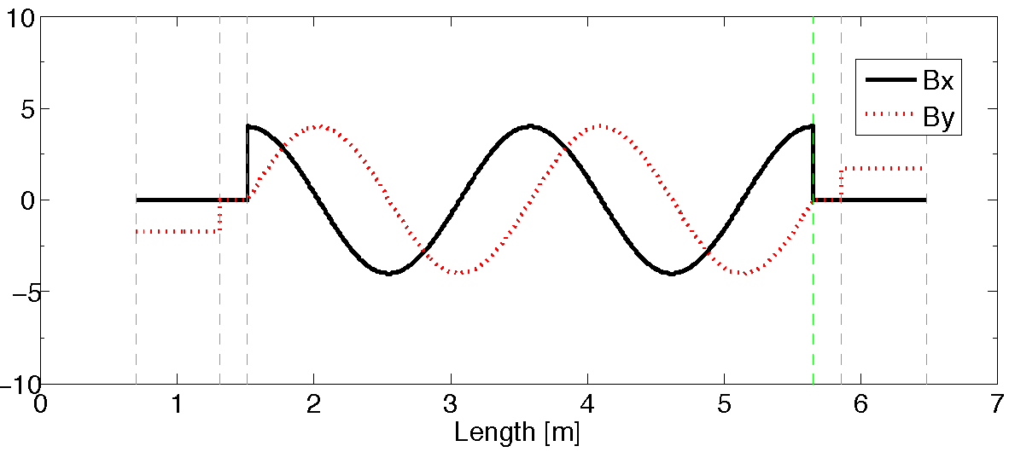
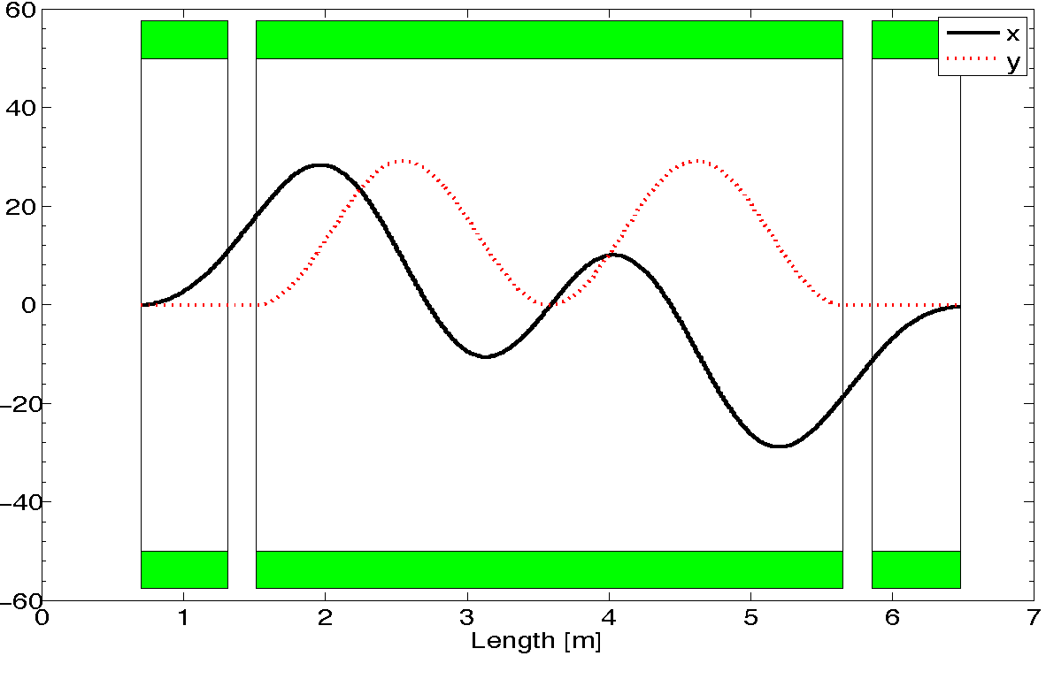
A Novel Siberian Snake for the Main Injector
Single snake design (5.8m long):
1 helical dipole + 2 conv. dipoles
  helix: 4T / 4.2 m / 4” ID
  dipoles: 4T / 0.62 m / 4” ID
use 2-twist magnets
  4π rotation of B field
never done before in a high energy ring
  RHIC uses snake pairs
  single-twist magnets (2π rotation)

Slide 13
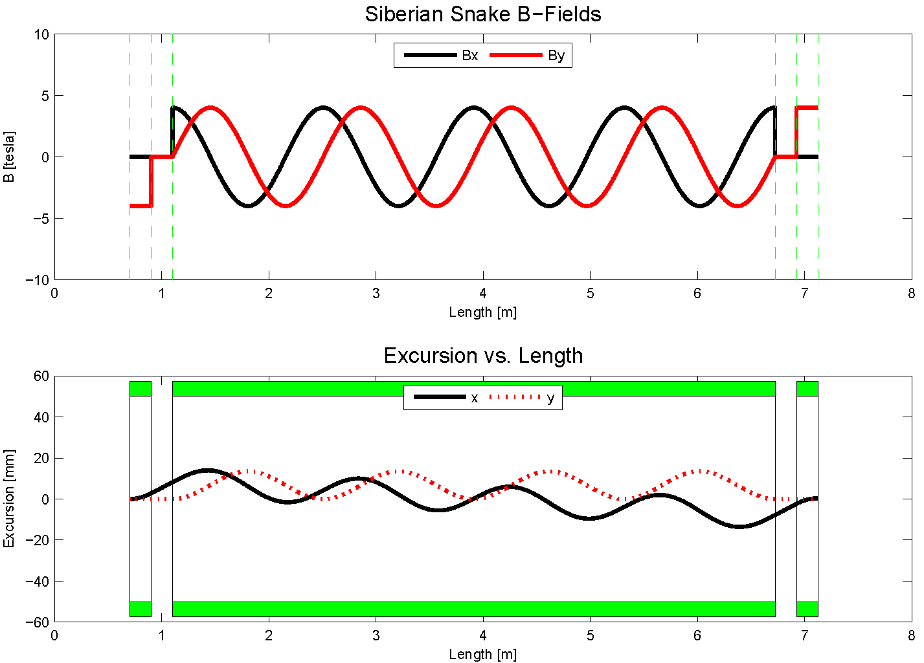
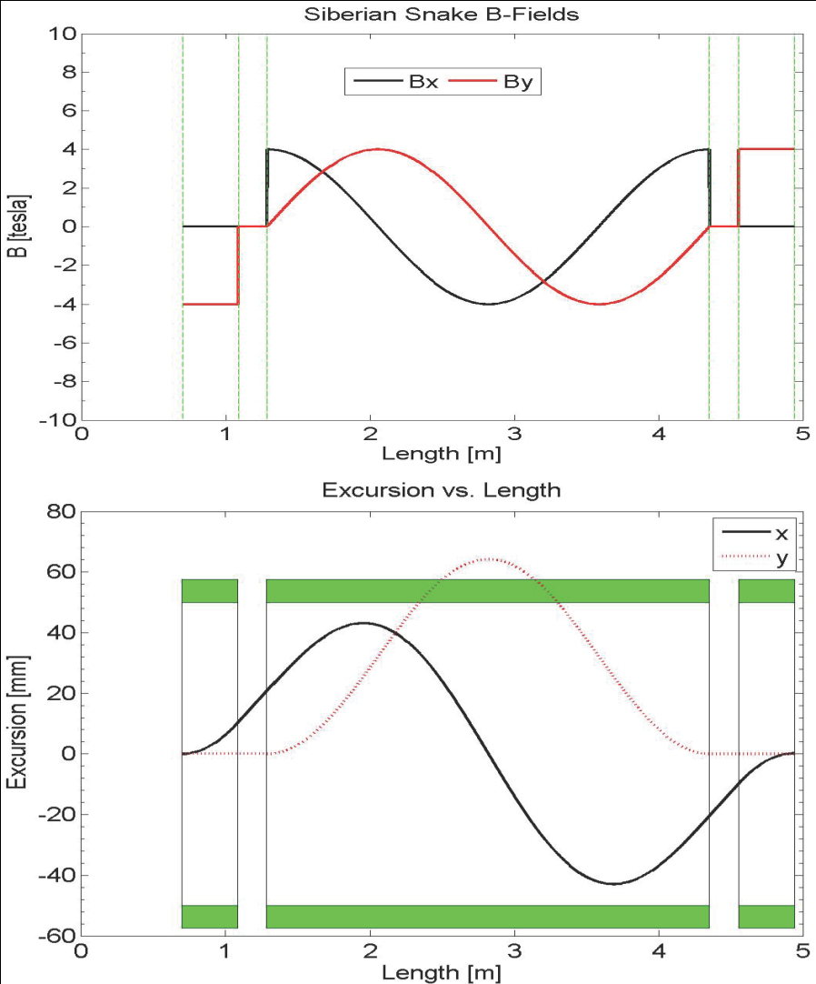
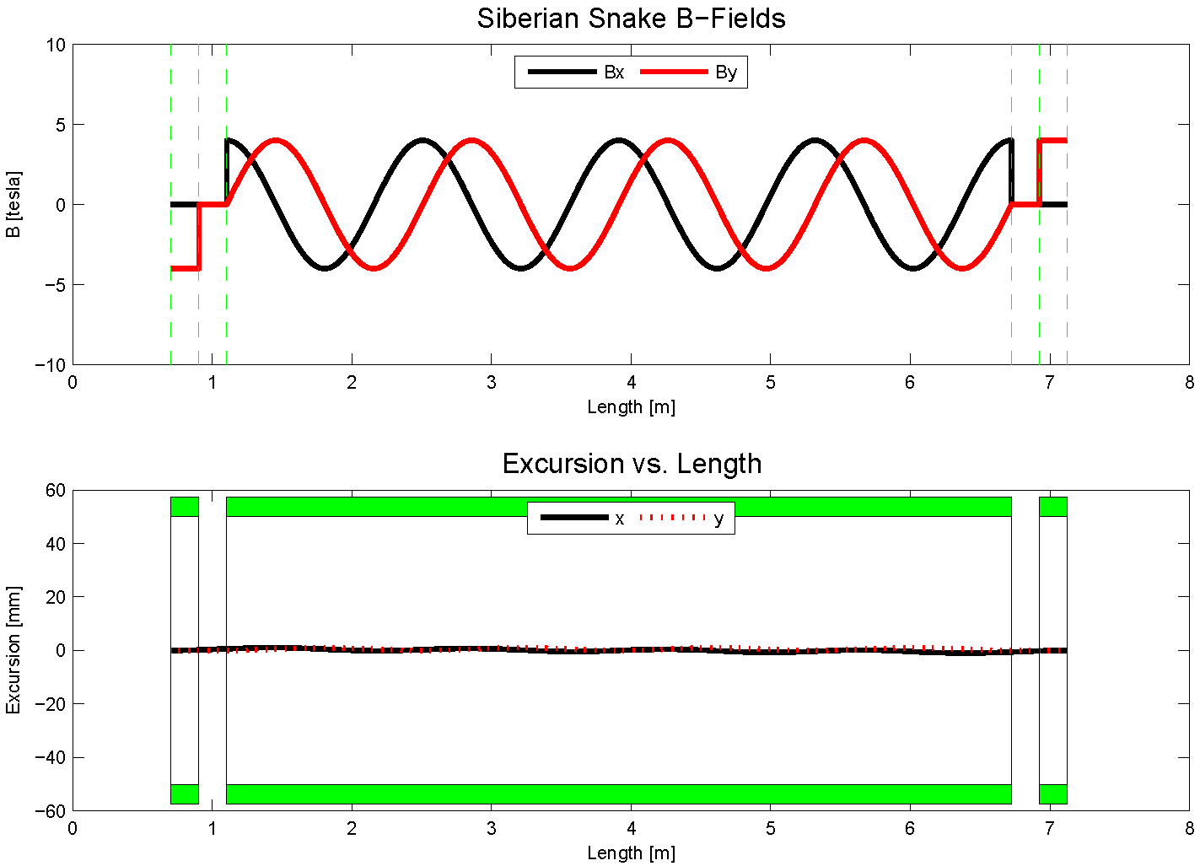
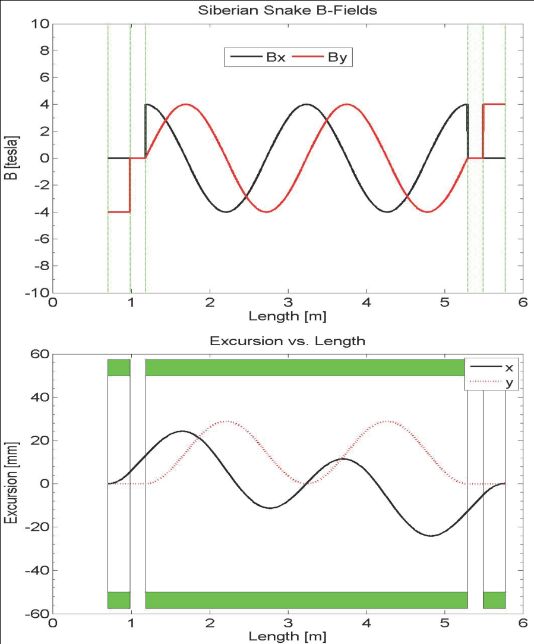
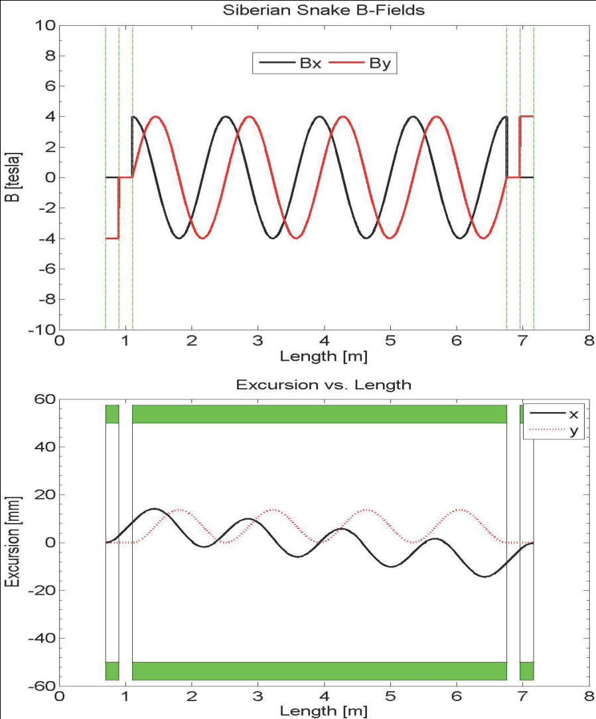
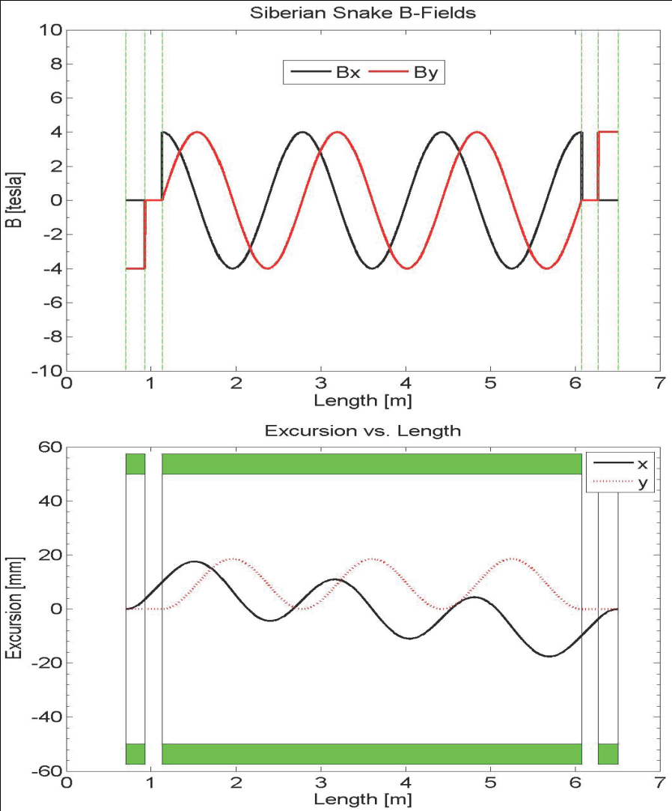
Siberian Snake Studies
8.9 GeV 4T
4-twist 4T
8.9 GeV
120 GeV
beam excursions shrink w/ number of twists
beam excursions shrink w/ beam energy

Slide 14
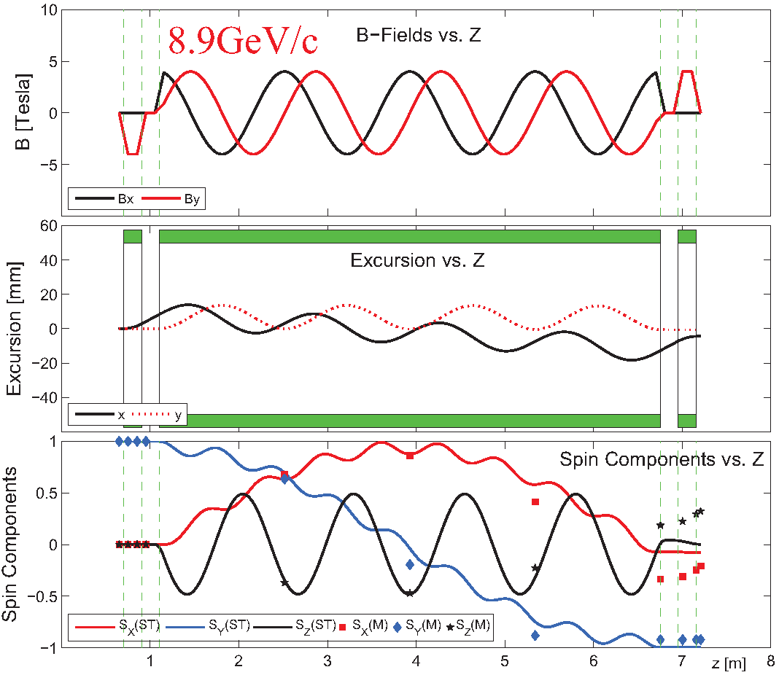
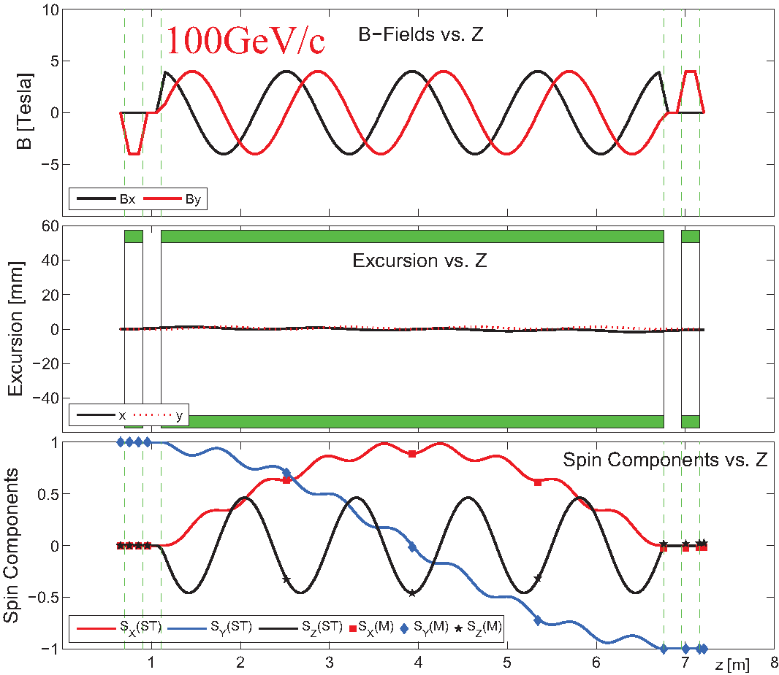
Siberian Snake Studies- II
Including fringe fields
x, y, z spin components vs distance
transport matrix formalism (E.D. Courant): fringe field not included, β = 1 (fixed)
spin tracking formalism (Thomas-BMT): fringe field included, β varibale
fringe fields have <0.5% effect at 8.9 GeV and <<0.1% effect at 100 GeV [arXiv: 1309.1063]

Slide 15
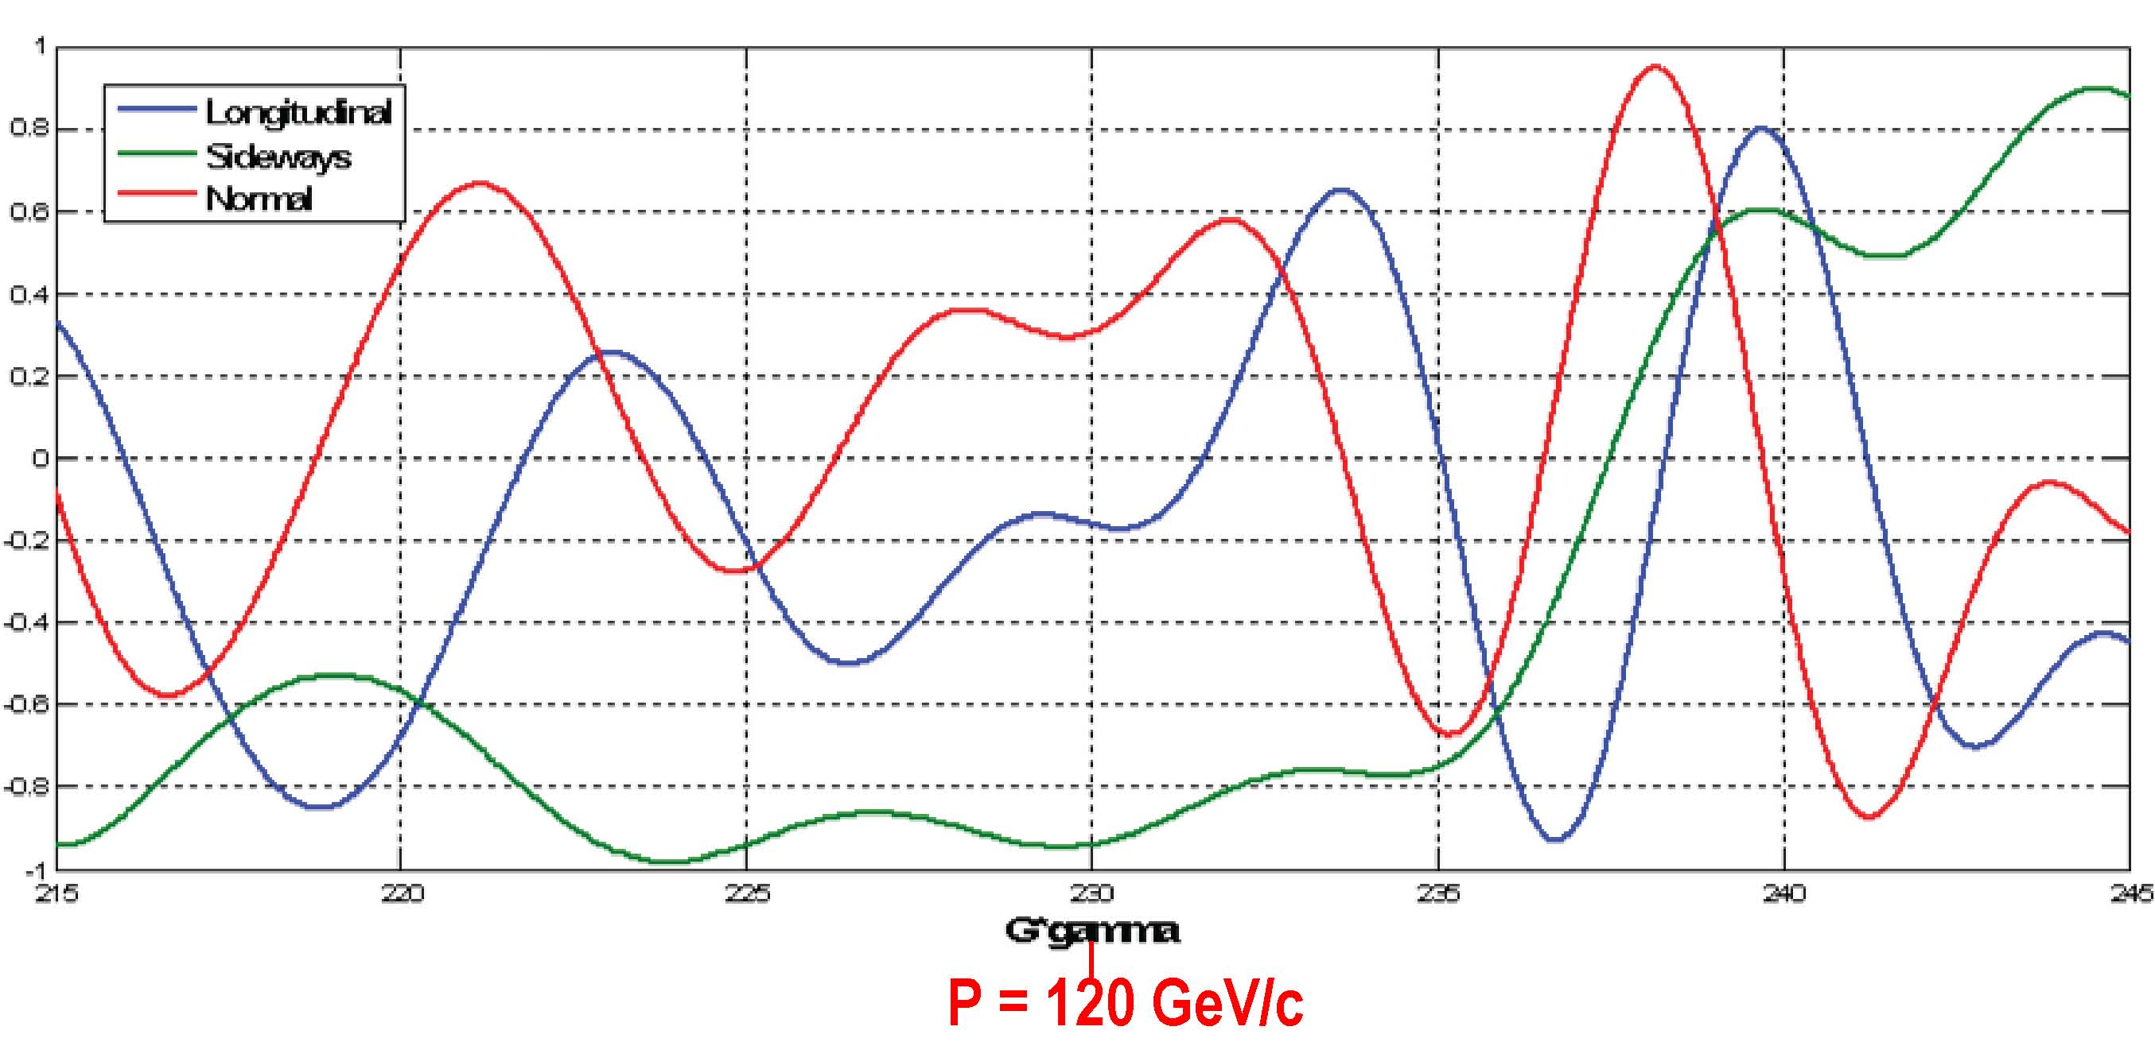
Spin direction control for extracted beam
Spin rotators used to control spin direction at BNL
Spin@Fermi collaboration recent studies (to save $$)
  rotate beam at experiment by changing proton beam energy around nominal 120 GeV
  radial (“sideways”) / vertical (“normal”)
Spin component magnitudes
112 GeV/c
128 GeV/c
124.5 GeV/c
Notes:
Beam direction can be rotated w/in the horizontal plane or into the vertical direction as required by the experiments. This is at the end of a 2.4 km long beam line with 140 bending magnets, some w/ horizontal fields, some w/ vertical and some w/ skew fields.

Slide 16
The Path to a polarized Main Injector
Stage 1 approval from Fermilab: 14-November-2012
Collaboration with A.S. Belov at INR and Dubna to develop polarized source
Detailed machine design and costing using 1 snake in MI
  Spin@Fermi collaboration provide design
    get latest lattice for NOVA:
      translate “mad8” optics file to spin tracking code (“zgoubi”)
    determine intrinsic resonance strength from depolarization calculations
    do single particle tracking with “zgoubi” with novel single-snake
    set up mechanism for adding errors into the lattice:
      orbit errors, quadrupole mis-alignments/rolls, etc.
    perform systematic spin tracking
      explore tolerances on beam emittance
      explore tolerances on various imperfections: orbit / snake / etc
  Fermilab (AD) does verification & costing

Slide 17
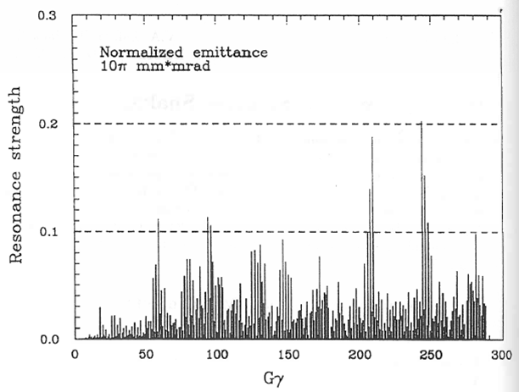
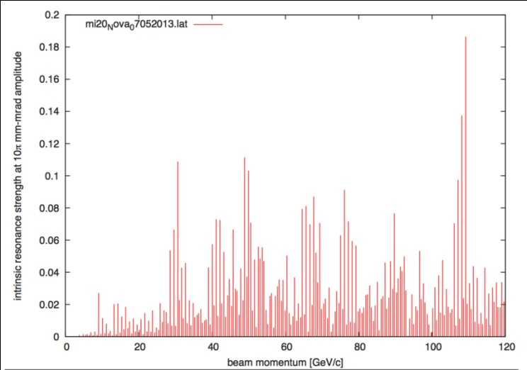
Intrinsic Resonance Strength in Main Injector
Depol calculations: single particle at 10π mm-mrad betatron amplitude
1995 Spin@Fermi report
  before MI was built
using NOVA lattice (July 2013)
very similar: largest resonance strength just below 0.2
  → one snake sufficient (E. Courant rule of thumb)

Slide 18
Another Way to Add Polarization: E1039
Polarized Target at Fermilab
Probe Sea-quark Sivers Asymmetry
with a polarized proton target at SeaQuest
sea-quark Sivers function poorly known
significant Sivers asymmetry expected
from meson-cloud model
KMAG
FMAG
Polarized Target
use current SeaQuest setup
a polarized proton target, unpolarized beam
Proton Beam 120 GeV/c
Ref: Andi Klein (ANL)

Slide 19
Summary
SeaQuest (E906):
  What is the structure of the nucleon? ?
  How does it change in the nucleus?
    provide better understanding on the physical
    mechanism which generates the proton sea
Polarized Drell-Yan (E1027):
  QCD (and factorization) require sign change in Sivers
  asymmetry:
    test fundamental prediction of QCD
    (in non-perturbative regime)
  Measure DY with both Beam or/and Target polarized
    broad spin physics program possible
  Path to polarized proton beam at Main Injector
    perform detailed machine design and
    costing studies
      proof that single-snake concept works
      applications for JPARC, NICA, ….
    Secure funding
Fermilab

Slide 20
Thank You
Notes:
Provide polarized beam in slow extraction mode (assumed 70% in stat. analysis)

