Slide 1
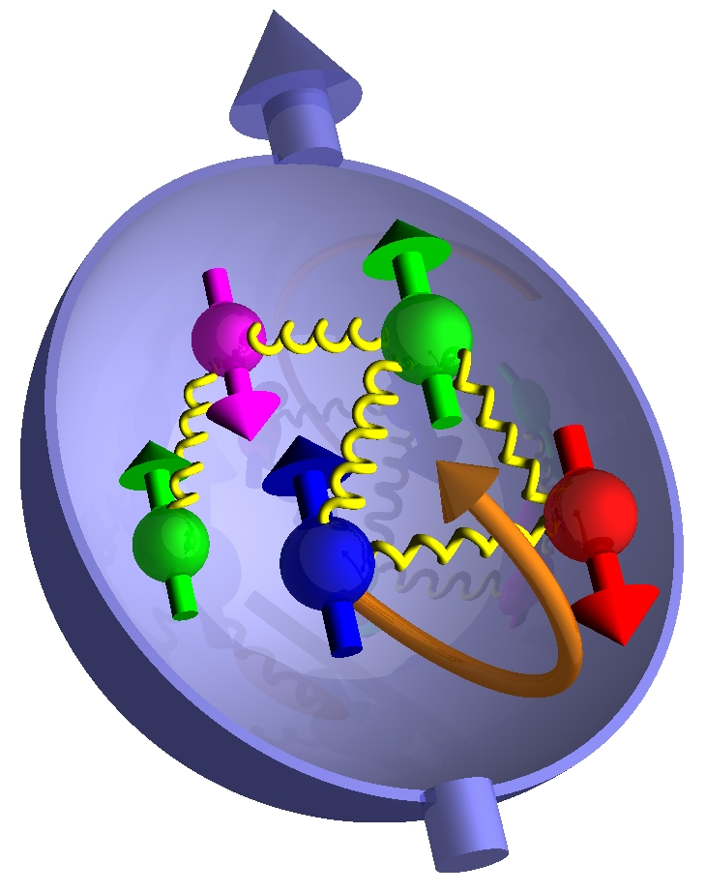
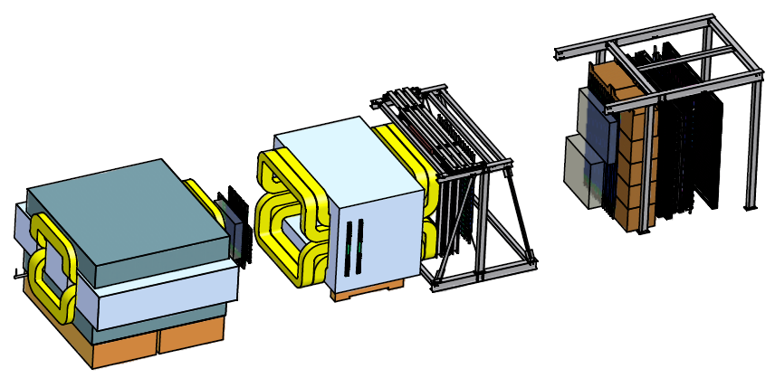
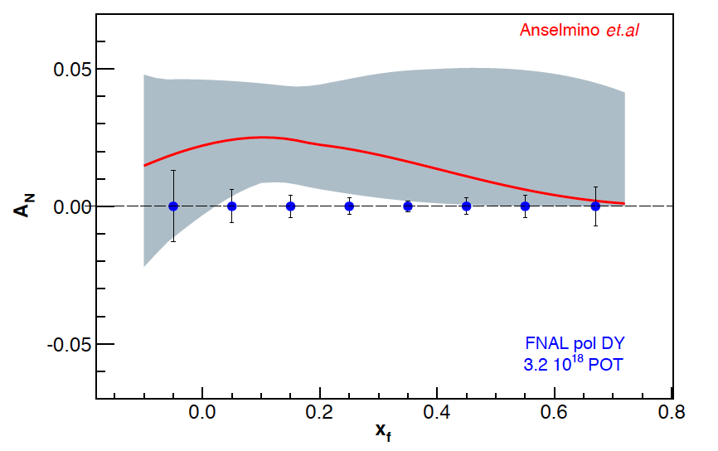
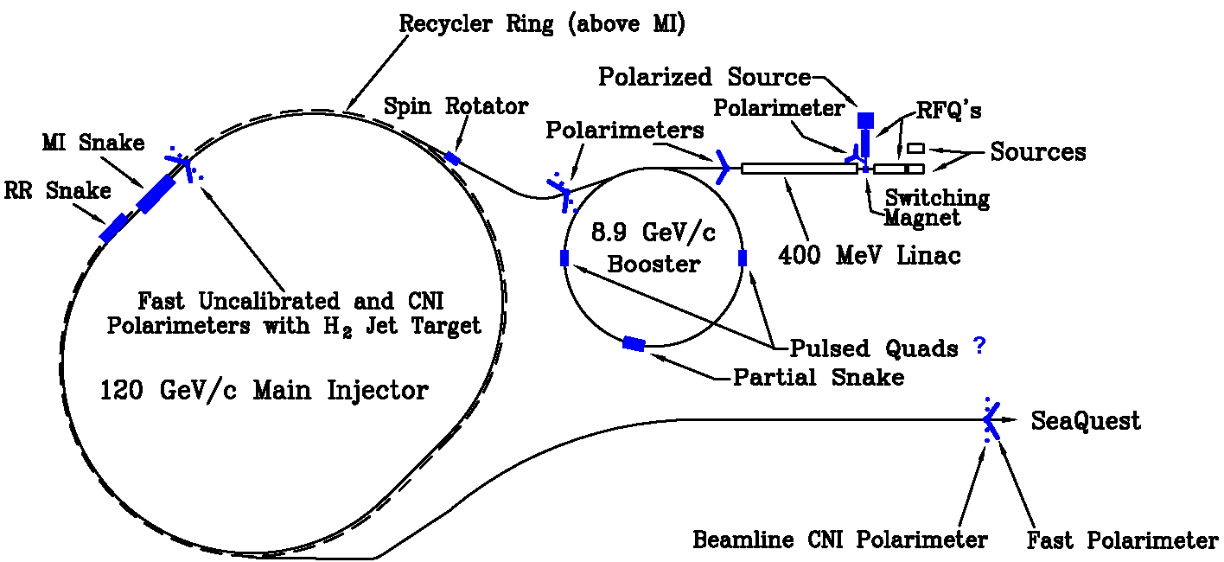
Probing Valence Quarks and the Sivers Distribution with Polarized-Beam Drell-Yan
Paul E Reimer
Physics Division
Argonne National Laboratory
7 October 2014
Parton Distributions & Sivers effect
Importance of Drell-Yan
Fermilab E906/SeaQuest
Polarized Fermilab Main Injector
This work is supported in part by the U.S. Department of Energy, Office of Nuclear Physics, under Contract No. DE-AC02-06CH11357.

Slide 2
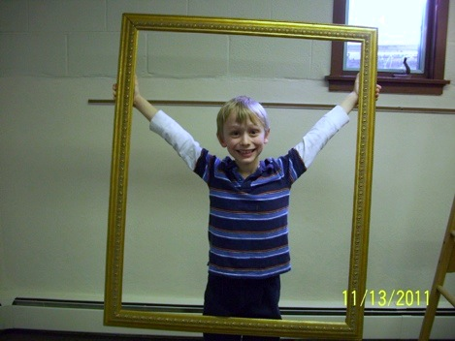
The Big Picture

Slide 3
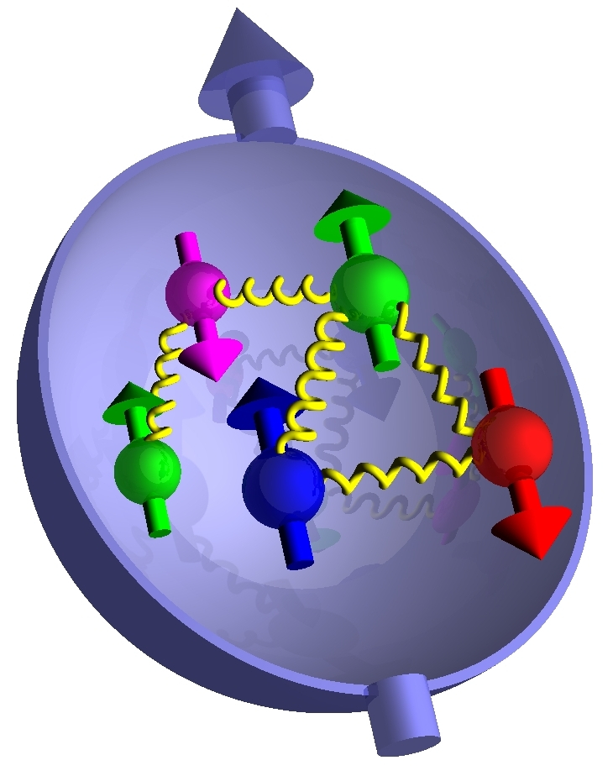
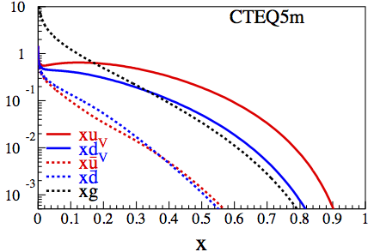
The proton in terms of parton distributions
Survive k_{T} integration

Slide 4
Transverse Momentum Distributions: Introduction
Survive k_{T} integration
k_{T} - dependent, T-even

Slide 5
Transverse Momentum Distributions: Introduction
Survive k_{T} integration
Sivers Function
k_{T} - dependent, T-even
k_{T} - dependent,
“NaiveT-odd”
Boer-Mulders Function

Slide 6
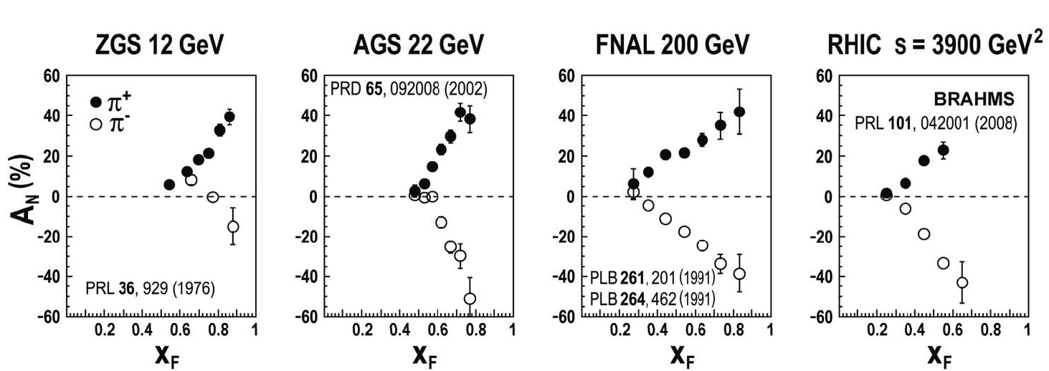
Single Spin Asymmetries
C. Aidala SPIN 2008 Proceeding and CERN Courier June 2009
Single spin asymmetries in Hadron-Hadron interactions have been observed over a wide range of center-of-mass energies
Explanations:
  k_{T} dependent fragmentation function in hadronization of quarks
    Collins Fragmentation Function, H_{1T}^{⊥,qgH}(k_{T},x,Q²)
  k_{T} dependent parton distribution in transversely polarized nucleon
    Sivers Distribution Function, F_{1T}^{⊥q}(k_{T},x,Q²)
    Apparently T-Odd—but not really!

Slide 7
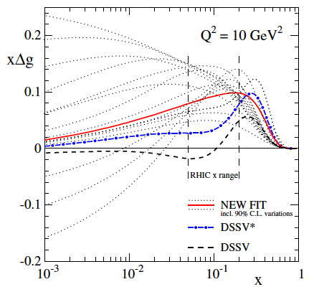
Sivers Function and the Spin Crisis
Correlation between unpolarized quarks and a nucleon’s transverse polarization
½ ΔΣ ≈ 25%
ΔG may be as high as 15%¹
L ??? unmeasured
Non-zero Sivers distribution _ non-zero quark orbital momentum
¹de Florian et al. Phys. Rev. Lett. 113,

Slide 8
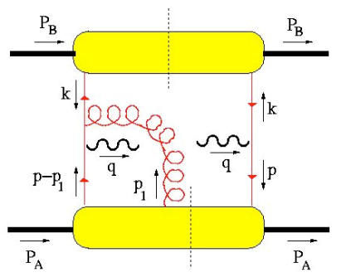
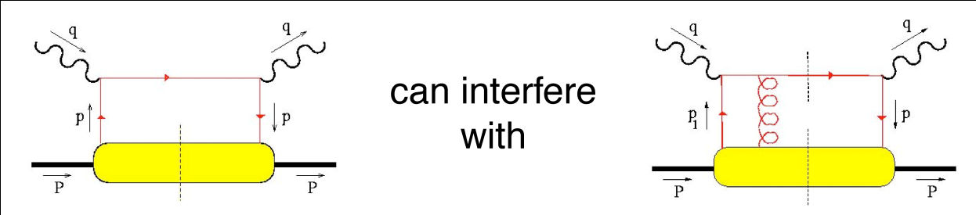
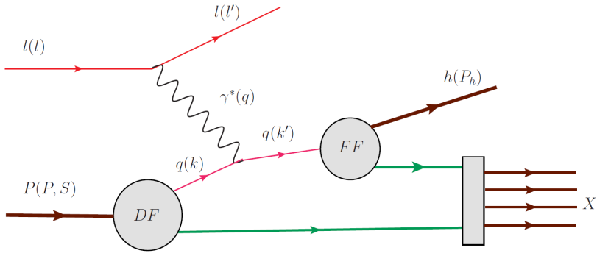
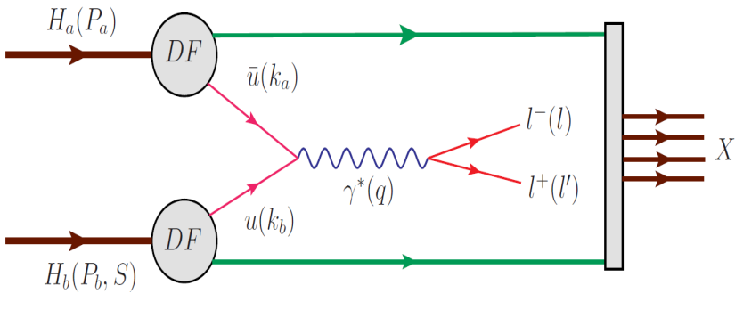
“Naïve” T-odd observables
Naïve T-odd effect (F_{1T}^{⊥q}) must arise from interference between spin-flip and non-flip amplitudes w/different phases
soft gluons “gauge links” required for color gauge invariance
soft gluon re-interactions are final (or initial) state interactions … and may be process dependent!
Kotzinian, DY workshop,
CERN, 4/10
spacelike (DIS) vs. Timelike (Drell-Yan) virtual photon
Notes:
To produce a T-odd observable, such as the Sivers function, you must have an interference between spin-flip and non-flip amplitudes, and one of the amplitudes must have an imaginary part.
And all of these should all be completely suppressed in the perturbative hard scattering subprocess xsec.
But a leading twist distribution function is just a forward scattering amplitude, how can it contain an interference?
But because of the data, and the vigorous theoretical effort surrounding these data, Brodksy, Hwang and Smith re-examined the factorization theorem and found that for the case of TMD PDFs, one has to be careful to include these diagrams, where a soft gluon re-interacts between the struck quark and the proton. This looks like higher twist … but no, these are soft gluons, which are the gauge links required for color gauge invariance.
While in DIS this final state interaction is attractive, in D-Y the initial state interaction is repulsive, leading to a sign change

Slide 9
QCD Predictions
Kotzinian, DY workshop,
CERN, 4/10
spacelike (DIS) vs. Timelike (Drell-Yan) virtual photon
Fundamental prediction of the gauge formulation of QCD and factorization
  goes to the heart of our ability to use QCD
World Wide Race to measure verify or disprove this property
Notes:
To produce a T-odd observable, such as the Sivers function, you must have an interference between spin-flip and non-flip amplitudes, and one of the amplitudes must have an imaginary part.
And all of these should all be completely suppressed in the perturbative hard scattering subprocess xsec.
But a leading twist distribution function is just a forward scattering amplitude, how can it contain an interference?
But because of the data, and the vigorous theoretical effort surrounding these data, Brodksy, Hwang and Smith re-examined the factorization theorem and found that for the case of TMD PDFs, one has to be careful to include these diagrams, where a soft gluon re-interacts between the struck quark and the proton. This looks like higher twist … but no, these are soft gluons, which are the gauge links required for color gauge invariance.
While in DIS this final state interaction is attractive, in D-Y the initial state interaction is repulsive, leading to a sign change

Slide 10
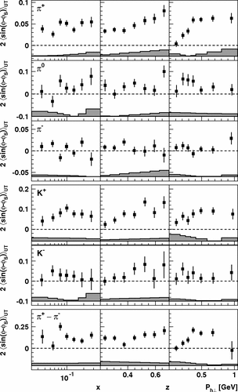
SIDIS Sivers' measurements
HERMES, Airapetian et al. Phys. Rev. Lett. 103, 152002
Global fit to sin(φ_{h} –φ_{S}) asymmetry in SIDIS from HERMES, and COMPASS
Comparable measurements needed for single spin asymmetries in Drell-Yan process
Caution:
  Must cover same kinematics with Drell-Yan and SIDIS (or have robust QCD evolution)
  Right now, nothing excludes a node

Slide 11
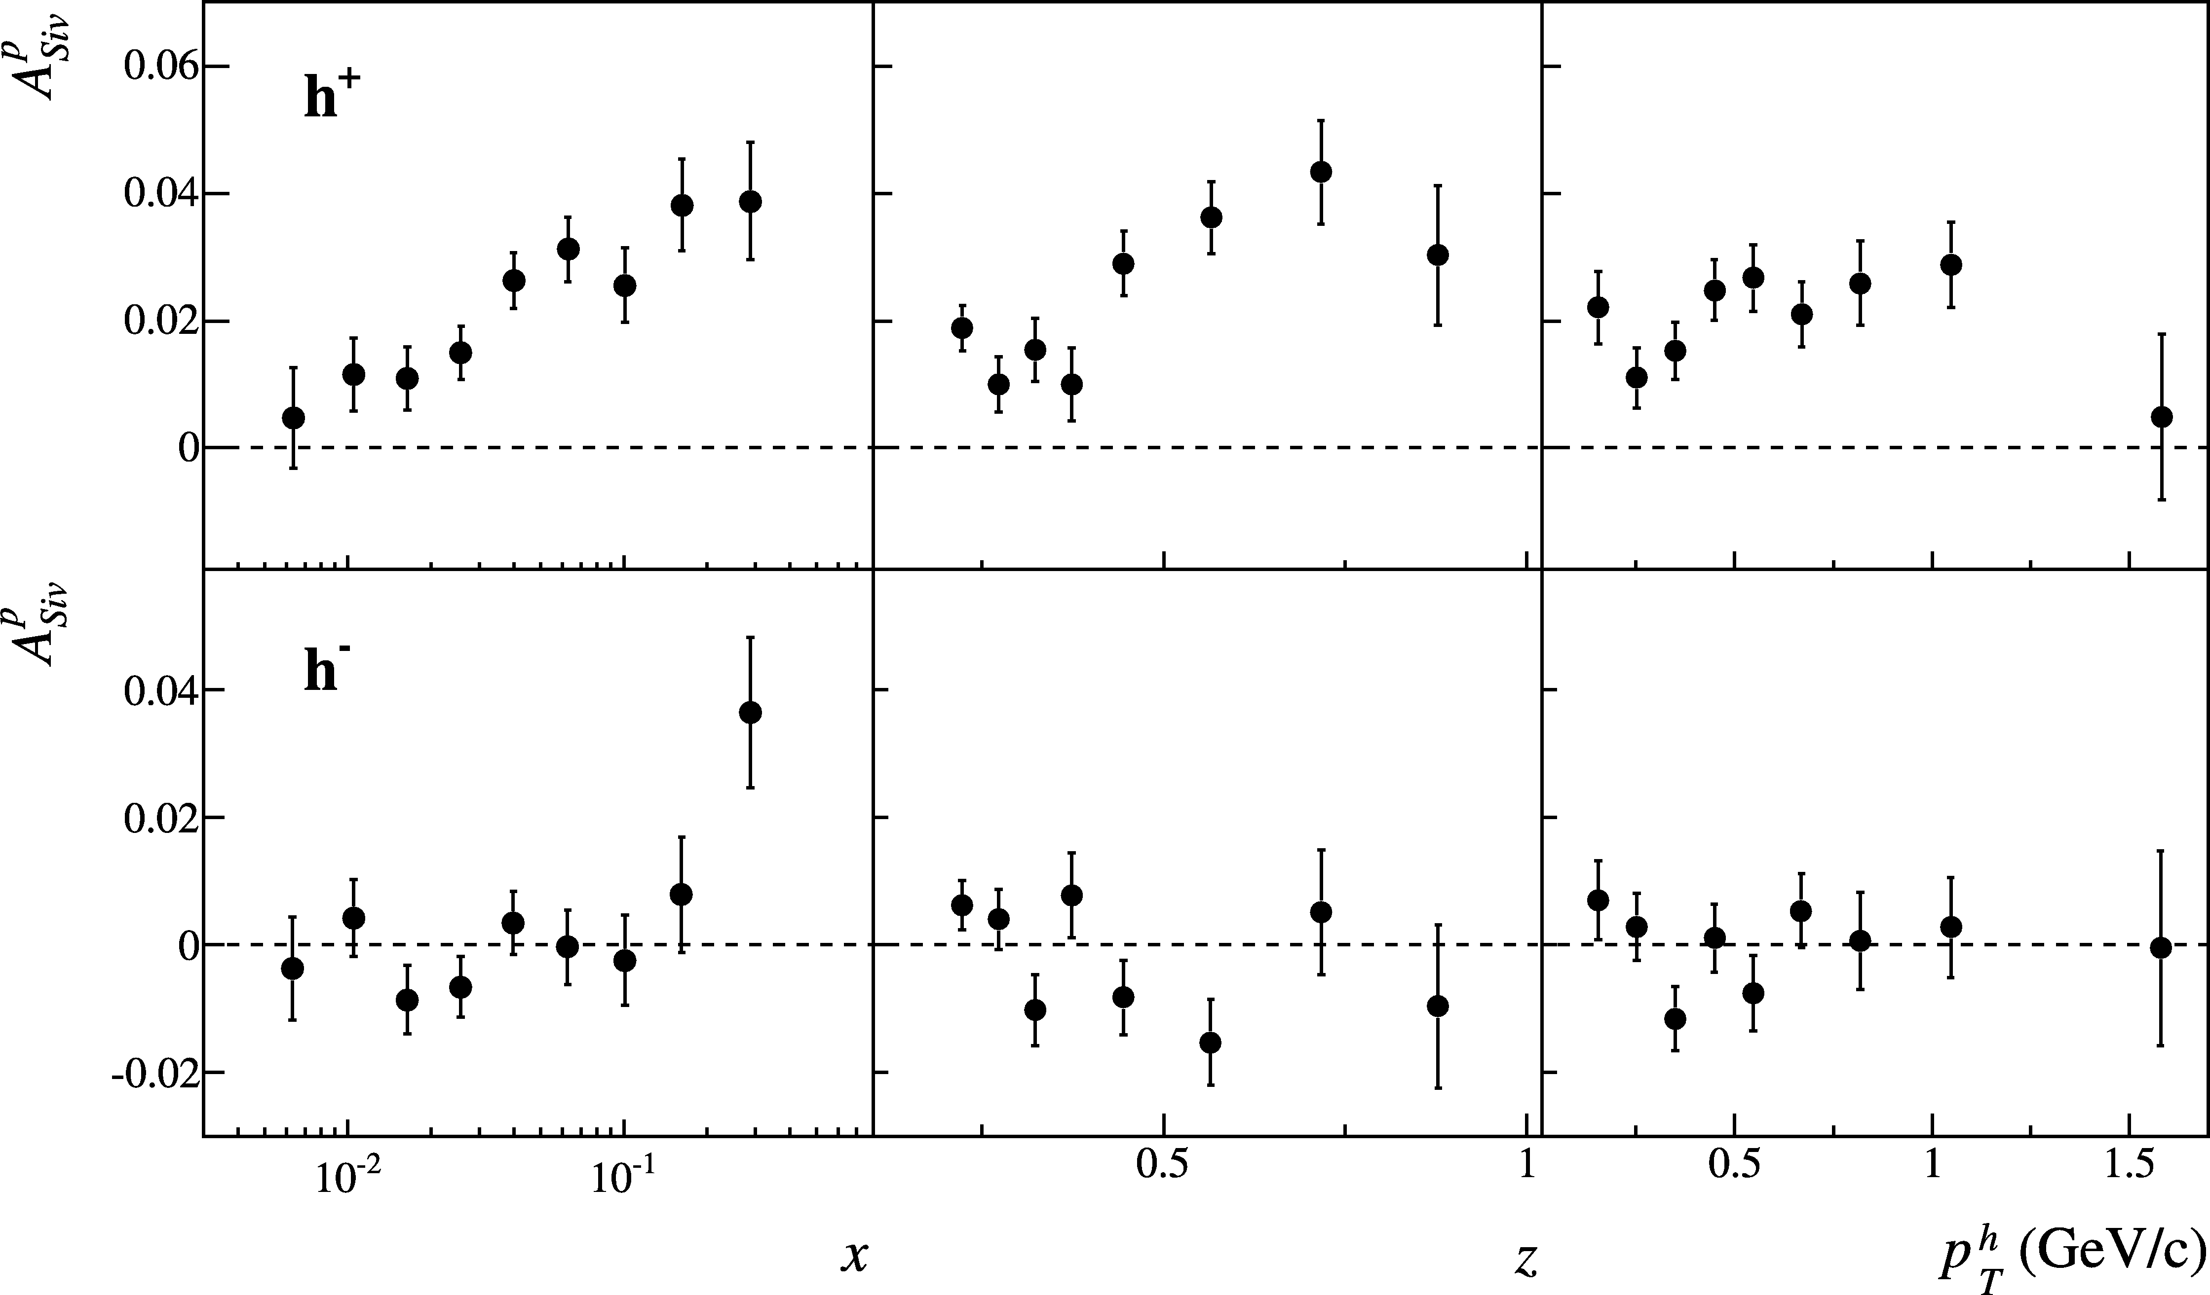
SIDIS Sivers' measurements
COMPASS, Adloph et al. Phys Lett. B, 717, 383
Global fit to sin(φ_{h} –φ_{S}) asymmetry in SIDIS from HERMES, and COMPASS
Comparable measurements needed for single spin asymmetries in Drell-Yan process
Caution:
  Must cover same kinematics with Drell-Yan and SIDIS (or have robust QCD evolution)
  Right now, nothing excludes a node

Slide 12
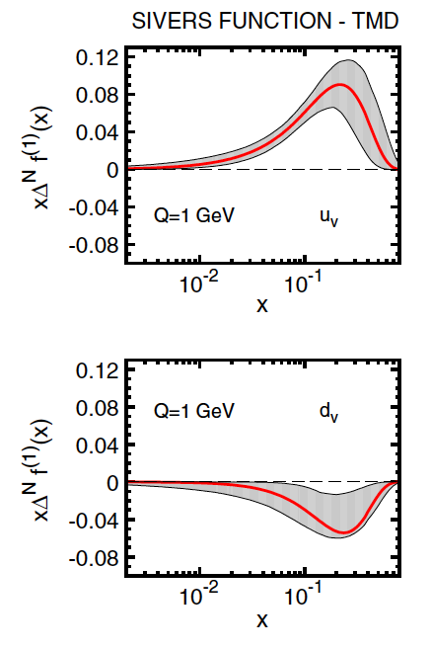
Fits of Sivers asymmetries
Data fit to extract Sivers distributions
Shown at left are the 1st moments
Anselmino et al. Phys. Rev. D 86 014028 (2012)

Slide 13
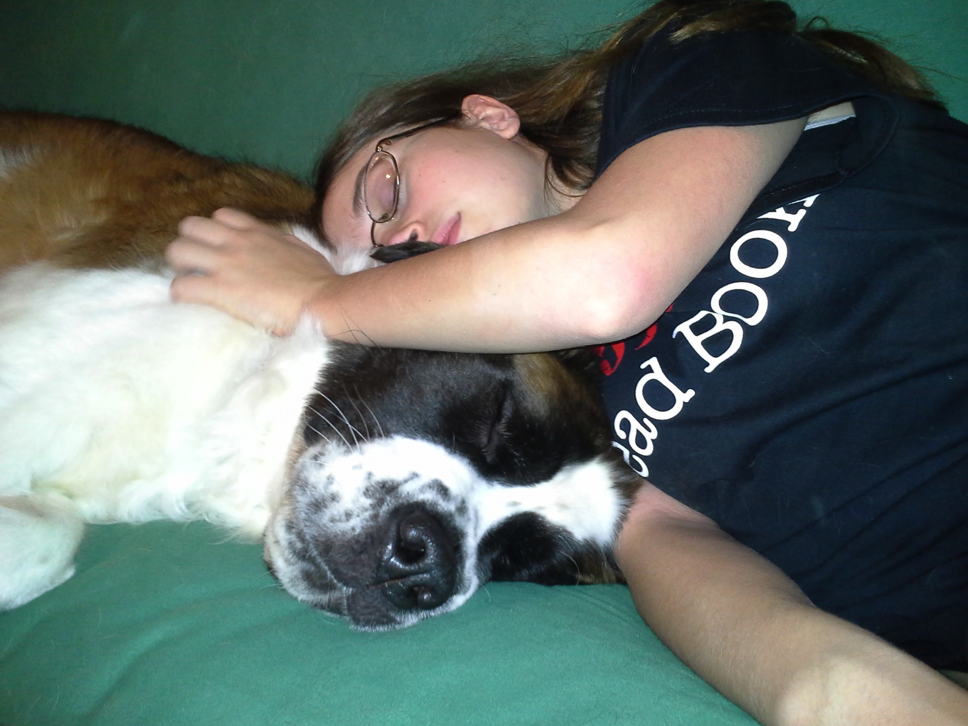
Time to move on from the just Sivers distribution

Slide 14
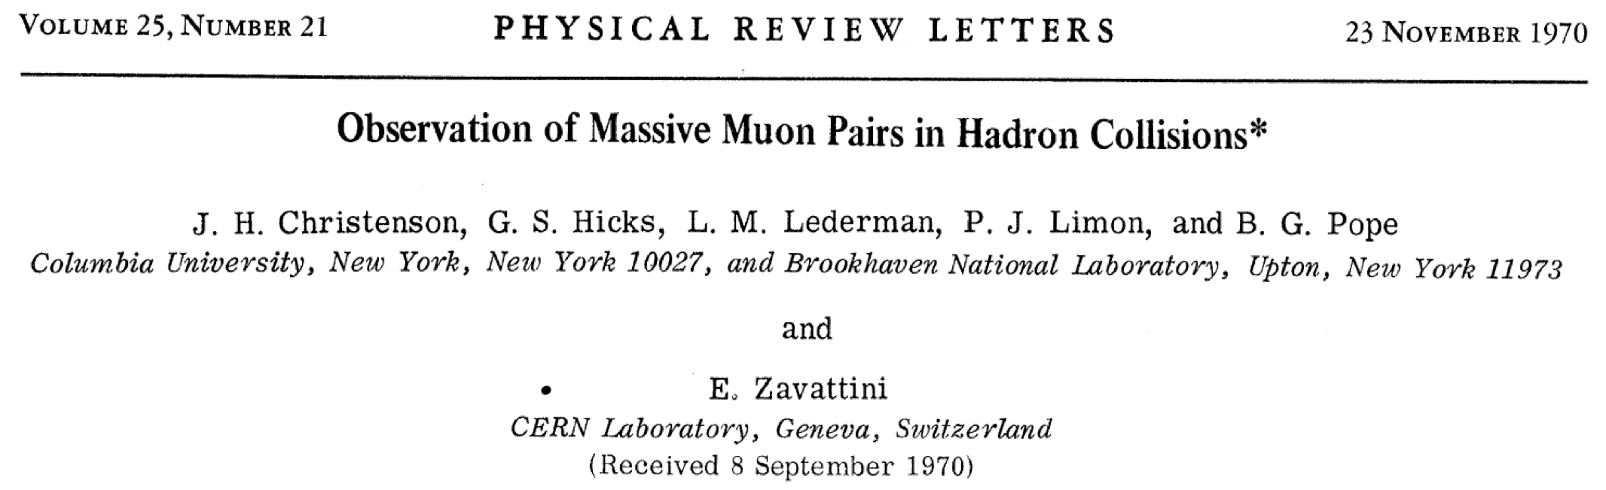
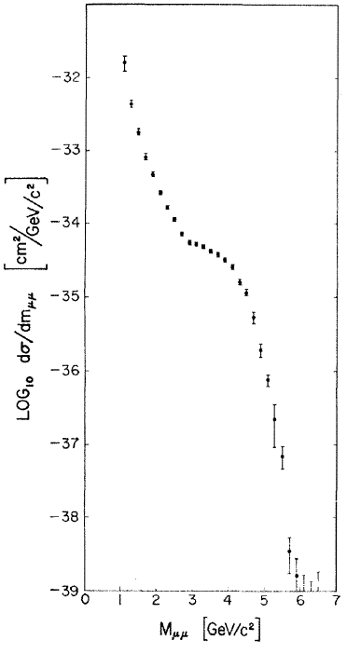
Early Muon Pair Data—soon to be called Drell-Yan
Muon Pairs in the mass range 1 < m_{μμ} < 6.7 GeV/c² have been observed in collisions of high-energy protons with uranium nuclei. At an incident energy of 29 GeV, the cross section varies smoothly as dσ/dm_{μμ} ≈ 10⁻³² / m_{μμ}⁵ cm² (GeV/c)⁻² and exhibits no resonant structure. The total cross section increases by a factor of 5 as the proton energy rises from 22 to 29.5 GeV.

Slide 15
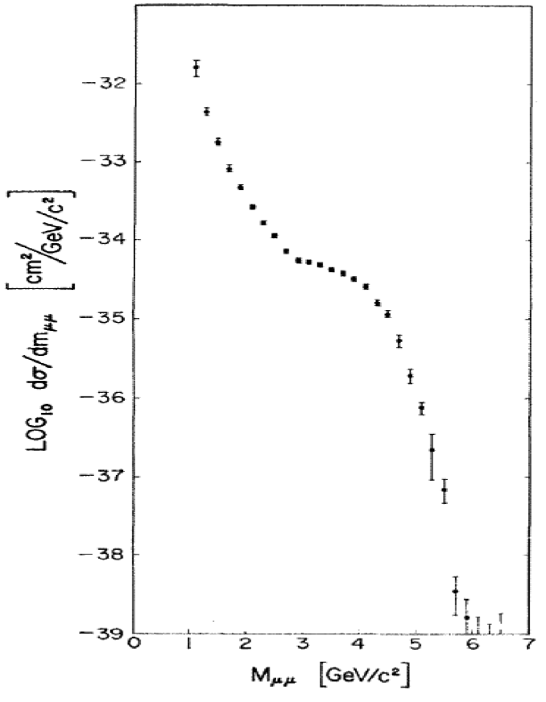
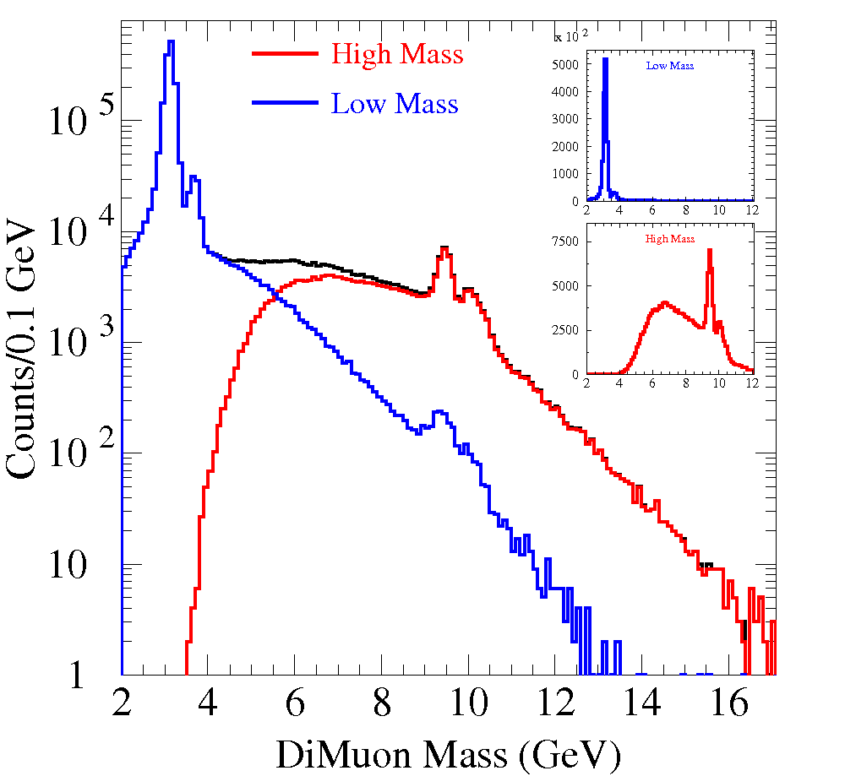
Early Muon Pair Data—soon to be called Drell-Yan
Don’t miss the tree when looking at the beautiful scenery

Slide 16
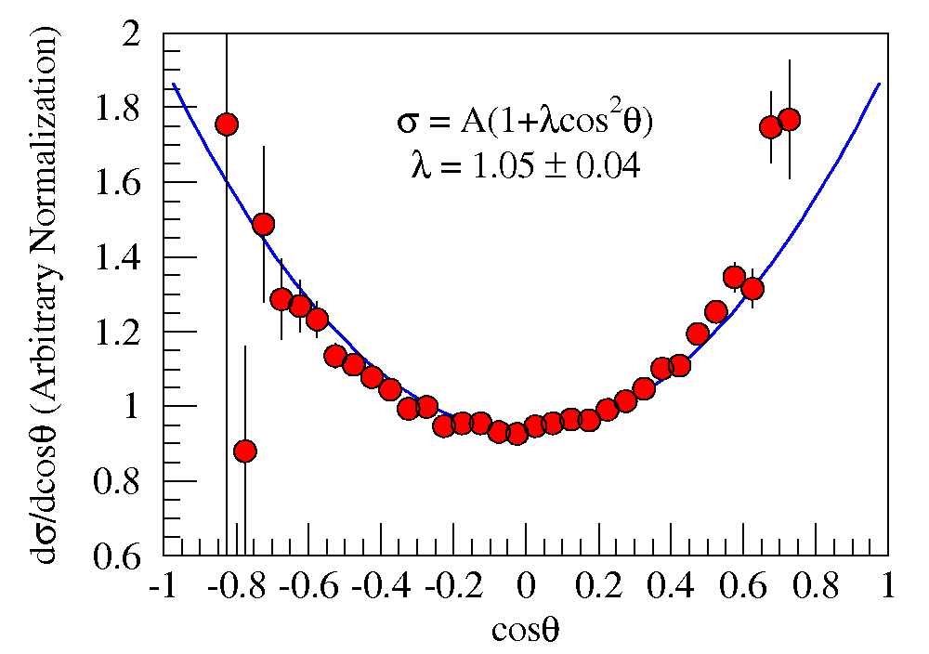
Drell and Yan’s explanation
Also predicted
λ(1+cos²θ)
angular distributions.
Fermilab E-866/NuSea
unpublished

Slide 17
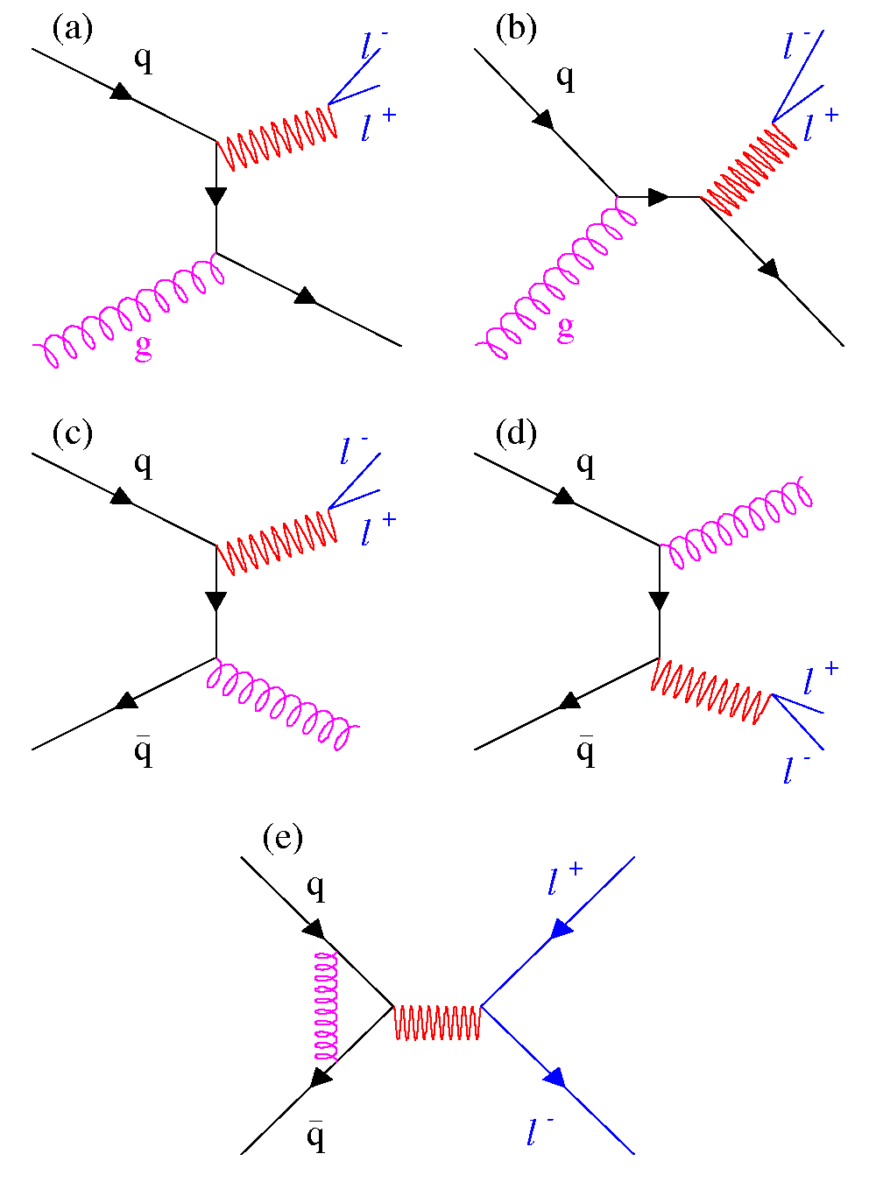
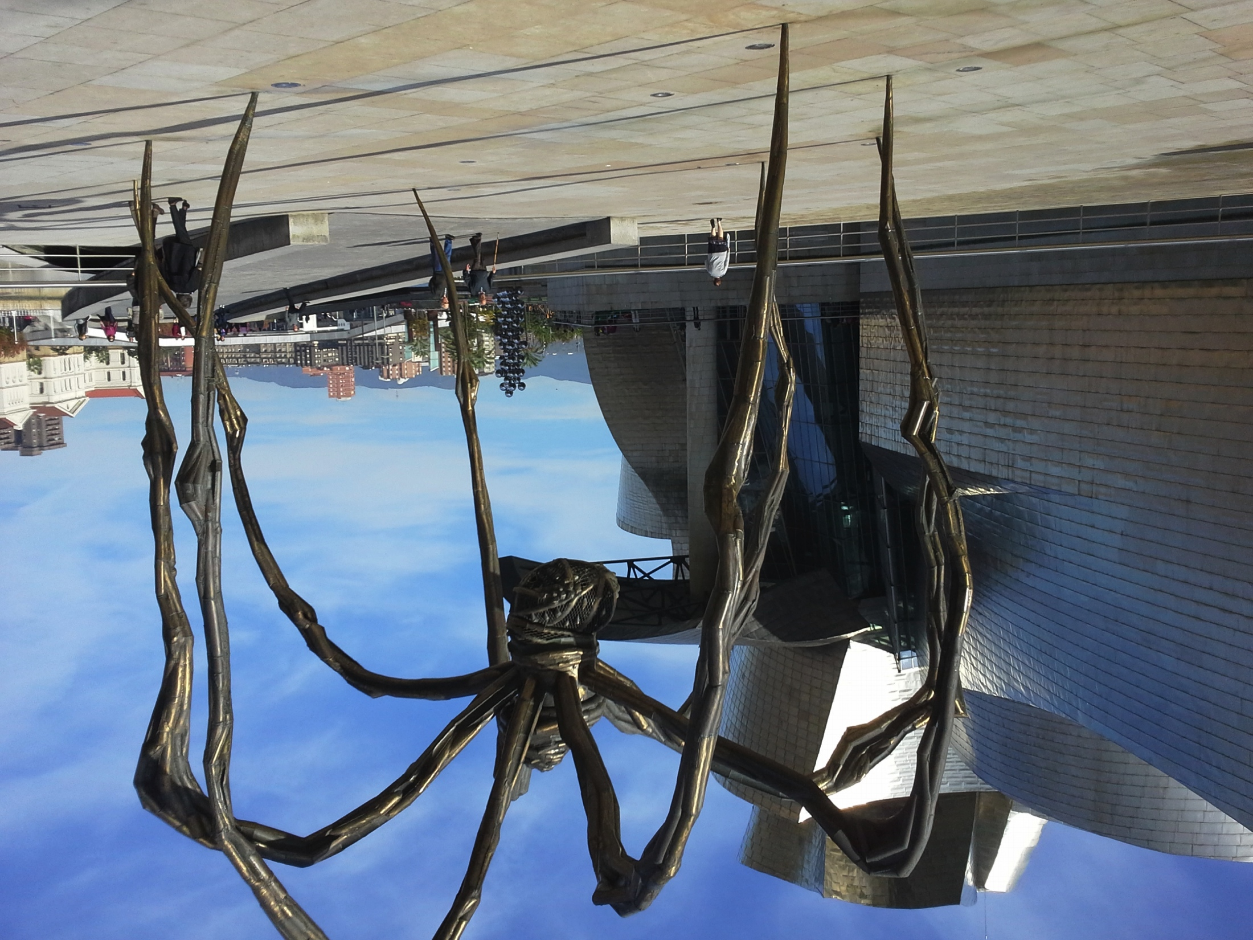
Drell-Yan Cross Section
Next-to-Leading Order
These diagrams are responsible for up to 50% of the measured cross section
Parton distributions are Universal!
Intrinsic transverse momentum of quarks (although a small effect, λ > 0.8)
Soft gluon resummation at all orders
Angular Distributions
Higher Twist??

Slide 18
Drell-Yan Cross Section
Next-to-Leading Order
These diagrams are responsible for up to 50% of the measured cross section
Parton distributions are Universal!
Intrinsic transverse momentum of quarks (although a small effect, λ > 0.8)
Soft gluon resummation at all orders
Angular Distributions
Higher Twist??

Slide 19
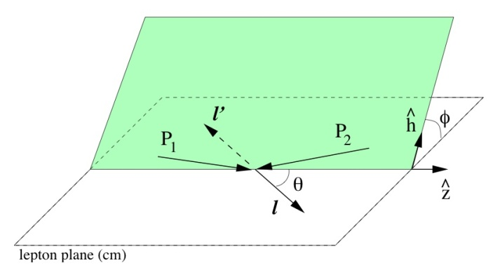
Leading order Single Spin Drell-Yan Cross Section
Formula: from Aram Kotzinian
Slide: content from Oleg Denisov’s
Boer-Mulders of target hadron
Sivers for beam nucleon
Boer-Mulders of target and h₁⊥ and pretzelosity of beam
Boer-Mulders of target and h₁ and transversity of beam
(with polarized beam and unpolarized target)
Notes:
Phi_b = azimuthal angle of transverse spin orientation of beam (in target rest frame)
theta and phi are polar and azimuthal angles of dimuon pair (in dimuon c.m. frame)
Sivers mechanism manifests itself in the sin phi_b(…) modulation of xsec.
Structure function F^1_TU provides signal for Sivers function

Slide 20
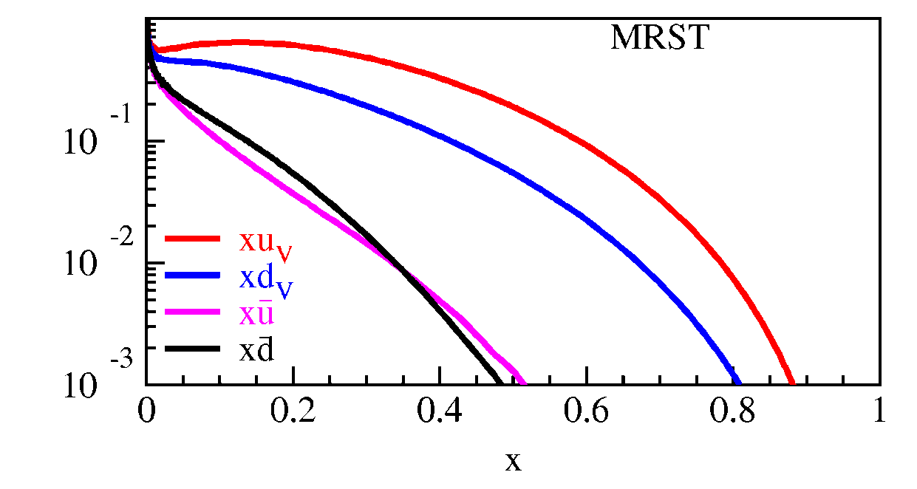
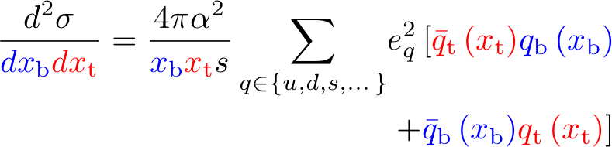
Drell-Yan Cross Section
Measured cross section is a convolution of beam and target parton distributions
Proton Beam
  Target antiquarks and beam
u-quark dominance
  (2/3)² vs. (1/3)²
x_{target}
x_{beam}

Slide 21
Drell-Yan Cross Section
Measured cross section is a convolution of beam and target parton distributions
Proton Beam
  Target antiquarks and beam
u-quark dominance
  (2/3)² vs. (1/3)²
x_{target}
x_{beam}
Acceptance limited (Fixed Target)
Beam | Sensitivity | Experiment
Hadron | Beam valence quarks target antiquarks | Fermilab, RHIC (forward acpt.) J-PARC
Anti-Hadron | Beam val. antiquarks Target valence quarks | GSI-FAIR Fermilab Collider
Meson | Beam val. antiquarks Target valence quarks | COMPASS

Slide 22
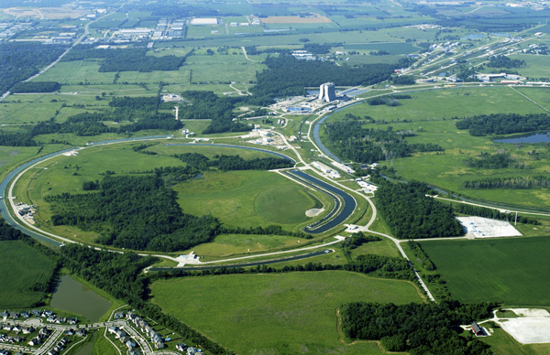
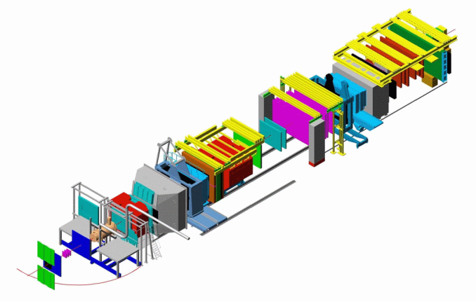
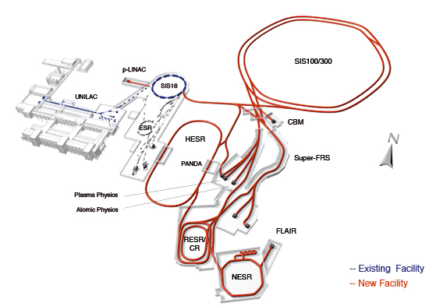
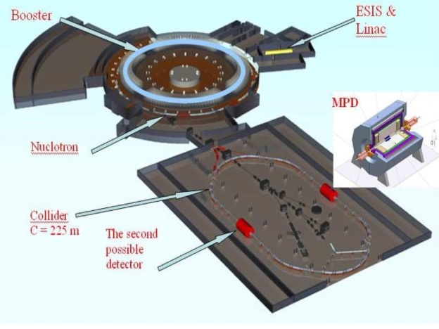
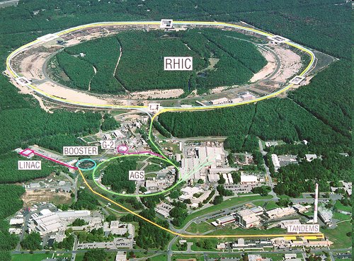
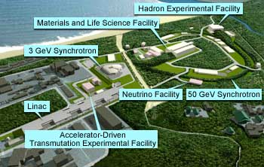
Present and Proposed Drell-Yan Experiments
Fixed Target Beam lines
Tevatron 800 GeV
Main Injector 120 GeV
Fermilab E-906/Drell-Yan
  Better statistical precision (unpolarized)
  Polarized Beam and Target measurements approved
COMPASS
  Pion beam—valence distributions
  Polarized garget
GSI FAIR—PAX and Panda experiments
RHIC
J-PARC
JINR Dubna-NICA

Slide 23
SeaQuest Experiment
Fixed Target Beam lines
Tevatron 800 GeV
Main Injector 120 GeV

Slide 24
Station 4:
Hodoscope array
Prop tube tracking
Station 2 and 3:
Hodoscope array
Drift Chamber tracking
Station 1:
Hodoscope array
MWPC tracking
Solid Iron Focusing Magnet, Hadron absorber and beam dump
Mom. Meas.
(KTeV Magnet)
4.9m
Hadron Absorber
(Iron Wall)
Liquid H₂, d₂, and solid targets
25m
Drawing: T. O’Connor and K. Bailey

Slide 25
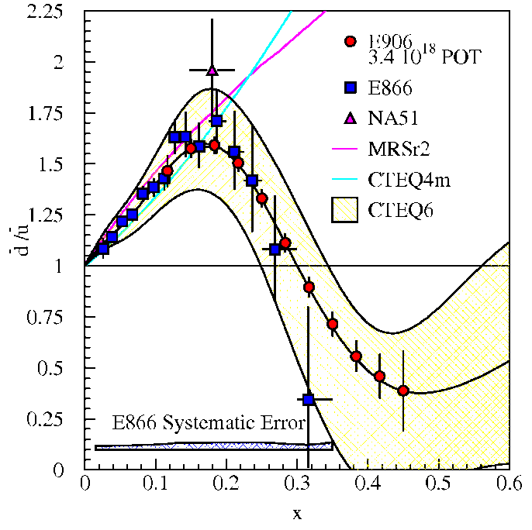
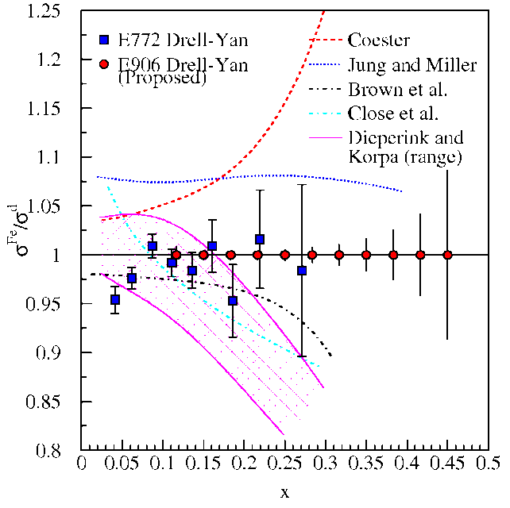
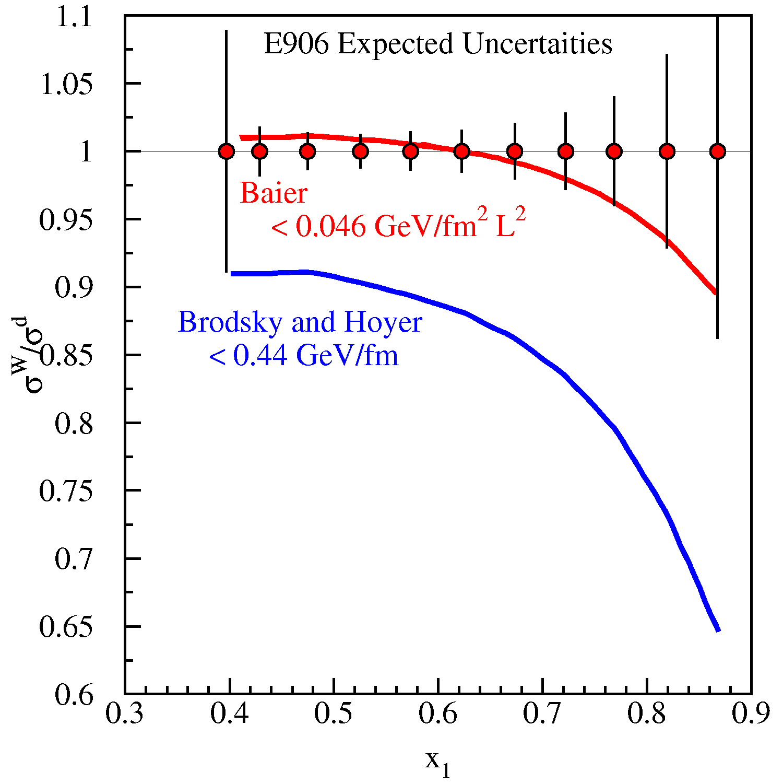
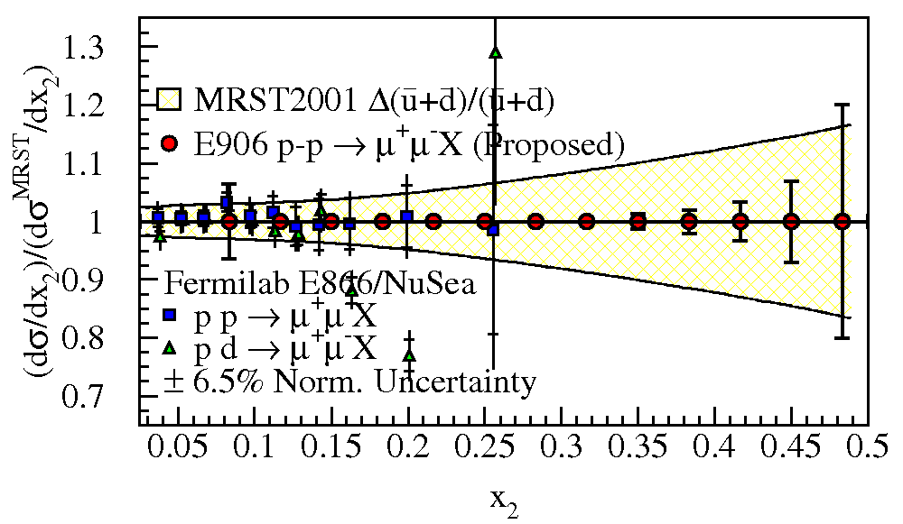
SeaQuest Physics Program
(Unpolarized)
Dbar/ubar
Sea Quark EMC Effect
J/y Nuclear Dependence
Partonic Energy Loss
Absolute Magnitude of the Quark Sea
Preliminary

Slide 26
Station 4:
Hodoscope array
Prop tube tracking
Station 2 and 3:
Hodoscope array
Drift Chamber tracking
Station 1:
Hodoscope array
MWPC tracking
Mass Spectrum based on fraction of recorded data with improvements expected in tracking efficiencies
Solid Iron Focusing Magnet, Hadron absorber and beam dump
Mom. Meas.
(KTeV Magnet)
4.9m
Hadron Absorber
(Iron Wall)
Liquid H₂, d₂, and solid targets
25m
Drawing: T. O’Connor and K. Bailey

Slide 27
Fermilab E906/SeaQuest Collaboration
Abilene Christian University
Ryan Castillo, Michael Daugherity, Donald Isenhower, Noah Kitts, Lacey Medlock, Noah Shutty, Rusty Towell, Shon Watson, Ziao Jai Xi
Academia Sinica
Wen-Chen Chang, Ting-Hua Chang, Shiu Shiuan-Hao
Argonne National Laboratory
John Arrington, Don Geesaman*, Kawtar Hafidi,
Roy Holt, Harold Jackson, David Potterveld,
Paul E. Reimer*, Brian Tice
University of Colorado
Ed Kinney, Joseph Katich, Po-Ju Lin
Fermi National Accelerator Laboratory
Chuck Brown, Dave Christian, Su-Yin Wang, Jin-Yuan Wu
University of Illinois
Bryan Dannowitz, Markus Diefenthaler, Bryan Kerns, Hao Li, Naomi C.R Makins, Dhyaanesh Mullagur R. Evan McClellan, Jen-Chieh Peng, Shivangi Prasad, Mae Hwee Teo,
Mariusz Witek, Yangqiu Yin
KEK
Shin'ya Sawada
Los Alamos National Laboratory
Gerry Garvey, Xiaodong Jiang, Andreas Klein, David Kleinjan, Mike Leitch, Kun Liu, Ming Liu, Pat McGaughey, Joel Moss
Mississippi State University
Lamiaa El Fassi
University of Maryland
Betsy Beise, Yen-Chu Chen, Kazutaka Nakahara
University of Michigan
Christine Aidala, McKenzie Barber, Catherine Culkin, Vera Loggins, Wolfgang Lorenzon, Bryan Ramson, Richard Raymond, Josh Rubin, Matt Wood
National Kaohsiung Normal University
Rurngsheng Guo, Su-Yin Wang
RIKEN
Yoshinori Fukao, Yuji Goto, Atsushi Taketani, Manabu Togawa
Rutgers, The State University of New Jersey
Ron Gilman, Ron Ransome, Arun Tadepalli
Tokyo Tech
Shou Miyaska, Kei Nagai, Kenichi Nakano, Shigeki Obata, Florian Sanftl, Toshi-Aki Shibata
Yamagata University
Yuya Kudo, Yoshiyuki Miyachi, Shumpei Nara
*Co-Spokespersons

Slide 28
Additional SeaQuest Presentations
Talks
L. Donald Isenhower | SeaQuest (Fermilab E906) Potentials on the Study of the EMC Effect and Other Topics | Wed 8 Oct | 8:30 pm | King’s 2
Kun Liu | The E-906/SeaQuest experiment at Fermilab | Thurs 9 Oct | 10:45 am | King’s 2
R. Evan McClelland | E906/SeaQuest Trigger System and J/ψ Production with 120 GeV Protons | Thurs 9 Oct | 7:00 pm | Queen’s 4
Kei Nagai | Performance of the Drift Chambers for E906/SeaQuest Drell-Yan Experiment at Fermilab | Sat 11 Oct | 10:30 am | Kona 4
Poster Presentations
Noah Kitts | SeaQuest / E906 Shift Alarm System | Fri 10 Oct | 1:30 pm | Grand Promenade
Anthony Brown | Measuring the protons per pulse using an in beam Cherenkov counter at SeaQuest
Matt Wood | Optimization of Target-Dump Separation at Fermilab Seaquest Experiment
Zhaojia Xi | The monitoring of environmental conditions for SeaQuest

Slide 29
Drell-Yan Experiments
Experiment | Facility | Particles | Energy | x_{b} or x_{t} | Lumin. (cm-2 s⁻¹) | Date
COMPASS | CERN | π± + p^{h} | 160 GeV √s = 17.4 GeV | x_{t} = 0.1-0.3 | 2 × 10³² | 2014, 2018
PAX | GSI | p^{h}+ p-bar | collider √s = 14 GeV | x_{b} = 0.1-0.9 | 2 × 10³⁰ | > 2020
PANDA |  | p-bar + p^{h} | 15 GeV √s = 5.5 GeV | x_{t} = 0.2-0.4 | 2 × 10³² | > 2018
NICA | JINR | p^{h}+ p | collider √s = 20 GeV | x_{b} = 0.2-0.8 | 1 × 10³¹ | > 2018
PHENIX/STAR | RHIC | p^{h}+p^{h} | Collider √s = 510 GeV | x_{b} = 0.05-0.1 | 2 × 10³² | > 2018
fsPHENIX |  | p^{h}+p^{h} | √s = 200 GeV √s = 510 GeV | x_{b} = 0.1-0.5 x_{b} = 0.05-0.6 | 8 × 10³¹ 6 × 10³² | > 2021
SeaQuest | FNAL | p+p | 120 GeV √s = 15 GeV | x_{t} = 0.1-0.44 x_{b} = 0.2-0.8 | 3 × 10³⁵ | 2013-2015
E-1039 |  | p+p^{h} |  |  | 4 × 10³⁵ | 2016
E-1027 |  | p^{h}+p |  |  | 2 × 10³⁵ | >2018

Slide 30
Fits of Sivers asymmetries
Data fit to extract Sivers distributions
Shown at left are the 1st moments
Why Polarized-Beam D-Y?
Existing Sivers SIDIS data better constrain valence distributions
Some fits of sea distributions show much smaller effect.
Need valence data
Anselmino et al. Phys. Rev. D 86 014028 (2012)
Experiment | Particles | Lumin. (cm-2 s⁻¹)
COMPASS | π± + p^{h} | 2 × 10³²
GSI | p^{h}+ p-bar | few × 10³²
NICA | p^{h}+ p | 1 × 10³¹
RHIC | p^{h}+p^{h} | few × 10³²
E-1027 | p^{h}+p | 2 × 10³⁵

Slide 31
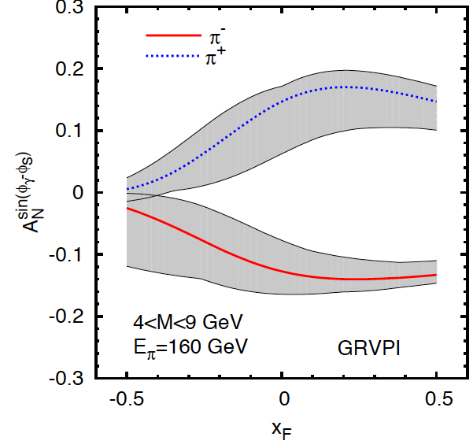
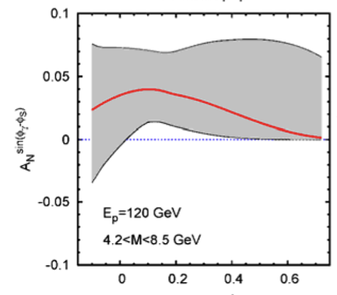
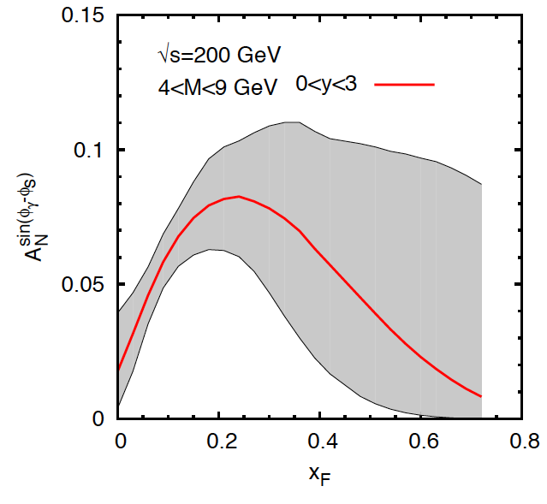
A_{N}^{sin(φγ-φs)} prediction Anselmino et al
COMPASS
Fermilab
Anselmino, et al Phys. Rev. D79 (2009) 054010 and private communication (for Fermilab)
Uncertainties in predictions dominated by uncertainties in SIDIS data
Also predictions for GSI PAX, GSI PANDA, J-PARC, JINR NCIA, IHEP SPASCHARM
RHIC

Slide 32
Polarized Beam Drell-Yan at Fermilab
The Plan:
Use fully understood SeaQuest Spectrometer
Add polarized beam.

Slide 33
Polarized Beam Drell-Yan at Fermilab
The Plan:
Use fully understood SeaQuest Spectrometer
Add polarized beam.
Cost Est.: $6M +$4M Contingency & Management = $10M
based on earlier 2 snake estimate
SPIN@FERMI Collaboration
Talk by C. Aidala

Slide 34
Expected Precision from E-1027 at Fermilab
~1,288k DY events
Experimental Conditions
  Same as SeaQuest
  luminosity: L_{av} = 2 x 10³⁵ (10% of available beam time: I_{av} = 15 nA)
  3.2 X 10¹⁸ total protons for 5 x 10⁵ min: (= 2 yrs at 50% efficiency) with P_{b} = 70%
Can measure not only sign, but also the size & maybe shape of the Sivers function!

Slide 35
Fermilab E1027 Collaborating Institutes
(Polarized Beam Drell-Yan)
Abilene Christian University
Argonne National Laboratory
University of Basque Country
University of Colorado
Fermi National Accelerator Laboratory
University of Illinois
KEK
Los Alamos National Laboratory
University of Maryland
University of Michigan
RIKEN
Rutgers,
The State University of New Jersey
Tokyo Tech
Yamagata University
Wolfgang Lorenzon and Paul E Reimer
Co-Spokespersons

Slide 36

Polarized-Beam Drell-Yan at Fermilab
Proposed to PAC in Summer 2012
Granted Stage I approval after Fall 2012 PAC
Approximate cost is $10M
  All on accelerator complex

Slide 37
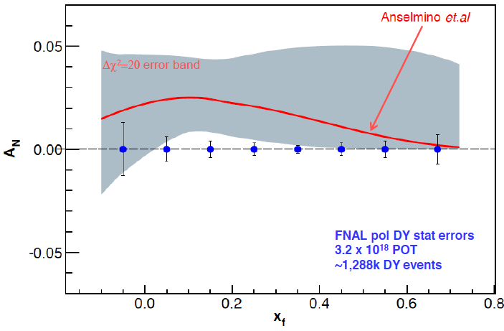
Summary
The Sivers distribution contains unique information on
  QCD gauge invariance and factorization
  Angular momentum
The Sivers distribution must be measured with Drell-Yan
  Valence-Sea separation
Key parameters to an experiment are
  Achievable integrated Luminosity
  Cost effectiveness
Fermilab Polarized Main Injector is the way to go

