Slide 1
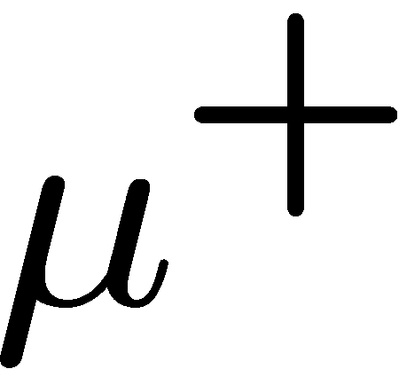
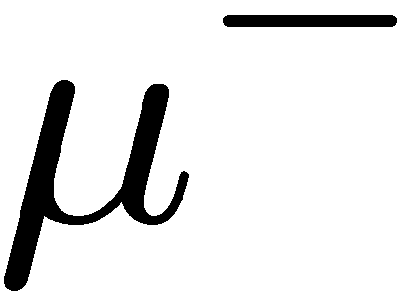
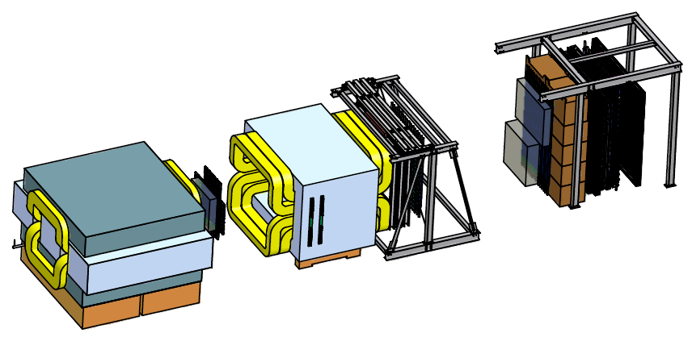
Drell-Yan Scattering at Fermilab: SeaQuest and Beyond
Wolfgang Lorenzon
(1-November-2010)
Santa Fe Drell-Yan Workshop
Introduction
SeaQuest: Fermilab Experiment E906
What will we learn?
What will we measure?
How will we measure it?
Beyond SeaQuest
Polarized Drell-Yan at FNAL?
What would we learn?
This work is supported by

Slide 2
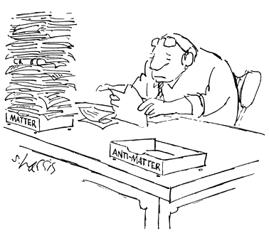
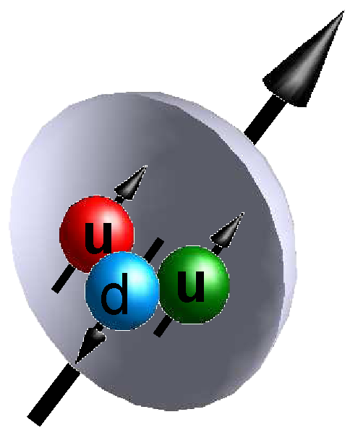
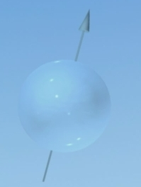
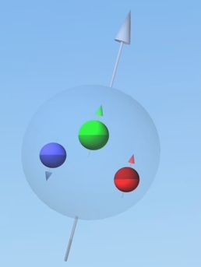
Internal Landscape of the Proton
Just three valence quarks?
http://www.sciencecartoonsplus.com/index.htm
2

Slide 3
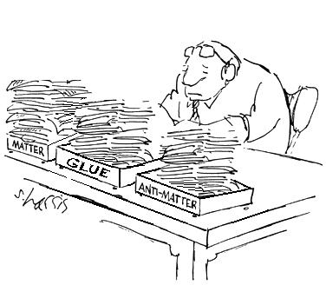
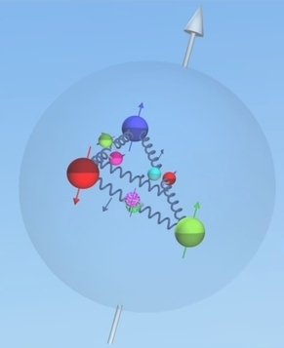
Internal Landscape of the Proton
Just three valence quarks?
No!!
And, quark distributions change in the nucleus
http://www.sciencecartoonsplus.com/index.htm
3

Slide 4
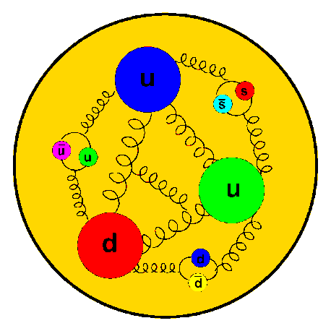
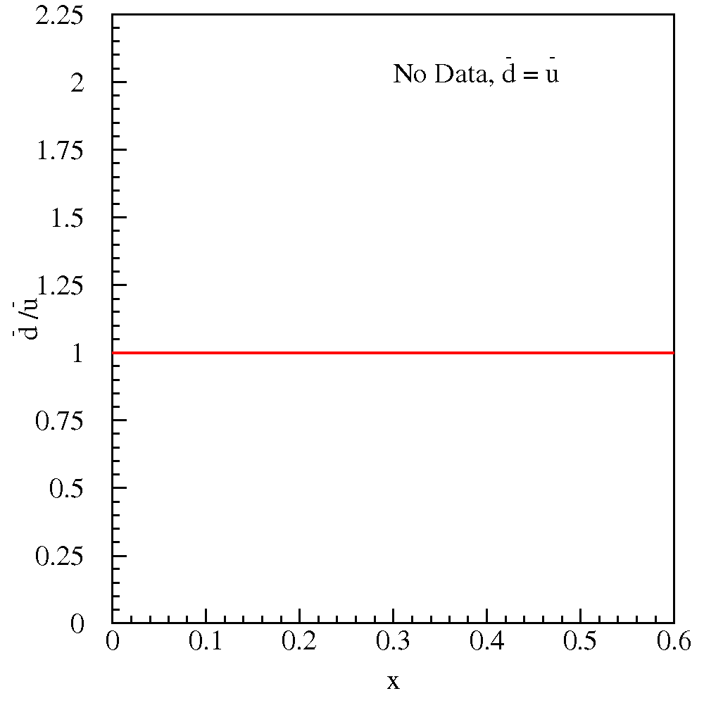
Flavor Structure of the Proton
No Data,
Constituent Quark Model Pure valence description: proton = 2u + d
Perturbative Sea sea quark pairs from g qq should be flavor symmetric:
What does the data tell us?
4

Slide 5
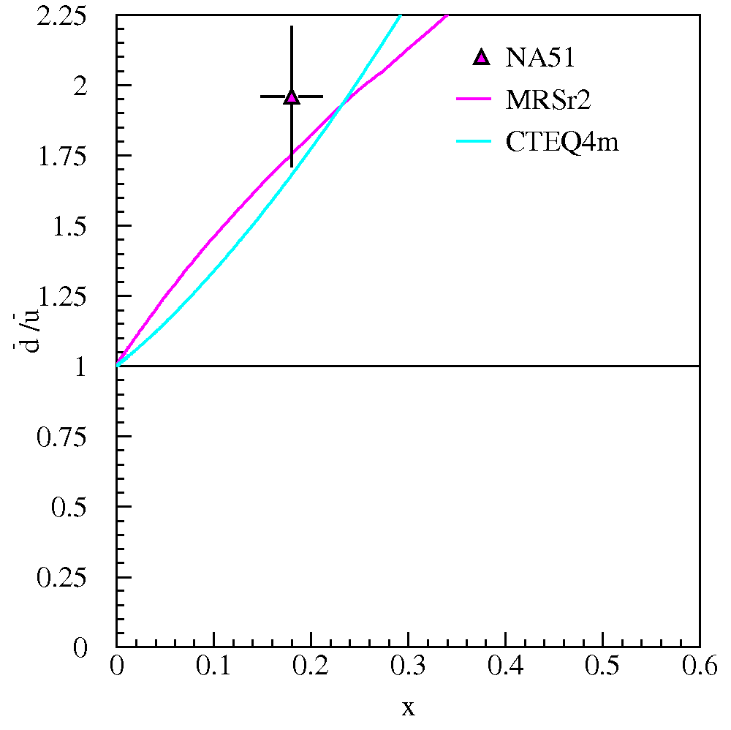
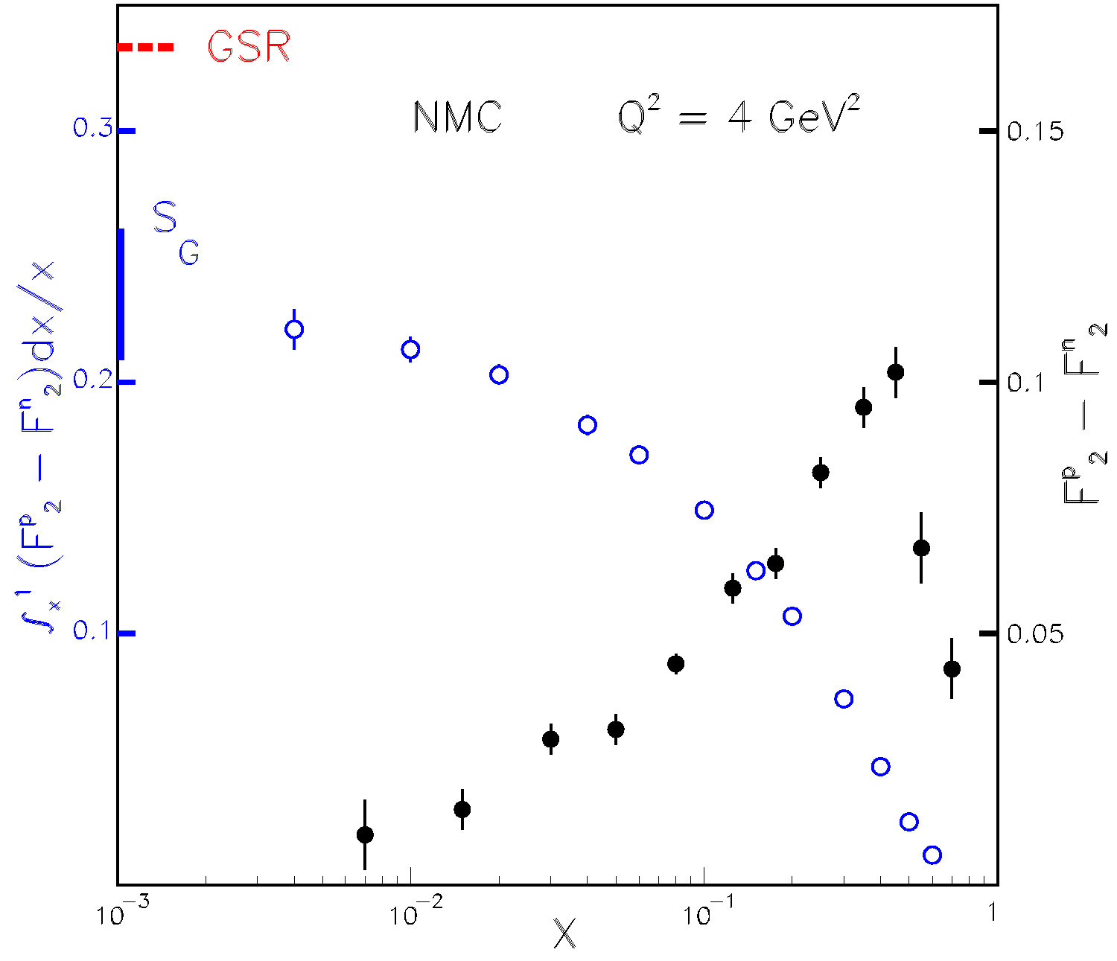
Flavor Structure of the Proton: Brief History
Perturbative Sea
NMC (Gottfried Sum Rule)
NA51:
Knowledge of parton distributions is data driven
Sea quark distributions are difficult for Lattice QCD
5

Slide 6
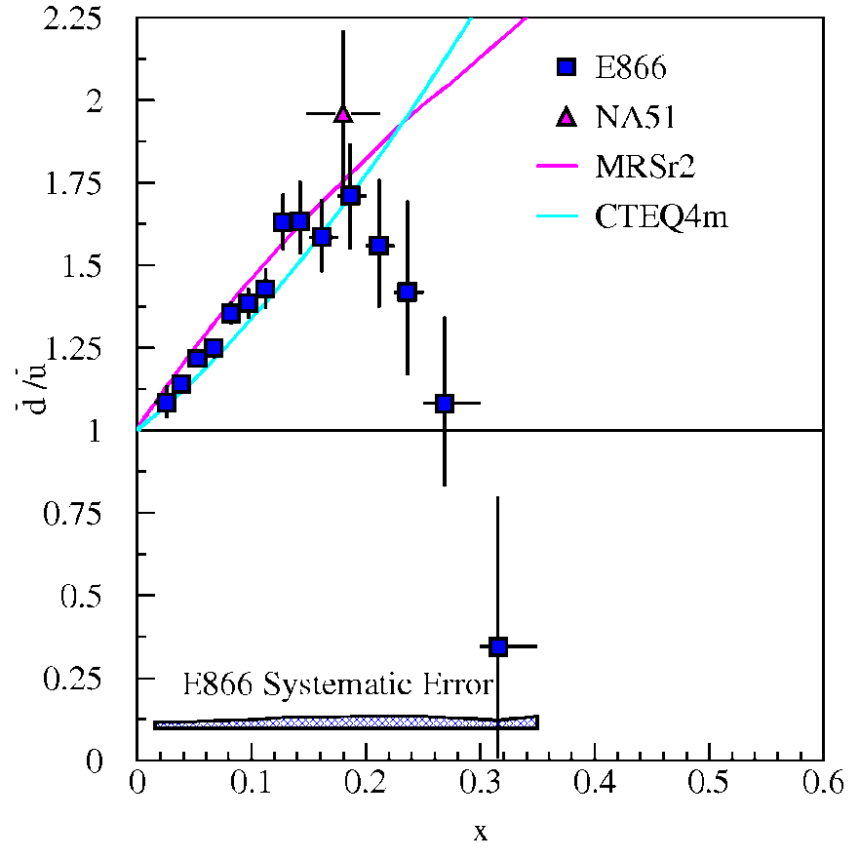
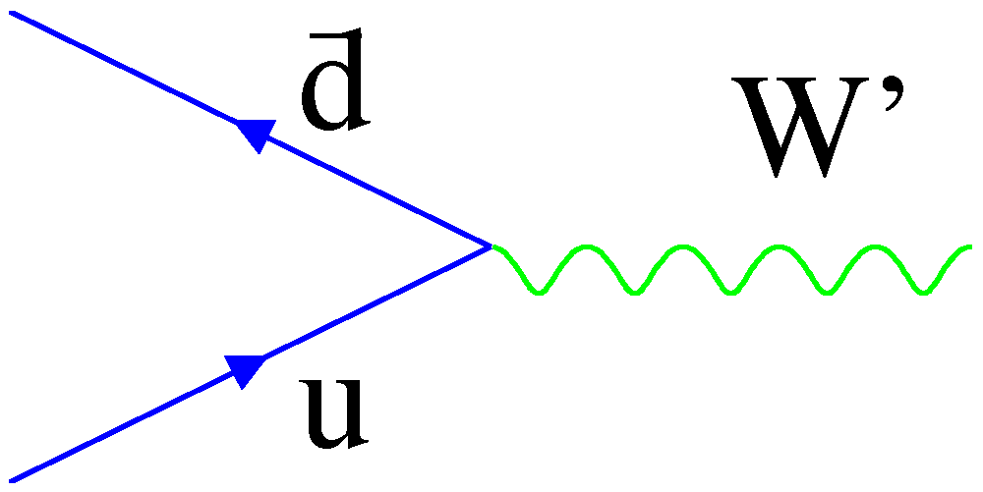
Flavor Structure of the Proton: Brief History
Perturbative Sea
NMC (inclusive DIS)
NA51 (Drell-Yan)
E866/NuSea (Drell-Yan)
E866:
What is the origin of the sea?
Significant part of the LHC beam
W’
6
Notes:
Production of W bosons in p-p collisions offers sensitivity to the antiquark distributions.

Slide 7
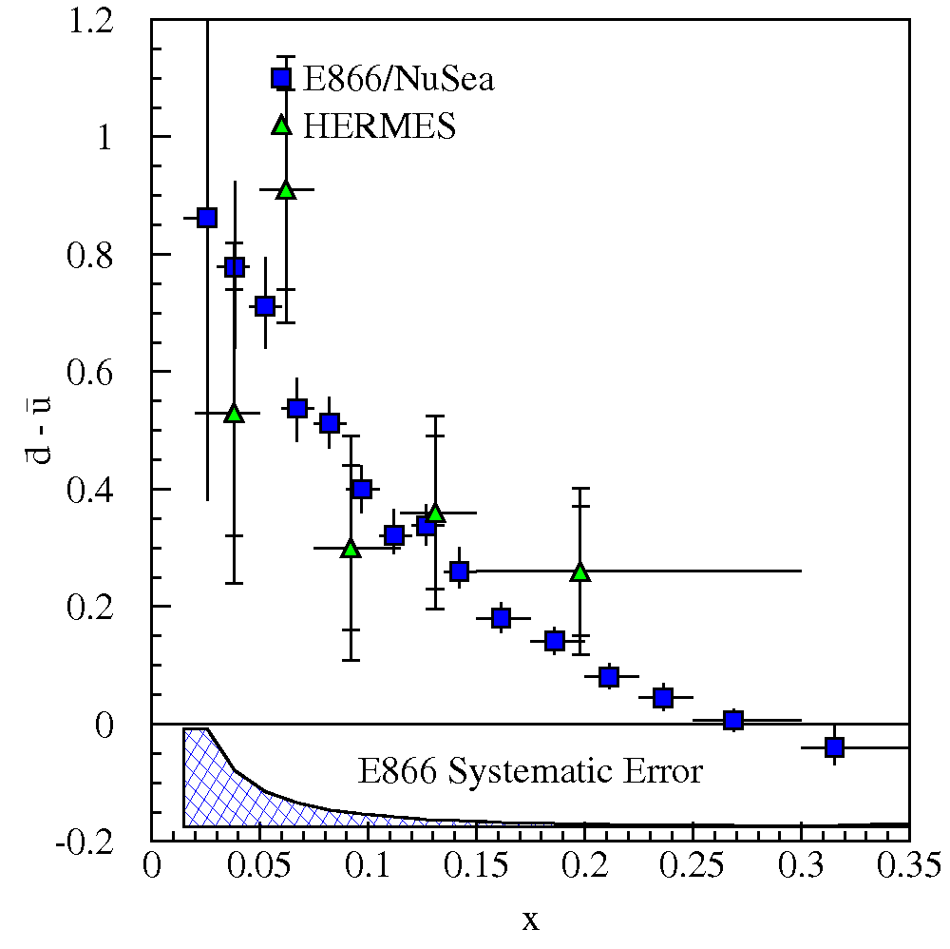
Flavor Structure of the Proton - III
There is a gluon splitting component which is symmetric
Symmetric sea via pair production from gluons subtracts off
No gluon contribution at 1st order in α_{s}
Non-perturbative models are motivated by the observed difference
A proton with 3 valence quarks plus glue cannot be right at any scale!!
7
Notes:
D-bar-u-bar is pure flavor non-singlet quantity (its integral is Q^2 independent, and its Q^2 evolution does not depend on gluon distributions of proton in leading order).

Slide 8
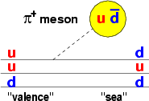
Flavor Structure of the Proton - IV
Non-perturbative models: alternate d.o.f.
Meson Cloud Models Chiral-Quark Soliton Model Statistical Model Quark sea from cloud of 0 mesons:
quark d.o.f. in a pion mean-field: u d + π⁺
nucleon = chiral soliton
one parameter: dynamically generated quark mass
expand in 1/N_{c}:
nucleon = gas of massless partons
few parameters: generate parton distribution functions
input: QCD: chiral structure DIS: u(x) and d(x)
⇒ important constraints on flavor asymmetry for polarization of light sea
8
Notes:
Chiral quark models couple mesons directly to constituent quarks. There are also instanton models which allow large d-bar - u-bar.
Note, in each of these models, flavor and spin distributions are intimately linked.

Slide 9
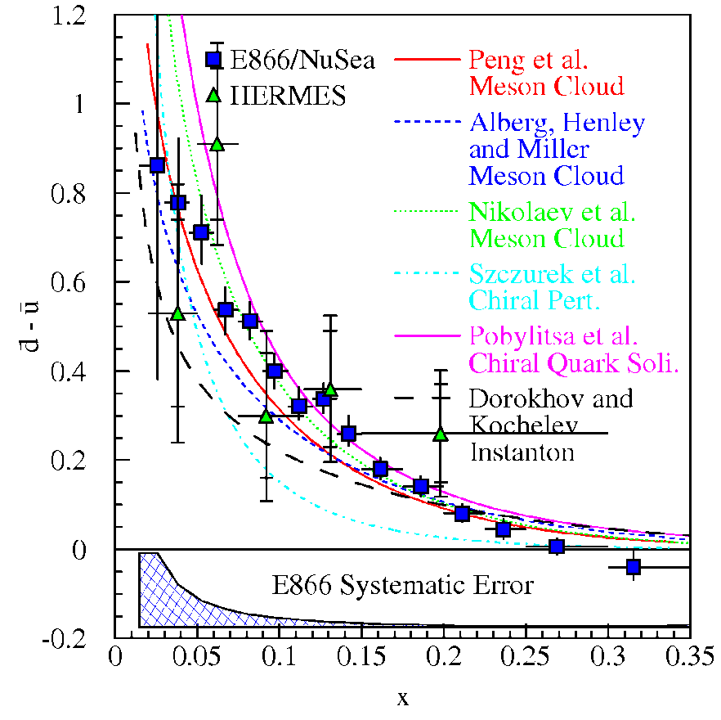
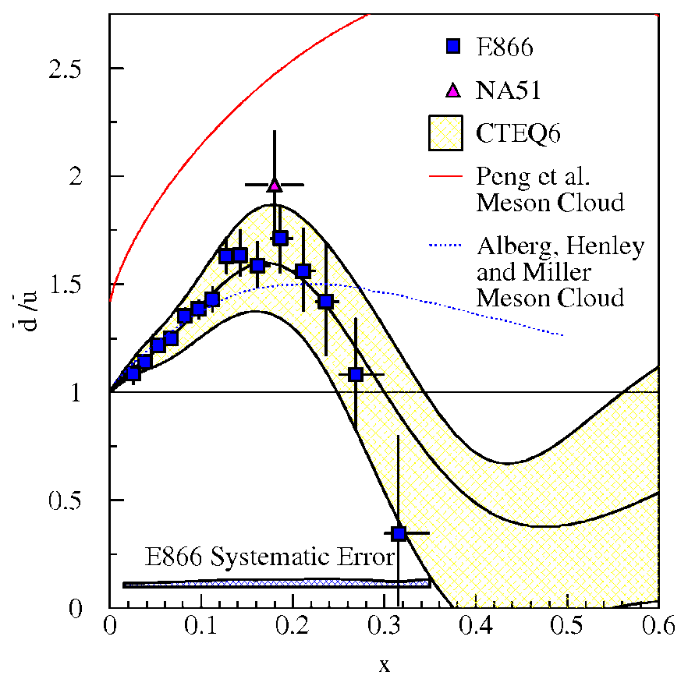
Flavor Structure of the Proton - V
Comparison with models
High x behavior is not explained
Perturbative sea seems to dilute meson cloud effects at large x (but this requires large-x gluons)
Measuring the ratio is powerful
Are there more gluons and thus symmetric anti-quarks at higher x?
Unknown other mechanisms with unexpected x-dependence?
9
Notes:
None of these models consistently incorporate the flavor symmetric sea and consequently all substantially over-predict the ratio for x>0.23.
Meson cloud model level off at 1.5 to 5 (depending on baryons included in calcs) until x>0.5 and then level off to unity. Instanton model predicts ratio ~4.
-> possible interpretation of E866 results is that perturbative gluon mechanism begins to dominate over non-pert mechs at lower x than previously expected (indicating larger gluon component in proton – those gluon distributions are poorly constrained currently: 30-40% at x=0.4).
In contrast to SIDIS, D-Y measurement of ratio has much smaller systematic errors and acceptance corrections.

Slide 10
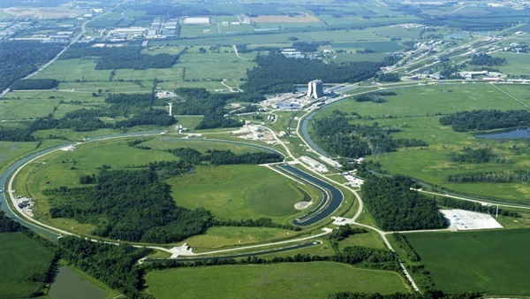
SeaQuest: Fermilab Experiment E906
E906 will extend Drell-Yan measurements of E866 (with 800 GeV protons) using upgraded spectrometer and 120 GeV proton beam from Main Injector
Lower beam energy gives factor 50 improvement “per proton” !
Drell-Yan cross section for given x increases as 1/s
Backgrounds from J/Ψ and similar resonances decreases as s
Use many components from E866 to save money/time, in NM4 Hall
Hydrogen, Deuterium and Nuclear Targets
Tevatron 800 GeV
Main Injector 120 GeV
10

Slide 11
Fermilab E906/Drell-Yan Collaboration
Abilene Christian University
Donald Isenhower
Rusty Towell, S. Watson
Academia Sinica
Wen-Chen Chang, Yen-Chu Chen,
Da-Shung Su
Argonne National Laboratory
John Arrington, Don Geesaman*,
Kawtar Hafidi, Roy Holt, Harold Jackson,
David Potterveld, Paul E. Reimer*,
Josh Rubin
University of Colorado
Ed Kinney, Po-Ju Lin
Fermi National Accelerator Laboratory
Chuck Brown, David Christian
University of Illinois
Naomi C.R Makins, Jen-Chieh Peng
KEK
Shinya Sawada
Ling-Tung University
Ting-Hua Chang
Los Alamos National Laboratory
Gerry Garvey, Mike Leitch, Ming Liu, Pat McGaughey
University of Maryland
Betsy Beise, Kaz Nakahara
University of Michigan
Wolfgang Lorenzon,
Richard Raymond
Chiranjib Dutta
*Co-Spokespersons
National Kaohsiung Normal University
Rurngsheng Guo, Su-Yin Wang
University of New Mexico
Imran Younus
RIKEN
Yuji Goto, Atsushi Taketani, Yoshinori Fukao, Manabu Togawa
Rutgers University
Ron Gilman, L. El Fassi
Ron Ransome, Elaine Schulte
Thomas Jefferson National
Accelerator Facility
Dave Gaskell, Patricia Solvignon
Tokyo Institute of Technology
Toshi-Aki Shibata
Yamagata University
Yoshiyuki Miyachi
Jan, 2009
Collaboration contains many of the E-866/NuSea groups and several new groups (total 19 groups as of Aug 2010)
11

Slide 12
Drell-Yan Spectrometer for E-906 (25m long)
Drell-Yan Spectrometer for E906
Station 3
(Hodoscope array, drift chamber track.)
Station 1
(hodoscope array,
MWPC track.)
4.9m
Iron Wall
(Hadron absorber)
Station 4
(hodoscope array, prop tube track.)
KTeV Magnet
(Mom. Meas.)
Solid Iron Magnet
(focusing magnet, hadron absorber and beam dump)
Station 2
(hodoscope array, drift chamber track.)
Targets
(liquid H₂, D₂, and solid targets)

Slide 13
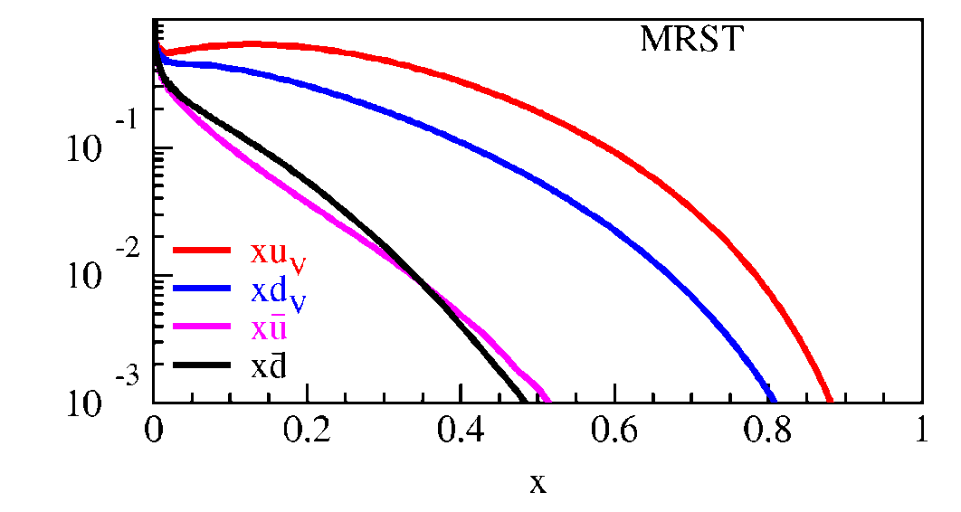
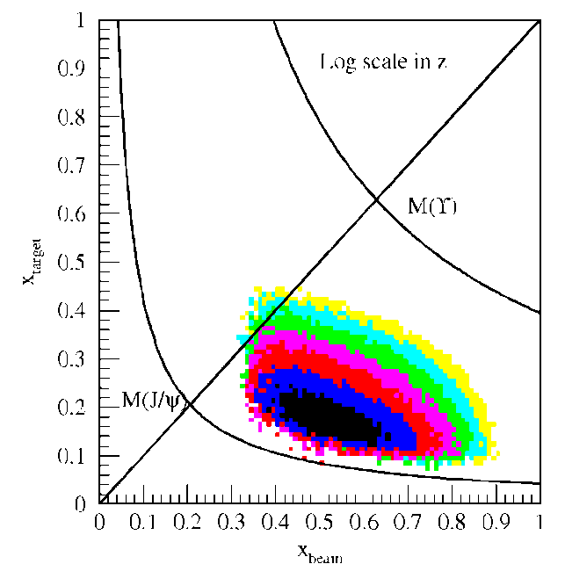
Fixed Target Drell-Yan: What we really measure
Drell-Yan Spectrometer for E906
Measure yields of μ⁺μ⁻ pairs from different targets
Reconstruct p_{γ} , M²_{γ}= x_{b}x_{t}s
Determine x_{b}, x_{t}
Measure differential cross section
Fixed target kinematics and detector acceptance give x_{b} > x_{t}
x_{F} = 2p||^{γ}/s^{1/2} ≈ x_{b} – x_{t}
Beam valence quarks probed at high x
Target sea quarks probed at low/intermediate x
x_{target}
x_{beam}
E906 Spect.
Monte Carlo
Notes:
Determine mass and momentum of virtual photon
Determine momentum fraction x_b and x_t of partons in beam and target
Measure absolute differential cross section
Sensitivity of D-Y process to anti-quark distribution of target or beam clear from examining diff. cross section
At large x, parton distributions are dominated by valence distributions, at small x by sea distributions
So in limit of large x_b and small x_t, cross section is dominated by first term -> providing direct sensitivity to antiquark sea of target nuclei
So if we just have to design the right experiment: This is E906.

Slide 14
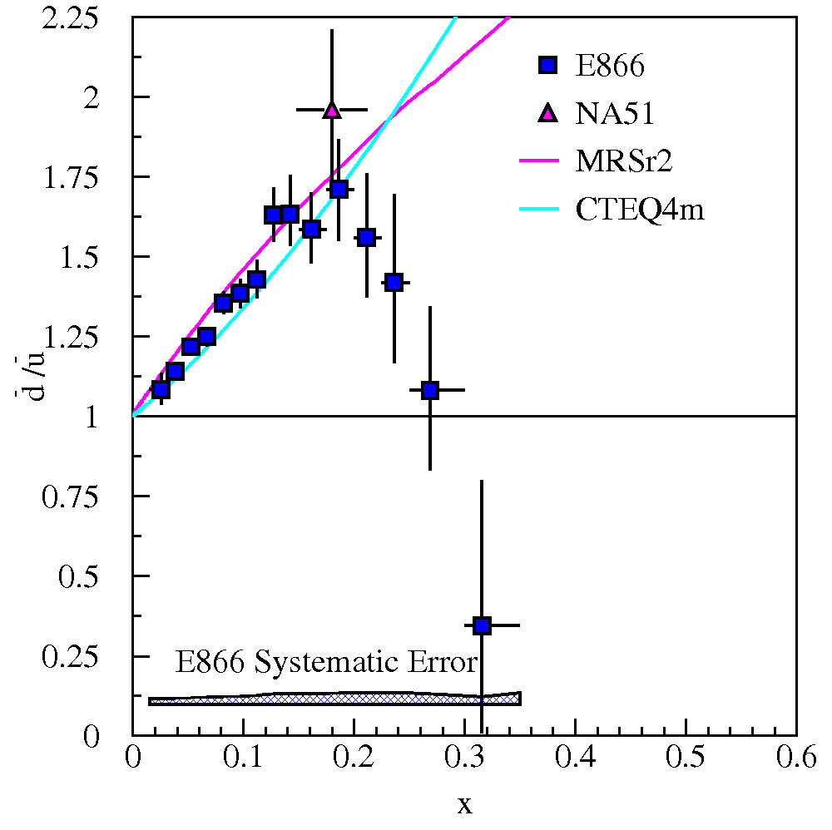
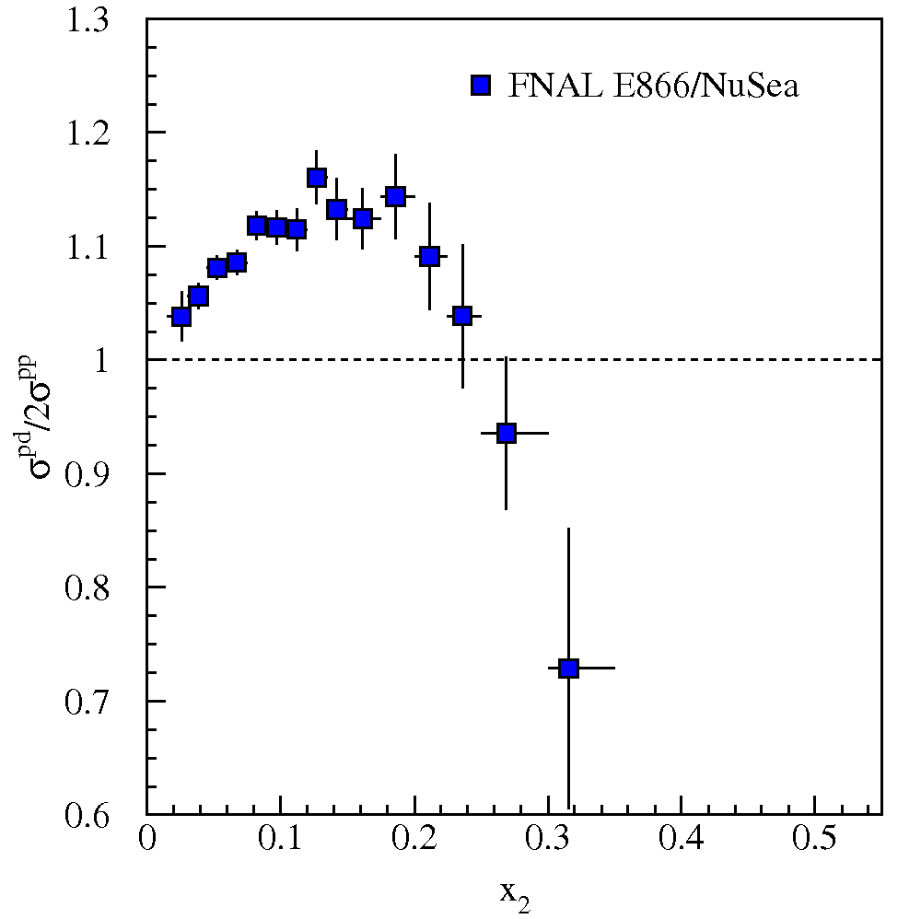
Fixed Target Drell-Yan: What we really measure - II
Measure cross section ratios on Hydrogen, Deuterium (and Nuclear) Targets

Slide 15
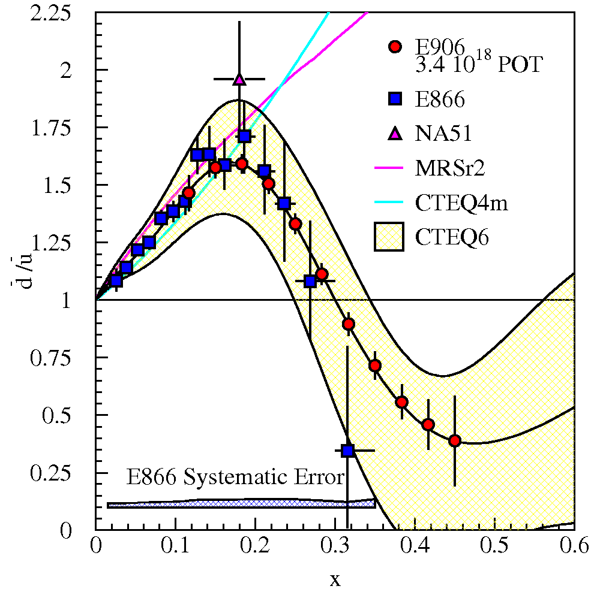
SeaQuest Projections for d-bar/u-bar Ratio
SeaQuest will extend these measurements and reduce statistical uncertainty
SeaQuest expects systematic uncertainty to remain at ≈1% in cross section ratio
5 s slow extraction spill each minute
Intensity:
2 x 10¹² protons/s (=320 nA)
1 x 10¹³ protons/spill

Slide 16
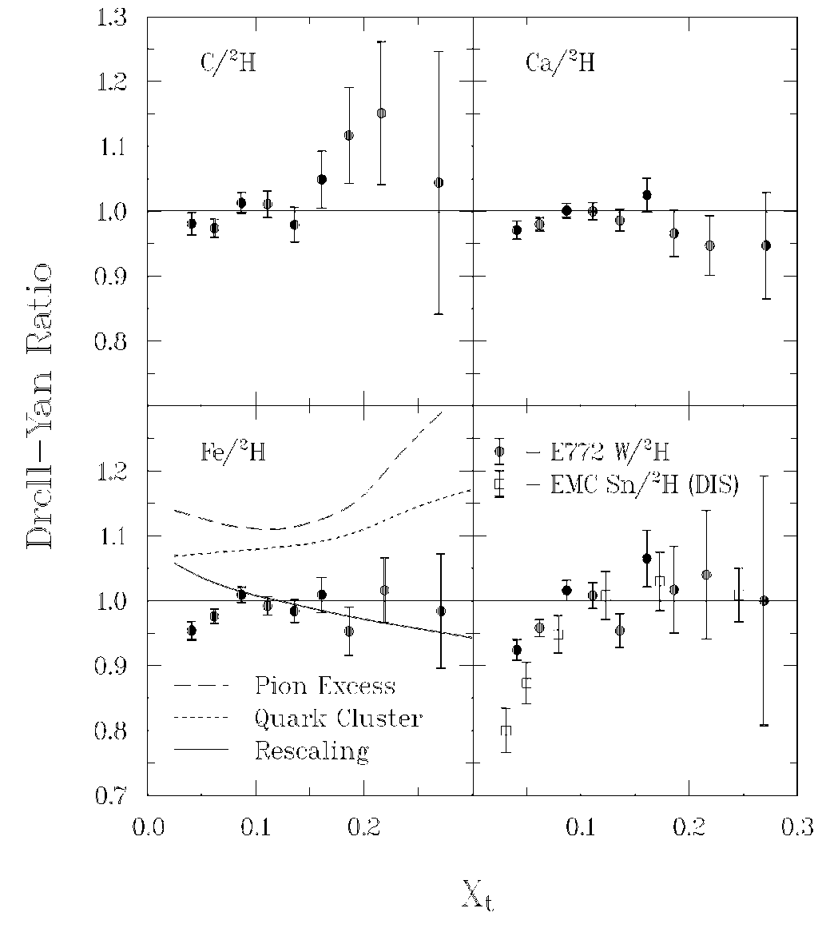
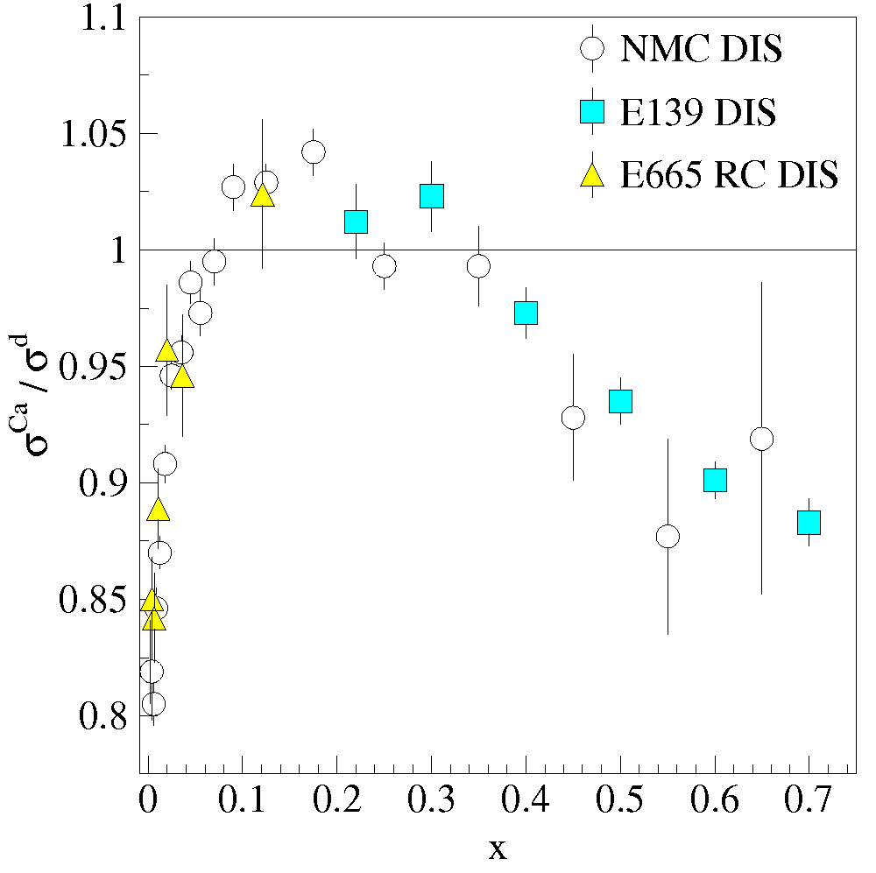
Sea quark distributions in Nuclei
EMC effect from DIS is well established
Nuclear effects in sea quark distributions may be different from valence sector
Indeed, Drell-Yan apparently sees no Anti-shadowing effect (valence only effect)
Alde et al (Fermilab E772) Phys. Rev. Lett. 64 2479 (1990)
E772 D-Y
Anti-Shadowing
Shadowing
EMC Effect
Notes:
The distributions of partons in a free nucleon differ from those of a nucleon bound in heavy nuclei (EMC effect).
Nuclear effects in sea quark distributions may be entirely different from those in valence sector. And indeed, unlike e and mu scattering, D-Y data from E772 show no anti-shadowing (although with limited stats).

Slide 17
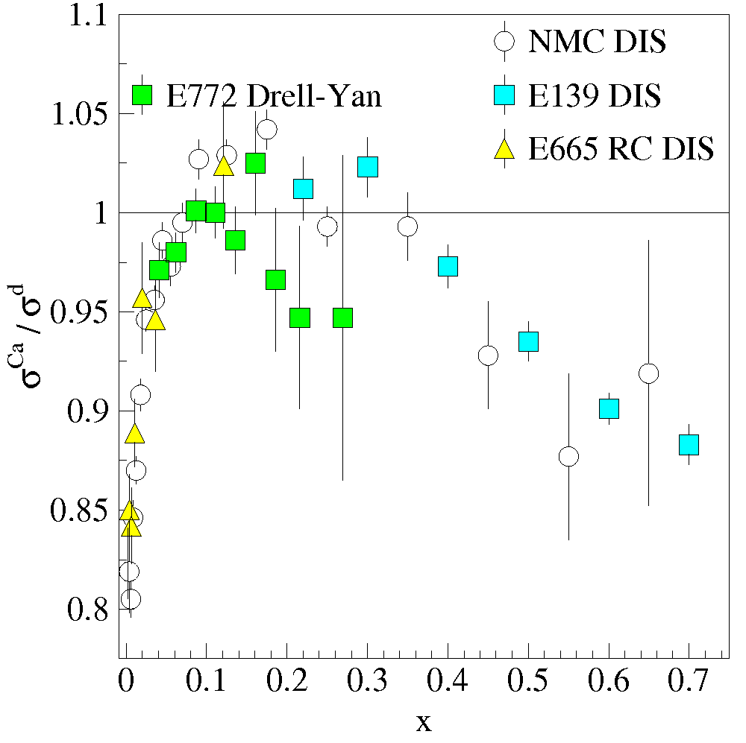
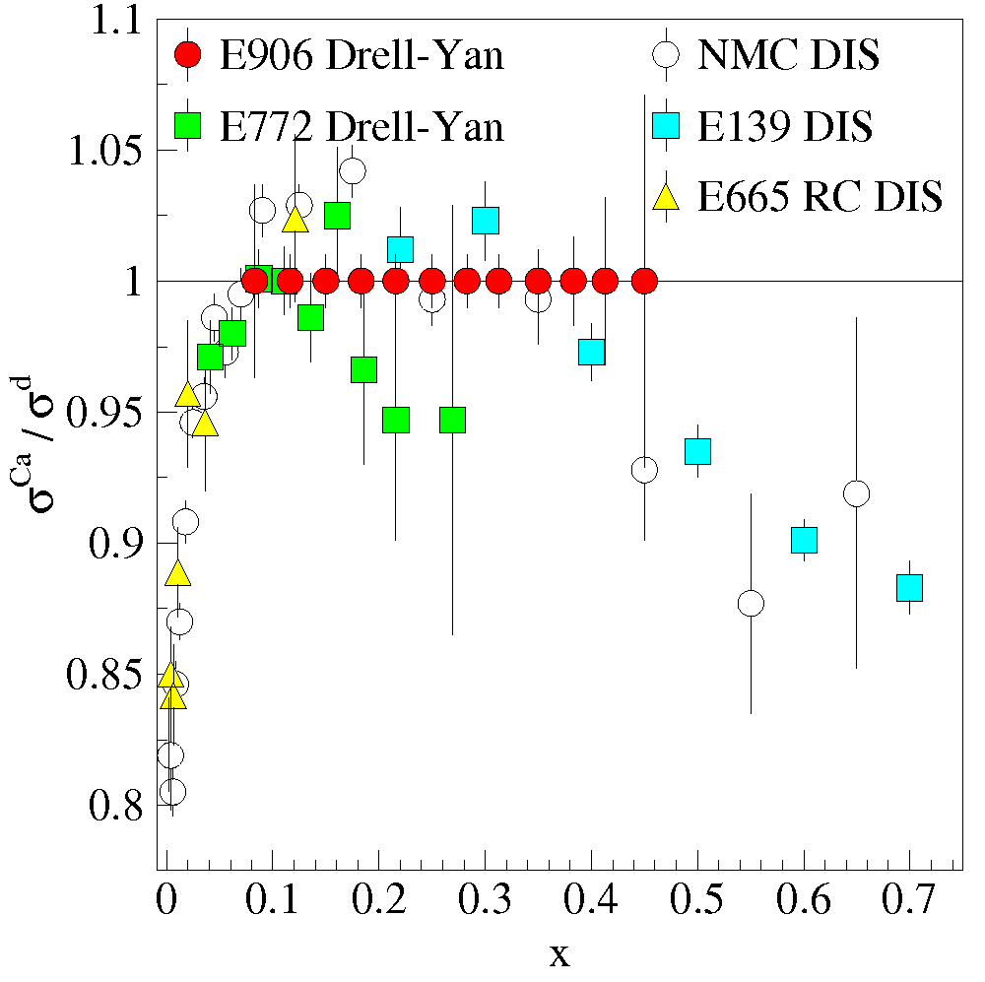
Sea quark distributions in Nuclei - II
SeaQuest can extend statistics and x-range
Are nuclear effects the same for sea and valence distributions?
What can the sea parton distributions tell us about the effects of nuclear binding?

Slide 18
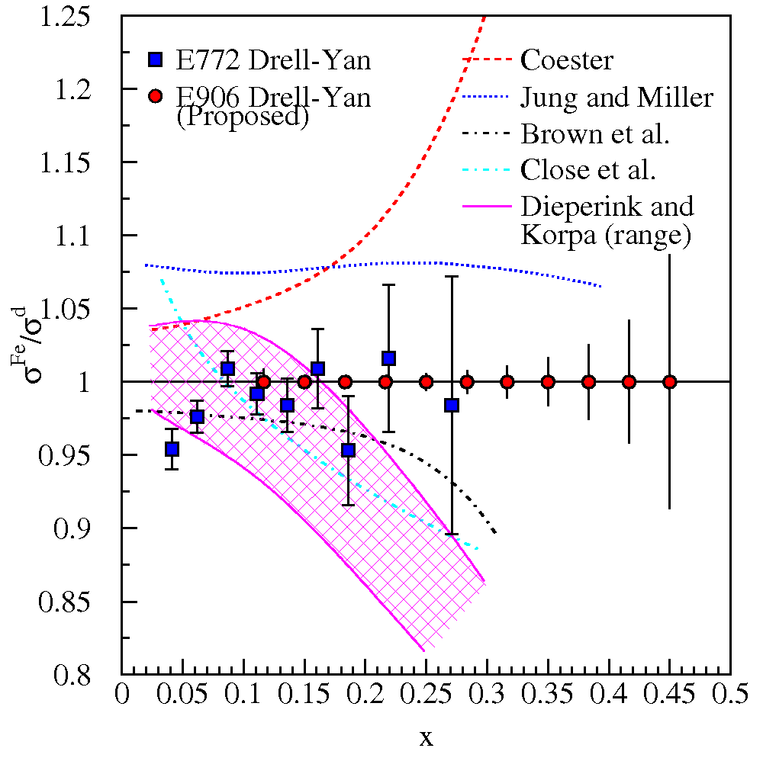
Where are the exchanged pions in the nucleus?
The binding of nucleons in a nucleus is expected to be governed by the exchange of virtual “Nuclear” mesons.
No antiquark enhancement seen in Drell-Yan (Fermilab E772) data.
Contemporary models predict large effects to antiquark distributions as x increases
Models must explain both DIS-EMC effect and Drell-Yan
SeaQuest can extend statistics and x-range
Notes:
In context of nuclear convolution models, virtual pion contributions to nuclear structure functions were expected to lead to sizeable increases in sea distributions of nuclei compared with deuterium. But except for shadowing region, little nuclear dependence was found in the E772 D-Y measurements. The non-observation of nuclear pions call into question the most widely believed traditional meson-exchange model of the nucleus, which presents a fundamental problem for NP. The expected enhancement to the sea Fe to D is based on Coester’s model calcs.
If large nuclear effects were found that might signal that nuclear effects may be important in the D/H ratio.

Slide 19
Fermilab Seaquest Timelines
Fermilab PAC approved the experiment in 2001, but experiment was not scheduled due to concerns about “proton economics”
Stage II approval in December 2008
Expect to start running around Thanksgiving for 2 years of data collection
Expt. Funded
Experiment
Construction
Experiment Exp.
Runs Runs
Shutdown
2008
2009
2010
2011
2012
2013
2014
Beam: low intensity
high intensity
no Tevatron extension
June 2010
Apparatus available for future programs at, e.g. Fermilab, J-PARC or RHIC
significant interest from collaboration for continued program

Slide 20
Fermilab Seaquest Timelines
Fermilab PAC approved the experiment in 2001, but experiment was not scheduled due to concerns about “proton economics”
Stage II approval in December 2008
Expect to start running around Thanksgiving for 2 years of data collection
Expt. Funded
Experiment
Construction
Experiment Exp.
Runs Runs
2008
2009
2010
2011
2012
2013
2014
Beam: low intensity
low intensity
low intensity
w/ Tevatron extension
Apparatus available for future programs at, e.g. Fermilab, J-PARC or RHIC
significant interest from collaboration for continued program

Slide 21
Beyond SeaQuest
Polarized Drell-Yan Experiment
Not yet done!
transverse momentum dependent distributions functions (Sivers, Boer-Mulders, etc)
Transversely Polarized Beam or Target
Sivers function in single-transverse spin asymmetries (SSA) (sea quarks or valence quarks)
− sea quark effects might be small
− valence quark effects expected to be large
transversity Boer-Mulders function
Beam and Target Transversely Polarized
flavor asymmetry of sea-quark polarization
transversity (quark anti-quark for pp collisions)
− anti-quark transversity might be very small

Slide 22
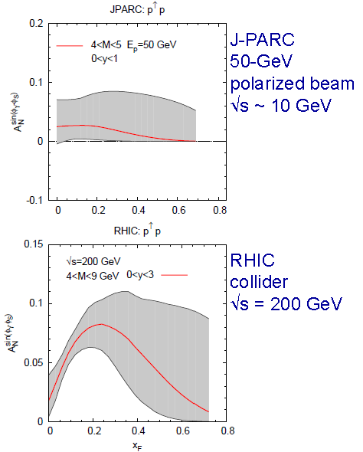
Sivers Function
described by transverse-momentum dependent distribution function
captures non-perturbative spin-orbit coupling effects inside a polarized proton
leads to a sin (φ – φ_{S}) asymmetry in SIDIS and Drell-Yan
done in SIDIS (HERMES, COMPASS)
Sivers function is time-reversal odd
leads to sign change
fundamental prediction of QCD (goes to heart of gauge formulation of field theory)
Predictions based on fit to SIDIS data
Anselmino et al. PRD79, 054010 (2009)

Slide 23
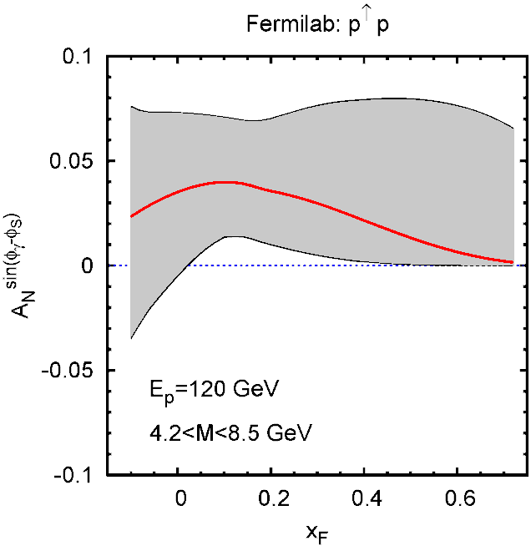
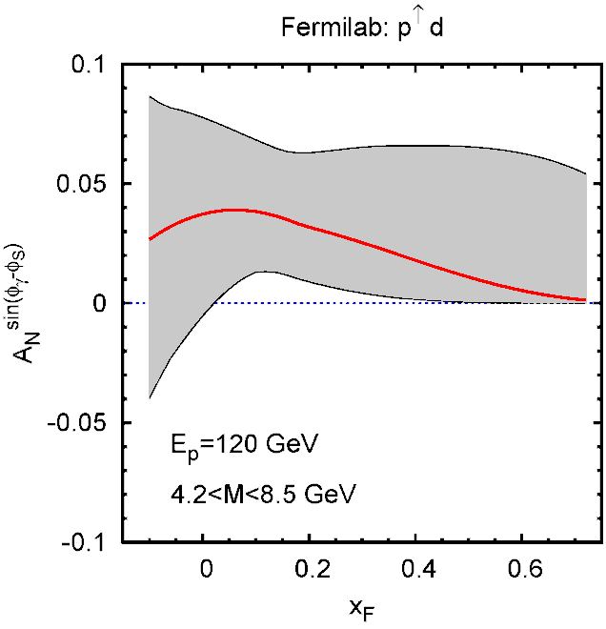
Sivers Function
described by transverse-momentum dependent distribution function
captures non-perturbative spin-orbit coupling effects inside a polarized proton
leads to a sin (φ – φ_{S}) asymmetry in SIDIS and Drell-Yan
done in SIDIS (HERMES, COMPASS)
Sivers function is time-reversal odd
leads to sign change
fundamental prediction of QCD (goes to heart of gauge formulation of field theory)
Predictions based on fit to SIDIS data
FNAL
120 GeV
polarized beam
√s ~ 15 GeV
(hydrogen)
FNAL
120 GeV
polarized beam
√s ~ 15 GeV
(deuterium)
Anselmino et al. priv. comm. 2010

Slide 24
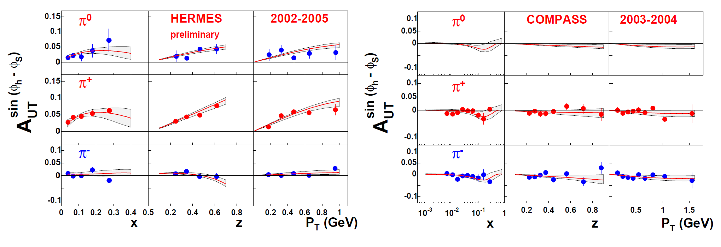
Sivers Asymmetry Measurements
HERMES (p)
COMPASS (d)
Global fit to sin (φ_{h} – φ_{S}) asymmetry in SIDIS (HERMES, COMPASS)
Comparable measurements needed for single spin asymmetries in Drell-Yan process
BUT: COMPASS (p) data do not agree with global fits (Sudakov suppression)

Slide 25
Importance of Factorization in QCD
A. Bacchetta , DY workshop, CERN, 4/10

Slide 26
Polarized Drell-Yan at Fermilab Main Injector
SeaQuest di-muon Spectrometer
fixed target experiment
luminosity: L = 3.4 x 10³⁵ /cm²/s
I_{av} = 1.6 x 10¹¹ p/s (=26 nA)
N_{p}= 2.1 x 10²⁴ /cm²
2-3 years of running: 3.4 x 10¹⁸ pot
Polarized Beam in Main Injector
use Seaquest spectrometer
use SeaQuest target
liquid H₂ target can take ~5 x 10¹¹ p/s (=80 nA)
1 mA at polarized source can deliver 8.1 x 10¹¹ p/s (=130 nA) (A. Krisch: Spin@Fermi study in (1995))
Scenarios:
L = 1 x 10³⁶ /cm²/s (60% of available beam delivered to experiment)
L = 1.7 x 10³⁵ /cm²/s (10% of available beam delivered to experiment)
x-range:
x₁ = 0.3 – 0.9 (valence quarks) x₂ = 0.1 – 0.5 (sea quarks)

Slide 27
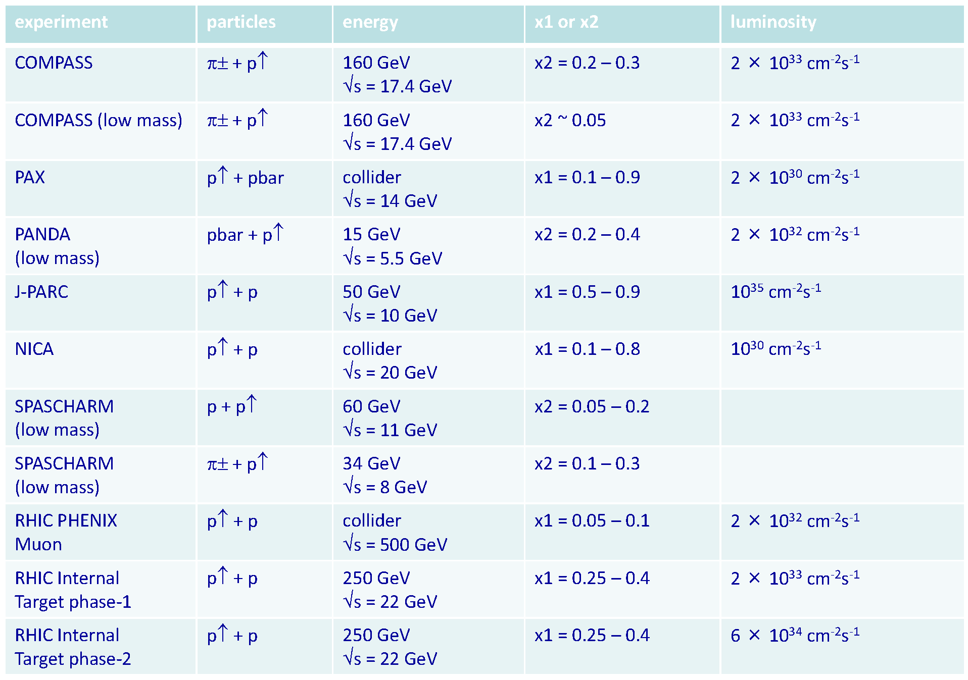
Planned Polarized Drell-Yan Experiments
rates
Yuji Goto
April 27, 2010
DY workshop
CERN
Fermilab p↑ + p 120 GeV x₁ = 0.3 − 0.9 ~1 x 10³⁶ cm⁻² s⁻¹
Main Injector √s = 15 GeV polarized
Polarized M.I. beam intensity: 2.3 x 10¹² p/pulse (w/ 2.8 s/pulse) on SeaQuest target (60% delivered to NM4) -> L = 1 x 10³⁶ /cm²/s (SeaQuest lH₂ target limited)

Slide 28
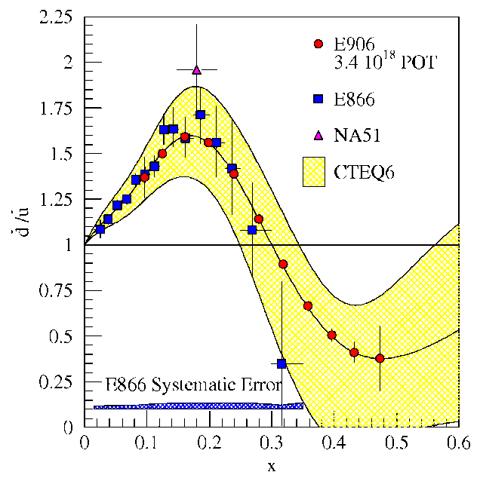
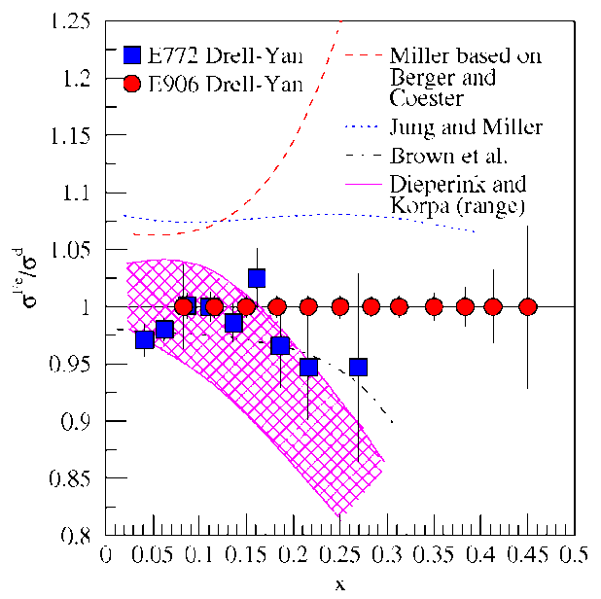
Drell-Yan fixed target experiments at Fermilab
What is the structure of the nucleon?
What is ?
What is the origin of thesea quarks?
What is the high x structure of the proton?
What is the structure of nucleonic matter?
Where are the nuclear pions?
Is anti-shadowing a valence effect?
SeaQuest: 2010 - 2013
significant increase in physics reach
Beyond SeaQuest
Polarized Drell-Yan (beam/target)
Notes:
While providing direct input to the parton distributions fits, the ultimate impact of E906 will be to provide a better understanding on the physical mechanism which generates the sea of the proton.

Slide 29
Thank you!
Notes:
In addition to D-Y ratio measurements, the absolute D-Y p-H and p-D cross sections can be determined.

Slide 30
Additional Material
Notes:
In addition to D-Y ratio measurements, the absolute D-Y p-H and p-D cross sections can be determined.

Slide 31
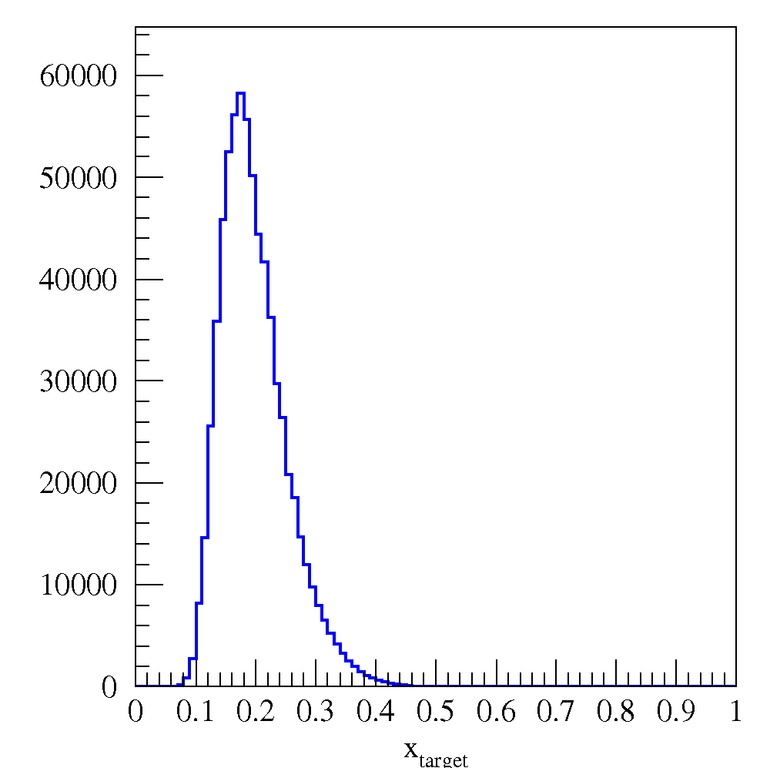
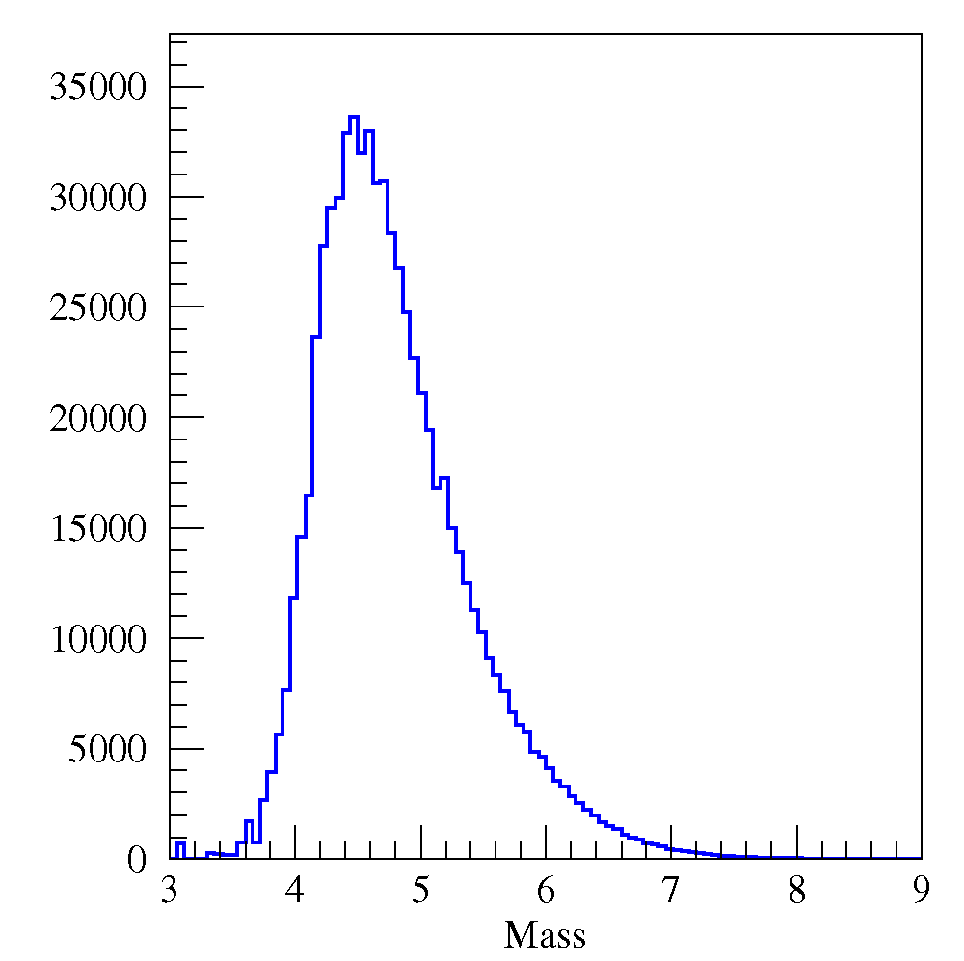
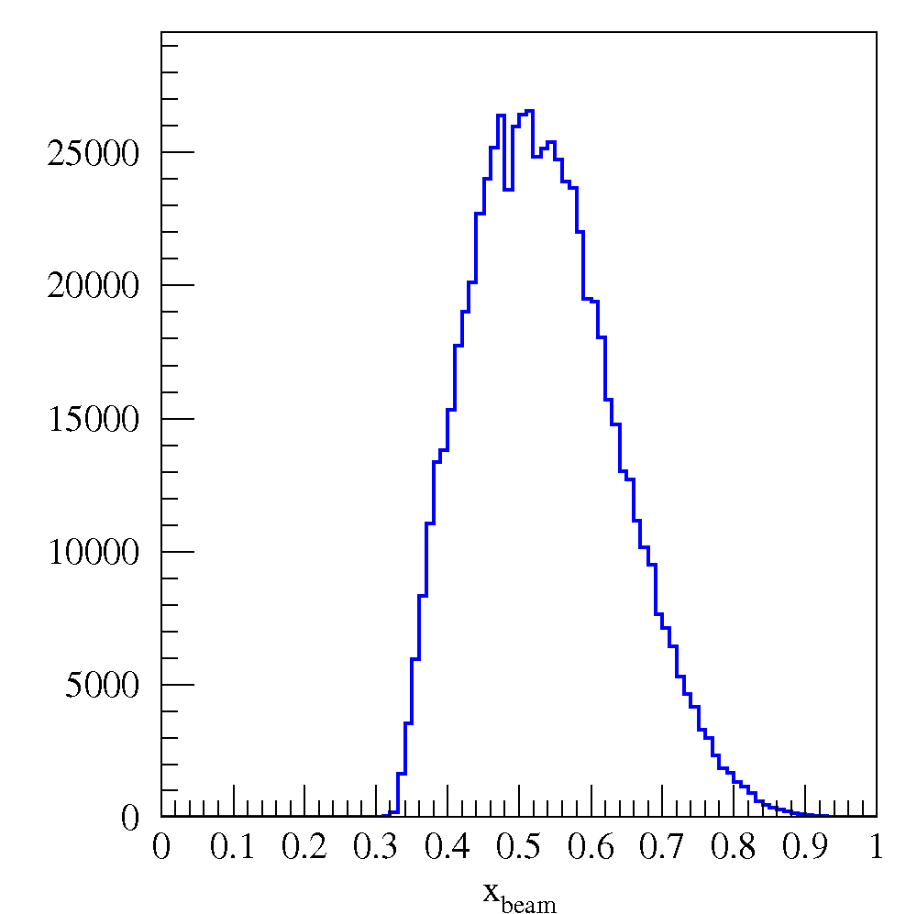
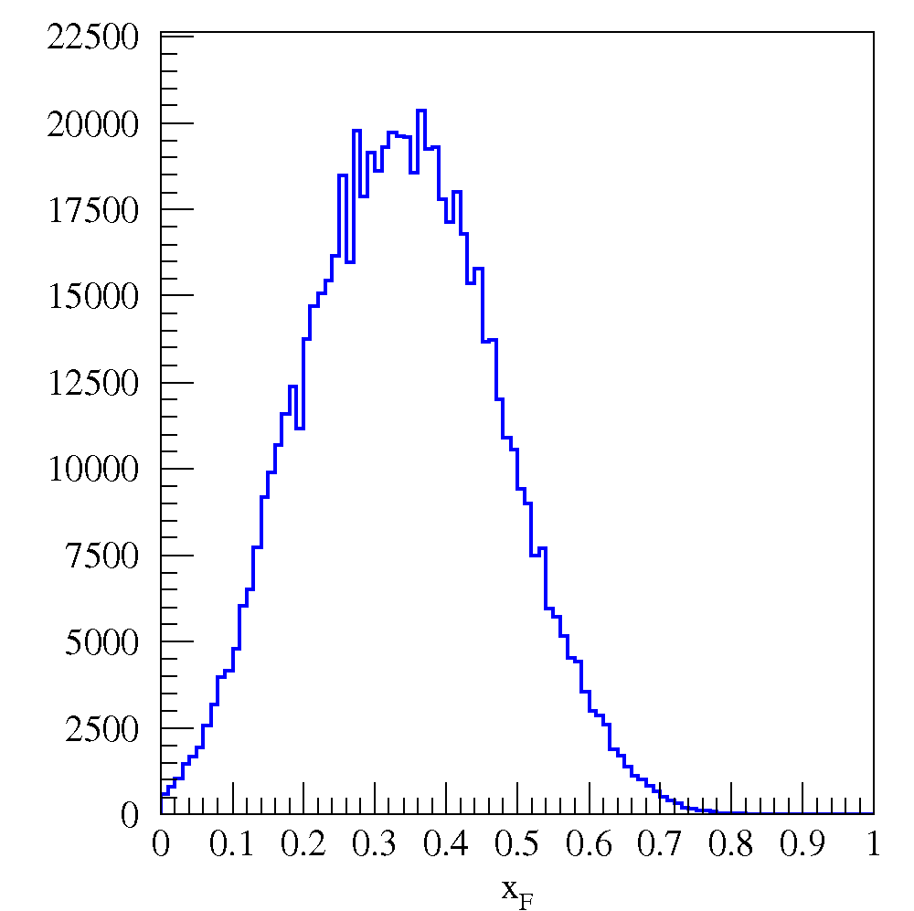
Drell-Yan Acceptance
Programmable trigger removes likely J/ψ events
Transverse momentum acceptance to above 2 GeV
Spectrometer could also be used for J/ψ, ψ⁰ studies
x_{target}
x_{beam}
x_{F}
Mass

Slide 32
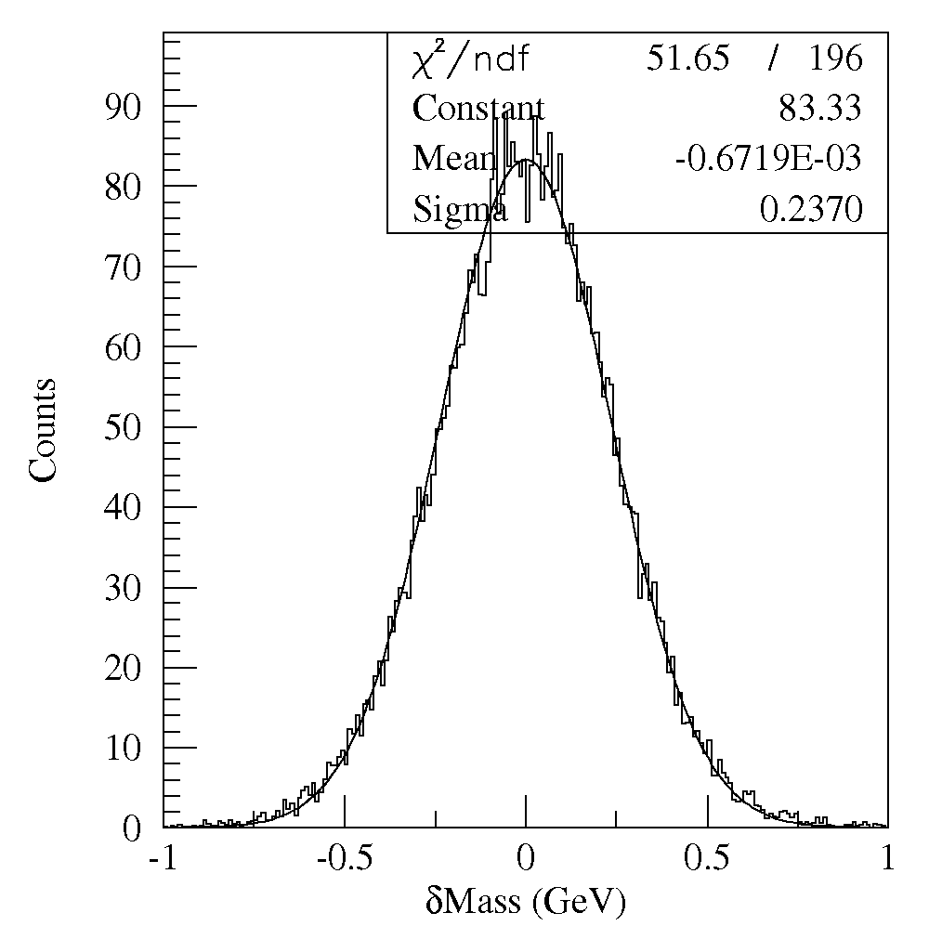
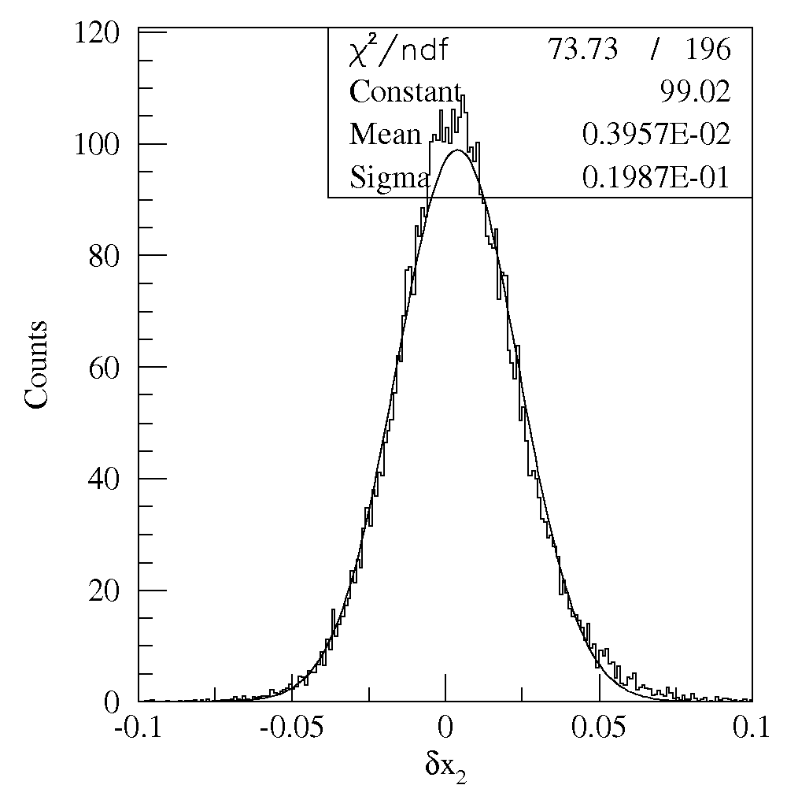
Detector Resolution
240 MeV
Mass Res.
0.04 x₂ Res.
Triggered Drell-Yan events

Slide 33
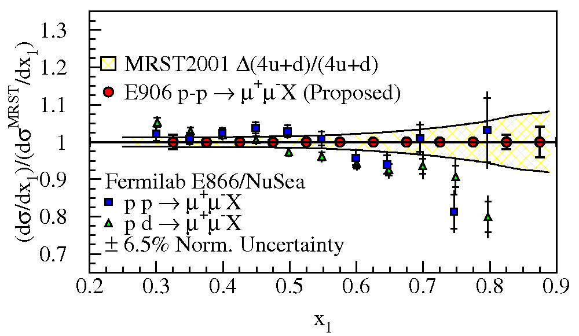
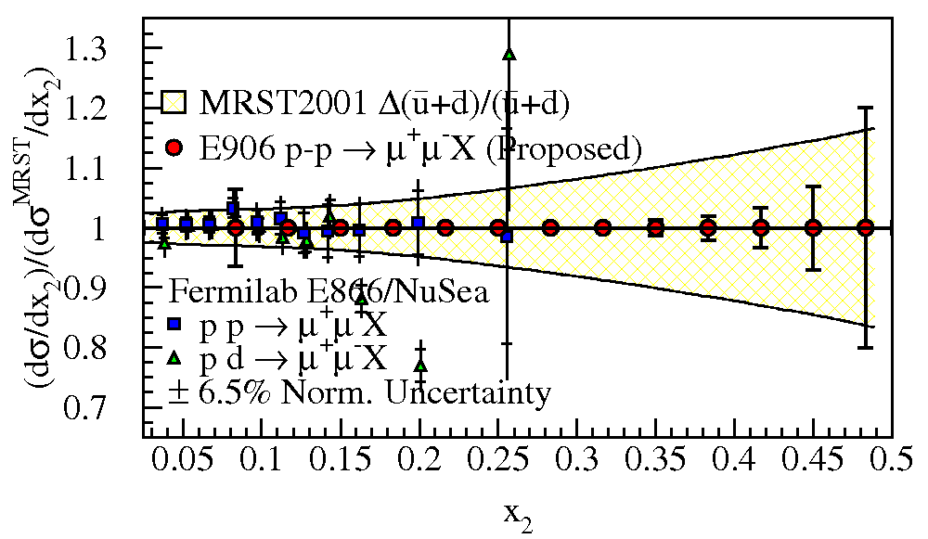
SeaQuest Projections for absolute cross sections
Measure high x structure of beam proton
large x_{F} gives large x_{beam}
High x distributions poorly understood
nuclear corrections are large, even for deuterium
lack of proton data
In pp cross section, no nuclear corrections
Measure convolution of beam and target PDF
absolute magnitude of high x valence distributions (4u+d)
absolute magnitude of the sea in target ( ) (currently determined by ν-Fe DIS)
Preliminary
Preliminary
Notes:
In addition to D-Y ratio measurements, the absolute D-Y p-H and p-D cross sections can be determined.

Slide 34
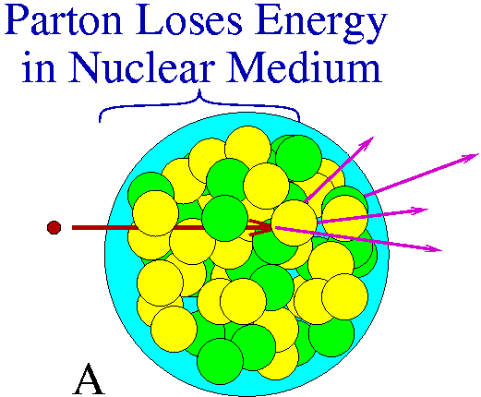
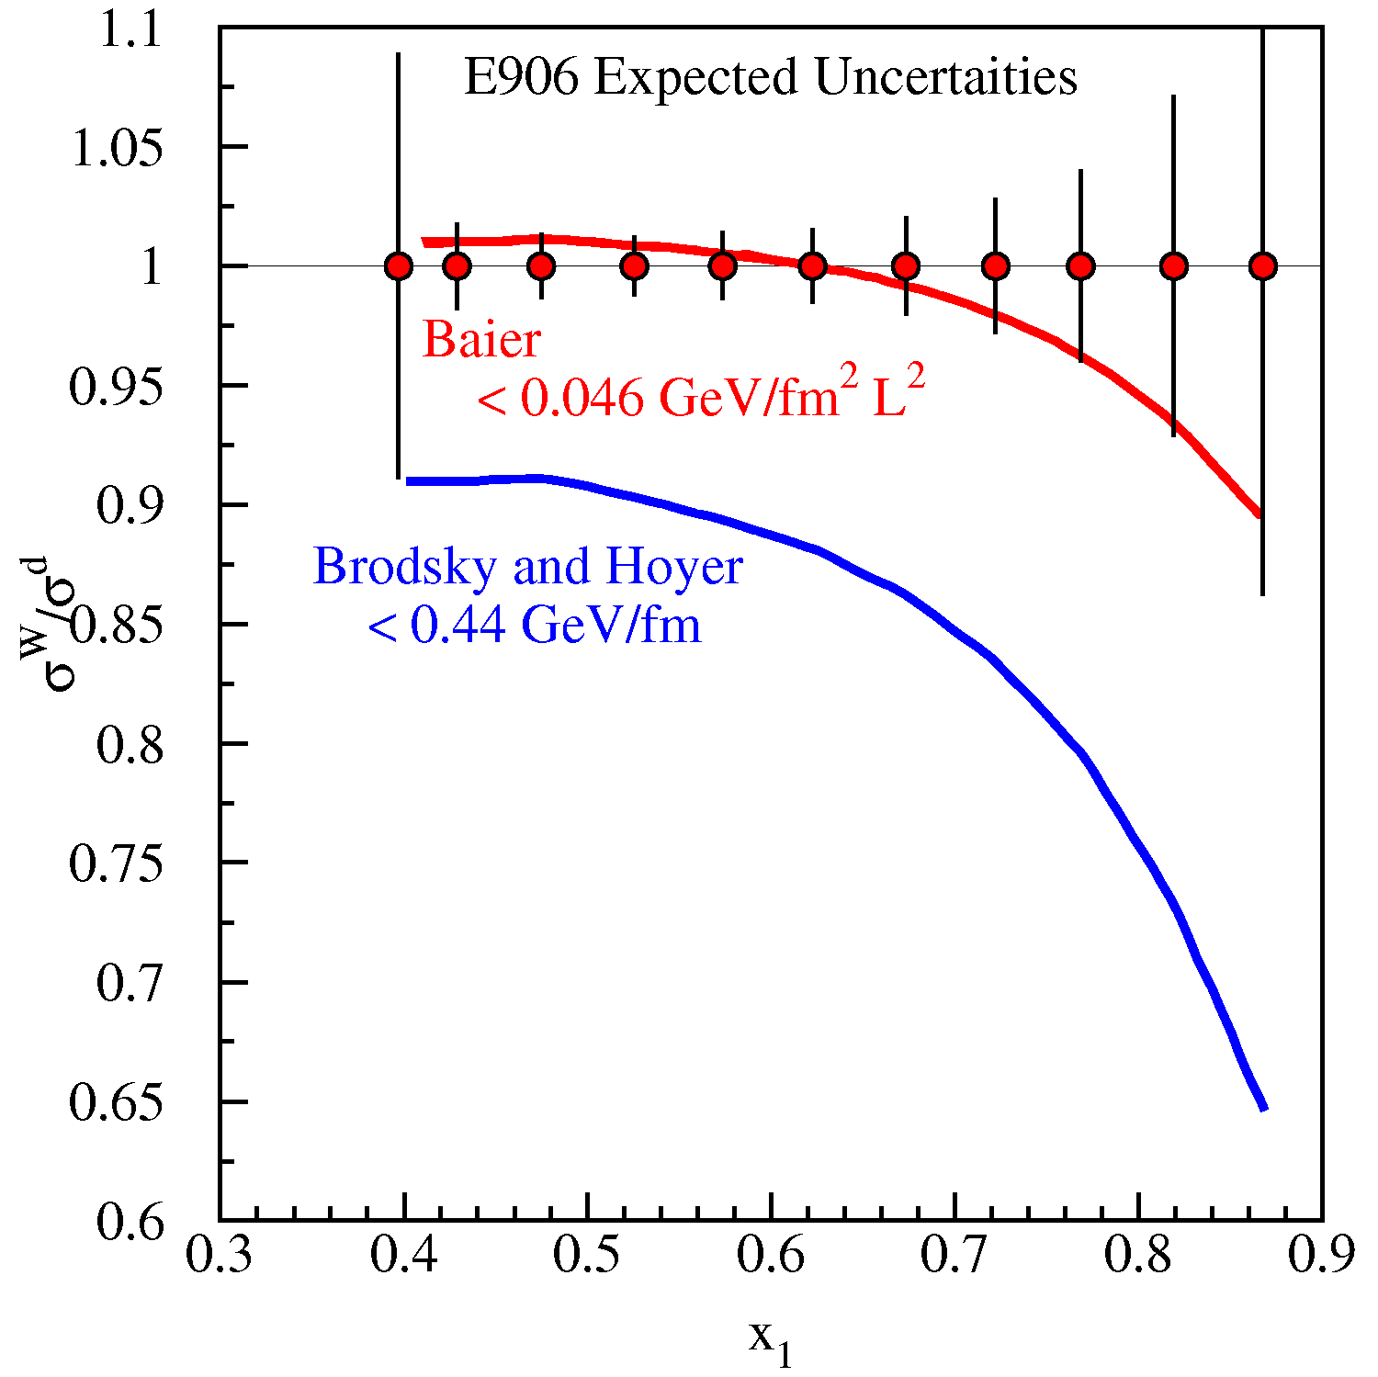
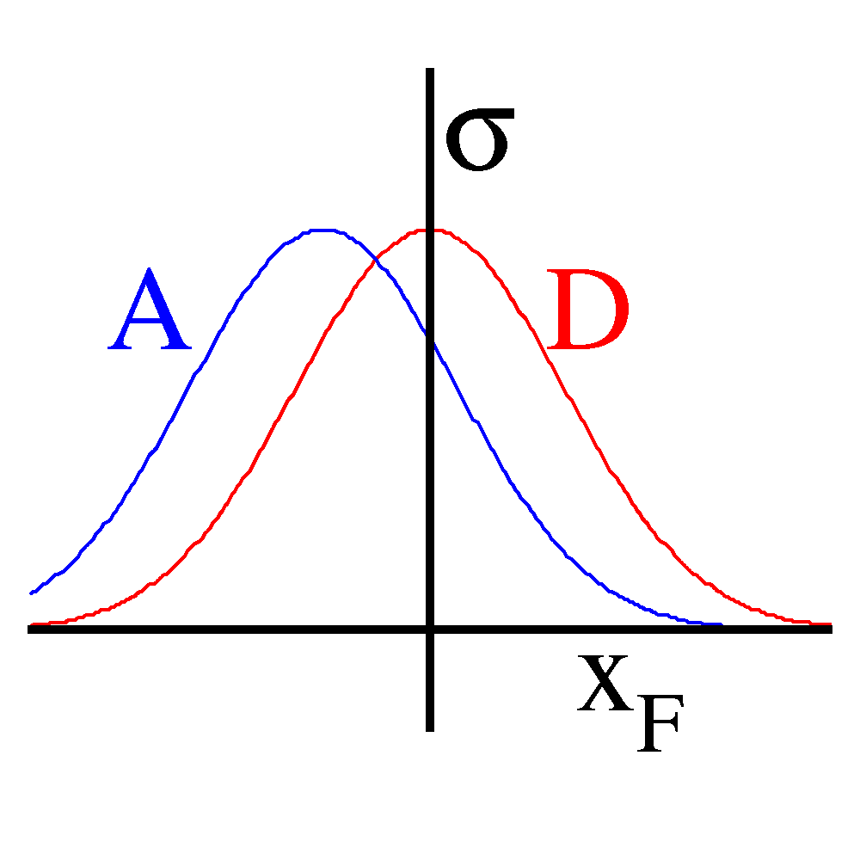
Partonic Energy Loss in Cold Nuclear Matter
An understanding of partonic energy loss in both cold and hot nuclear matter is paramount to elucidating RHIC data.
Pre-interaction parton moves through cold nuclear matter and looses energy.
Apparent (reconstructed) kinematic value (x₁ or x_{F}) is shifted
Fit shift in x₁ relative to deuterium
shift in Δx₁ ∝ 1/s (larger at 120 GeV)
E906 expected uncertainties
Shadowing region removed
Energy loss upper limits based on E866 Drell-Yan measurement
X₁
LW10504
E906 will have sufficient statistical precision to allow events within the shadowing region, x₂ < 0.1, to be removed from the data sample
Notes:
D-Y process provides excellent means to study interaction of fast partons traversing cold nuclei (di-mu in final state does not interact strongly in medium) -> use it to estimate energy loss of fast quarks in cold nuclear matter.
Various forms of energy loss have been proposed, each of which can be expressed in terms of the average change in incident-parton fraction, Delta x1, prior to the collision vs A.
Baier et al have model that goes with shift in x_1 as –k/s * A^(2/3)
While Brodsky and Hoyer (and Galvin and Milana) have a dependence of –k/s * A(1/3)
Ultimate sensitivity will be limited by our ability to separate incident-parton energy loss from nuclear modifications of target anti-quark distributions.

Slide 35
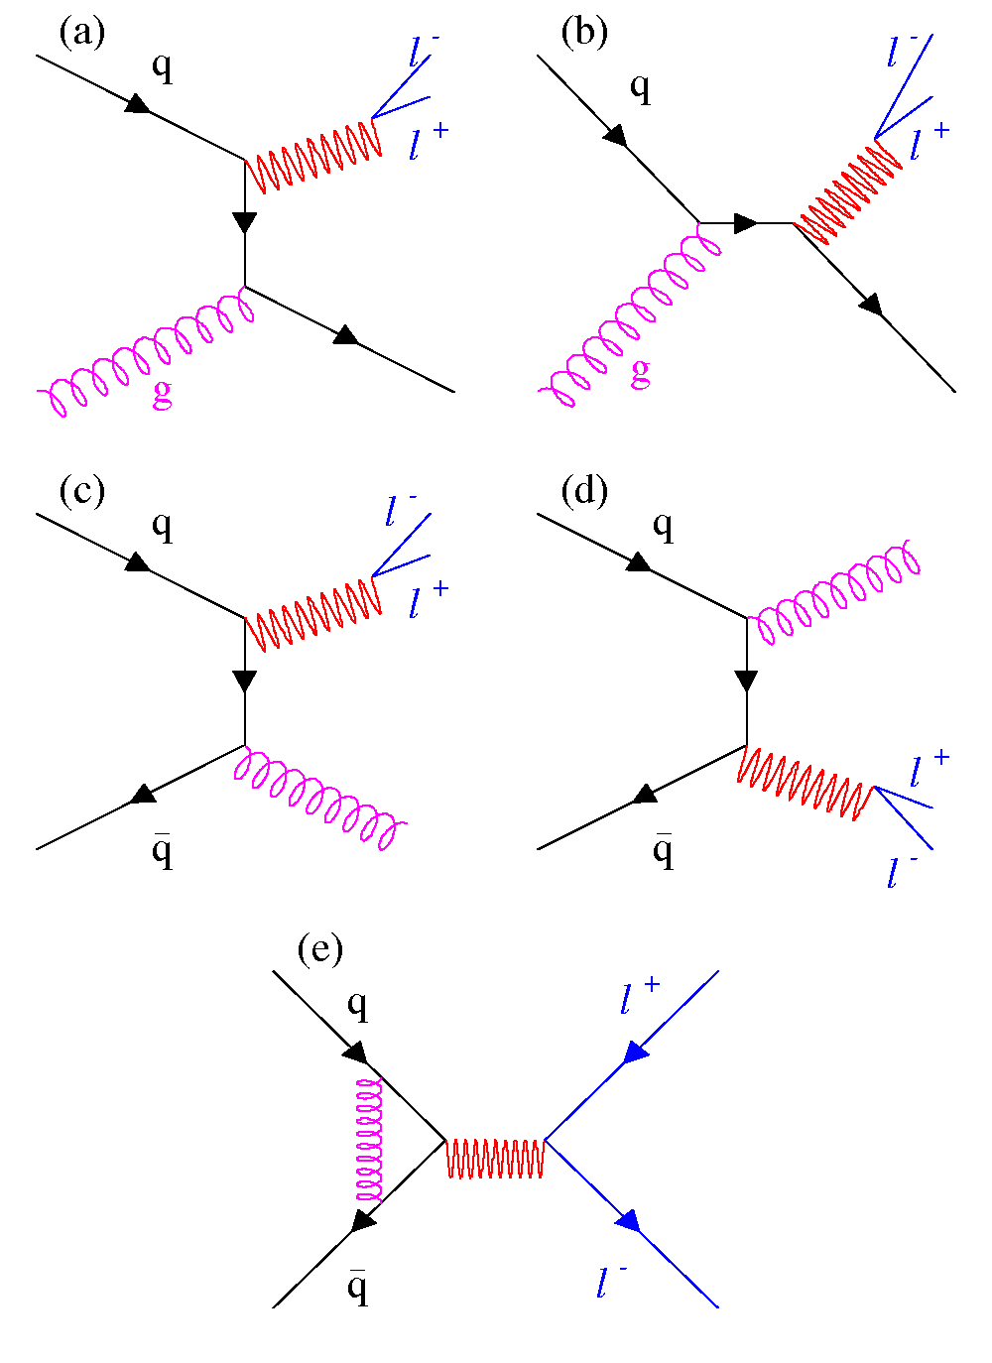
Next-to-Leading Order Drell-Yan
Next-to-leading order diagrams complicate the picture
These diagrams are responsible for 50% of the measured cross section
Intrinsic transverse momentum of quarks (although a small effect, λ > 0.8)

Slide 36
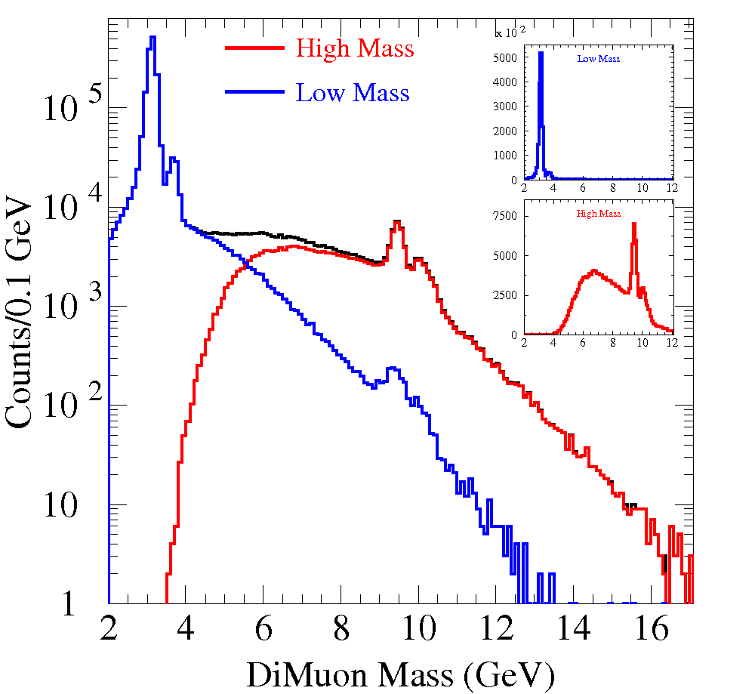
Drell-Yan Mass Spectra
Data From Fermilab E-866/NuSea
800 GeV proton beam on hydrogen target
Edge of Spectrometer Acceptance

Slide 37
Drell Yan Process
Similar Physics Goals as SIDIS:
parton level understanding of nucleon
electromagnetic probe
Timelike (Drell-Yan) vs. spacelike (DIS) virtual photon
Drell-Yan
SIDIS
A. Kotzinian, DY workshop, CERN, 4/10
Cleanest probe to study hadron structure:
hadron beam and convolution of parton distributions
no QCD final state effects
no fragmentation process
ability to select sea quark distribution
allows direct production of transverse momentum-dependent distribution (TMD) functions (Sivers, Boer-Mulders, etc)
Notes:
Assuming factorization is valid in QCD, Drell-Yan can be written as a hard scattering process, and the direct production of two transverse momentum-dependent distribution (TMD) functions (Sivers, Boer-Mulders, etc); and SIDIS allows to measure convolution of DF with FF.
If universality is valid in QCD, DF in D-Y and SIDIS are identical.

Slide 38
Sivers Function Measurements
T-odd observables
SSA observable ~ odd under naïve Time-Reversal
since QCD amplitudes are T-even, must arise from interference (between spin-flip and non-flip amplitudes with different phases)
Cannot come from perturbative subprocess xsec at high energies:
q helicity flip suppressed by
need suppressed loop-diagram to generate necessary phase
at hard (enough) scales, SSA’s must arise from soft physics
A T-odd function like must arise from interference (How?)
soft gluons: “gauge links” required for color gauge invariance
such soft gluon interactions with the soft wavefunction are final (or initial) state interactions … and maybe process dependent!
leads to sign change:
Brodsky, Hwang & Smith (2002)
and produce a T-odd effect!
(also need )
e.g. Drell-Yan)
38
Notes:
A T-odd function like the Sivers function must arise from interference. But a leading twist distribution function is just a forward scattering amplitude, how can it contain an interference?
But because of the data, and the vigorous theoretical effort surrounding these data, Brodksy, Hwang and Smith re-examined the factorization theorem and found that for the case of TMD PDFs, one has to be careful to include these diagrams, where a soft gluon re-interacts between the struck quark and the proton
While in DIS this final state interaction is attractive, in D-Y the initial state interaction is repulsive, leading to a sign change

