Slide 1
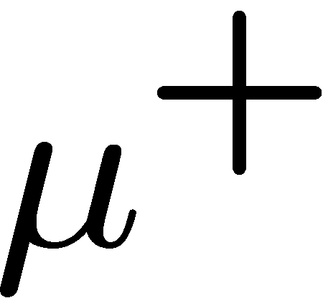
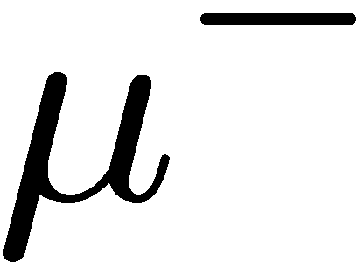
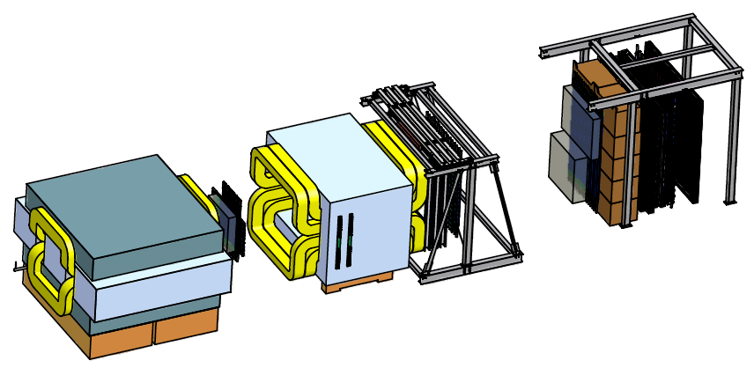
Drell-Yan Scattering at Fermilab: SeaQuest and Beyond
Wolfgang Lorenzon
(1-September-2011)
Transversity-2011 Workshop
Introduction
SeaQuest: Fermilab Experiment E906
Sea quarks in the proton
Sea quarks in the nucleus
other topics
Beyond SeaQuest
Polarized Drell-Yan at FNAL?
This work is supported by
With help from Chiranjib Dutta (U-M), and Paul Reimer (Argonne)

Slide 2
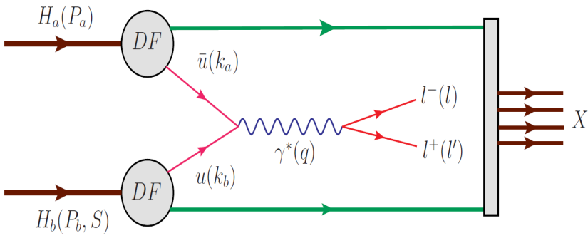
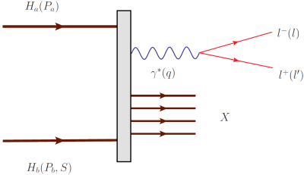
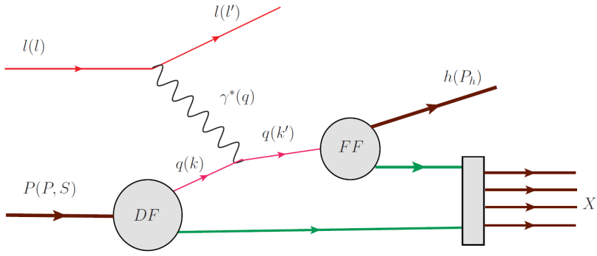
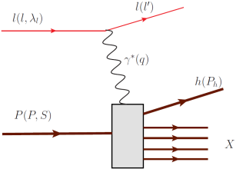
Drell Yan Process
Similar Physics Goals as SIDIS:
parton level understanding of nucleon
electromagnetic probe
Timelike (Drell-Yan) vs. spacelike (DIS) virtual photon
Drell-Yan
SIDIS
A. Kotzinian, DY workshop, CERN, 4/10
Cleanest probe to study hadron structure:
hadron beam and convolution of parton distributions
no QCD final state effects
no fragmentation process
ability to select sea quark distribution
allows direct production of transverse momentum-dependent distribution (TMD) functions (Sivers, Boer-Mulders, etc)
Notes:
Assuming factorization is valid in QCD, Drell-Yan can be written as a hard scattering process, and the direct production of two transverse momentum-dependent distribution (TMD) functions (Sivers, Boer-Mulders, etc); and SIDIS allows to measure convolution of DF with FF.
If universality is valid in QCD, DF in D-Y and SIDIS are identical.

Slide 3
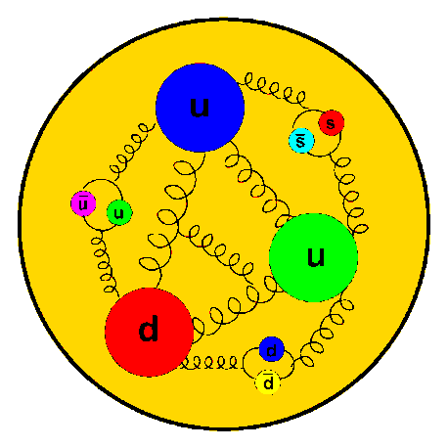
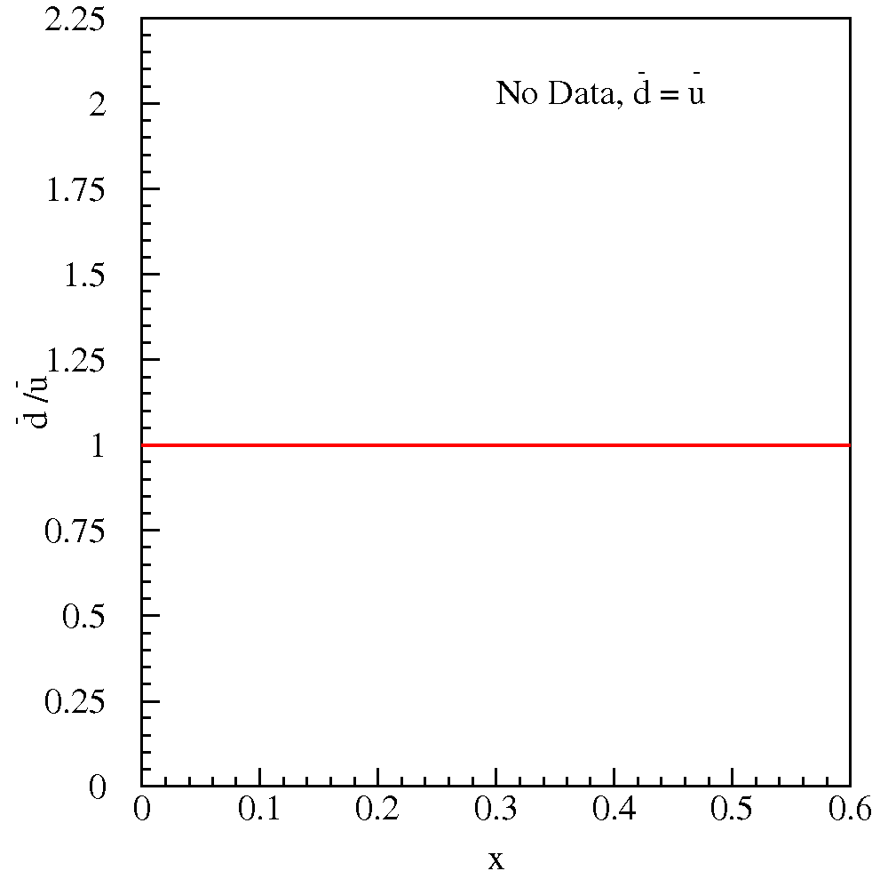
Flavor Structure of the Proton
No Data,
Constituent Quark Model Pure valence description: proton = 2u + d
Perturbative Sea sea quark pairs from g qq should be flavor symmetric:
What does the data tell us?
3

Slide 4
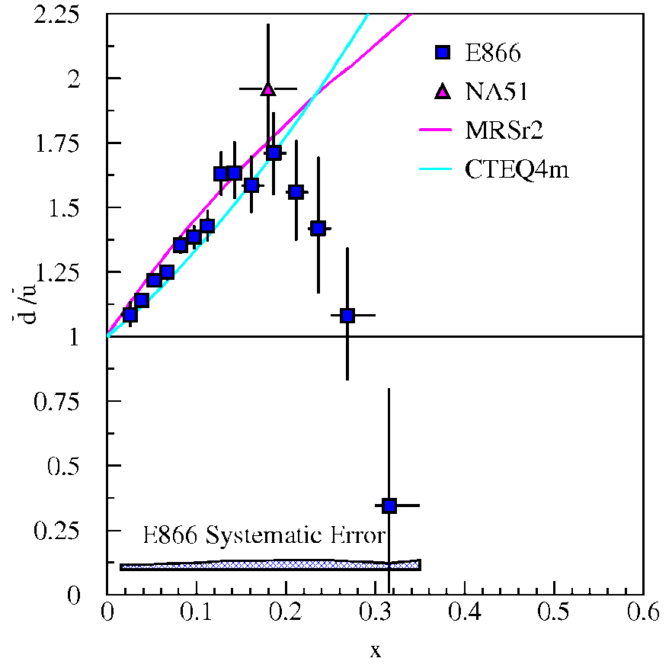
Flavor Structure of the Proton: Brief History
E866:
Perturbative Sea
NMC (inclusive DIS)
NA51 (Drell-Yan)
E866/NuSea (Drell-Yan)
What is the origin of the sea
Knowledge of parton distributions is data driven
Sea quark distributions are difficult for Lattice QCD
4
Notes:
Production of W bosons in p-p collisions offers sensitivity to the antiquark distributions.

Slide 5
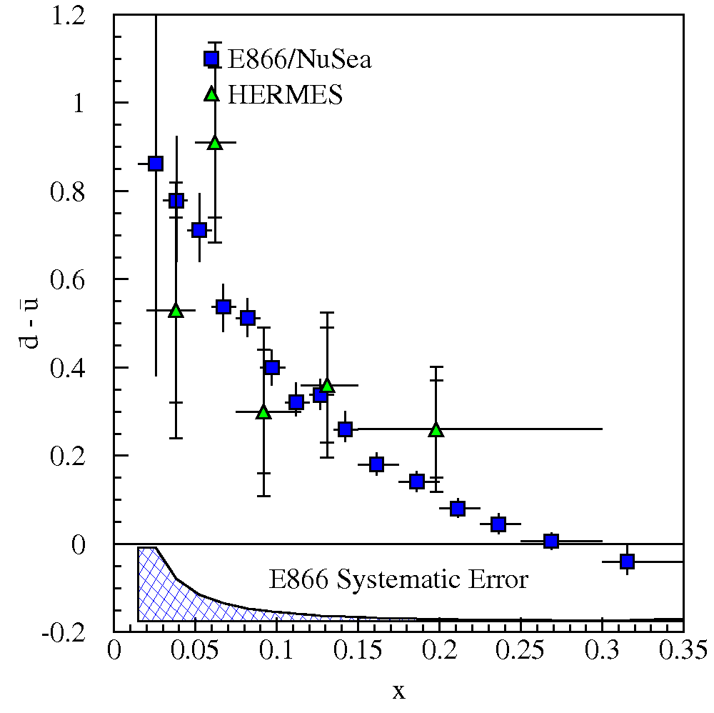
Flavor Structure of the Proton: What creates Sea?
There is a gluon splitting component which is symmetric
Symmetric sea via pair production from gluons subtracts off
No gluon contribution at 1st order in α_{s}
Non-perturbative models are motivated by the observed difference
A proton with 3 valence quarks plus glue cannot be right at any scale!!
5
Notes:
D-bar-u-bar is pure flavor non-singlet quantity (its integral is Q^2 independent, and its Q^2 evolution does not depend on gluon distributions of proton in leading order).

Slide 6
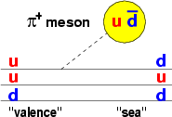
Flavor Structure of the Proton: Models
Non-perturbative models: alternate d.o.f.
Meson Cloud Models Chiral-Quark Soliton Model Statistical Model Quark sea from cloud of 0 mesons:
quark d.o.f. in a pion mean-field: u d + π⁺
nucleon = chiral soliton
one parameter: dynamically generated quark mass
expand in 1/N_{c}:
nucleon = gas of massless partons
few parameters: generate parton distribution functions
input: QCD: chiral structure DIS: u(x) and d(x)
⇒ important constraints on flavor asymmetry for polarization of light sea
6
Notes:
Chiral quark models couple mesons directly to constituent quarks. There are also instanton models which allow large d-bar - u-bar.
Note, in each of these models, flavor and spin distributions are intimately linked.

Slide 7
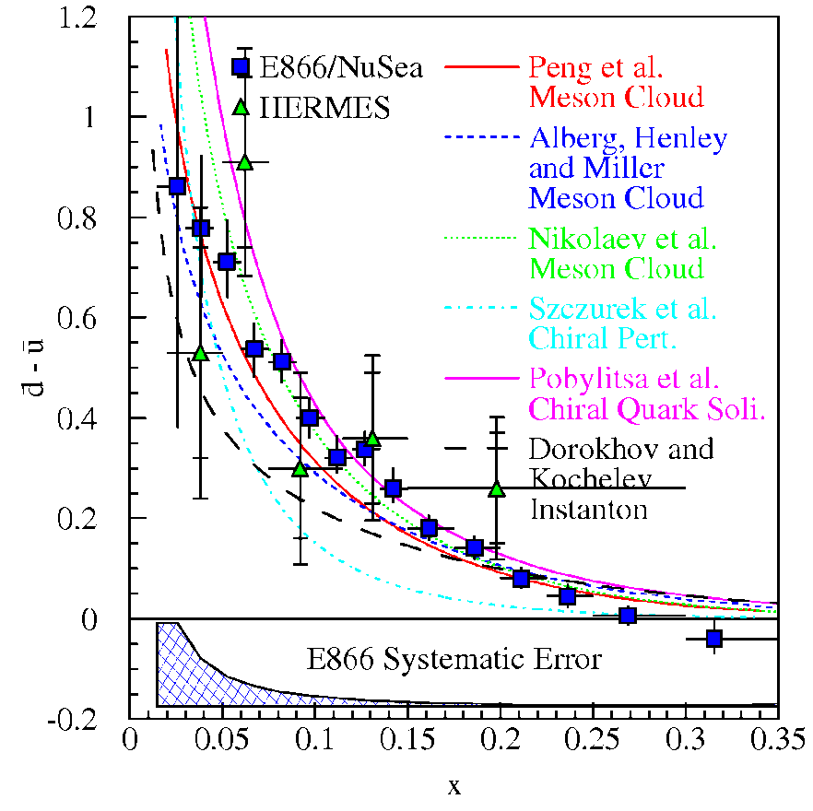
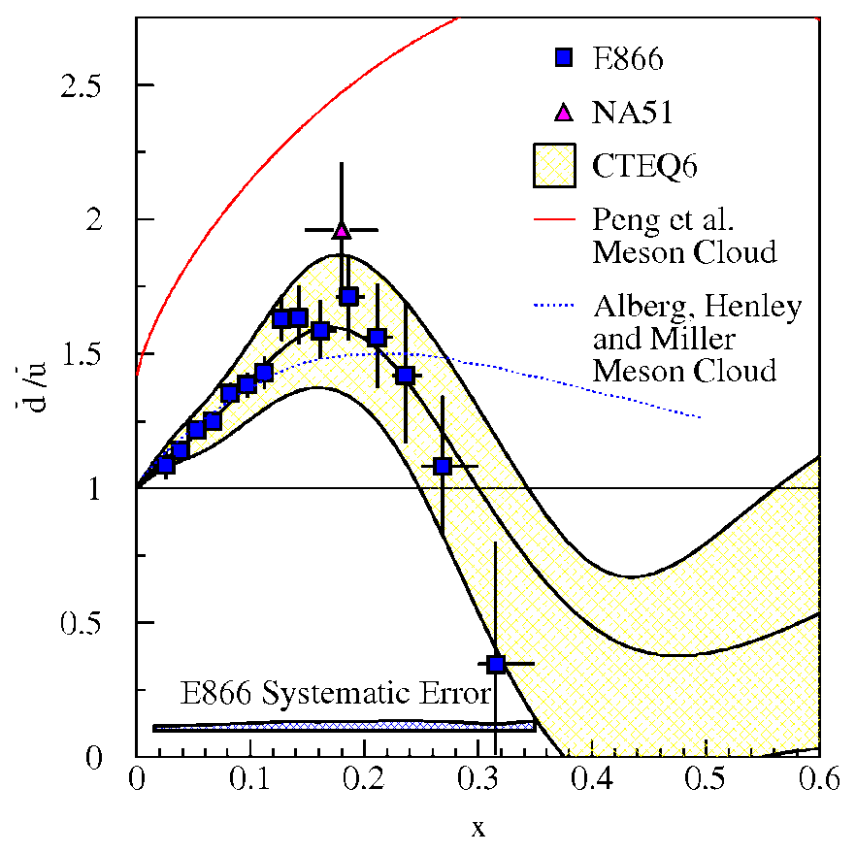
Flavor Structure of the Proton: What creates Sea?
Comparison with models
High x behavior is not explained
Perturbative sea seems to dilute meson cloud effects at large x (but this requires large-x gluons)
Measuring the ratio is powerful
Are there more gluons and thus symmetric anti-quarks at higher x?
Unknown other mechanisms with unexpected x-dependence?
7
Notes:
None of these models consistently incorporate the flavor symmetric sea and consequently all substantially over-predict the ratio for x>0.23.
Meson cloud model level off at 1.5 to 5 (depending on baryons included in calcs) until x>0.5 and then level off to unity. Instanton model predicts ratio ~4.
-> possible interpretation of E866 results is that perturbative gluon mechanism begins to dominate over non-pert mechs at lower x than previously expected (indicating larger gluon component in proton – those gluon distributions are poorly constrained currently: 30-40% at x=0.4).
In contrast to SIDIS, D-Y measurement of ratio has much smaller systematic errors and acceptance corrections.

Slide 8
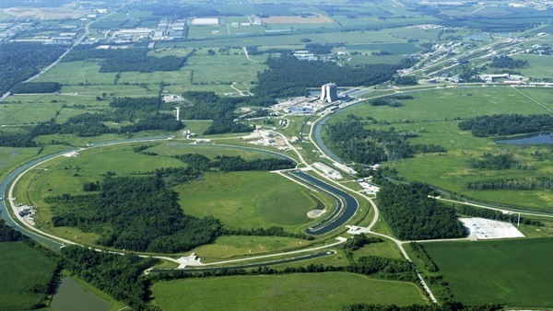
SeaQuest: Fermilab Experiment E906
E906 will extend Drell-Yan measurements of E866/NuSea (with 800 GeV protons) using upgraded spectrometer and 120 GeV proton beam from Main Injector
Lower beam energy gives factor 50 improvement “per proton” !
Drell-Yan cross section for given x increases as 1/s
Backgrounds from J/Ψ and similar resonances decreases as s
Use many components from E866 to save money/time, in NM4 Hall
Hydrogen, Deuterium and Nuclear Targets
Tevatron 800 GeV
Main Injector 120 GeV
8

Slide 9
Fermilab E906/Drell-Yan Collaboration
Abilene Christian University
Donald Isenhower, Tyler Hague
Rusty Towell, Shon Watson
Academia Sinica
Wen-Chen Chang, Yen-Chu Chen
Shiu Shiuan-Hal, Da-Shung Su
Argonne National Laboratory
John Arrington, Don Geesaman*
Kawtar Hafidi, Roy Holt, Harold Jackson
David Potterveld, Paul E. Reimer*
Josh Rubin
University of Colorado
Ed Kinney, J. Katich, Po-Ju Lin
Fermi National Accelerator Laboratory
Chuck Brown, David Christian
University of Illinois
Btyan Dannowitz, Markus Diefenthaler Dan Jumper, Bryan Kerns, Naomi C.R Makins, R. Evan McClellan, Jen-Chieh Peng
KEK
Shinya Sawada
Ling-Tung University
Ting-Hua Chang
Los Alamos National Laboratory
Christian Aidala, Gerry Garvey, Mike Leitch, Han Liu, Ming Liu Pat McGaughey, Joel Moss, Andrew Puckett
University of Maryland
Betsy Beise, Kaz Nakahara
University of Michigan
Chiranjib Dutta,
Wolfgang Lorenzon, Uttam Paudel, Richard Raymond Qu Zhongming
*Co-Spokespersons
National Kaohsiung Normal University
Rurngsheng Guo, Su-Yin Wang
University of New Mexico
Imran Younus
RIKEN
Yoshinori Fukao, Yuji Goto, Atsushi Taketani, Manabu Togawa
Rutgers University
Lamiaa El Fassi, Ron Gilman, Ron Ransome, Brian Tice, Ryan Thorpe Yawei Zhang
Tokyo Institute of Technology
Shou Miyasaka, Ken-ichi Nakano Florian Saftl, Toshi-Aki Shibata
Yamagata University
Yoshiyuki Miyachi
Jan, 2009
Collaboration contains many of the E-866/NuSea groups and several new groups (total 17 groups as of Aug 2011)
9

Slide 10
Drell-Yan Spectrometer for E906 (25m long)
Drell-Yan Spectrometer for E906
Station 3
(Hodoscope array, drift chamber track.)
Station 1
(hodoscope array,
MWPC track.)
4.9m
Iron Wall
(Hadron absorber)
Station 4
(hodoscope array, prop tube track.)
KTeV Magnet
(Mom. Meas.)
Solid Iron Magnet
(focusing magnet, hadron absorber and beam dump)
Station 2
(hodoscope array, drift chamber track.)
Targets
(liquid H₂, D₂, and solid targets)

Slide 11
Drell-Yan Spectrometer for E906 (Reduce, Reuse, Recycle)
Drell-Yan Spectrometer for E906
St. 4 Prob Tubes: Homeland Security via Los Alamos
St. 3 & 4 Hodo PMTs: E866, HERMES, KTeV
St. 1 & 2 Hodoscopes: HERMES
St. 2 Support Structure: KTeV
St. 2 & 3 tracking: E866
Target Flasks: E866
Cables: KTeV
Hadron Absorber: FNAL
Shielding blocks: FNAL old beamline
2nd Magnet: KTeV mom analysis magnet
Solid Fe Magnet Coils: E866 SM3 Magnet
Solid Fe Magnet FLUX Return Iron: E866 SM12 Magnet
Expect to start collecting data: November 2011

Slide 12
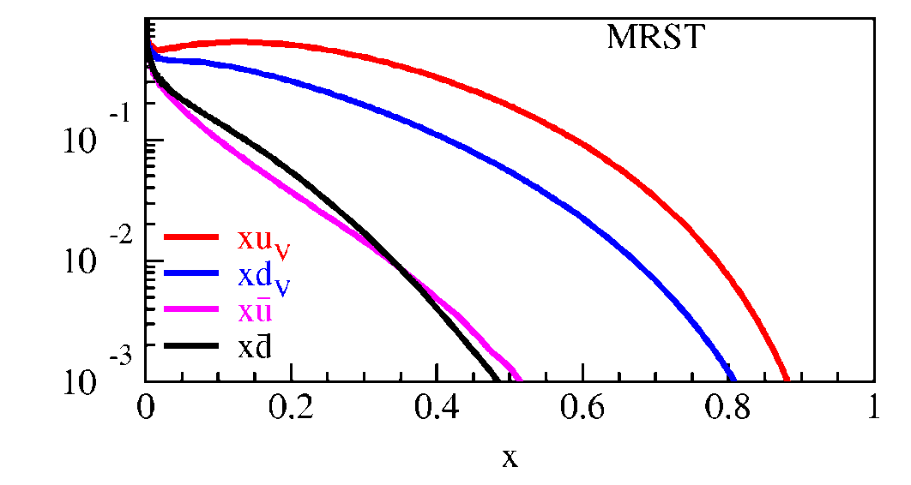
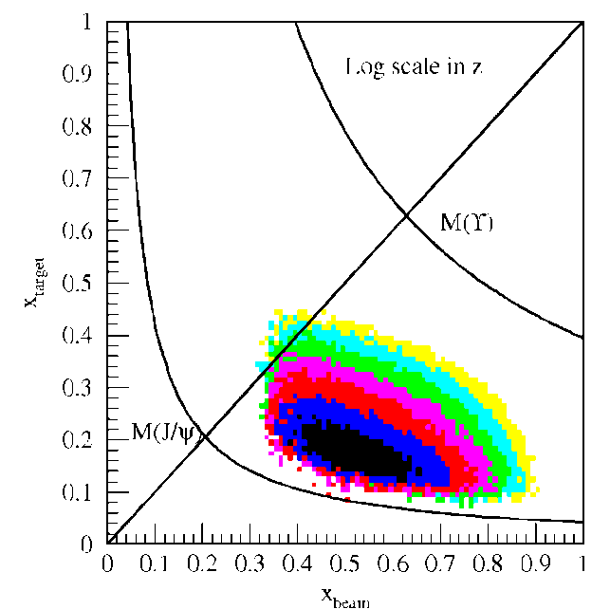
Fixed Target Drell-Yan: What we really measure
Drell-Yan Spectrometer for E906
Measure yields of μ⁺μ⁻ pairs from different targets
Reconstruct p_{γ} , M²_{γ}= x_{b}x_{t}s
Determine x_{b}, x_{t}
Measure differential cross section
Fixed target kinematics and detector acceptance give x_{b} > x_{t}
x_{F} = 2p||^{γ}/s^{1/2} ≈ x_{b} – x_{t}
Beam valence quarks probed at high x
Target sea quarks probed at low/intermediate x
x_{target}
x_{beam}
E906 Spect.
Monte Carlo
Notes:
Determine mass and momentum of virtual photon
Determine momentum fraction x_b and x_t of partons in beam and target
Measure absolute differential cross section
Sensitivity of D-Y process to anti-quark distribution of target or beam clear from examining diff. cross section
At large x, parton distributions are dominated by valence distributions, at small x by sea distributions
So in limit of large x_b and small x_t, cross section is dominated by first term -> providing direct sensitivity to antiquark sea of target nuclei
So if we just have to design the right experiment: This is E906.

Slide 13
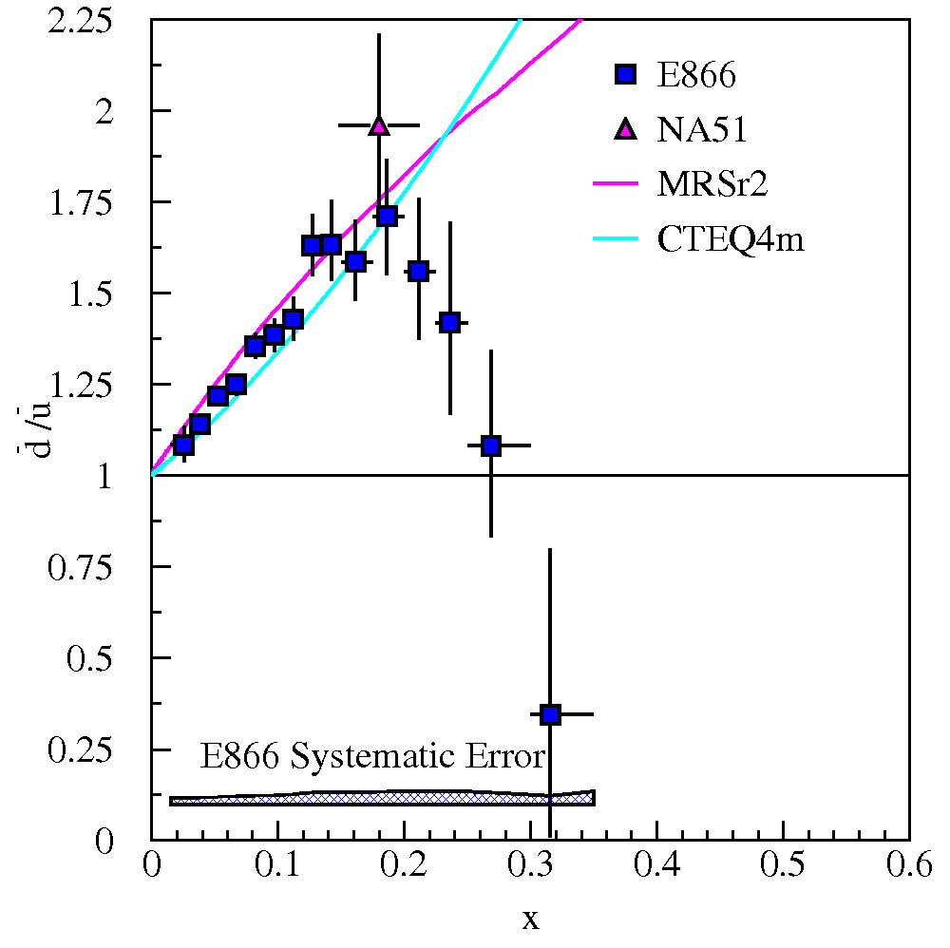
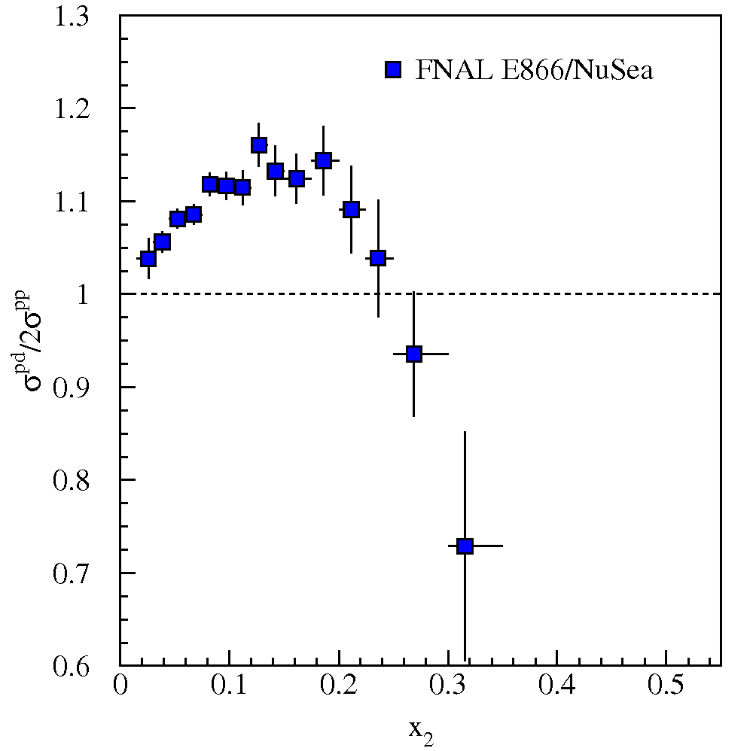
Fixed Target Drell-Yan: What we really measure - II
Measure cross section ratios on Hydrogen, Deuterium (and Nuclear) Targets

Slide 14
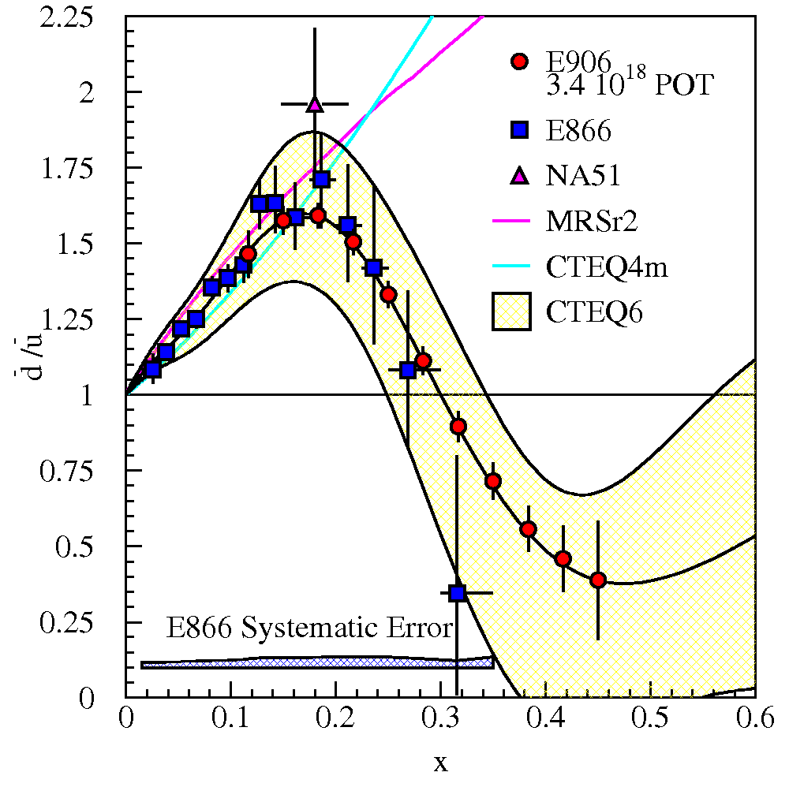
SeaQuest Projections for d-bar/u-bar Ratio
SeaQuest will extend these measurements and reduce statistical uncertainty
SeaQuest expects systematic uncertainty to remain at ≈1% in cross section ratio
5 s slow extraction spill each minute
Intensity:
2 x 10¹² protons/s (I_{inst} =320 nA)
1 x 10¹³ protons/spill

Slide 15
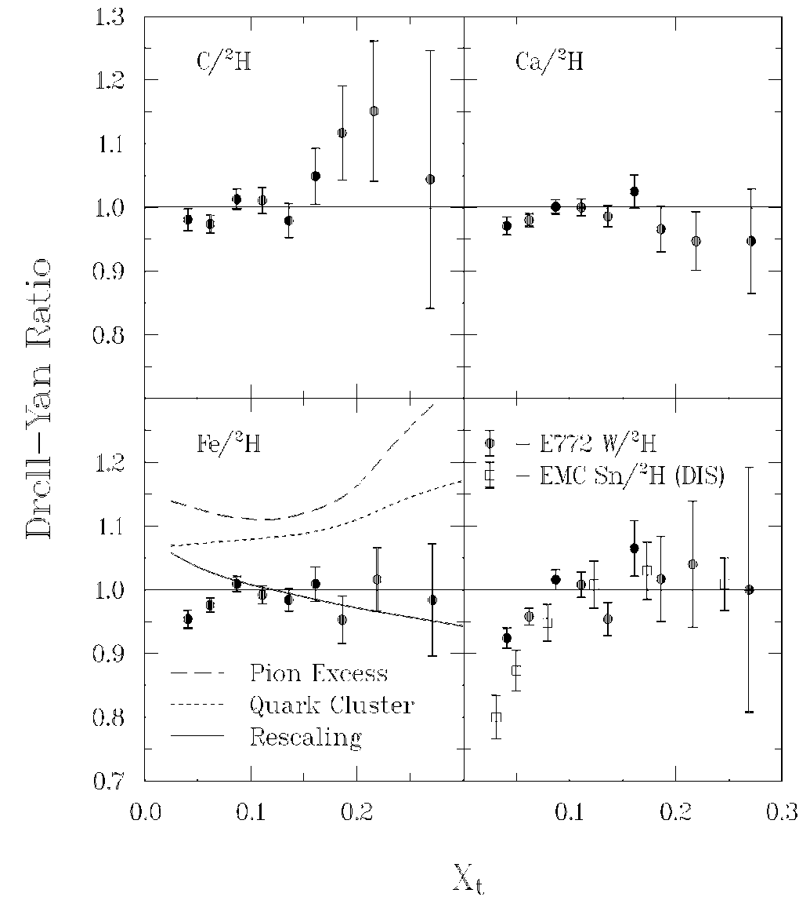
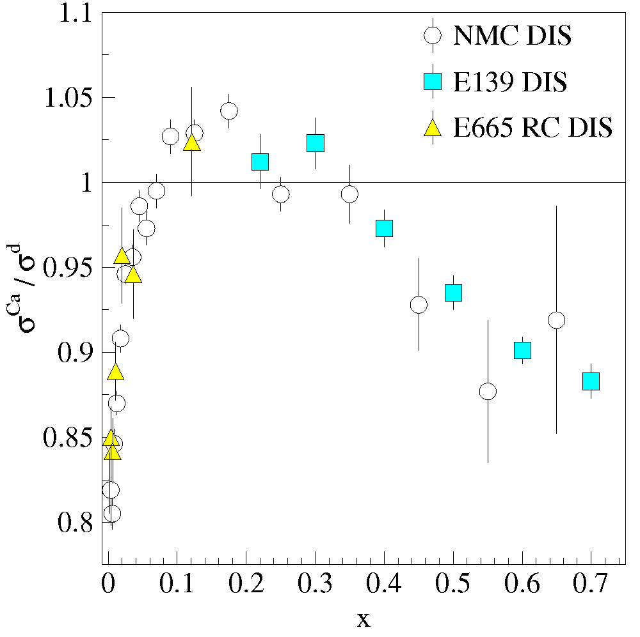
Sea quark distributions in Nuclei
EMC effect from DIS is well established
Nuclear effects in sea quark distributions may be different from valence sector
Indeed, Drell-Yan apparently sees no Anti-shadowing effect (valence only effect)
Alde et al (Fermilab E772) Phys. Rev. Lett. 64 2479 (1990)
E772 D-Y
Anti-Shadowing
Shadowing
EMC Effect
Notes:
The distributions of partons in a free nucleon differ from those of a nucleon bound in heavy nuclei (EMC effect).
Nuclear effects in sea quark distributions may be entirely different from those in valence sector. And indeed, unlike e and mu scattering, D-Y data from E772 show no anti-shadowing (although with limited stats).

Slide 16
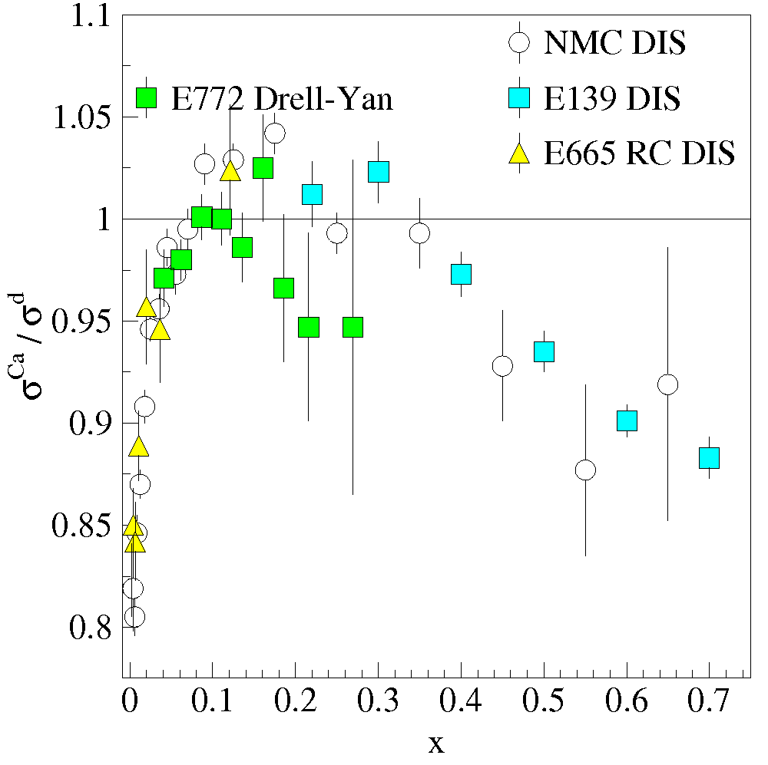
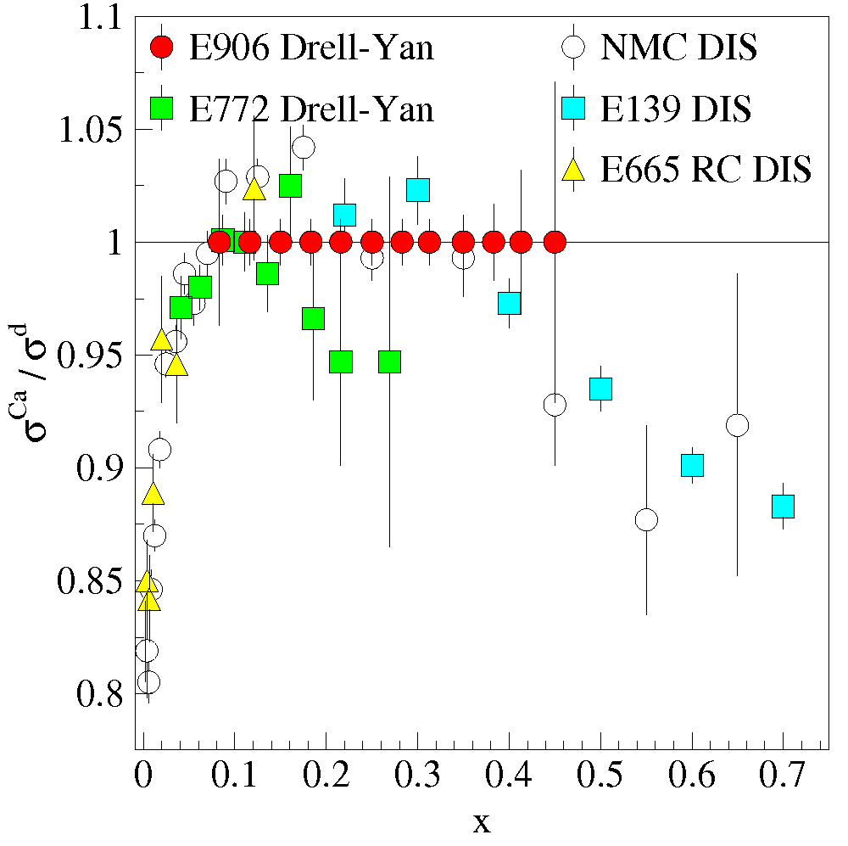
Sea quark distributions in Nuclei - II
SeaQuest can extend statistics and x-range
Are nuclear effects the same for sea and valence distributions?
What can the sea parton distributions tell us about the effects of nuclear binding?

Slide 17
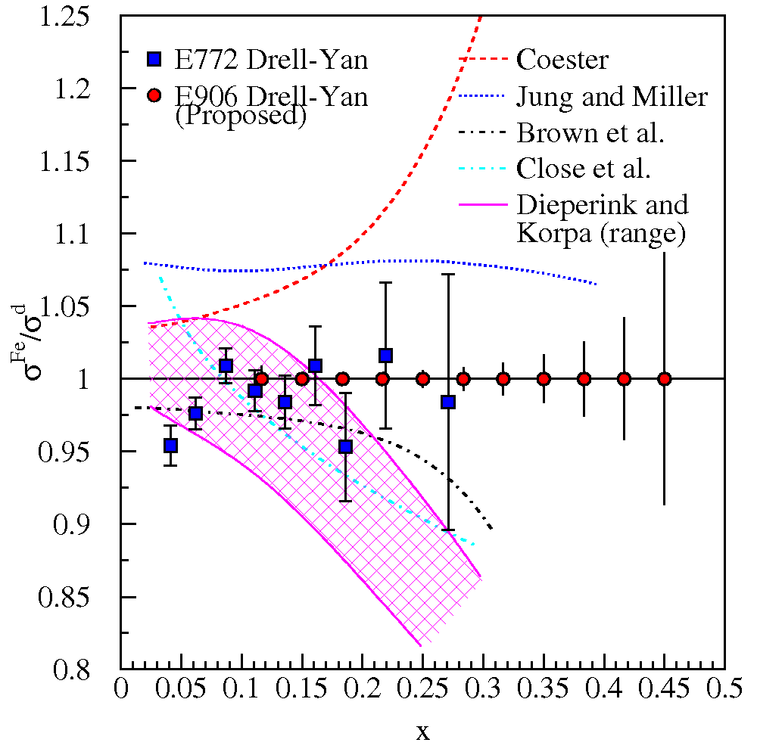
Where are the exchanged pions in the nucleus?
The binding of nucleons in a nucleus is expected to be governed by the exchange of virtual “Nuclear” mesons.
No antiquark enhancement seen in Drell-Yan (Fermilab E772) data.
Contemporary models predict large effects to antiquark distributions as x increases
Models must explain both DIS-EMC effect and Drell-Yan
SeaQuest can extend statistics and x-range
If large nuclear effects were found → nuclear effects may be important in D/H
Notes:
In context of nuclear convolution models, virtual pion contributions to nuclear structure functions were expected to lead to sizeable increases in sea distributions of nuclei compared with deuterium. But except for shadowing region, little nuclear dependence was found in the E772 D-Y measurements. The non-observation of nuclear pions call into question the most widely believed traditional meson-exchange model of the nucleus, which presents a fundamental problem for NP. The expected enhancement to the sea Fe to D is based on Coester’s model calcs.
If large nuclear effects were found that might signal that nuclear effects may be important in the D/H ratio.

Slide 18
Fermilab Seaquest Timelines
Fermilab PAC approved the experiment in 2001, but experiment was not scheduled due to concerns about “proton economics”
Fermilab Stage II approval in December 2008
Expect first beam in November 2011 (for 2 years of data collection)
Expt. Funded
Experiment
Construction
Exp. Experiment
Runs Runs
Shutdown
2009
2010
2011
2012
2013
2014
2015
Beam: low intensity
high intensity
Aug 2011
Apparatus available for future programs at, e.g. Fermilab, (J-PARC or RHIC)
significant interest from collaboration for continued program:
Polarized beam in Main Injector
Polarized Target at NM4

Slide 19
Beyond SeaQuest
Polarized Drell-Yan Experiment
Not yet done!
transverse momentum dependent distributions functions (Sivers, Boer-Mulders, etc)
Transversely Polarized Beam or Target
Sivers function in single-transverse spin asymmetries (SSA) (sea quarks or valence quarks)
− valence quark effects expected to be large
− sea quark effects might be small
transversity Boer-Mulders function
baryon production, incl. pseudoscalar and vector meson production, elastic scattering, two-particle correlations, J/ψ and charm production
Beam and Target Transversely Polarized
flavor asymmetry of sea-quark polarization
transversity (quark anti-quark for pp collisions)
− anti-quark transversity might be very small

Slide 20
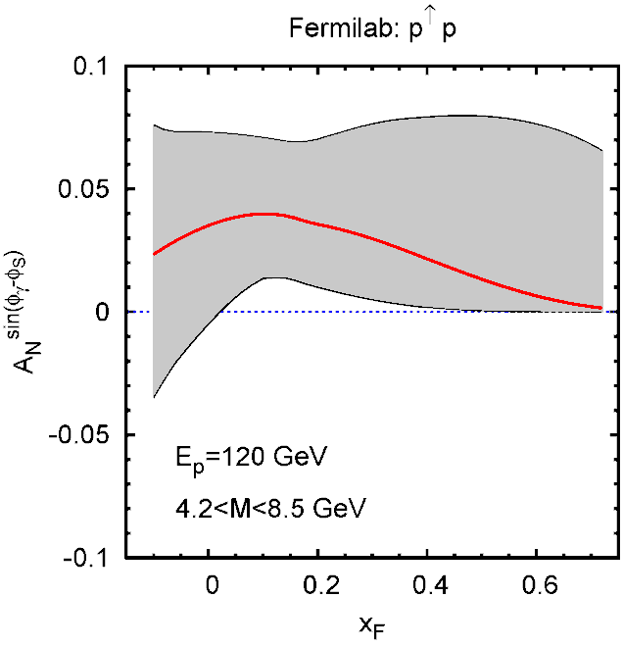
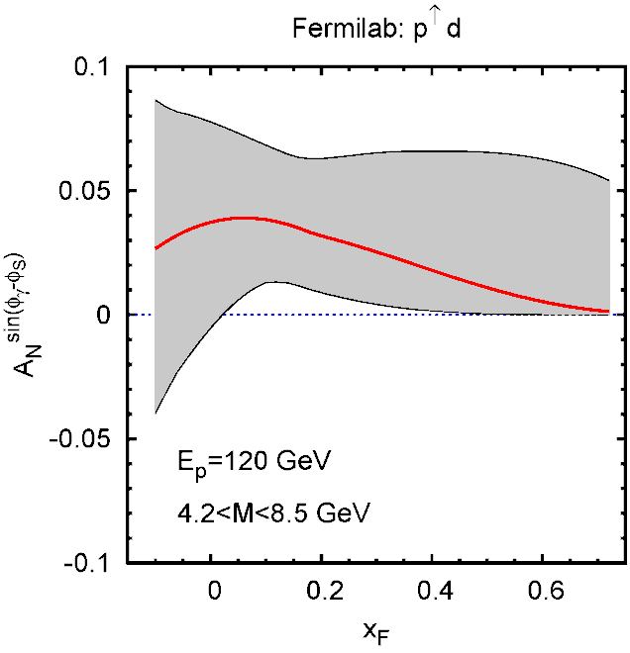
Sivers Function
described by transverse-momentum dependent distribution function
captures non-perturbative spin-orbit coupling effects inside a polarized proton
leads to a sin (φ – φ_{S}) asymmetry in SIDIS and Drell-Yan
done in SIDIS (HERMES, COMPASS)
Sivers function is time-reversal odd
leads to sign change
fundamental prediction of QCD (goes to heart of gauge formulation of field theory)
Predictions based on fit to SIDIS data
FNAL
120 GeV
polarized beam
√s ~ 15 GeV
(hydrogen)
FNAL
120 GeV
polarized beam
√s ~ 15 GeV
(deuterium)
Anselmino et al. priv. comm. 2010

Slide 21
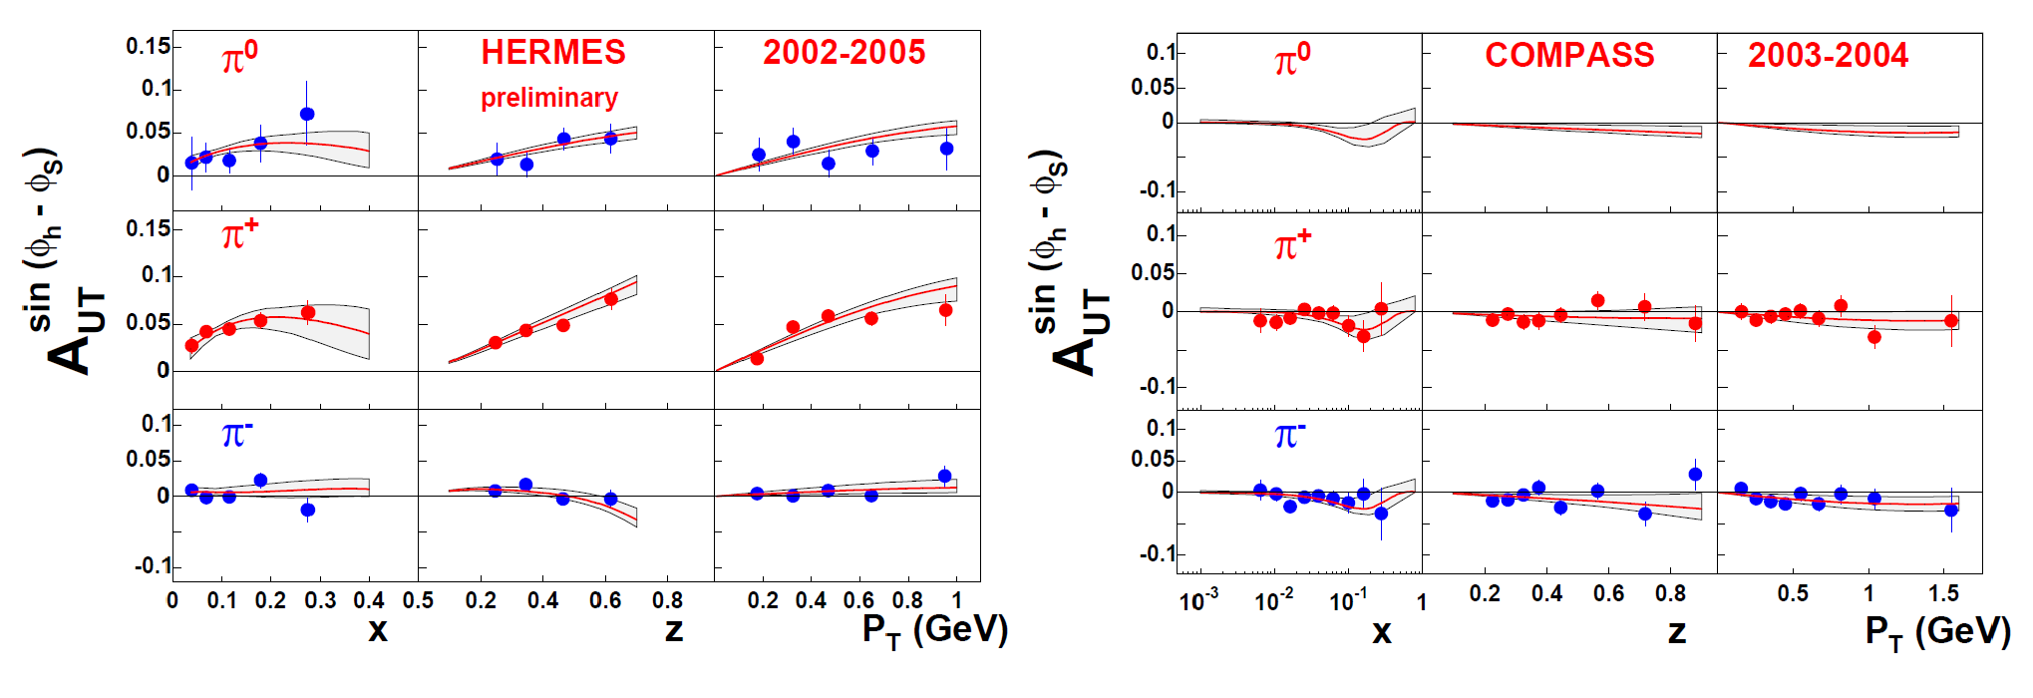
Sivers Asymmetry Measurements
HERMES (p)
COMPASS (d)
Anselmino et al. EPJA 39, 89 (2009)
Global fit to sin (φ_{h} – φ_{S}) asymmetry in SIDIS (HERMES, COMPASS)
u- and d-Sivers DF almost equal size, but different sign (d slightly larger)
Comparable measurements needed for single spin asymmetries in Drell-Yan process
BUT: COMPASS (p) data (2007 & 2100) smaller Sivers asym. than HERMES
maybe due to y or z dependence?
do global fits with all available data

Slide 22
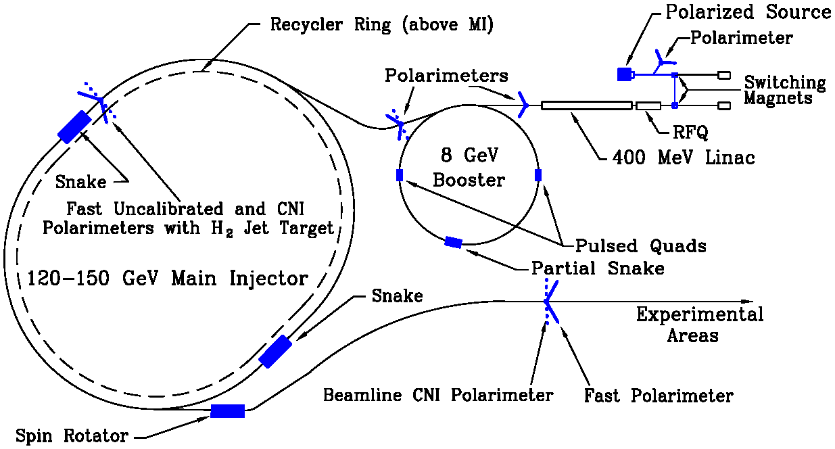
Polarized Drell-Yan at Fermilab Main Injector
Polarize Beam in Main Injector (A. Krisch’s talk)
Use SeaQuest di-muon Spectrometer
fixed target experiment
luminosity: L_{av} = 3.4 x 10³⁵ /cm²/s
I_{av} = 1.6 x 10¹¹ p/s (=26 nA)
N_{p}= 2.1 x 10²⁴ /cm²
approved for 2-3 years of running: 3.4 x 10¹⁸ pot
by 2015: fully understood, optimized for Drell-Yan, and ready to take pol. beam

Slide 23
Polarized Drell-Yan at Fermilab Main Injector - II
SeaQuest di-muon Spectrometer
luminosity: L_{av} = 3.4 x 10³⁵ /cm²/s [I_{av} = 1.6 x 10¹¹ p/s (=26 nA) / N_{p}= 2.1 x 10²⁴ /cm² ]
approved for 3.4 x 10¹⁸ pot
Polarized Beam in Main Injector
use Seaquest spectrometer
use SeaQuest target
liquid H₂ target can take I_{av} = ~5 x 10¹¹ p/s (=80 nA)
1 mA at polarized source can deliver about I_{av} = ~1 x 10¹² p/s (=150 nA) for 100% of available beam time (A. Krisch: Spin@Fermi report in (Aug 2011))
26 μs linac pulses, 15 Hz rep rate, 12 turn injection into booster, 6 booster pulses into Recycler Ring, followed by 6 more pulses using slip stacking in MI
1 MI pulse = 1.9 x 10¹² p
using three 2-s cycles (1.33-s ramp time, 0.67-s slow extraction) /min (=10% of beam time): → 2.8 x 10¹² p/s (=450 nA) instantaneous beam current , and I_{av} = ~0.95 x 10¹¹ p/s (=15 nA)
Scenarios:
L = 2.0 x 10³⁵ /cm²/s (10% of available beam time: I_{av} = 15 nA)
L = 1 x 10³⁶ /cm²/s (50% of available beam time: I_{av} = 75 nA)
x-range:
x_{b} = 0.3 – 0.9 (valence quarks) x_{t} = 0.1 – 0.4 (sea quarks)

Slide 24
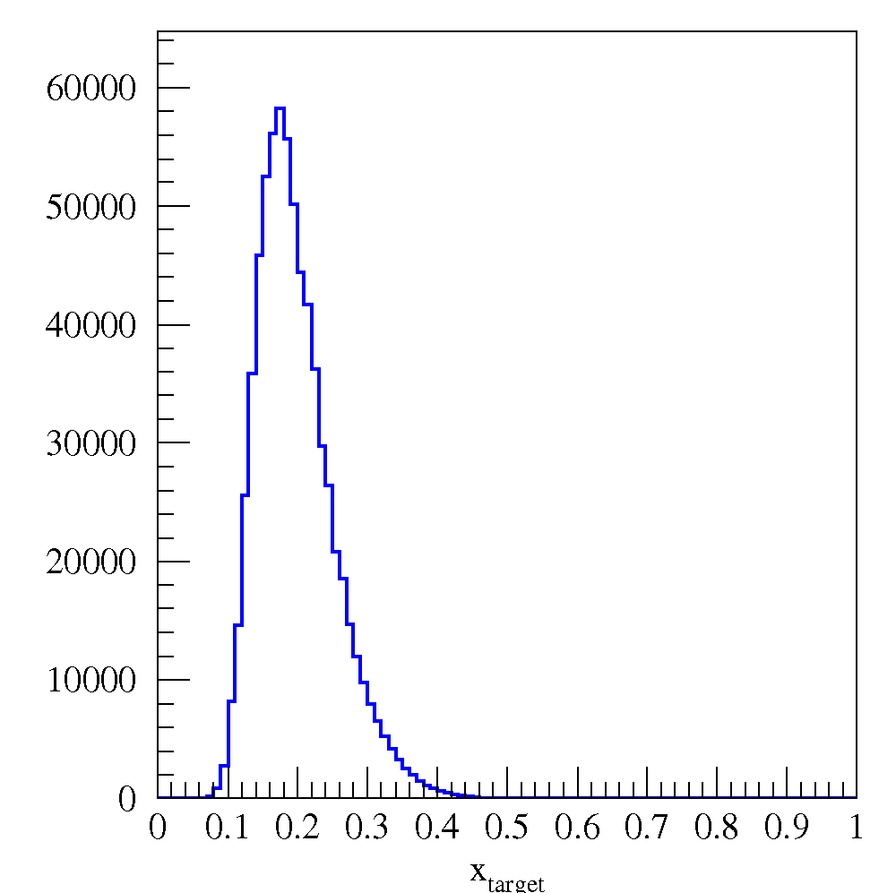
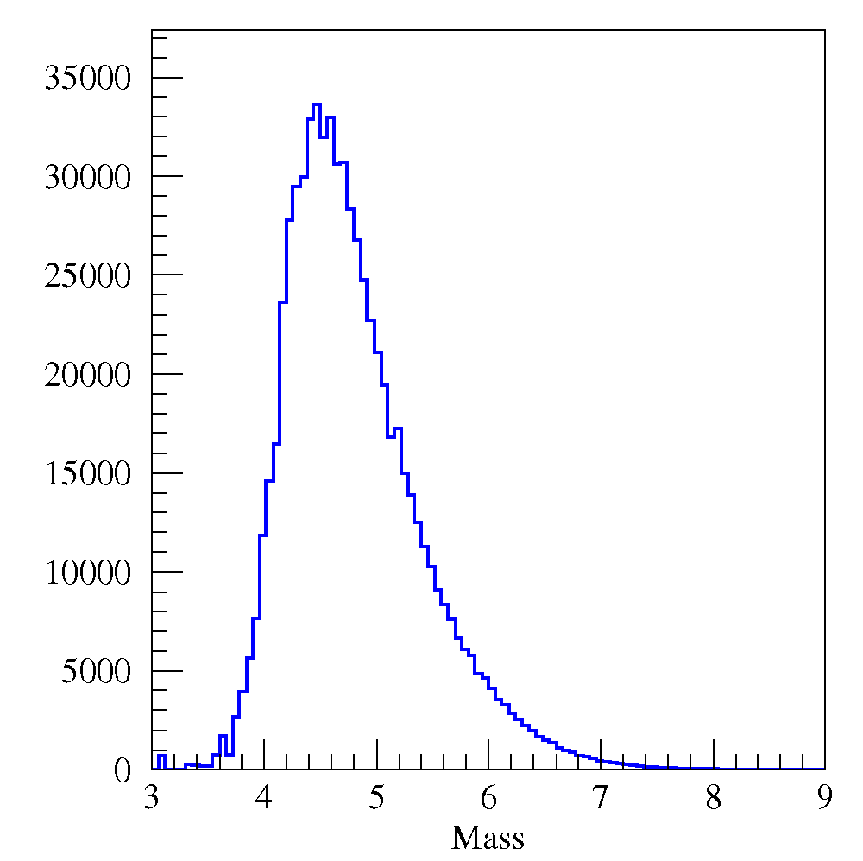
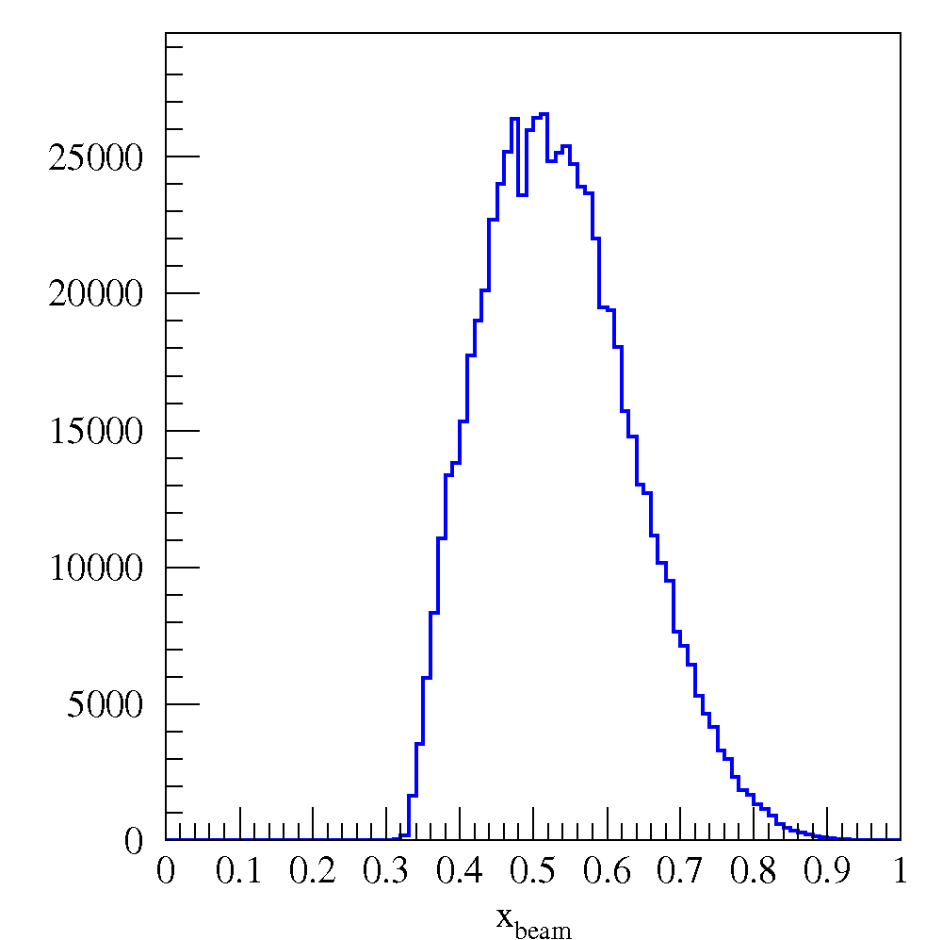
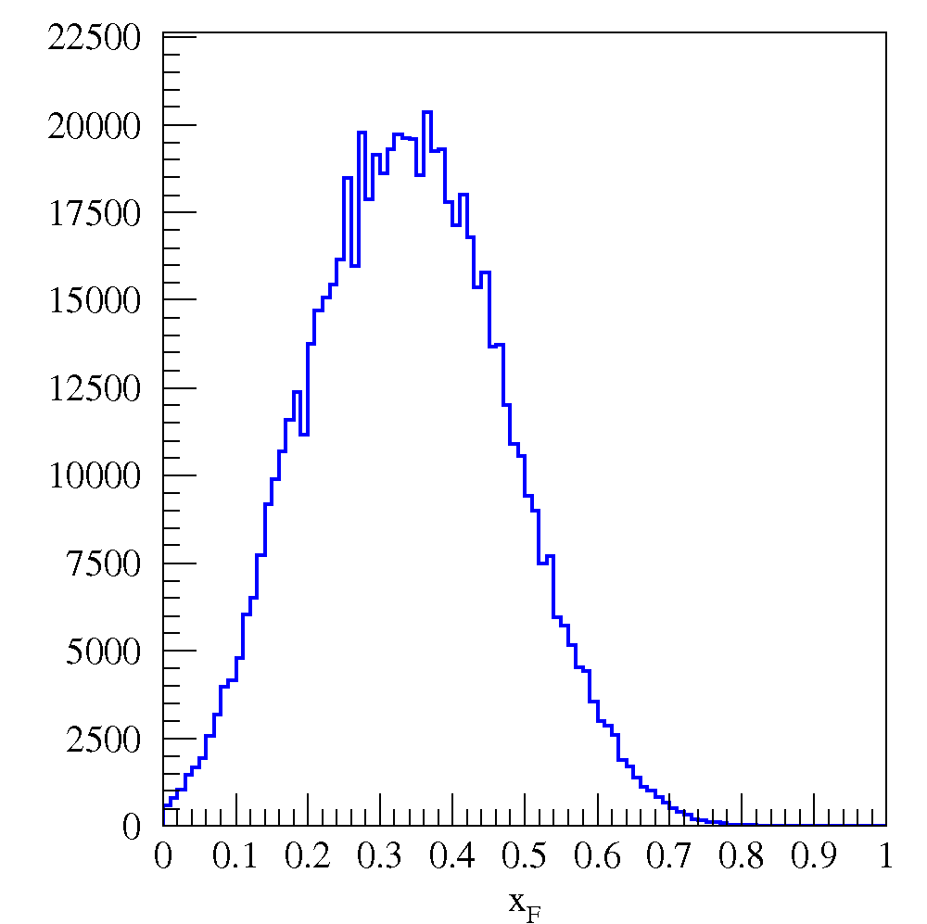
SeaQuest: Drell-Yan Acceptance
Programmable trigger removes likely J/ψ events
Transverse momentum acceptance to above 2 GeV
Spectrometer could also be used for J/ψ, ψ⁰ studies
x_{target}
x_{beam}
x_{F}
Mass

Slide 25
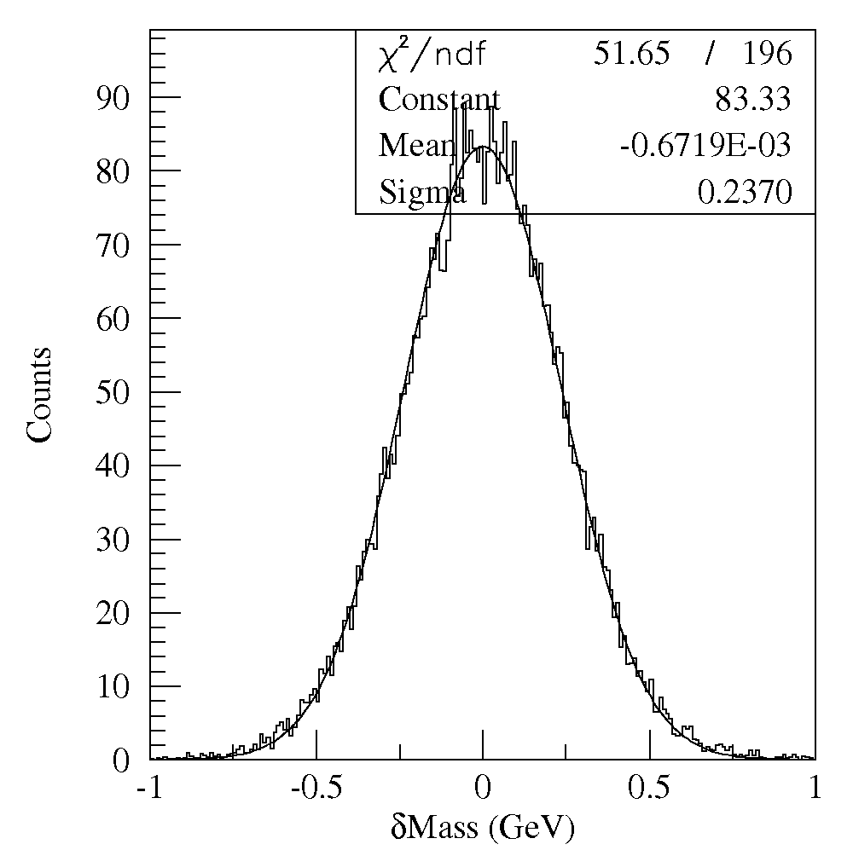
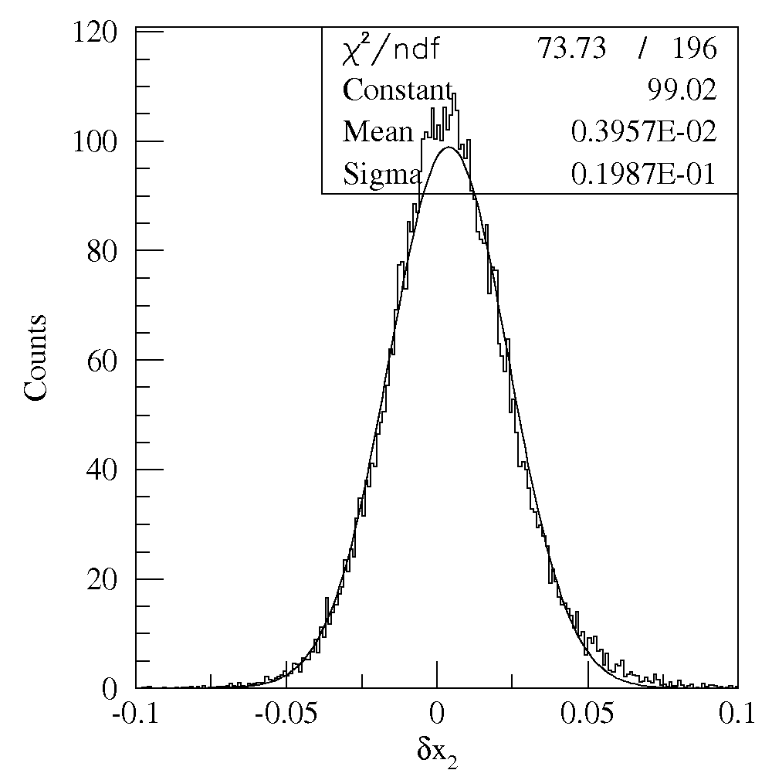
SeaQuest: Detector Resolution
240 MeV
Mass Res.
0.04 x₂ Res.
Triggered Drell-Yan events

Slide 26
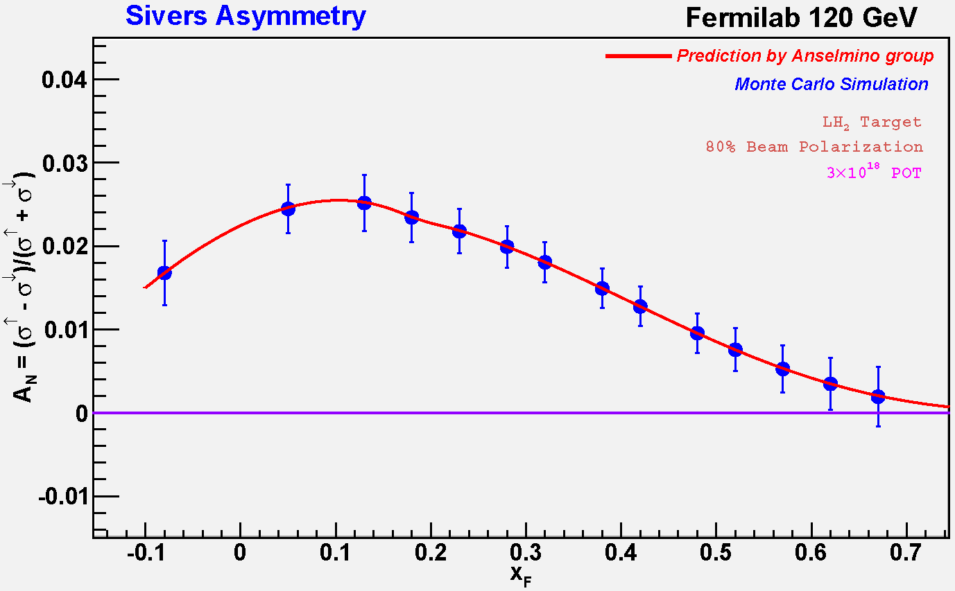
Polarized Drell-Yan at Fermilab Main Injector - III
Experimental Sensitivity
luminosity: L_{av} = 2 x 10³⁵ (10% of available beam time: I_{av} = 15 nA)
100 fb⁻¹ for 5 x 10⁵ min: (= 2 yrs at 50% efficiency)
Can measure not only sign, but also the size & shape of the Sivers function !
Note:
100 fb⁻¹
6.6 Mio DY events
Notes:
Note that SSA A_N^sin(phi-phi_s) is scaled by 2/pi

Slide 27
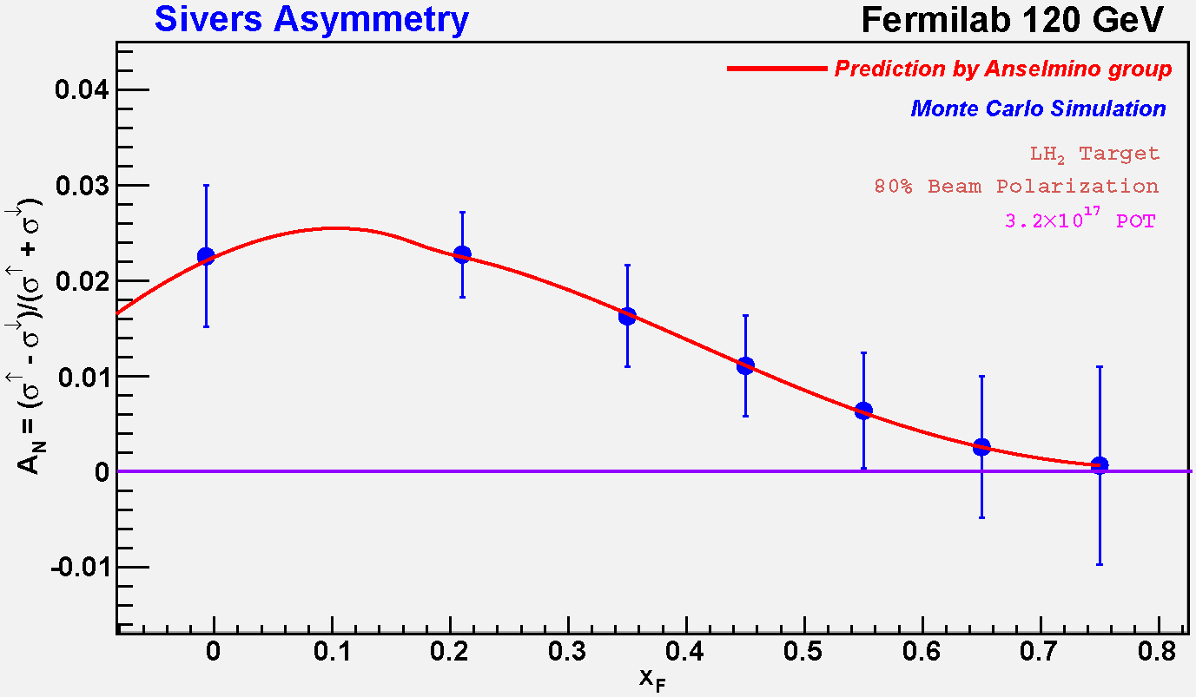
Polarized Drell-Yan at Fermilab Main Injector - III
What if?
luminosity: L_{av} = 2 x 10³⁴ (= 10x lower than expected)
10 fb⁻¹ for 5 x 10⁵ min: (= 2 yrs at 50% efficiency)
Can still measure sign, AND shape of the Sivers function, with 10x less L_{int} !
What if the sign changes, BUT ?
10 fb⁻¹
660k DY events

Slide 28
Planned Polarized Drell-Yan Experiments
experiment | particles | energy | x₁ or x₂ | luminosity | timeline
COMPASS (CERN) | π± + p↑ | 160 GeV √s = 17.4 GeV | x₂ = 0.2 – 0.3 x₂ ~ 0.05 (low mass) | 2 x 10³² cm⁻² s⁻¹ | 2014
PAX (GSI) | p↑ + p_{par} | collider √s = 14 GeV | x₁ = 0.1 – 0.9 | 2 x 10³⁰ cm⁻² s⁻¹ | >2017
PANDA (GSI) | p_{par} + p↑ | 15 GeV √s = 5.5 GeV | x₂ = 0.2 – 0.4 | 2 x 10³² cm⁻² s⁻¹ | >2016
J-PARC | p↑ + p | 50 GeV √s = 10 GeV | x₁ = 0.5 – 0.9 | 1 x 10³⁵ cm⁻² s⁻¹ ? | >2015 ?
NICA (JINR) | p↑ + p | collider √s = 20 GeV | x₁ = 0.1 – 0.8 | 1 x 10³⁰ cm⁻² s⁻¹ | >2014
PHENIX (RHIC) | p↑ + p | collider √s = 500 GeV | x₁ = 0.05 – 0.1 | 2 x 10³² cm⁻² s⁻¹ | >2018
RHIC internal target phase-1 | p↑ + p | 250 GeV √s = 22 GeV | x₁ = 0.25 – 0.4 | 2 x 10³³ cm⁻² s⁻¹ | >2015
RHIC internal target phase-1 | p↑ + p | 250 GeV √s = 22 GeV | x₁ = 0.25 – 0.4 | 3 x 10³⁴ cm⁻² s⁻¹ | >2018
A_{n}DY RHIC (IP-2) | p↑ + p | collider √s = 500 GeV | x₁ = 0.1 - 0.3 | 2 x 10³² cm⁻² s⁻¹ | 2013
SeaQuest (unpol.) (FNAL) | p + p | 120 GeV √s = 15 GeV | x₁ = 0.3 – 0.9 X₂ = 0.1 – 0.45 | 3.4 x 10³⁵ cm⁻² s⁻¹ | 2011
pol. SeaQuest (FNAL) | p↑ + p | 120 GeV √s = 15 GeV | x₁ = 0.3 – 0.9 | 1 x 10³⁶ cm⁻² s⁻¹ | >2014

Slide 29
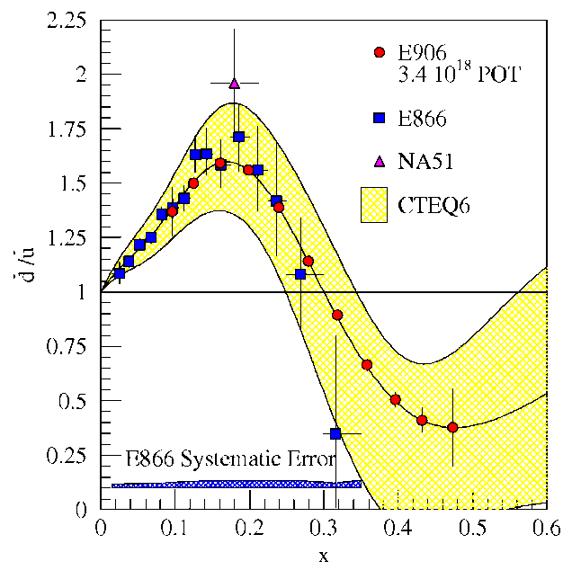
Drell-Yan fixed target experiments at Fermilab
What is the structure of the nucleon?
What is ?
What is the origin of the sea quarks?
What is the structure of nucleonic matter?
Where are the nuclear pions?
Is anti-shadowing a valence effect?
SeaQuest: 2011 - 2014
significant increase in physics reach
Beyond SeaQuest
Polarized beam at Fermilab Main Injector
Polarized target at Main Injector
high-luminosity Drell-Yan program: complementary to spin programs at RHIC and JLAB
Notes:
While providing direct input to the parton distributions fits, the ultimate impact of E906 will be to provide a better understanding on the physical mechanism which generates the sea of the proton.

