Slide 1
CAN WE UNDERSTAND THE PAMELA POSITRON EXCESS AS WINOS?
Gordy Kane
January 2009
Ann Arbor
arXiv 0812.4555, see also 0807.1509
Phill Grajek, Aaron Pierce, Dan Phalen, Scott Watson

Slide 2
LSP, WINO LSP, VERY WELL MOTIVATED FOR DARK MATTER
-- over two decades
-- anomaly mediated supersymmetry breaking
-- “split” supersymmetry
-- M theory compactified on G₂ manifold
-- MSSM scan – Hewett, Rizzo et al
EXCESS GALACTIC POSITRONS LONG AGO PREDICTED AS SIGNAL OF LSP DARK MATTER
NAIVELY, CURRENT SIGNAL + CONSTRAINTS DO NOT SEEM TO DESCRIBE DATA WELL
BUT SHOULD NOT QUICKLY DISCARD SUCH AN ATTRACTIVE EXPLANATION

Slide 3
CAN A WINO LSP DESCRIBE THE PAMELA DATA?
Rate – too small with thermal equilibrium cosmology and standard propagation parameters, even though wino annihilates well into e⁺
normalize to local relic density – right procedure if most LSPs of non-thermal origin, e.g. moduli decay
we use no “boost factors” – small, energy dependent boost factors may actually be appropriate, and would help noticeably
Antiprotons – no apparent signal – with somewhat different propagation parameters, factor 1.5 large -- OK simultaneously with rate? Note positrons and antiprotons have different energy loss mechanisms and come from different parts of the galaxy
Gammas? Egret – probably OK? Fermi/GLAST – strong signal expected
Synchrotron radiation – OK with somewhat different magnetic field parameters
SO, MAYBE

Slide 4
OTHER ISSUES
ATIC? – we do not describe this
Pulsars – Profumo; Hooper et al
Profile of galaxy dark matter – we use NFW in all calculations – results a little better if profile a little softer

Slide 5
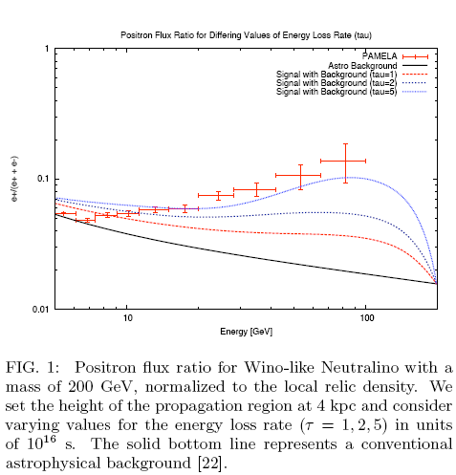
Note NYTimes – local density larger  1.5, v larger
0812.4555
e⁺ /(e⁻⁻ + e⁺ )
τ_{eff}=5
τ_{eff}=1
200
NOTE TURNOVER

Slide 6
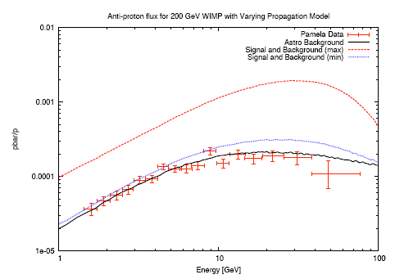
Note -- τ_{eff}=5, vary propagation
(1) factor 5 degeneracy
(2) Wino + background ≈1.5 PAMELA
(3) Conventional background
200 GeV wino + background
Donato et al, =0.85,K₀ =0.0016, L=1, V_{c} =13.5, V_{A} =22.4
Conclude within astrophysical uncertainties antiproton data does not exclude 200 GeV wino

Slide 7
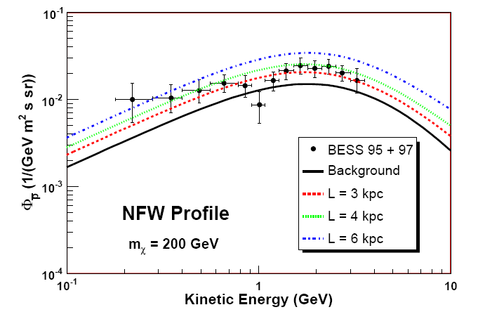
Variation of antiproton flux with height of diffusion cylinder

Slide 8
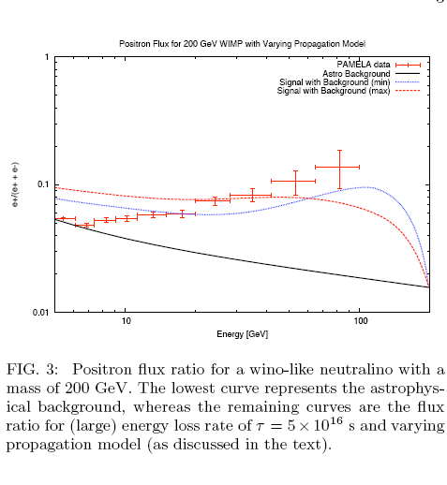
Same parameters as best antiproton description

Slide 9
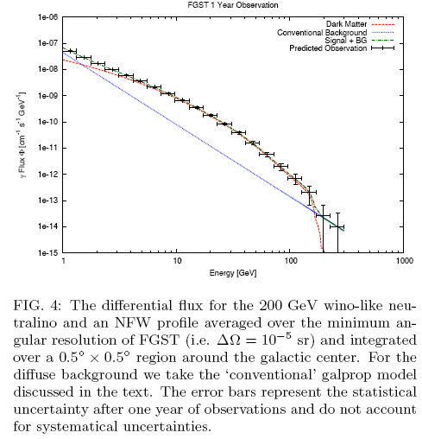
Expect clear excess below 200 GeV

Slide 10
Energy and particle dependent “boost factors”
Bergstrom, Edjso et al
Lavalle et al
Cosmic ray propagation depends on particle, energy
Positrons – nearby
Antiprotons – distance increases with energy
Lavalle et al consider distribution of clumps semi-analytically and with simulations
arXiv: 0709.3634 0808.0332 0812.3576

Slide 11
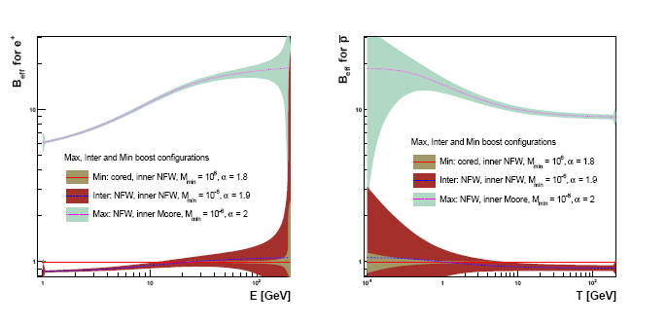
J. Lavalle et al
Antiproton “boost factors”
Positron “boost factors”

Slide 12
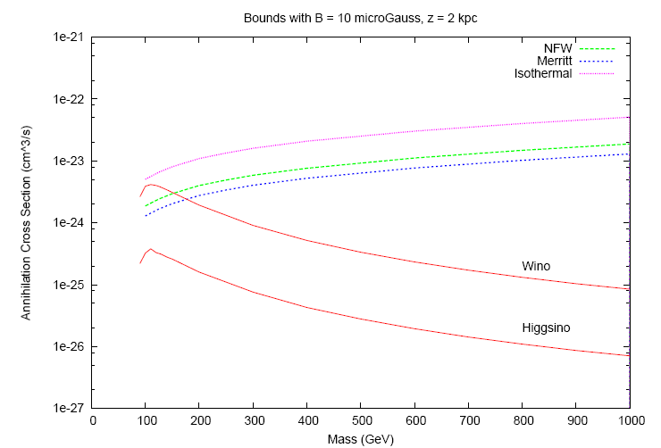
0807.1508
[U_{B} /(U_{rad} + U_{B} )=0.1]
Synchrotron radiation constraint
Allowed for masses with wino line below limit, e.g. green line

Slide 13
If wino LSP describes data, then probably need wino mass about 200 GeV – constraints worse for lower mass, rate smaller for larger mass
Can get satisfactory agreement with all positron, antiproton, gamma data separately
Showing can get good simultaneous agreement with all data and constraints is major computing problem – work underway

Slide 14
Dark matter at LHC
Is what is seen at LHC same as in indirect data?
Can we calculate the relic density?

Slide 15
LHC phenomenology of wino LSP well known
Early  1999, 2000
Moroi-Randall
Feng Moroi Randall Strassler
Ghergetta, Giudice, Wells
Recent
Yanagida et al ph/0610277
Acharya et al 0801.0478
Chargino, LSP nearly degenerate, so hard to see
Find via gluino, its decays as trigger – M_{gluino} ranges from about 2 to about 9 M_{wino} in models

Slide 16
CONCLUDE: premature to exclude wino LSP DM – still a promising candidate to describe PAMELA data including constraints
IMPROVED EXPERIMENTAL TESTS
VERY SOON:
PAMELA larger energy positrons 100-200 GeV – must see “turnover” (or flattening if one bin)
PAMELA higher energy electrons
Fermi/GLAST
Pulsar data
SOON
LHC
AMS-02

Slide 17
THEORY ISSUES:
Non-thermal cosmology – any string theory, any supersymmetric theory? – seems to be so for supersymmetric theories that address EWSB, baryogenesis, inflation, etc
-- dark matter still annihilates after scalar, moduli decays, to equilbrium, so result characterized by decay temperature rather than freeze-out temperature – relic density still determined by _{ann} , M_{pl} , T → “wimp miracle”
-- existence proof: M-theory compactified on G2 manifold → wino LSP, relic density about right. most LSP’s from moduli decay 0804.0863
Energy dependent boost factors – increase for positrons, decrease for antiprotons
Galactic propagation for signals, backgrounds – understand degeneracies, produce detailed comprehensive model

Slide 18
If the PAMELA excess is indeed due to a wino LSP the implications are remarkable
Would have learned that the dark matter, about a fifth of the universe, is the W superpartner, and it approximate mass
Discovery of supersymmetry – guarantees can study superpartners at LHC
Would have learned that the universe had a non-thermal cosmological history, one we can probe
Conservative interpretation:
Keep LSP DM until clearly fails – not there yet – maybe successful
Comprehensive underlying theory generically suggests non-thermal origin of DM

Slide 20
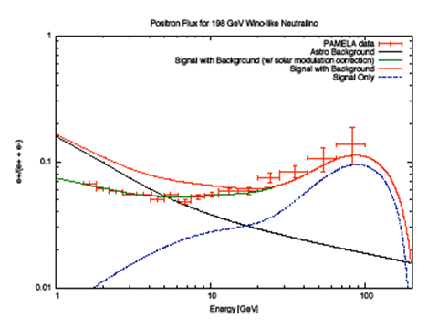
Rate “normalized” to local relic density, no “boost factor”
signal
Including solar wind effect from Clem et al 1996
Grajek, Kane, Pierce, Phalen, Watson

Slide 21
Calculate DM thermal relic density, as universe cools and expands
Leads to few percent of observed relic density for wino LSP

Slide 22
But moduli also give LSPs [
In G₂ moduli have vacuum value of order 20 in Planck scale units, mass (size of oscillation around minimum of potential) ≈ 50 TeV, decay
BR (moduli → superpartners) ≈ 25%

Slide 23
Finally moduli decays give most of relic density

