Slide 1
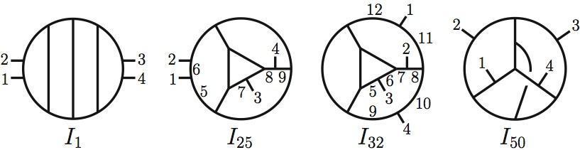
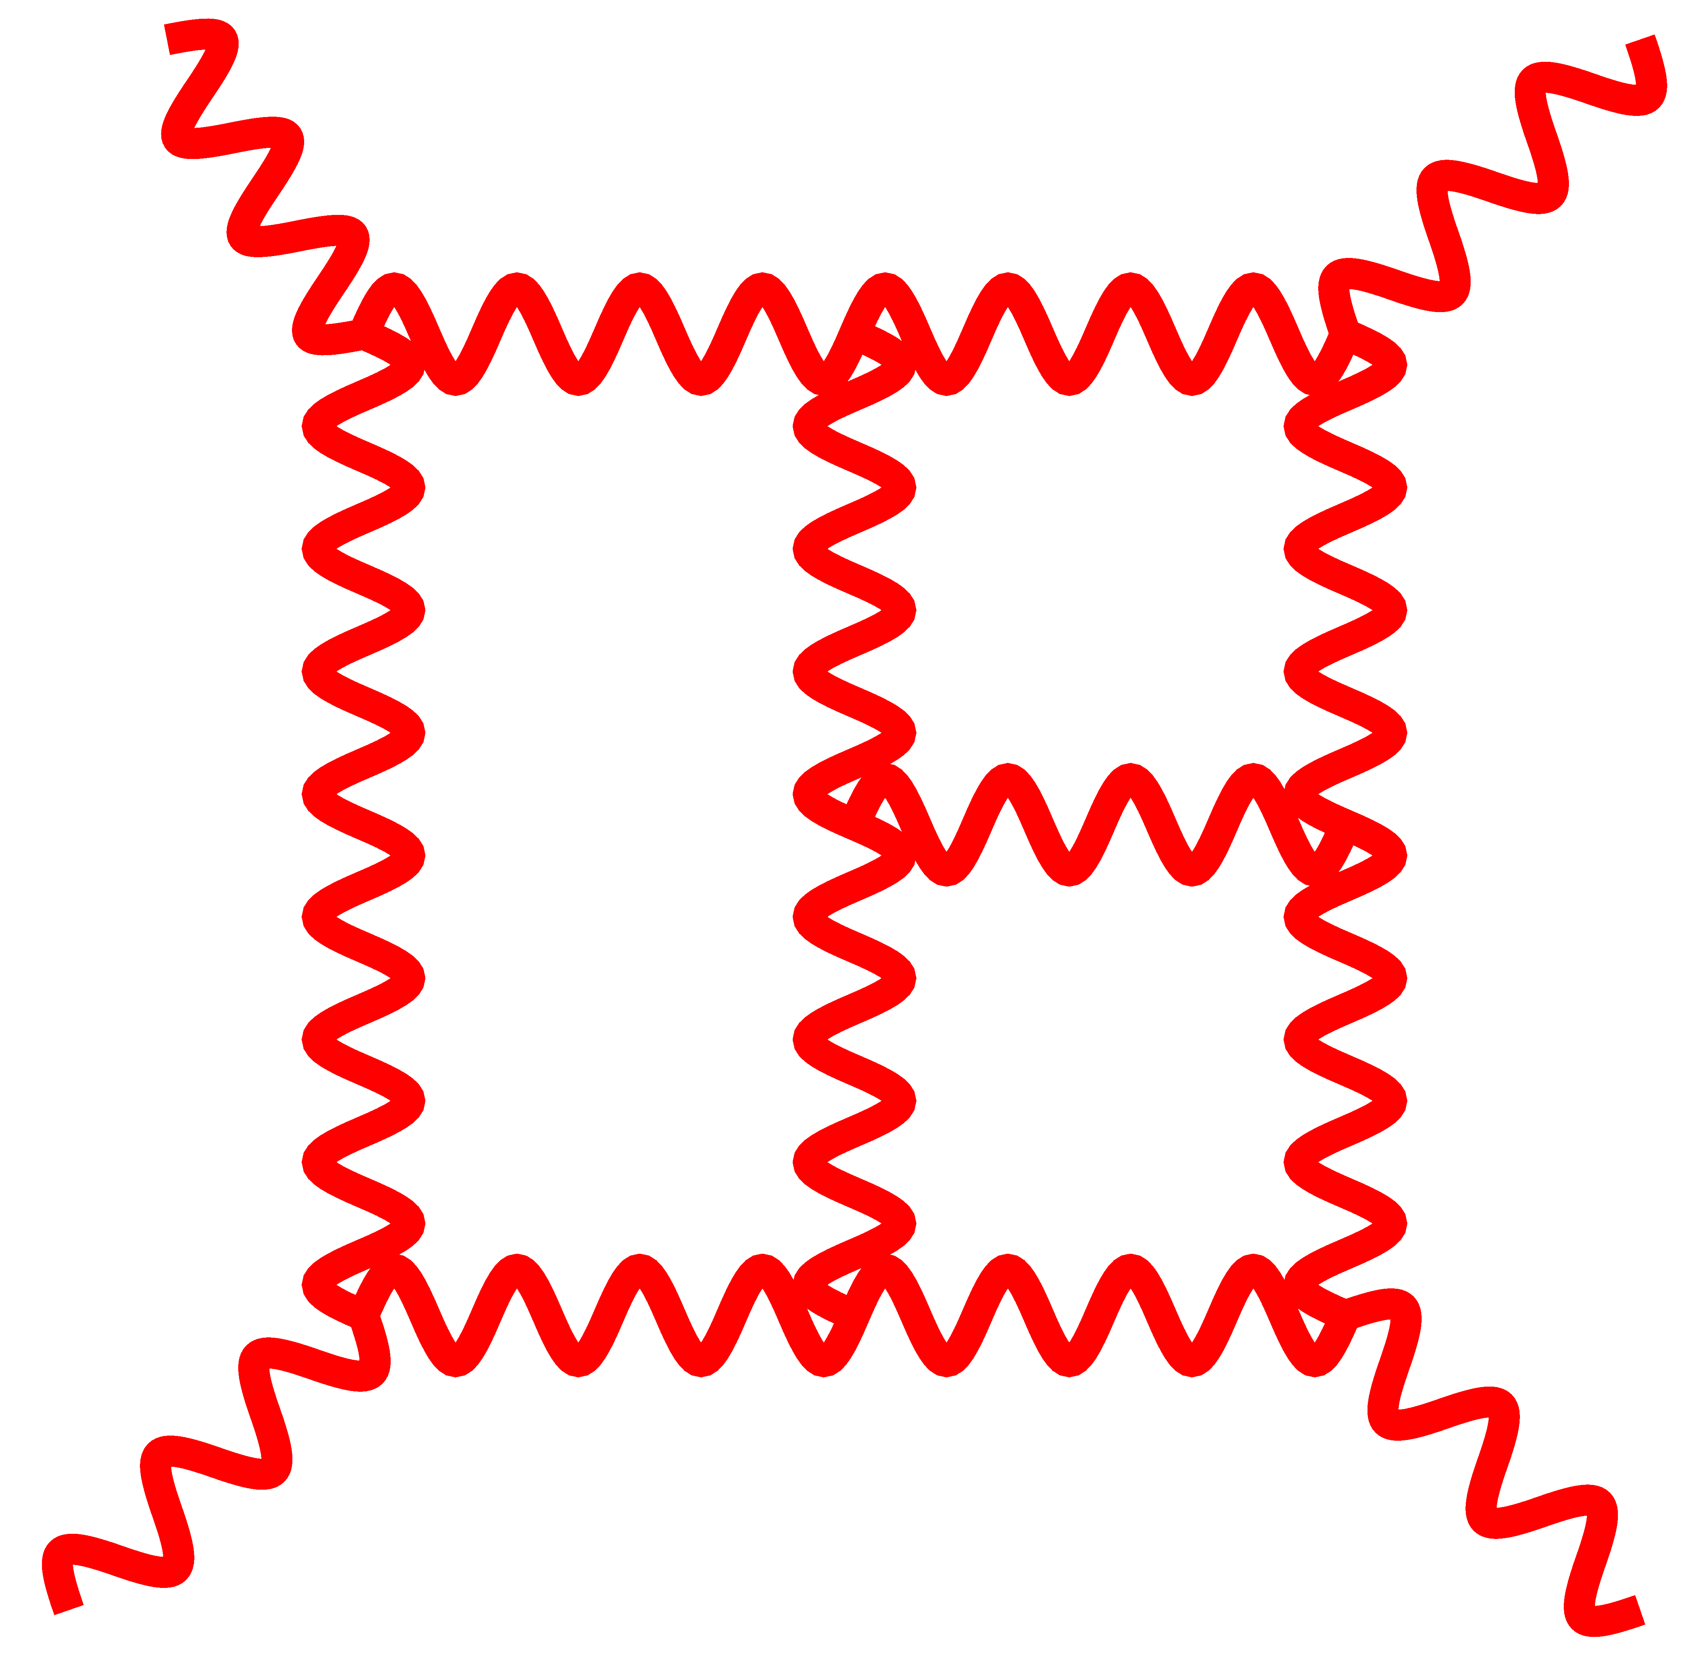
Gravity from Gauge Theory and UV Properties
Amplitudes 2011
November 13, 2011
Zvi Bern, UCLA
ZB, J. J.M. Carrasco, L. Dixon, H. Johansson, and R. Roiban ,
arXiv:0905.2326, arXiv:1008.3327, and to appear
ZB, J.J.M. Carrasco and H. Johansson, arXiv:0805.3993 anf arXiv:1004.0476
ZB, T. Dennen, Y.-t. Huang, M. Kiermaier, arXiv:1004.0693
ZB, C. Boucher-Veronneau, H. Johansson arXiv:1107.1935
ZB, T. Dennen, S. Davies, Y.-t. Huang, in progress
ZB, J. J.M. Carrasco, L. Dixon, H. Johansson, and R. Roiban , in progress
TexPoint fonts used in EMF.
Read the TexPoint manual before you delete this box.: AAAAAAAA
Notes:
Fix ref

Slide 2
Outline
See talks from Henrik Johansson,
Camille Boucher-Veronneau,
Stephan Stieberger, Rutger Boels
Review of BCJ duality.
Gravity amplitudes as double copies of gauge theory.
Generalized gauge invariance.
A very neat one-loop example.
UV properties of N = 4 supergravity.
Status of 5 loop N = 8 supergravity computation.

Slide 3
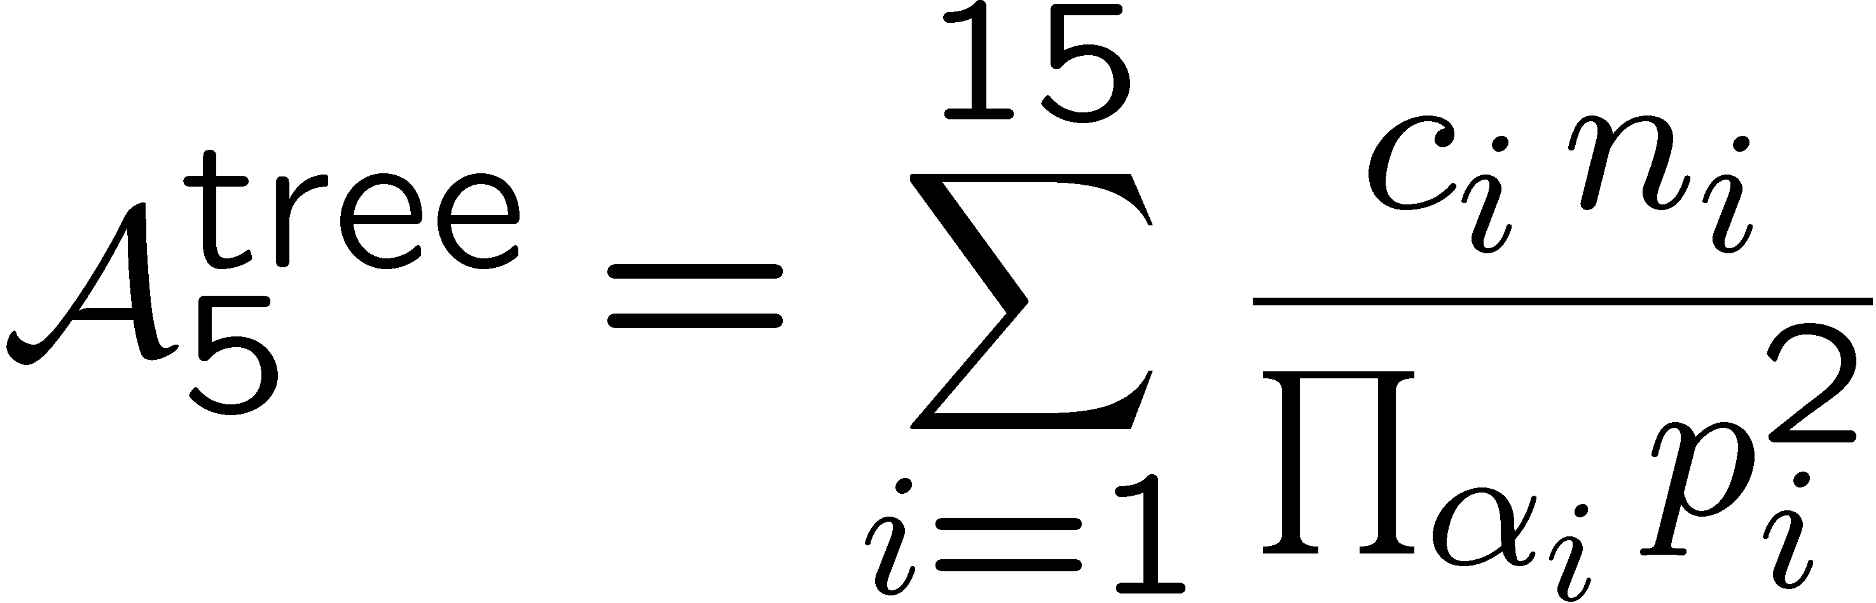
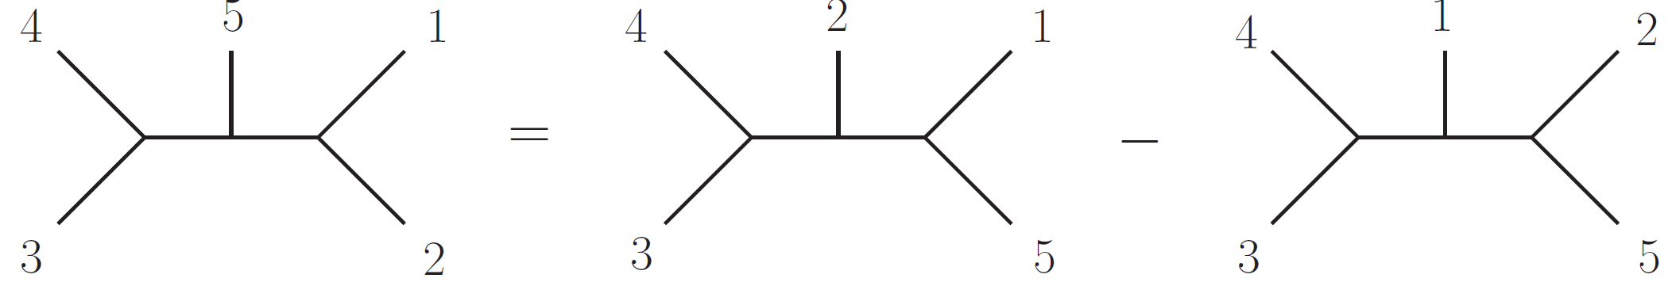
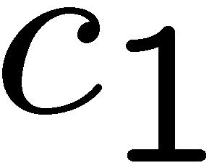
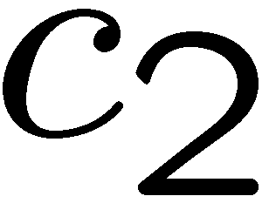
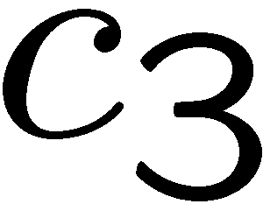
Duality Between Color and Kinematics
Consider five-point tree amplitude:
BCJ
color factor
kinematic numerator factor
Feynman propagators
⇔
Claim: We can always find a rearrangement so color and
kinematics satisfy the same Jacobi constraint equations.
Nontrivial constraints on amplitudes in field theory and string theory
BCJ, Bjerrum-Bohr, Feng,Damgaard, Vanhove, ; Mafra, Stieberger, Schlotterer;
Tye and Zhang; Feng, Huang, Jia; Chen, Du, Feng; Du ,Feng, Fu; Naculich, Nastase, Schnitzer
Notes:
Very nontrivial. Add refs.

Slide 4

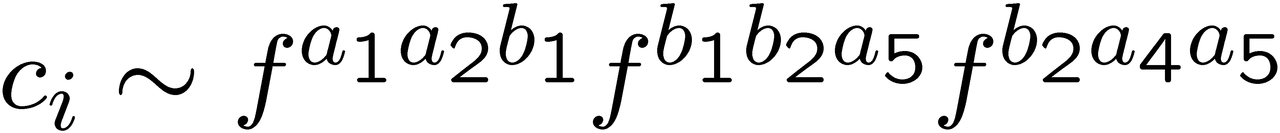

BCJ
Gravity and Gauge Theory
kinematic numerator
color factor
gauge
theory:
sum over diagrams
with only 3 vertices
Assume we have:
Then:
kinematic numerator of second gauge theory
Proof: ZB, Dennen, Huang, Kiermaier
gravity:
Gravity numerators are a double copy of gauge-theory ones!
This works for ordinary Einstein gravity and susy versions!
Cries out for a unified description of the sort given by string theory!
Notes:
Ordinary Einstein Gravity! Nontrivial beyond four points

Slide 5
Summary of Tree Checks and Understanding
1) Nontrivial consequences for tree amplitudes
BCJ
Proven using on-shell recursion and also string theory.
Bjerrum-Bohr, Damgaard,Vanhove; Steiberger; Sondergaard,; Chen, Du, Feng; Feng, Huang, Jai
2) Proof of gravity double-copy formula.
String theory understanding of duality.
Explicit formulas for numerators in terms of amplitudes.
Construction of Lagrangians with duality and double copy
properties, valid through 6 point trees.
6) In self-dual case, identification of symmetry.
ZB, Dennen, Huang, Kiermaier
Tye and Zhang; Mafra, Schlotterer Stieberger Bjerrum-Bohr, Damgaard, Vanhove, Sondergaard.
Kiermaier; Bjerrum-Bohr , Damgaard, Sondergaard; Mafra, Schlotterer , Stieberger
ZB, Dennen, Huang, Kiermaier
Montiero and O’Connell

Slide 6
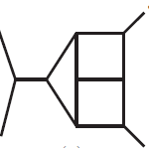

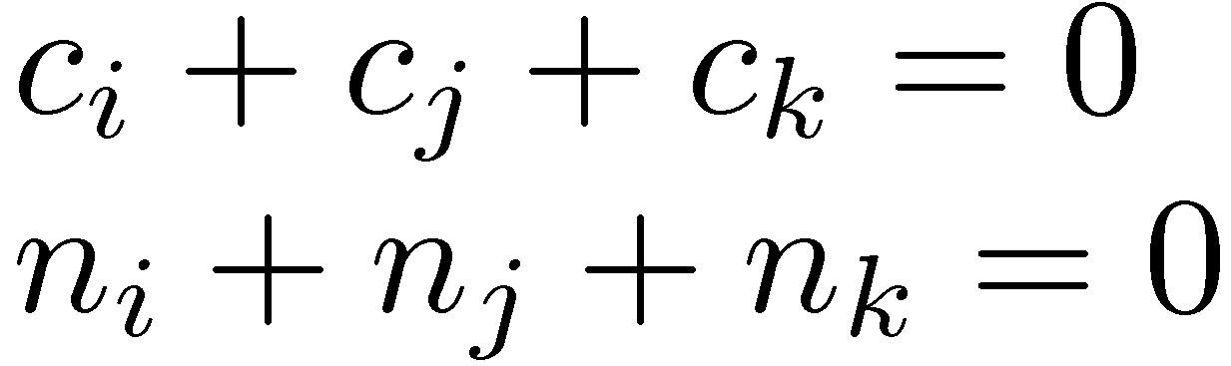
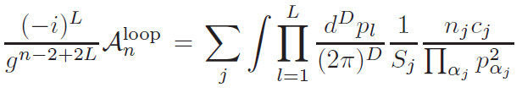
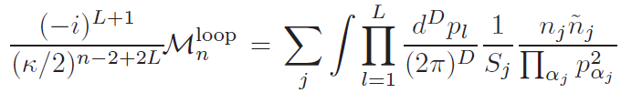
Loop-Level BCJ Conjecture
ZB, Carrasco, Johansson
sum is over
diagrams
kinematic
numerator
color factor
gauge theory
propagators
gravity
symmetry
factor
Loop-level conjecture is identical to tree-level one except
for symmetry factors and loop integration.
Double copy works if numerator satisfies duality.

Slide 7
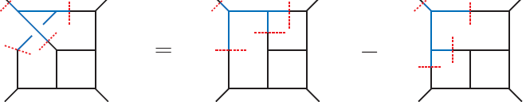
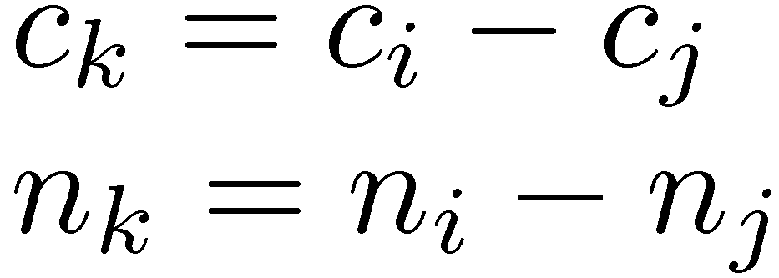
Nonplanar from Planar
BCJ
Planar determines nonplanar
We can carry advances from planar sector to the nonplanar sector.
Only at level of the integrands, so far, but bodes well for the
future

Slide 8
Gravity integrands are trivial!
BCJ
If you have a set of duality satisfying numerators.
To get:
gauge theory gravity theory
simply take
color factor kinematic numerator
Gravity integrands are free!
See Henrik’s and Camille’s talk

Slide 9


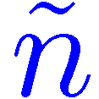
Gravity From Gauge Theory
N = 8 sugra: (N = 4 sYM) (N = 4 sYM)
N = 6 sugra: (N = 4 sYM) (N = 2 sYM)
N = 4 sugra: (N = 4 sYM) (N = 0 sYM)
N = 0 sugra: (N = 0 sYM) (N = 0 sYM)
N = 0 sugra: graviton + antisym tensor + dilaton
In this talk we discuss N = 4,5,6,8 sugra

Slide 10
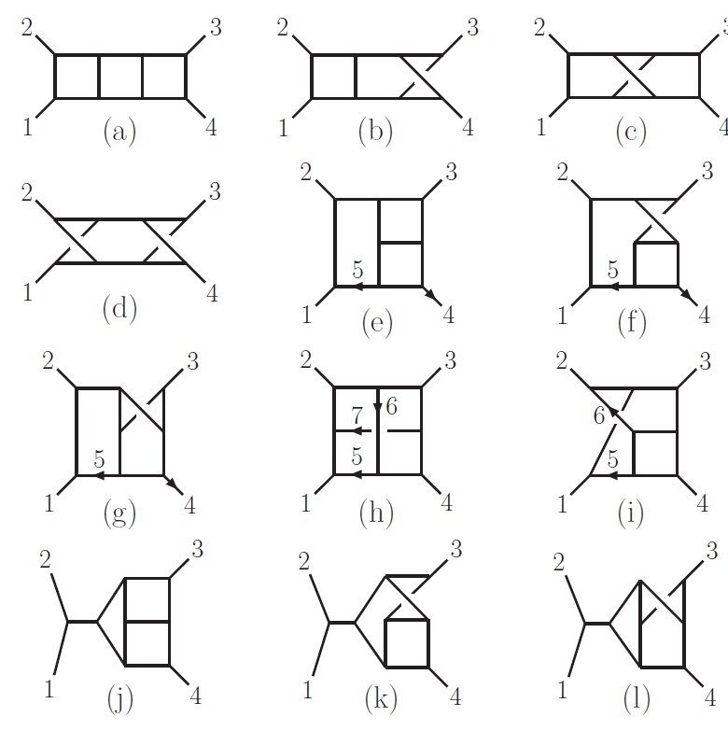
Master diagrams: One diagram to rule them all
ZB, Carrasco, Johansson (2010)
N = 4 super-Yang-Mills integrand
Diagram (e)
is the master
diagram.
Determine the
master numerator
in proper form
and duality
gives all others.
N = 8 sugra given
by double copy.

Slide 11
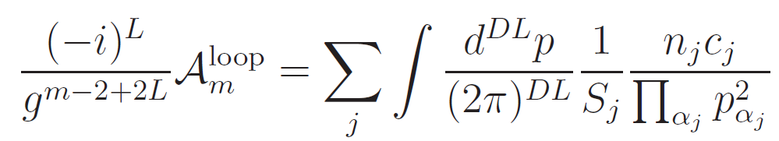

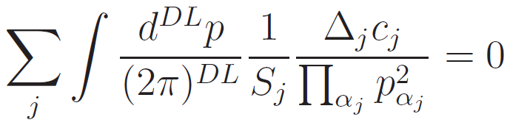
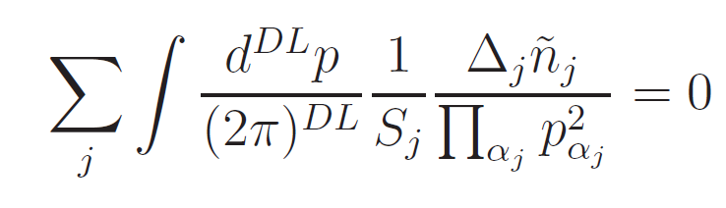
Generalized Gauge Invariance
BCJ
Bern, Dennen, Huang, Keirmaier
Tye and Zhang
gauge theory
Above is just a definition of generalized gauge invariance
gravity
Gravity inherits generalized gauge invariance from gauge theory.
Double copy works even if only one of the two copies has duality
manifest!

Slide 12
Gravity Generalized Gauge Invariance
Key point: Only one copy needs to satisfy BCJ duality. Second
copy can be any valid representation.
Key trick: Choose second copy representation to make calculation
as simple as possible.
Choose representations so that many diagrams vanish!

Slide 13
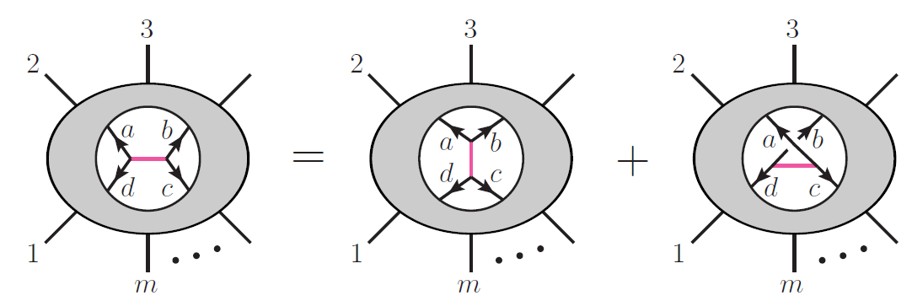
Generalized Gauge Invariance
think of these
as color diagrams
Replace left color factor with other two.
Color factor eliminated Numerator factor vanishes
Any single diagram can be set to zero this way.
In general, all but a small fraction of diagrams can be set to zero.

Slide 14
Implication for Gravity Double Copy
if this numerator vanishes
this numerator
is irrelevant
A trivial but very helpful observation.
Enhanced by using color Jacobi to generate zeros.

Slide 15
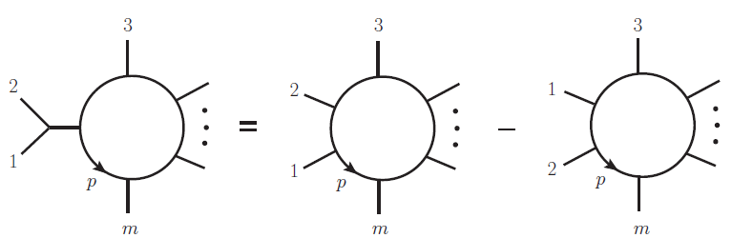
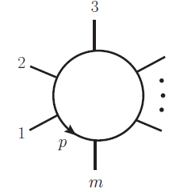
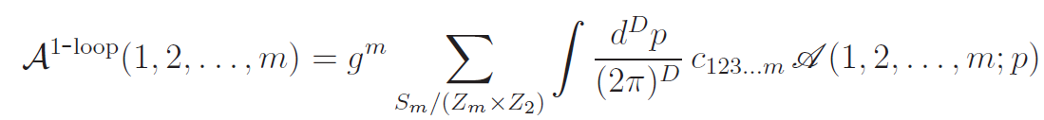
Color Jacobi to Eliminate Diagrams
color
Jacobi identity
m legs
All color factors
expressed in terms of
m-gon color factors
This is color
basis of Del Duca,
Dixon and Maltoni
integrand
only m-gon color factors
All other diagrams effectively set to zero: coefficient of color
factor vanishes.
All terms pushed into m-gons.
ZB, Boucher-Veronneau, Johansson

Slide 16
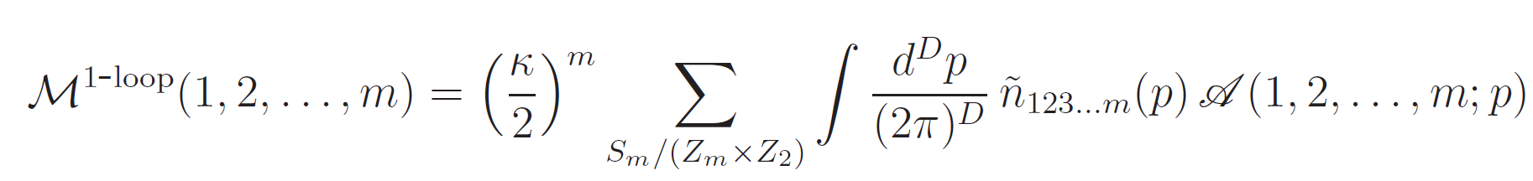

Gravity m-point Consequences
Replace color factor
with numerator factor
General one-loop gravity formula
integrand
Let’s suppose that you had a case where independent of loop momentum
integrated amplitude
Same considerations work at any loop order
Do we have any such cases with where numerators independent
of loop momentum?
Yes, N = 4 sYM 4,5 points at one-loop and 4 points at 2 loops !

Slide 17
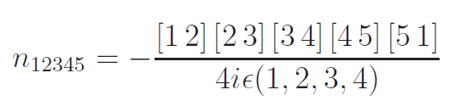
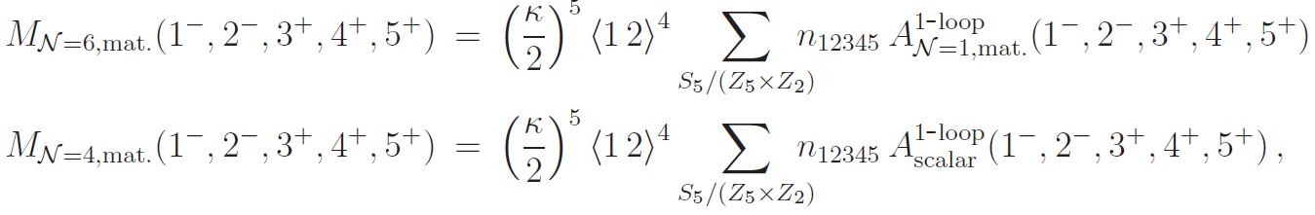
Five-Point Lower Susy Confirmation
ZB, Boucher-Veronneau, Johansson
Integrated expression in terms of basis of scalar integrals:
rational
Carrasco and Johansson
color factor replaced
by N = 4 numerator
known from
Dunbar, Ettle and Perkins (2011)
known from
ZB, Dixon and Kosower (1993)
It works!
Two loop example in Camille’s talk
Naculich, Nastase and Schnitzer have recent paper exploring amplitude
consequences: relations between N 4 sugra and subleading color

Slide 18
Application: UV divergences in supergravity

Slide 19
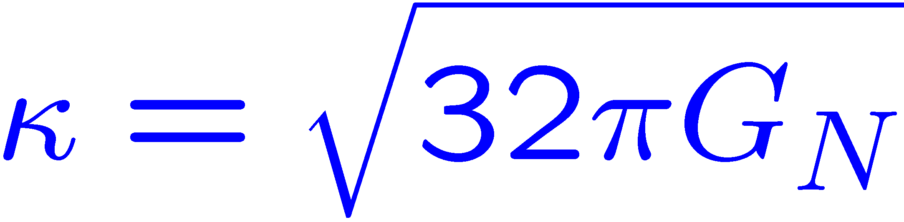
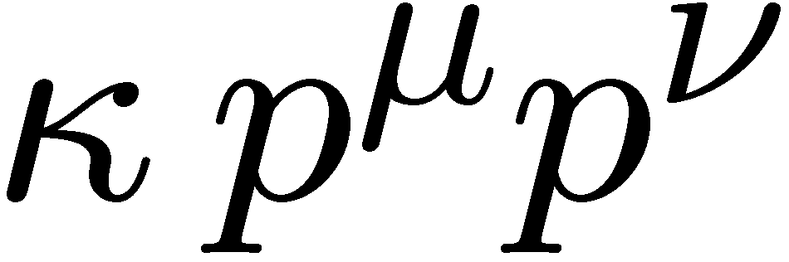
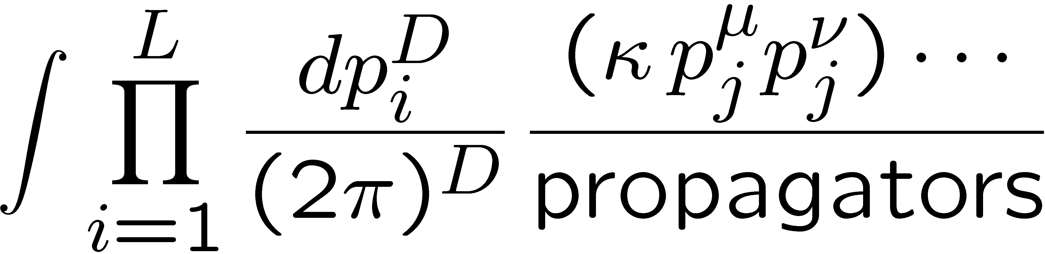
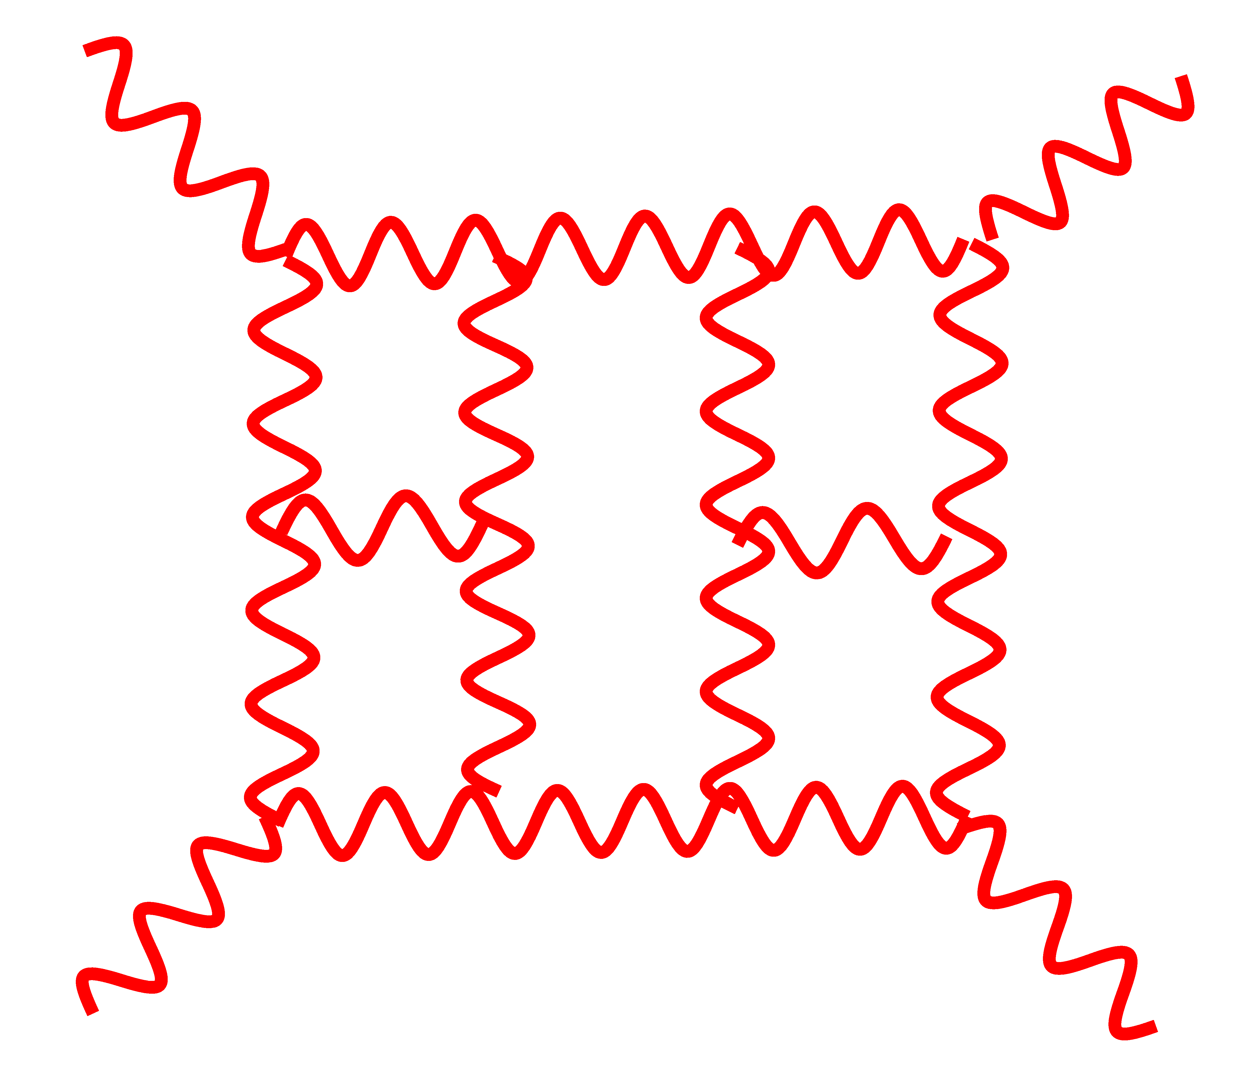
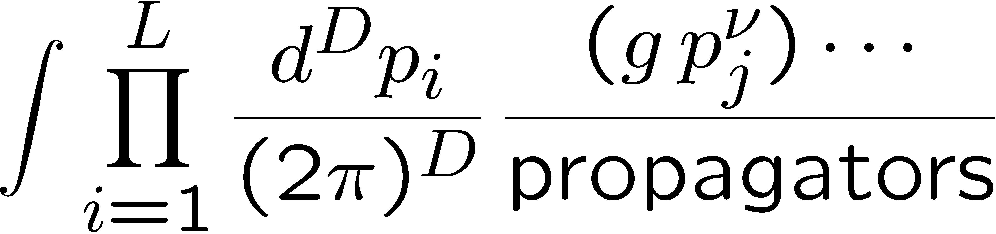
Power Counting at High Loop Orders
Dimensionful coupling
Gravity:
Gauge theory:
Extra powers of loop momenta in numerator
means integrals are badly behaved in the UV.
Non-renormalizable by power counting.
Reasons to focus on N = 8 supergravity:
With more susy expect better UV properties.
High symmetry implies technical simplicity.

Slide 20

Complete Three-Loop Result
ZB, Carrasco, Dixon, Johansson, Kosower, Roiban (2007)
Obtained via on-shell unitarity method:
Three loops is not only
ultraviolet finite it is
“superfinite”— finite for
D < 6.
At the time this calculation
was nontrivial.
Let’s trivialize it

Slide 21
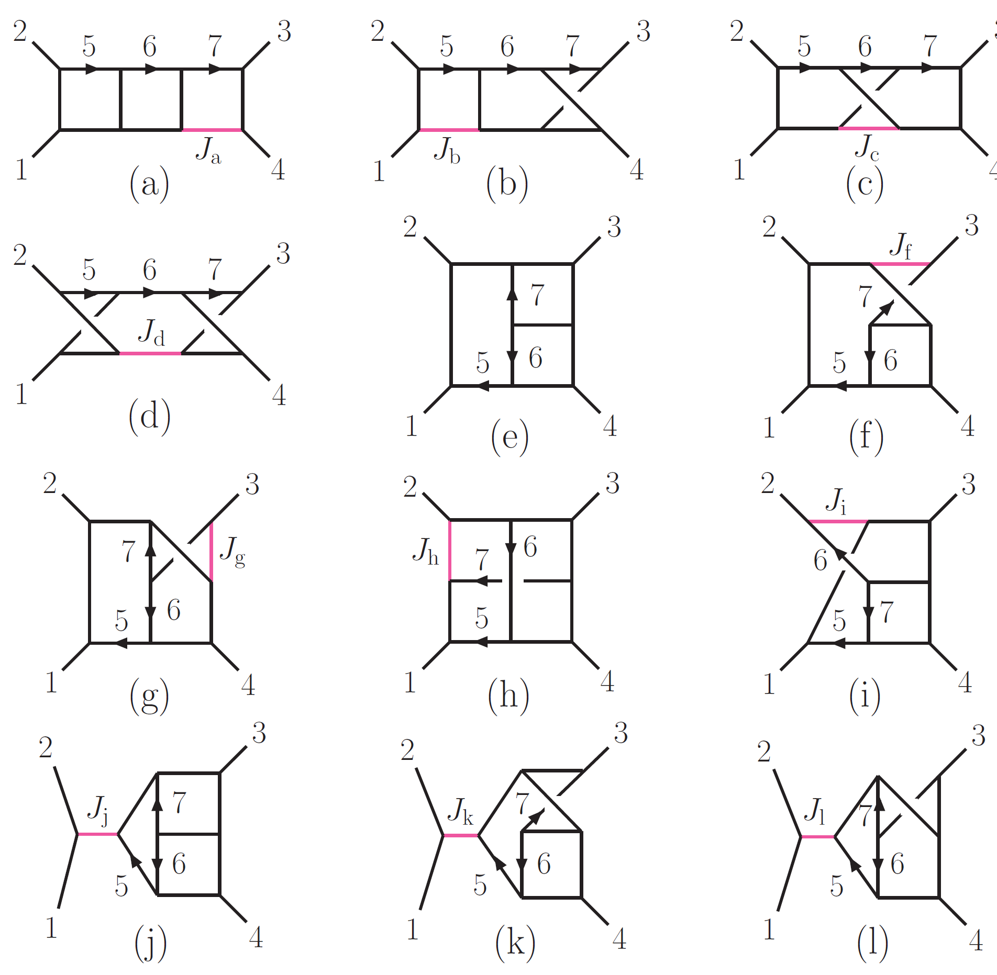
One diagram to rule them all
ZB, Carrasco, Johansson (2010)
N = 4 super-Yang-Mills integrand
Let’s review
the modern way
to obtain this
amplitude.
We need only
Diagram (e) and
we have them all
for free.

Slide 22
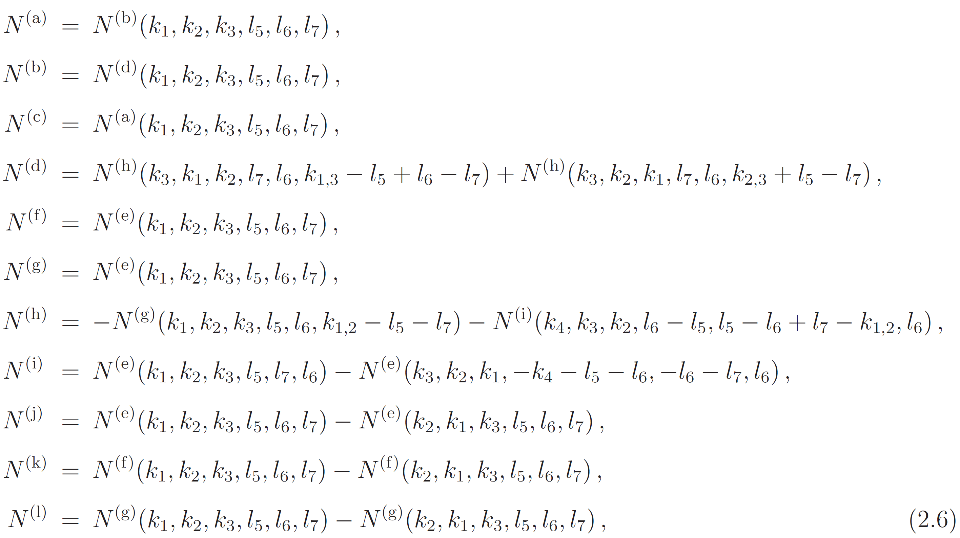
One diagram to rule them all
triangle subdiagrams
vanish in N = 4 sYM
All numerators solved in terms of numerator (e)

Slide 23
One diagram to rule them all
2
3
All other diagrams
determined from
master diagram
How do we calculate
the amplitude today?
7
6
1
5
(e)
4
Constraints:
Maximal cut correct, use known planar result.
Symmetries of diagrams hold in numerators.
No triangles, no powers of loop momenta in the box subdiagrams.
After removing st A₄^{tree} quartic in momenta (dimensional analysis).
Four parameter ansatz determine the entire amplitude!
Demand no loop momentum in numerator
Only planar information used. Nonplanars free.
Notes:
Check what was used

Slide 24
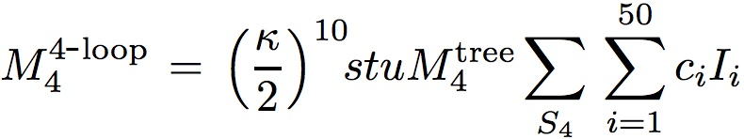
Four-Loop Amplitude Construction
ZB, Carrasco, Dixon, Johansson, Roiban
Get 50 distinct diagrams or integrals (ones with two- or
three-point subdiagrams not needed).
Integral
symmetry factor
leg perms
UV finite for D < 11/2
It’s very finite!
Originally took more than a year. Power count not manifest.
Today we follow exactly the same strategy as described above.
Construction is easy: 86 parameter (or smaller) ansatsz.

Slide 25
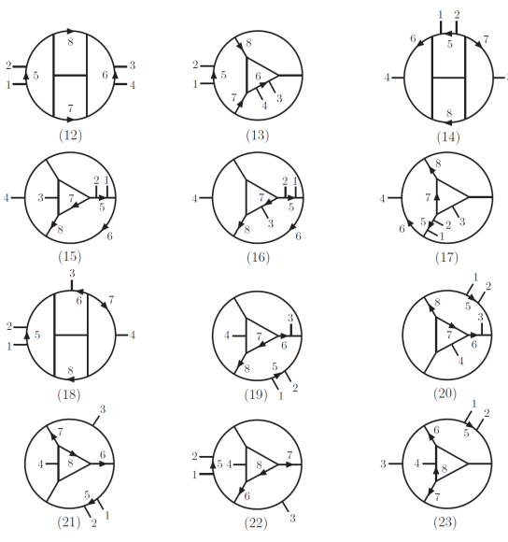
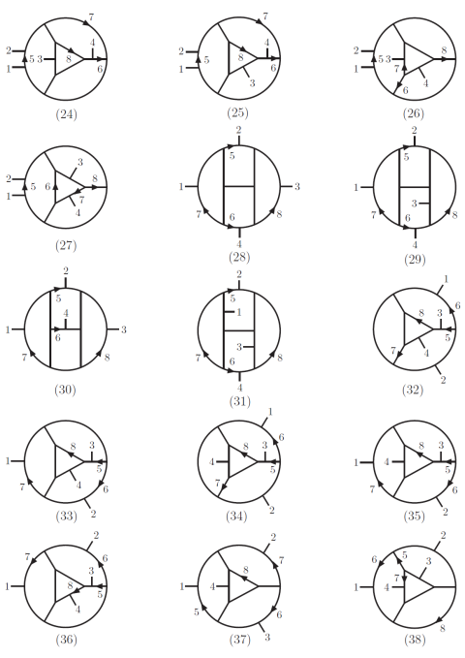
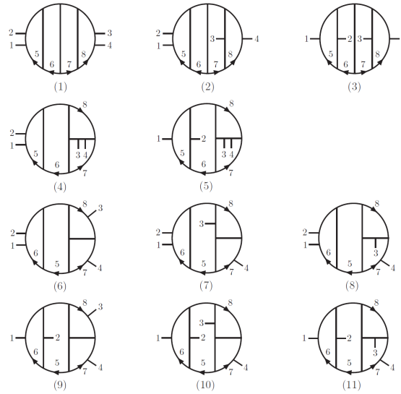
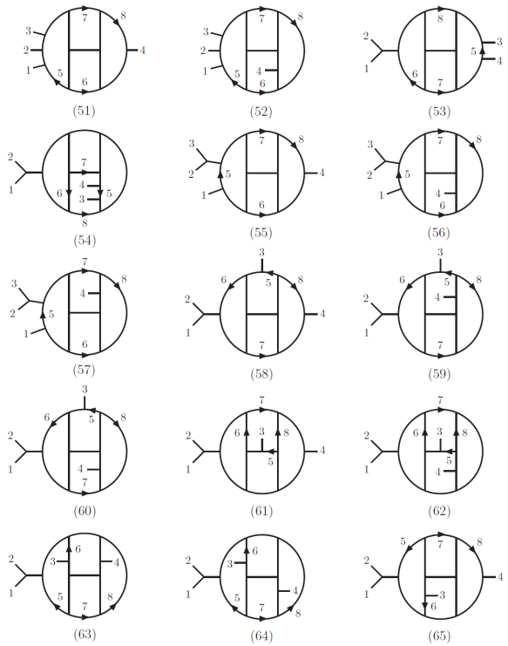
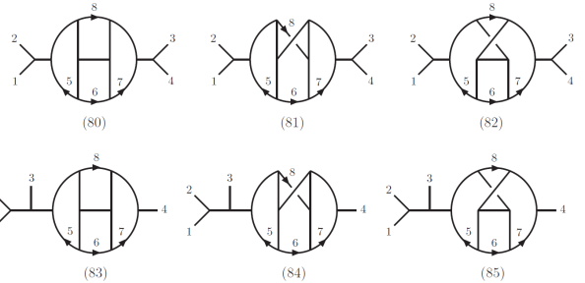
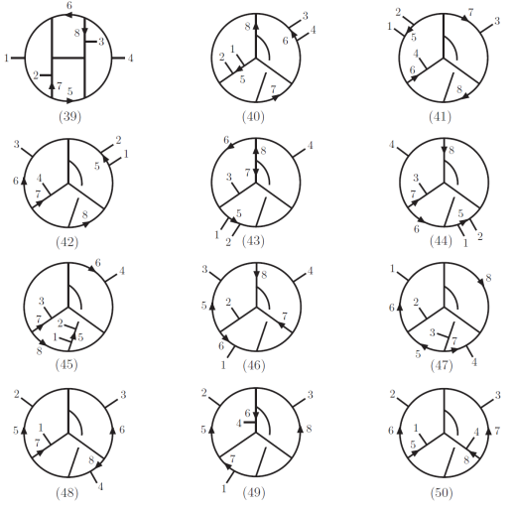
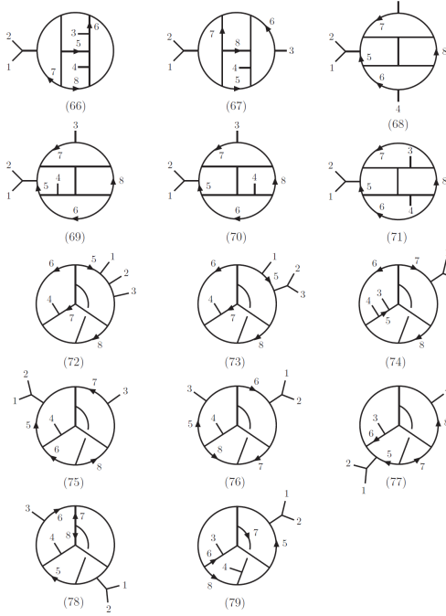
Four Loops
ZB, Carrasco, Dixon,
Johansson, Roiban

Slide 26
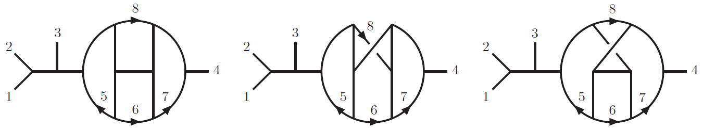
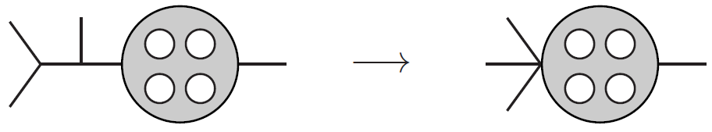
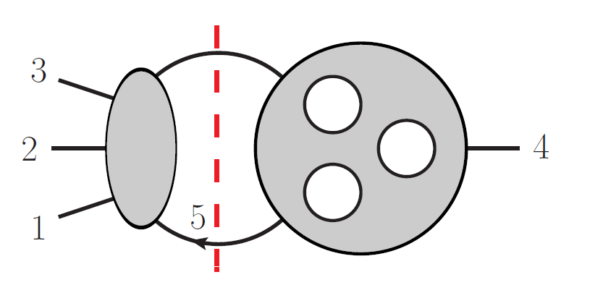
Snails in the Garden
ZB, Carrasco, Dixon,
Johansson, Roiban
(to appear)
p² = 0
BCJ correctly gives vanishing numerator: 0/0 ambiguity
Use this cut to determine the snails.
Integrand contributions non-vanishing.
For N = 4 sYM snail diagrams integrate to zero (scale free integrals)
but in critical dimension D = 11/2 they are UV divergent.
Wrong UV divergence if we drop them!
For N = 8 sugra snails are unimportant: get 0²/0 = 0.

Slide 27
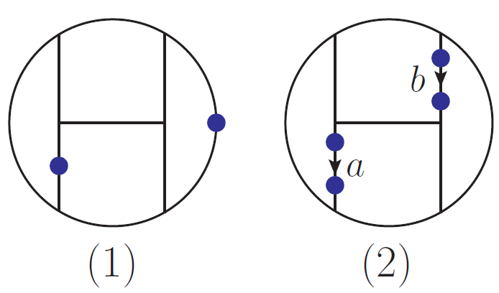
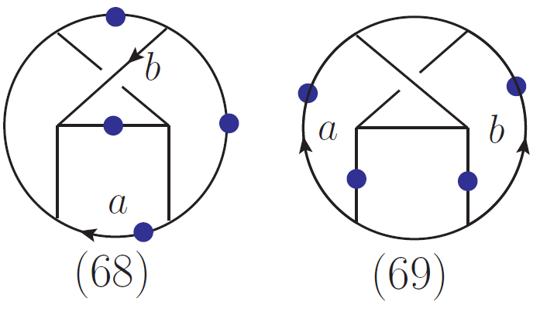
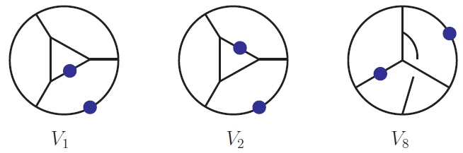
UV Divergences and Vacuum-Like Diagrams
ZB, Carrasco, Dixon, Johansson, Roiban
In critical dimension of D = 11/2 expand in large loop momenta
or small external momenta
We get 69 vacuum-like diagrams:
doubled propagator
After finding integral identities (slick form of ibp identities):
Only three integrals remain

Slide 28
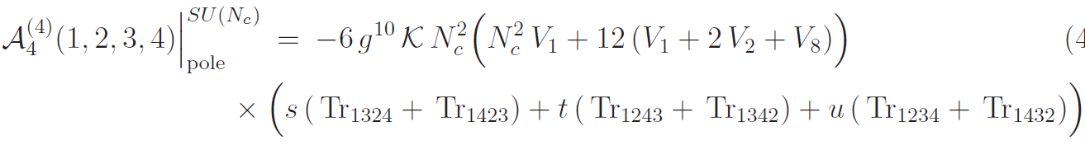
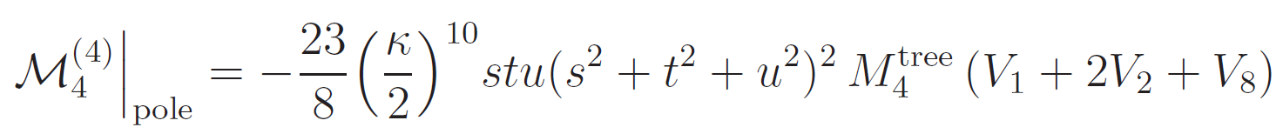
A Four Loop Surprise
ZB, Carrasco, Dixon, Johansson, Roiban (to appear)
Critical dimension D =11/2.
Encodes UV
divergences
in D = 11/2
gauge theory
same
divergence
gravity
Gravity UV divergence is directly proportional to subleading
color single-trace divergence of N = 4 super-Yang-Mills theory.
Same happens at 1-3 loops.

Slide 29
Current Status
Recent papers argue that trouble starts at 5 loops and by
7 loops we have valid UV counterterm in D = 4
under all known symmetries (suggesting divergences) .
Bossard, Howe, Stelle; Elvang, Freedman, Kiermaier; Green, Russo, Vanhove ; Green and Bjornsson ;
Bossard , Hillmann and Nicolai; Ramond and Kallosh; Broedel and Dixon; Elvang and Kiermaier;
Beisert, Elvang, , Freedman, Kiermaier, Morales, Stieberger
On the other hand:
cancellations are evident beyond this.
symmetry arguments don’t account for double copy.
To settle the debate it’s time to
to calculate again!

Slide 30
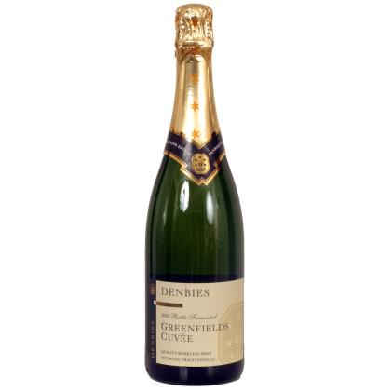

Status of 5 Loop Calculation
ZB, Carrasco, Dixon, Johannson, Roiban
900 such diagrams with ~100s terms each
We have 90% of the contributions complete…
But most complicated pieces remain.
Stay tuned. We are going to find out!
Place your bets!
At 5 loops in D=24/5 does
N = 8 supergravity diverge?
It’s game over in D = 4 if we
find a divergence here.
Kelly Stelle:
British wine
“It will diverge”
Zvi Bern:
California wine
“It won’t diverge”
Renata’s bet is against divergence

Slide 31
N = 4 supergravity
One year everyone believed that supergravity was finite.
The next year the fashion changed and everyone said that
supergravity was bound to have divergences even though
none had actually been found. — Stephen Hawking, 1994
To this day no one has ever proven that any pure
supergravity diverges in D = 4.
It’s about time to find an example!
Need to maximize the susy for simplicity.
Need to minimize the susy to lower the loop
order where we might find potential divergences
Candidate: N = 4 sugra at 3 loops.
N = 5, 6 finite at three loops. Bossard, Howe, Stelle

Slide 32
Three-Loop Construction
We saw examples where BCJ gives a powerful means for
determining integrated amplitudes when no loop momentum
in the numerator of N = 4 sYM copy.
See also Camille’s talk
N = 4 sugra : (N = 4 sYM) x (N = 0 YM)
N = 4 sYM
pure YM
N = 4 sugra linear
divergent
simple to see
finite for N=5,6
sugra
Use BCJ representation
Any representation
Pure YM 4 point amplitude has never been done at three loops.
A divergence here doesn’t really help us decide on N = 8 sugra.

Slide 33
Three-loop N = 4 supergravity
What is a convenient representation for pure YM copy?
Yes, I did say Feynman diagrams!
Answer: Feynman diagrams.
This case is very special
We can drop all Feynman diagrams where corresponding N = 4
numerators vanish.
We need only the leading UV parts, a tiny tiny fraction of the
amplitude.
Completely straightforward. Faster to just do it.

Slide 34
Multiloop N = 4 supergravity
Does it work? Test at 1, 2 loops
All supergravities
finite at 2,3 loops
One-loop: keep only box Feynman diagrams
F
+ perms
Becomes gauge
invariant after
permutation sum.
N = 0 Feynman diagram, including ghosts
N = 4 sYM box
numerator
Two-loop: keep only double box Feynman diagrams
F
F
+ perms
Feynman diagram including ghosts
Get correct results. Who would have imagined gravity is this simple?

Slide 35
Three-loop construction
ZB, Davies, Dennen, Huang
N = 4 sugra : (N = 4 sYM) x (N = 0 YM)
For N = 4 sYM copy use
known BCJ representation.
For N = 0 YM copy use Feynman
diagrams in Feynman gauge.
12 basic diagrams (include ghosts
and contact contributions in these)
Numerator: k⁷l⁹ + k⁸ l⁸ + finite
need to series expand in
external momenta k
log divergent
Notes:
Get numbers straight

Slide 36
Three loop results
ZB, Davies, Dennen, Huang
(in progress)
Want UV behavior.
Expand in small external momenta.
Get ~130 vacuum-like diagrams containing UV information.
cancelled
propagator
doubled
propagator
Currently analyzing the vacuum-like integrals.
Result:
We hope to be able to present the number soon.
Notes:
Get numbers straight

Slide 37
Summary
If the duality between color and kinematics holds, gravity
integrands follow immediately from gauge-theory ones.
In special cases, we can immediately obtain integrated gravity
amplitudes from integrated gauge theory ones.
BCJ duality gives us a powerful way to explore the UV
properties of gravity theories.
N = 8 sugra 4-point 3,4-loops fantastically simplified.
N = 4 sugra three loop divergence quite simple to get.
N = 8 sugra at 5 loops well on its way (unclear when we will
finish)
This is only the beginning of our exploration of gravity and
its UV properties.
see also Henrik’s talk
see also Camilles’s talk

Slide 38

Summary: The Future of our Field
Amplitudes 2011
November 13
Zvi Bern, UCLA
TexPoint fonts used in EMF.
Read the TexPoint manual before you delete this box.: AAAAAAAA
Notes:
Will say things that should be obvious to people but it is something that I think is important and needs repeating.

Slide 39
Fads come and go
Today our field is one of hottest ones around.
Yesterday’s impossible problems are today’s trivialities.
Is our field just another (albeit long lasting) fad?
Ringwaldmania (1989) .
M theory as a matrix model (1996)
Noncommutative field theory.
Dijkgraaf –Vafa. (2002)
String based model building (1986-1989).
etc.
Some disappear
completely and
some have tails
that fade in time
Question:
What should we do to ensure that we have a long-lasting impact,
so people care about what we are doing here 10 years from now?
Notes:
Jarad Ringwaldmania: High energy breakdown of perturbation theory in the electroweak instanton sector. Large lepton number violation

Slide 40
Links to other fields
Supergravity
AdS/CFT
String Theory
Amplitudes
QCD
Collider Physics
Pure Mathematics
The future health of our field demands that we produce explicit
results of direct interest to people outside our subfield.
TexPoint fonts used in EMF.
Read the TexPoint manual before you delete this box.: AAAAAAAA
Notes:
Look around the room: supergravity people, string theorist and hard core QCD people.

Slide 41

Two Pillars
Amplitudes
explicit
results
interesting
outside the field
symmetry
beauty
aesthetics
obviously
important
I want to
emphasize this
Our field will die without the support of both pillars
Notes:
Add little mermaid

Slide 42
The need for techniques that are general
When you discover a powerful technique in planar N = 4 sYM
see how far it can be pushed to more general problems e.g. QCD,
gravity or strings.
Example: Symbols
Talks from Henn, Volovich, Del Duca
Started life (in physics) by simplifying the two loop remainder
function on N = 4.
Easy apply to QCD: General tool for finding polylog identities.
Example: on-shell methods for integrals.
Focusing on general methods but keeping an eye on N = 4 sYM.
Talk from Kosower
Example: Studies of IR divergences
Of keen interest to both N = 4 community and phenomenology
communities.
Talk from Neubert

Slide 43
Looking Outwards: Our Field is Thriving
Can we solve N = 4 sYM theory and link to AdS/CFT?
Talks from Arkani-Hamed, Del Duca, Henn, Kaplan, Korchemsky,
Roiban, Skinner, Spradlin, Sokatchev, Travaglini, Trnka, Vieira, Volovich
Can we finally answer the question on whether UV finite
supergravity theories exist?
Talks from ZB, Boucher-Veronneau, Kallosh, Johansson, Stieberger
Studies of amplitudes in string theory.
Talks from Vanhove and Stieberger
Are there structures of use to our mathematician friends?
Talks from Arkani-Hamed, Trnka
Can we help our phenomenology friends with collider physics?
Talks from Boels, Kosower, Neubert
Notes:
This is all fantastically exciting precisely because we aren’t
engaged in naval gazing but are looking

Slide 44


Looking outwards: Our field is Thriving
jets
p
quark
gluon
p
jets of
hadrons
Key ideas originally worked out in N = 4 sYM theory today
play a central role in our ability to make precision predictions
of multijet processes.
Notes:
This is all fantastically exciting, precisely because we aren’t
engaged in naval gazing but are looking outwards.

Slide 45


NLO QCD Calculations of Z,W+3,4 jets
Berger, ZB, Dixon, Febres Cordero, Forde, Gleisberg, Ita, Kosower, Maitre [BlackHat collaboration]
BlackHat for one-loop
SHERPA for other parts
Data from Fermilab
Excellent agreement between
NLO theory and experiment.
A triumph for on-shell
methods.
Unitarity method originally
developed by studying one-loop
N = 4 sYM theory (BDDK 1994)

Slide 46

First NLO calculations of W,Z + 4 jets
Berger, ZB, Dixon, Febres Cordero, Forde, Gleisberg, Ita, Kosower, Maitre (BlackHat collaboration)
W + 4 jets H_{T} distribution
BlackHat + Sherpa
W
NLO QCD provides the best
available theoretical predictions.
On-shell methods really work!
2 legs beyond Feynman diagrams
for this type of process.
H_{T} [GeV] –total transverse energy

Slide 47
The Future
By all means hunt for aesthetically beautiful results
But don’t forget that the whole point is to find results of
important general interest outside our field.
If we do our job our hosts will need to plan for Amplitudes 2021

Slide 48

Let’s thank the organizers
for this great conference
Nathaniel Craig
Henriette Elvang
Michael Kiermaier
Aaron Pierce
Most of all
Angie Milliken

