Slide 1
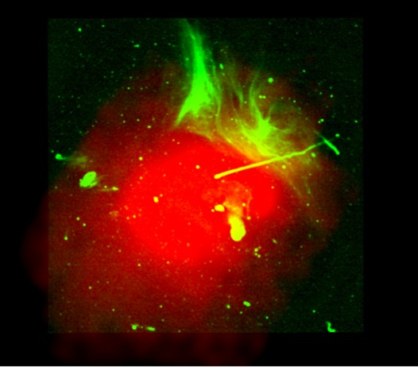
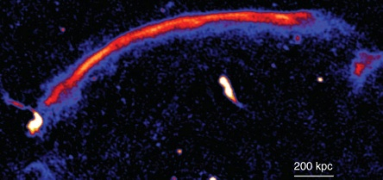
Diffusive Shock Acceleration Simulations of Radio Relics
Tom Jones
Hyesung Kang (PNU, Korea)
Dongsu Ryu (CNU, Korea)

Slide 2
The Context:
Several dozen (known) diffuse cluster “radio Gischt” or“radio relics”
~ Mpc scale, well outside cluster cores
Typically large length/width ratio
Integrated radio spectral index α ~ 1 typical (S_{ν} ~ ν^{-α} )
Typically highly polarized (several 10s %)
Sometimes paired opposite cluster core
Often indications of ongoing merger
Generally interpreted as “lit up” merger shocks
- Diffusive Shock Acceleration (DSA) or reacceleration
In a few cases (e.g., A3667) X-rays reveal shock; M~2
Such weak shocks are relatively inefficient particle accelerators:
- Especially for locally injected suprathermal particles
Radiating electrons have short lifetimes, limiting downstream emissions,
- Steepening spectra

Slide 3
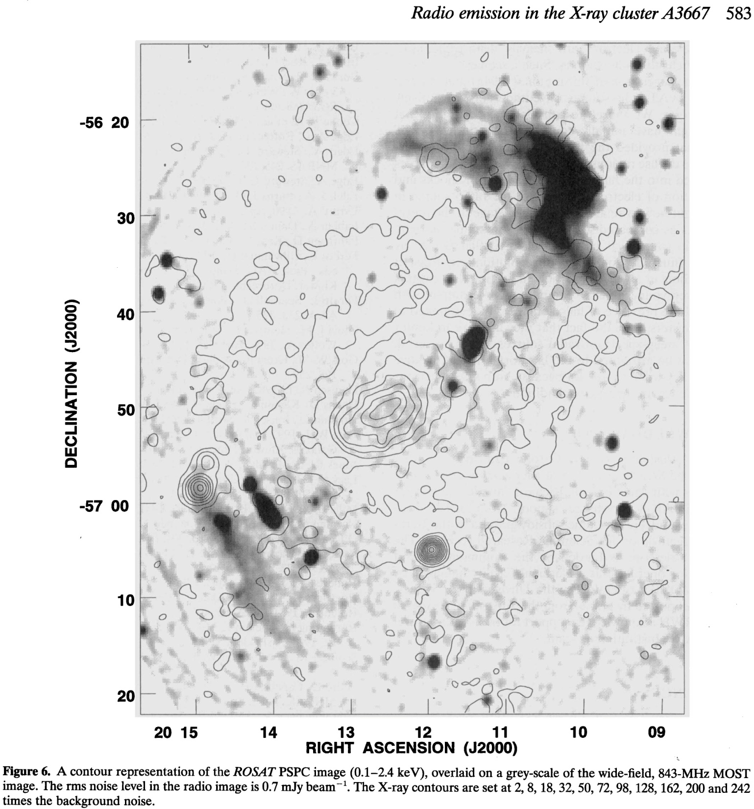
Example: A3667
Radio (gray)
ROSAT (contours)
X-ray shock
(next slide)
1 Mpc
Roettgering+ (97)

Slide 4
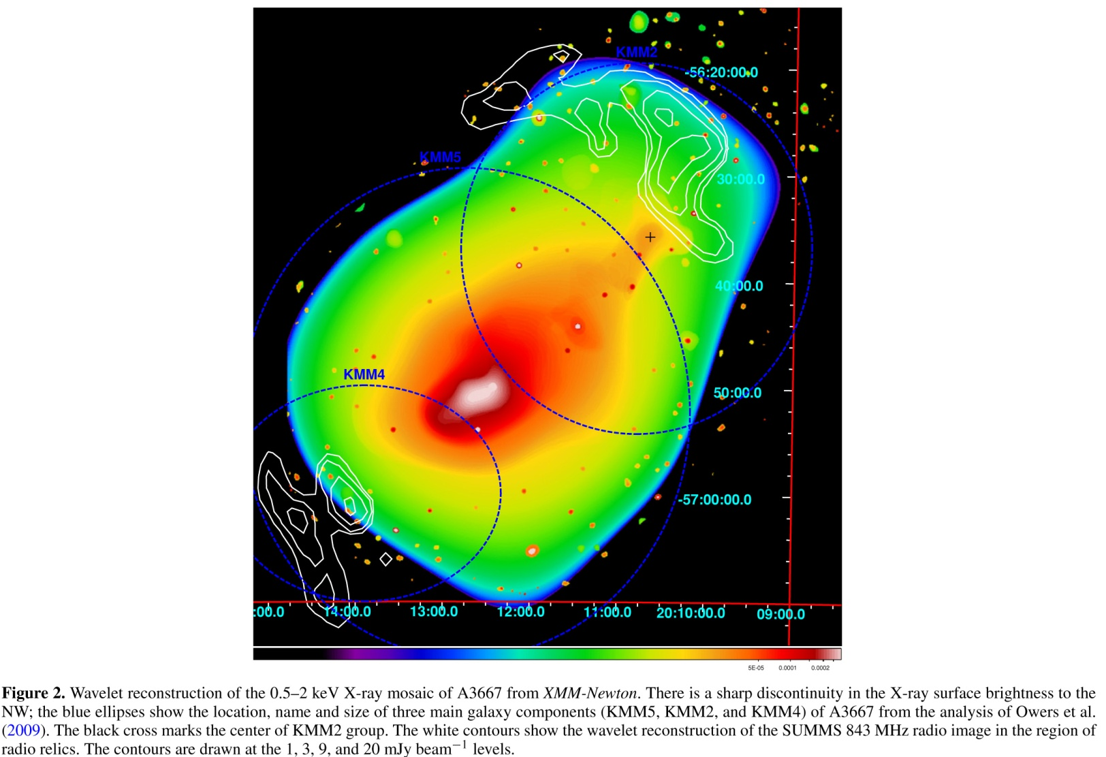
A3667
XMM (color)
Radio (contours)
Finoguenov + (10)
X-ray shock
M ≈ 1.9
(Akamatsu + (12))

Slide 5
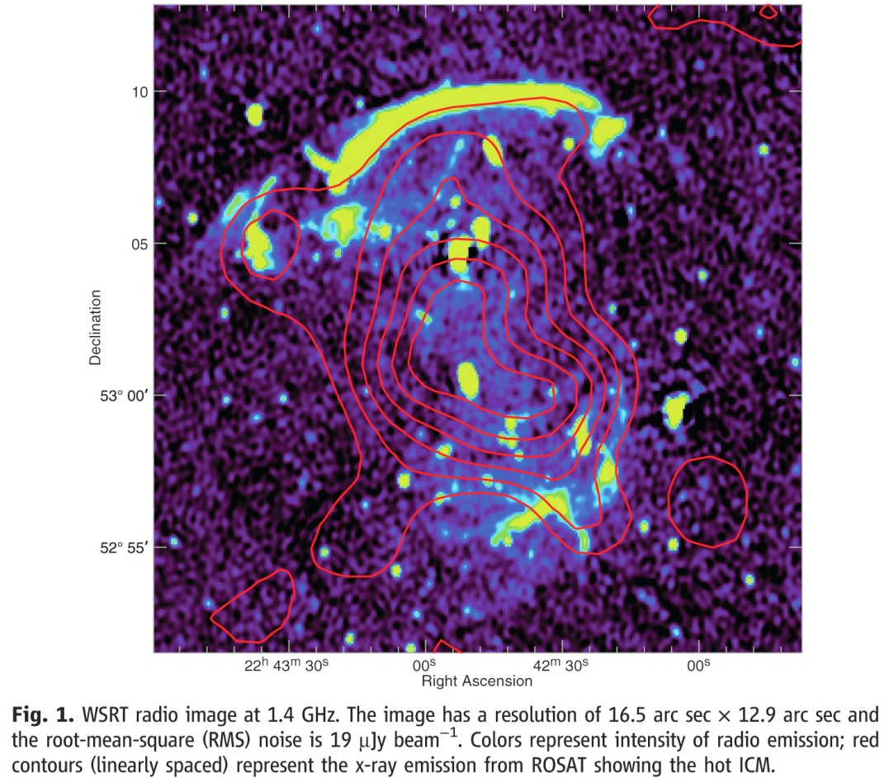
Example: CIZA J2242.8+53.01 **
“The Sausage”
Radio (color)
ROSAT (contours)
1 Mpc
** Modeled
in KRJ 12
Van Weeren + (10)

Slide 6
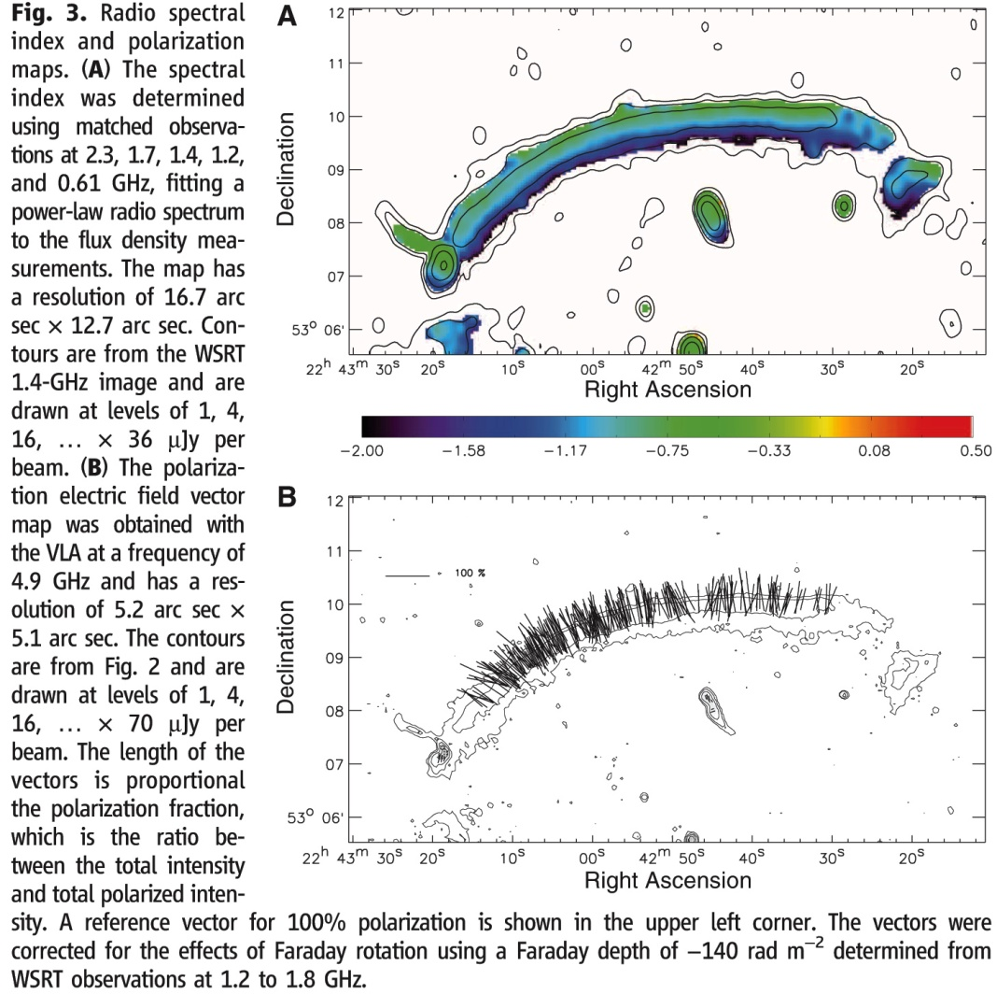
CIZA J2242.8+53.01
Radio spectral
index map
Integrated
spectral index
α=1.08
100 %
Radio polarization
map (E-vector)
Corrected for FR
Van Weeren + (10)

Slide 7
Example: A2256
Radio (green)
ROSAT (red)
0.5 Mpc
Rudnick + (P.C.)

Slide 8
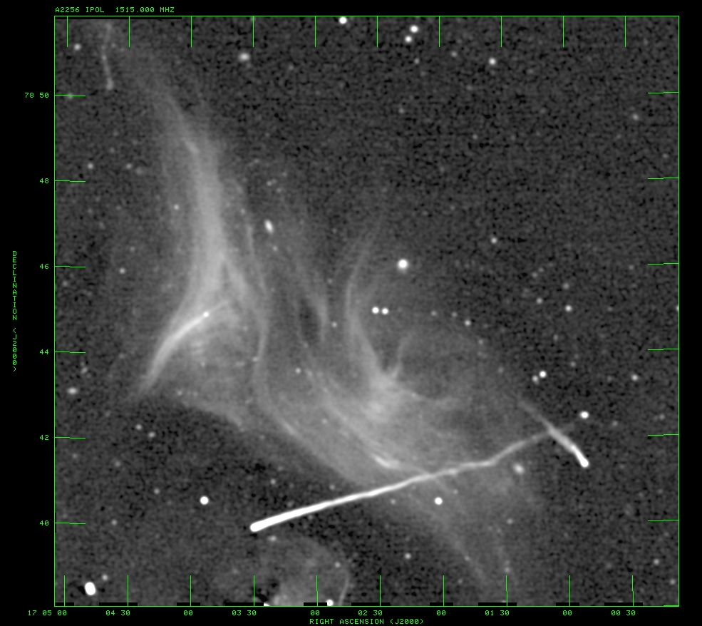
A2256
JVLA 20 cm
5 arcsec resolution
Rudnick + (P.C.)

Slide 9
A2256
RM component histogram
corrected for Galaxy
Each LoS through relic
has two RM components
(+ galaxy foreground
subtracted here)
Brighter component ≈ 0 rm²
(no contrib. from cluster)
Fainter component ≈ +50 rm²
(behind brighter comp.)
Note: all LoS same sign
For ~ 50 kpc path length
n_{e-3} B_{||,μG} ~ 1
Rudnick + (P.C.)

Slide 10
A2256
Brighter component
Polarization (E-vector)
Fainter component
has similar distribution
Synchrotron filaments
trace magnetic filaments
Rudnick + (P.C.)

Slide 11
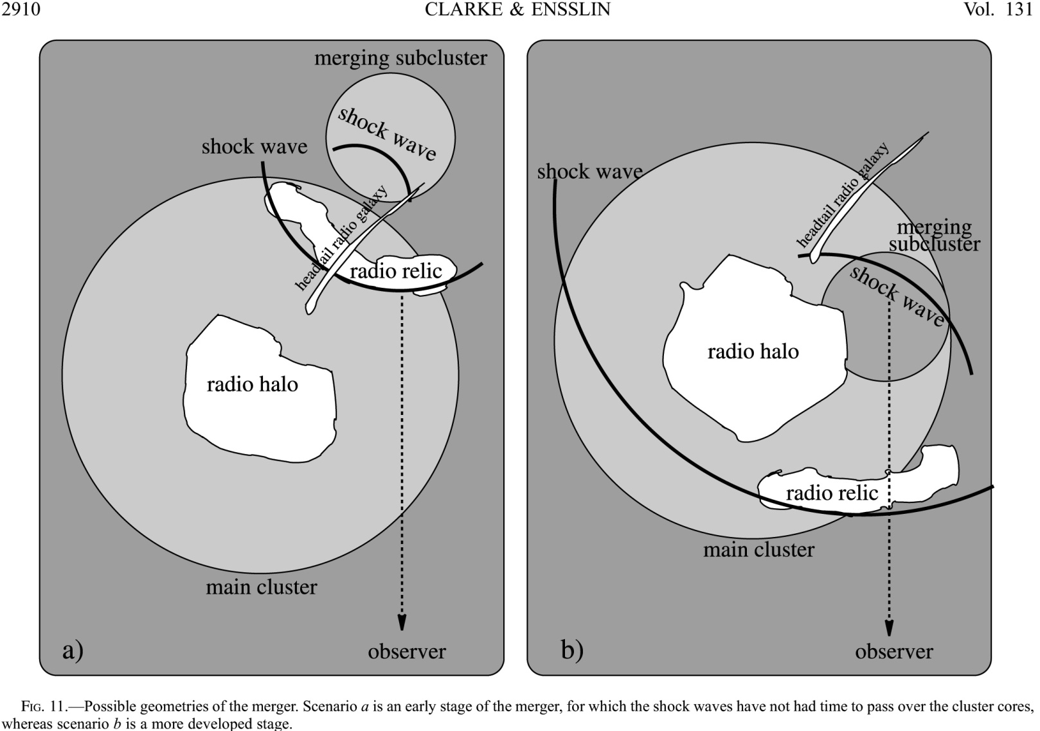
A2256
Relic likely on near side of cluster
Clarke & Ensslin (06)

Slide 12
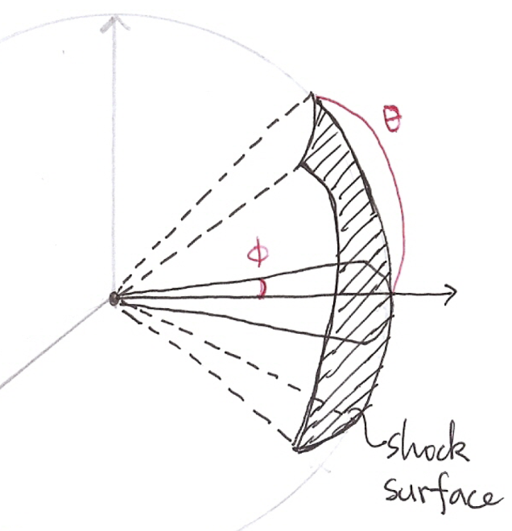
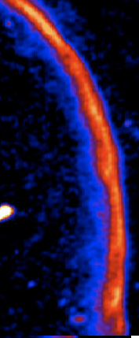
Modeling of a Relic as a partial thin shell
R/l_{shell} ≥ 1Mpc/50kpc ~ 200
↔ l_{shell}
R
Pole view
3
Intensity integration
along lines of sight
⇒ Flux per beam
θ
←
x
1
2
s
∨
(
Plane shock simulation results
side view:
observed projection on the sky
mapping onto
a spherical shell

Slide 13
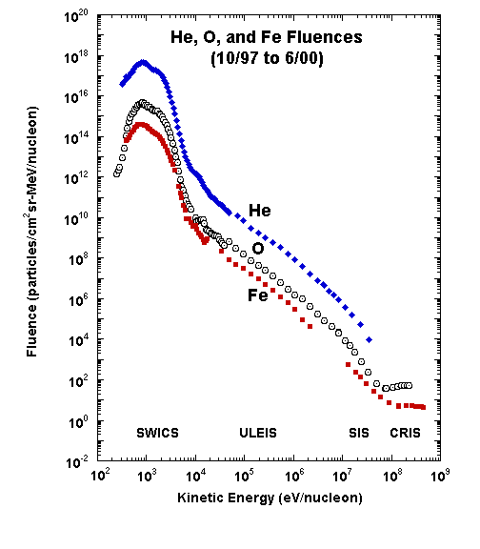
Cartoon of DSA
Injection
by thermal pool
Fermi 1st order
Shock front
~r_{g} (thermal ion)
> <
B
mean field
particle
For ion thermal-leakage injection
v >Δu, v> v_{inj} ~ few c_{s,2}
--Difficult in weak shocks--
U₁
U₂
U₁=U_{s}
U₂ =U₁-∆U
upstream
downstream
streaming particles
λ_{mfp} >>r_{g}
shock rest frame
upstream
downstream
Pre-existing, slope s<q
Shock injected:
⇒
Test particle,
steady state,
no losses
Particles diffuse; κ=(1/3)λ_{mfp} v,
Time between crossings, t_{diff}~4κ (1/u₁ + 1/u₂)/v
2012-10-11
13

Slide 14
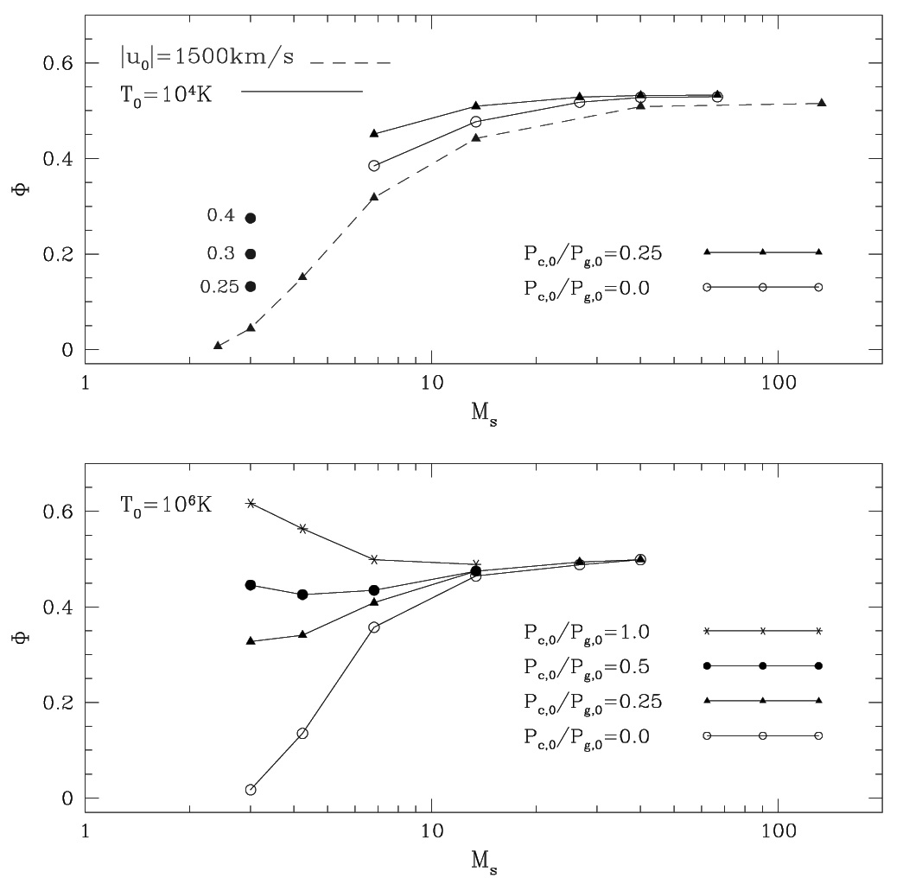
DSA (Proton) Efficiencies vs Mach number:
Small for “internal, “ merger shocks
--Electron acceleration efficiencies likely much smaller,
--since electrons much harder to inject
P_{c,0}/P_{g,0} is upstream
CR (proton) pressure
compared to
upstream
thermal pressure
Φ=P_{c,2}/ρ₁u₁²
local injection only
Kang & Jones 05
M_{s}=5

Slide 15
DSA Pretty Fast in Merger Shocks: Fast Shock Speeds
Radiative Losses (Synch + IC) Limit Electron Maximum Gains
B_{e} is the “equivalent”
field, combining
synchrotron and IC

Slide 16
Energy balance for electrons at the shock:
⇒ γ_{e,eq}
Cooling downstream (no re-acceleration):
Cooling limits electron propagation distance, l(γ_{e}):
In a steady state this steepens the integrated electron spectral index by one

Slide 17
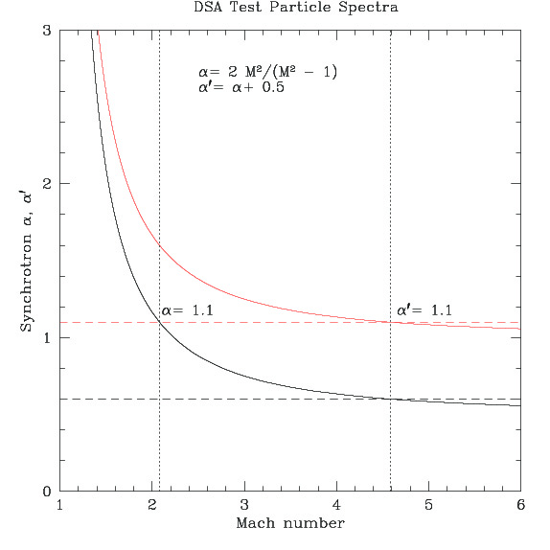
Relations Between Shock Mach and Synchrotron Spectrum
For injected electrons
(red)
Vertical lines:
Shocks leading to
synch. slope 1.1
from shock injected
electrons
Integrated, including losses is in red

Slide 18
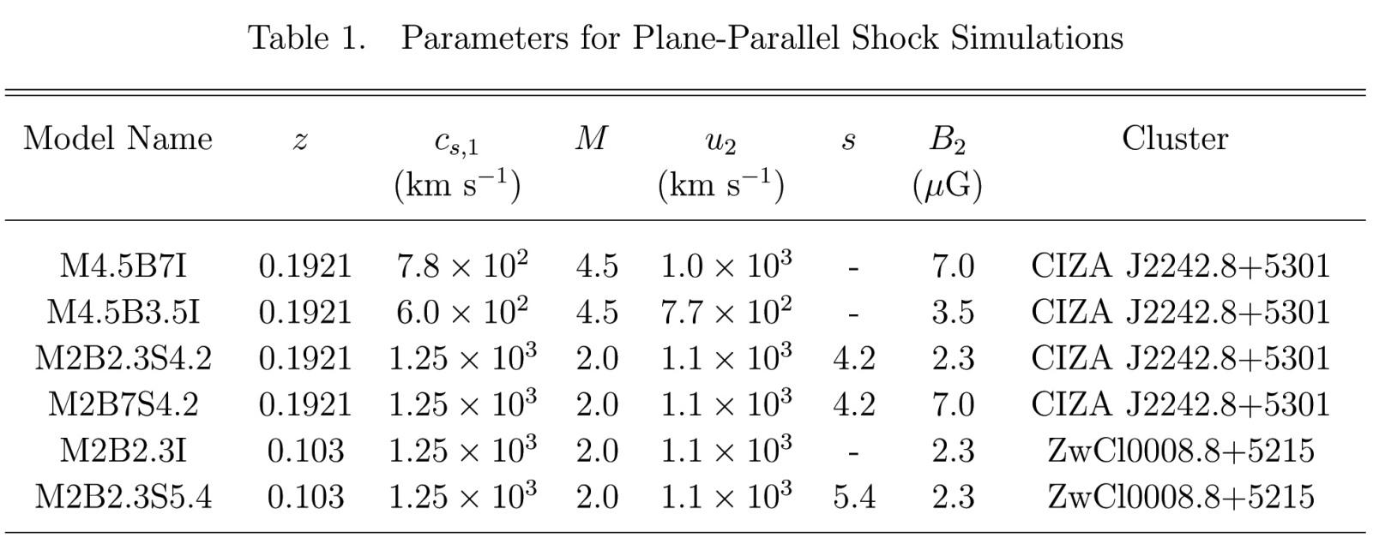
DSA Simulation¹ Model Parameters
All models: pre shock density, n_{e} =10⁻⁴ cm⁻³ (⇒R ~ R₅₀₀)
pre shock magnetic field B₀ = 1 μG
Model Naming Conventions
“MX” means shock Mach number =X
“I” models include thermal-leakage injection
(K_{e/p} = 0.01) (electron injection fraction, ξ_{e} ~ 10⁻⁷ -10⁻⁶)
“BX” means post shock B=X μG
“SX” means upstream CRs f(p) ~ p^{-s} with s = X
¹Time dependent simulations using CRASH with nested grids (Kang + (12))
“CRASH” = Cosmic Ray Acceleration at SHocks

Slide 19
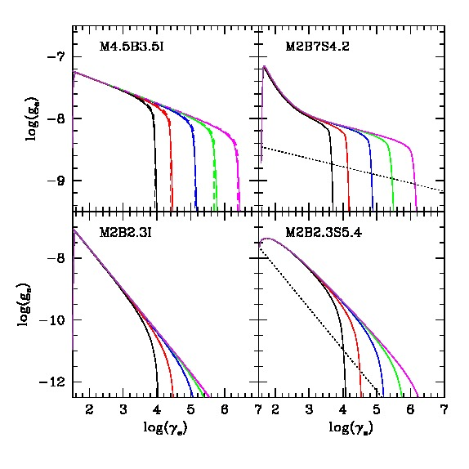
Steady State DSA Downstream Electron Distributions:
(CIZA)
(CIZA)
x=0.3 kpc
x=0.4 kpc
x=86 kpc
x=100 kpc
(ZwC)
(ZwC)
x=0.4 kpc
x=0.4 kpc
x=120 kpc
x=120 kpc

Slide 20
Relic Model Geometry Parameters
CIZA : R_{s} = 1.5 Mpc; ψ = 10º , 20º
ZwC : R_{s} = 1.0 Mpc; ψ = 25º , 30º
ψ
R_{s}

Slide 21
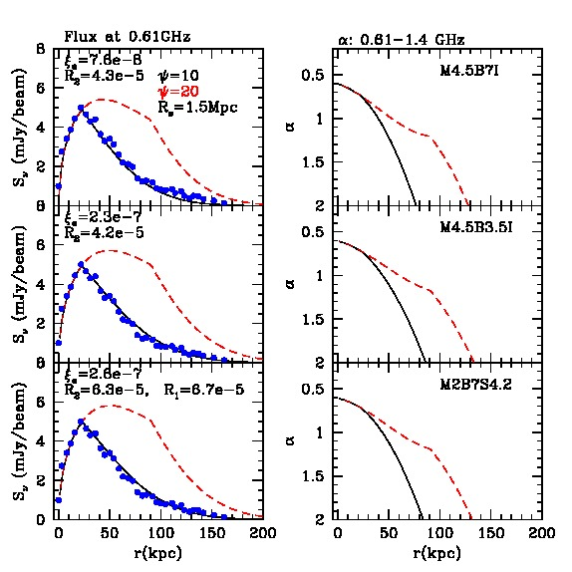
Fitting 610 MHz CIZA Brightness Profiles vs ψ
CIZA
Injection Only
Stronger B
ξ_{e} is electron injection fraction
R₂ =P_{ce,2}/P_{gasl,2}
R₁ = P_{ce,1}/P_{gas,1}
Injection Only
Weaker B
Required CRe
Efficiencies R₂ ~ 10⁻⁴
Implied CRp
Pressures ~ 1%
Weaker Shock
Upstream CRe
Blue Dots from
Van Weeren + (10)
x
x

Slide 22
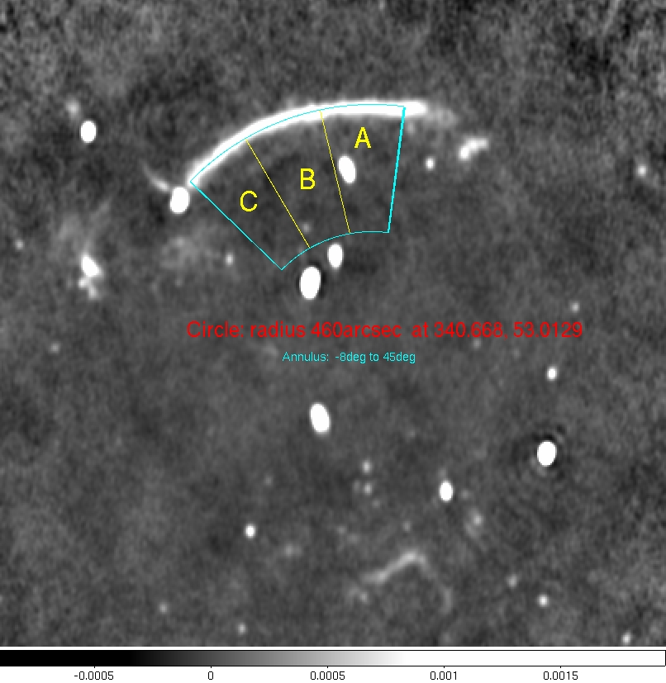
Detailed Fits to CIZA Sectors:
Van Weeren, LR + (P.C.)

Slide 23
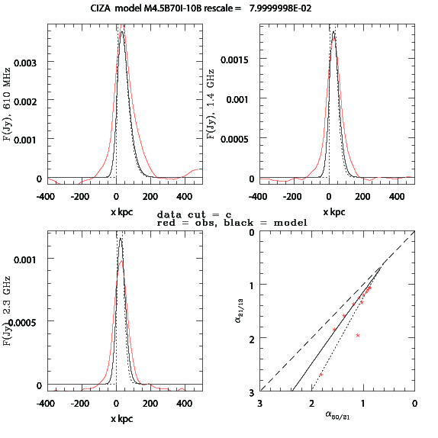
Detailed Fits to CIZA Sectors (Sector C):
Mach 4.5
Injection Only
Stronger B, ψ = 10º
Flux profiles
@610 MHz,
1.4 GHz, and 2.3 GHz
Red: Obs
Dotted: model
Solid: convolved
15 sec beam
concave
Color-color plot
across profile
convex
Red: Obs.

Slide 24
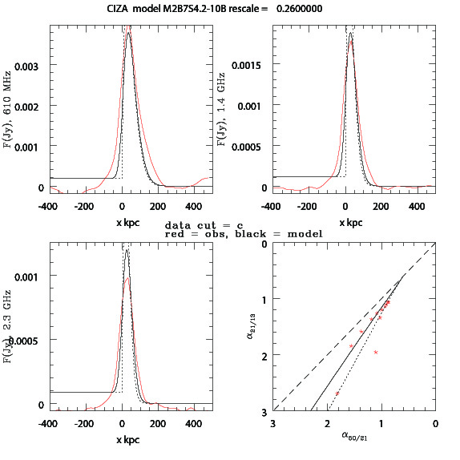
Detailed Fits to CIZA Sectors (Sector C):
Mach 2
Upstream CRe
Stronger B, ψ = 10º
Flux profiles
@610 MHz,
1.4 GHz, and 2.3 GHz
Color-color plot
across profile
concave
convex
Red: Obs.

Slide 25
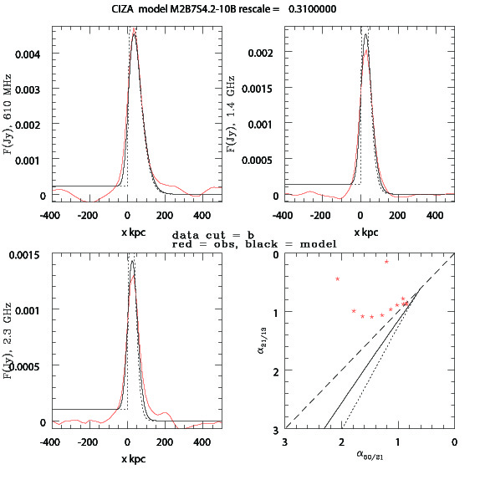
Detailed Fits to CIZA Sectors (Sector B):
Mach 2
Upstream CRe
Stronger B, ψ = 10º
Flux profiles
@610 MHz,
1.4 GHz, and 2.3 GHz
Color-color plot
across profile
concave
convex
Red: Obs.

Slide 26
Summary
Radio Gischt Relics can be unique probes of structure formation dynamics
Reveal moderate strength shocks during merger events.
Radio emission highlights shock electron acceleration or reacceleration
& potentially magnetic field enhancements/organization.
Weak shocks (M ~ 2, perhaps some stronger)
Efficiency injecting electrons from thermal pool likely poor
With steep spectra through DSA, such shocks very inefficient
Reacceleration of existing, upstream population more efficient
Estimating shock properties from radio spectral properties is tricky
because of rapid electron cooling, possibly multiple electron sources
Detailed, multi-frequency, high resolution radio data essential

Slide 27
The End

