Slide 1
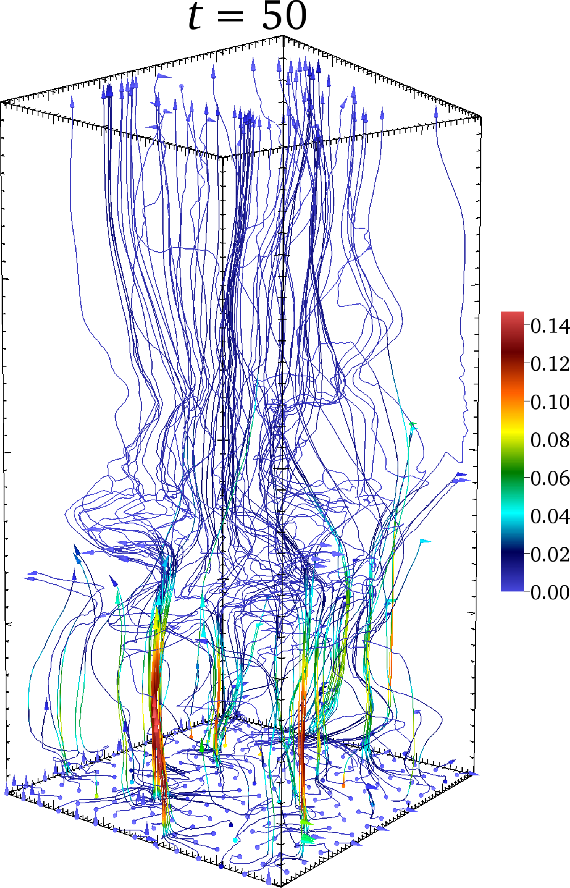
The Physics of the ICM core: Conduction, the HBI, and cold filaments
Chris Reynolds (UMd)
with…
Mark Avara (UMd)
Steve Balbus (Oxford)
Tamara Bogdanovic (Georgia Tech)
Matt Kunz (Princeton)

Slide 2
Outline
Motivation: why study conduction in ICM cores?
Non-linear behaviour of the HBI
(β, resolution) parameter space survey
HBI ≠ insulation of conductive heat flux
Cold filaments in clusters
Subtle nature of local thermal instability
Filament condensation in Braginskii-MHD models
AGN heating and the isotropy problem
Notes:
Picking up from Matt’s talk and addressing some of the physics relevant to cooling cores
Start off with a few comments about why its still interesting to consider conduction
New results on the HBI… HBI not necessarily produce insulation
Some comments regarding role of filaments filaments in the ICM

Slide 3
3Gyr cooling radius
Perseus cluster (1Ms/Chandra)
Fabian et al. (2011)
Notes:
Motivation… fampus Perseus cluster with 3Gy cooling radius drawn
Obvious evidence for interaction between AGN and ICM
Paradigm is that the AGN is the heater

Slide 4
Is all “just” AGN feedback, isn’t it?
Maybe but…
Direct evidence for AGN heating is still elusive!
Clearly lots of ICM-AGN interaction (cavities, ripples), but the heating mechanism remains elusive! Fail to see strong shocks!
Effervescent heating (Roychowdhury+04), dissipation of sound waves (Fabian+05) or turbulence (Ruszkowski+10), CR heating…
The isotropy problem
The obvious AGN energy output is in form of narrow jets
How do jets heat the core isotropically? (Vernaleo & CSR 2006)
The multi-scale feedback problem
Cooling core ~100kpc, but accretion radius <10pc
How is such a tight feedback-loop maintained?
Still worth keeping an open mind about alternatives…
Notes:
May well be right, but a few words of caution
Still haven’t seen AGN heating! (no lack of ideas)
Isotropy problem; multiscale feedback problem
Still worth looking at alternatives – next few minutes, look at role of conduction

Slide 5
<0
>0
(Outskirts)
(Core)
(azimuthal)
(radial)
Balbus & Reynolds (2010)

Slide 6
Can thermal conduction offset cooling throughout (at least some of) the ICM core?
Problem:
HBI = insulation
But is this true??
Notes:
One question…
Problem… HBI gives insulation
Is this true?

Slide 7
Examine behaviour as a function of numerical resolution and initial magnetic field (Avara et al.)
Hot
Buffer (isotropic κ)
0.1H
Resolution N×N
Active region
(anisotropic κ)
Cold
2-d
Uniform gravity
Uniform κ
No radiative cooling
Initially…
Linear temperature profile
Vertical uniform B-field
Buffer (isotropic κ)
Notes:
Work performed by Mark Avara
Parameter survey of simulations as fun of…
Guide you eye… simulation set up… domain, buffers

Slide 8
Notes:
Lines are magnetic fields… initial beta, panel shows flux
Single mode
Behaviour has been seen before…

Slide 9
Increasing magnetic field strength
HEAT FLUX PERSISTS DESPITE HBI ACTIVITY
HBI SHUTS OFF CONDUCTION
STABLE
Increasing resolution
Notes:
Full parameter space… regimes

Slide 10
Notes:
Single mode

Slide 11
Power-law spectrum of fluctuations rather than single mode…

Slide 12
Filaments are all HBI stable… they result from the competing need to satisfy magnetic flux conservation in the presence of an instability that actively re-orients vertical field.

Slide 13
Notes:
Resolution dependence more subtle

Slide 14
Temperature
Radial conductive heat flux
Bogdanovic, Reynolds, Balbus & Parrish (2009)
also see Parrish et al. (2009), Ruszkowski & Oh (2009, 2010)
Notes:
Streamers also seen in global simulations
Undergo collapse from the inside out... Even if conduction-driven turbulence were to rescue the cluster, would not be resolved

Slide 15
Cold filaments, AGN fueling and the isotropy problem
Notes:
Switch gear a little… talk about cold filaments

Slide 16
7th April 2009
IAS
Fabian et al. (2008)
Notes:
Spectacular filament system in perseus

Slide 17
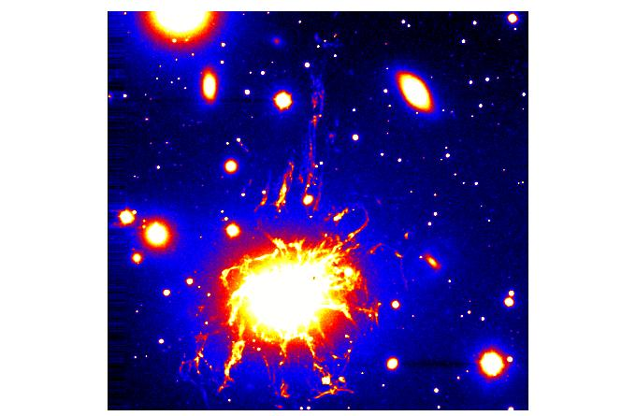
Notes:
-alpha map

Slide 18
McDonald et al. (2010)
Also Voit et al. (2008)

Slide 19
Kunz,Bogdanovic, Reynolds & Stone (2012)
Notes:
Semi-global, radiative-HBI simulations discussed by Matt
With and without pressure anisotropies…
Strong cold filamants form

Slide 20
Courtesy M.Kunz

Slide 22
Subtleties of local thermal instability
Classical Field result (no gravity):
Buoyancy effects stabilize local thermal instability! If we have L_{net}=L(ρ,P,T) then gas is locally thermally stable if atmosphere is convectively stable! (Balbus & Soker 1989)
Why then do we see filaments collapsing?
Significant heating via conduction, giving L_{net} an explicit spatial dependence
Due to viscosity, atmosphere can be globally stabilized long enough for the local instability to work! (Kunz et al. 2012)
Alternative… include a “bulk heating” term from the AGN that is a function of position (Sharma et al. 2012)

Slide 24
Conclusions
Reason to challenge HBI=insulation assertion
Local results depend upon initial field strength
Global results may be strongly resolution limited
Case that AGN heating dominates ICM core is still not solid!
Cold filaments & AGN feedback
Braginskii viscosity promotes formation of cold filaments via local thermal instability
Hypothesis : AGN fed by filaments, jets periodically realigned, feedback isotropized over few cooling times.

