Slide 1

RUN A
‘KATA PRACTITIONER DAY’
IN YOUR REGION
We encourage you to run a Kata Practitioner Day (KPD) in your region or within your organization. The purpose of a KPD is to provide an uncomplicated 1-day forum for sharing first-hand experiences and lessons learned from real practice of the Improvement Kata and Coaching Kata.
A KPD is a forum for practitioners to share their knowledge with anyone who is interested in Toyota Kata and scientific thinking.
You can organize a KPD for a geographic region, an industry segment or even inside a single organization where Toyota Kata is being practiced. A KPD is a “local” or “regional” sharing event that’s intended to be inexpensive, high-value, and not requiring long travel and overnight stay.
The only content you need for a successful KPD is:
  • One specialist speaker (30-minute presentation)
  • 3-5 Toyota Kata practitioners to present (15-20 minutes each)
  • Facilitation of the Kata in the Classroom (KiC-1) exercise
The next pages have suggestions and ideas for organizing and marketing your KPD.

Slide 2
Example KPD Agenda
(Adjust the start time and number of practitioner presentations to suit your situation)
9:00 WELCOME to the Kata Practitioner Day by the hosts
9:10 – 9:40 SPECIALIST GUEST SPEAKER (a professor or sports or music coach
on a topic such as Learning New Skills, Deliberate Practice,
Neuroscience of Learning, Scientific Thinking, etc.)
9:40 – 10:00 PRACTITIONER Presentation 1
10:00 – 10:10 Discussion / Q&A
10:10 – 10:30 Break & Networking
10:30 – 10:50 PRACTITIONER Presentation 2
10:50 – 11:10 PRACTITIONER Presentation 3
11:10 – 11:30 PRACTITIONER Presentation 4
11:30 – 12:00 Discussion / Q&A
12:00 – 12:45 LUNCH
12:45 – 2:15 HANDS-ON EXERCISE: Kata in the Classroom (KiC-1) exercise
(Instructions at www.katatogrow.com)
2:15 – 2:30 Break & Networking
2:30 – 2:50 PRACTITIONER Presentation 5 (optional)
2:50 – 3:15 Discussion. Summary and conclusion by the hosts
Organizing your KPD
Organization is decentralized. Each KPD handles its own sponsorship, registration, and other organization. The fee for attending a KPD generally ranges from U.S. $150 per person to free, with the average being about $90.
Marketing your KPD
KPDs are usually hosted and marketed in collaboration with a local/regional business consortium, a community college, a manufacturing extension Partnership (MEP) office, or at a host company that has a large meeting room. These organizations are often happy to have you bring the content while they organize the meeting space & lunch food and also help publicize the event.
Sharing your KPD
Be sure to take photos during your KPD and share them on social media both during and after the event.
Follow-up after the event
It’s a good idea to send some useful Toyota Kata / scientific thinking content to the KPD participants about one week after the event, such as a video link, document, etc. This helps you build interest and community.
Example KPD flyers
On the next pages are several marketing flyers from previous KPDs, to help you get ideas for your KPD.

Slide 3


Slide 7



Slide 8
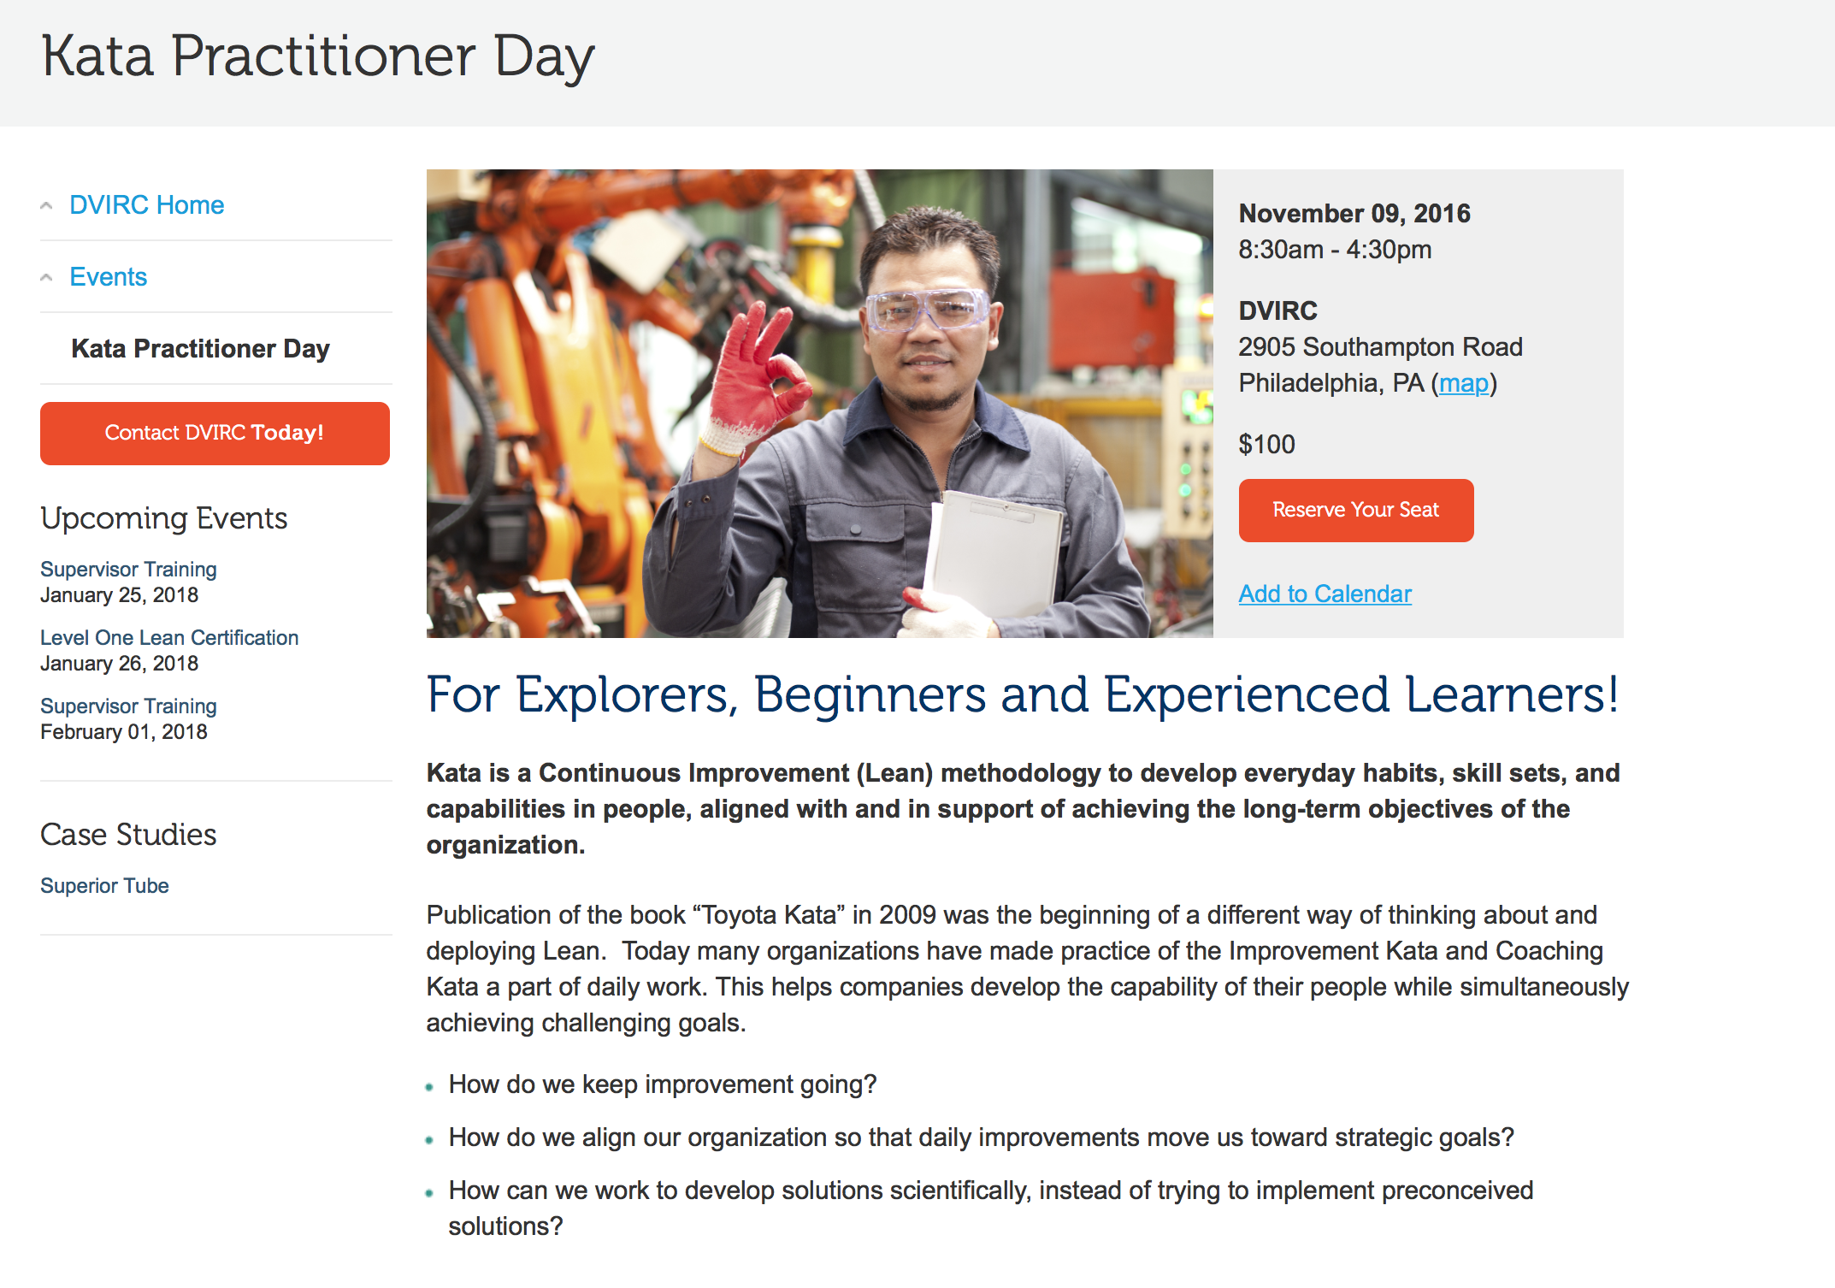
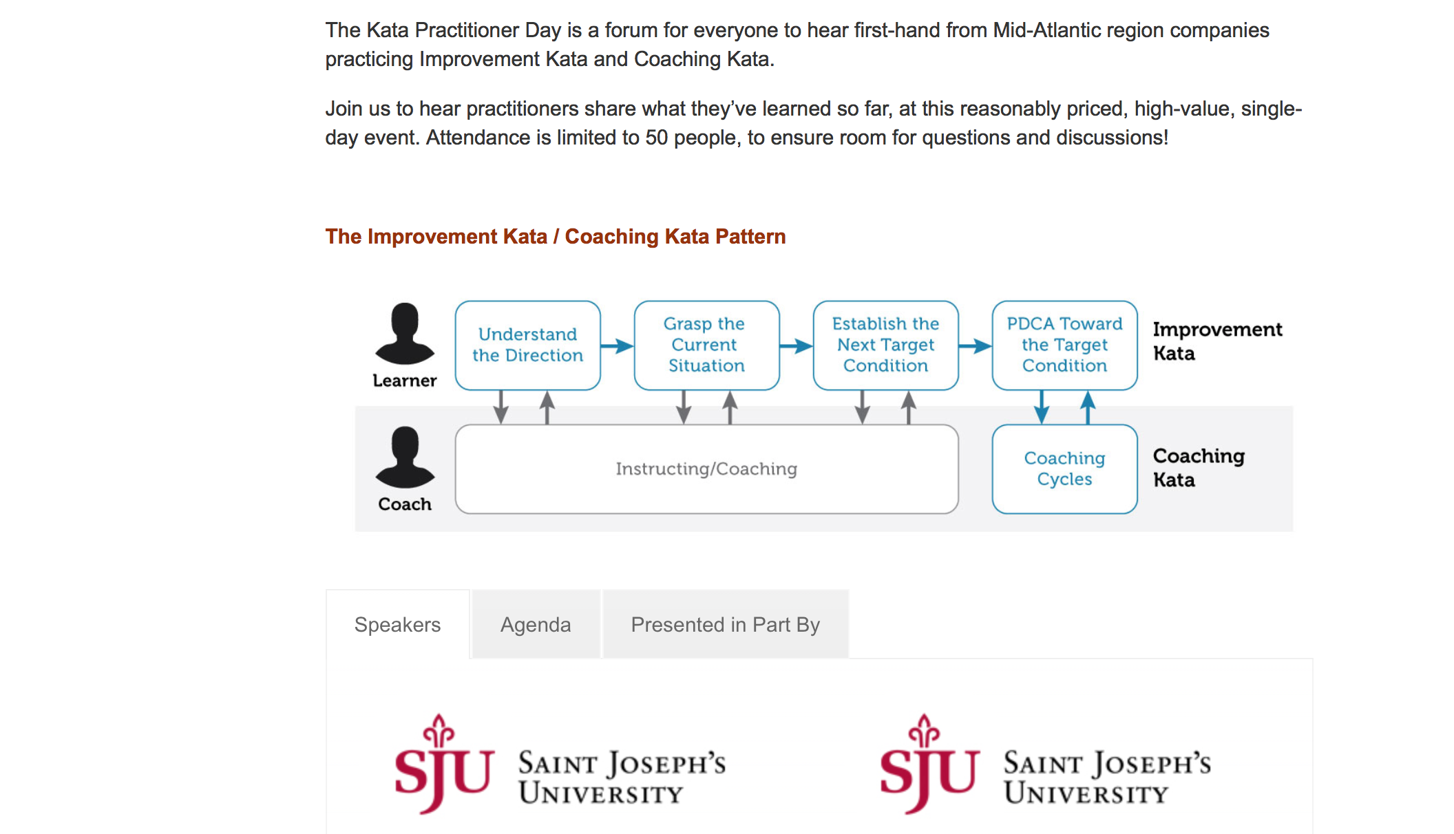

Slide 9

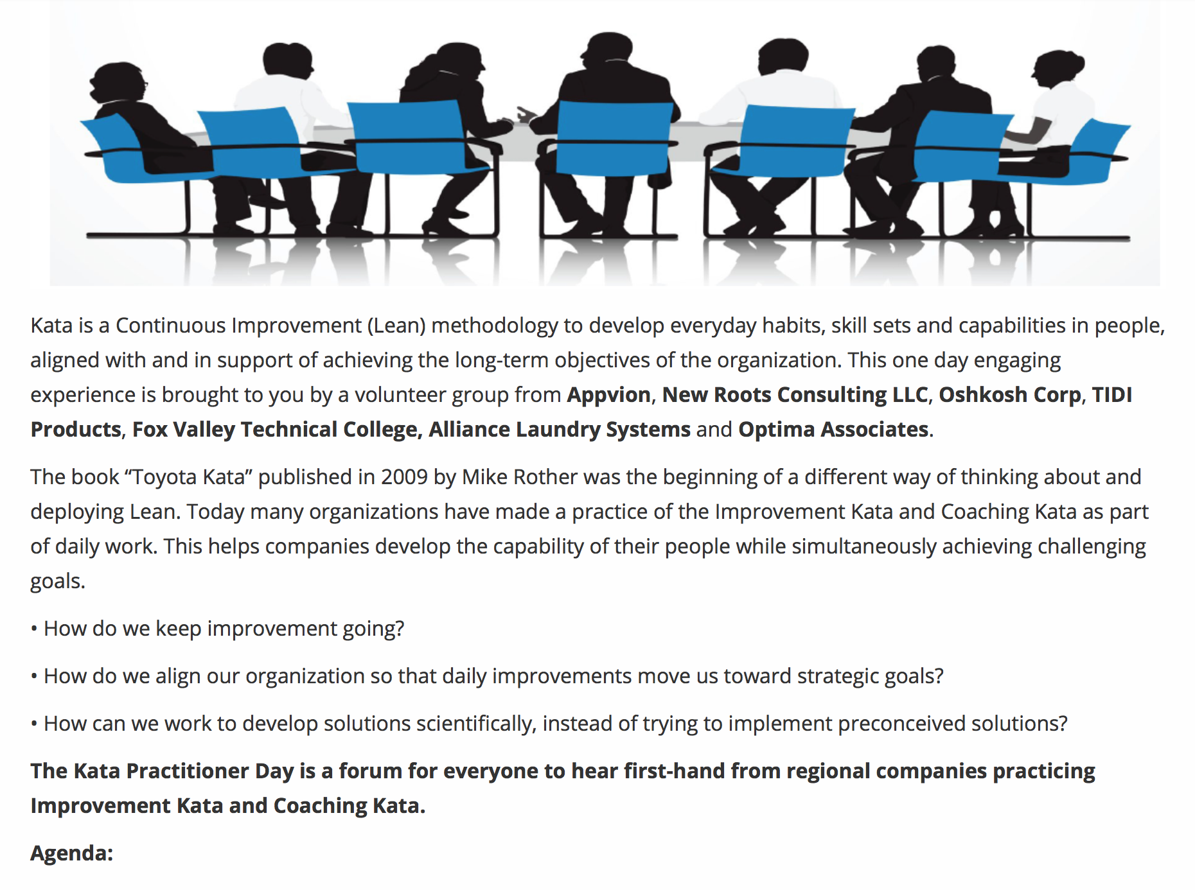

Slide 10
