Slide 1
WATCHERS OF THE SKY
Philip Hughes
Department of Astronomy
University of Michigan
phughes@umich.edu
www-personal.umich.edu/~phughes/

Slide 2
Overview
Background
  Astronomy
  Physics
  Technology
Facts & Figures
  What makes this unique?
  Gee whiz factors
Science Goals

Slide 3
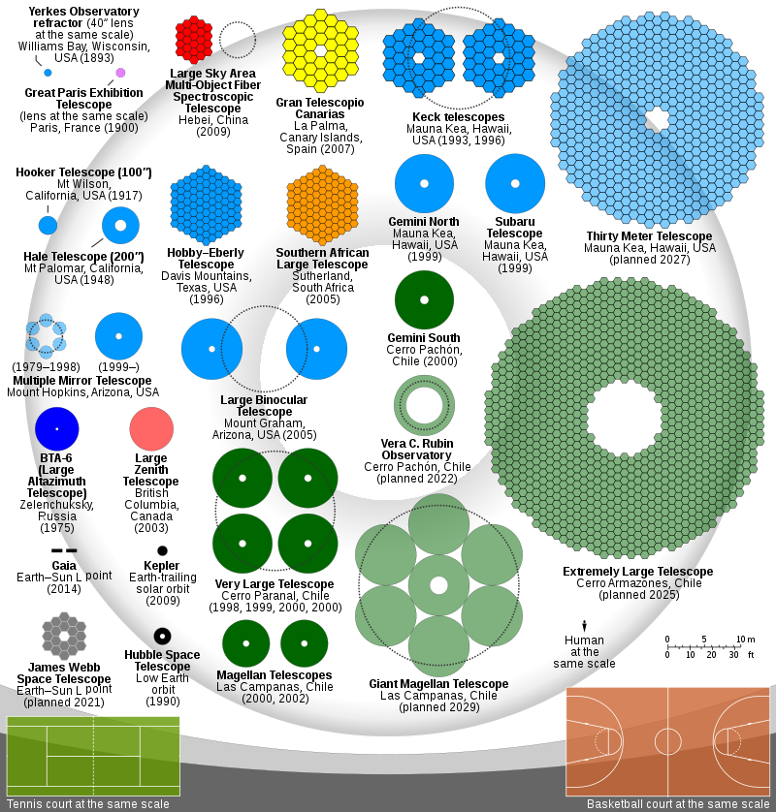

Slide 4
Primary Mirror
You cannot cast a 39 meter primary mirror
The giant primary is made up of 798 individual hexagonal segments
Doesn’t this impact the image?
No & Yes!!

Slide 5
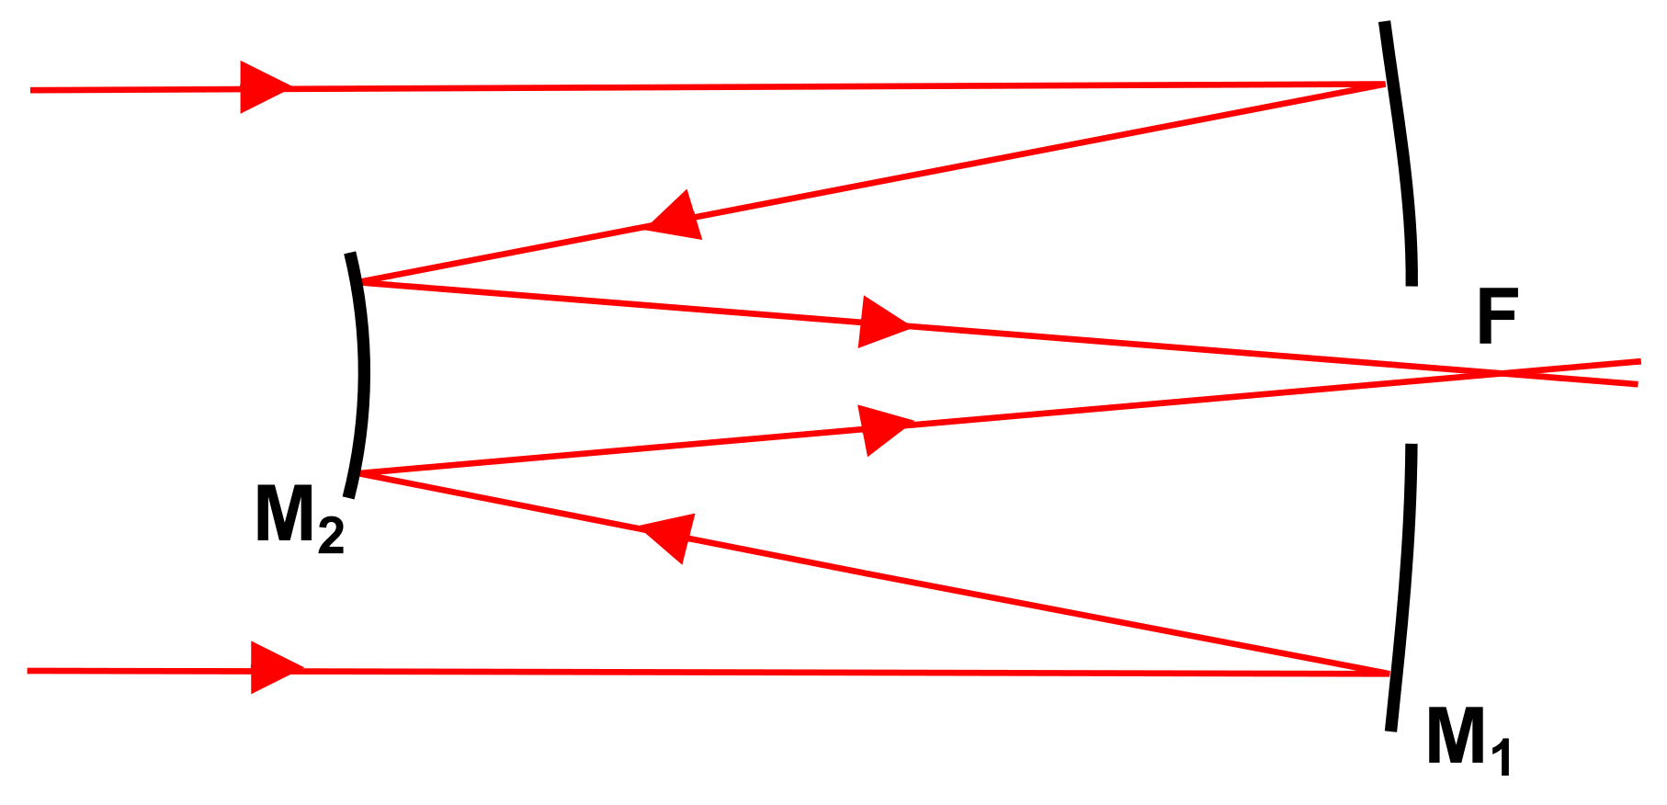
Recap: Reflecting Telescopes

Slide 6
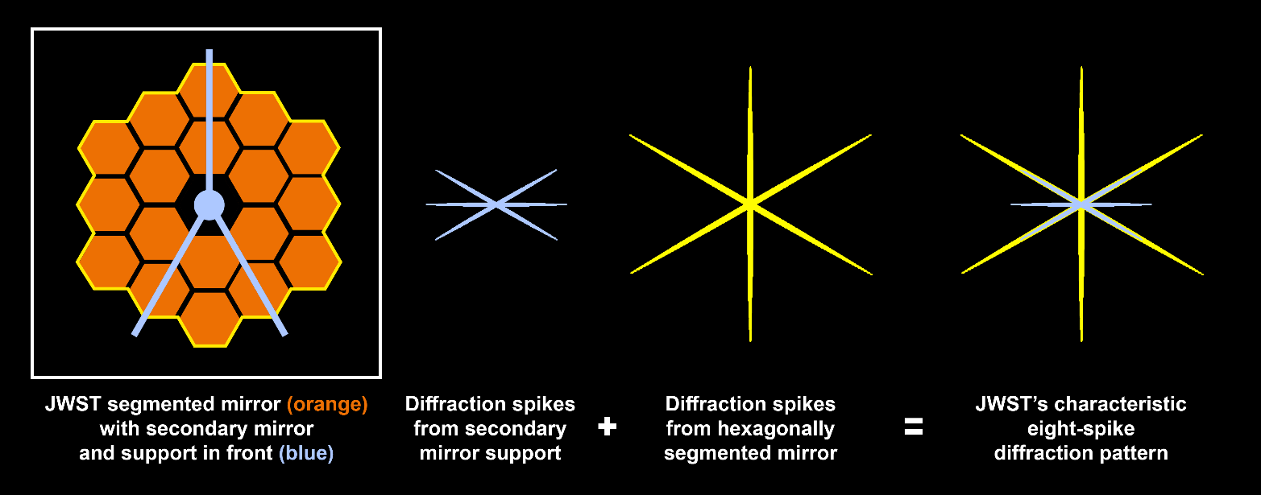
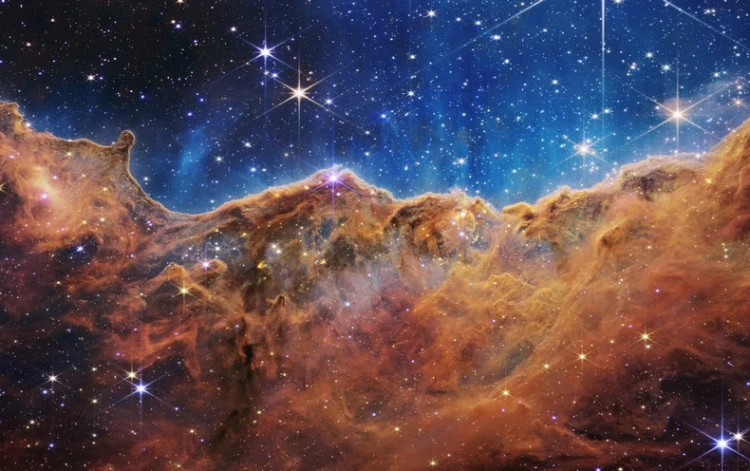
EW 2023: JWST
Secondary: held by 3 struts
Contributes to “iconic” diffraction spike pattern

Slide 7
Alignment
In a multi-segment design like this, a lot of work has to go into ensuring alignment
Edge sensors on each segment monitor its position
Actuators (typically 3 on each segment) make adjustments
The mirror support system is critical: this is designed to evenly distribute stresses, and provide a “warping harness” to slightly change mirror shape in response to gravitational/thermal effects
A computer system monitors and controls all this

Slide 8
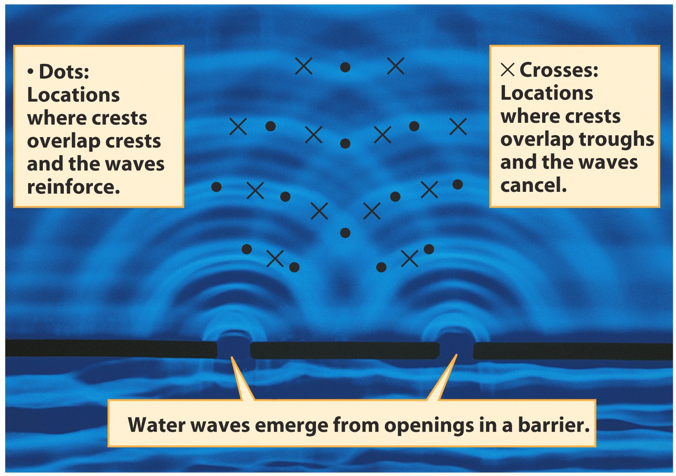
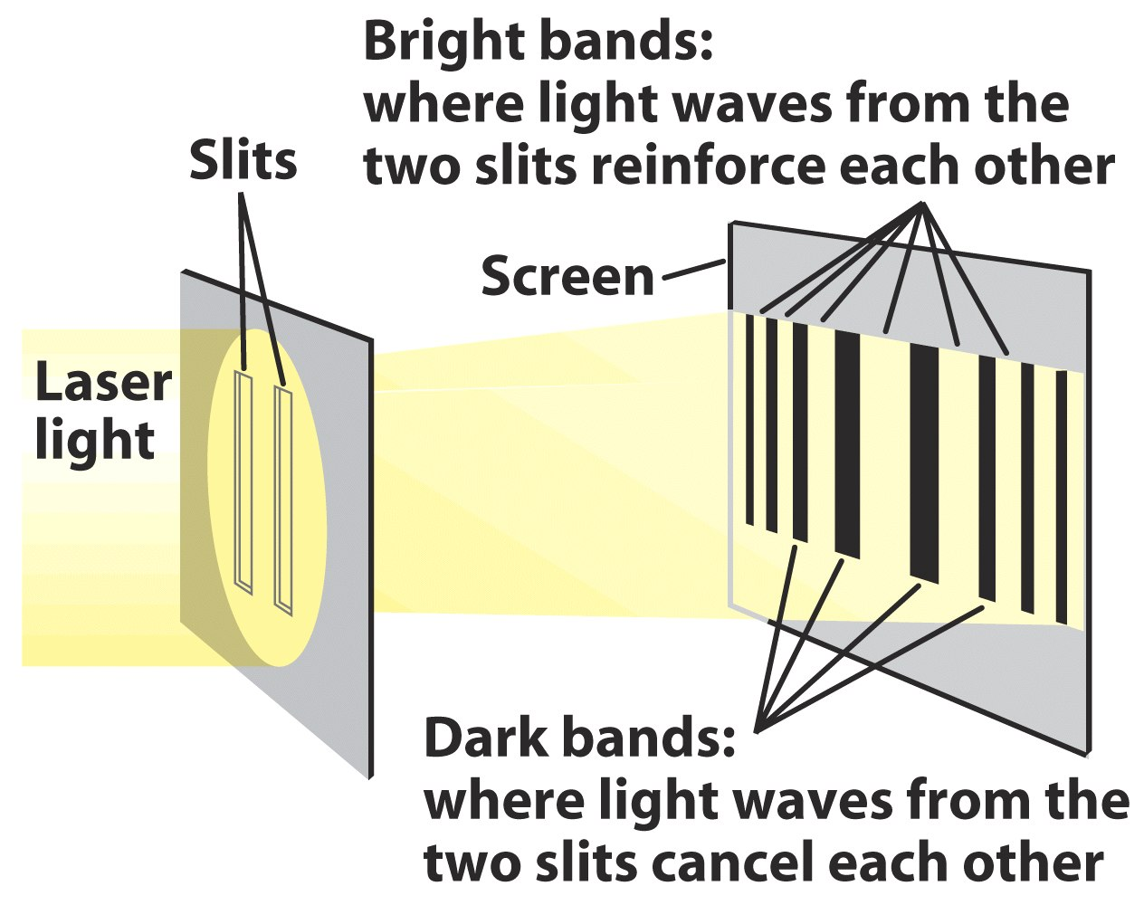
Atmosphere: Adaptive Optics
Young's slit experiment (1801)

Slide 9
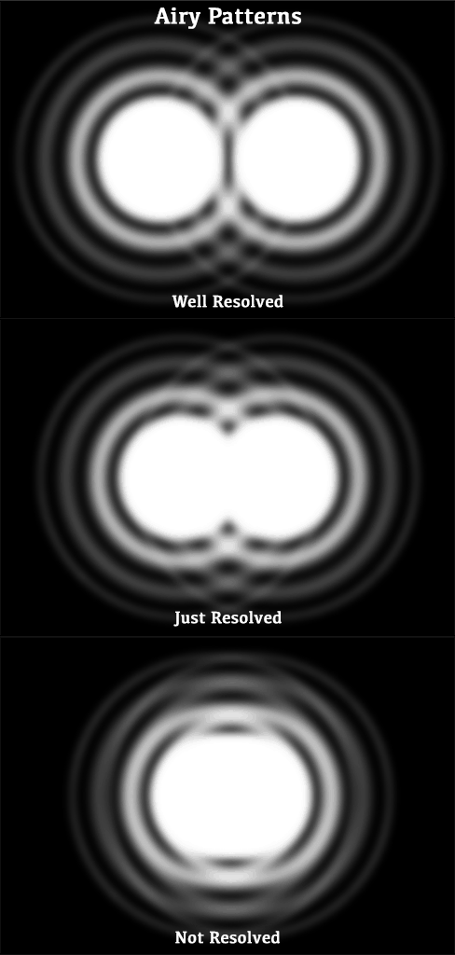

Diffraction
“Diffraction Limit” is the goal!

Slide 10
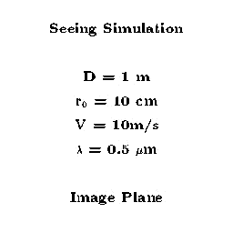
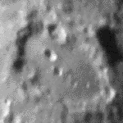
Adaptive Optics
Wavefronts are distorted by inhomogeneity in intervening medium
Wavefronts are corrected by mirror – arbitrarily deformable in an ideal world

Slide 11
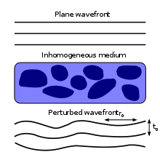
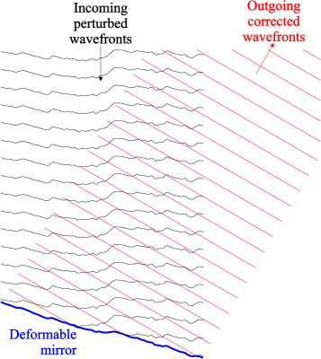

Slide 12
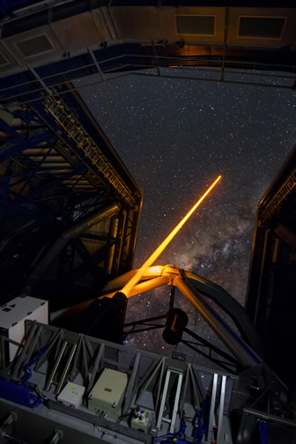
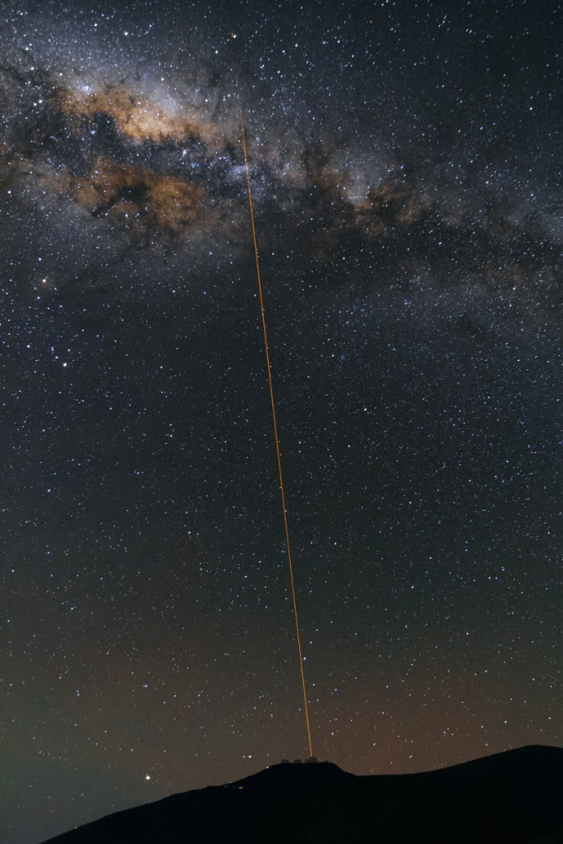
A Practical Approach…
Bright star or laser – sample incoming wavefronts
A tuned laser excites atoms in the mesospheric sodium layer at about 90km altitude, causing fluorescence
The sodium results from the vaporization of cosmic dust
ESO VLT, Paranal, Chile

Slide 13
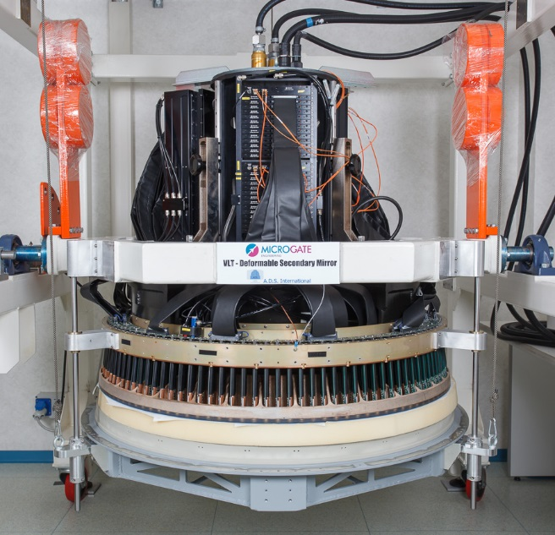
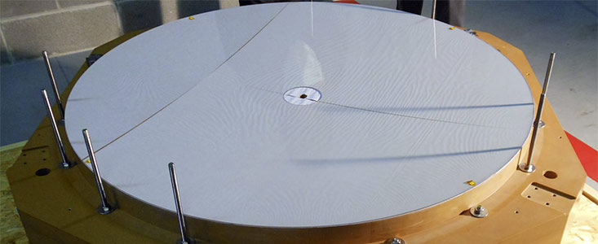
A Practical Approach…
Deformable mirror
  eg, ESO shell mirror
  1.2m diameter, 2mm thick, deformed > 1000 times per second by > 1000 actuators

Slide 14
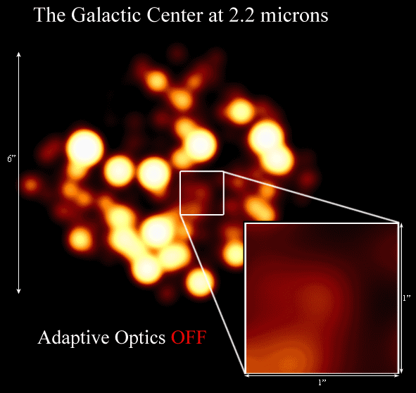

Slide 15
Atmosphere: Lucky Imaging
High speed camera (and bright object!) with exposure time less than 100 ms
During any one frame change in Earth’s atmosphere is minimal
Select a subset (10%) least influenced by atmosphere, shift and add
Example shows triple star system with 50,000 images, 40 images per second

Slide 16
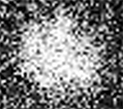

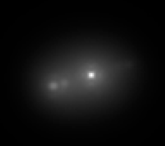
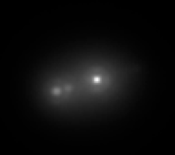

single exposure, low image quality
100%
50%
10%
1% of all 50,000 frames

Slide 17

Atmosphere: Speckle Interferometry
Atmosphere causes image to break up into blobs called “speckles”
Fourier analysis (spectral decomposition, cf. sound across frequency bands) provides information on “original” image – allows the removal of atmospheric effects

Slide 18
Recap: Spectroscopy Is Important!
Star
Which elements are seen in the spectrum of this star?
a) All 4 b) Fe + H c) H + Ca d) Fe, H & Ca
Hydrogen and Calcium are strong

Slide 19
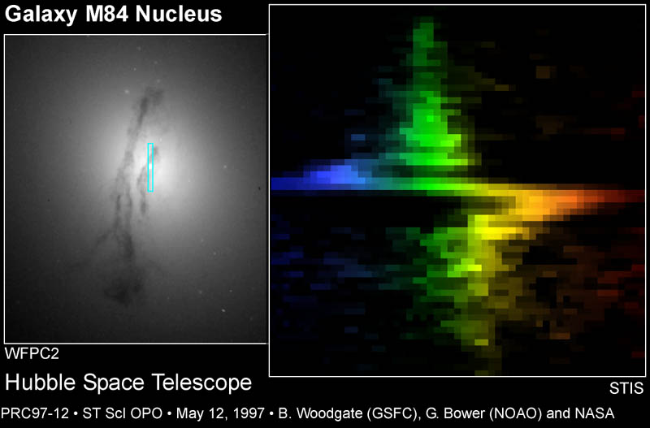
Spectroscopy: Slit
Spectrum of ionized Hydrogen and Nitrogen taken with STIS

Slide 20
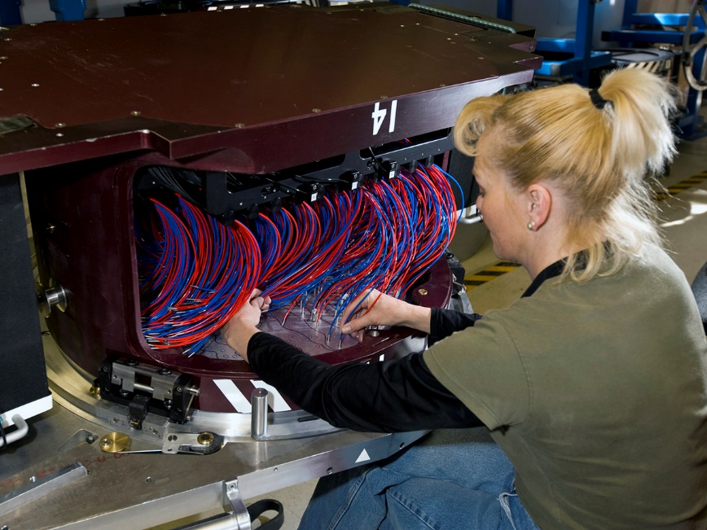
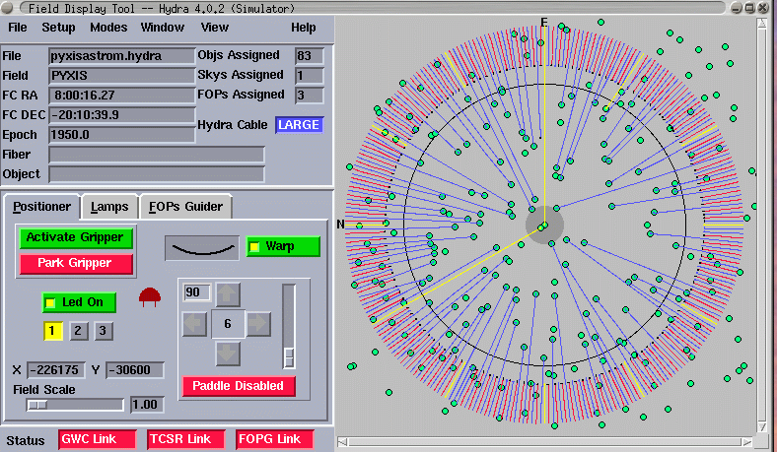
Spectroscopy: Multifibers
Example shows BOSS plug plate with 1000 fiber holes; 2000 plates in the whole project
Get simultaneous spectra of all 1000 objects in the field making otherwise impossible projects possible
Each plate must be plugged manually or by robot – need care to avoid tangles/collisions!

Slide 21
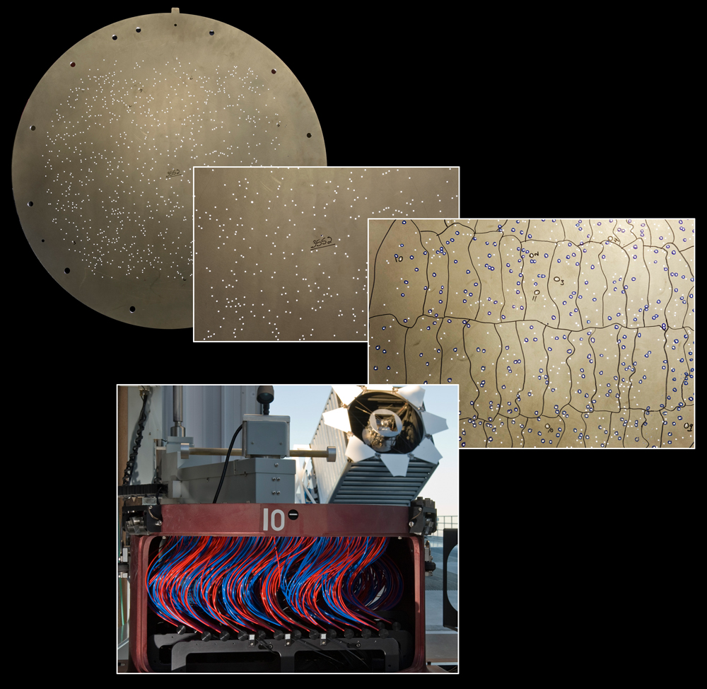

Slide 22

Spectroscopy: Integral Field

Slide 23
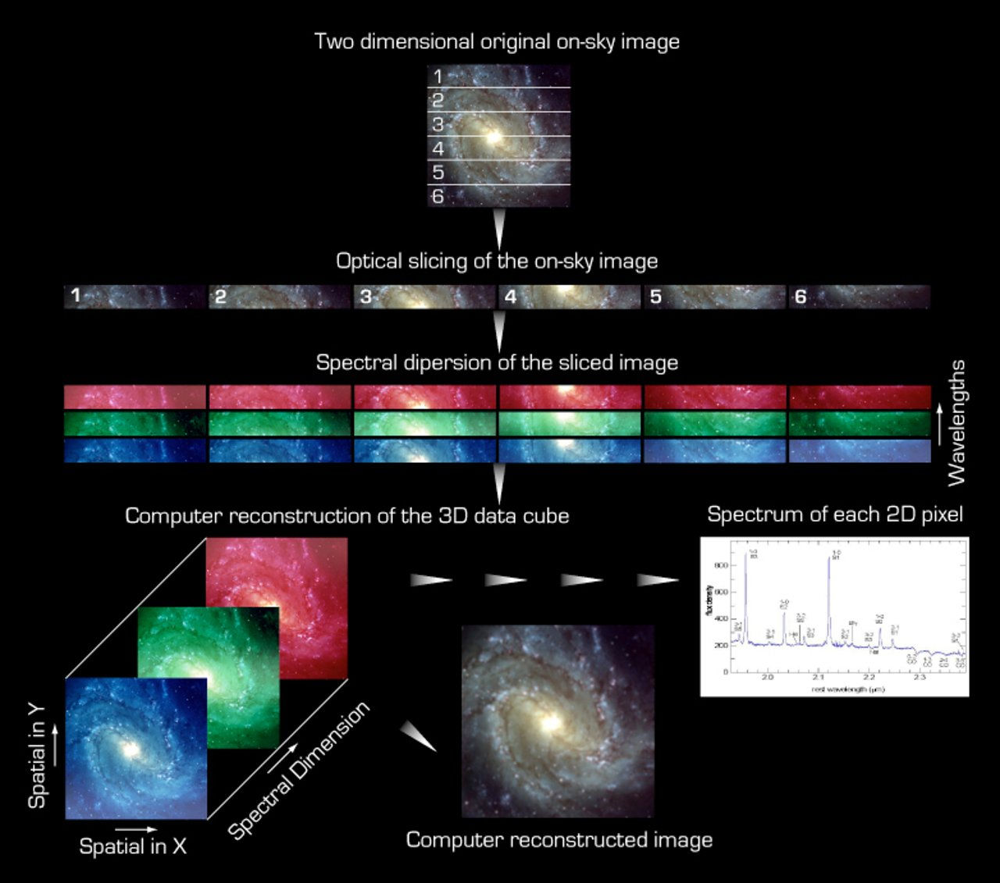

Slide 24
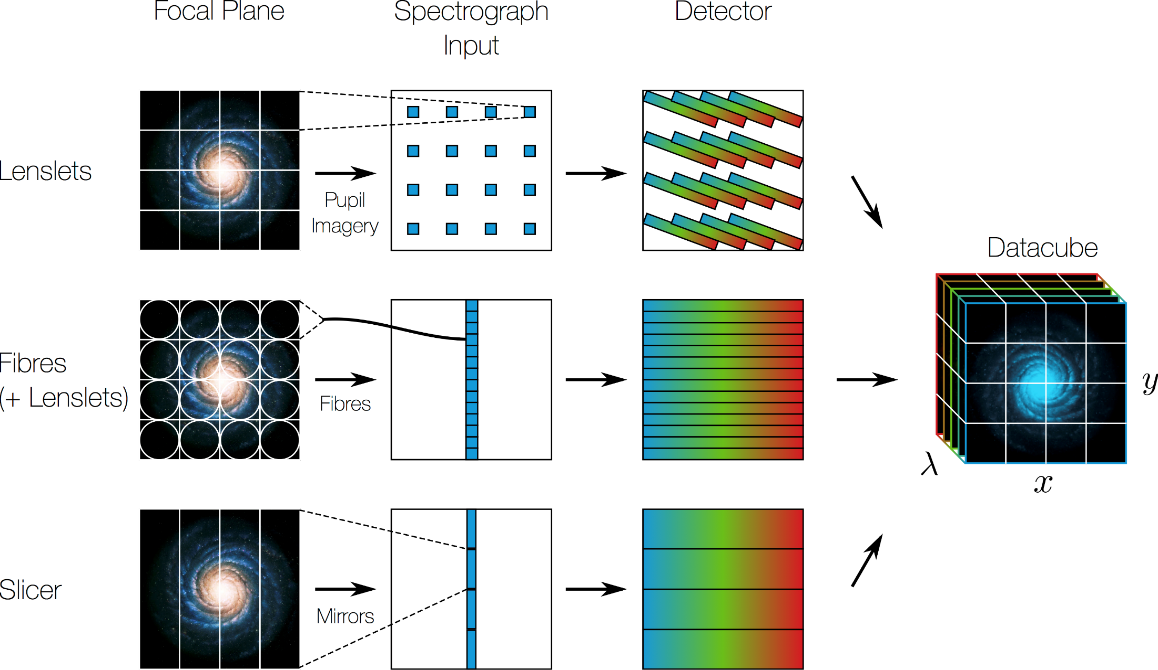

Slide 25
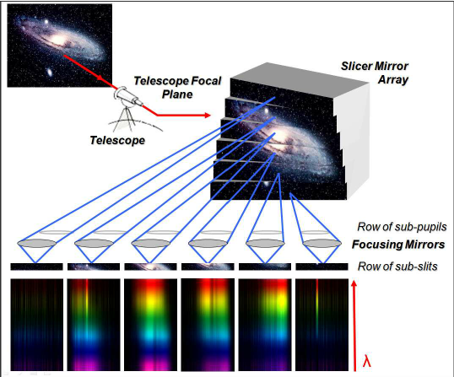

Slide 26
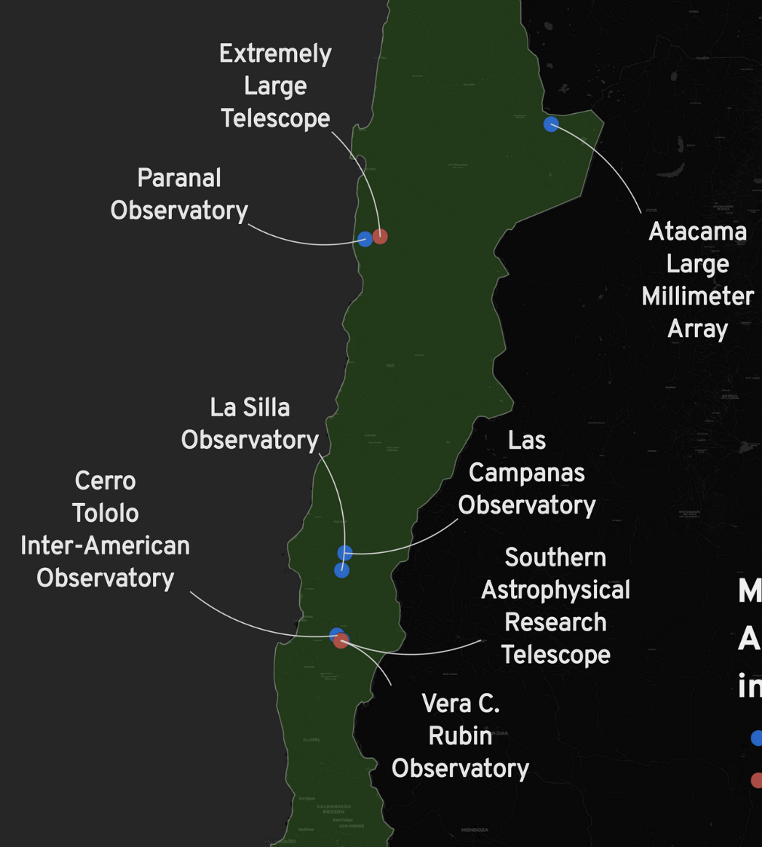
Location
Management: European Southern Observatory, Garching, Germany
ELT Observatory: Cerro Armazones, Chile
Construction & Operation: many organizations and consortia, including companies and universities

Slide 27
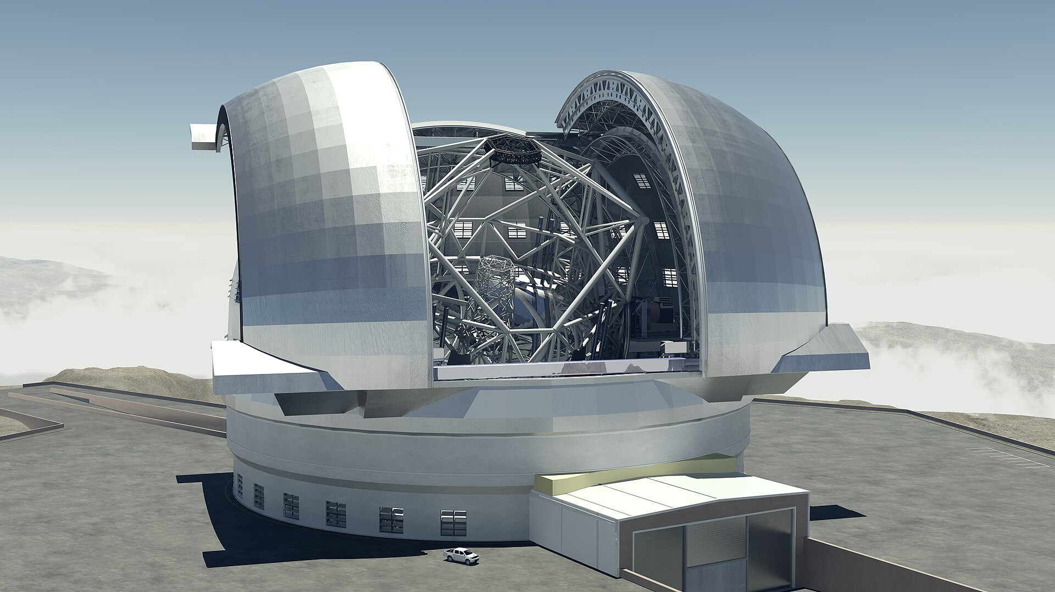

Slide 28
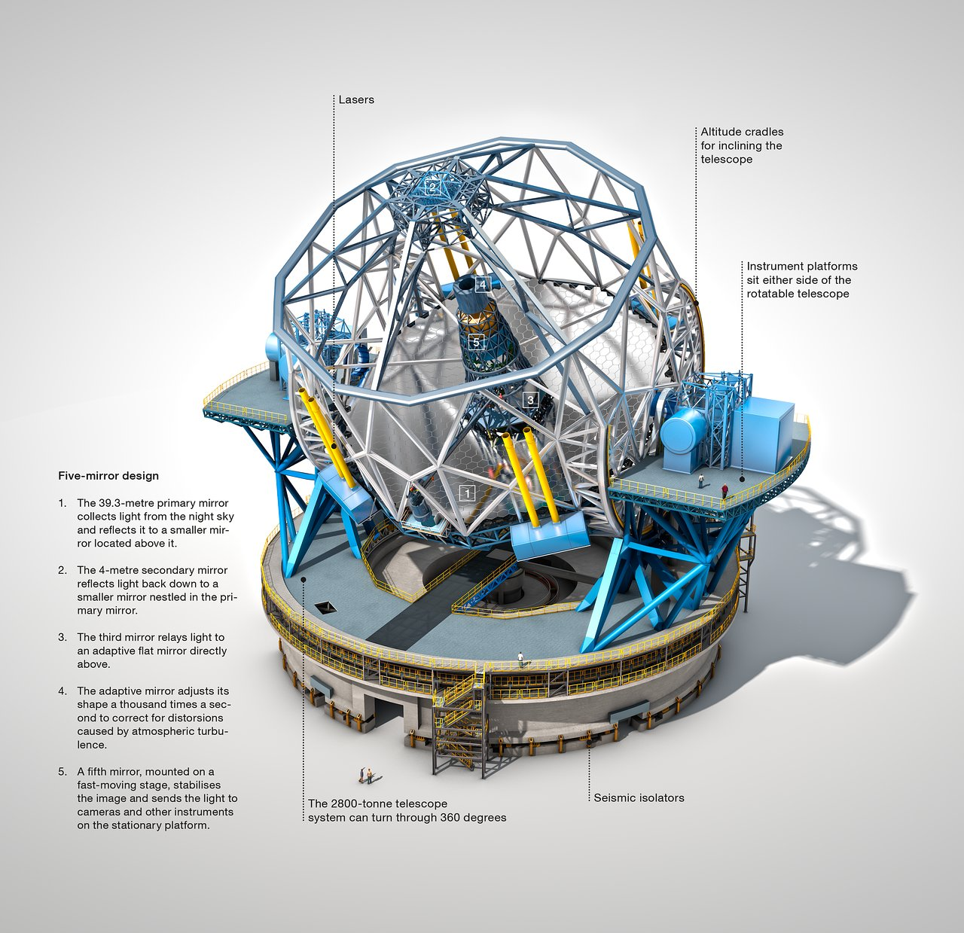

Slide 29
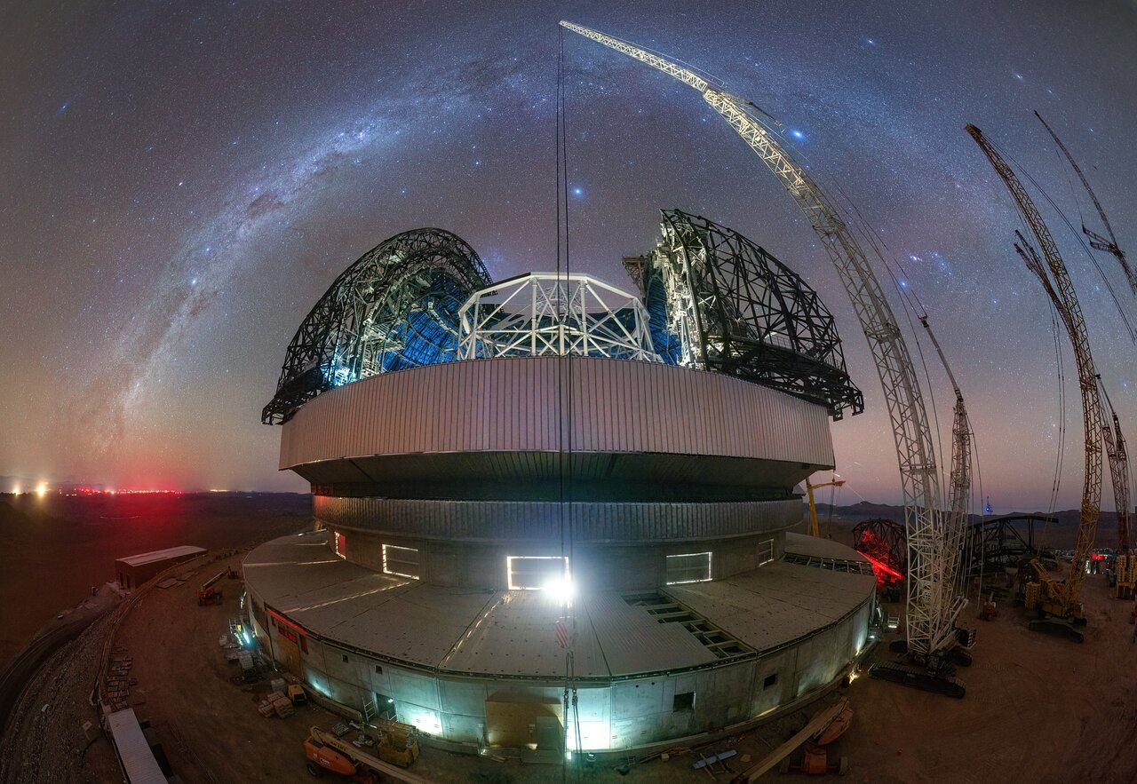
April 2025

Slide 30
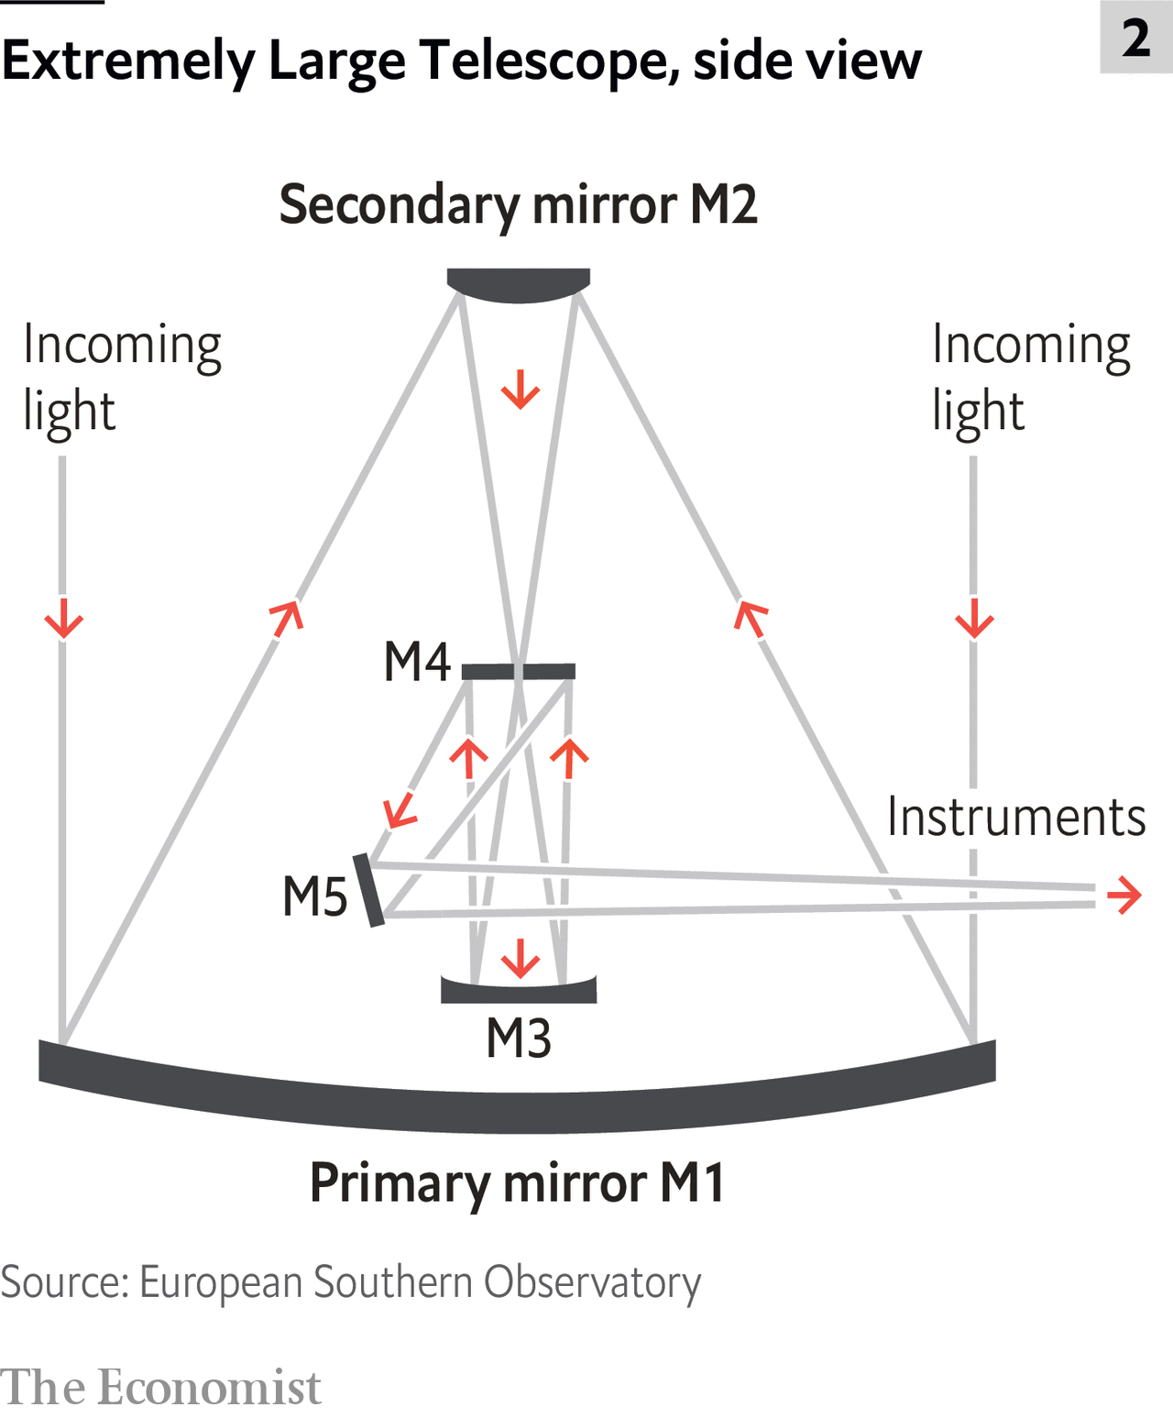
ELT Mirror Design

Slide 31
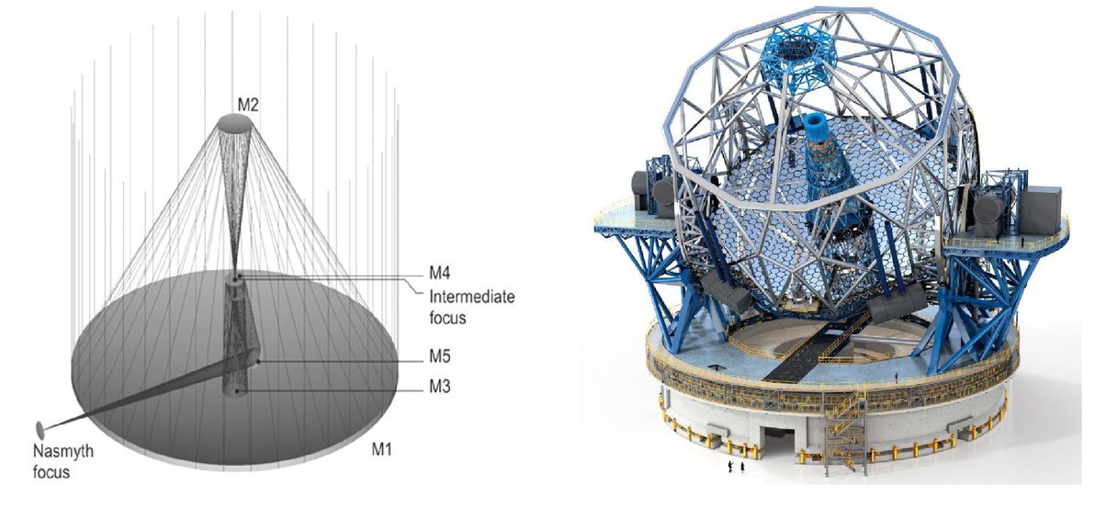
Nasmyth Focus
James Nasmyth, 1808-90 – Scottish engineer
Facilitates attachment of massive/complex instrumentation – no need to “hang” it below the Cassegrain focus

Slide 32
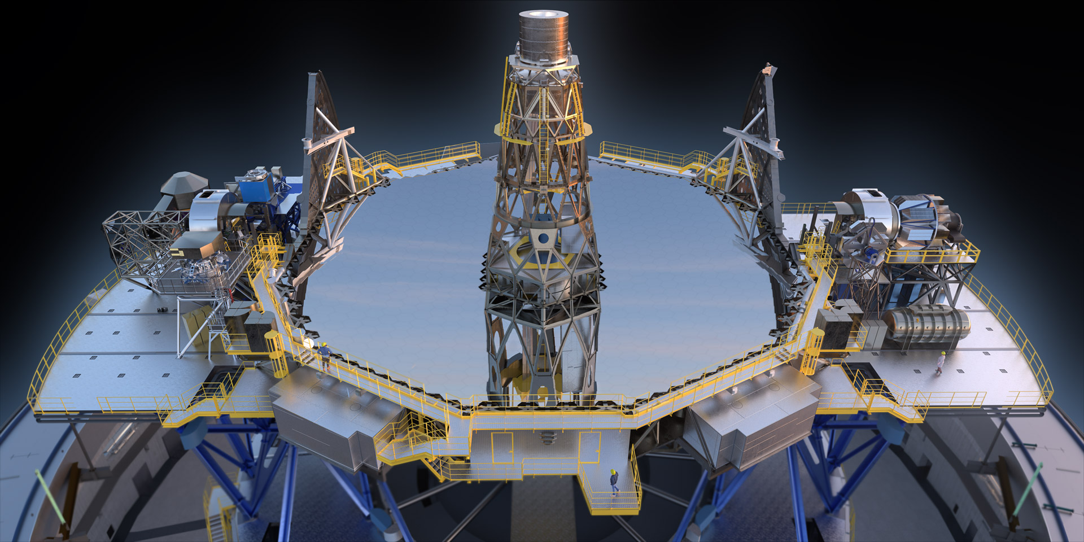
ELT Mirror M1
The giant primary mirror:
39m diameter, 798 hexagonal segments, each 1.4m across; position/shape controlled to 10s nm

Slide 33
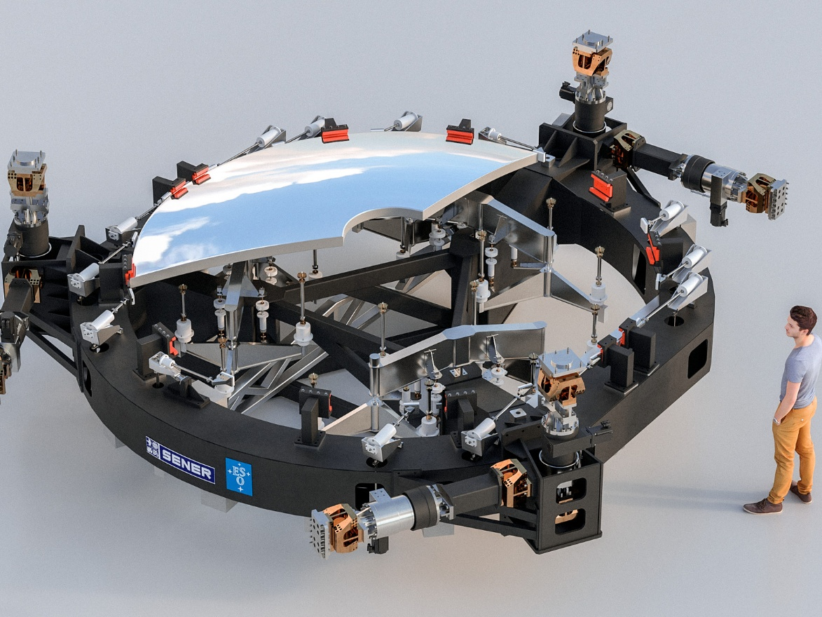
ELT Mirror M2
4.25m diameter, the largest secondary ever built
Mirror weighs 3 tonnes, and with cell and structure 12 tonnes
Anchored to the telescope main structure, 60m above ground

Slide 34
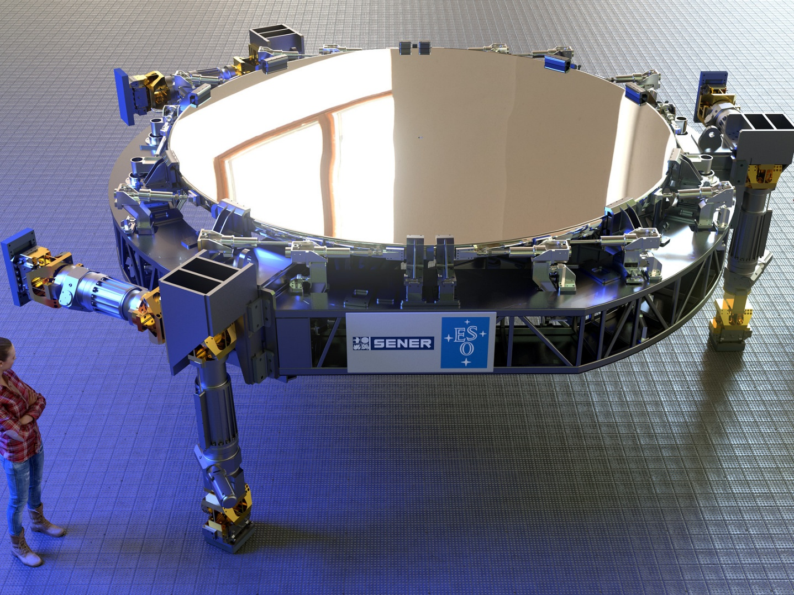
ELT Mirror M3
4m diameter
Mirror weighs 3 tonnes, and with cell and structure 12 tonnes

Slide 35
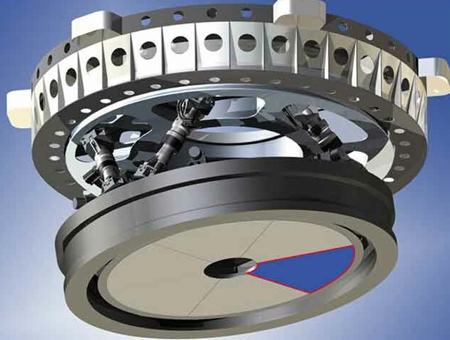
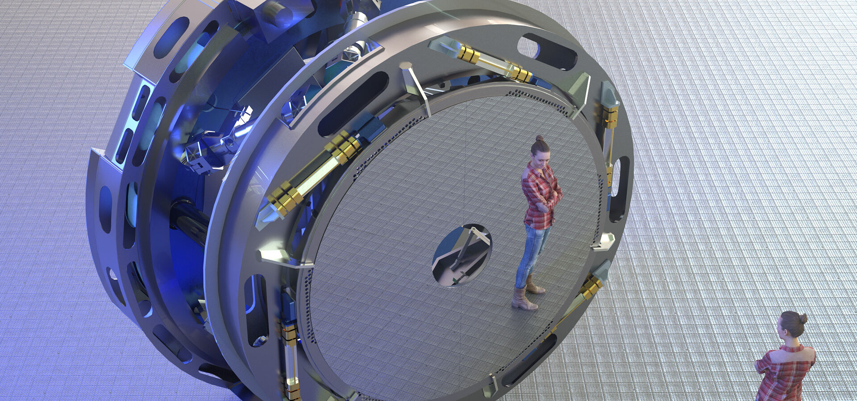
ELT Mirror M4
At 2.4m diameter, the largest adaptive optics mirror ever built

Slide 36
ELT Mirror M4
At 2.4m diameter, the largest adaptive optics mirror ever built
Made of 6 “petals”, less than 2mm thick
More than 5000 actuators [linear motors with magnet-coil assembly] change the mirror shape by up to 50 microns, up to 1000 times per second, to allow for atmospheric turbulence and residual telescope vibration
Sensors co-located with actuators measure position 70,000 times per second with accuracy 10s nm

Slide 37
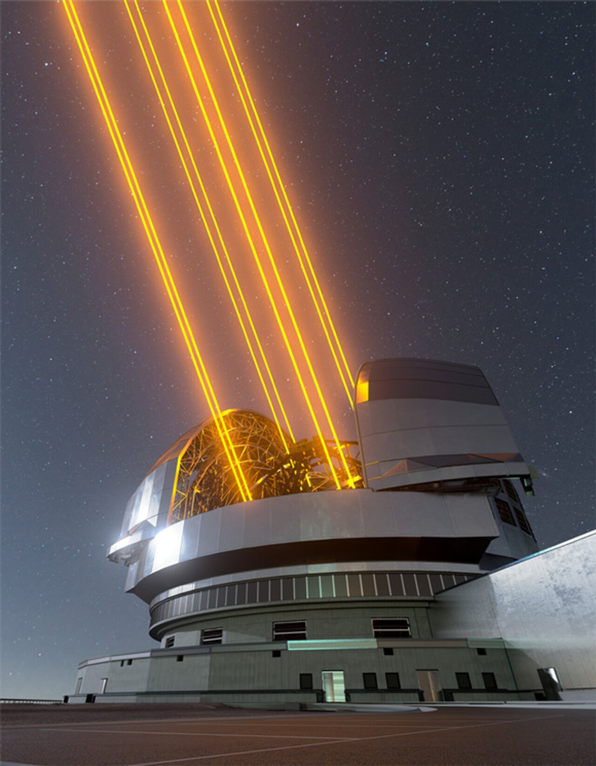
ELT Laser Guide Stars
Up to 8 guide star 22W lasers (not all necessarily in use at once)
Used with 3 complementary wavefront sensing cameras:
  ALICE optical/natural
  LISA optical/laser
  FREDA ir/laser
Computers analyze the signals in real time – 500 times per second – and feed information to the actuators to deform the mirror

Slide 38
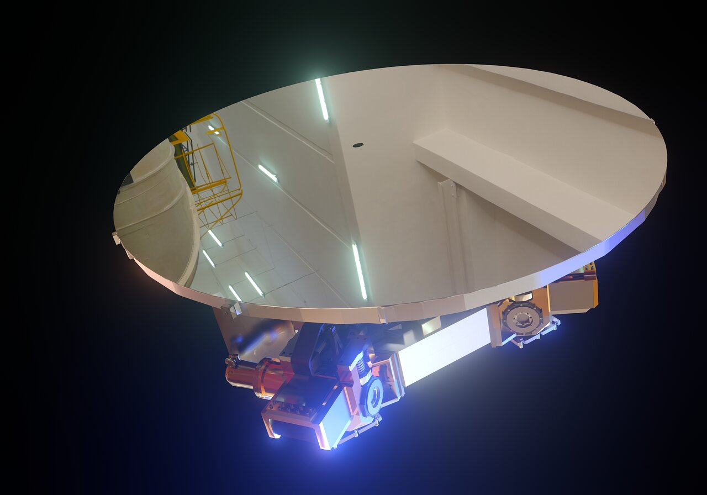
ELT Mirror M5
At 2.2x2.7m this is the largest flat, rigid, tip-tilt mirror ever built – part of the adaptive optics system

Slide 39
ELT Mirror M5
At 2.2x2.7m this is the largest flat, rigid, tip-tilt mirror ever built
Also made of 6 “petals” brazed together
Part of the adaptive optics system, but also has a switching mechanism to feed the appropriate Nasmyth platform

Slide 40
Instrumentation
HARMONI: High Angular Resolution Monolithic Optical and Near-infrared Integral field spectrograph
MICADO: Multi-adaptive optics Imaging Camera for Deep Observations
METIS: A mid-infrared imager & spectrograph
MOSAIC: A multi-object spectrograph
HIRES: A high resolution spectrograph
PCS: A dedicated planetary camera & spectrograph

Slide 41
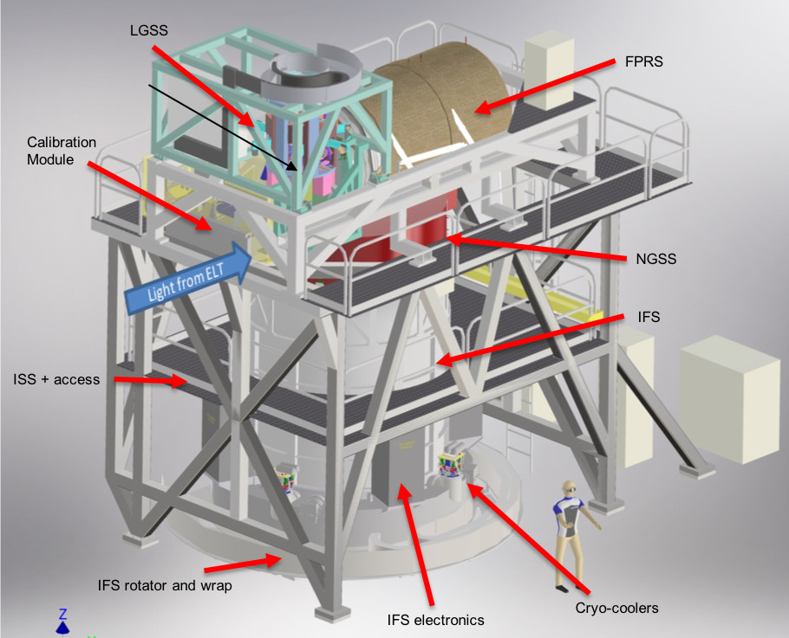
HARMONI

Slide 42
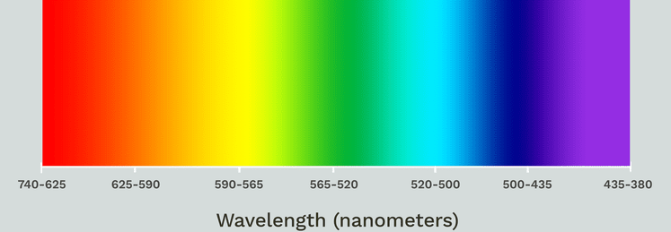
HARMONI
A flexible integral field spectrograph – does “image slicing” to provide a 3D data cube
The “slicer” divides an image into many “spatial pixels” called spaxels
The user can choose between 4 spaxel scales (between 4mas and 60mas): smaller scale has smaller field of view but higher spatial resolution
The user can choose from a range of spectral resolutions spanning 450 to 2450 nm

Slide 43
Spaxels? You’re Kidding Me!
The rectangular field is 214x152 “pixels”, so about 31,000 “pixels”; these are the “spaxels”
This field of view is split into 8 subfields
Each of the subfields is sliced into 38 narrow strips
Subfields are paired, and the 2x38 slitlets are arranged into a long “pseudo-slit” and send to one of four spectrographs
Each spectrograph has 2 detectors
Yes – an image would help clarify this!!

Slide 44
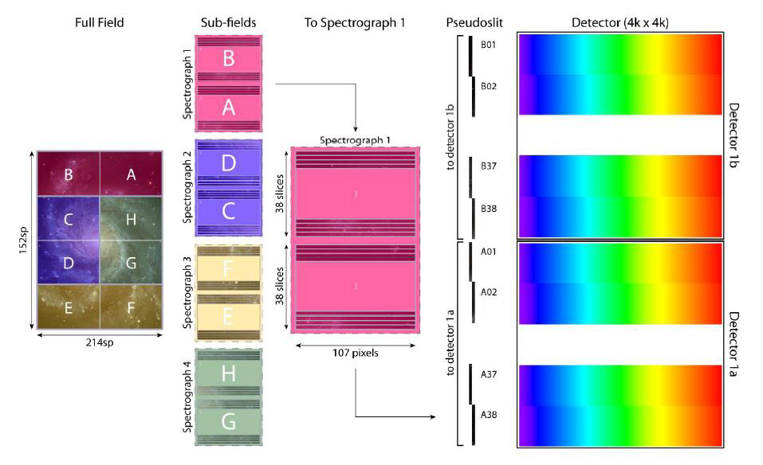

Slide 45
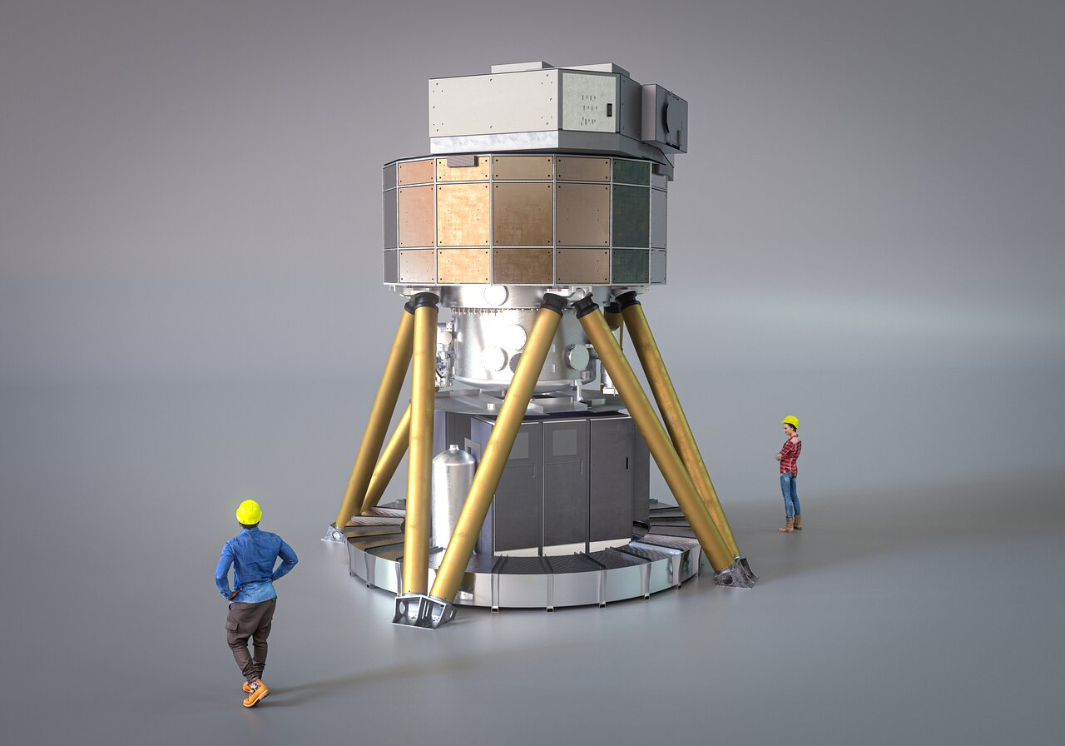
MICADO

Slide 46
MICADO
A camera providing sensitive imaging and high resolution spectroscopy in the near infra-red
Camera has an array of 3x3 detectors, each with 4096x4096 pixels
Notable: will produce the highest resolution images ever achieved in astronomy
Notable: will allow astrometry with precision of 50 microarcseconds
Notable: has “built in” adaptive optics
Notable: has “built in” coronograph to block star-light and reveal exoplanets

Slide 47
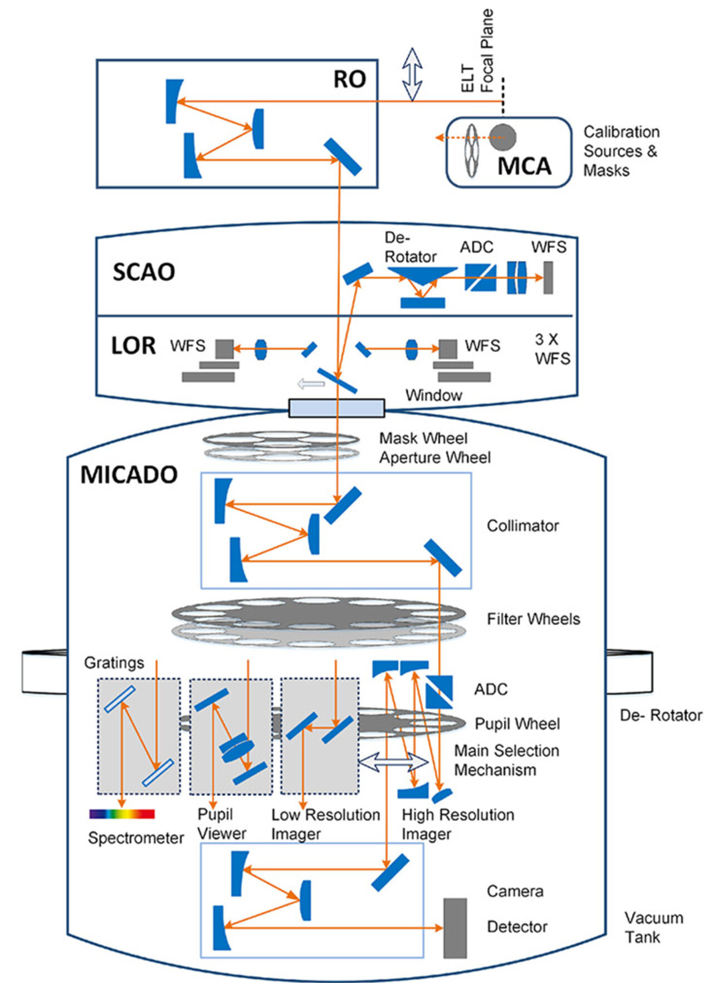

Slide 48
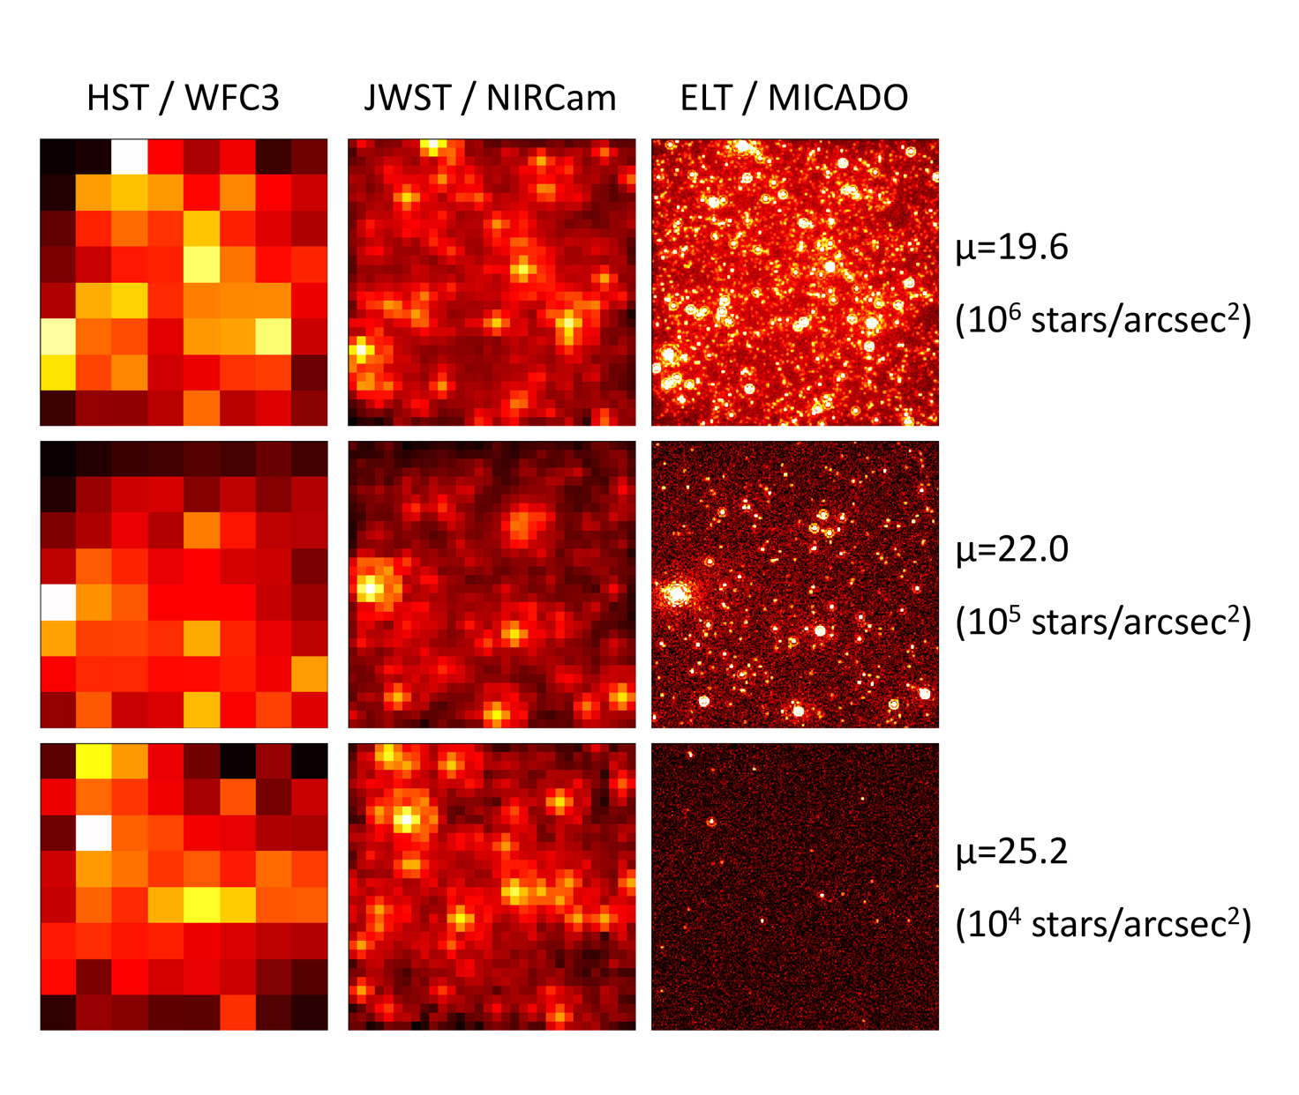

Slide 49
ELT Science Goals 1
Exoplanets
Characterize atmospheres of potentially habitable exoplanets, looking for biosignatures such as methane & oxygen
Study planet formation through protoplanetary and debris disks

Slide 50
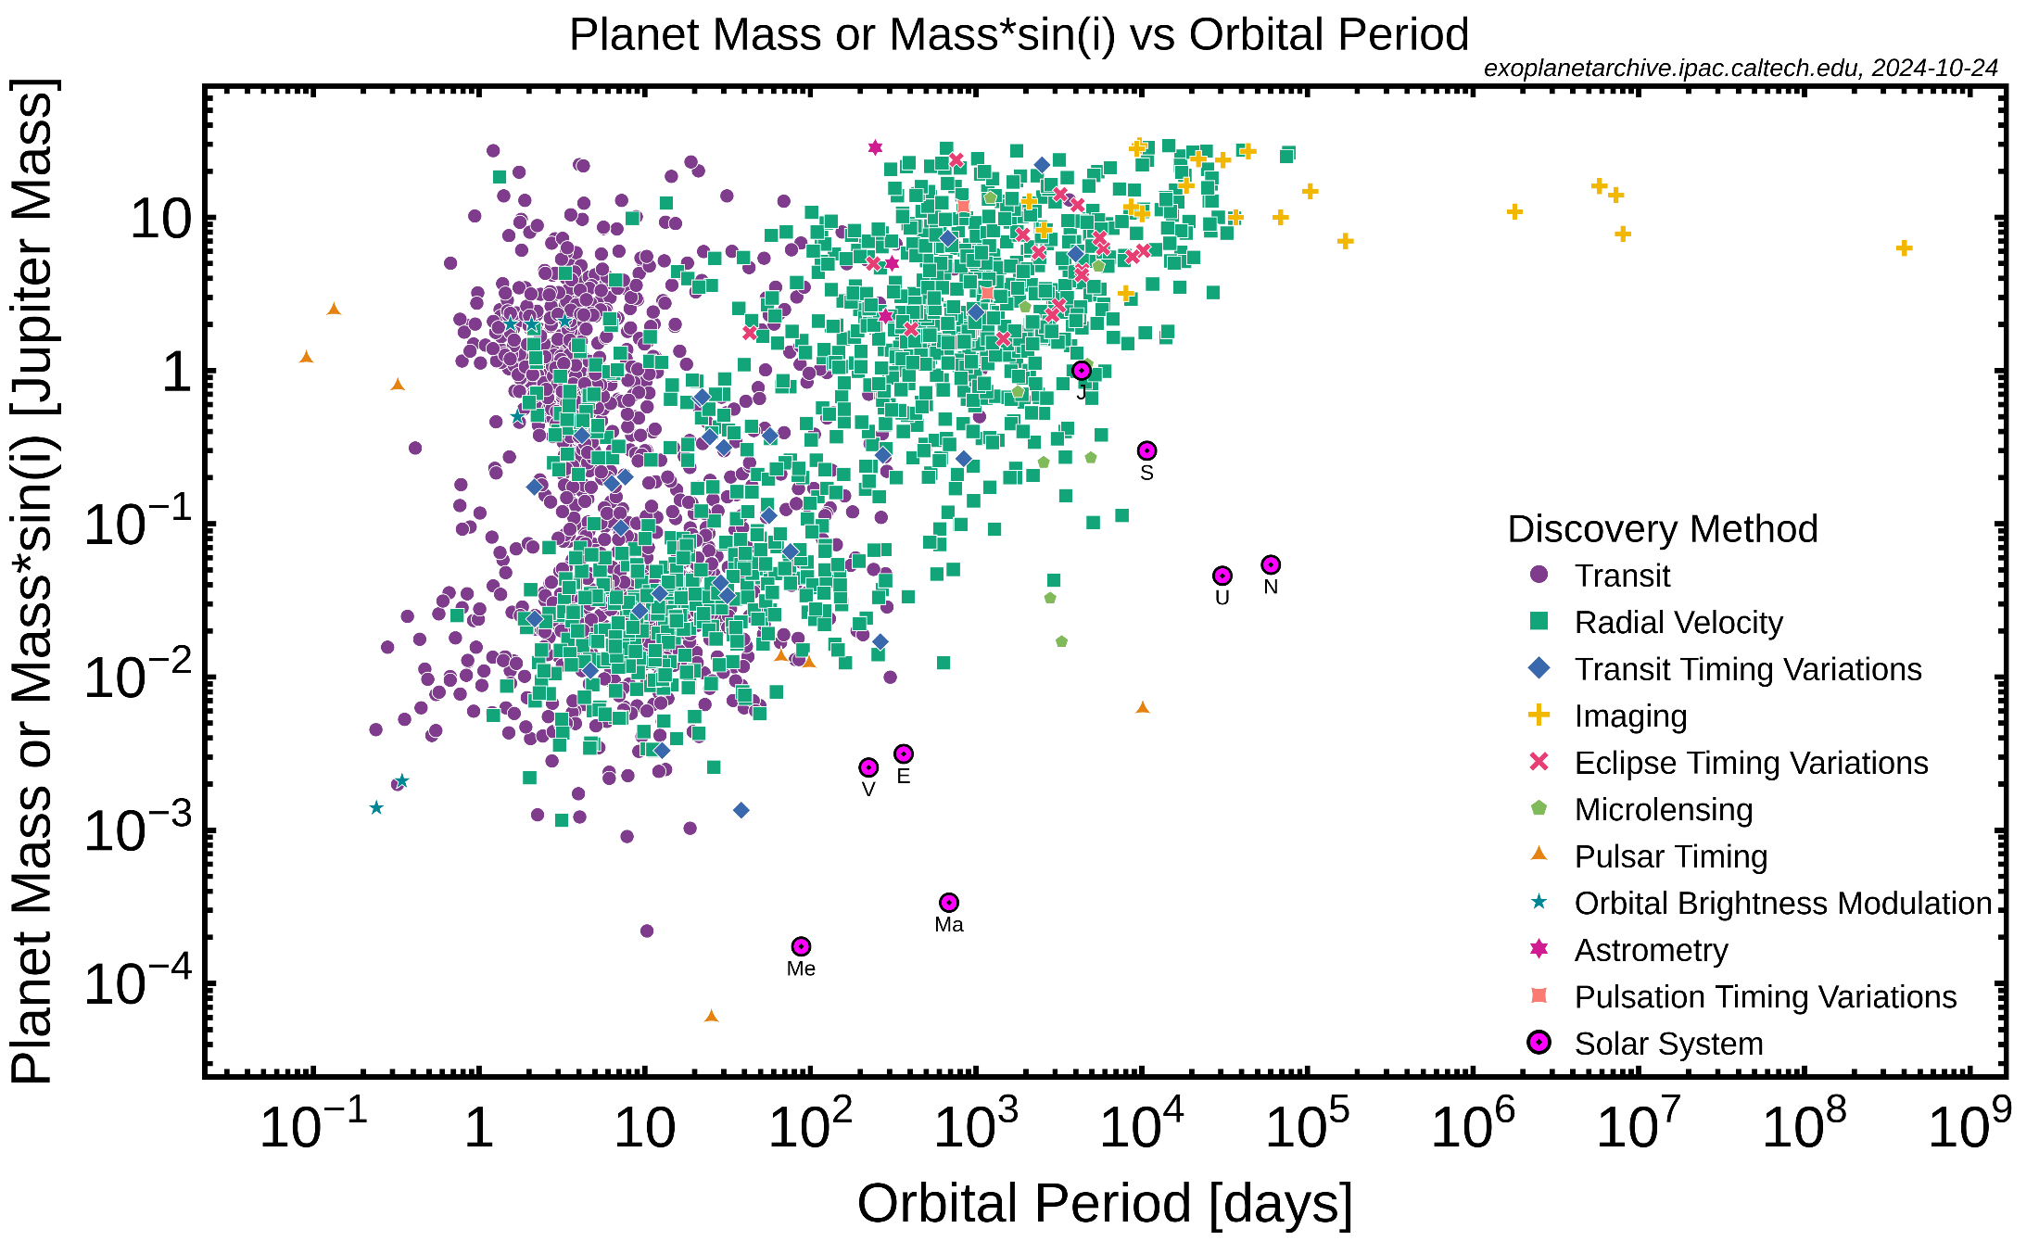
Exoplanet Demographics

Slide 51
The Rise Of Oxygen
In the Earth’s early, Oxygen-free atmosphere, simple organisms would have been anaerobic; they were probably
  chemoautotrophs – getting energy from inorganic compounds
    modern Archaea in hot springs get their energy from H/S/Fe compound reactions
Photosynthesis evolved from light absorbing pigments, that eventually allowed
  photohetero(auto)trophs – getting energy from sunlight
    “blue-green” algae release oxygen

Slide 52
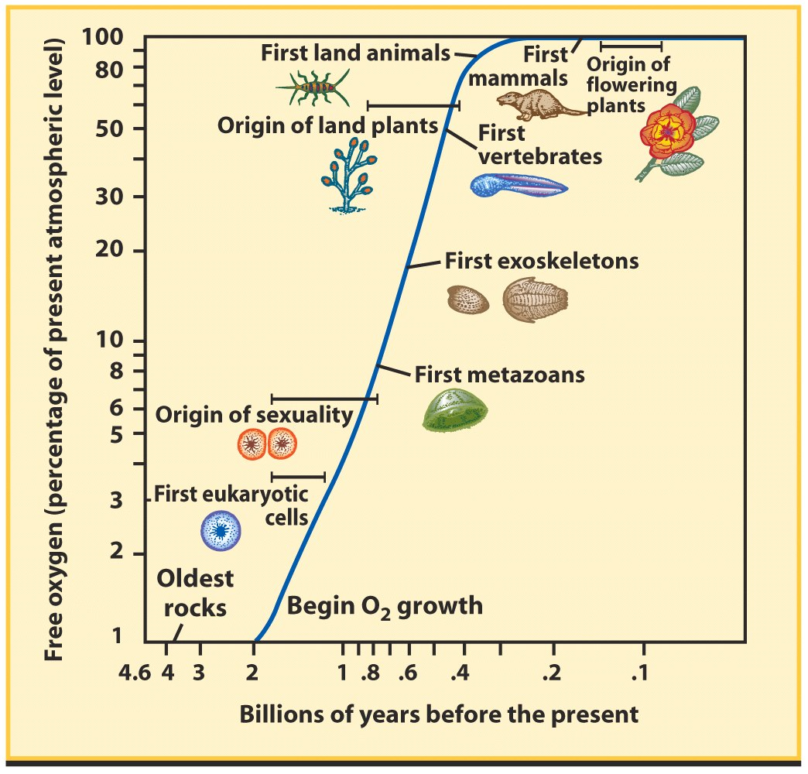
The Rise Of Oxygen
Oxygen is highly reactive:
  Oxidizes surface rock & Fe minerals in oceans
  Rocks > 2 billion years old have only 1% modern oxygen levels
  No more than 10% current until about 1 billion years ago
  Then reaches current levels
Oxygen needs life!
  O₂/O₃ in exoplanet atmosphere is a promising indication of life

Slide 53
Exoplanet Atmospheres
As of early 2025, 249 atmospheres have been studied
We are probing structure, as for planets in our Solar System:
  day/night temperature and latitude differences, circulation and clouds
We are beginning to probe composition; 60 different molecules have been found, including
  TiO, CO, H₂0, CO₂, CH₄

Slide 54
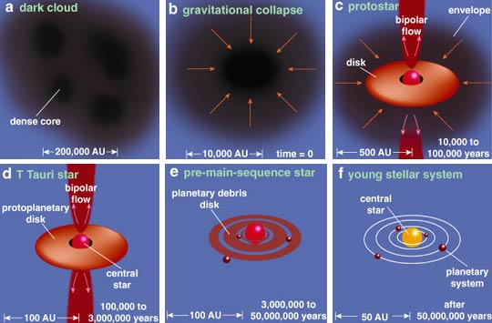
Planet Formation

Slide 55
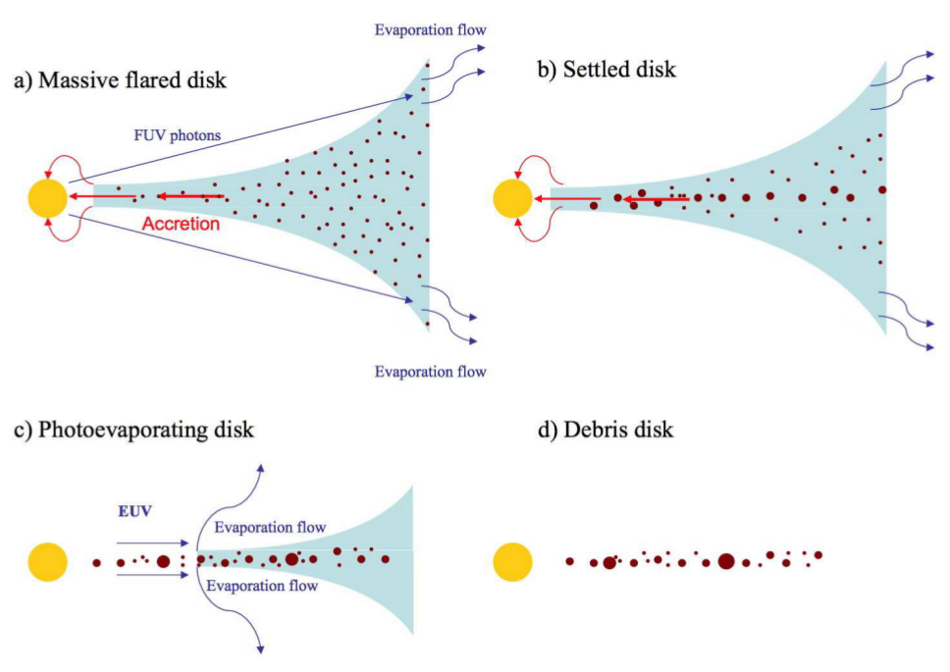
Planet Formation

Slide 56
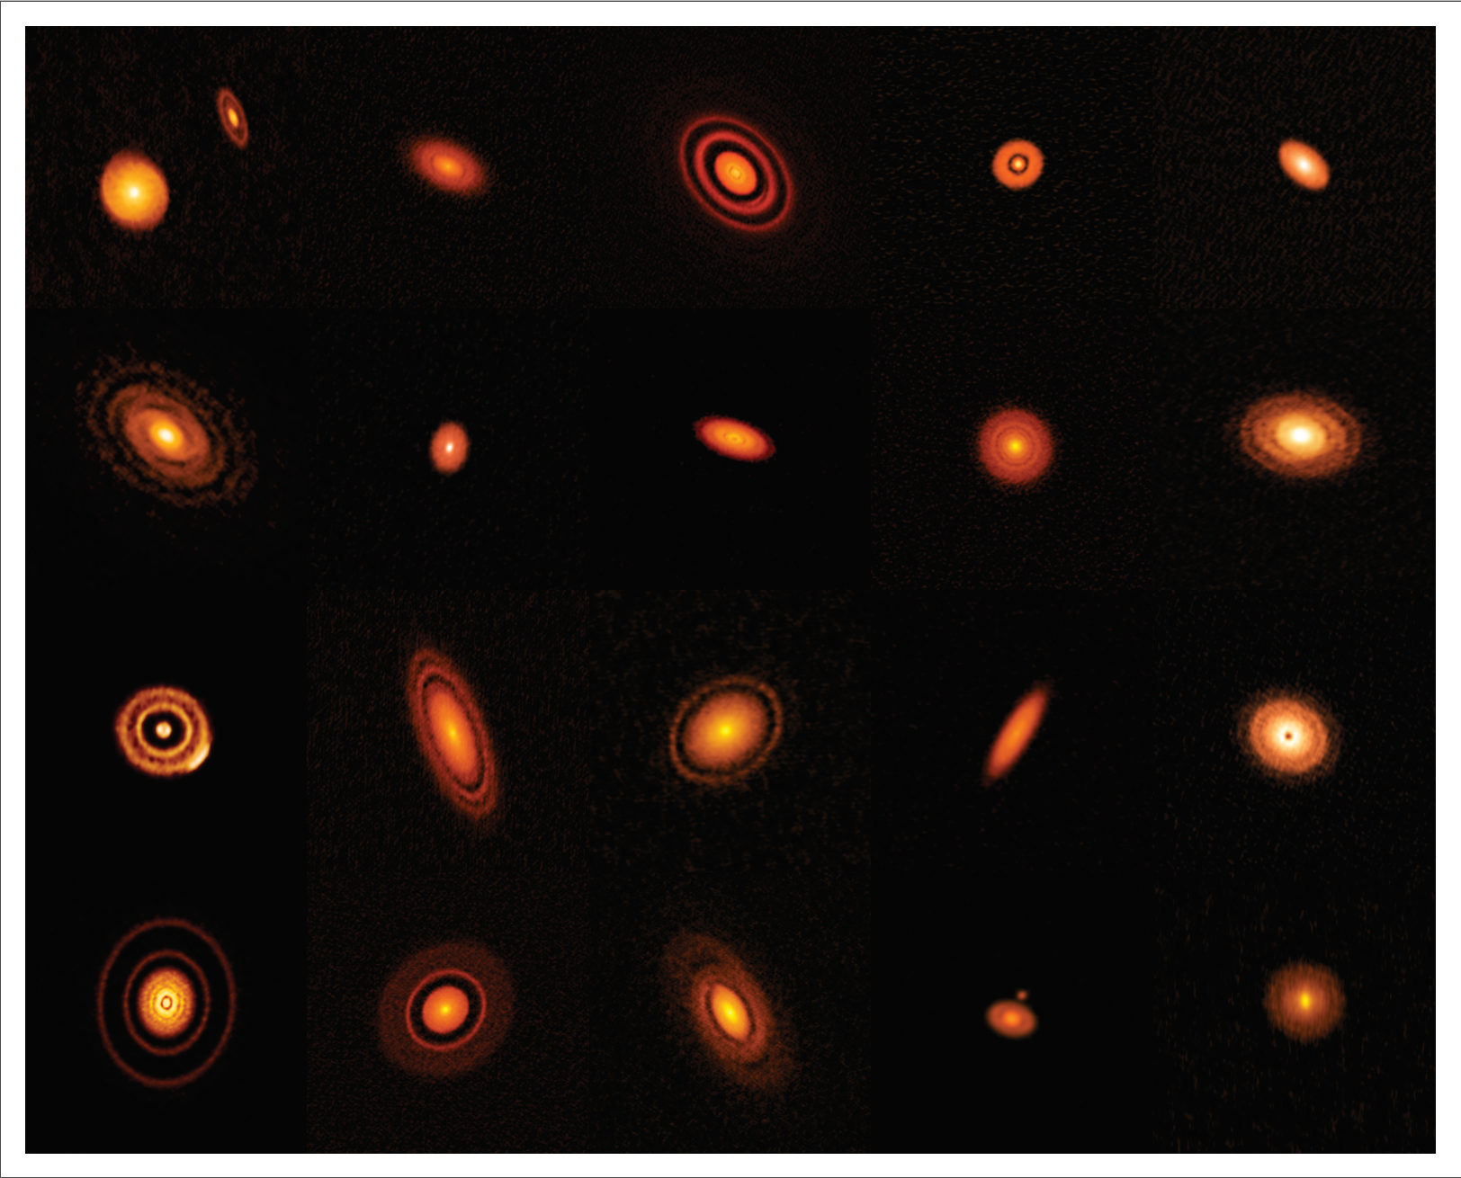

ALMA

Slide 57
ELT Science Goals 2
The First Galaxies
When did the 1st galaxies form?
What was the rate of star formation, and what did the early stellar populations look like?

Slide 58

A Compact History

Slide 59

A Potential Problem
Supermassive Black Holes/Galaxies exist only 100s millions of years after the Big Bang

Slide 60
A Potential Problem
It is unlikely that they have time to grow by accretion from few solar mass stellar seeds
At some point in cosmic time black holes with a mass up to a million solar masses had to exist to provide the seeds for those of greater than a billion solar masses
How are the intermediate mass seeds created?

Slide 61


Slide 62
ELT Science Goals 3
Dark Matter & Dark Energy
See last week on the Rubin Observatory
This is a study of fundamental physics; but that’s not all…

Slide 63
ELT Science Goals 4
More Fundamental Physics
Observations across a range of objects and distances can test whether constants such as the “fine structure constant”*, proton-to-electron mass ratio, etc. are the same from place to place and time to time [through subtle changes in spectral line positions]
By observing orbits about black holes, we can test the validity of General Relativity
*Measures how strongly charged particles interact electromagnetically

Slide 64
ELT Science Goals 5
Solar System Objects
See last week on the Rubin Observatory, plus….
Study the atmospheres of the gas giants
Study (cryo-)volcanism on the gas giant’s moons

Slide 65
Giant Planet Atmospheres
High resolution spectroscopy will determine chemical composition
Doppler imaging will probe global circulation & dynamics; we will better understand the 3-D structure of these atmospheres – temperature structure, cloud cover and wind patterns
Repeated observations will probe short & long term changes in chemical make up, temperature and winds
All the above will provide a crucial baseline for comparison with exoplanet atmospheres

Slide 66

Jupiter
International Gemini Obs. / NOIRLAB
Lucky imaging!

Slide 67
(Cryo-)Volcanism On Moons
High resolution imaging will reveal overlapping debris fields, and thus identify individual volcanoes and changes
This will tell us how the moon’s surface is sculpted and inform comparative planetology
High resolution spectroscopy will probe chemical composition of ejecta & plumes
Study of plumes will probe how they interact with the planetary magnetic field / produce a plasma torus

Slide 68



IR image of Io from Juno probe
Image of Io plume from New Horizons probe
Io plasma torus from Earth

Slide 69


Enceladus water plumes / Cassini:
Cryovolcanism

Slide 70


Slide 71
Is It Worth It?
Construction cost: about $1.5 billion (provided by ESO member states)
Annual operations: $54 million
First light: March 2029
Thoughts?

