Slide 1
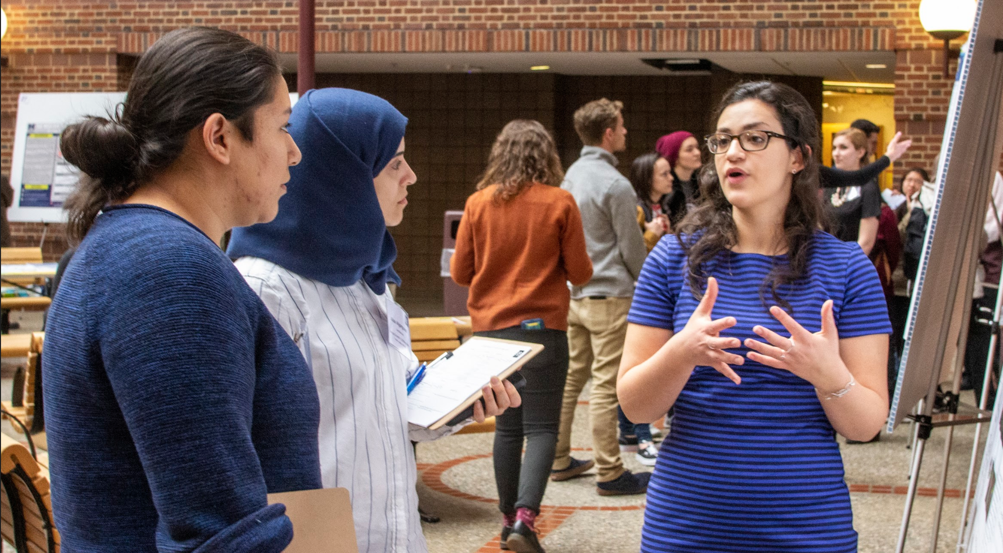
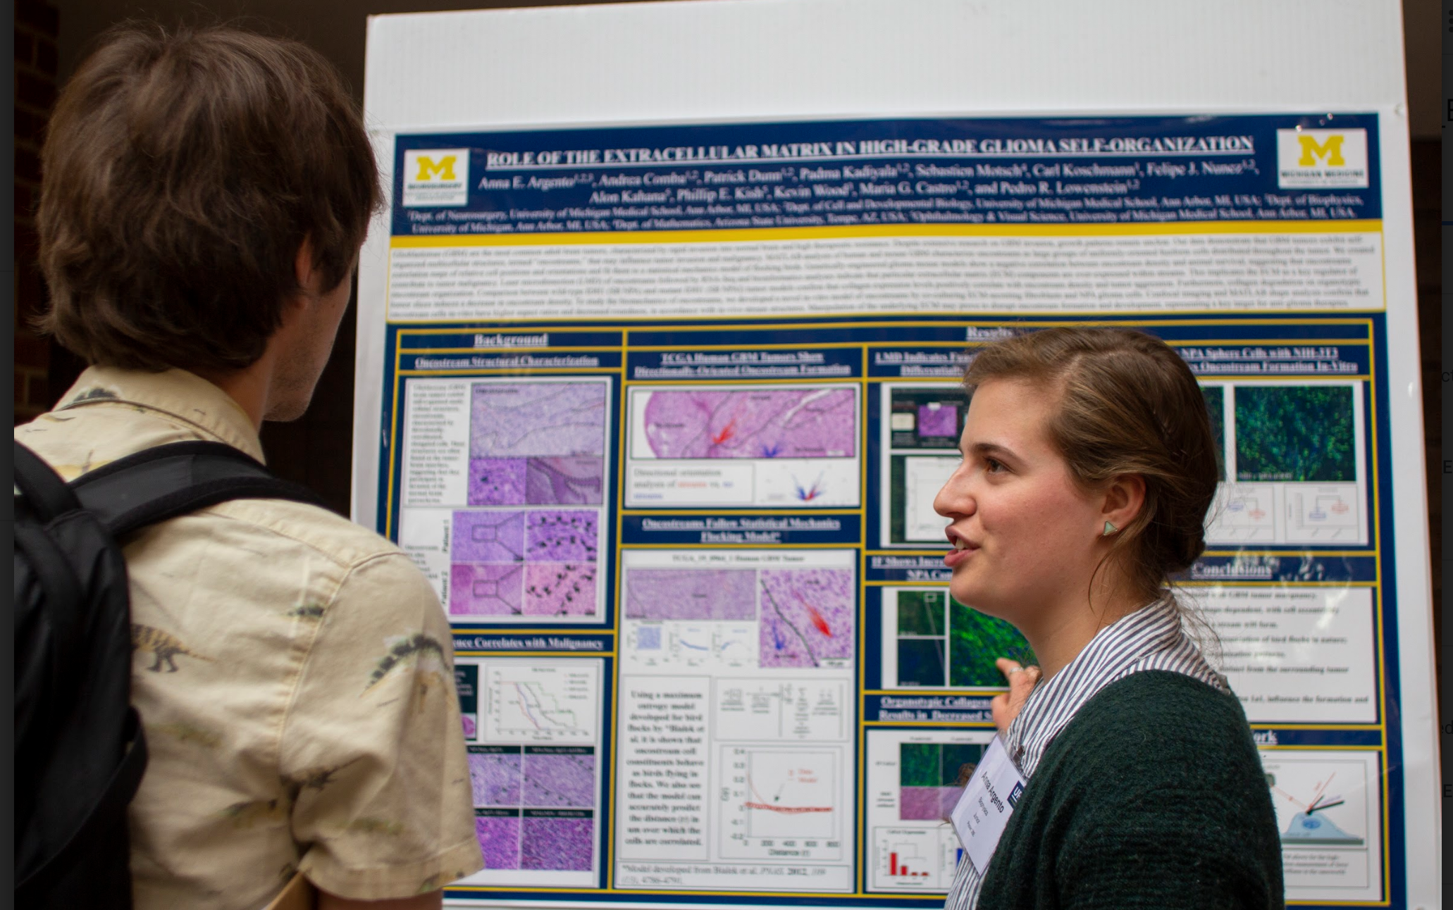
WHAT IS RESEARCH & HOW CAN YOU GET INVOLVED?
Notes:
URS’s mission is to support undergraduate research at the University of Michigan across all disciplines by holding workshops and a yearly poster symposium.
Hannah

Slide 2
What is Undergraduate Research?
Contributing towards a research project as an undergraduate student
Usually between 4-12 hours a week
This could be your own project under a professor, or a side-project with an upperclassman/graduate student/post-doctoral research mentor
Working towards publishing a paper in a research journal or presenting results at a conference and gaining hands-on experience in a field of your choice
Credit, Work-study, Volunteer, Employment (employment vs credit tend to be mutually exclusive)
Notes:
Hannah

Slide 3
Potential Misconceptions!
“I am a ____; therefore it is too early/late to start undergraduate research”
It is never too early/late to join a research group! As long as you can demonstrate your interest and passion for the work!
Undergraduate Researchers are only there to do menial work (Ex: pipette, wash glassware, clean up excel documents, etc)
While research often includes doing tasks such as these, at U of M, there is a culture of involvement and if you find yourself doing these actions more than the other group members, talk to your mentor, principal investigator, about how to start on more complicated tasks!
Notes:
Jon

Slide 4
Potential Misconceptions!
I do not have the skillset or knowledge of techniques to work in a specific group...
Most research groups are designed to have graduate students who will mentor you through the process of learning these techniques so you can take on your own projects!
I do not have time to dedicate to doing research.. although I want to.
Dependent on your project, most research groups can be very flexible about hours and time commitment as long as you are transparent with your mentor & PI about how much time you have.
Be transparent/realistic about the time you are willing to spend in lab a week so you are matched up with a research experience that meets your needs
Notes:
Jon

Slide 5
Potential Misconceptions!
I have to do research in order to be successful at the University of Michigan…
Although U of M has a very strong research culture, if you are not interested in doing research, there are many other organizations, types of employment, and activities which you can dedicate your time to. With that said, we suggest you give research a try to figure out if it is for you!
Once I have joined a research group, I am committed to it for my Undergraduate Career
Many undergraduate researchers change research groups as they figure out what their passions are and grow as students and learners. Changing subject area or groups within the same subject area is quite common! Open communication is the best strategy for this!
Notes:
Jon

Slide 6
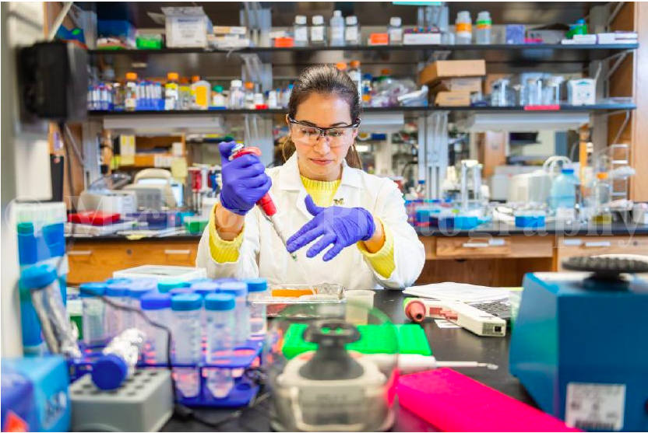
Goals of Undergraduate Research
To learn techniques relevant to your field of interest
To develop general skills (communication, writing, etc.)
To identify research/career interests
To learn more about existing projects/questions in your field of interest
To develop long-term relationships with faculty members and graduate students in your field
To have fun!
Notes:
Abby

Slide 7
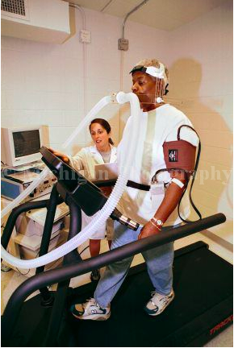
Routes to Involvement
UROP (Undergraduate Research Opportunities Program)
Emailing Professors
Departmental Involvement
Summer Research Opportunities and Funding (External and Internal)
University of Michigan Student Employment Office
Notes:
Abby

Slide 8
Departmental Involvement
Once you have declared a major, some departments try to connect you with research/ research for credit opportunities in their departmental emails
Research can be used to fill degree requirements
Professors (sometimes) often are encouraged by students who have declared their major as it demonstrates interest in a subject and dedication to the field
Declaring your major can give you priority for certain research opportunities
You do NOT need to have declared your major to get involved in research
Notes:
Nikki

Slide 9
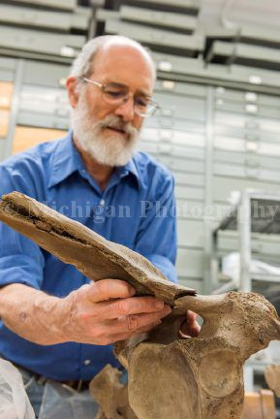
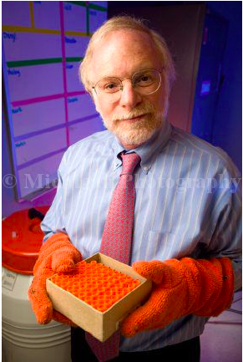
Routes to Involvement: Emailing Professors
Do your research
Understand basis of their research (read group website & some of their previous papers)
Email them with genuine interest, demonstrate that you have specific interest
Ask them if they have any opportunities and what they would expect of you
Highlight why you are interested in contributing to their research - be specific
Ask questions about their research if you have them- this demonstrates your interest in their research
Notes:
Nikki

Slide 10
Routes to Involvement: Summer Programs
Check the website of your department of interest
Reach out to the undergraduate program director for your department
Apply early! Aim to find a lab by February/March
Also look for external research at institution websites
NSF (National Science Foundation) REU Programs
NIH (National Institute of Health)
Amgen Scholars
Individual University and Hospital Research Funding Programs
****many require recommendation letters so keep that in mind during your application timeline (give 3-4 weeks)
Notes:
Nikki

Slide 11
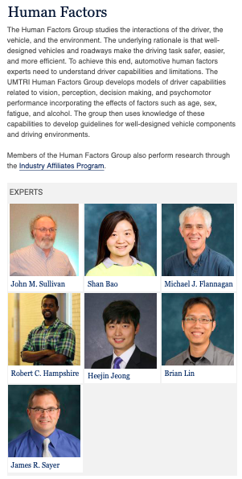
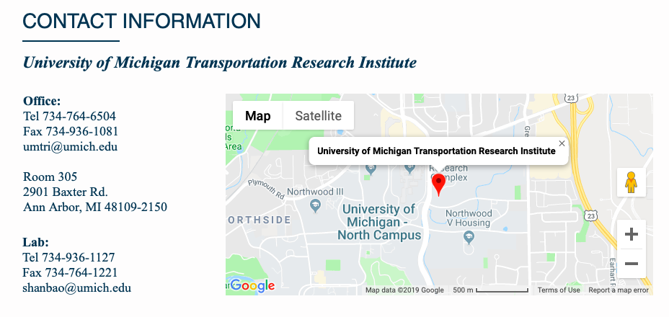
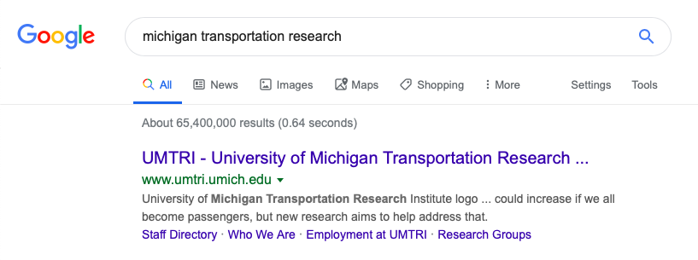
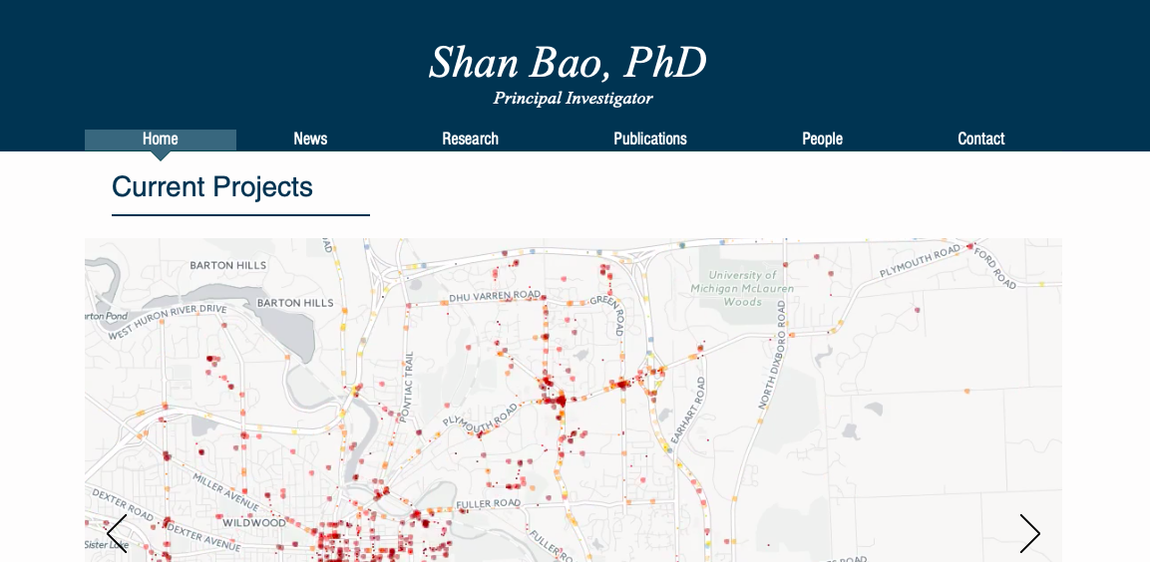
Example!
Let’s say Billy Magic is interested in transportation research
He could google “Michigan transportation research”
Then find faculty on the page
Find an interesting faculty member
Find contact information and send an email!
Notes:
Drew

Slide 12
Starting at a new lab
Don’t be afraid to ask questions, make mistakes, and admit to them
You are not expected to know everything
You are there to learn.
Define your time commitment and work this out with your PI/other mentors
Take lots of notes when observing others
If it isn’t the right research match for you- do not be afraid to find a different lab
Attend and take notes in lab/groups meetings - you can learn a lot from the other work going on in your lab
Interact with research group members outside your projects
Ask about seminars on campus/online that you can attend
Notes:
Drew

Slide 13
STUDENT PANEL!
Follow us on social media to keep up with our events throughout the year!
@umich_ursymposium
Undergraduate Research Symposium
@URSymposium

